Slide 1
Requested Information
Summary of each subgroup’s strategy and status to meet the overall goals
Status of collecting for each technology input for detector complementarity studies
P Rossi & TK Hemmick

Slide 2
Were we are: Summary Table
 | P Range | Contr. ϑ_{c} | Param. | Pro/Con | Ext. Const | MONTECARLO Sim.
psec TOF LGAD TOF | Up to 10 Depending on the σ_{T} and L | NO | ~YES | YES | ~ YES | NO
dual RICH (aerogel, gas) | 2-60 @ 1.6 m | YES Chroma Emission Pixel Field Tracking | YES | YES | YES Simulated constant w/ momentum | YES GEMC/Geant4 AI-driven Optimization
GEM RICH (Gas Electron Multipliers) | 20-50 @1m | Chroma (Emission) Pixel Tracking | YES | YES | YES | YES (Simplified)
modular RICH (mRICH) | 2-10 @ 3 cm | YES Chroma Emission Pixel Tracking | ~YES | YES | YES (tracking) | ~YES GEMC/Geant4 work in progress
DIRC | 2-6 @ 1.7 cm | YES Tracking Mult. Scat Chrom, Emis, pix | YES | YES | YES | YES GEMC/Geant4 without B field

Slide 3
Important notes on the table
Almost all «yes» but still many open questions:
  Simulation are still preliminary except for a couple of detectors
  For sensors and electronics in the detector acceptance radiation hardness can be an issue not yet evaluated
  R&D on photon sensors is still on going (magnetic field tolerance? No currently proven sensor solution for 3T magnetic field )
  No discussion on the material budget
  Assumption on the available space in some cases is not realistic
  Sensor time resolution for psTOF is very challenging (should be proven)

Slide 4
Hadron Arm Cartoons
Either
LAPPD
mRICH
Gas’
Gas’
mRICH/TOF
Fresnel
MPGD
PMT
dRICH
dRICH

Slide 5
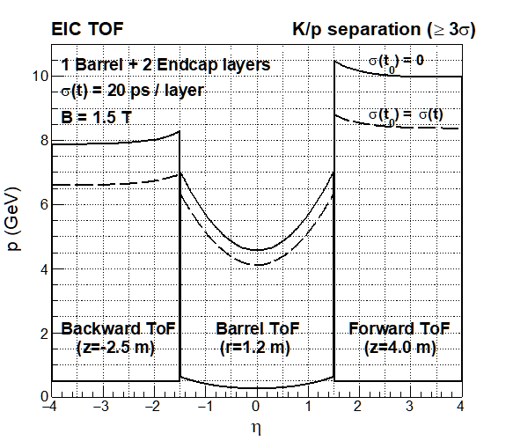
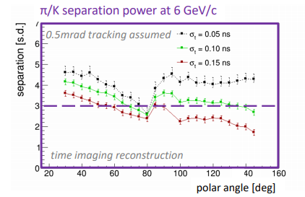
Barrel Cartoon
DIRC
Length of equal performance ~1.2 meters
LGAD TOF
Not presently addressed by us:
  Proximity focus liquid RICH(?) ala ALICE HMPID
  dE/dx from TPC
  TORCH

Slide 6
Electron Arm
Need further consideration following Pavia…

