Slide 1


What jets studies at RHIC can tell us about QGP properties
Probing
Jamie Nagle
University of Colorado
Fat Jacks in Philly
ALICE
ATLAS
sPHENIX
STAR
CMS
sPHENIX
CMS
THEORY
ALICE
STAR
ATLAS
APS Division of Nuclear Physics: 2014 Long-range plan
Joint Town Meetings on QCD
Temple University
September 13-15, 2014

Slide 2
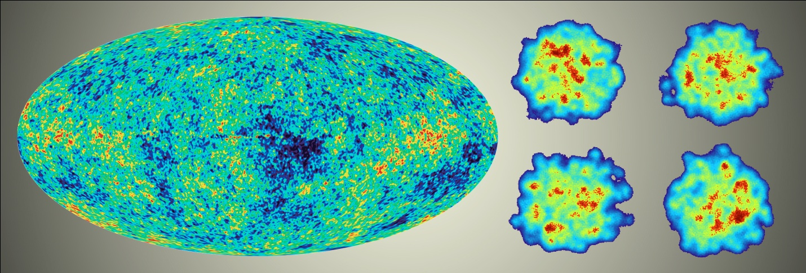
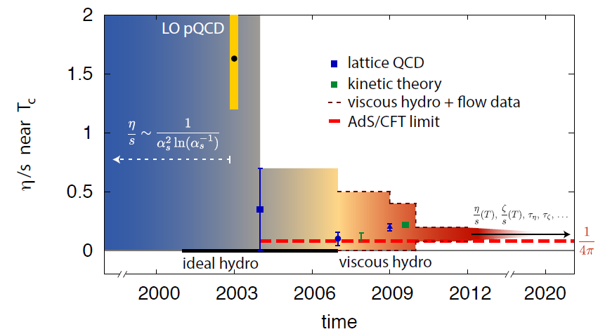
Great Accomplishments in the Field
“Little Bang” Standard Model of Quark-Gluon Plasma
SM allows us to ask a new class of questions
Note the critical role of theory and modeling,
and theory-experiment collaboration

Slide 3

Emergent Phenomena
Connection from the QCD Lagrangian to
phenomena of confinement and asymptotic
freedom was fundamental
Connection from QCD to the emergent phenomena of near perfect fluidity of the Quark-Gluon Plasma near the phase transformation is just as fundamental
Pinning down the η/s tells us the nature of the QGP,
while leaving
open the
“how” and “why” questions

Slide 4
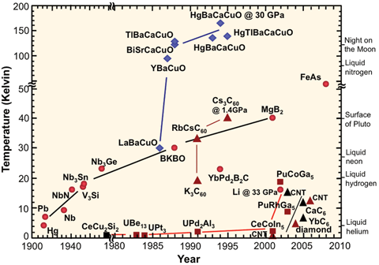
How and Why Questions
High Temperature superconductivity
Nobel prize for discovery…
and another Nobel prize awaiting the
answer to the “how” and “why” questions
“One shouldn’t work on semiconductors,
that is a filthy mess; who knows
whether any semiconductors exist.”
Wolfgang Pauli [1931]
Perhaps like thinking on heavy ion collisions
before perfect fluid discovery…

Slide 5
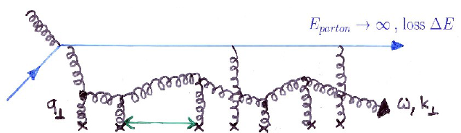
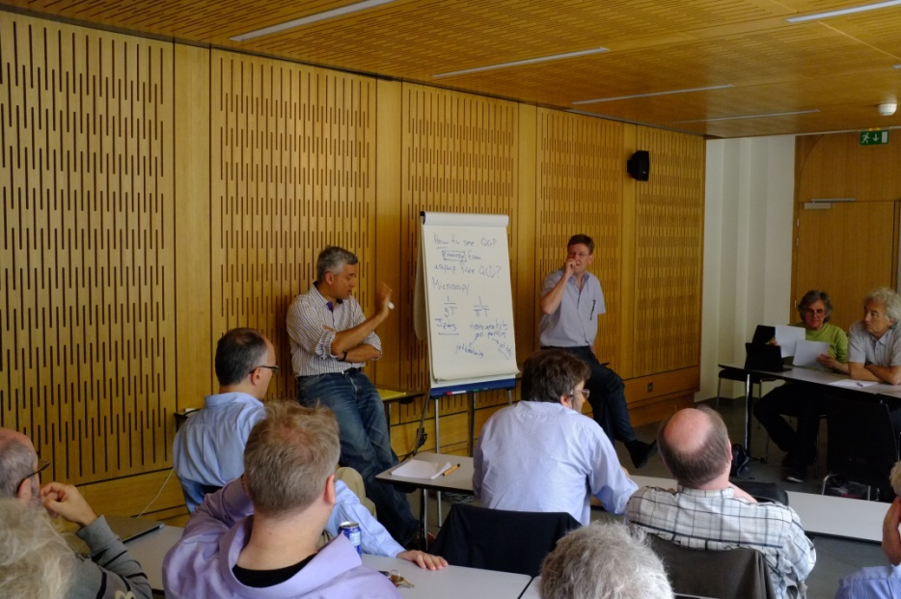
Probing the QGP across Length Scales
Hard Scattered Partons Traversing the QGP
(Jets, Dijets, γ-Jet, Fragmentation, Medium Response)
Length scale set by initial energy, coherent energy lost
20-50 GeV (0.01-0.004 fm), 1-5 GeV (0.2-0.05 fm)
Beauty Quarkonia
Length scale set by size of state (Υ(1s,2s,3s) ~ 0.28, 0.56, 0.78 fm)
Krishna refers to this as
microscopy of the QGP
Critical to push jets to lower energy, looking for hard radiation to understand what it’s being scattered from?

Slide 6
RHIC Probing Region of Strongest Coupling
The textbook (or Wiki entry) on the Quark-Gluon Plasma will be incomplete without
a fundamental explanation for how the perfect fluid emerges at strong coupling near T_{c}
from an asymptotically free theory of quarks and gluons
Jet observables at RHIC enabled by the sPHENIX upgrade
are critical to providing this explanation by probing the QGP near 1-2 T_{c} and over a broad ranges of scales
Measurements of jets only at the LHC will leave these questions with an incomplete answer
(particularly right where the coupling may be strongest)

Slide 7
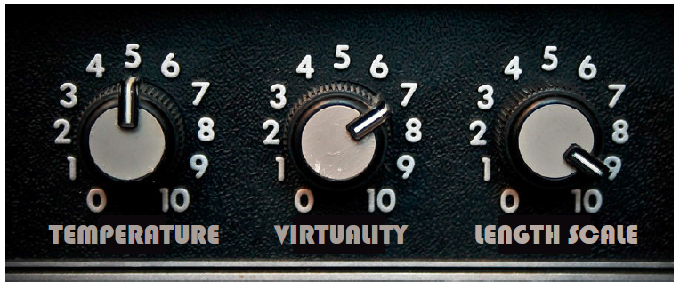
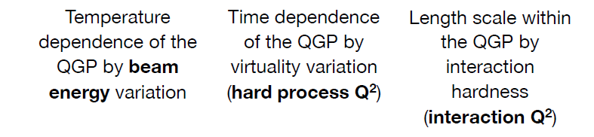
Critical Knobs to Turn
How do the parton shower and medium evolve together?
Can we observe the strongest coupling near T_{c} definitively
What are the inner workings?
(quasiparticles, fields, modes)

Slide 8
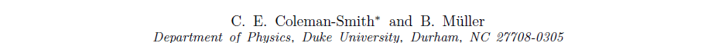
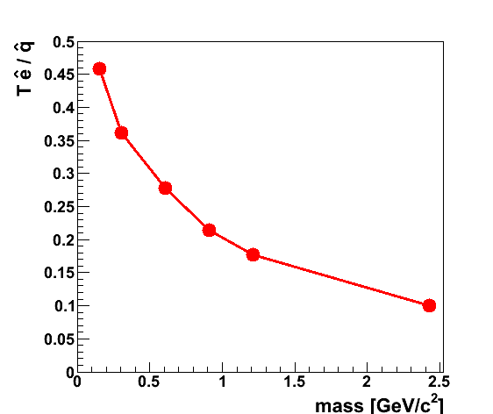
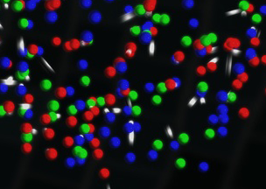
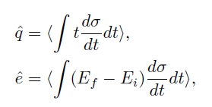
QGP Constituent Mass Dependence
http://arxiv.org/abs/arXiv:1209.3328
qhat → scattering of leading parton → radiation e-loss
ehat → energy transferred to the QGP medium
Jet E_{T} = 30 GeV
T = 350 MeV
α_{s} = 0.3
Limit of infinitely massive scattering centers yields all radiative e-loss.
Medium parton

Slide 9
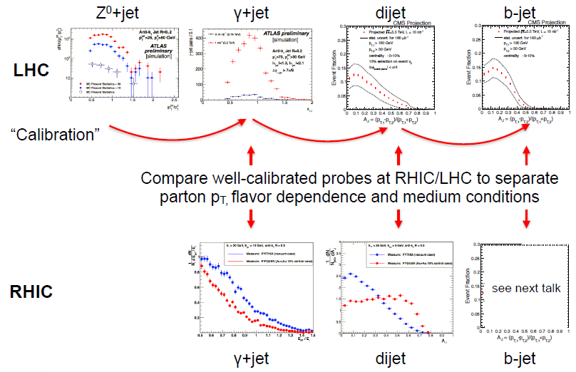
No one key Observable, Instead a Data Army
Bulk QGP Constraints (η/s example)
Very close coordinated effort by experimentalists and theorists
spectra, v₂ → v_{n}, HBT → HBT versus Ψ_{n}, direct photons → photon v_{n}
Over-constraining the theory →
Current “Standard Little Bang” Model
Path to precision QGP bulk properties
Jet Probe Physics
Not one key observable alone.
It is the army of observables in
concert with theory that has
the physics pay-off.
Nicely shown in Gunther’s talk

Slide 10
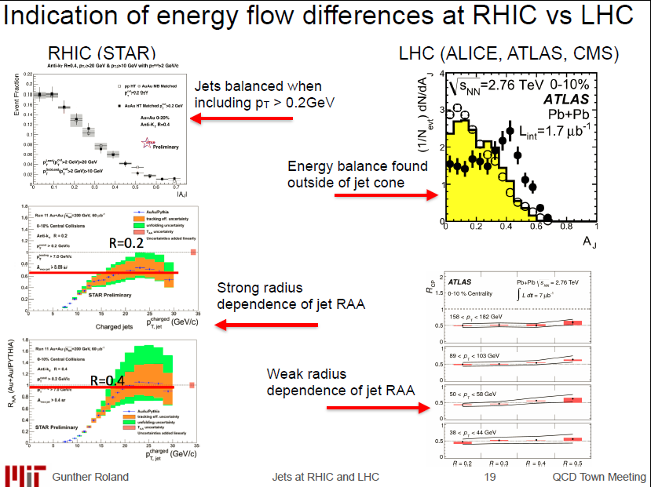
RHIC and LHC Jet Observables

Slide 11
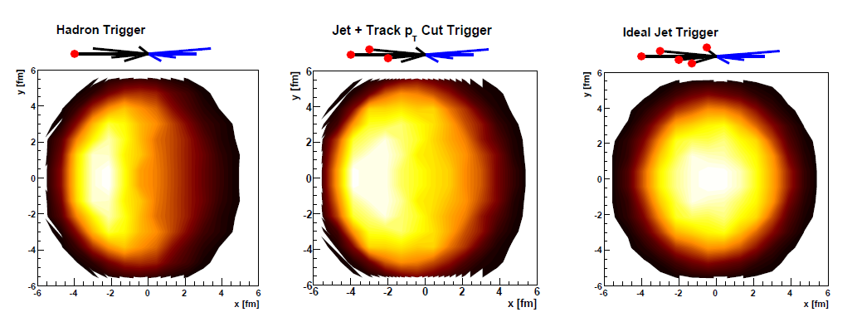
Jet Geometry Engineering
Thorsten Renk has explored the ability to engineer
the surface and energy loss bias to gain more information.
Works particularly well at RHIC due to steeply falling jet spectrum.
Key to measure jets with no minimum p_{T} selection and no trigger bias. Thus, one can explore the full range of engineered geometries.
Systematic measurements enabled “tomography”

Slide 12
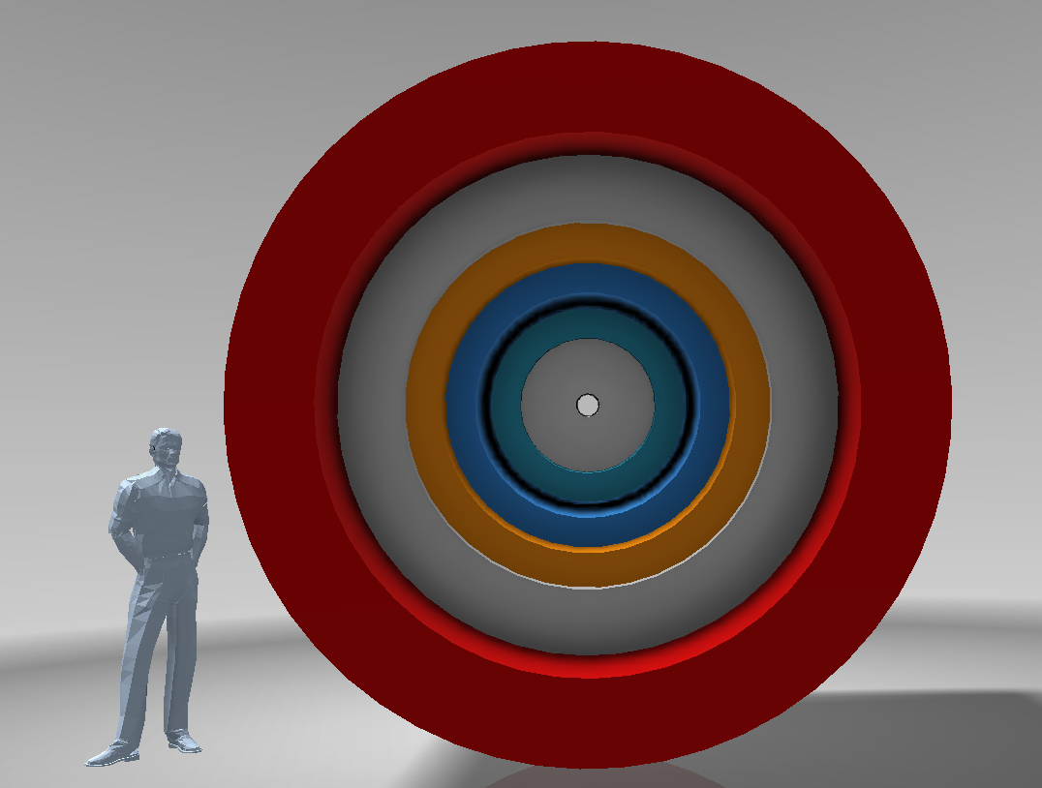

sPHENIX in a Nutshell
BaBar Magnet 1.5 T
Coverage |η| < 1.1
All silicon tracking
Heavy flavor tagging
Electromagnetic
Calorimeter
Two longitudinal
Segment Hadronic Calorimeter
Common Silicon Photomultiplier readout for Calorimeters
Full clock speed digitizers, digital information for triggering
High data acquisition rate capability ~ 15 kHz

Slide 13
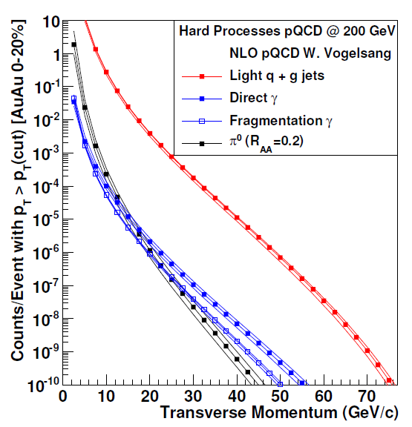
RHIC II Luminosities → Opening New Doors
RHIC II + sPHENIX can record
50 billion events
within |z|<10cm in 20-weeks
Run-14 performance so successful, same delivery would allow sampling of 200 billion events for jets and direct photons
New C-AD projection will allow Au+Au sampling of
0.5 trillion events
Critical similar statistics in
p+p and p+A
10⁷ jets > 20 GeV recorded
10⁴ photons > 20 GeV recorded
e.g. 10⁵ photons > 20 GeV sampled from ½ trillion evts (S/B > 3)

Slide 14
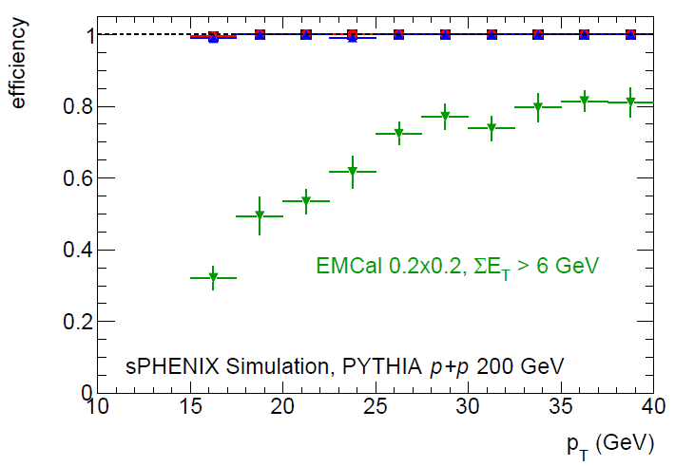
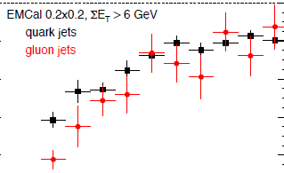
Jets Near Term and Long Term
LHC Run-3 provides great jet statistics for fully differential measurements (e.g. jets > 120 GeV)
Similarly great jet statistics at RHIC for jets > 20 GeV!
Benefits of strong sPHENIX and STAR programs (different jet approaches with overlap too)
Full Calo. Trigger
Run-14 + 16:
STAR mb ~ 400 jets > 50 GeV
EMCal triggered ~ 8,000 jets
Run-2020’s
STAR min. bias ~ 1,200 jets > 50 GeV in central events
sPHENIX min. bias ~ 9,000 jets > 50 GeV in central events
sPHENIX full calorimeter Trigger ~ 50,000 jets > 50 GeV in central events
Quarks/Gluons

Slide 15
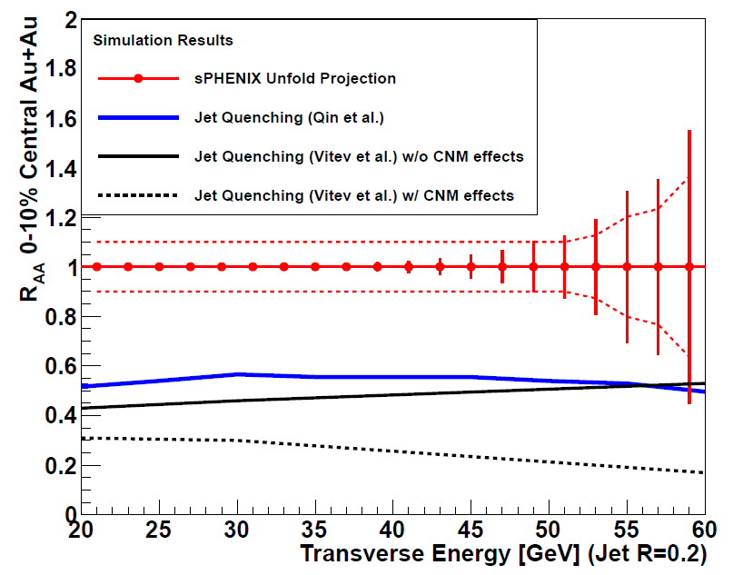
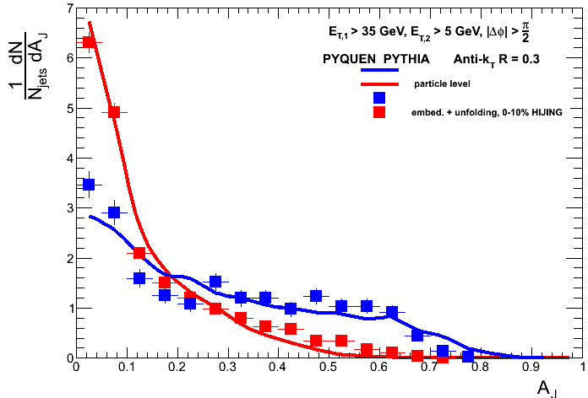
Jet Observables
50 billion MB events
E₁ > 35 GeV, R = 0.3
Truth = solid lines
Boxes = Measure + Unfold
PYTHIA (vacuum case)
PYQUEN (quenched case)
Full suite of jet observables. With and without tracking information.
Single hadrons (up to 40 GeV/c)
Di-hadrons
Hadron-jet
Jet-hadron
Jet (narrow) – jet (wide)
Photon – hadron
Photon – jet
Very differential
All centralities and geometries
Same energy p+p, p+A

Slide 16
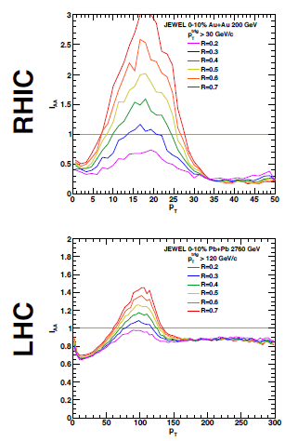
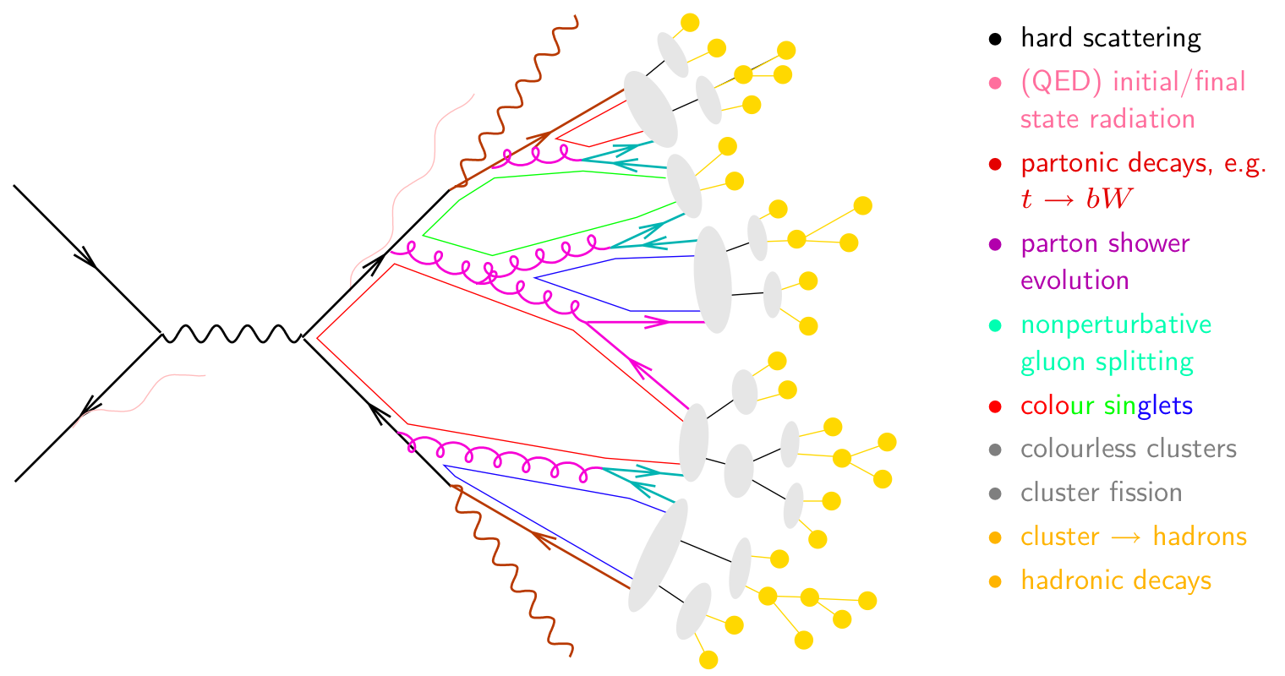
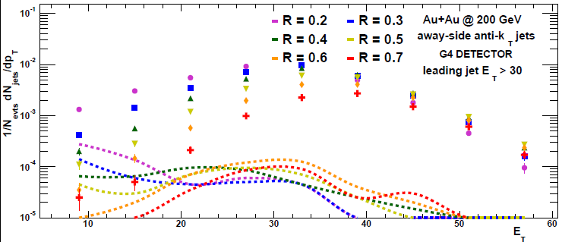
Jet Observables
Trigger Jet R=0.2
I_{AA}
Away Side Jet
R=0.2, 0.4, 0.7
Look for jet energy shifted to larger radius or underneath and equilibrated.
JEWEL predicts huge effect at RHIC.
Good purity even for large R jets!
I_{AA}
Reco. jets
fakejets

Slide 17
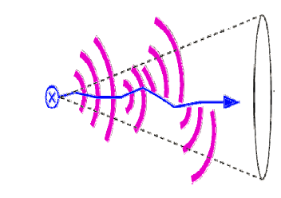
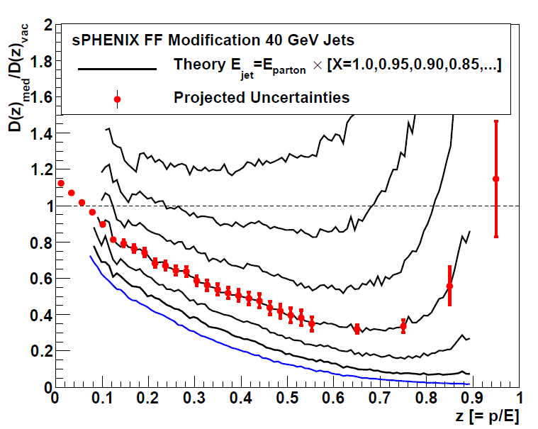
Unique Measurements
Predictions that Fragmentation Function D(z) = p / E_{parton} will have dramatic high-z suppression
If E_{jet} < E_{parton} in A+A due to out of cone radiation or
medium excitation or … then shifting z denominator
sPHENIX enables precision measurement
Cannot be done otherwise at RHIC
Coupled with precision measure at LHC across different jet energies and different QGP couplings →Definitive Answers
arXiv:0710.3073

Slide 18
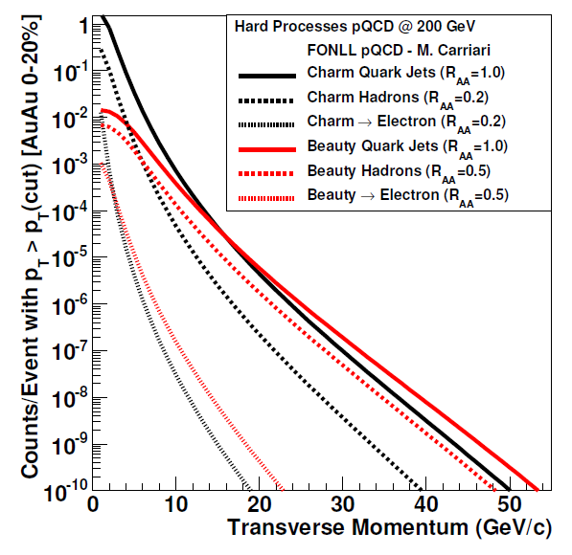
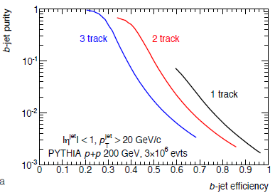
Beauty Tagged Jets at RHIC and LHC
Variety of proven techniques: soft lepton tagging, track counting, secondary vertex reconstruction
Charm
Beauty
Key tests of mass dependence of radiative energy loss
Again, crucial to have overlapping energy ranges with RHIC and LHC

Slide 19
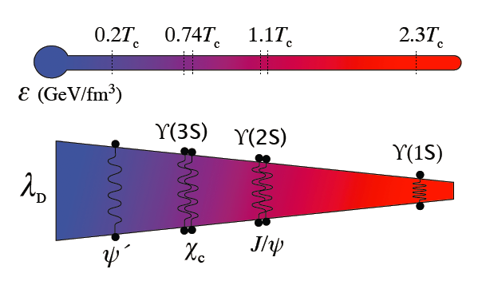
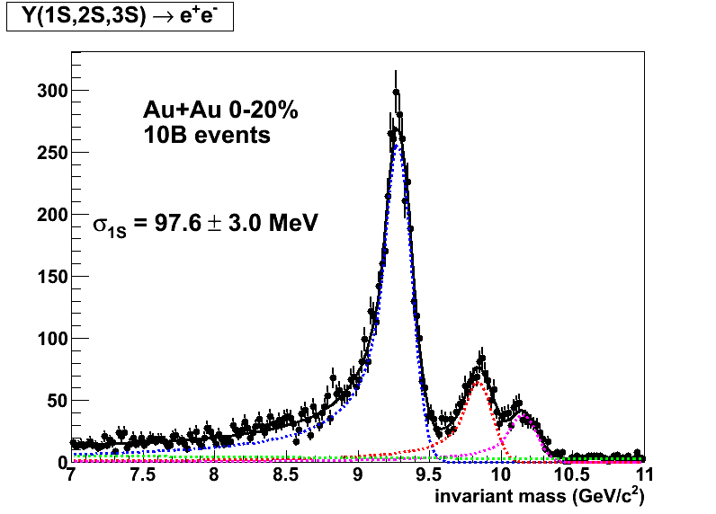
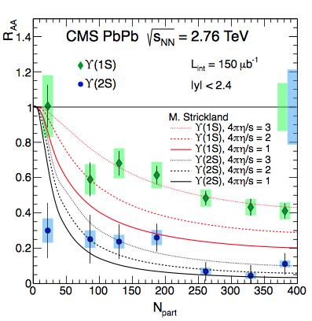
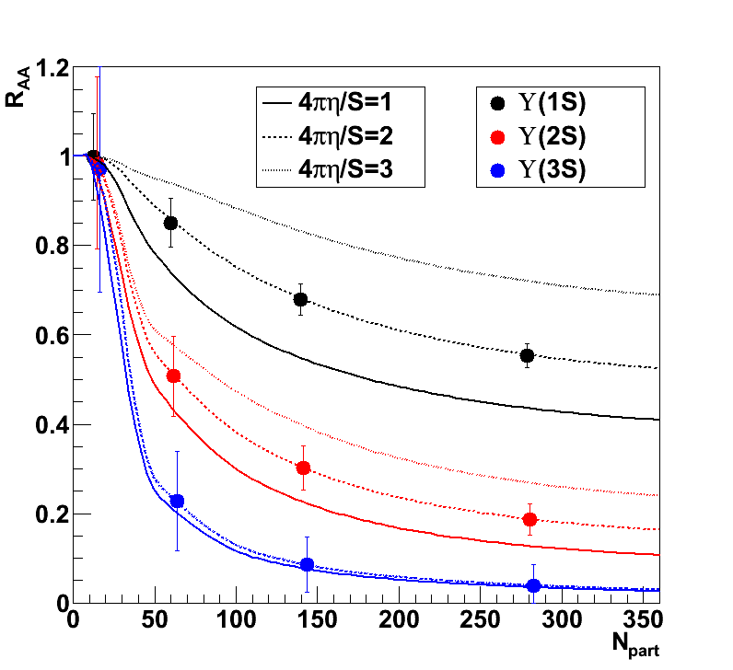
Another Key Length Scale Probe
sPHENIX
Updated
Tracking
Configuration
Expect x10 reduction in statistical uncertainties with LHC Run-3

Slide 20
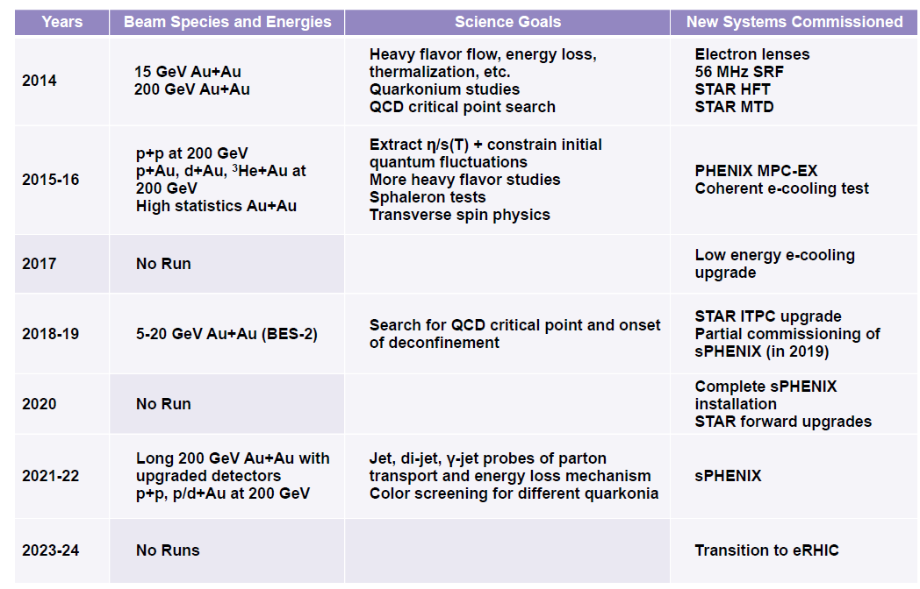
Brookhaven Lab Proposed 10 Year Plan
Excellent timing with Run-3 at LHC

Slide 21
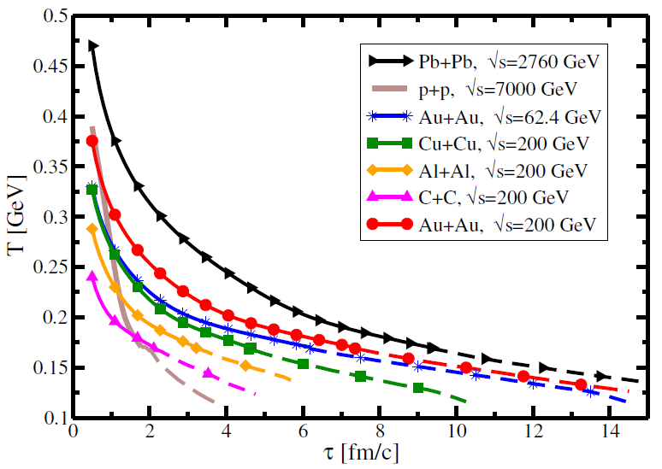
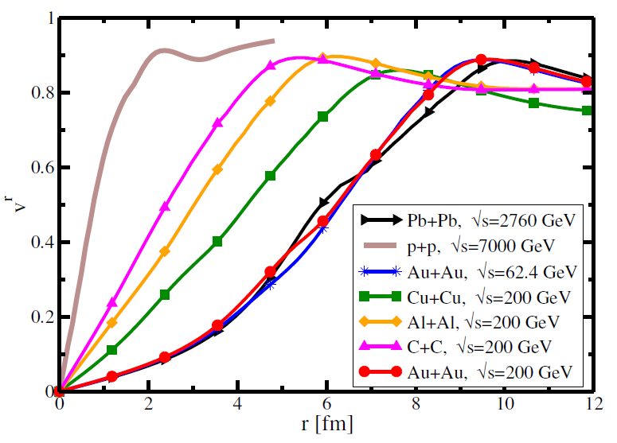
Not Leaving Key Physics on the Floor
Only two years of sPHENIX running?
Extending the program
- Lower Energy Running (39, 62 GeV)
Energy Hadron p_{T} Jet E_{T}
200 40 GeV/c 70 GeV
100 23 GeV/c 35 GeV
62.4 18 GeV/c
39 12 GeV/c
Lighter Ion Running (C+C, Al+Al)
Strengthened p+A program
arXiv:1409.0040

Slide 22
World Context Summary
The impact of the planned scientific program on the advancement of nuclear physics in the context of
current and planned
world-wide capabilities
sPHENIX is crucial to the advancement of our knowledge of the QGP in key areas
sPHENIX will provide key measurements that will add uniquely to our picture of strongly interacting matter
‘How’ and ‘why’ questions on the QGP will be left with incomplete answers without sPHENIX
in conjunction with STAR at RHIC
and ALICE, ATLAS, CMS at LHC

Slide 23
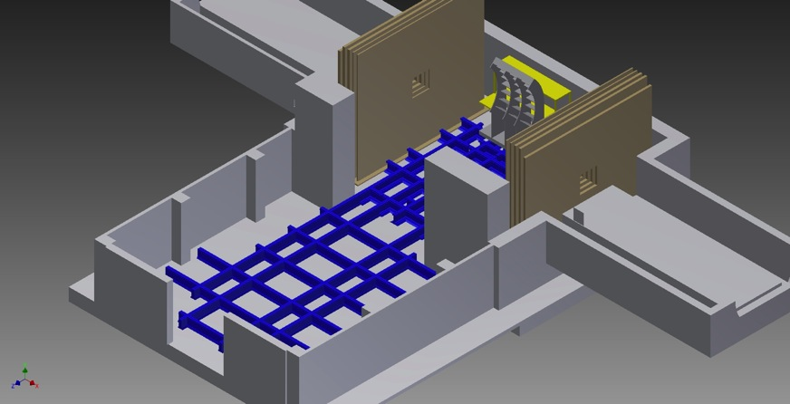
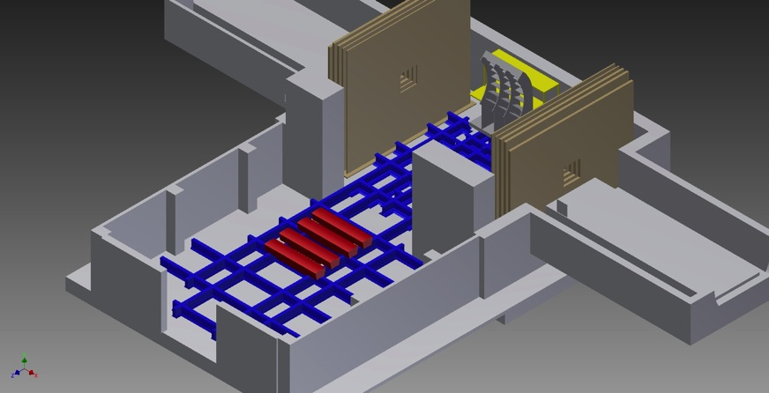
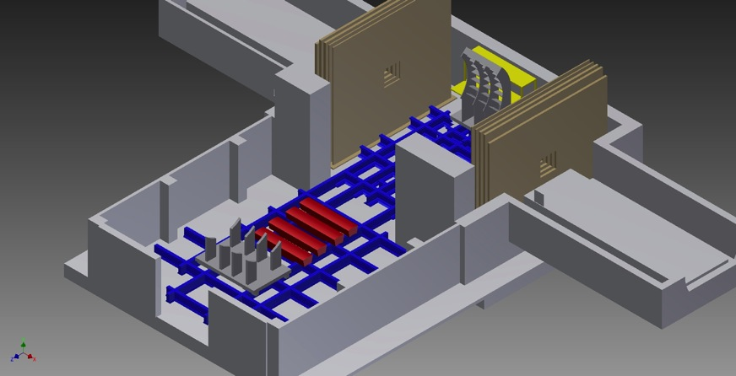

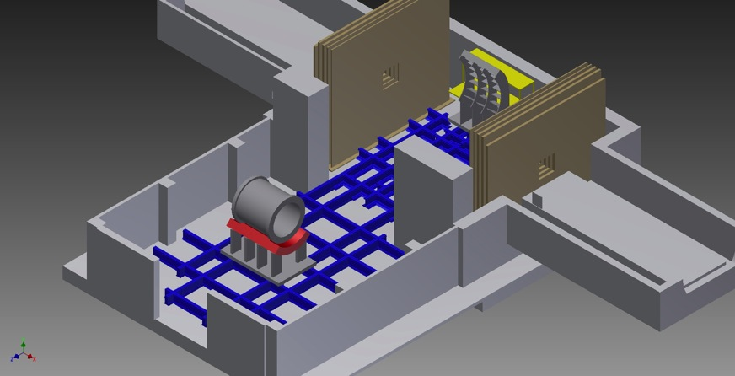
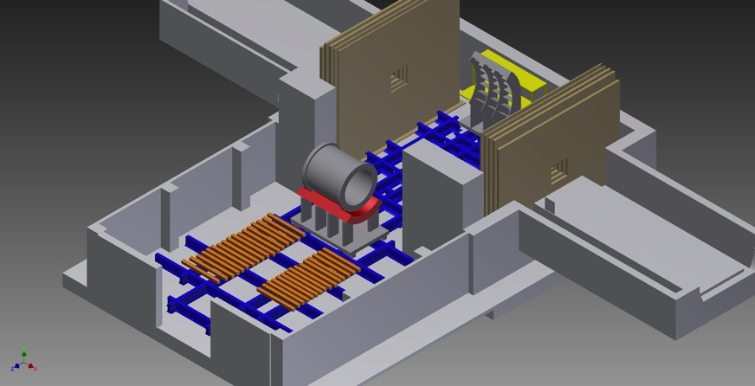

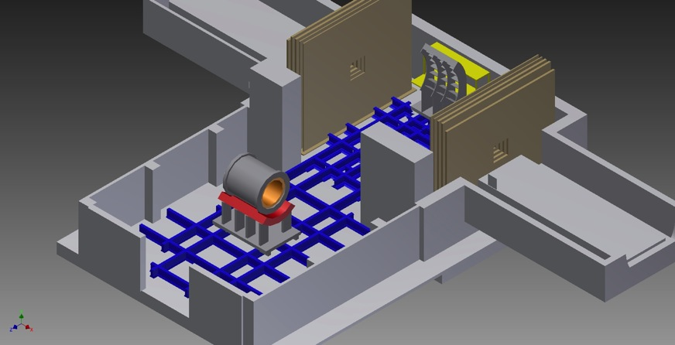
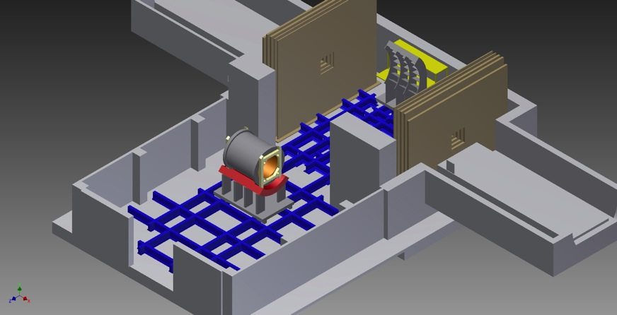
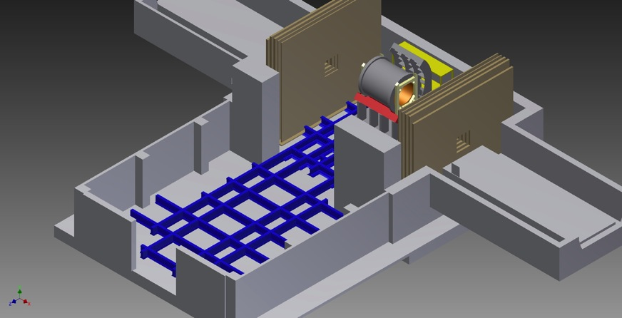
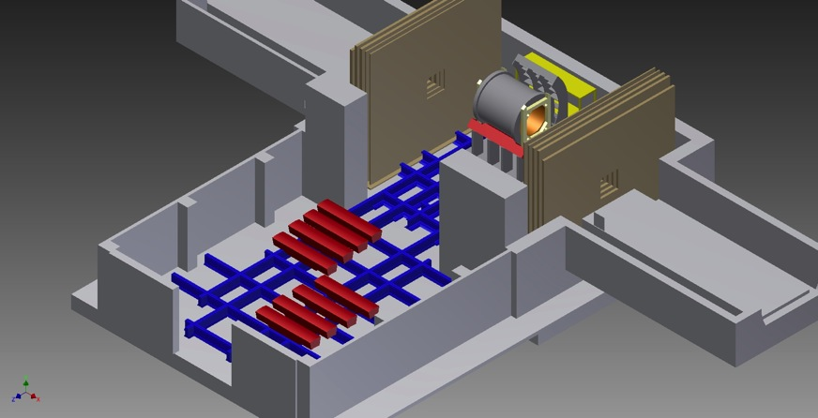
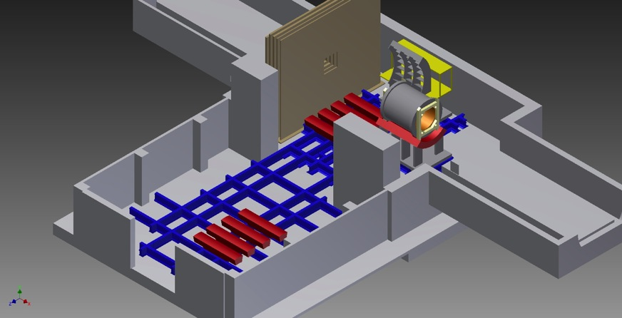
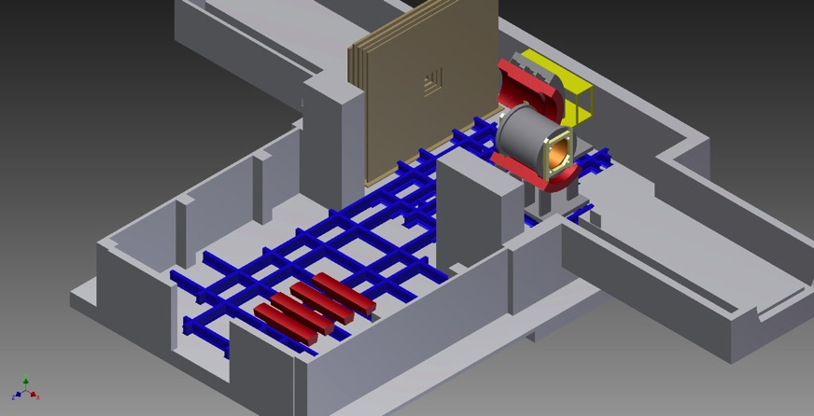
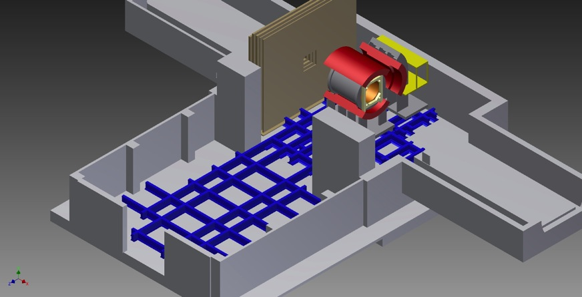
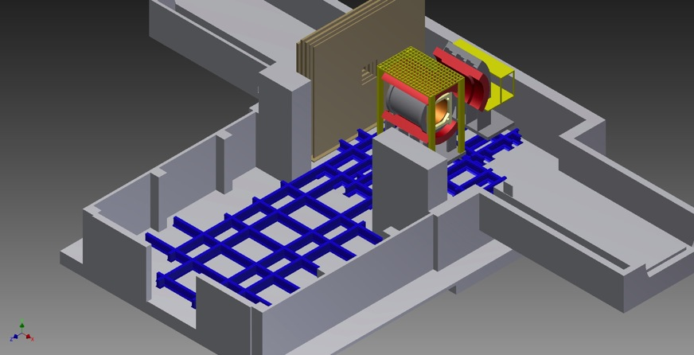

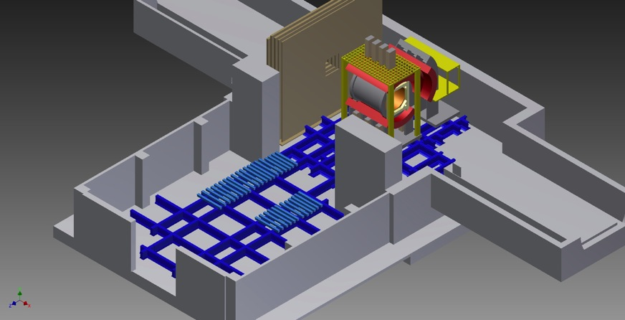
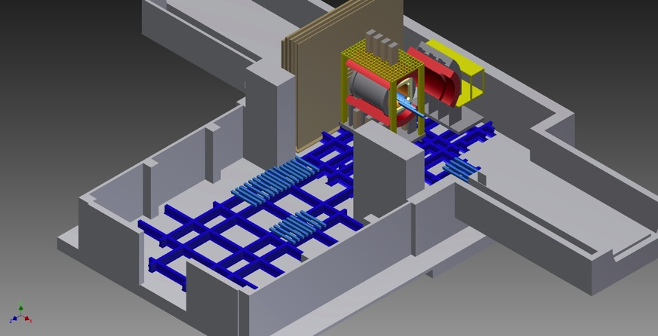
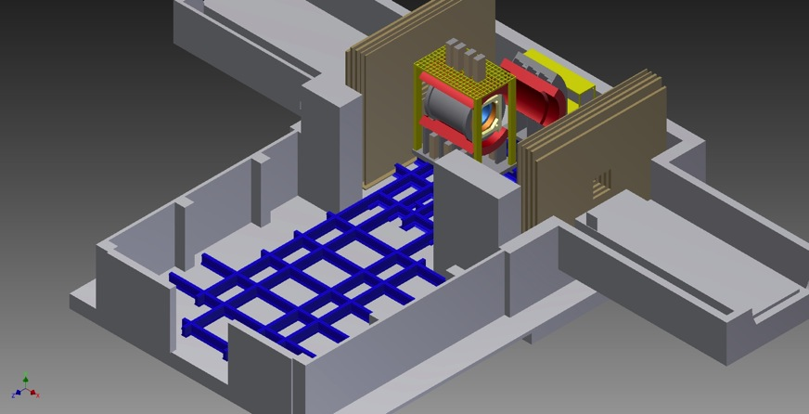






sPHENIX to Reality
Now witness the firepower of this fully operational sPHENIX

Slide 24
EXTRAS

Slide 25


Electron Ion Collider (EIC) Detector Concept
Built around the BaBar Magnet and sPHENIX Calorimetry
BaBar magnet has extra coil density near the ends – with proper flux return shaping, provides good analyzing power at very forward angles
sPHENIX EMCal meets EIC detector specifications
http://arxiv.org/abs/arXiv:1402.1209

