Slide 1

Some Highlights from Cold QCD since 2007
Roy J. Holt
(presented by Rolf Ent)
QCD Town Meeting
98% of work
2% of work
Temple University
13 September 2014

Slide 2
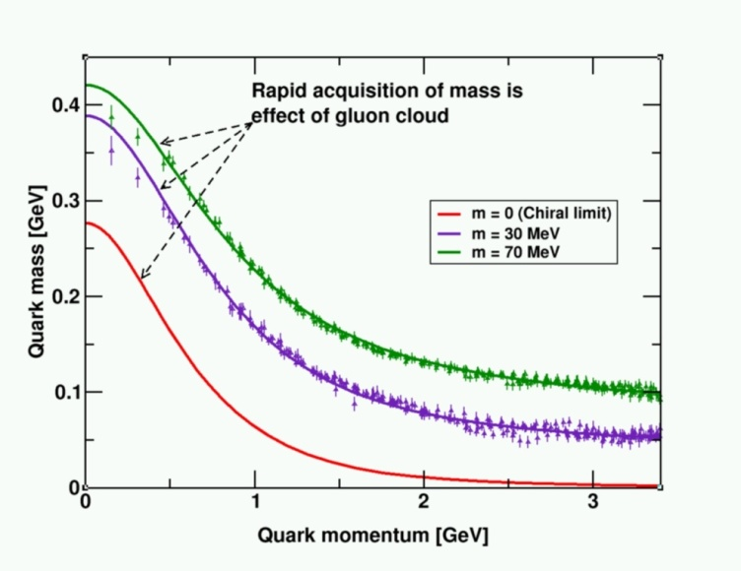
Key questions in hadron physics
What is confinement and how is it connected with dynamical chiral symmetry breaking, the origin of more than 98% of visible mass in the Universe?
  What are the dynamics underlying elastic and transition
  form factors and structure functions of hadrons?
  How does valence quark structure affect the sea?
  Where is the missing spin in the nucleon? Are there
  significant contributions from gluons or valence
  quark orbital angular momentum?
  Can we reveal a novel landscape of nucleon
  substructure through measurements of new
  multidimensional distribution functions?
  Do gluonic excitations have a role in the spectroscopy
  of light mesons and baryons?
How do nuclei emerge from QCD?
  What is the relation between short-range N-N correlations and the partonic structure of nuclei?
Is QCD well enough known for Standard Model tests?
  What QCD phenomena will impact the new generation of semi-leptonic Standard Model tests?

Slide 3
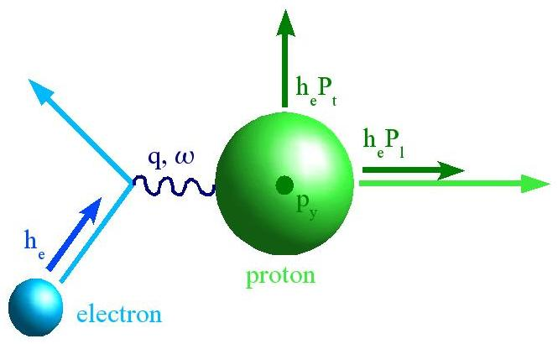
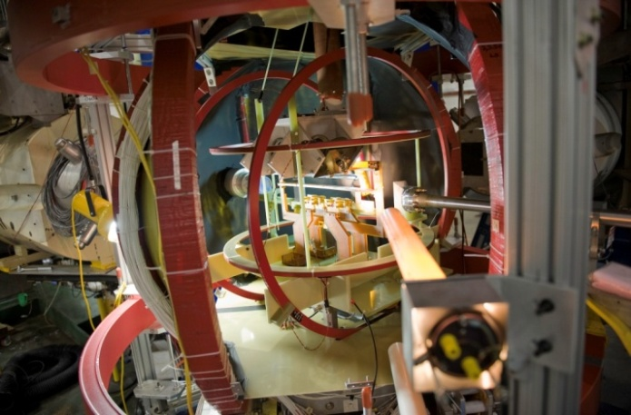
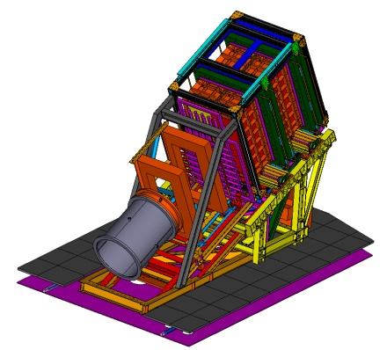
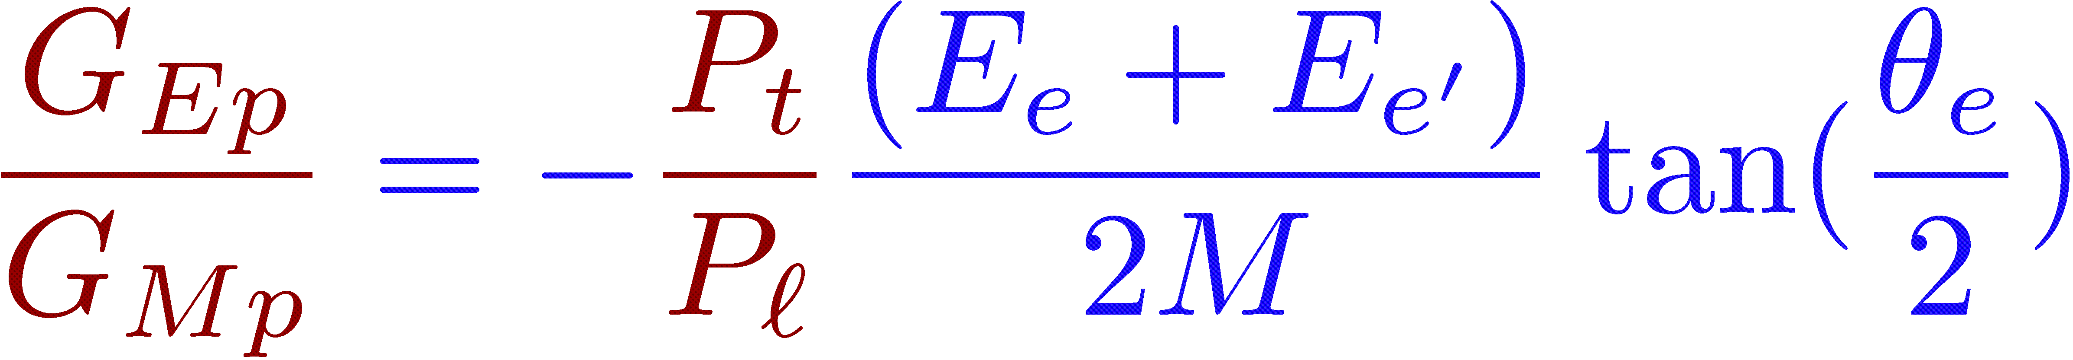
Tremendous advances in electron scattering
Unprecedented capabilities:
High Intensity
High Duty Factor
High Polarization- M. Poelker (2012 Lawrence Award)
Parity Quality Beams
Large acceptance detectors
State-of-the-art polarimetry,
polarized targets
Focal plane polarimeter
– Jefferson Lab
Polarized ³He target

Slide 4
13 SC Milestones in Hadronic Physics – 3 related to BNL/RHIC-Spin, and 10 related to JLab (2 for 12 GeV and 2 for Theory)
Year | # | Milestone
2009 | HP3 | Complete the combined analysis of available data on single π, η and K photo-production of nucleon resonances and incorporate the analysis of two-pion final states into the coupled-channel analysis of resonances.
2010 | HP4 | Determine the four electromagnetic form factors of the nucleons to a momentum-transfer squared, Q², of 3.5 GeV² and separate the electroweak form factors into contributions from the u, d and s-quarks for Q² < 1 GeV² .
2010 | HP5 | Characterize high-momentum components induced by correlations in the few-body nuclear wave functions via (e,e'N) and (e,e'NN) knock-out processes in nuclei and compare free proton and bound proton properties via measurement of polarization transfer in the ⁴He (e,e’p) reaction.
2011 | HP6 | Measure the lowest moments of the unpolarized nucleon structure functions (both longitudinal and transverse) to 4 GeV² for the proton, and the neutron, and the deep inelastic scattering polarized structure functions g₁(x,Q²) and g₂(x,Q²) for x=0.2-0.6, and 1 < Q² < 5 GeV² for both protons and neutrons.
2012 | HP7 | Measure the electromagnetic excitations of low-lying baryon states (<2 GeV) and their transition form factors over the range Q²=0.1–7 GeV² and measure the electro- and photo-production of final states with one and two pseudoscalar mesons.
2012 | HP11 | Measure the helicity-dependent and target-polarization-dependent cross-section differences for Deeply Virtual Compton Scattering (DVCS) off the proton and the neutron in order to extract accurate information on generalized parton distributions for parton momentum fractions, x, of 0.1 – 0.4, and squared momentum transfer, t, less than 0.5 GeV² .
2013 | HP8 | Measure flavor-identified q and q contributions to the spin of the proton via the longitudinal-spin asymmetry of W production.
2013 | HP12 | Utilize polarized proton collisions at center of mass energies of 200 and 500 GeV, in combination with global QCD analyses, to determine if gluons have appreciable polarization over any range of momentum fraction between 1 and 30% of the momentum of a polarized proton.
2014 | HP9 | Perform lattice calculations in full QCD of nucleon form factors, low moments of nucleon structure functions and low moments of generalized parton distributions including flavor and spin dependence.
2014 | HP10 | Carry out ab initio microscopic studies of the structure and dynamics of light nuclei based on two-nucleon and many-nucleon forces and lattice QCD calculations of hadron interaction mechanisms relevant to the origin of the N-N interaction.
2015 | HP13 | Test unique QCD predictions for relations between single-transverse spin phenomena in p-p scattering and those observed in deep-inelastic lepton scattering.
2018 | HP14 | Extract accurate information on spin-dependent and spin-averaged valence quark distributions to momentum fractions x above 60% of the full nucleon momentum
2018 | HP15 | The first results on the search for exotic mesons using photon beams will be completed.

Slide 5
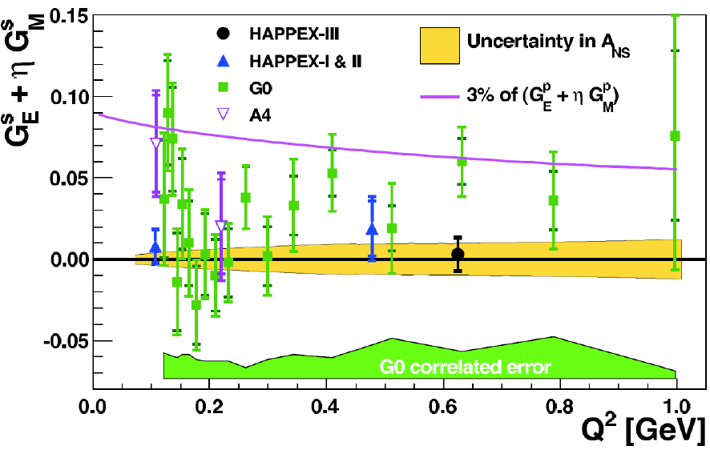
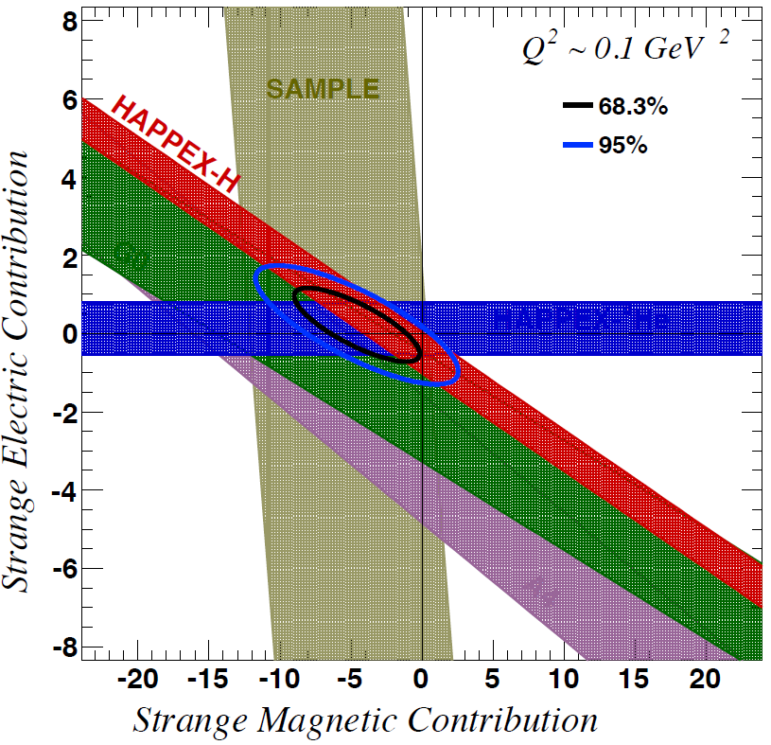
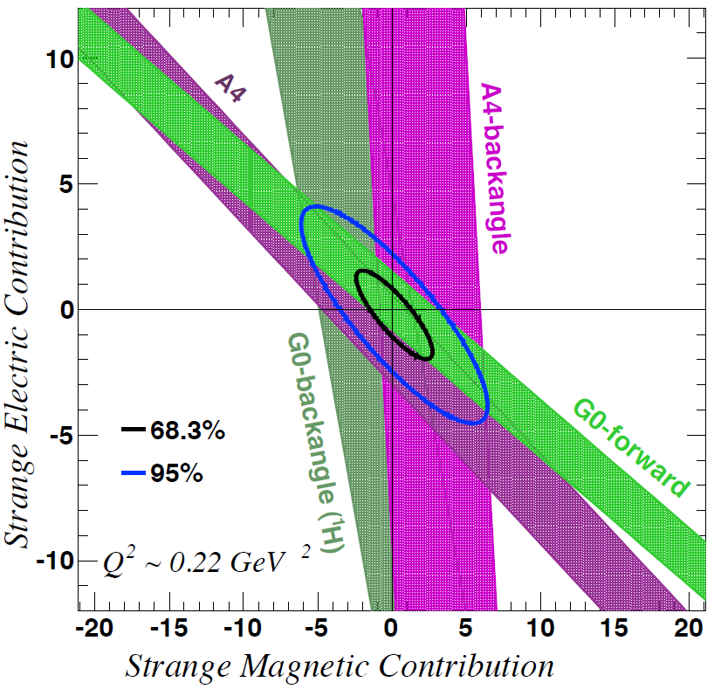
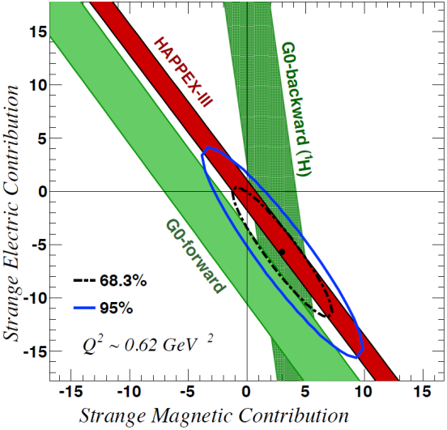
Strangeness Contribution to Nucleon Form Factors
HAPPEx-3: PRL 108 (2012) 102001
G0-Backward: PRL 104 (2010) 012001
Purple line represents 3% of the proton form factors
Strange quarks do not play a substantial role in the long-range electromagnetic structure of nucleons
Neglect strange form factors -Flavor separation of the proton form factor
NSAC milestone HP4 (2010) completed

Slide 6
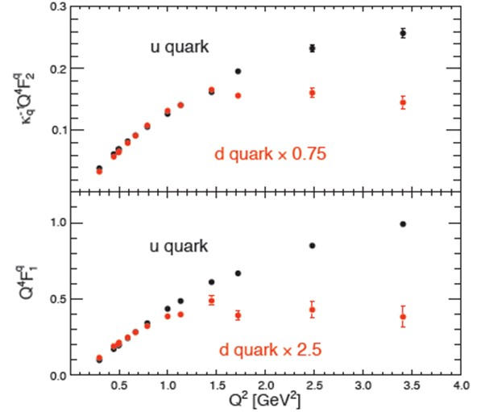


Flavor separation of nucleon form factors
HAPPEx, G0, A4 →
G_{E}^{s} = G_{M}^{s} = 0
Q⁴F₂^{q}/κ
Very different behavior for u & d quarks
Evidence for diquark correlations – axial diquark -> soft f.f.
Six 12-GeV experiments to extend Q² range
Cates, de Jager,
Riordan, Wojtsekhowski,
PRL 106 (2011) 252003
Q⁴ F₁^{q}
NSAC milestone HP4 (2010) completed
See Ron Gilman talk, and Tanja Horn’s talk for progress on pion form factor

Slide 7

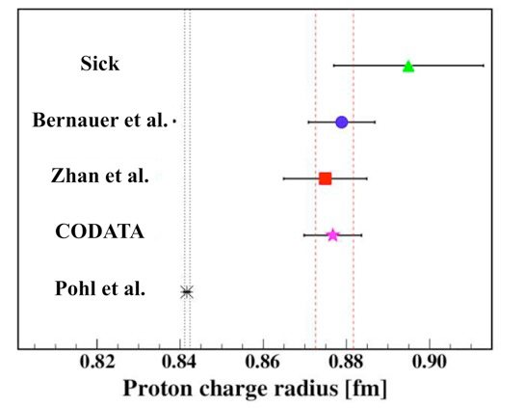
Proton Radius Puzzle
~7 σ
PSAS 2012 Symposium
ECT* Workshop - Nov. 2012
MITP Workshop – June 2014
⁴He charge radii from electron
scattering and μ-⁴He agree!
r_{p}≅0.8768(69)fm (ep atom)
r_{p}≅0.8772(46)fm (ep scattering)
r_{p}=0.84184(67)fm (μp atom)
Future sub 1% measurements:
(1) ep elastic scattering at JLab
(2) μp elastic scattering at PSI - 16 U.S. institutions!
(3) Follow up experiments at Mainz
X. Zhan et al, PLB 705 (2011) 59
Thanks to R. Gilman, H. Gao

Slide 8
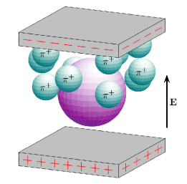
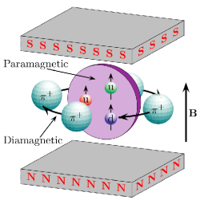
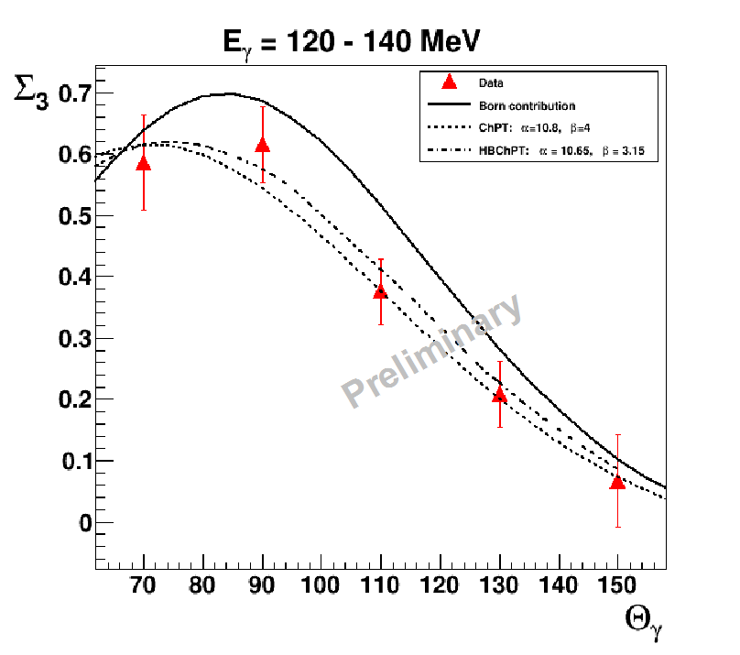
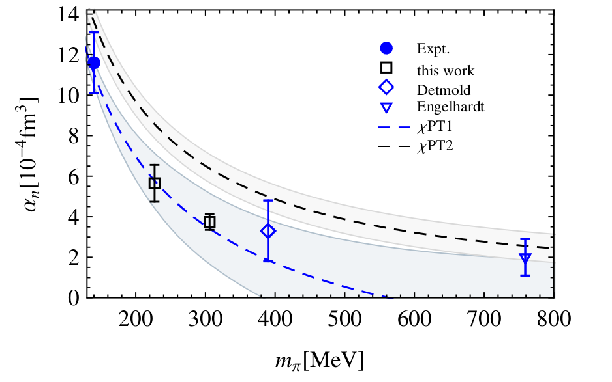
Hadron polarizabilities – Compton scattering
α
β
Thanks to: A. Alexandru, H. Gao, H. Griesshammer,
W. Briscoe, R. Miskimen, B. Norum, G. Feldman,
P. Martel, G. O’Rielly, E. J. Downie
Fundamental: uncertainty in proton radius, EM nucleon self energy
High Intensity Gamma Source (HIγS) (7 U.S. institutions)
  Polarized ³He, H, D (HIFROST) targets almost ready
MAMI (3 U.S. institutions)
  World’s first measurements of double pol. Σ2x, Σ2z (arXiv:1408.1576)
  New measurements of beam asymmetry Σ3, first below pion threshold
  World’s first extraction of individual spin pol., new scalar pol. extraction in progress
LUND (3 U.S. institutions)
  Deuteron RCS, doubled world data set χEFT fit
THEORY (7 U.S. institutions)
  LQCD α_{n}, β_{n} with χEFT extrapolation fits exp’t
  Construction of statistically coherent database
  New results changed PDG values of α_{p}, β_{p}
  Ongoing χEFT work on p, n, D, ^{3,4}He, ⁶Li
Sokhoyan, Downie et al
Alexandru et al
See D. Phillips, C. Howell’s talks

Slide 9
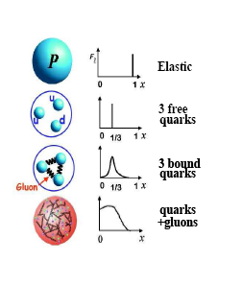







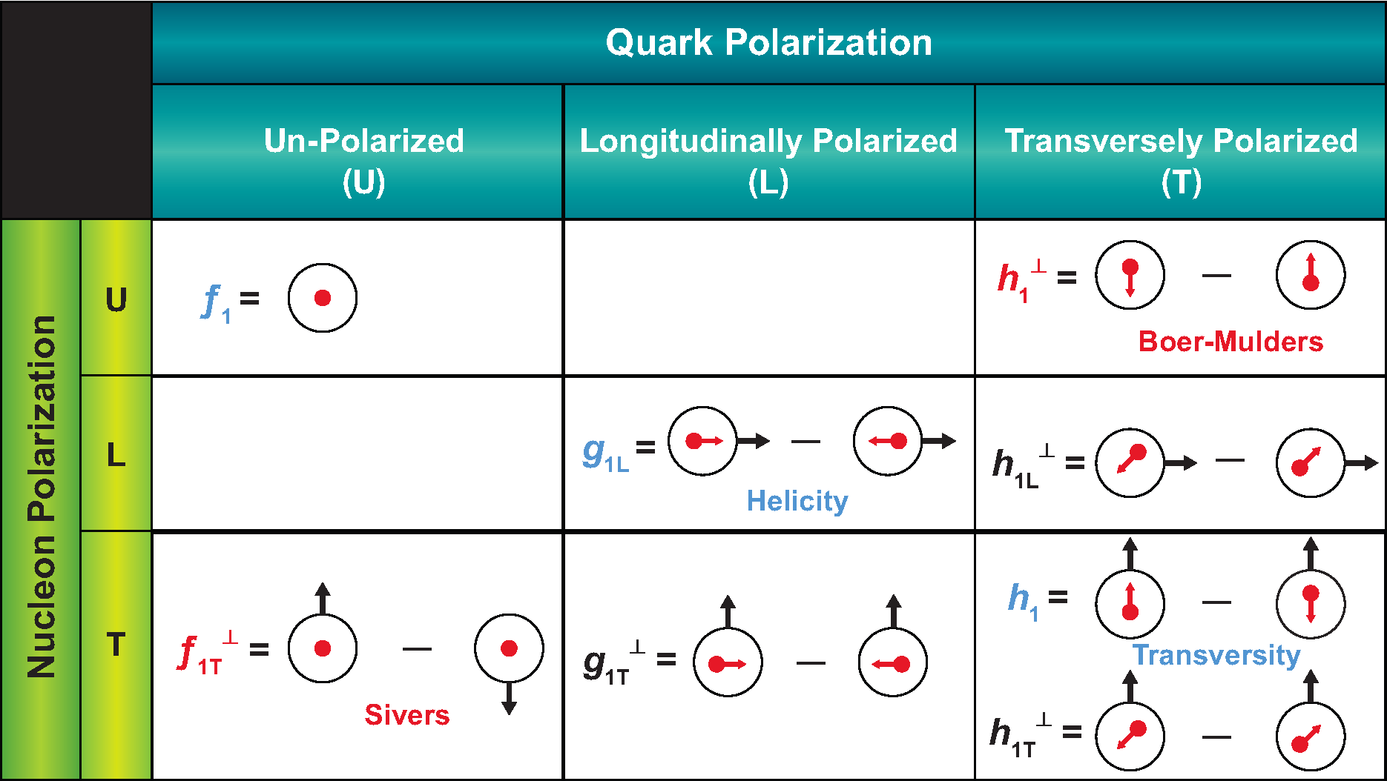
Partonic structure of the nucleon
leptonic
hadronic
Structure function
Parton model
Quark charge
Prob. of q in proton
EIC whitepaper

Slide 10
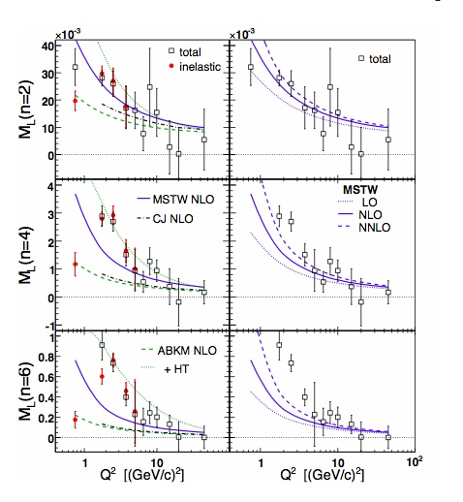
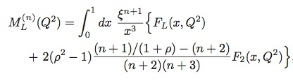

Unpolarized and Polarized Structure Functions – measure the lowest moments of (separated, p and n) structure functions
Moments are x-weighted: Needed (largely JLab) L/T and g₁/g₂ separated data at large x
PRL 110 (2013) 15, 152002
Thanks to C. Keppel, S. Kuhn, Z.-E. Meziani
NSAC milestone HP6 (2011) completed

Slide 11
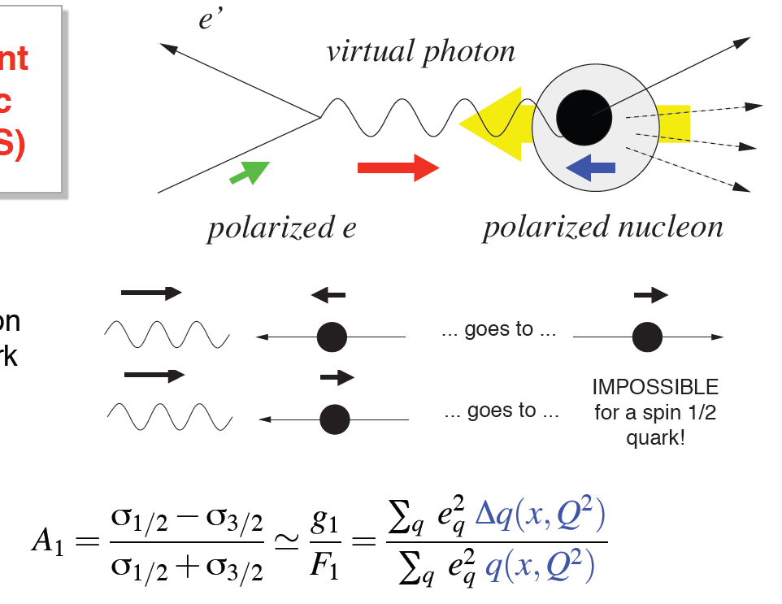
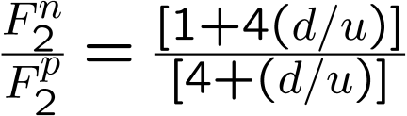
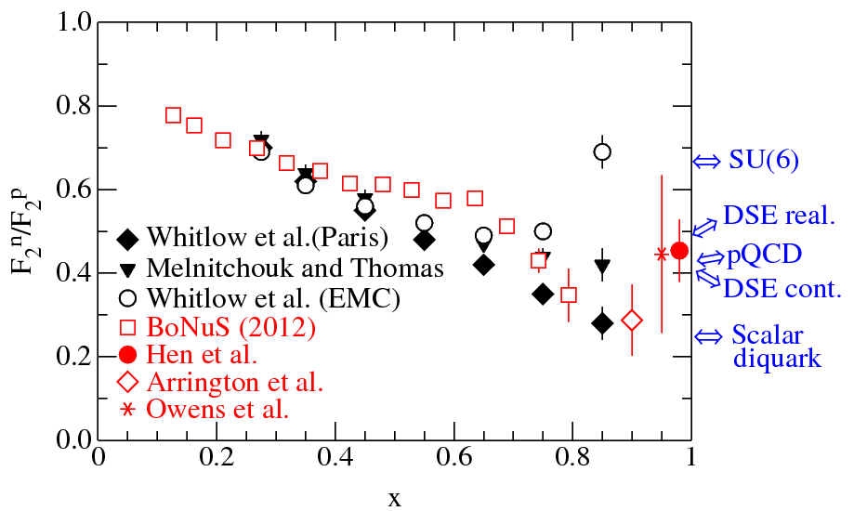
Unpolarized and Longitudinally Polarized Structure Functions
Parton model ->
Parno et al.,
arXiv:1406.1207
A₁^{p}
NSAC milestone HP6 (2011) completed, steps toward HP14 (2018)
Upgraded JLab has unique capability to define the valence region
6 JLab 12-GeV experiments
Thanks to C. Keppel, K. Kumar, G. Petratos, C. D. Roberts, S. Kuhn, Z.-E. Meziani

Slide 12
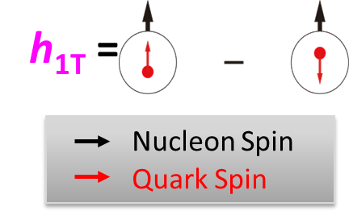

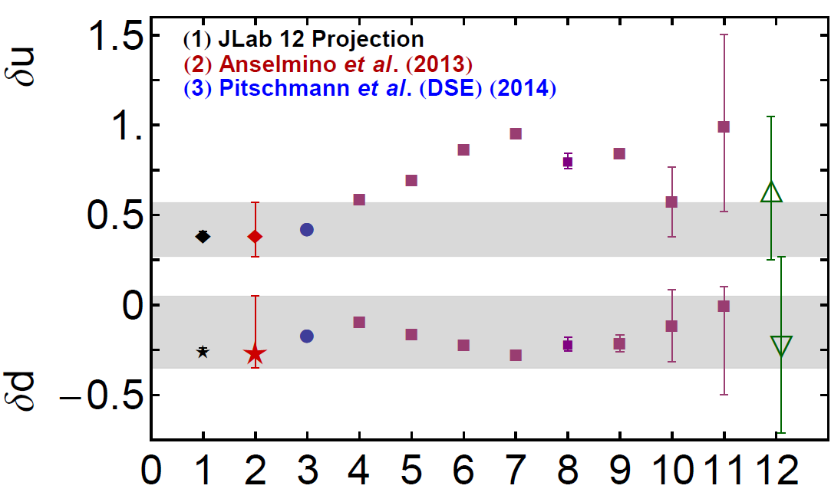

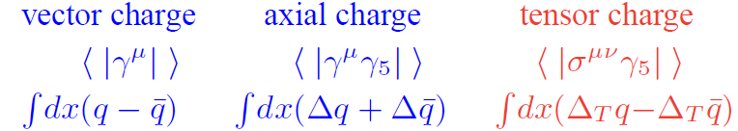
Tensor charge from transversity measurements at JLab
JLab 12 GeV Projection (Prokudin)
Anselmino et al., PRD87 (2013) 094019
Pitschmann et al. (DSE) (2013) [including axial-vector diquarks but contact interaction]
Hecht et al. (DSE), PRC64 (2001) 025204 [only scalar diquarks]
Cloët et al., PLB659 (2008) 214
Pasquini et al., PRD76 (2007) 034020
Wakamatsu, PLB653 (2007) 398
Alexandrou et al, PoS (2014) 150 [ Lattice QCD]
Gockeler et al., PLB627 (2005) 113
Gamberg et al., PRL 87 (2001) 242001
He et al., PRD52 (1995) 2960
Bacchetta et al., JHEP 1303 (2013) 119
Distribution of transversely polarized quarks inside a transversely polarized proton
Tensor Charge
Collins fragmentation function from KEK-B/Belle
- M. Grosse-Perdekamp (UIUC)
Four 12-GeV experiments
δd benefits from SoLID
Thanks to A. Prokudin, C. D. Roberts and Z.-E. Meziani

Slide 13
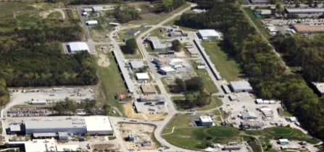
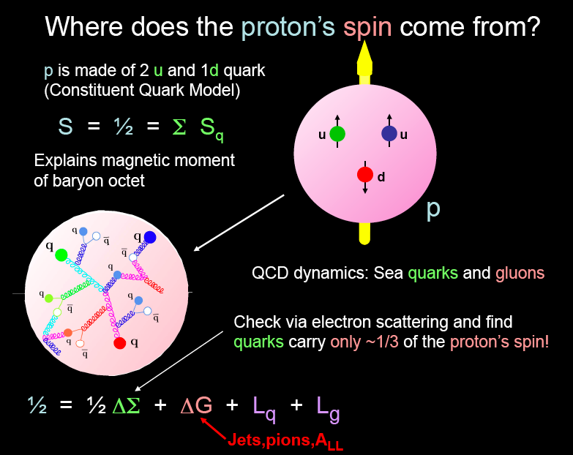
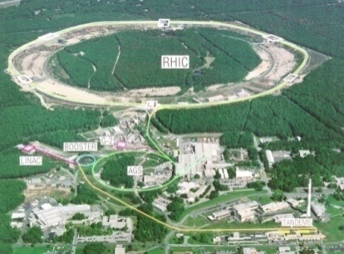
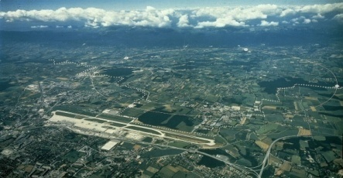
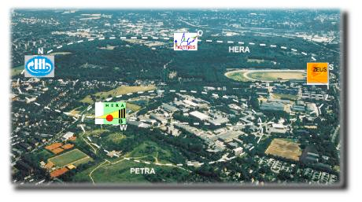
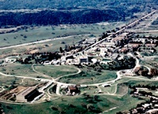
Worldwide quest: spin structure of the nucleon
From DIS measurements
ΔΣ ≈ 0.3
ΔG = 1.0±1.2
quark polarization Δq(x)
→first 5-flavor separation from HERMES: Δq ≈ 0
RHIC-spin: future charge- current measurements
gluon polarizationΔG(x)
→RHIC-spin, HERMES, COMPASS
orbital angular momentum L
→ GPD’s and TMD’s
What is the origin of the proton spin?
Spin budget of the proton
30%
70%
Jets, pions, A_{LL}
Far future: EIC
See Ralf Seidl, Janwei Qiu’s talks.

Slide 14
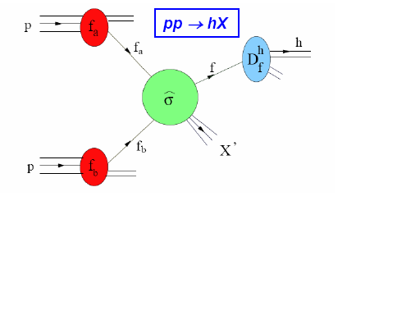
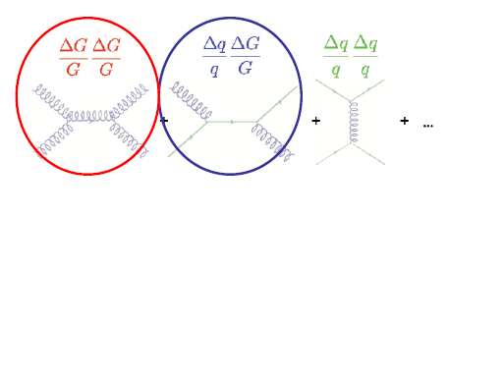
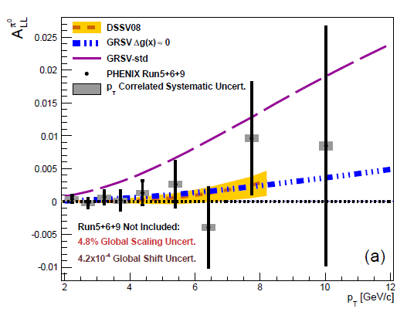
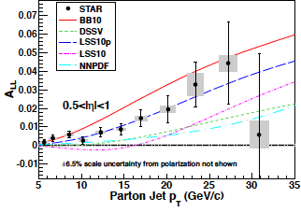
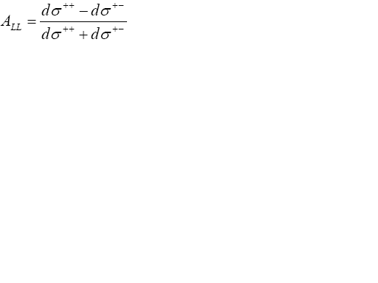
Measurement of the gluon polarization Δg at RHIC
Dominates at low p_{T}
Dominates at high p_{T}
D. de Florian et al,
PRL 113 (2014) 01200
E. Nocera et al,
arXiv 1406.5539
PRD 90 (2014) 012007
arXiv:1405.5134
1
ʃdxΔg(x,Q²=10GeV²) = 0.20^{+.06}_{-.07}
DSSV++
NSAC milestone HP12 (2013)
0.05
0.2
NNPDFpol1.1
ʃdxΔg(x,Q²=10GeV²) = 0.17+-0.06
0.05

Slide 15
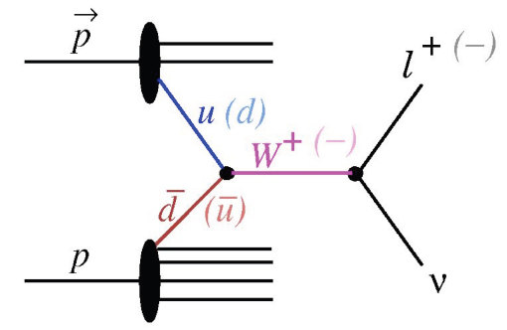
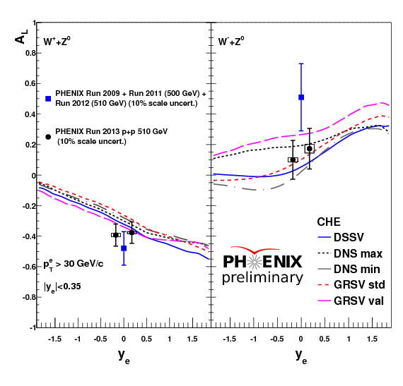
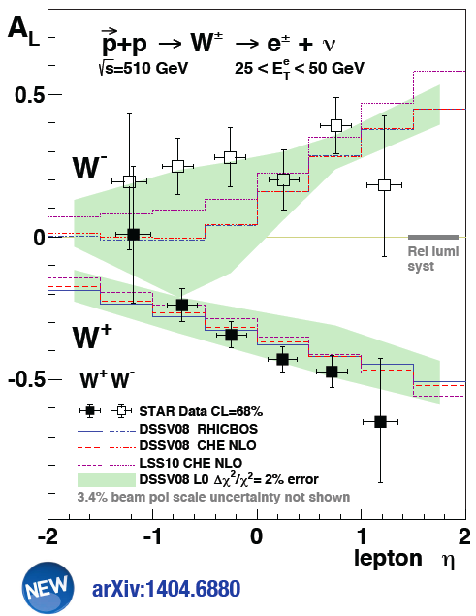
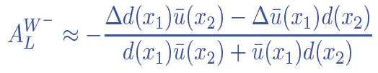

W production expected from RHIC runs 12+13
Provides an important check of SIDIS method
No fragmentation function
Q²=M_{W}² (no high twist effects)
NSAC milestone HP8 (2013)
J. Nagle, Z. Xu, D. Morrison, RHIC PAC 2014
See R. Seidl’s talk
http://www.bnl.gov/npp/pac0614.asp
Thanks to E. Aschenaur

Slide 16
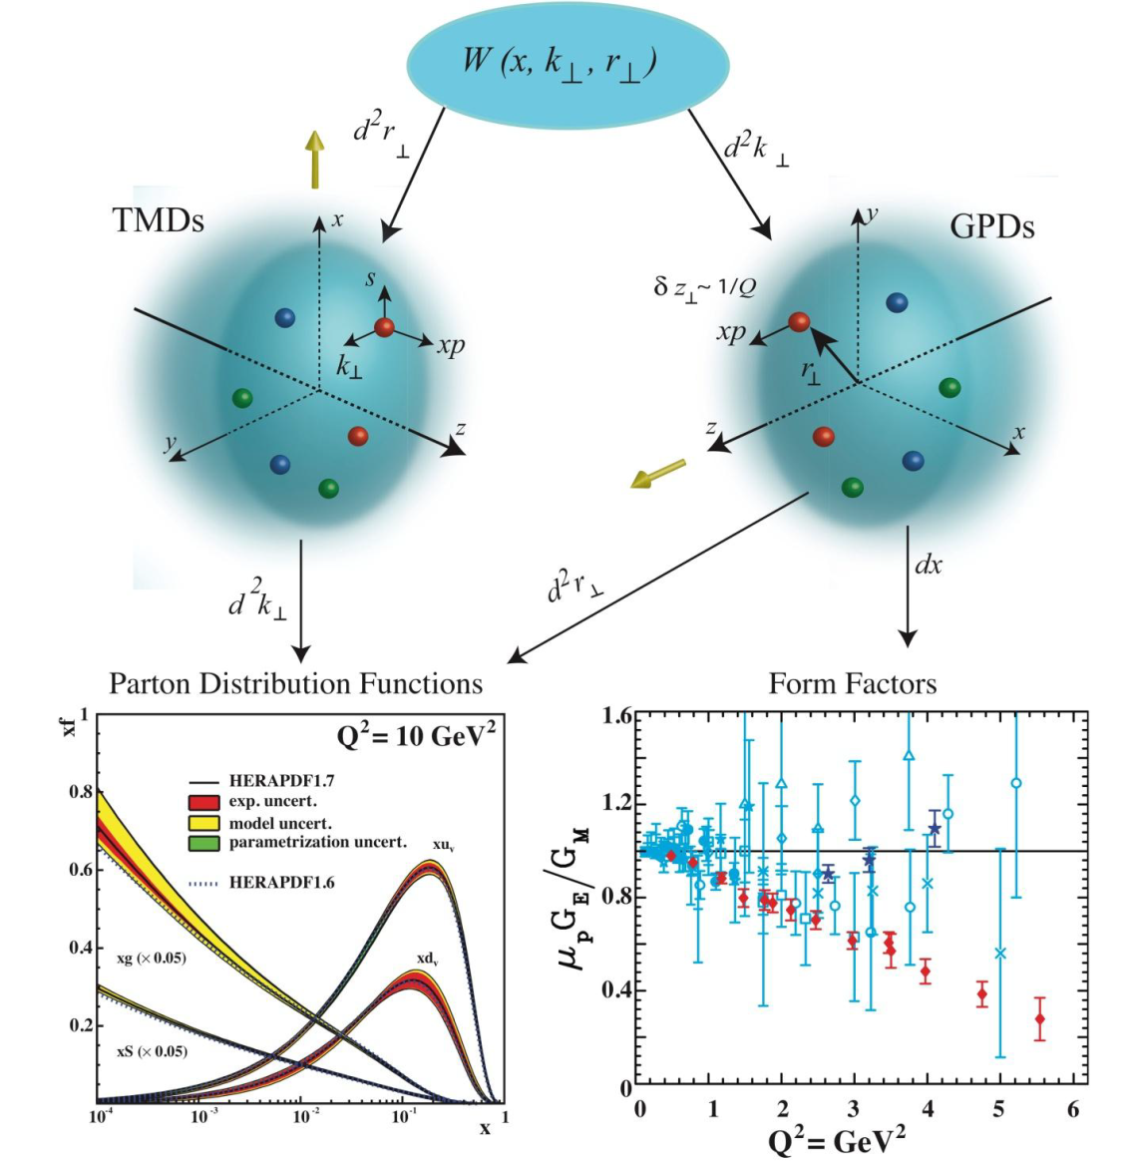
Multidimensional parton distribution functions
Transverse momentum distribution functions
Generalized parton distribution functions
eg., Sivers distribution
eighteen 12-GeV experiments! See Naomi Makins, Andreas Metz’, Jen-Chieh Peng’s talks
JLab whitepaper

Slide 17
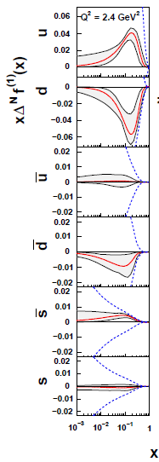
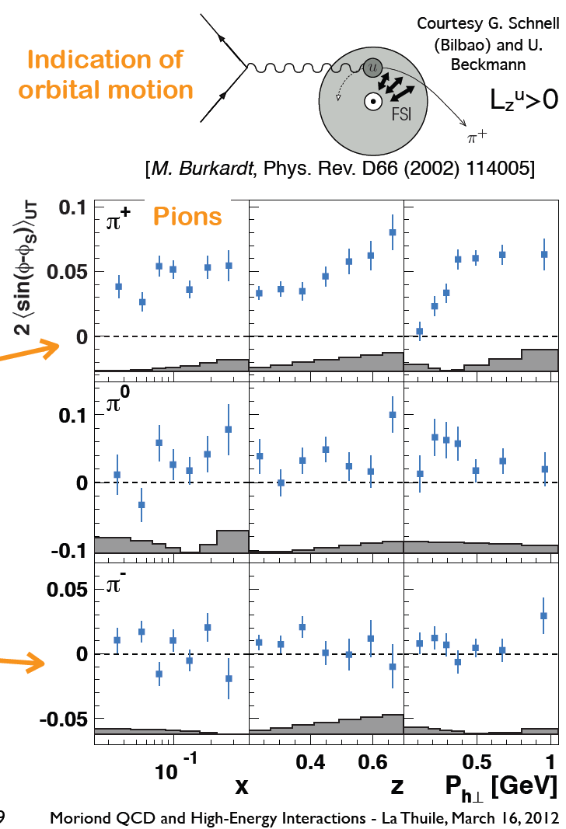
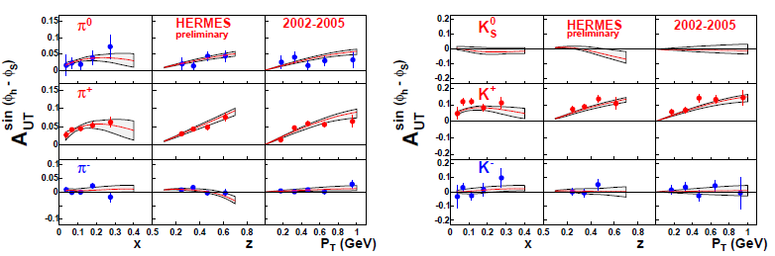
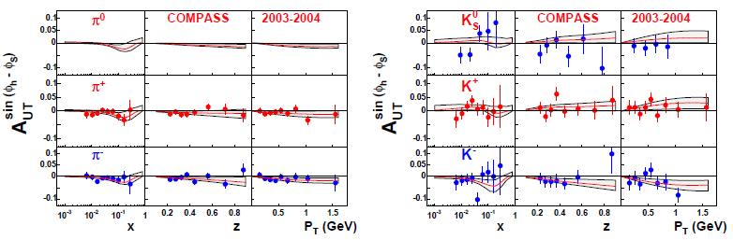
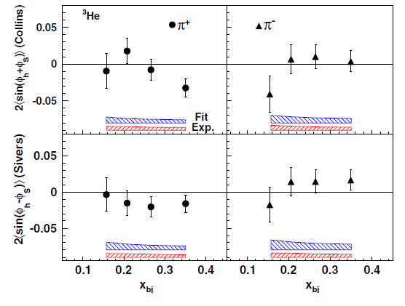
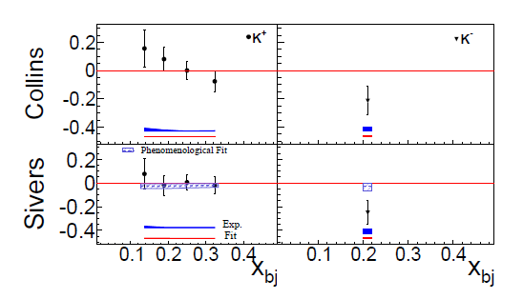
The Sivers function
X. Qian et al., PRL 39 (2011) 89
Y. Zhao, et al., arXiv 1404.7204
HERMES
COMPASS
JLab
π⁺
π⁻
K⁺
K⁻
u and d quark Sivers functions are opposite in sign.
  L. Gamberg et al, PRD 77 (2008) 094016 → axial diquarks
Sea quark Sivers functions are non-zero.
Thanks to J.-C. Peng
Anselmino et al., Eur. Phys. J. A39 (2009) 89

Slide 18
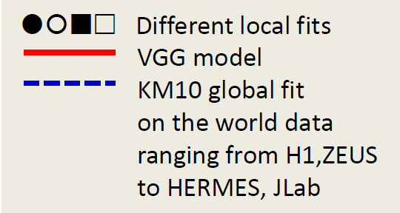
Generalized parton distributions and DVCS → Imaging
e’
The First Crude Images - the GPD H in Im DVCS
e
t
γ
γ*
(Q²)
x+ξ
x-ξ
~
~
H, H, E, E (x,ξ,t)
p
p’
~
Vector: H (x,ξ,t)
Tensor: E (x,ξ,t)
Axial-Vector: H (x,ξ,t)
Pseudoscalar: E (x,ξ,t)
~
Quark angular momentum
(Ji’s sum rule)
See A. Metz’ talk
Notes:
18

Slide 19
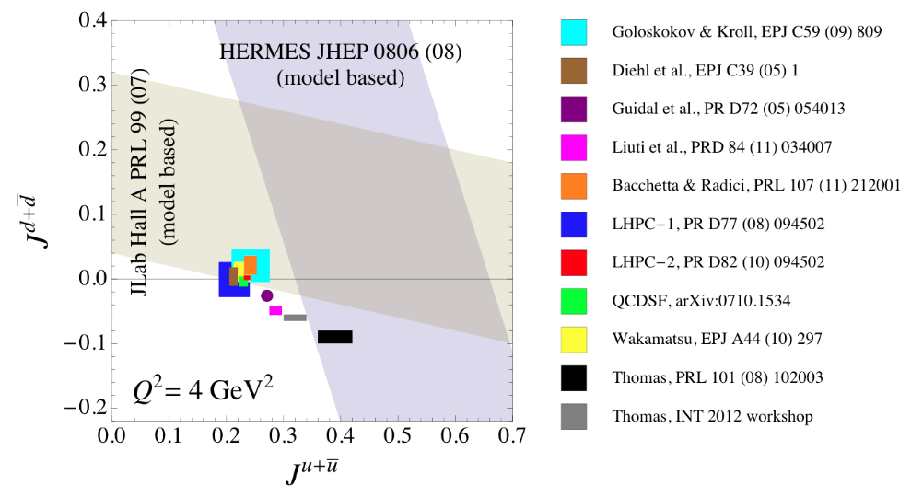
Extraction of quark total angular momentum
A. Radyushkin,
PRD 56 (1996) 5524
C. Munoz Camacho et al,
PRL 97 (2006) 262002 ;
F. X. Girod et al,
PRL 100 (2008)162002.
1
( H(x,ξ,t=0) + E(x,ξ,t=0) ) x dx = J_{quark}
=1/2 ΔΣ + Δ L_{z}
-1
X. Ji, Phy.Rev.Lett.78,610(1997)
NSAC milestones HP11 (2012), HP9 (2014)
(experiment) (lattice)
DVCS is the “golden channel”: γ* + N -> γ + N’
“Lattice + experiment provides a much greater constraint on GPDs than from either alone.” - J. Negele
Major program for JLab 12 GeV, COMPASS-II, EIC
Plot credit: JLab whitepaper

Slide 20
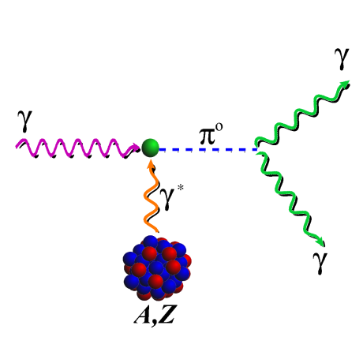







Fundamental properties of hadrons π⁰ lifetime J^{P} of the Λ(1405)
γ + p → K⁺ + (1405)
(1405) → ⁺ + π⁻
PrimEx-I, PRL 106 162303 (2011)
Precision measurements provide a test of low-energy QCD
Thanks to M. Pennington and H. Gao
K. Moriya et al, PRL 112 (2014) 082004

Slide 21



Mesons and exotic hybrid mesons
Z(4430)⁻
J^{P} = 1⁺
Meson properties are becoming well described by QCD
Hybrids are predicted by modern QCD treatments: DSE, lattice
Discovery of exotic (charmonium-like four-quark) heavy meson
at LHCb - Z(4430)
J. Dudek et al, PRD 83 (2011) 111502
See talks by M. Pennington and C. Meyer
NSAC milestone HP15 (2018)
Plot credit: NP2010
J. Aaij et al, PRL 112 (2014) 222002

Slide 22


Baryon resonances – JLab Physics Analysis Center
AO : ANL-Osaka [PRC88(2013)035209] J : Juelich [EPJA49(2013)44] BG : Bonn-Gatchina [EPJA48(2012)5]
J^{P}(L_{2I 2J})
See talks by M. Doering and R. Gothe
channels : γΝ, πΝ ηΝ, ΚΛ, ΚΣ, ππΝ (πΔ, ρΝ, σΝ)
State N(mass)J^{P} | PDG 2010 | PDG 2012
N(1880)1/2⁺ |  | **
N(1895)1/2⁻ |  | **
N(1900)3/2⁺ | ** | ***
N(1875)3/2⁻ |  | ***
N(2150)3/2⁻ |  | **
N(2060)5/2⁻ |  | **
Data of 2007-2013 :7 JLab CLAS, 8 ELSA, 2 MAMI publications
were essential
Future: J-PARC, Mainz 6 U. S. institutions
NSAC milestones HP3 (2009) completed, HP7 (2012)
New Lattice calculations: arXiv:1201.2349
N* resonances and exotic baryons.
Coupled channels dynamics are essential!
Thanks to K. Hicks, W. Briscoe, V. Burkert, M. Pennington, T.-S. H. Lee

Slide 23



Quarks in the nucleus: the EMC effect and short range N-N interactions
EMC effect depends on local nuclear density
J. Seely et al, PRL 103 (2009)
EMC effect is correlated with short range N-N interaction – L. Weinstein et al, PRL 106, 052301 (2011) , J. Arrington et al, PRC 86 (2012) 065204, N. Fomin et al, PRL 108, 092502 (2012)
Plot credit: JLab whitepaper
  Flavor, isospin and spin dependence of EMC effect? JLab@12, Drell-Yan, MINERvA
NSAC milestone HP5 (2010): completed and more…
See D. Higinbotham’s ’s talk

Slide 24


Parity-violating electron scattering
σ ~ | M_{γ} + M_{Z} |² = |M_{γ}|² + |M_{Z}|² + 2 Re(M_{γ}*)(M_{Z})
APV = (σ_{R}- σ_{L})/(σ_{R} – σ_{L})
First indication of non-zero
electron-vector and quark-axial-vector coupling
First determination of proton’s weak charge
D. Androic et al, PRL 111 (2014) 141803
NSAC milestone FI11 (2014)
D. Wang et al, Nature 506 (2014) 7486
See K. Kumar’s talk

Slide 25


Determining the neutron radius of ²⁰⁸Pb
Parity violating electron scattering
2
R_{N} calibrates equation of state of Neutron Rich Matter
+
²⁰⁸Pb
²⁰⁸Pb
S. Abrahamyan et al, PRL 108 (2012) 112502
Weak charge
density
Charge
density
C. J. Horowitz et al , Phys. Rev. C 85 (2012) 032501
Thanks to R. Michaels

Slide 26
Non-JLab, non-RHIC cold-QCD experiments
Program | Contact | Status | Lab | # U.S. MEP Institutions | Education – # U.S. MEP postdocs, grad. students, undergrads
n polarizability, GDH, few-body | H. Gao | Ongoing | HIγS | 9 | 2, 5, 3
Drell-Yan | D. Geesaman, P. Reimer | Ongoing | FNAL | 8 | 7, 7, 4
COMPASS-II | M. Grosse-Perdekamp | Ongoing | CERN | 1 | 1, 2, 4
N polarizability | R. Miskimen | Ongoing | Mainz | 3 | 2, 3, 1
Baryon resonances | W. Briscoe | Ongoing | Mainz | 6 | 1, 3, 6
MINERvA | R. Ransome | Ongoing | FNAL | 2 | 2, 2, 2
N polarizability, GDH, few-body, Bethe-Heitler | B. Norum | Ongoing | HiγS | 4 | 2, 1, 2
OLYMPUS | R. Milner | Ongoing | DESY | 4 | 3, 6, 6
HERMES | H. Jackson | Ongoing | DESY | 3 | 1, 4, 1
BES-III | M. Shepherd | Ongoing | BES | 1 | 1 ,2, 0
Threshold pion photoproduction | A. Bernstein | Ongoing | Mainz | 3 | 1, 0, 0
Radiative pion production | B. Norum | New | Mainz | 2 | 0.2, 0, 0
Polarized Drell-Yan | W. Lorenzon | New | FNAL | 8 | 0.5, 0.5, 3
N polarizability | R. Miskimen | New | HIγS | 4 | 0, 0, 1
Proton radius | R. Gilman | New | PSI | 16 | 1, 0, 0
Baryon resonances | K. Hicks | New | J-PARC | 6 | 2, 5, 0*
Charmed mesons | K. Seth | New | GSI | 1 | 1, 2, 0
Hadron program at HIGS (next 3 years)
Static- Electromagnetic-Polarizabilities
of the proton and neutron
Spin Polarizabilities of the proton
Spin Structure and the Gerasimov-Drell-Hearn (GDH) Sum Rule Measurements
Future program at HIGS (beyond 3 years)
Chiral Dynamics using photopion production
Spin Polarizabilities of the neutron
*Expected
Thanks to C. Howell

Slide 27
Many thanks to
Helpful documents:
NP2010 Report
NSAC 2007 Long Range Plan
Whitepaper drafts:
JLab 12 GeV
The Case for Continuing RHIC Operations
Electron Ion Collider
A Polarized p+p and p+A program for the next years, STAR Collab.
Future opportunities in p+p and
p+A collisions at RHIC with the
forward sPHENIX detector, PHENIX
Collab.
JLab12, RHIC, COMPASS-II proposals
STAR and PHENIX decadal plans
NSAC Performance Measures 2008
B. Jacak
H. Jackson
K. Joo
B. Keister
C. Keppel
W. Korsch
K. Kumar
T.-S. H. Lee
M. Liu
W. Lorenzon
T. LeCompte
N. Makins
C. Meyer
Z.-E. Meziani
R. McKeown
R. Michaels
R. Milner
R. Miskimen
H. Montgomery
D. Morrison
J. Nagle
B. Norum
K. Orginos
G. O’Rielly
K. Paschke
M. Ahmed
A. Alexandru
E. Aschenauer
J. Arrington
T. Barnes
D. Beck
W. Briscoe
V. Burkert
M. Burkhardt
G. Cates
A. Desphande
C. Djalali
E. Downie
R. Ent
G. Feldman
C. Gagliardi
H. Gao
D. Geesaman
R. Gilman
H. Griesshammer
M. Grosse-Perdekamp
K. Hafidi
K. Hicks
T. Horn
C. Howell
J.-C. Peng
M. Pennington
D. Phillips
G. Petratos
J. Qiu
R. Ransome
P. Reimer
C. Roberts
J. Ro che
J. Rubin
K. Seth
M. Shepherd
M. Stratmann
B. Surrow
B. Tice
S. Vigdor
W. Vogelsang
H. Weller
R. Wiringa
B. Wojtsekhowski
N. Xu
Z. Xu

Slide 28
Extra Slides

Slide 29
Concluding statement
Understanding hadrons will be one of nuclear physics’ greatest contributions to science
New 21st century tools have positioned us well for the next decade:
  JLab 12 GeV, RHIC - Major U.S. facilities lead the world
  FNAL – MI, CERN COMPASS-II, HIγS, Mainz, J-PARC, FAIR provide targeted experiments that complement the central program
  Far future: EIC
We are camped on one of the most interesting frontiers in science

Slide 30



Elastic electron scattering from a nucleon
j_{μ}=<e’|γ_{μ}|e>
J_{μ}=<p’|Γ_{μ}|p>
Deep inelastic
scattering
Nucleon vertex:
1990 Nobel Prize
Dirac Pauli
Cross section for scattering
from a point-like object
1961 Nobel Prize
Form factors describing nucleon shape/structure

Slide 31
Pion form factor
Benchmark data for the lightest Nambu-Goldstone Boson of QCD
Time-like region:
e⁺
DSE
π⁺
γ
AdS/QCD
QCDSF/UKQCD
e⁻
π⁻
DSE
Space-like region:
e’
γ
π⁺
e
π⁺
p
n
Form factor data can be extended by x2 in Q² with 12 GeV Upgrade.

Slide 32


The proton form factor: Re-wrote the textbooks
Polarization measurements ) Revolutionized our knowledge
⇒
NP2010
Two-photon experiments: OLYMPUS (DESY), JLab, Novosibirsk
proton
neutron

Slide 33

Strangeness contribution to the proton form factor
strange quarks appear to have a small role in the long-range electromagnetic structure of nucleons
Neglect strange form factors -Flavor separation of the proton form factor
NSAC milestone HP4 (2010) completed
HAPPEx-3: PRL 108 (2012) 102001
G0-Backward: PRL 104 (2010) 012001
D. Kaplan and A. Manohar, NP B310 (1988) 527
Thanks to D. Beck, R. Ent

Slide 34

Only JLab 12 GeV can access these form factors to ~10 GeV²
Locations of the zeroes depend on the relative probability of finding scalar & axial diquarks in proton
Requires SBS
Plot credit: JLab whitepaper
Six 12-GeV experiments

Slide 35




Hadron polarizabilities – Compton scattering
“Faraday effect”
HIγS projection
D. Shukla, A. Nogga, D. Phillips, PRL (2007)
Lattice calculations
Chiral perturbation theory
Interplay of “pion cloud” and shorter distance effects
Pion polarizability
  COMPASS –II (CERN)
  (UIUC)
High Intensity Gamma Source (HIγS)
  Proton, neutron – polarized H target
  Polarized ³He target (9 U.S. institutions)
MAMI (3 U.S. institutions)
  Polarized hydrogen target + Crystal Ball
  Complete proton in 2014, begin neutron
Thanks to H. Gao, H. Griesshammer, D. Phillips, W. Briscoe, R. Miskimen, B. Norum, E. Downie

Slide 36


Electron/positron scattering from the proton
VEPP-3 storage ring, Novosibirsk
D. Nikolenko, priv. comm. (2012)

Slide 37




MINERνA
A 1-20 GeV neutrino-nucleus experiment at Fermilab
Selected Results
Charged-current inclusive ν_{μ} cross section ratios per nucleon C, Fe, Pb to CH show unexpected deficit at low x, excess at high x.
Phys. Rev. Lett. 112, 231801 (2014)
dσ^{C}/dx
Neutrinos nuclear dependence different from electrons.
A problem for PDF extraction and oscillation experiments.
dσ^{CH} /dx
Phys Rev. Lett. 111, 002051 and 002052 (2013)
Charged-current quasielastic (CCQE) ν_{μ} cross section probes axial structure and nucleon-nucleon correlations.
CCQE essential to oscillation experiments but sensitive to nuclear models.
dσ^{Fe}/dx
dσ^{CH} /dx
Energy near vertex suggests 25% of events have additional proton in final state
→np pairs in initial state
dσ^{Pb}/dx
dσ^{CH} /dx
Thanks to B. Tice

Slide 38
Moments of the Proton F_{L} Structure Function
Phys. Rev. Lett. 110 (2013) 15, 152002
Addresses DOE Nuclear Science Performance Measure HP6: “Measure the lowest moments of the unpolarized nucleon structure functions (both longitudinal and transverse) to 4 GeV² for the proton….”
Moments are x-weighted:
Needed (largely Jefferson Lab) longitudinal/transverse separated data at large x for global analysis
Thanks to C.E. Keppel,

Slide 39
Unpolarized and Longitudinally Polarized Structure Functions
Parton model ->
Parno et al.,
arXiv:1406.1207
Upgraded JLab has
unique capability to
define the valence region
NSAC milestone HP6 (2011) completed, steps toward HP14 (2018)
Thanks to C. Keppel, K. Kumar, G. Petratos, C. D. Roberts, S. Kuhn, Z.-E. Meziani
Six JLab 12 GeV experiments

Slide 40
Spin Structure of the neutron – valence region
Polarized electron scattering from a polarized nucleon
Three 12-GeV experiments
(benefits from SoLID)
NSAC milestone HP14 (2018)
Thanks to N. Makins, Z.-E. Meziani, S. Kuhn, C. D. Roberts

Slide 41








Transverse Momentum Distributions: The Sivers effect
DIS
HERMES
Drell-Yan
NSAC Milestone HP13 (2015) “Test unique QCD predictions for relations between single-transverse spin phenomena in p-p scattering and those observed in deep-inelastic scattering.”
COMPASS-II, RHIC-spin, polarized FNAL
Thanks to H. Jackson, M. Burkhardt

Slide 42




DVCS measurements and imaging
Thanks to Z.-E. Meziani, JLab whitepaper

Slide 43





Drell-Yan is the best way to measure anti-quark distributions
What is the A dependence of antiquarks?
Experiment E906 FNAL:
3 national labs, 7 U. S. universities, 3 off-shore national labs, 4 off-shore universities
Experiment is underway!
Longer term: Polarized FNAL, J-PARC at 50 GeV (beyond 2017)?
Thanks to D. Geesaman, P. Reimer, J.-C. Peng

Slide 44





Polarized Drell-Yan and W production (2014+)
STAR
polarized
Sivers
Delivered 500 pb⁻¹
PHENIX
FNAL Polarized SeaQuest (>2017)
8 U.S. institutions, 4 off-shore institutions
COMPASS-II (2014, if upgraded)
1 U. S. institution
Thanks to E. Aschenauer, W. Lorenzon, M. Liu, M. Grosse-Perdekamp
Forward upgrades -> transverse spin asymmetries

Slide 45
Polarized Drell-Yan

Slide 46


Transversity and tensor charge
Quark transverse polarization in a transversely polarized nucleon:
  Can be probed in Semi-Inclusive DIS, Drell-Yan processes.
  Does not mix with gluons, has valence like behavior.
  Nucleon tensor charge can be extracted from the lowest moment of h₁ and compared to LQCD calculations
h_{1T} =
Nucleon Spin
Quark Spin
Tensor Charge
Intrinsic property
Like axial or vector charge
Thanks to Z.-E. Meziani

Slide 47


Transversity Projected Data -12 GeV JLab
h_{1T} =
Nucleon Spin
Quark Spin
Polarized ³He with SoLID
Thanks to R. McKeown

Slide 48


PDG 2012/13 - Partial N/Δ spectrum
Clustering of states near 1.9 GeV leads to “spin multiplets” or “parity doublets”
Parity doublets could indicate “restoration of chiral symmetry” at high masses.
Notes:
Here are shown all 8 states that have been included as new or with upgraded evidence.
It is interesting to see if these states fit into the SU(6) and Lattice QCD spectrum.

Slide 49
New Baryons and Decays from JLab KY photoproduction data
State N((mass)J^{P} | PDG 2010 | PDG 2012 | KΛ | KΣ | Nγ
N(1880)1/2⁺ |  | ** | ** | * | **
N(1895)1/2⁻ |  | ** | ** | * | ***
N(1900)3/2⁺ | ** | *** | *** | ** | ***
N(1875)3/2⁻ |  | *** | *** | ** | ***
N(2150)3/2⁻ |  | ** | ** |  | **
N(2060)5/2⁻ |  | ** |  | ** | **
Bonn-Gatchina Analysis – A.V. Anisovich et al., EPJ A48, 15 (2012)
(First coupled-channel analysis that includes nearly all new photoproduction data)

Slide 50


Illuminating nuclei at JLab
Triple coincidence experiment at JLab
-> strong short range tensor force
Probability of finding two nucleons with a relative momentum q
p
np
n(p)
pp
R. Schiavilla et al, PRL 98 (2007) 132501
NN tensor correlations are preserved in nuclei.
R. Subedi et al, Science 320 (2008) 1476
NSAC milestones HP5 (2010), HP10 (2014)

Slide 51

EMC effect and short range N-N interaction
EMC effect is correlated with short range N-N interaction – L. Weinstein et al, PRL 106, 052301 (2011) , J. Arrington et al, arXiv:1206.6343
  Flavor, isospin and spin dependence of EMC effect? JLab@12, Drell-Yan, MINERvA
Plot credit: JLab whitepaper
SRC Scaling factors x_{B} ≥ 1.5
N. Fomin et al, PRL 108, 092502 (2012)
Four JLab 12 GeV experiments

Slide 52

Probing the nucleon-nucleon interaction in nuclei
p
n(p)
R. Subedi et al, Science 320 (2008) 1476
I. Korover, arXiv: 1401.6138
R. Schiavilla et al, PRL 98 (2007) 132501

Slide 53


Determining the neutron radius of ²⁰⁸Pb
Parity violating electron scattering
2
R_{N} calibrates equation of state of Neutron Rich Matter
+
²⁰⁸Pb
²⁰⁸Pb
S. Abrahamyan et al, PRL 108 (2012) 112502
Thanks to R. Michaels

Slide 54



Nuclei as laboratories
Prehadron: small object with a smaller cross section than that of quark-N or hadron-N interaction
Credit: J. Rubin
X. Qian et al., PRC81:055209 (2010);
B. Clasie et al, PRL99:242502 (2007) ;
L. El Fassi et al, PLB (2012)
Future: JLab at 12 GeV
Plot credit: JLab whitepaper

Slide 55

Heavy flavor energy loss
Strong Suppression of Open Charm at P_{t}> 2 GeV in central collisions indicative of significant energy loss of charm quarks in the hot dense medium.
STAR arXiv 1404.6185

Slide 56


Hadronization and quark propagation in nuclear matter
What governs the transition of quarks and gluons into pions and nucleons? NSAC 2007
Production length
Parton energy loss
Formation length
Color transparency
Hadron multiplicity
p_{T} broadening
CEBAF @ 12 GeV + CLAS12: ideal facility to study light quark hadronization:
12 GeV Anticipated Data: 10³⁵ cm⁻²s⁻¹
W. Brooks, K. Hafidi, K. Joo et al.

