Slide 1
RHIC at Twenty
Satoshi Ozaki
Berndt Mueller
June 12, 2020

Slide 2
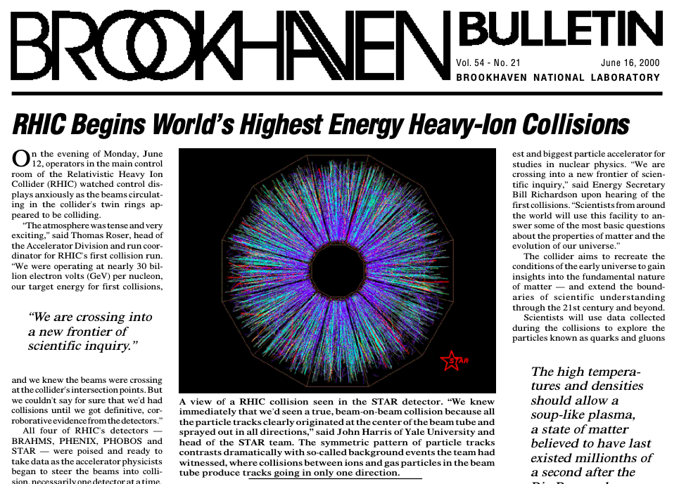

Slide 3
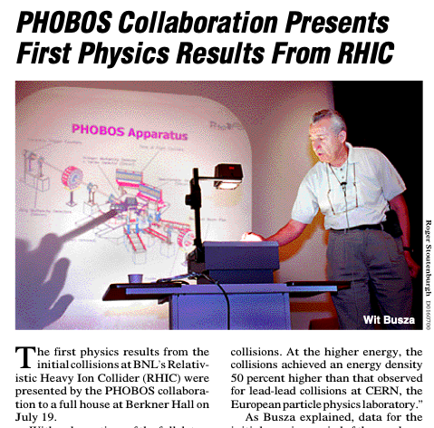
June 12, 2020
July 19, 2020

Slide 4

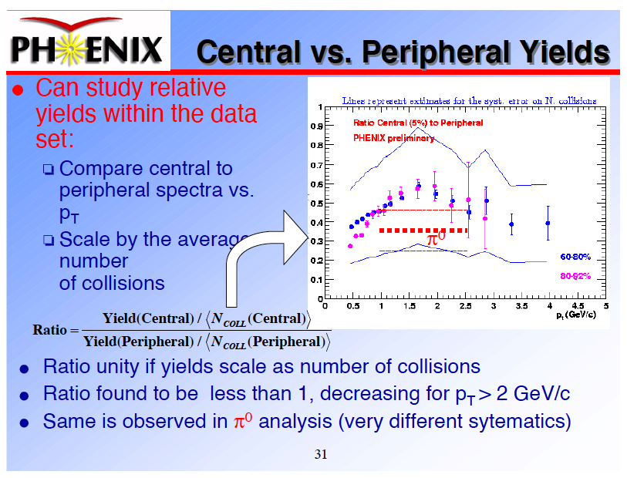
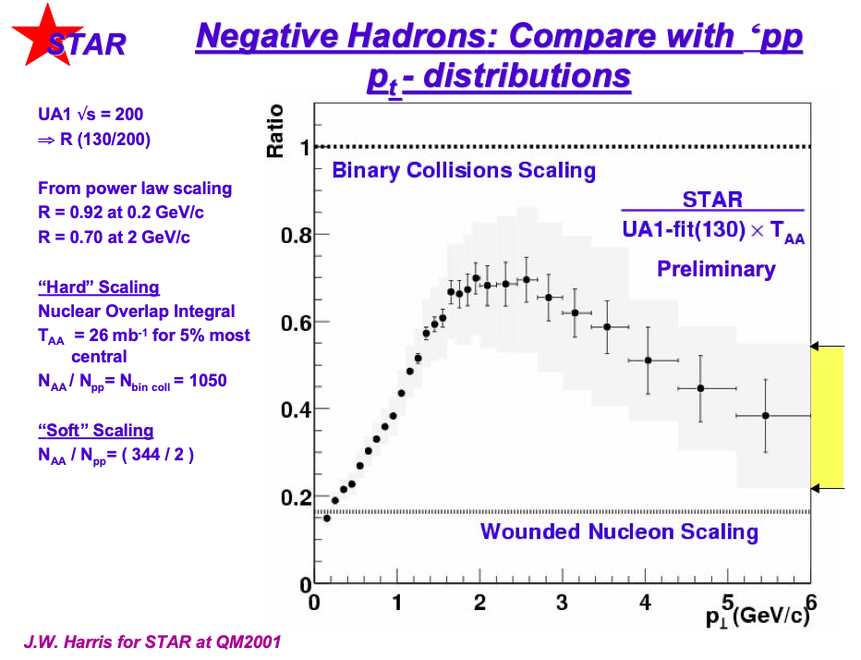
A conference remembered as much for its science as for its food
Jet Quenching

Slide 5
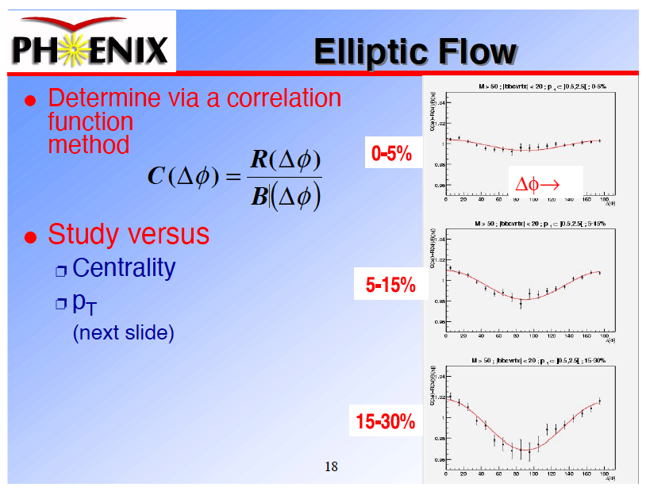
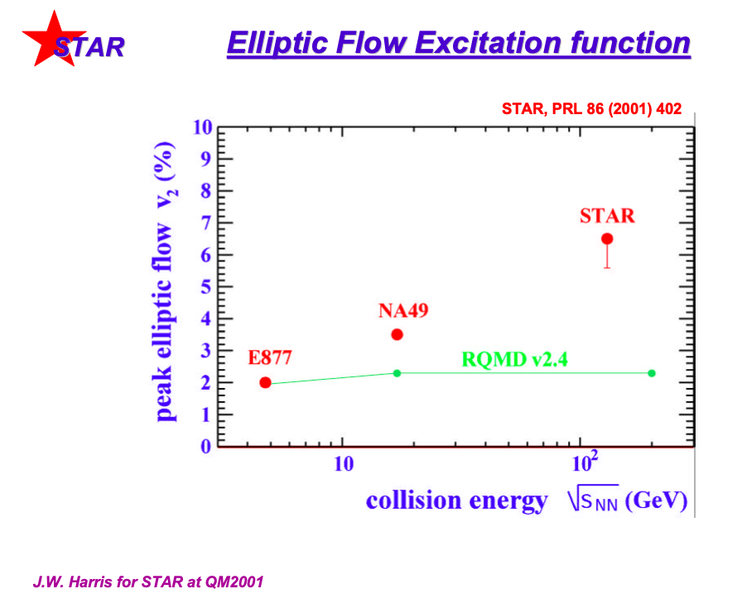
On the Verge of Re-Creating Creation. Then What?
New York Times - Week In Review, Jan. 28, 2001

Slide 6
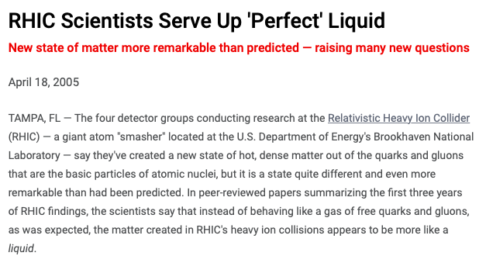
RHIC’s Answer (2005)

Slide 7
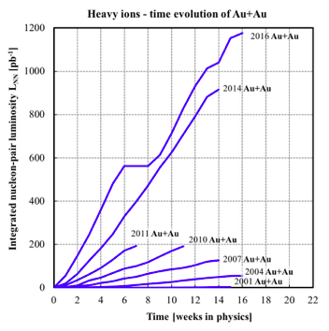
Breaking Records (again and again)

Slide 8
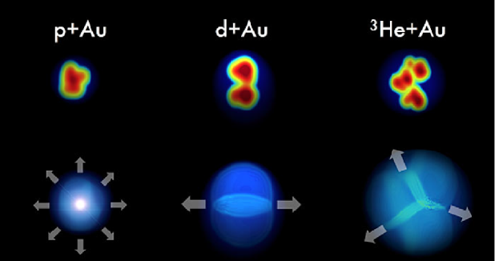
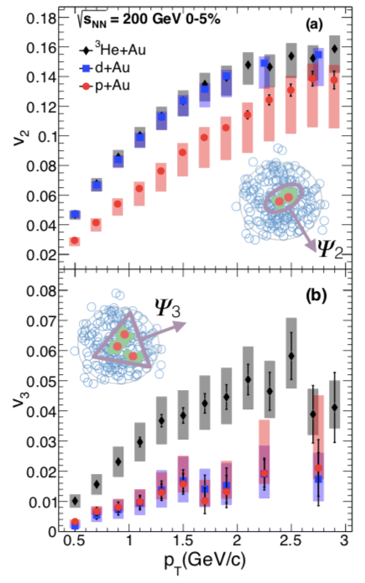
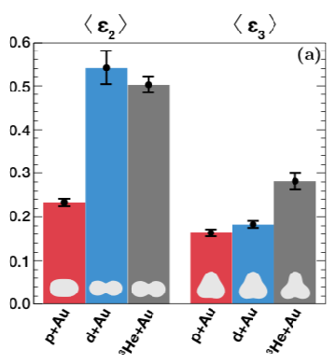
Surprises keep coming
3He+Au
d+Au
Nature Physics 15 (2019) 214
p+Au
v₂
The QGP droplets created in collisions of p+Au, d+Au, ³He+Au have characteristically different shapes resulting in different emission patterns.
v₃
The ordering of flows follows the ordering of shapes (ε₂, ε₃)
3He+Au
v₂(d,³He+Au) > v₂(p+Au)
v₃(³He+Au) > v₃(p,d+Au)
p+Au
d+Au
8

Slide 9

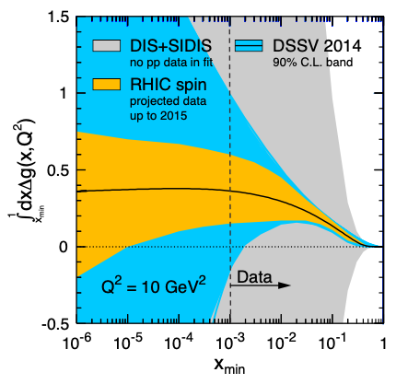
RHIC Spin Program: An amazing success story

Slide 10
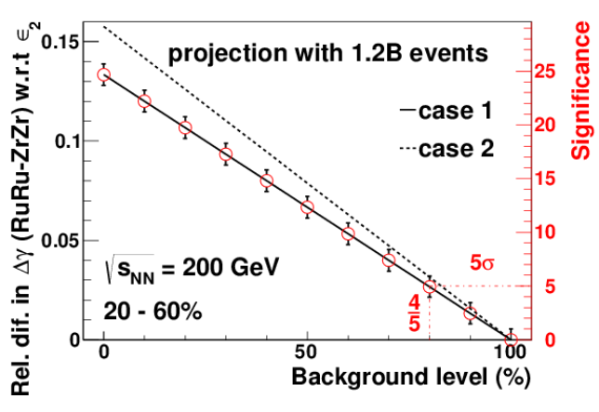

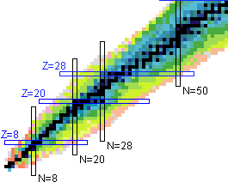
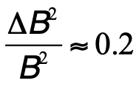
More to come: 2018 Isobar Comparison Run
3B events recorded!
The isobar comparison run will tell us to with +/- 6% precision what fraction of the observed charge separation is due to the CME. Double blind analysis of several observables is in its final phase – results expected in late 2020 – unprecedented in heavy ion physics.

Slide 11
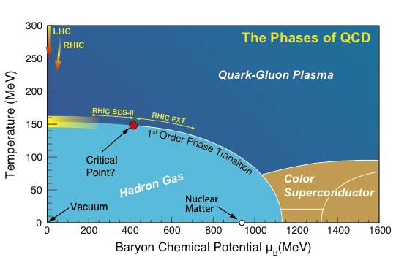
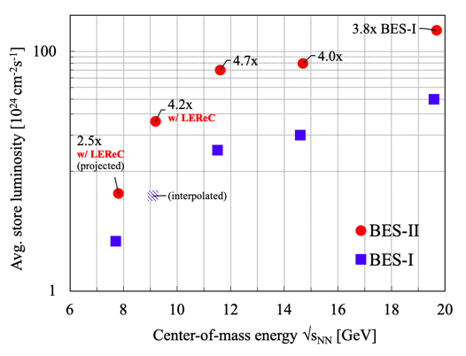
More to come: Beam Energy Scan II
LEReC = Low Energy RHIC electron Cooling
First-ever electron cooling with bunched beams
Test case for electron cooling at EIC
Beam Energy Scan Goals:
What is the phase boundary of ordinary nuclear matter, i.e. matter composed of baryons and mesons?
Is there a critical point in the QCD phase diagram and, if so, where is it located?
  3-year run program: 12 energies
  7 energies new (fixed target)
  >10-fold statistics for all energies
  10.5 energy runs complete!

Slide 12
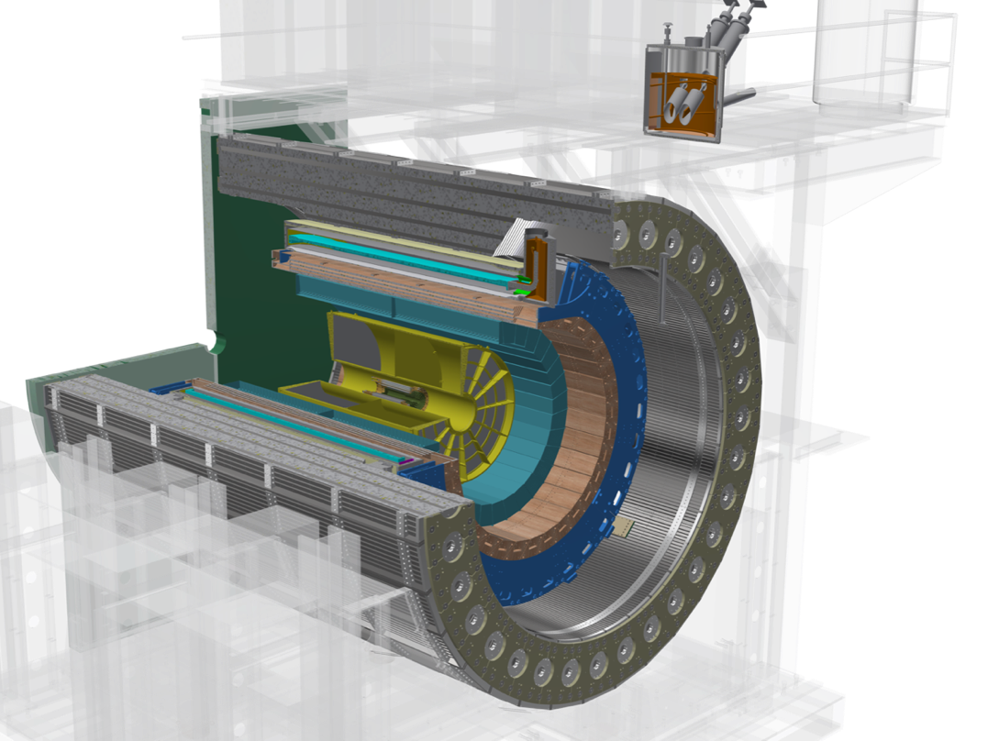
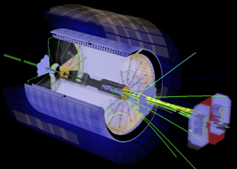
More to come: sPHENIX & Forward STAR
High energy jets probe the structure of the QGP on different length scales and determine where and how it changes from particle-like quarks and gluons to a structureless “perfect” liquid
Heavy quark atoms probe the QGP structure at different scales
New STAR forward detector systems in construction for FY 2022 RHIC run will enable measurements of physics important for EIC science program

Slide 13

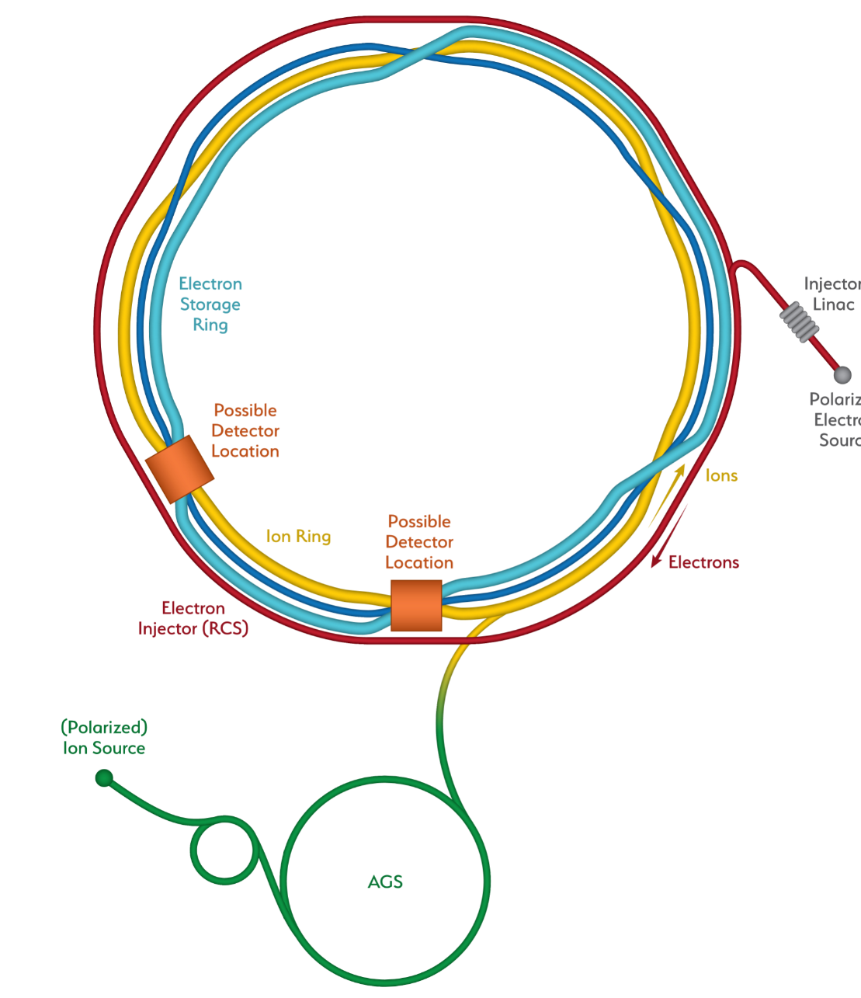
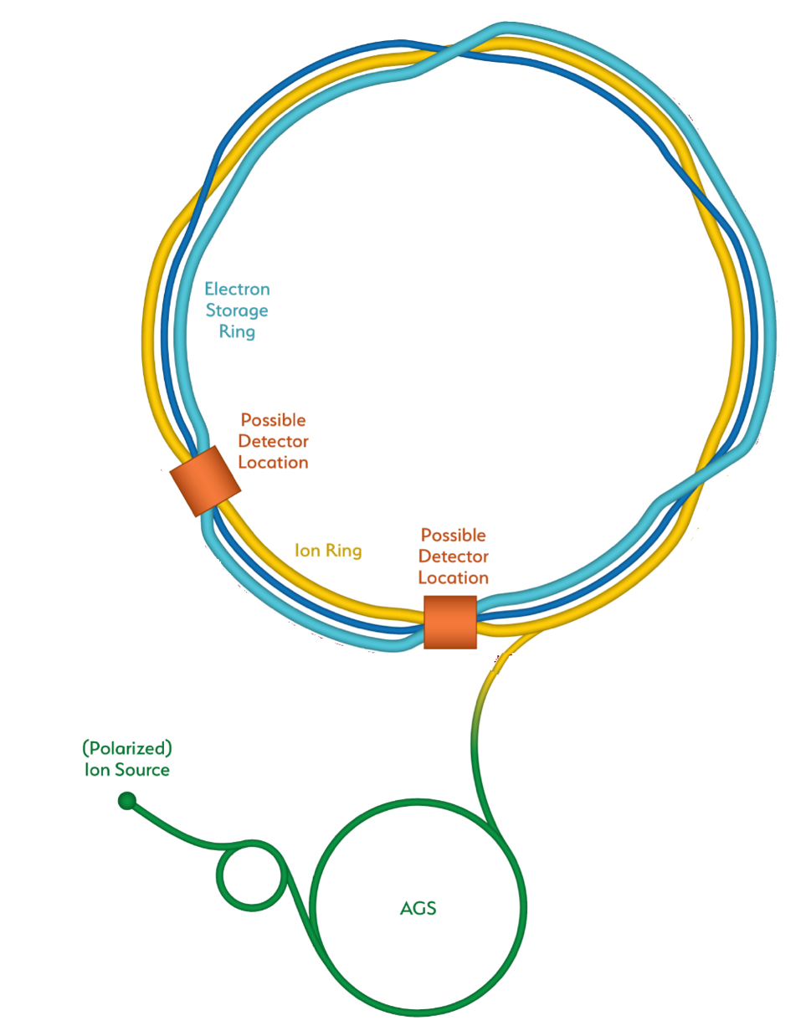
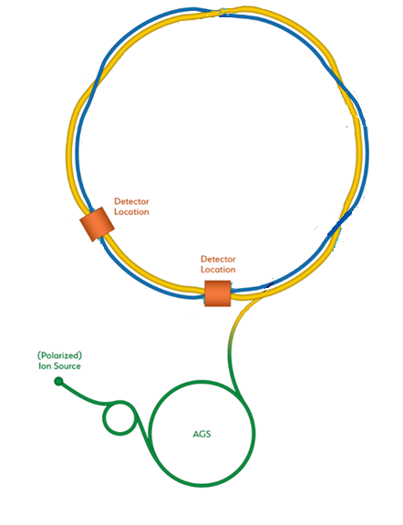
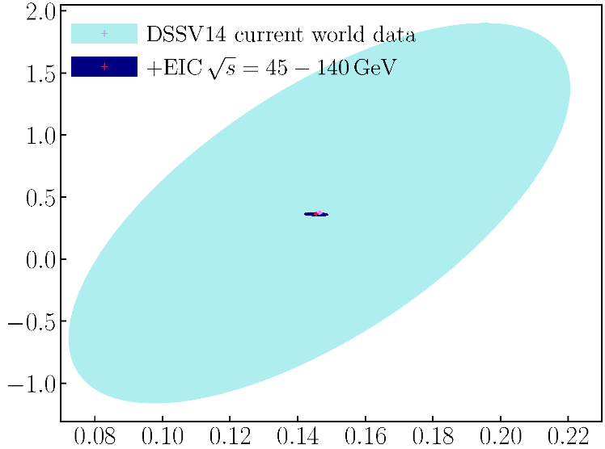
RHIC’s Future “Reincarnation” as EIC
Hadron Storage Ring
Electron Storage Ring
Electron Injector Synchrotron
Possible on-energy Hadron
injector ring
Hadron injector complex
BNL-EIC
Gluons
Quarks

Slide 14
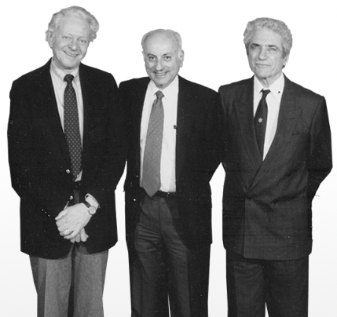
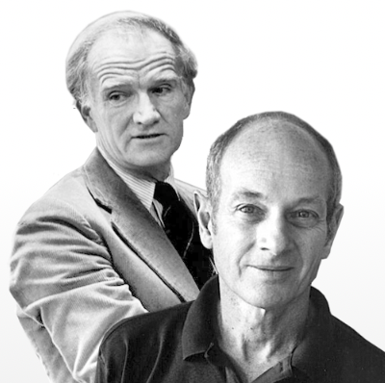
Powered by the world’s most impactful accelerator:
The AGS turns 60 on July 29, 1960
Muon neutrino
J/ψ
CP violation

Slide 15
Satoshi Ozaki
RHIC Project Leader

