Slide 1
LBNE vs. LBNO Sensitivity Check
Xin Qian
BNL

Slide 2
Outline
Cross Check LBNO HPPS LE Sensitivity
Comparison with LBNE Sensitivity
Comparison of LBNO HPPS LE vs. Mary’s fluxes
Understand the impact of >1st maxima in LBNO vs. LBNE
Understand the impact of θ₁₃ constraint
Inverted MH Case

Slide 3
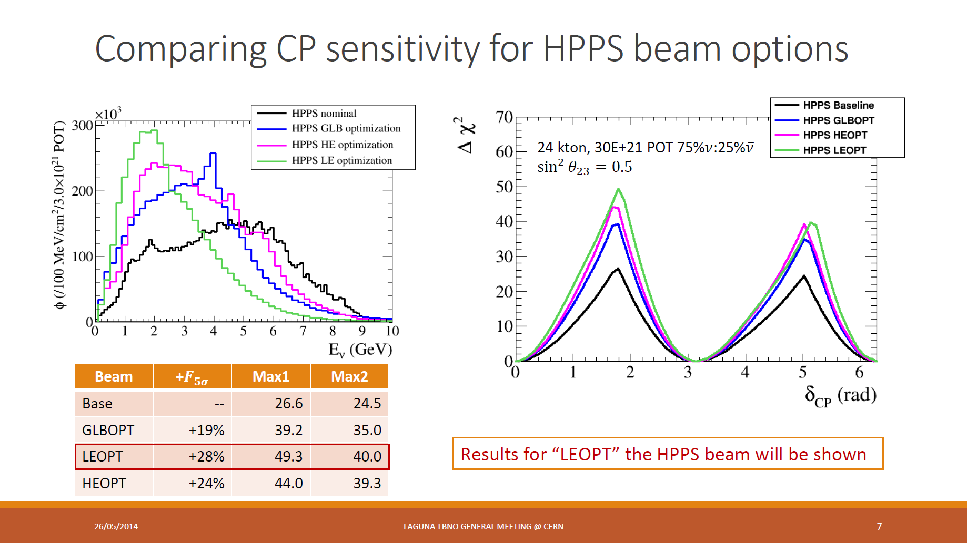
HPPS LE optimization has twice CPV sensitivity than the nominal beam
We want to understand why

Slide 4
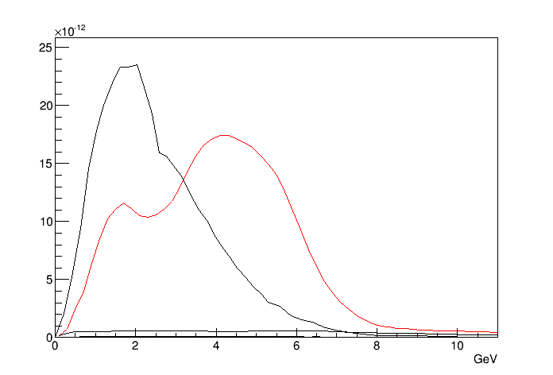
Procedure
Modify from Mary’s 120 GeV flux
LBNO ν_{μ} flux obtained from digitization
Scale Mary’s neutrino flux (ν_{μ} , ν_{e} , ν_{τ} ) and antineutrino flux by the ratio of black/red
With fake LBNO flux, check the CPV and MH sensitivity

Slide 5
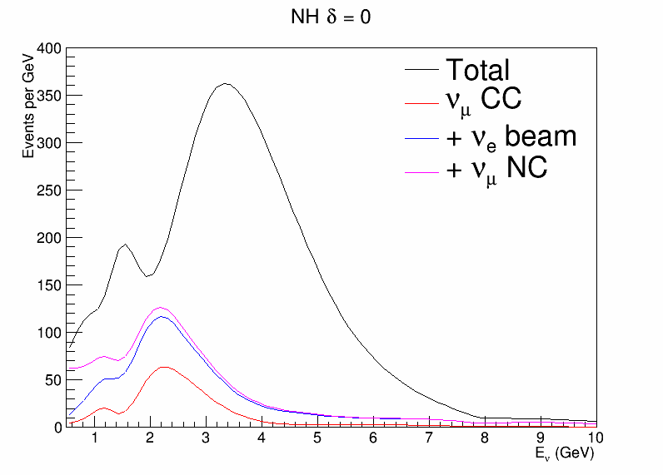
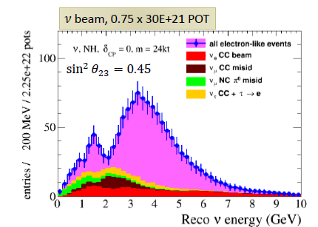
Neutrino Spectrum Validation
Signal: 921
Background: 328
Signal: 922
Background: 300

Slide 6
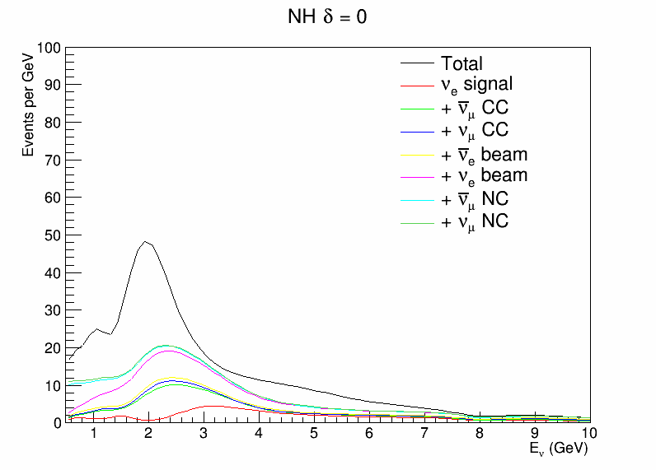
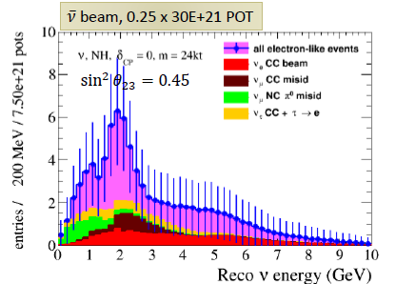
Antineutrino Spectrum Validation
Signal: 48
Background: 30
Signal: 68
Background: 52

Slide 7
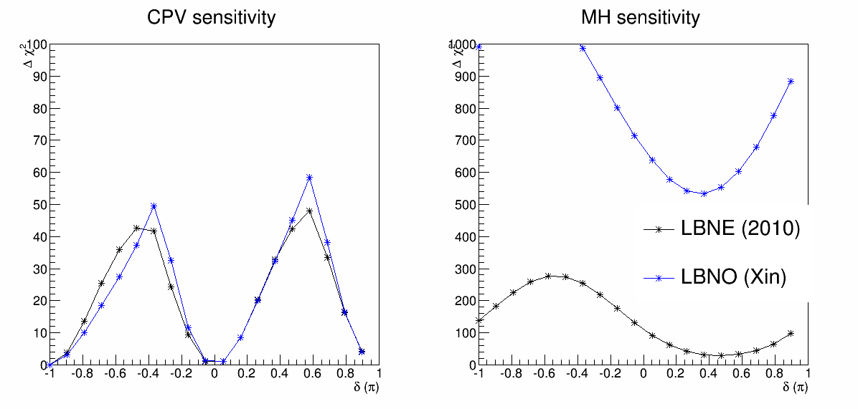
LBNO vs. LBNE Sensitivity Comparison
LBNO case: 50 GeV + 24 kt @ 1 MW running 8.3 years (75% vs. 25%)
30e21 POT
Neutrino signal: 921
Neutrino background: 328
Antineutrino signal: 50.6
Antineutrino neutrino: 17.6
Antineutrino background: 52
LBNE case: 120 GeV + 34 kt @ 1 MW running 10 years (50% vs. 50%)
8.3e21 POT
Neutrino signal: 1050
Neutrino background: 672.2
Antineutrino signal: 228.6
Antineutrino neutrino: 87.9
Antineutrino background: 404

Slide 8
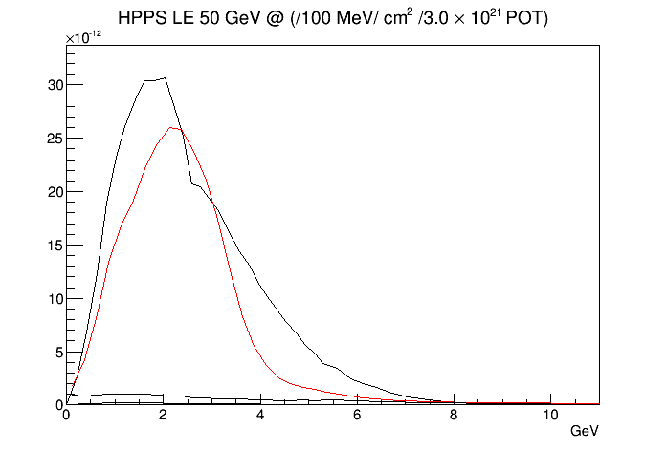
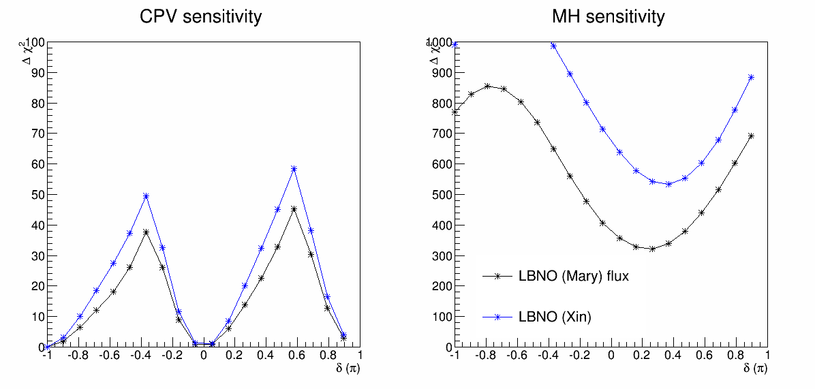
Comparison with Mary’s fluxes (I)
Mary quickly generated a beam with 50 GeV beam energy with FNAL

Slide 9
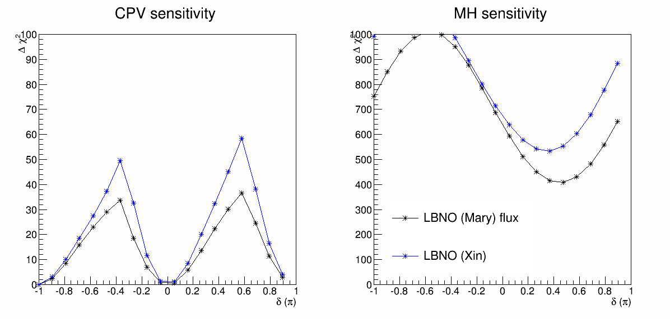
Comparison with Mary’s flux (II)
Mary’s flux generated with 120 GeV beam

Slide 10
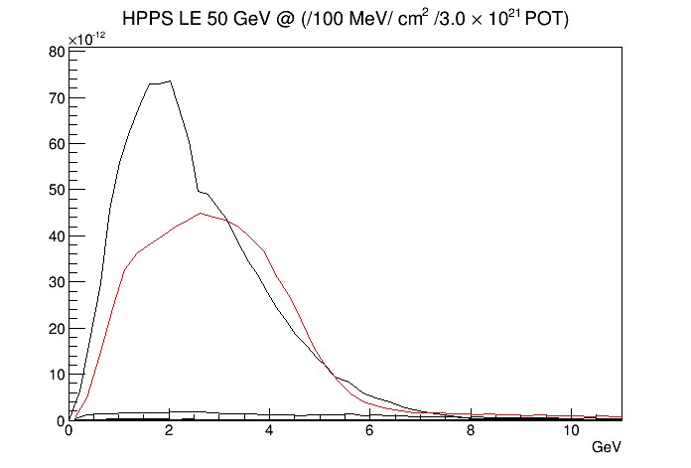
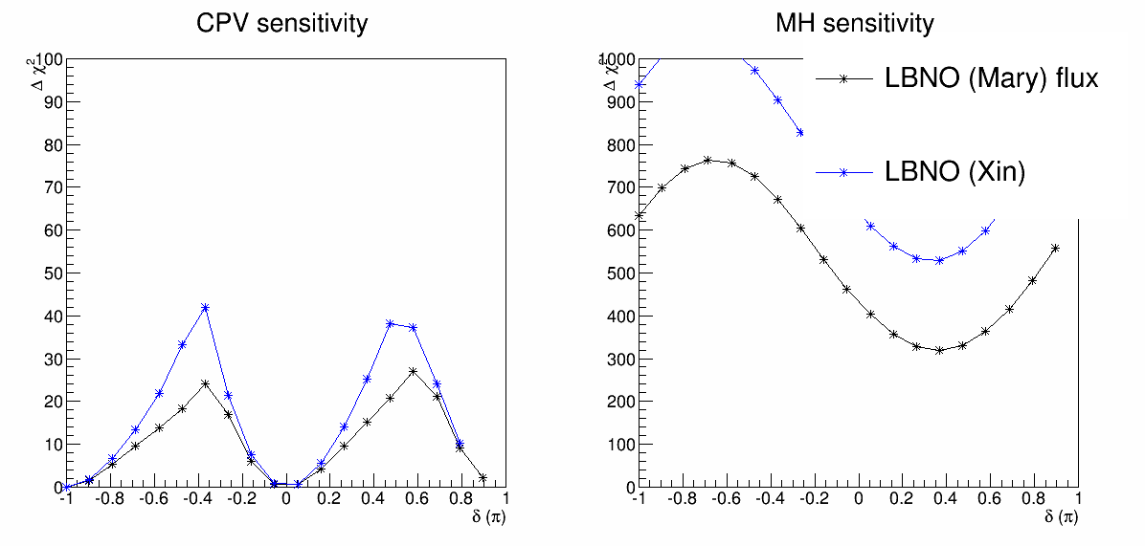
Comparison with Mary Flux (III)
LBNE 2010 beam

Slide 11
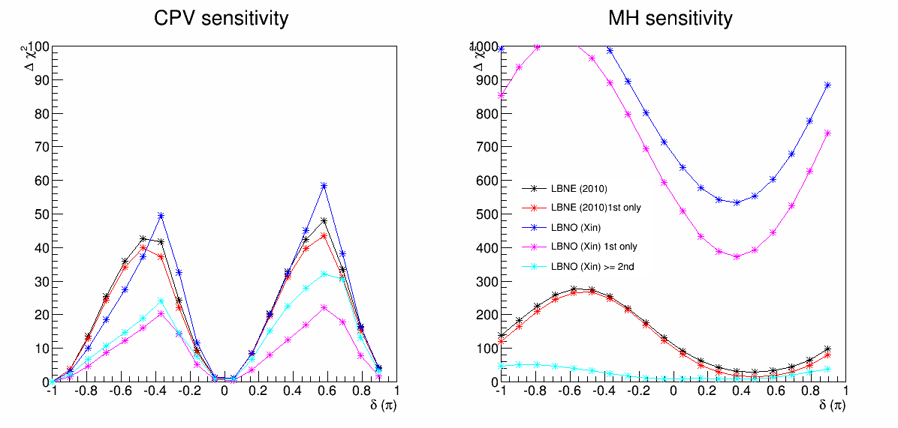
Understand the >1st oscillation maxima
For CPV
(>=) 2nd oscillation maxima has relative large impact in LBNO
2nd oscillation maxima is not as important in LBNE

Slide 12
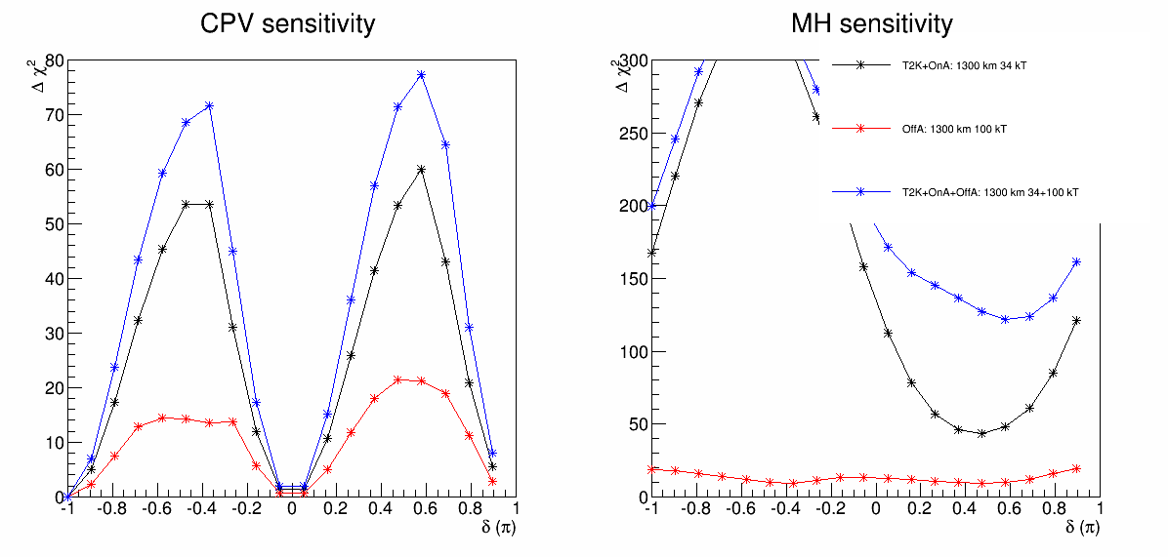
2nd LBNE enhanced by 100 kT off-axis
Blue is with 2nd oscillation maxima contribution (100 kT WC)
Effect on CPV is not as large as expected

Slide 13
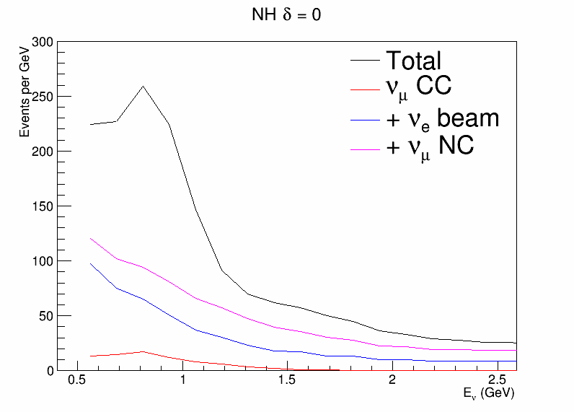
Neutrino Spectrum Comparison
Signal: 117.3
Background: 136.6
Signal: 117
Background: 168.2

Slide 14
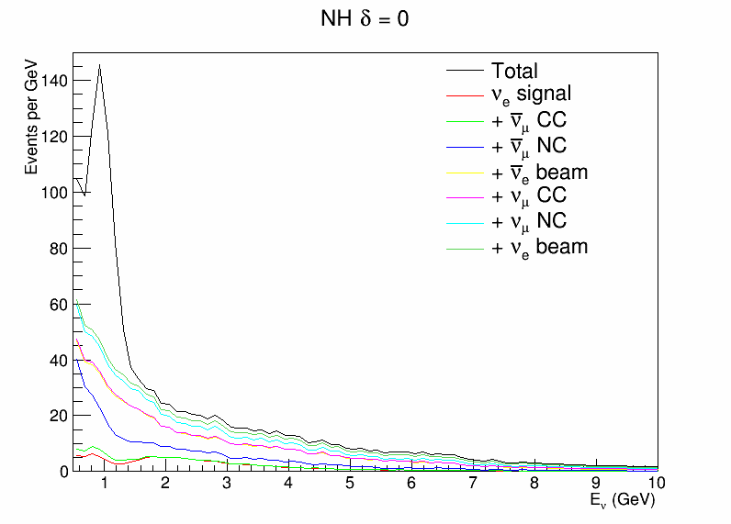
Antineutrino Spectrum Comparison
Signal: 36
Neutrino 2.3
Background: 19.8
Signal: 76.3
Neutrino: 16
Background: 106.

Slide 15
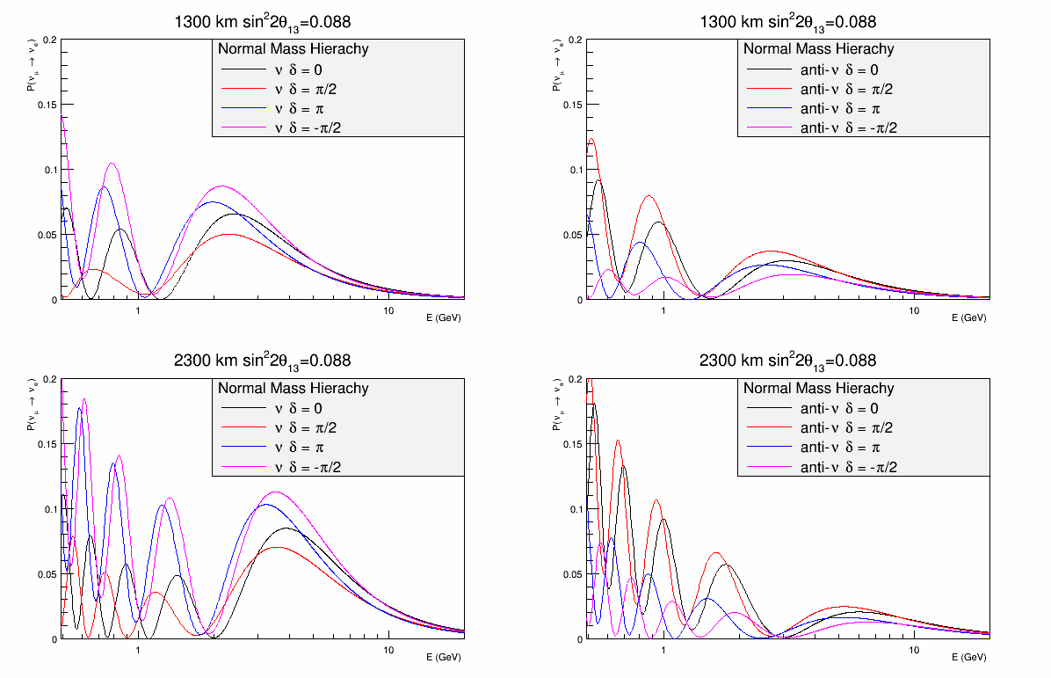
Oscillation Probability
LBNO covers more than 2nd oscillation (3rd and 4th ) (0.5 → 2.5 GeV)
LBNE just covers the 2nd oscillation maxima (0.5→1.2 GeV)
There are shape information as well
Thanks Brett to point this out for VLBE

Slide 16

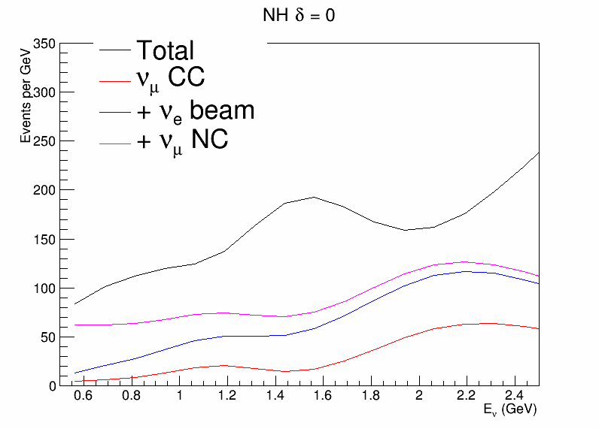
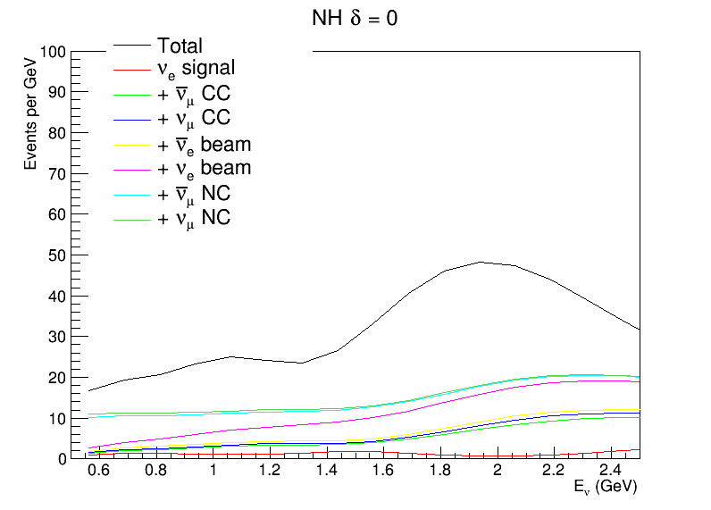
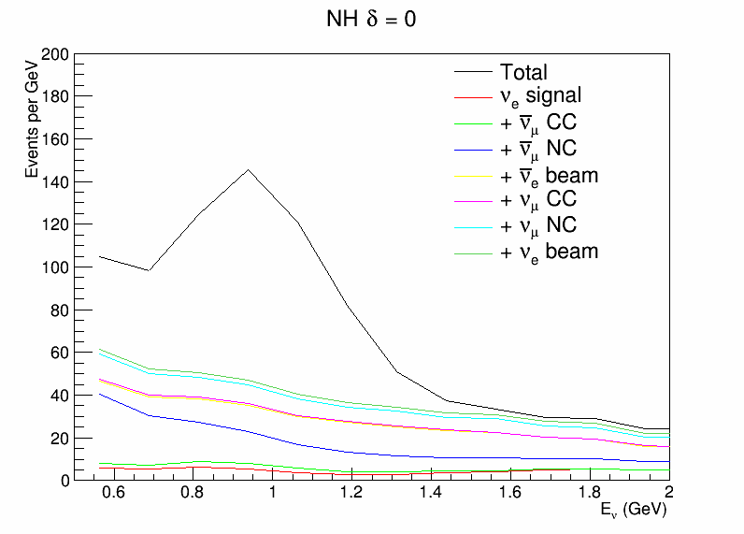
Delta = 0
Neutrino
Antineutrino

Slide 17
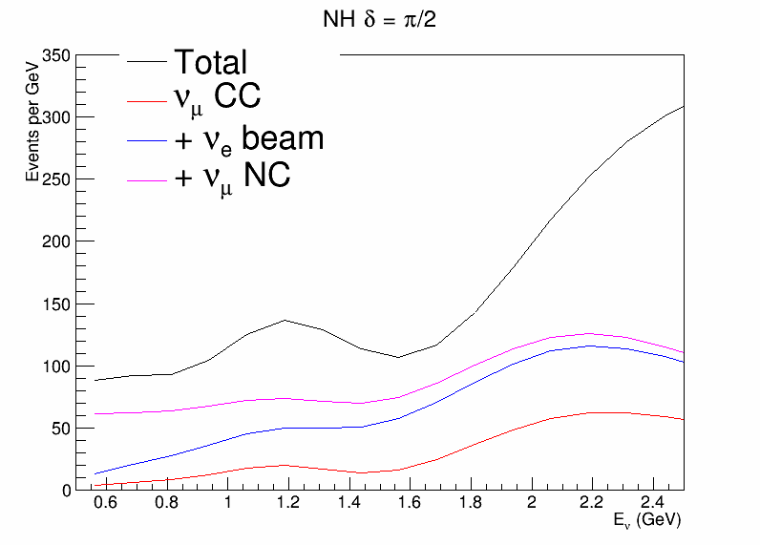

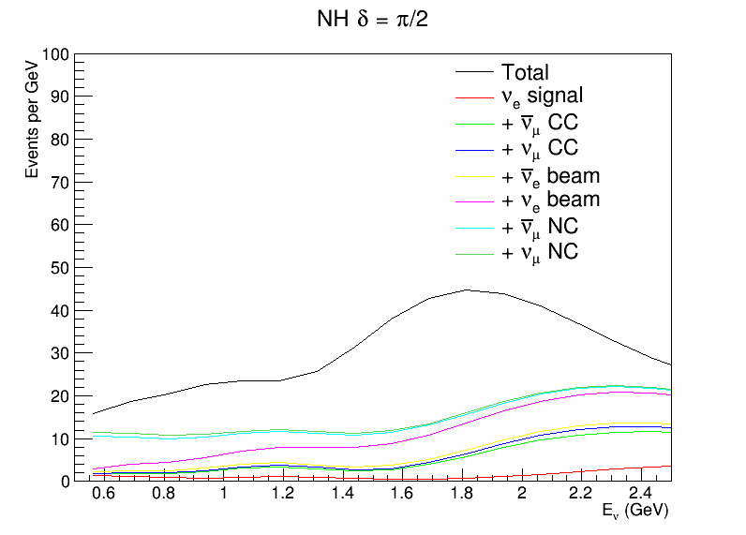
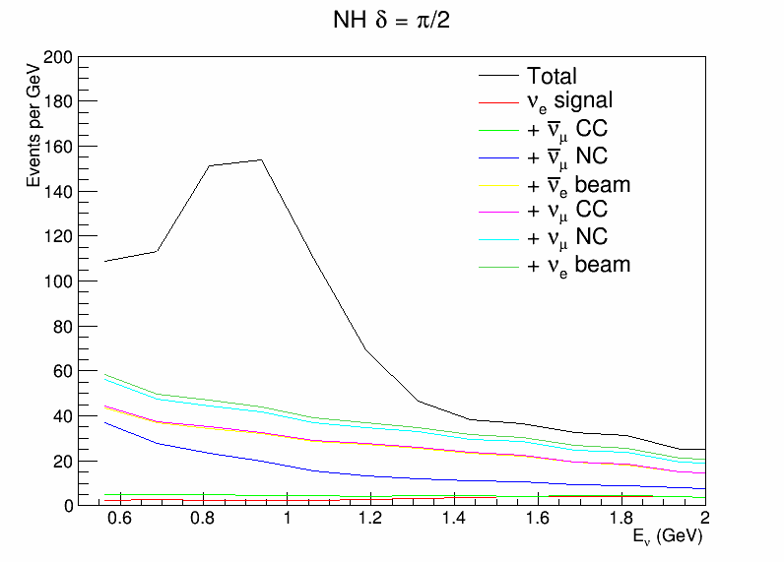
Delta = pi/2
Neutrino
Antineutrino

Slide 18
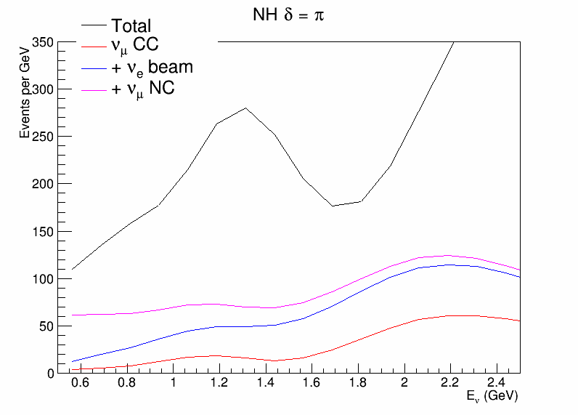

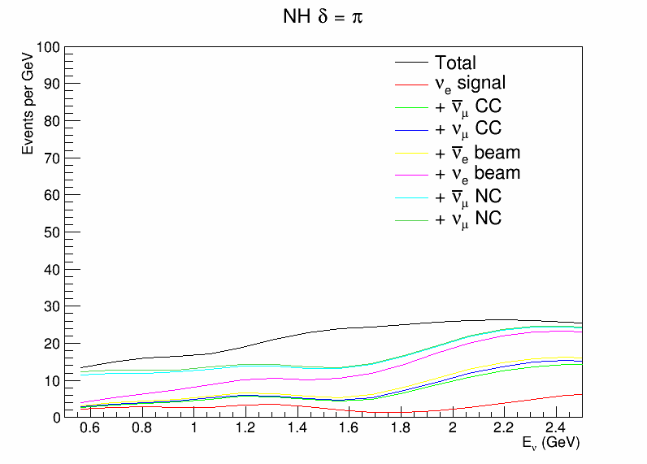
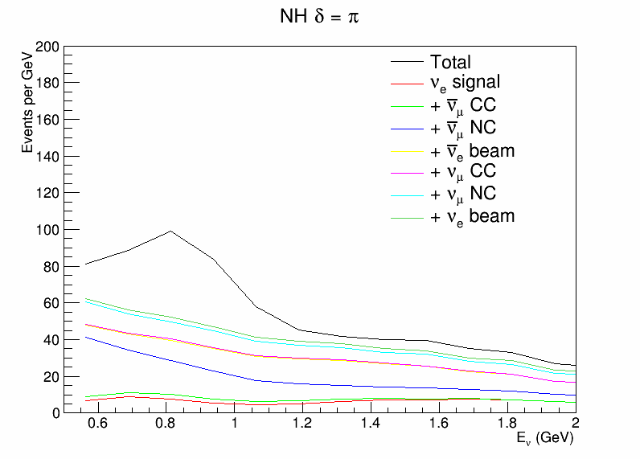
Delta = pi
Neutrino
Antineutrino

Slide 19
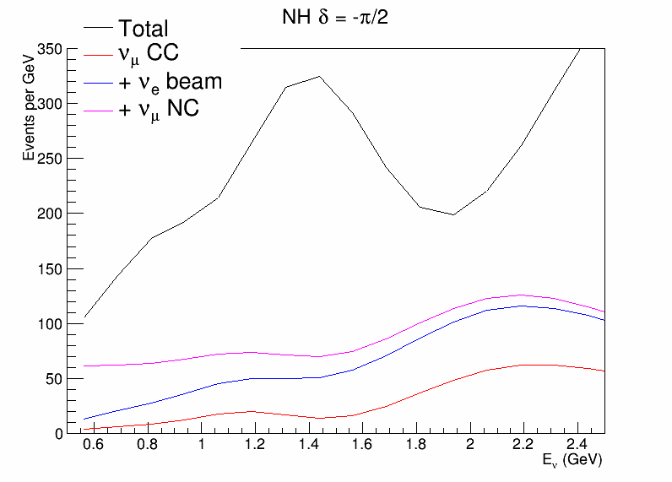
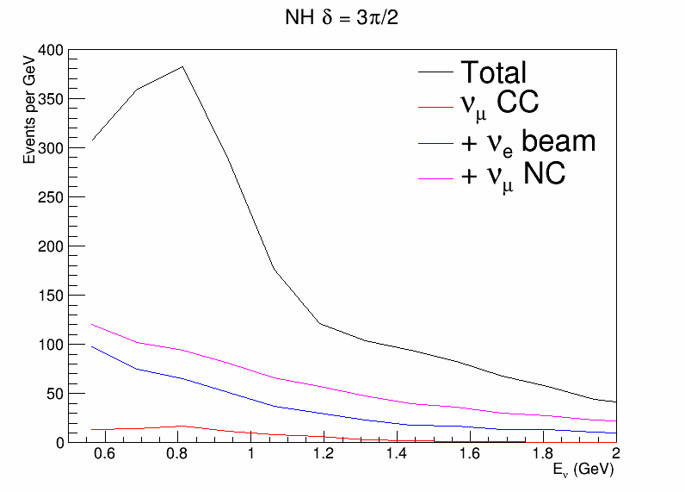
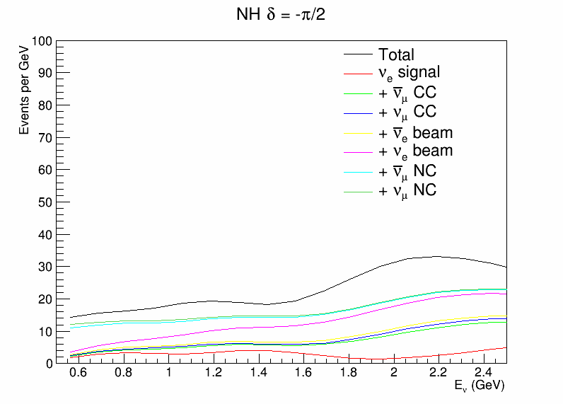
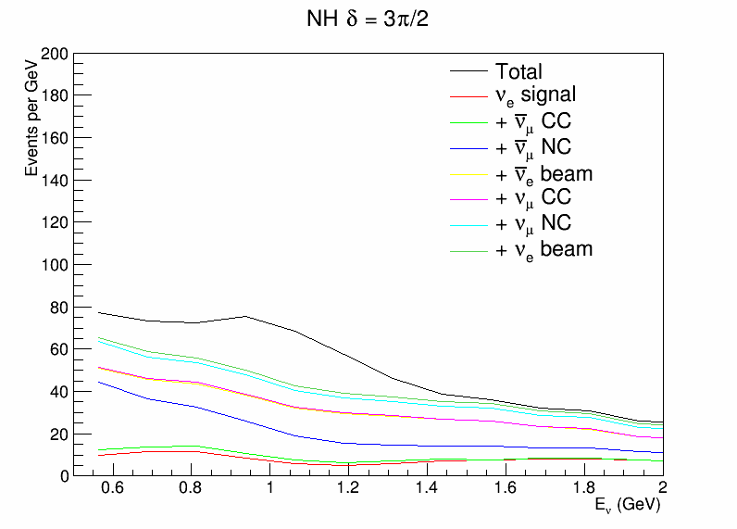
Delta = -pi/2
Neutrino
Antineutrino

Slide 20
Discussion
Off-axis detector has slightly larger signal to noise ratio due to WC detector
Can try to go to lower threshold
LBNO > 2nd oscillation maxima has some spectral information

Slide 21
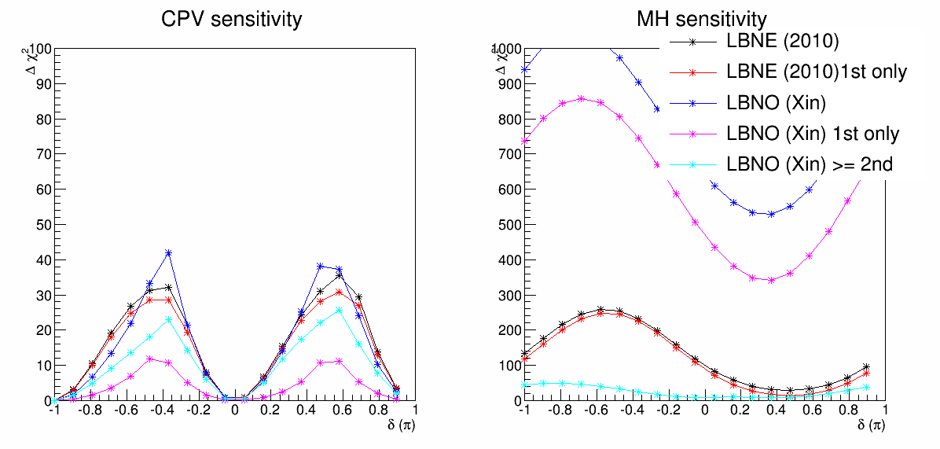
Test the impact of the theta 13
Use 20% constraint of sin^2 theta13 instead of 3% constraint

Slide 22
Understand the >1st oscillation maxima
For CPV
(>=) 2nd oscillation maxima has relative large impact in LBNO
2nd oscillation maxima is not as important in LBNE

Slide 23
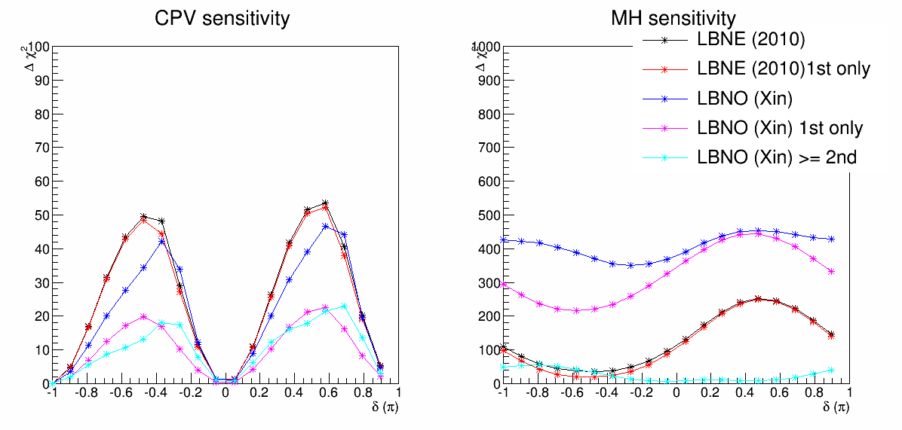
Inverted Case 3% theta13 constraint
LBNO case: 50 GeV + 24 kt @ 1 MW running 8.3 years (75% vs. 25%)
30e21 POT
Neutrino signal: 204
Neutrino background: 342
Antineutrino signal: 172.4
Antineutrino neutrino: 4.58
Antineutrino background: 51
LBNE case: 120 GeV + 34 kt @ 1 MW running 10 years (50% vs. 50%)
8.3e21 POT
Neutrino signal: 475
Neutrino background: 673
Antineutrino signal: 406.3
Antineutrino neutrino: 43
Antineutrino background: 400

Slide 24
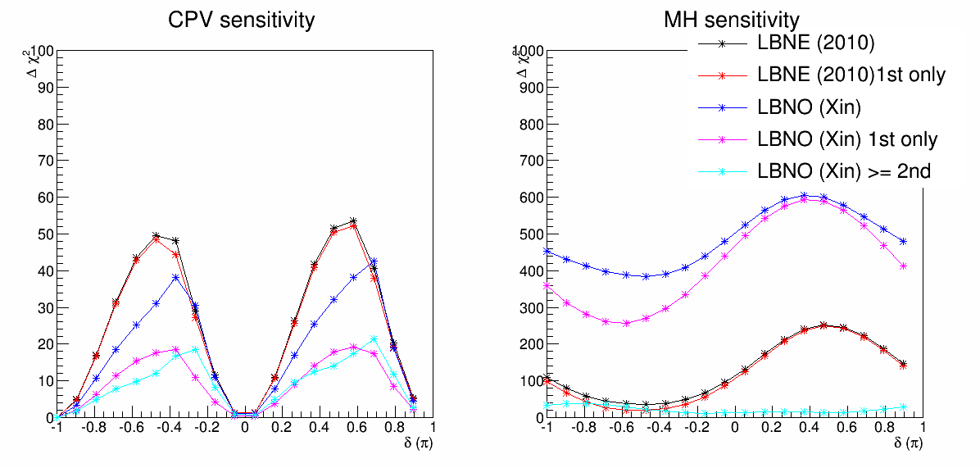
Inverted Case LBNO (50% vs. 50%)
LBNO case: 50 GeV + 24 kt @ 1 MW running 8.3 years (75% vs. 25%)
30e21 POT
Neutrino signal: 137
Neutrino background: 229
Antineutrino signal: 172.4
Antineutrino neutrino: 7.2
Antineutrino background: 102
LBNE case: 120 GeV + 34 kt @ 1 MW running 10 years (50% vs. 50%)
8.3e21 POT
Neutrino signal: 475
Neutrino background: 673
Antineutrino signal: 406.3
Antineutrino neutrino: 43
Antineutrino background: 400

Slide 25
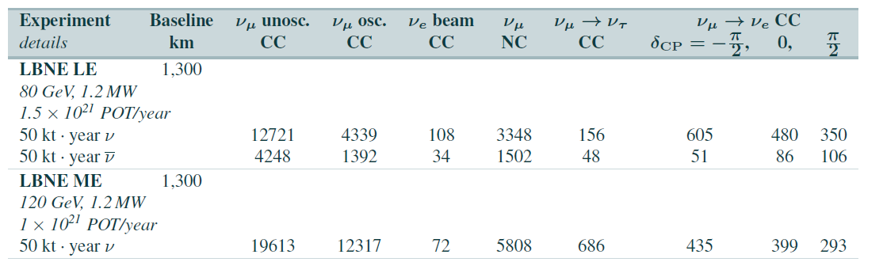
What would be our events?
Take Sciopp document
According to Jim’s calculation, we have 4.3e25 kt GeV POT --> 2866 events /2 ~ 1433 events factor of 2 because only neutrino mode
For 120 GeV * 1e21 POT * 50 kT ~ 6e24, we have 399 events.

Slide 26
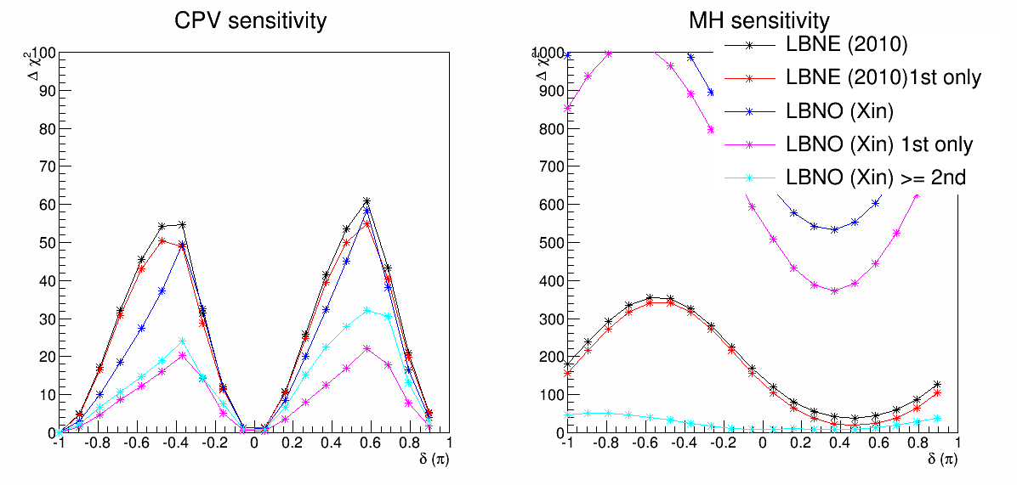
Scale Up LBNE (NH)

Slide 27
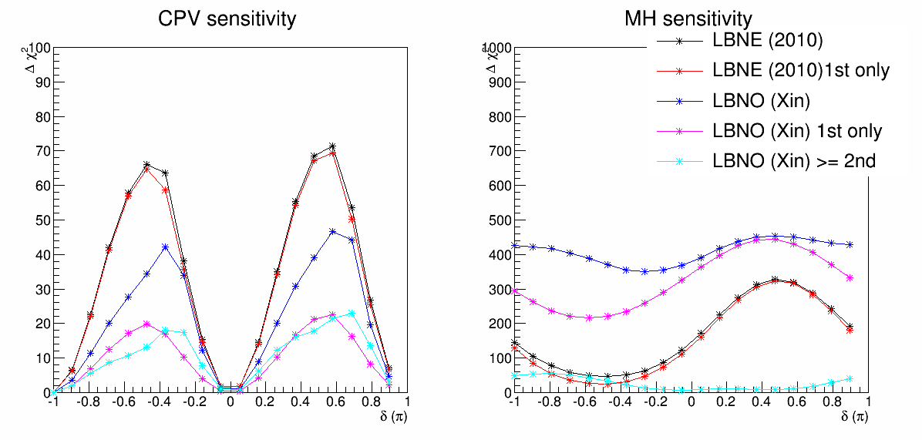
Scale Up LBNE (IH)

Slide 28
Additional idea to check baseline impact on CPV
Use LBNO flux + 24 kt @ 1300 km vs. Pre-scale-up LBNE + 34 kt (Mary’s idea)
Apple vs. Apple Comparison

Slide 29
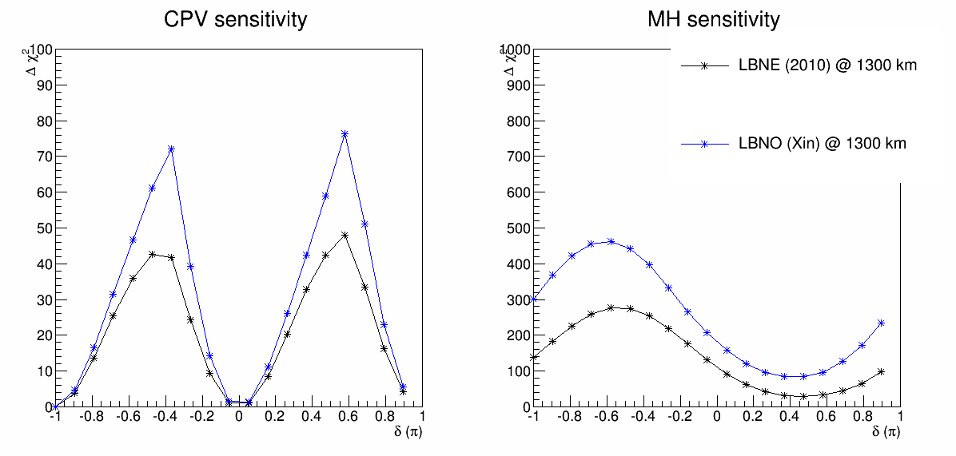
LBNO 1300 kmvs. LBNE Sensitivity Comparison
LBNO case: 50 GeV + 24 kt @ 1 MW running 8.3 years (75% vs. 25%)
30e21 POT
Neutrino signal: 1079
Neutrino background: 1008
Antineutrino signal: 339
Antineutrino neutrino: 20
Antineutrino background: 153.3
LBNE case: 120 GeV + 34 kt @ 1 MW running 10 years (50% vs. 50%)
8.3e21 POT
Neutrino signal: 1050
Neutrino background: 672.2
Antineutrino signal: 228.6
Antineutrino neutrino: 87.9
Antineutrino background: 404

Slide 30
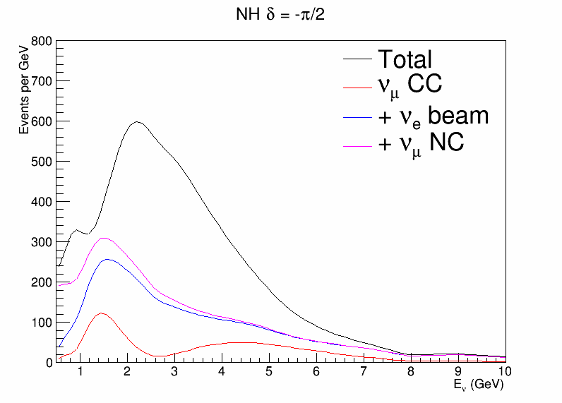
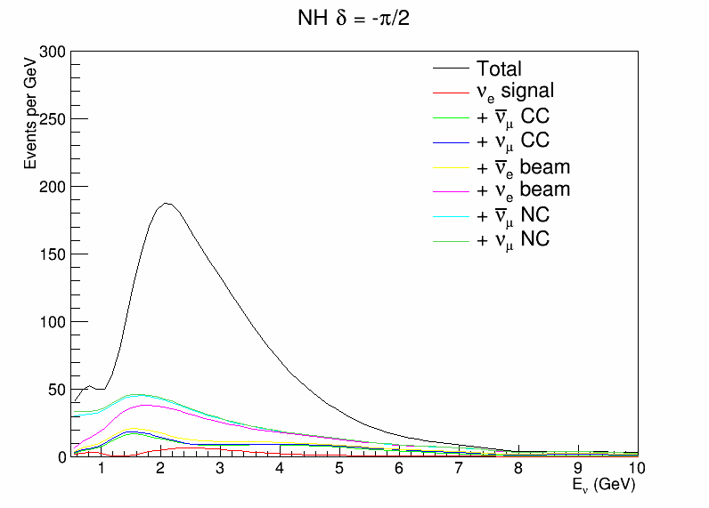
Spectra of LBNO @ 1300 km

Slide 31
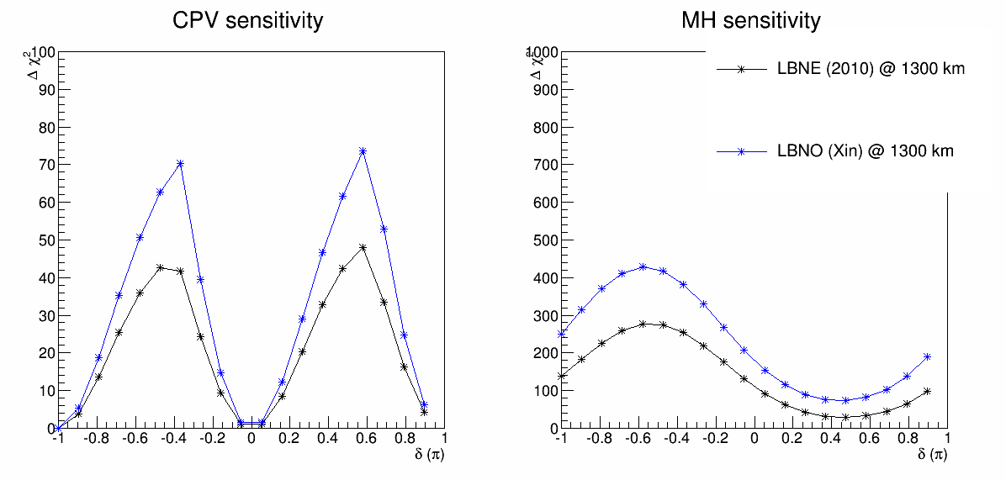
LBNO 1300 km vs. LBNE Sensitivity Comparison
LBNO case: 50 GeV + 24 kt @ 1 MW running 8.3 years (50% vs. 50%)
30e21 POT @ 1300 km
Neutrino signal: 722
Neutrino background: 674.
Antineutrino signal: 679.
Antineutrino neutrino: 40
Antineutrino background: 307.3
LBNE case: 120 GeV + 34 kt @ 1 MW running 10 years (50% vs. 50%)
8.3e21 POT
Neutrino signal: 1050
Neutrino background: 672.2
Antineutrino signal: 228.6
Antineutrino neutrino: 87.9
Antineutrino background: 404

Slide 32
Discussions
2300 km has clear advantage over 1300 km in determining the MH
2300 km relies on 1st oscillation maxima
1300 km relies on the 2nd oscillation to break the degeneracy
500 MeV threshold should be reduced in LBNE Note: uBooNE is looking at 100 MeV photons …
1st maxima @ 1300 km clearly has advantage over 1st maxima @ 2300 km in CPV
2300 km has an imbalanced 1st oscillation maxima
> 1st maxima @ 2300 km has some advantages over 2nd maxima @ 1300 km in CPV
2300 km covers more energies, shape information etc
>=2nd oscillation maxima is more important for 2300 km for the CPV search
For IH, 1300 km has some advantages over the 2300 km for CPV search
With LBNO flux, 1300 km out-performs 2300 km

Slide 36
Event Rates Comparison
LBNO condition
50 GeV beam, 24 kt LAr, 30e21 POT
With LBNE case, how many years?
1.2 MW @ 120 GeV, 34 kt LAr
1.2 MW @ 120 GeV for 1 year = 1e21 POT
About 8.8 years of running
6.6 years in neutrino
2.2 years in antineutrino mode

Slide 37
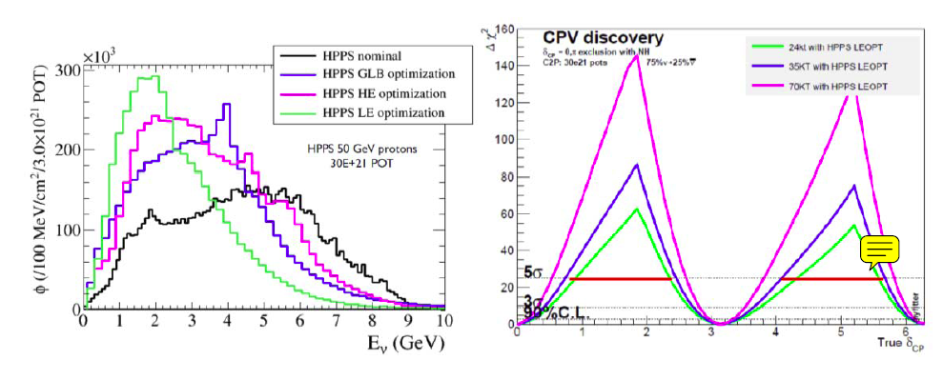
Introduction
Milind pointed me to Jim’s note on the LBNE vs. LBNO CPV sensitivity
The claim is that HPPS+LE optimization @ 30e21 POT would reach about 5-sigma CPV at 50% CP phase range!
Based on Jim’s calculation, this corresponds to 4.3x10²⁵ kt GeV POT of our configuration. (1.2 MW 120 GeV → 10²¹ POT per year)

Slide 38
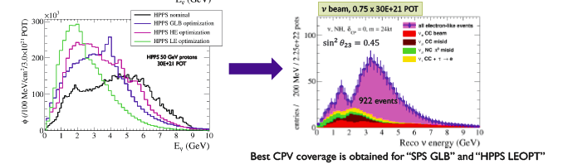
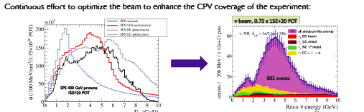
What’s the weird part?
The number of events corresponding to this sensitivity is only 922 events (according to the above plot). Similarly we can compare to SPS beam (~800 events)

Slide 39
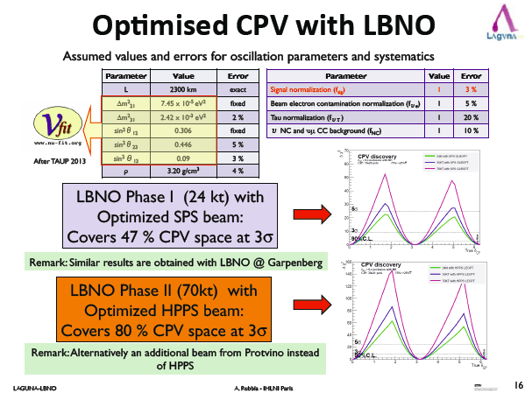
What’s the weird part?
With the similar total number of events (800 vs. 933), the sensitivity of HPPS beam is almost a factor of 3 higher than the SPS beam (24 kton)

Slide 40
What would be our events?
Take Sciopp document
According to Jim’s calculation, we have 4.3e25 kt GeV POT --> 2866 events /2 ~ 1433 events factor of 2 because only neutrino mode
For 120 GeV * 1e21 POT * 50 kT ~ 6e24, we have 399 events.

Slide 41
What are LBNO claims?
With HPPS optimized beam (933 events), the sensitivity is similar to LBNE (1433 events)?
The HPPS optimized beam (933 events) would give a factor of 3 better sensitivity than the SPS beam (~800 events)?

Slide 42
Let’s check the 2nd oscillation Maxima
34 kT LAr on-axis wide band beam + 100 kT Water Cerenkov at off-axis focusing on the 2nd oscillation peak
1.2 MW beam running 10 years (5+5)
LAr neutrino: 1298 events (total 2128)
LAr antineutrino: 282 events (total 889)
WC neutrino: 116 events (total 275)
WC antineutrino: 76 events (total 182)

Slide 43
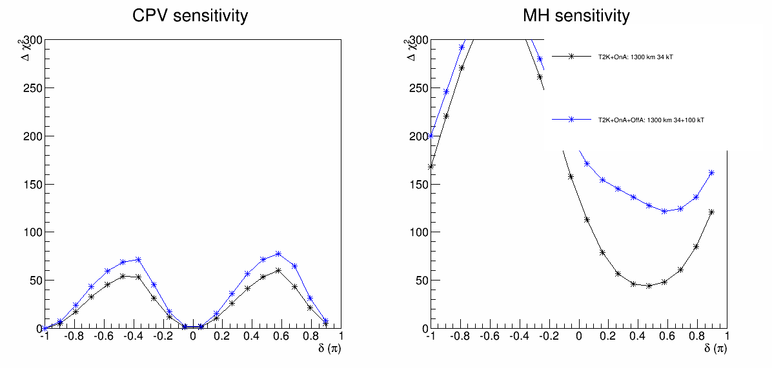
Sensitivity
Blue is with 2nd oscillation maxima contribution (100 kT WC)
Effect on CPV is not as large as expected

Slide 44
My Wrong Guess
The LBNO sensitivity of HPPS (phase-II) is obtained by adding the SPS sensitivity (phase-I) and the HPPS sensitivity (phase-II) (total events 1700 neutrino for phase I+II)
Compared to LBNE sensitivity of 1433 neutrino

Slide 45
How Important is 2nd oscillation maxima for LBNO CPV?
For this study, we only care the relative effect
Add in 2nd oscillation maxima vs. not adding in 2nd oscillation maxima
We can simply use the LBNE setup, and change the baseline from 1300 km to 2300 km

Slide 46
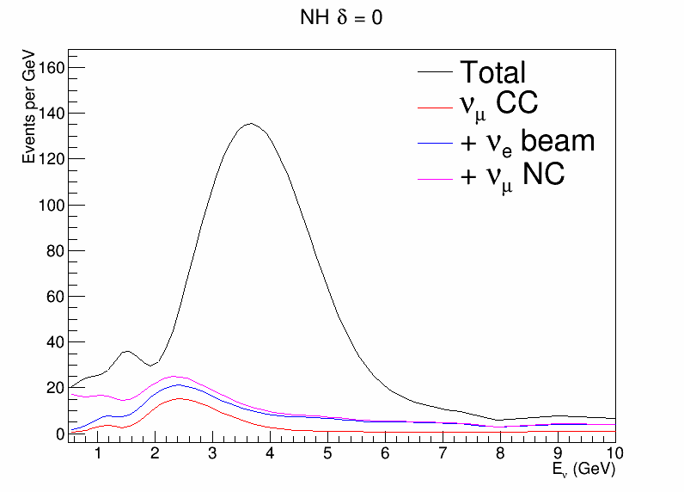
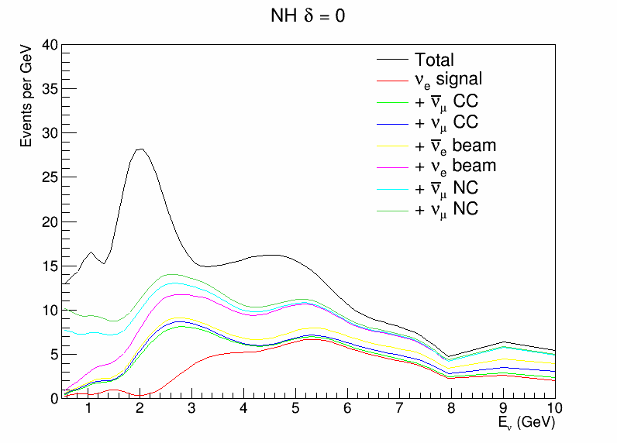
“LBNO” Neutrino Spectrum
Neutrino
Anti- Neutrino
LBNO setup:
1st maxima > 2.5 GeV
2nd maxima < 2.5 GeV

Slide 47
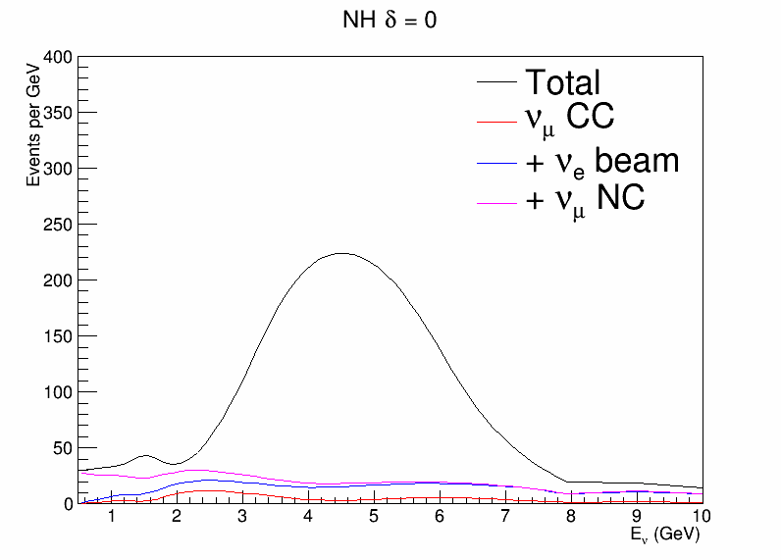
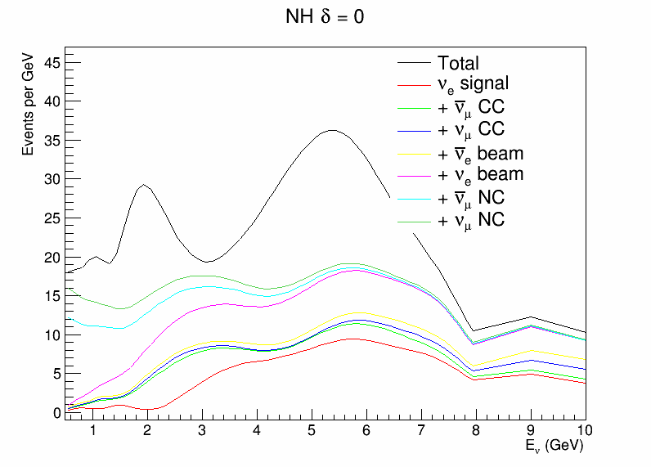
LBNO tuned (Mary)

Slide 48
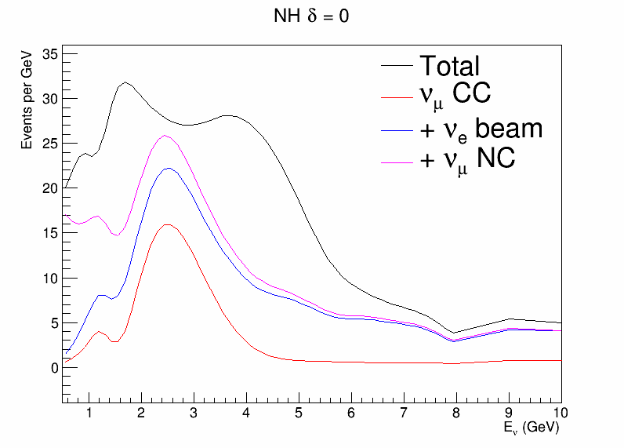

LBNO Inverted MH

Slide 49


“LBNE” Neutrino Spectrum
Neutrino
Anti- Neutrino
LBNE setup:
1st maxima > 1.5 GeV
2nd maxima < 1.5 GeV

Slide 50

Results
For CPV, 2nd oscillation has larger impact for LBNO setup
For MH, 2nd oscillation has larger impact for LBNE setup

Slide 51

LBNO tuned flux
For LBNO tuned flux (enhanced 1st oscillation maxima)
The CPV is sensitivity is better
The importance of 2nd oscillation maxima is slightly worse
Still more important than the 2nd oscillation maxima of LBNE

