Slide 1

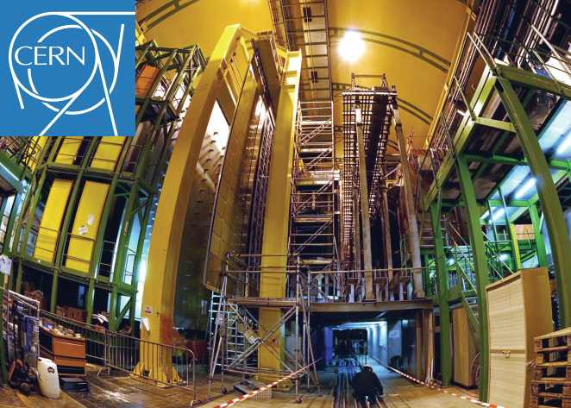

RICH Simulation experience from LHCb
EICUG Software seminar
From LHCb RICH software group
Sajan Easo
27-05-2020

Slide 2
Preamble
Description of LHCb and its RICH system
Software framework and simulations
RICH Detector description and physics processes
Comparison with real data from LHCb
Design for further upgrades
RICH for RUN1 and RUN2 (2010-2018)
RICH for RUN3 (2021 onwards)
Gaudi software framework and the applications
GEANT4 in LHCb
LHCb specific processes
Validation using prototypes in testbeams

Slide 3
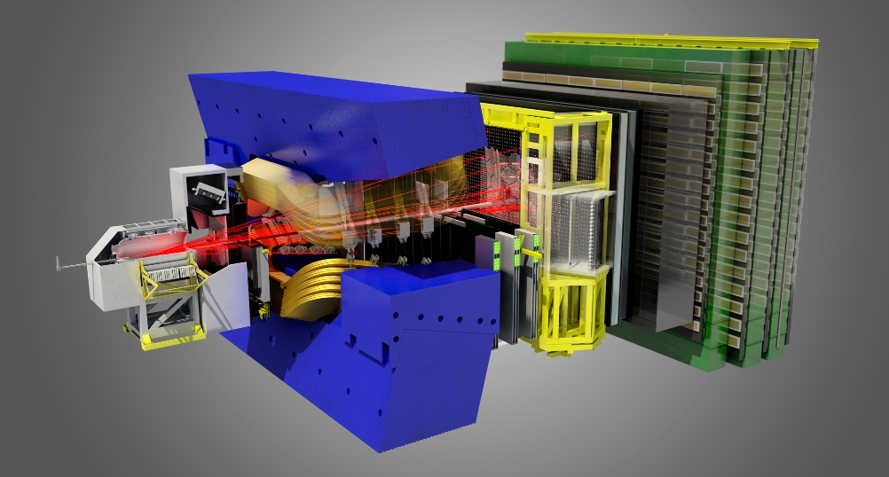
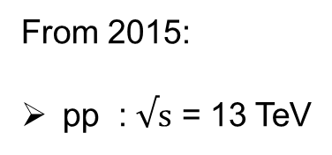


The LHCb Experiment
From 2015:
pp : $√s$ = 13 TeV
Magnet
RICH2
RICH1
RICH1:
RICH2:
C₄F₁₀ < ~ 60 GeV/c
Photodetectors:
Top + Bottom
CF₄: < ~ 100 GeV/c
Photodetectors:
Left+ Right
Before 2015:
Vertex
Locator
Calorimeter
Tracking stations
Muon
chamber
pp : $√s$ = 8 TeV
Aerogel < 10 GeV/c
Before 2012:
pp : $√s$ = 7 TeV
2 < η < 5, Forward spectrometer.
Overall acceptance ~ 10→300 mrad, Momentum range : 2-100 GeV/c
LHCb collaboration has over 1400 members from 85 institutes in 19 countries, including USA.

Slide 4
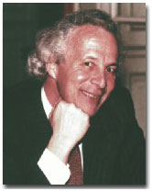

LHCb Timeline
T. Ypsilantis
Run3
( 2021-2024 )
Run4
( 2027-2030 )
J.Seguinot
RUN4 schedule is being revised
RUN1, 2 | Mid 1990’s - 2010
RUN3 | 2010 – 2020
RUN4, 5 | - ~ 2026
T.Ypsilantis, J.Seguinot et.al.
were part of LHCb-RICH
Nucl. Inst. Meth. A (1994) 30-51
“Theory of ring imaging Cherenkov counters”
LHCb Design and installation:
LHCb-RICH software development:
~ 2000 | First version of Gaudi Framework in C++, started to be used in LHCb. I started on GEANT4 for LHCb-RICH
2002 | First version of GEANT4 simulation for RICH and Calorimeter in LHCb
2004 | DC04: First production RUN of LHCb simulations using GEANT4
2010 | Arrival of LHCb real data and comparison with simulations. This continued until the end of RUN2.
2011 | I started on the simulations to design RICH upgrade for RUN3. This led to PID upgrade TDR in 2013
2015 | RICH reconstruction became part of HLT (online ) processing.

Slide 5
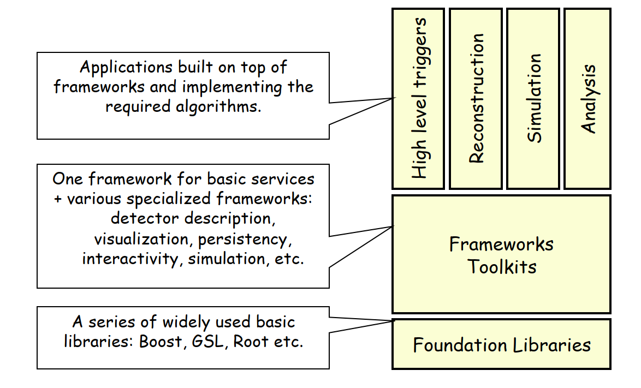
LHCb software framework
Shared between all applications
Event model / Physics event model
GenParts
StrippedDST
Detector
Description
RawData
Conditions
Database
Simulation
Gauss
Analysis
DaVinci
Recons.
Brunel
HLT
Moore
Digit.
Boole
MCHits
AOD
DST
MCParts
Digits
Gaudi
Common framework for all applications
Gaudi was originally developed in LHCb. It is now a general framework. It is also used by other experiments, including ATLAS, Fermi space telescope and Daya Bay.
It is an open source project and is released by CERN LCG.
It has user guides, tutorials and other documentation at
https://gaudi-framework.readthedocs.io/en/latest/user_guide.html

Slide 6
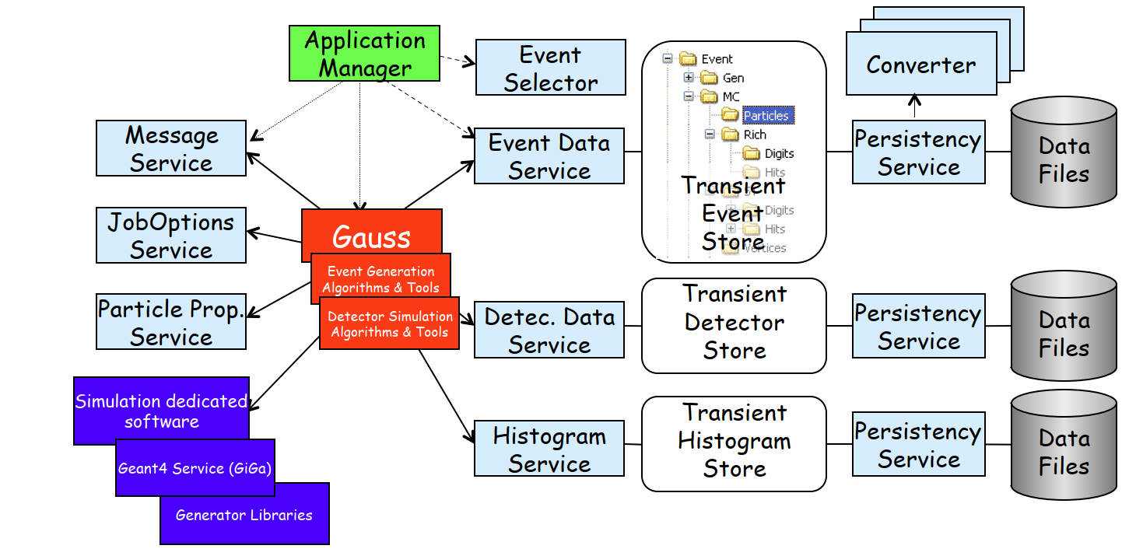
LHCb software framework
Gaudi Object Diagram
Application software : Set of
Gaudi Algorithms and Tools
GAUSS : Event generation and
detector simulation
BOOLE: Readout response and
digitization of hits
Separation between “data” and “algorithms”
Separation between “transient” and “persistent” representations of data
Well defined component “interfaces”
- Simulation code encapsulated in specific places (Algorithms, Tools)
M.Clemencic et.al., “The LHCb simulation application, Gauss: Design, evolution and experience”,
J.Phys. Conf. Ser. 331 (2011) 032023

Slide 7
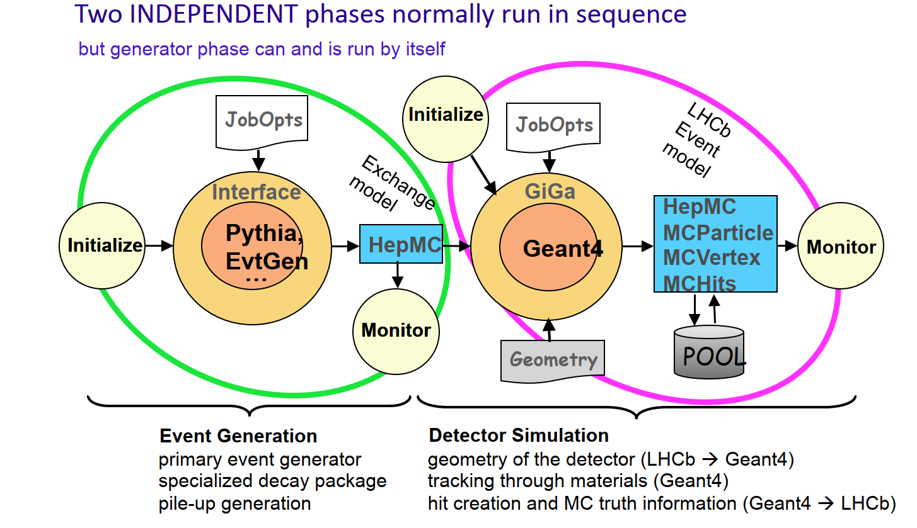
LHCb software framework: GAUSS
Communication between Gauss and
GEANT4 is through an
interface package named GiGa
Information from G4Hits created in each detector gets copied to the corresponding MCHits.

Slide 8
Encapsulation of GEANT4 in Gauss
Persistency
Service
Data
Files
G4 Kine
G4 Hits
Event Loop controlled by Gaudi
Transient Event Store
Kine
‘Convertion’
Algorithms
^{(a)} Geant4 Interface for Gaudi Applications (I.Belyaev) CHEP, 2001, Beijing.
Hits
‘Conversion’
Algorithms
Gauss
(Gaudi)
GiGa
Service
Geant4
Transient Detector
Store
GiGaGeom
Conversion
Service
Action
GiGa^{(a)}
G4 Geom
Action
Detector geometry converted from the same source as other applications
Embedded Geant4 control and Configuration
Persistency
Service
Data
Files
Dynamic loading of physics (sub-)lists
Transformation of transient objects to/from GEANT4 is easy to configure and control in Gauss.

Slide 9
RICH geometry
Persistent representation of detector data: The technology choice at the time, was to use XML language to describe the geometry
The XML DTDs (Document Type Definition) were created for the geometry and material objects .
Each subdetector, including the RICH used this schema to create the XML geometry database.
The general structure of LHCb detector description was similar to that of GEANT4 geometry classes.
Hence the conversion in the GiGa interface to the GEANT4 geometry and material classes was mostly
straightforward.
Few exceptions included, creating detector mis-alignments in simulation, creating optical surfaces etc.
Eventually conversion of these were also taken care of.
The XML files are parsed using an ‘IBM XMLparser technology’ behind the scenes. The XML database is converted to an SQLITE database for Gaudi to access.
We also had the concept of ‘Detector elements’ which were objects which contain various parameters
regarding specific volumes. e.g. temperature of a gas, gains of channels, orientation of a plane etc.
‘Detector elements’ were defined in the database with a DTD. They enabled the corresponding C++
classes to access such information directly, whenever needed.

Slide 10
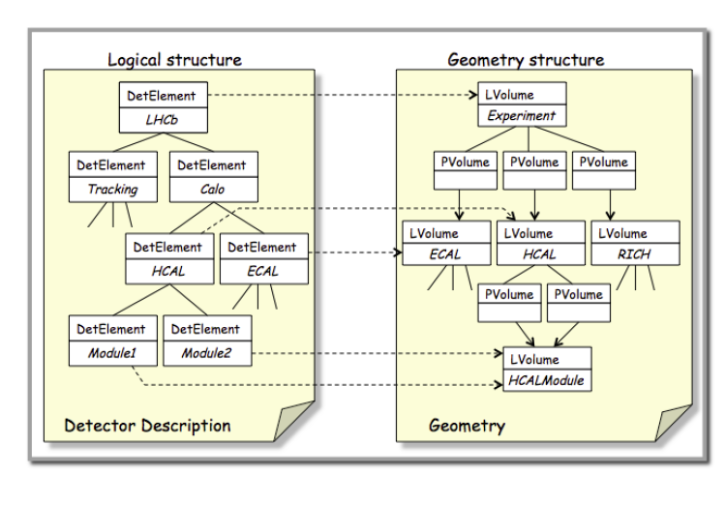
RICH geometry
Different tools were used for geometry overlap testing:
LHCb graphics application named Panoramix
GEANT4 with OpenGL, DAWN etc.,
Shoot lines in different directions using
Gaudi transport service and look for
intersections at geometry boundaries
“New twist to an old story”, after 20 years:
The XML file structure for Database has some drawbacks
Solution: Move towards using DD4HEP structure
in the coming years.
Difficult to perform ‘do loops’, for repeated operations
in the database files.
Difficult to interface to modern ROOT graphics structures
This will also involve modifications to the corresponding
detector element implementations.

Slide 11
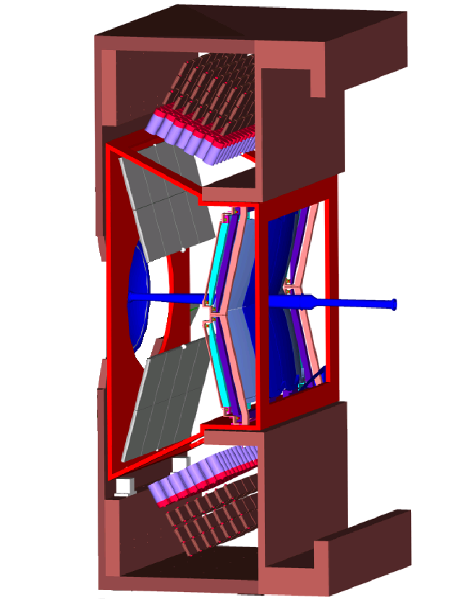
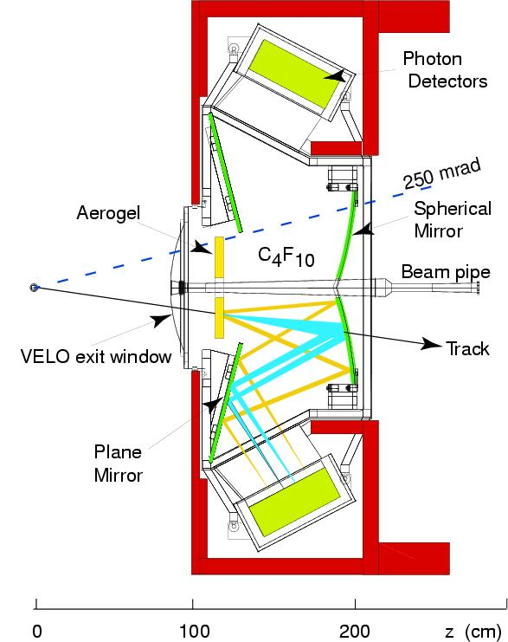
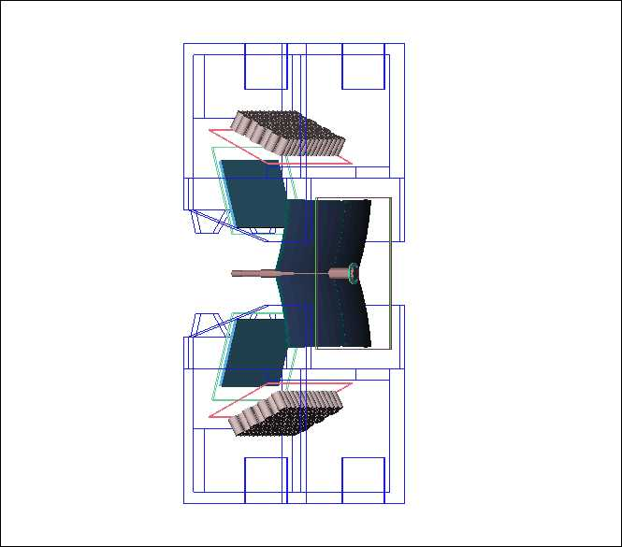
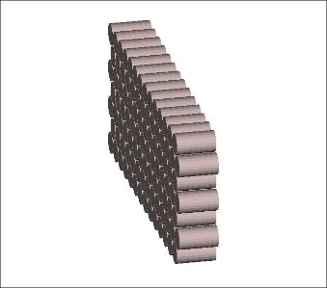
RICH1 pictures
RICH1 schematic figures
RICH1 in software : RUN2
LHCb: Panoramix graphics used here.
Some components set as invisible or
as wireframe for illustration.
Aerogel was removed for RUN2
4 m³ of C₄F₁₀ , n ~ 1.0014 , acceptance: 25-300 mrad
Array of HPDs

Slide 12
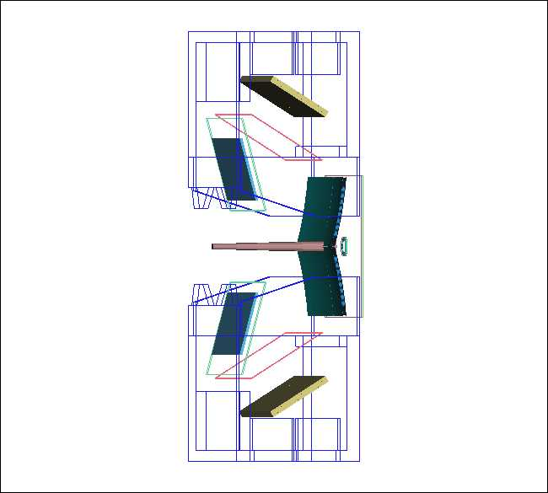
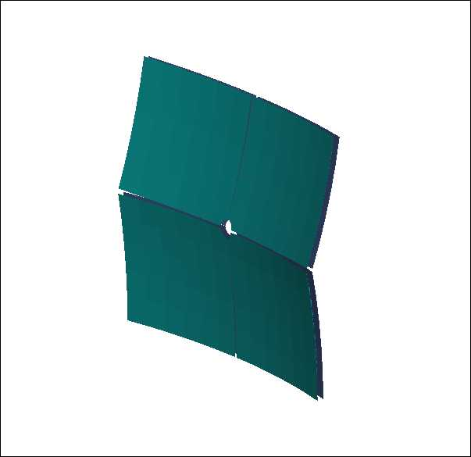
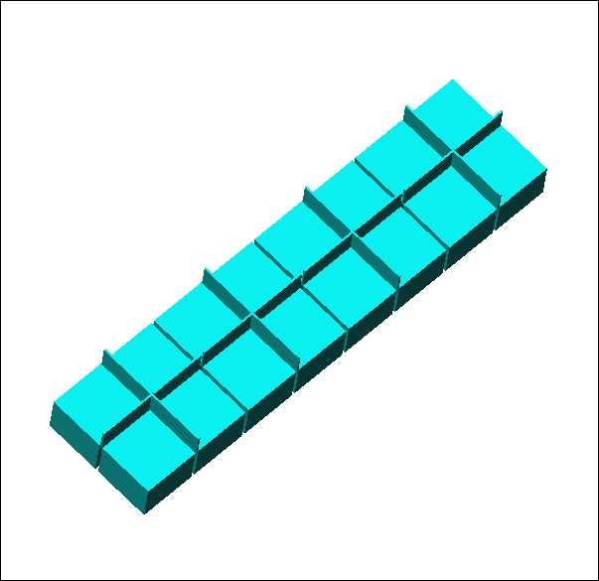
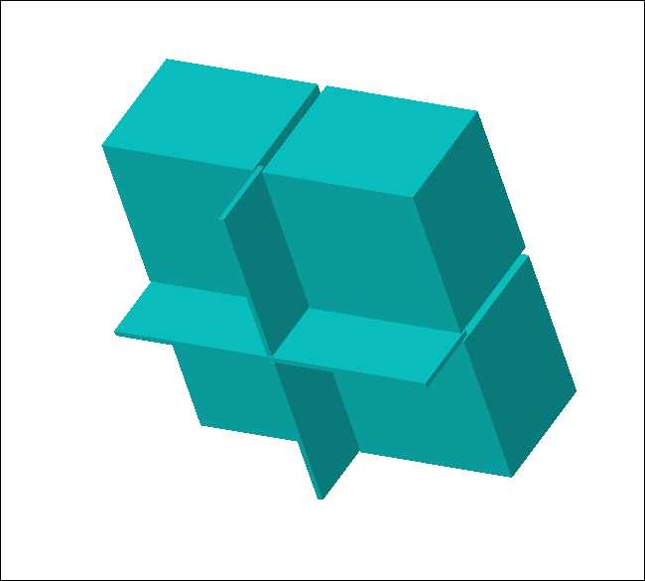
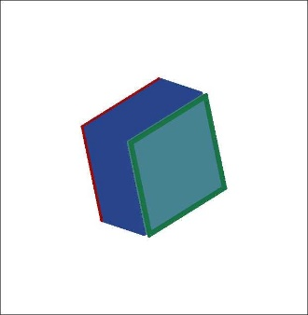
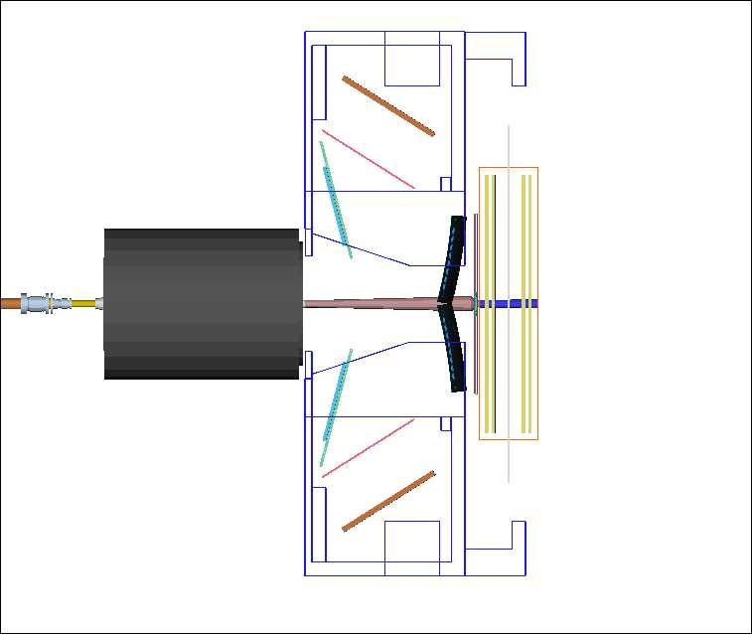
RICH geometry in software
RICH1 in software : RUN3
RICH1 MaPMT-Module
RICH1: spherical mirrors
Elementary Cell with 4 MaPMTs
MaPMT
RICH1
UT
VELO
LHCb: Panoramix graphics used here.
Some components are set as
invisible or as wireframe in graphics, for illustration.

Slide 13
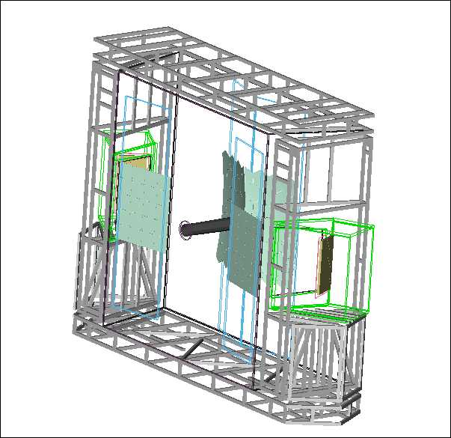
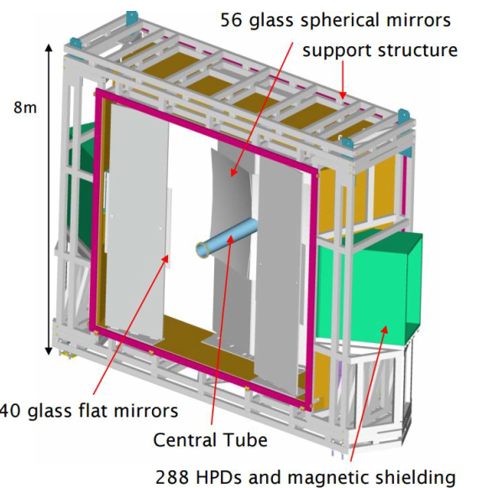
RICH geometry in software
RICH2 schematic figure
RICH2 in software
100 m³ CF_{4 ,} n ~ 1.0005, acceptance: 15-120 mrad

Slide 14
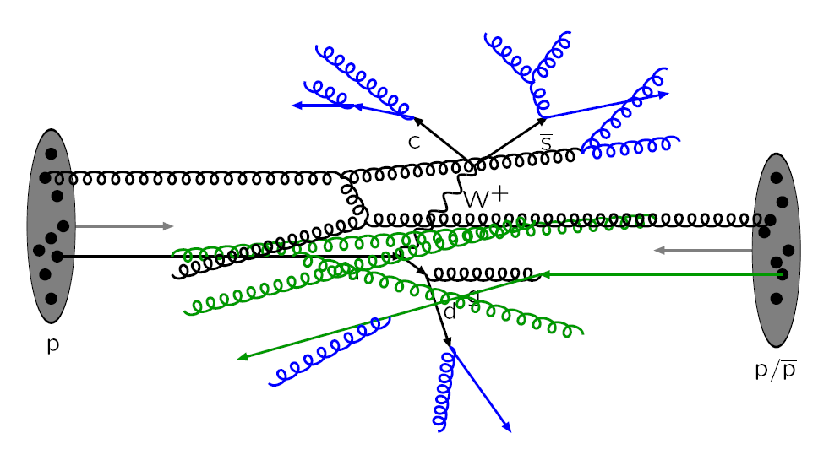
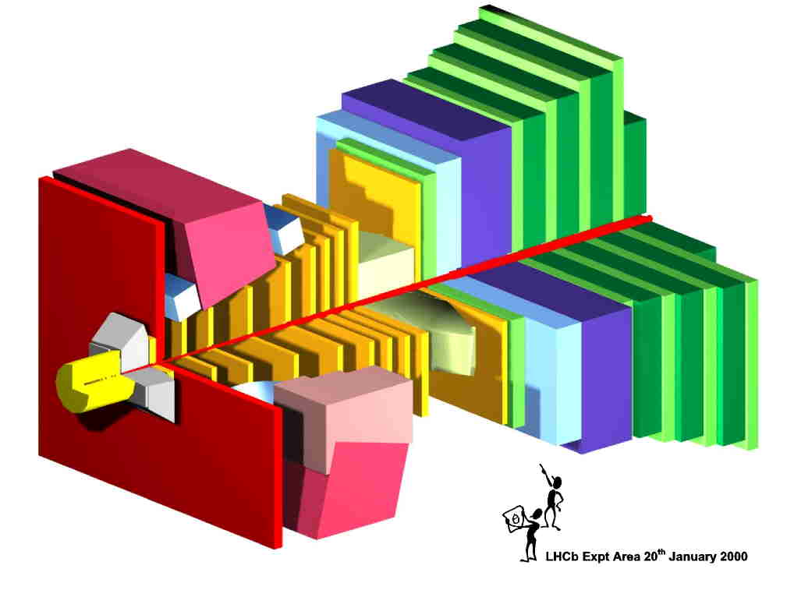
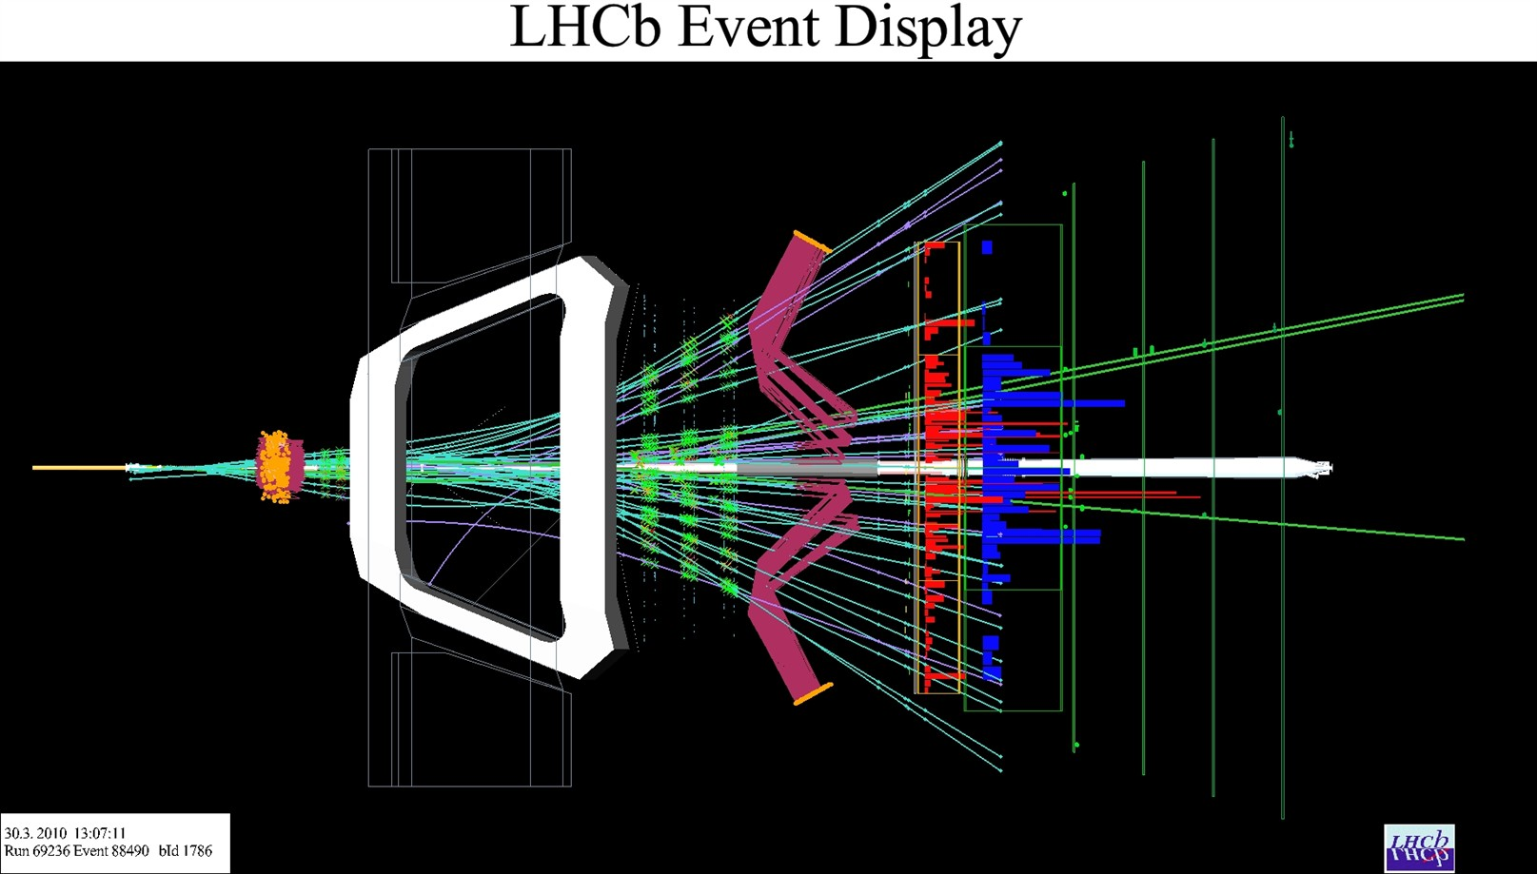
Simulation sequence
Random number reset
Pile-up number
determination
(veto empty events)‏
Pythia
EvtGen
Signal
Generation in
/Event/Gen/HepMCEvents
Generator Sequence
t=0
Vertex Smearing
Random number reset
Generation ->
G4 Primary Vertex
Geant4
Simulation inside the
detector
Simulation Sequence
Fill MCParticle/MCVertex/MCHits
in /Event/MC/Particles...
Digitization

Slide 15
RICH Simulation specific actions
For creating the sensitive detector where hits are created, one just sets an attribute for the corresponding
volume in the XML database. This is then automatically transferred to the GEANT4 through the various
interfaces.
For the general LHCb simulation, we did not make use of the ROGeometry in GEANT4
since the simulation of the readout was done in the Boole application separately.
But it was used in our test beam applications.
Once the structure is in place, the RICH specific software included some GEANT4 user actions activated
through the GiGa interface for optimizing the CPU time and for monitoring. The monitoring of performance
was done extensively.
We also had some RICH specific physics processes.

Slide 16
RICH physics processes
For electromagnetic and hadronic processes, LHCb uses the standard physics lists from GEANT4.
The RICH system in LHCb is part of that.
For Cherenkov photon production and transport the following processes are important:
G4Cerenkov, G4Scintillation , G4OpBoundaryProcess, G4OpRayleigh
For LHCb-RICH use case, we implemented some modifications for these processes
Examples:
Keep track of the Cherenkov angle and Scintillation angle at photon production,
for tests during the reconstruction. This required attaching ‘user info’ to photon tracks.
Avoid ‘almost infinite loops’ from total internal reflection of Cherenkov photons,
for example in a rectangular quartz plate.
Avoid the possibility of ‘almost infinite’ number of Rayleigh scattering steps.
Perform CPU time optimization, by having different wavelength ranges for Cherenkov
production and transport. For example, when there are multiple radiators,
one may restrict the wavelength range of photons produced in a radiator for reducing chromatic error.
But one may allow the photons produced elsewhere with a wavelength outside this range,
to travel through that radiator.

Slide 17
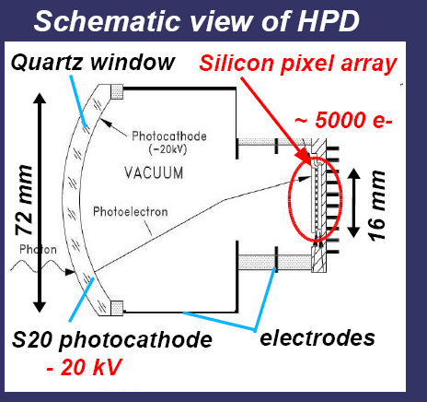
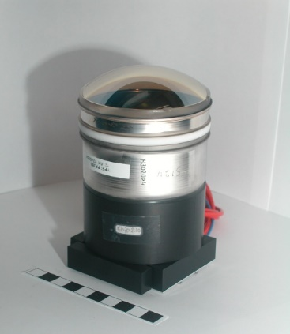
RICH physics processes
HPD
For RUN1 and RUN2 we used HPDs(Hybrid photo diode).
The photoelectrons are produced based on the
tables of QE versus photon energy.
The standard GEANT4 process did not use such an input.
Hence we created a special process for this.
Similarly, for the energy loss of photoelectron at the silicon anode, we created a special process.
Further details on the RICH simulation from LHCb:
“Simulation of LHCb RICH detectors using GEANT4”, S.Easo et.al., IEEE Trans. Nucl. Sci. 52 (2005) 1665.
Verification of physics processes:
The RICH physics processes were used in the RICH test beam simulation program.
The results from simulation were compared with the results from analyzing the real data
from different test beams where the RICH prototypes were tested.
These verifications were done in terms of Cherenkov angle resolutions and photon yield.
This procedure helped to validate the physics processes well before the LHCb data arrived.
In the old days, a version of this test beam program was available as a
‘GEANT4 example’ for some years.
Later this was replaced by other examples for optical processes.

Slide 18
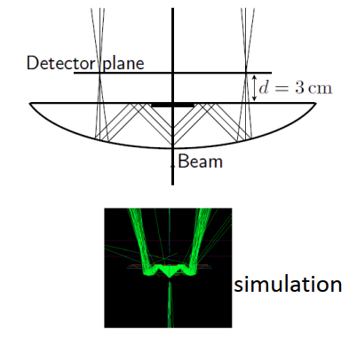
Examples of Testbeam results
Various aspects of the system were verified in different testbeams which used
different geometries.
Three of them are listed here:
“Performance of the LHCb RICH photo-detectors and readout in a system test using charged particles
from a 25 ns-structured beam”, M.adinolfi et.al. Nucl. Inst. Meth. A 603 (2009) 287-293
(b) “Performance of the LHCb RICH photodetectors in a charged particle beam”,
M.Adinolfi et.al.,Nucl. Inst. Meth. A 574 (2007) 39.
(c ) “Test of the photon detection system for the LHCb RICH Upgrade in a charged particle beam”
M.K. Baszczyk et.al., JINST 12, P010112 (2017)
Test beam in 2015
Cherenkov ring in 2015 test beam data
Number of hits per track
in 2015 test beam

Slide 19
LHCb-RICH performance from simulations: RUN2 and RUN3
Examples of Cherenkov Angle Resolutions and yields
Resolution (in mrad) | RICH1-2015 HPD, C₄F₁₀ | RICH1-upgrade MaPMT, C₄F₁₀
Chromatic | 0.84 | 0.58
Pixel | 0.60, PSF=0.86 | 0.44
Emission point | 0.76 | 0.37
Overall Overall+Track | 1.60 1.65 | 0.78 0.88
RICH2-2015 HPD, CF₄ | RICH2-upgrade MaPMT, CF₄
0.48 | 0.31
0.19 PSF=0.29 | 0.19
0.27 | 0.27
0.65 0.76 | 0.45 0.60
Yield | 32 | 42
24 | 22
Yield: Mean Number of RICH hits per
saturated track (Beta ~1).
Ref: “Overview of LHCb RICH Upgrade”,
S.Easo, Nucl.Inst.Meth. A 876 (2017) 160-163

Slide 20
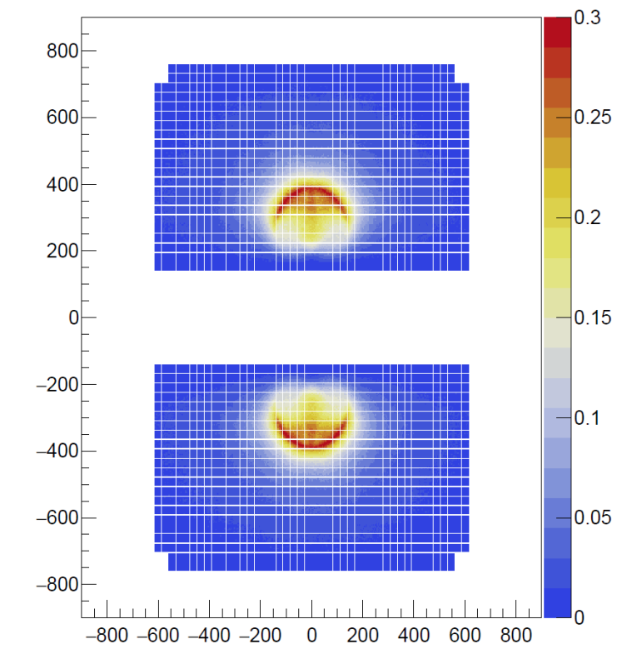
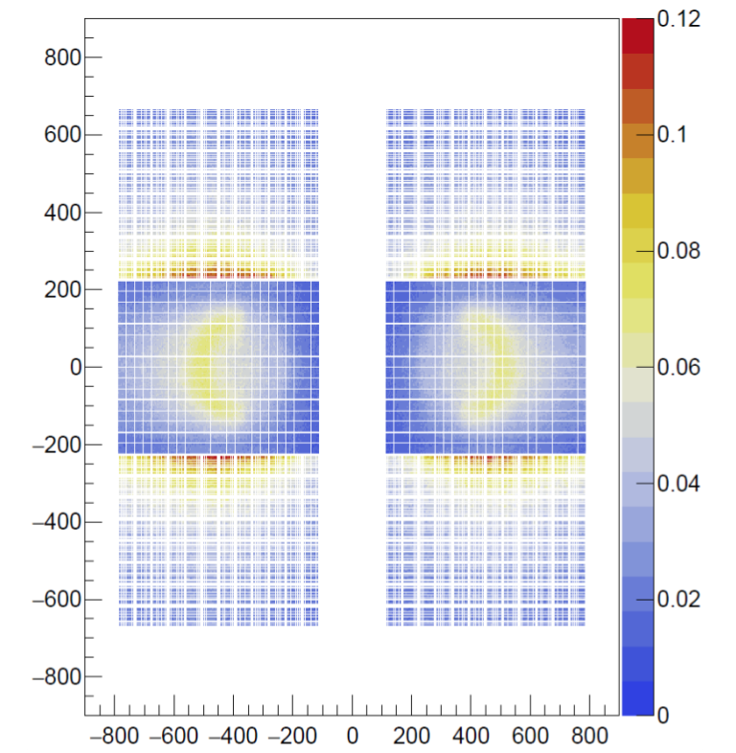
RICH data from simulation
mm
mm
Y
Y
mm
mm
RICH1
X
RICH2
X
Y vs X of the hit coordinates on the detector planes, from simulations.
This is normalized to the number of events.
B-meson signal events, RUN3 simulations

Slide 21
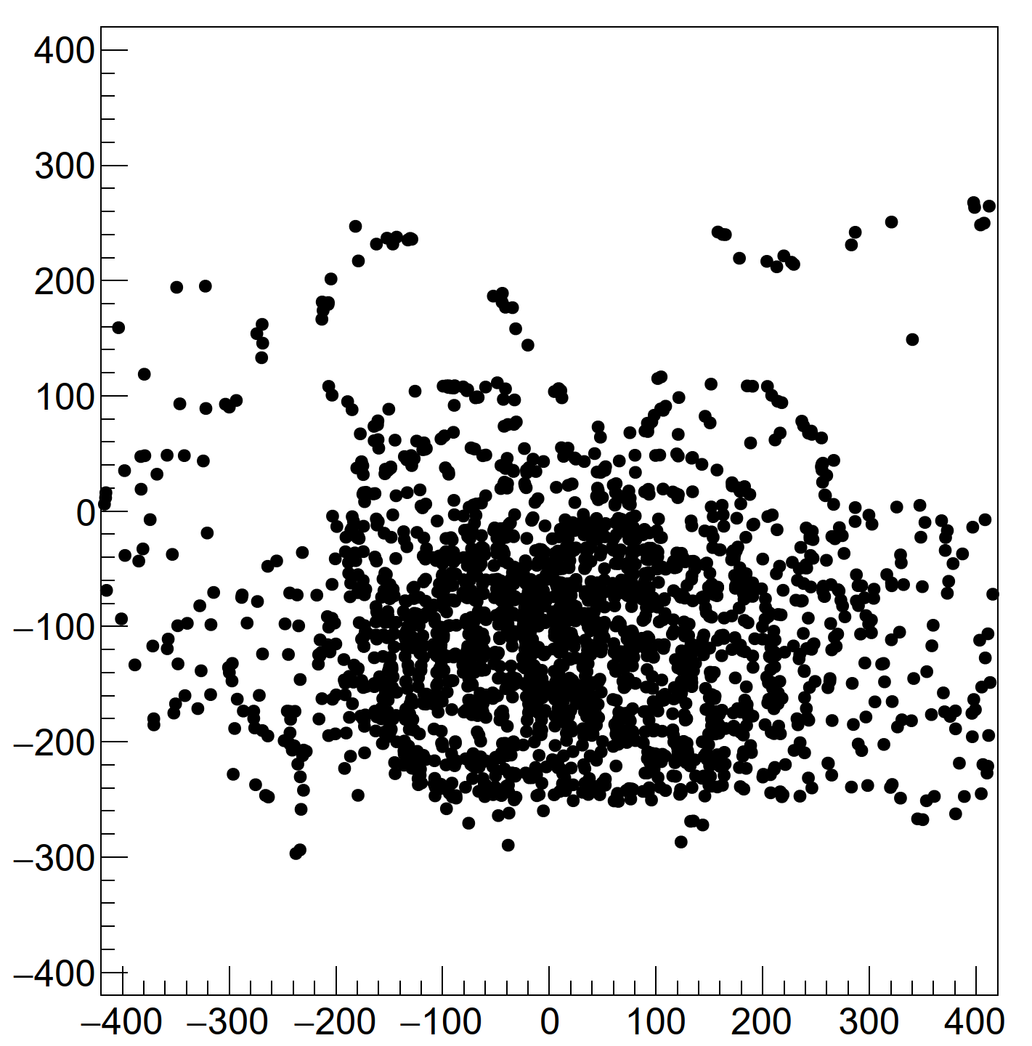
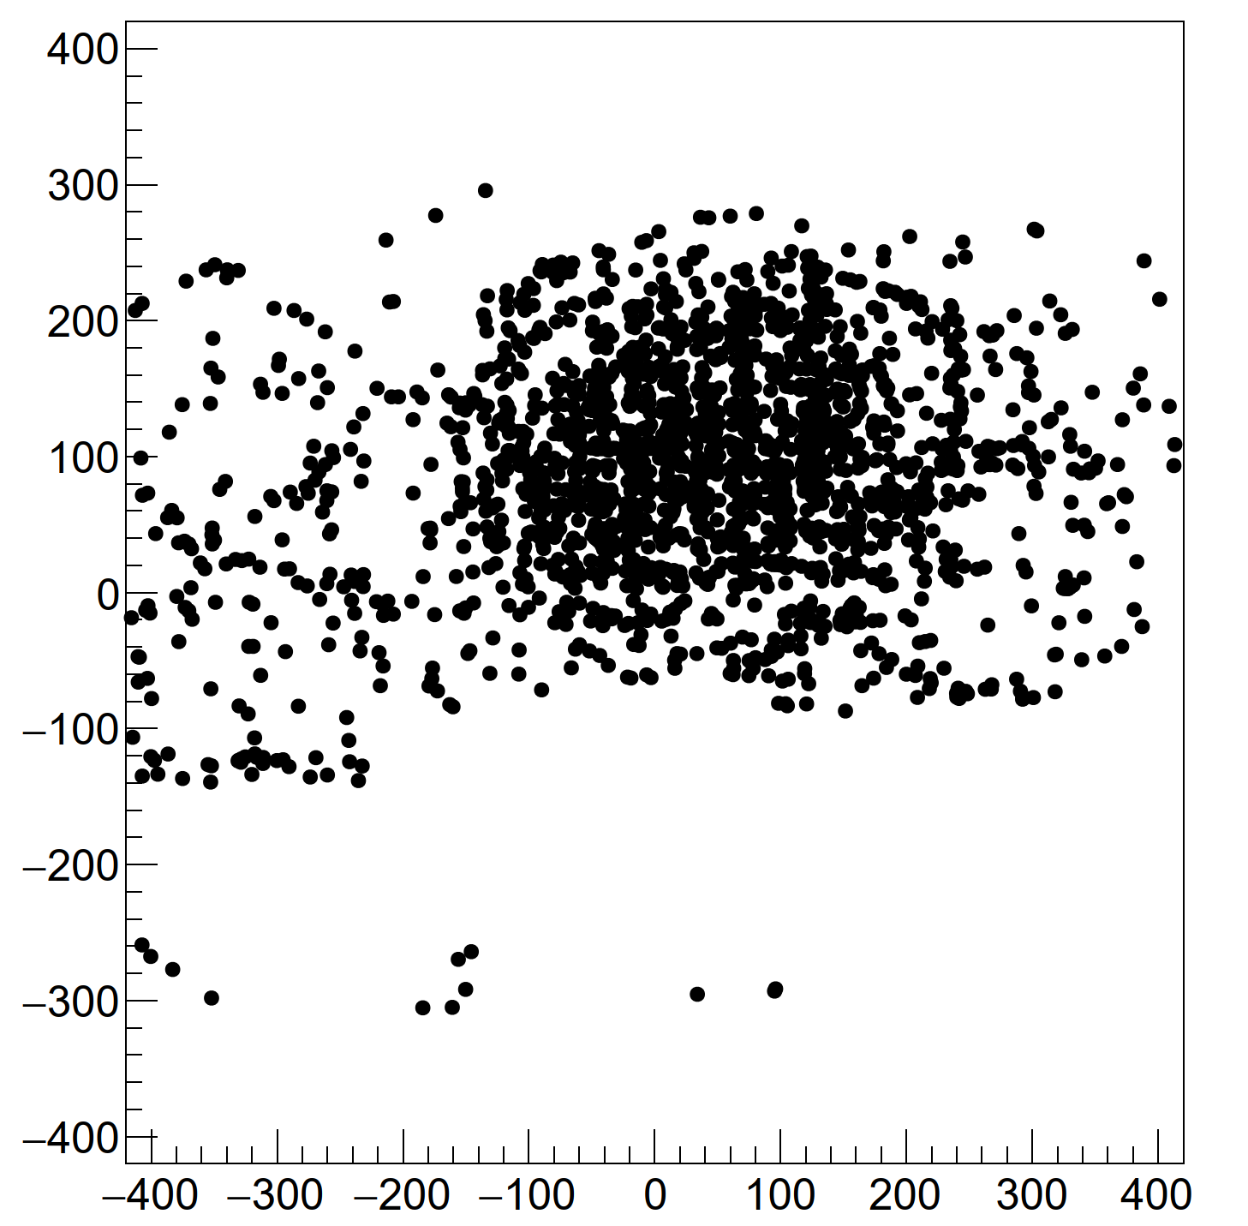
RICH data from simulation
mm
RICH1 TOP Plane
mm
RICH1 BOTTOM Plane
Y
Y
X
mm
X
mm
Y vs. X of the hit coordinates in the central region
of the detector plane in a single event in RICH1.
B-meson signal events, RUN3 simulations
Number of tracks ~ 215
Number of RICH1 hits ~ 5300

Slide 22
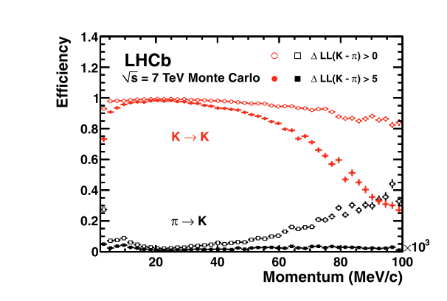
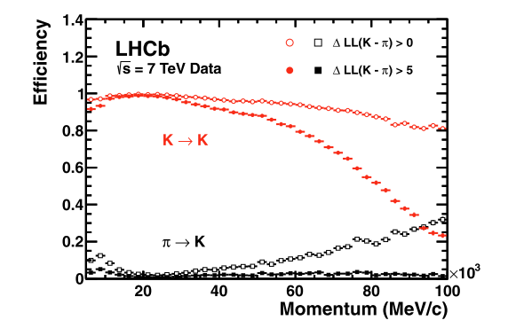
RICH data reconstruction
The reconstruction program is same for simulated and real data.
It is implemented within the Brunel application of the Gaudi software framework.
LHCb uses a log-likelihood algorithm for particle identification.
Ref: “RICH pattern recognition for LHCb”, R.Forty: Nucl. Inst. Meth. A 433 (1999) 257-261
Example of PID (particle identification) performances from simulation and real data, from 2011 configuration in RUN1.
Ref: “Performance of LHCb RICH detector at the LHC”, M.Adinolfi et.al., Eur. Phys. J.C. (2013) 73 : 2431

Slide 23
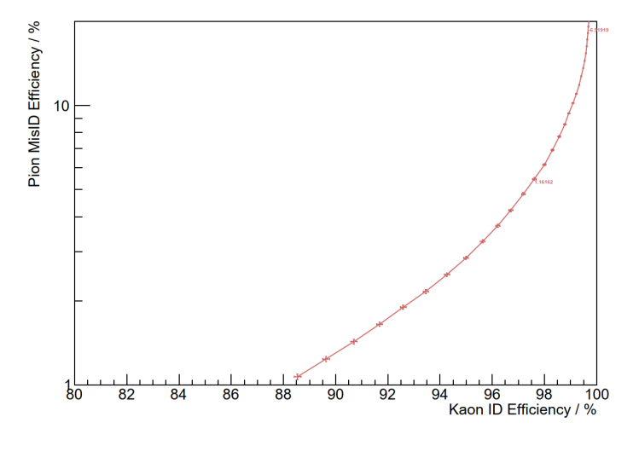
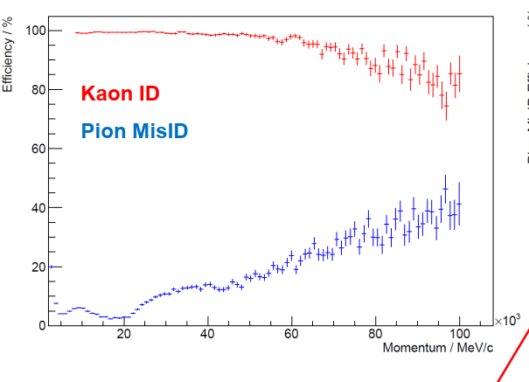
RICH data reconstruction
An example of PID performance expected for RUN3.
Δ LL (K-π)> 0.0
Δ LL (K-π)
PID performance averaged over the
momentum range 3-100 GeV/c
Each point corresponds to a different
cut on Δ LL (K-π)

Slide 24
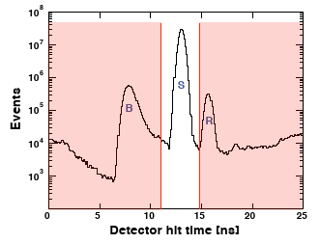
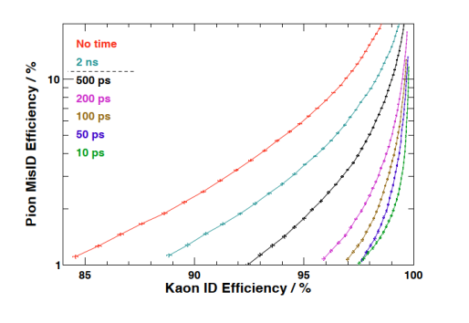
RICH Simulation: Using fast timing
In order to the reduce the backgrounds and improve the PID,
using the time gating of signals in hardware and software is useful.
For the designing the RICH for RUN3 and beyond, we are using the time
information of the hits, created in GEANT4.
We also simulate the processing times needed by the photon
detectors TTS (Transit Time Spread) and the readout.
An example of PID improvement with timing:
Hit time at RICH1

Slide 25

Prospects beyond the horizon
Updates for using DD4HEP structure for geometry description
Ray tracing of photons in simulation:
The LHCb simulations are run over billions of events in production runs.
Hence we try to optimize the CPU time wherever possible.
A major part of the CPU time taken for the RICH is from the transport of the optical photons in GEANT4.
Recently, the Daya Bay collaboration has successfully used GPUs to use ‘OptiX’ for the ray tracing of Cherenkov photons and achieved large gains in CPU time.
They interfaced ‘OptiX’ to GEANT4. Here the Cherenkov photon production and transport is done by ‘OptiX’ and the hits created are copied back into the GEANT4 structure. We are also in the process of moving towards using this.
GEANT4 is also looking into this.
In the distant future, there is also GEANTV, which aims to have
vectorized workflows for improving CPU time.

Slide 26
SUMMARY
The Gaudi framework is used for the software in LHCb, including the simulations of the RICH system.
The detector simulation is performed using GEANT4.
During the RICH simulation, Cherenkov photons are produced and transported through the optical geometry.
The RICH simulation has couple of custom made physics processes and various measures are taken to
optimize the CPU time.
Simulation studies are underway for using the ‘RICH hit time’ to improve the PID performance in the future.
There are also other developments foreseen for RICH simulation, making use of the modern GPUs.

Slide 27
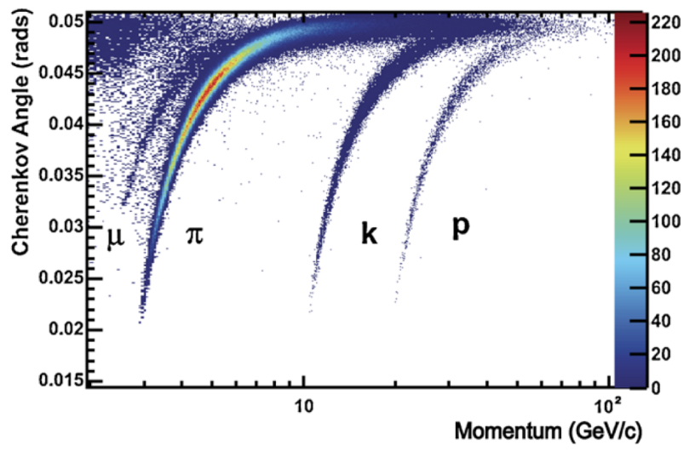
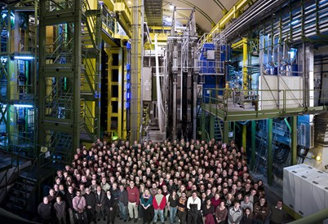
SUMMARY
I wish to acknowledge the support from my colleagues in LHCb and
especially from colleagues in the LHCb-RICH group.
I also received lot of useful help from our colleagues in the GEANT4 collaboration,
especially in the early days.
I hope this has some useful information for RICH simulation studies at the EIC detector.
Wish you all the success in that project ☺
EPJC (2013) ,73:2431
From RICH1 gas radiator

