Slide 1
sPHENIX MIE Overview
TPC | Project Director | Last CD Achieved | % Complete | CPI | SPI
$27.0M | Edward O’Brien | PD-2/3 | 44.3% BCWP/BAC @ 4/30/2019 | 1.03 | 0.90
Scope
Detector systems produced, tested and ready for installation: Time Projection Chamber w/ electronics, Electromagnetic Calorimeter w/ electronics, Hadronic Calorimeter w/ electronics, DAQ/Trigger, Minimum Bias Detector, Project Management
Not in scope
SC-Magnet, Bldg/Det Infrastructure, Installation and System Commissioning
Schedule
CD-0 received Sept 2016
CD-1/3A received Aug 2018
PD-2/3 received Sept 2019
Early completion Oct 2021 (14 months float to PD-4)
PD-4 Dec 2022
Cost
$27.0M AY TPC 38.9% contingency on BCWR

Slide 2
1008 Infrastructure & Facility Upgrade
TPC | Project Director | % Complete | CPI | SPI
$33.4 M AY | Edward O’Brien | 37.5% BCWP/BAC @ 4/30/2020 | 1.05 | 0.95
Scope
SC-Magnet support including the Flux Return, Cryogenics into Bldg 1008, Detector Carriage/Cradle, other Bldg 1008 Infrastructure improvements
sPHENIX Installation, Integration and Commissioning of each Subsystem is part of the scope
Not in Scope
PreOps prior to RHIC collisions
Schedule
sPHENIX Ready for Operations Oct 2022
First RHIC run of sPHENIX Feb 1, 2023
3.5 months float in schedule between sPHENIX ORR and nominal start of RHIC 2023 run.
Cost
$33.4 M AY Total Project Cost with 15.9% contingency on BCWR

Slide 3
sPHENIX Project Calendar
EMCal Sector 13-64 Electronics PRR Apr 8
ESRC review of sPHENIX cryo system Apr 9
TPC R3 GEM Pad plane Design Review Apr 16
TPC FEE Printed Circuit Board Review Apr 20
SAMPA v5 Performance Review (internal) Apr 27
Final Design Review Carriage X-Y Tables Apr 27
PRR revised beam pipe May 15
sPHENIX BHSO meeting May 20
L2 Managers’ meeting May 21
PRR for SAMPA v5 Production chips May 27
DOE Monthly May 27
EMCal installation fixture/ Large support rings Jun 10
LV/VAC power distribution to sPHENIX (internal) Jun 16
PRR for End Caps/Pole Tips mid-June
sPHENIX MIE Annual review (tentative) Wk of Jul 27

Slide 4
sPHENIX Technical Status
EMCal block factory has restarted at UIUC
Lund has sent 378 tested SAMPA v5 chips to BNL
We’ve received 3,000 EMCal SiPM daughter boards. Enough for ~ ½ the EMCal sectors.
TPC Fee preproduction pcb’s at BNL
OHCal tile production is restarted at Uniplast. The latest schedule has all OHCal tiles compete by mid-July.
~1300 tiles at Uniplast ready to ship to GSU
GSU HCal tile testing facility expected to reopen in early June. GSU plans to reopen June 1.
Delivery date for W powder is June 5.
We have been able to add 2.25 FTEs of Mech Eng to the I&F effort over the last month (2 junior engineers, 1 mid-career, 1 senior engineer)
CAD contract with outside vendor for 1008 floor-loading calculation awarded.
Should have preliminary results on floor loading in 1-2 weeks.
We will continue to hold remote reviews for major orders
Continue monthly status, EV, PCR for both 1.X and 2.X
Our priority upon BNL reopening is testing of electronics, especially the EMCal SiPM daughter cards, restart of the EMCal and HCal factories, continued cable production and assembly of prototype racks.
Expect that even if most of our group is allowed back on site that most will be encouraged to work remotely whenever possible.

Slide 5
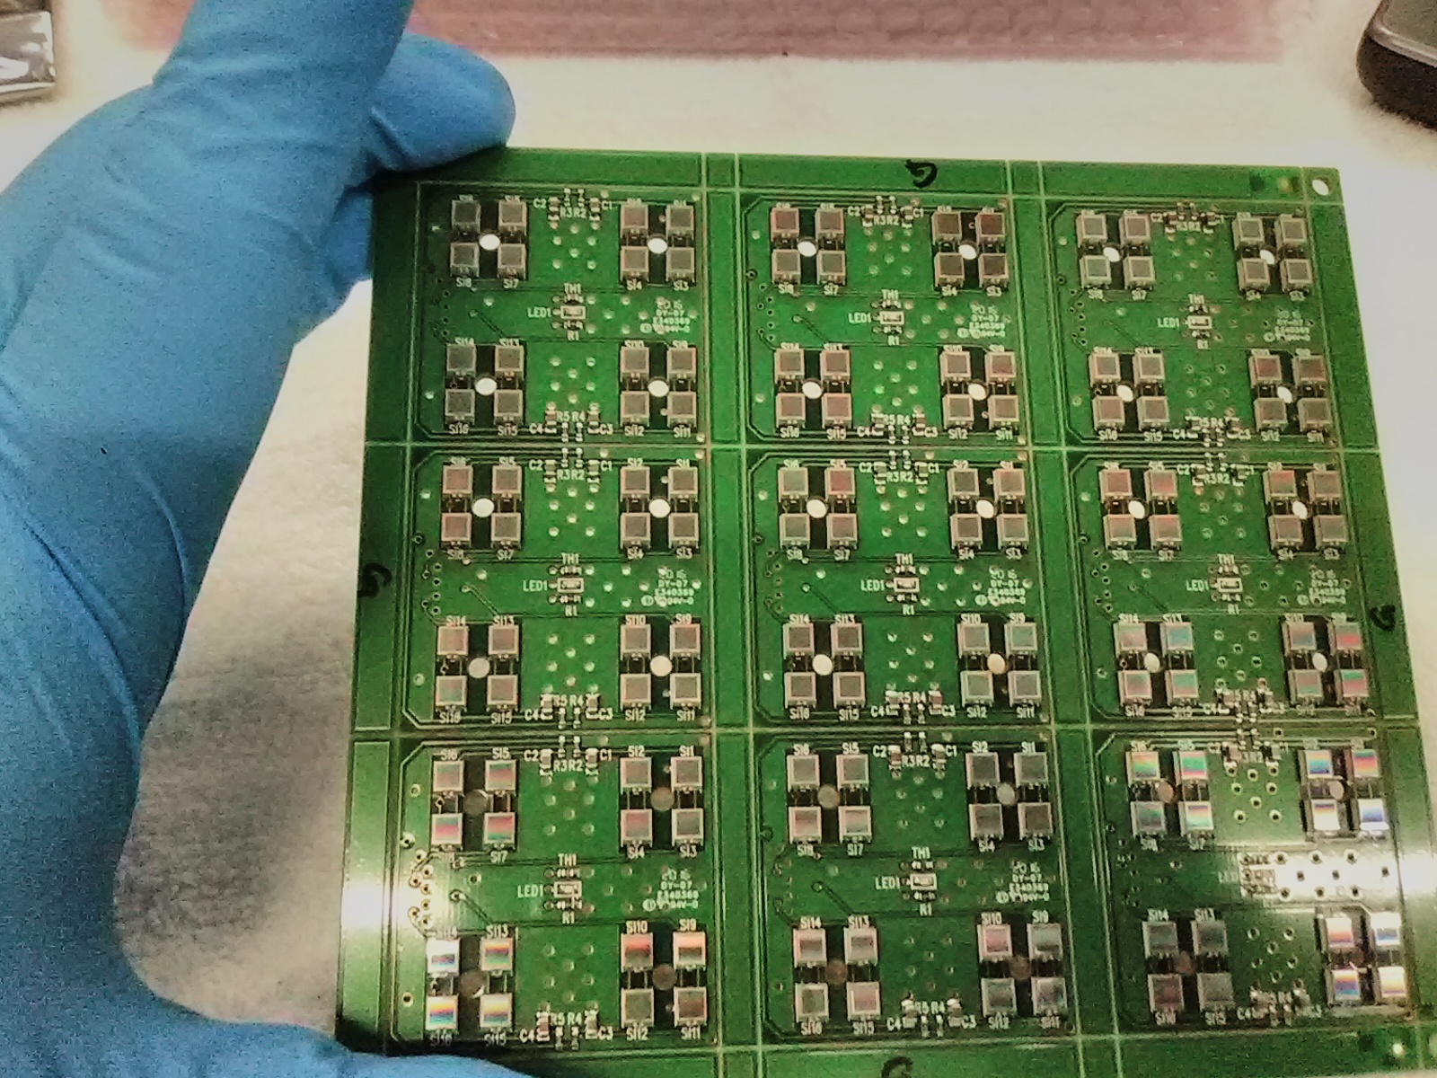
Si Photomultiplier Daughter Boards
3000 SiPM DBs at BNL.
Enough for ~ 50% of the EMCal sectors including the preproduction sectors.
Once testing is complete will order the balance of the production SiPM cards

Slide 6
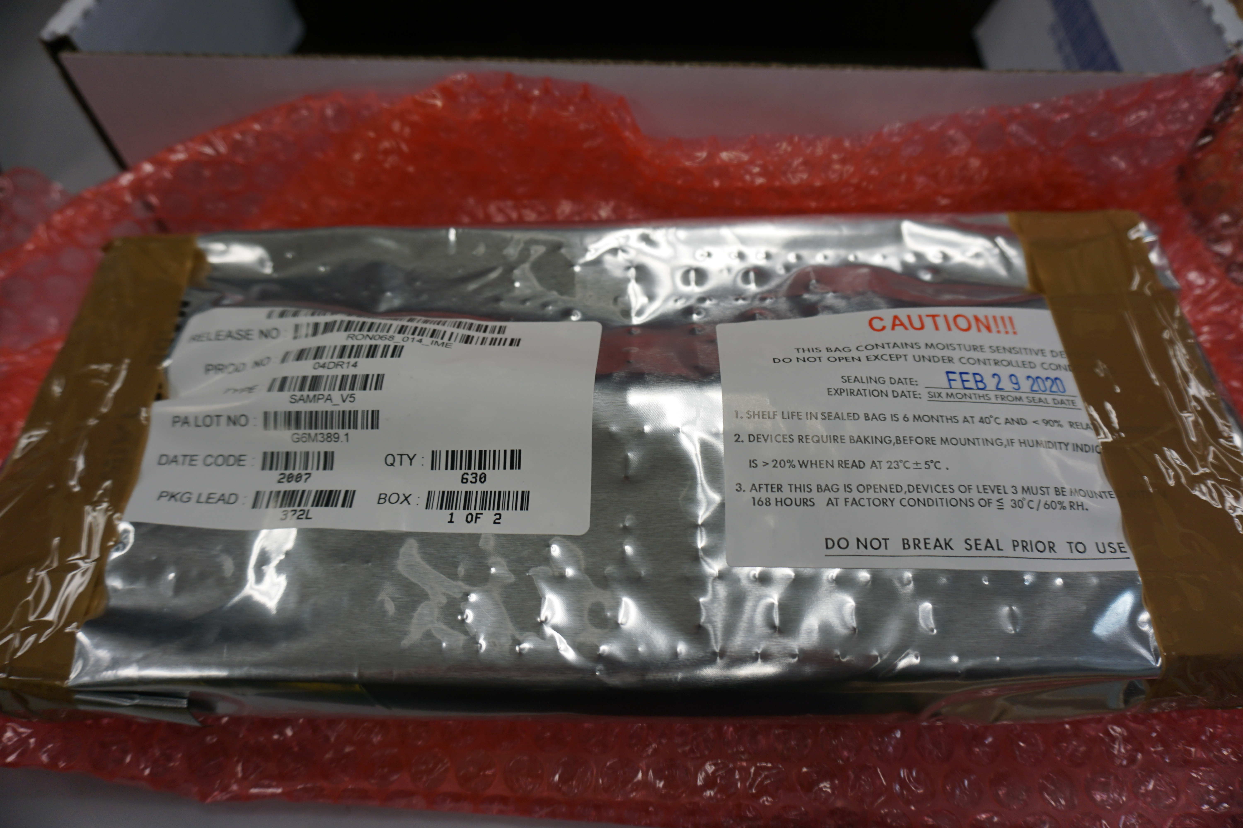
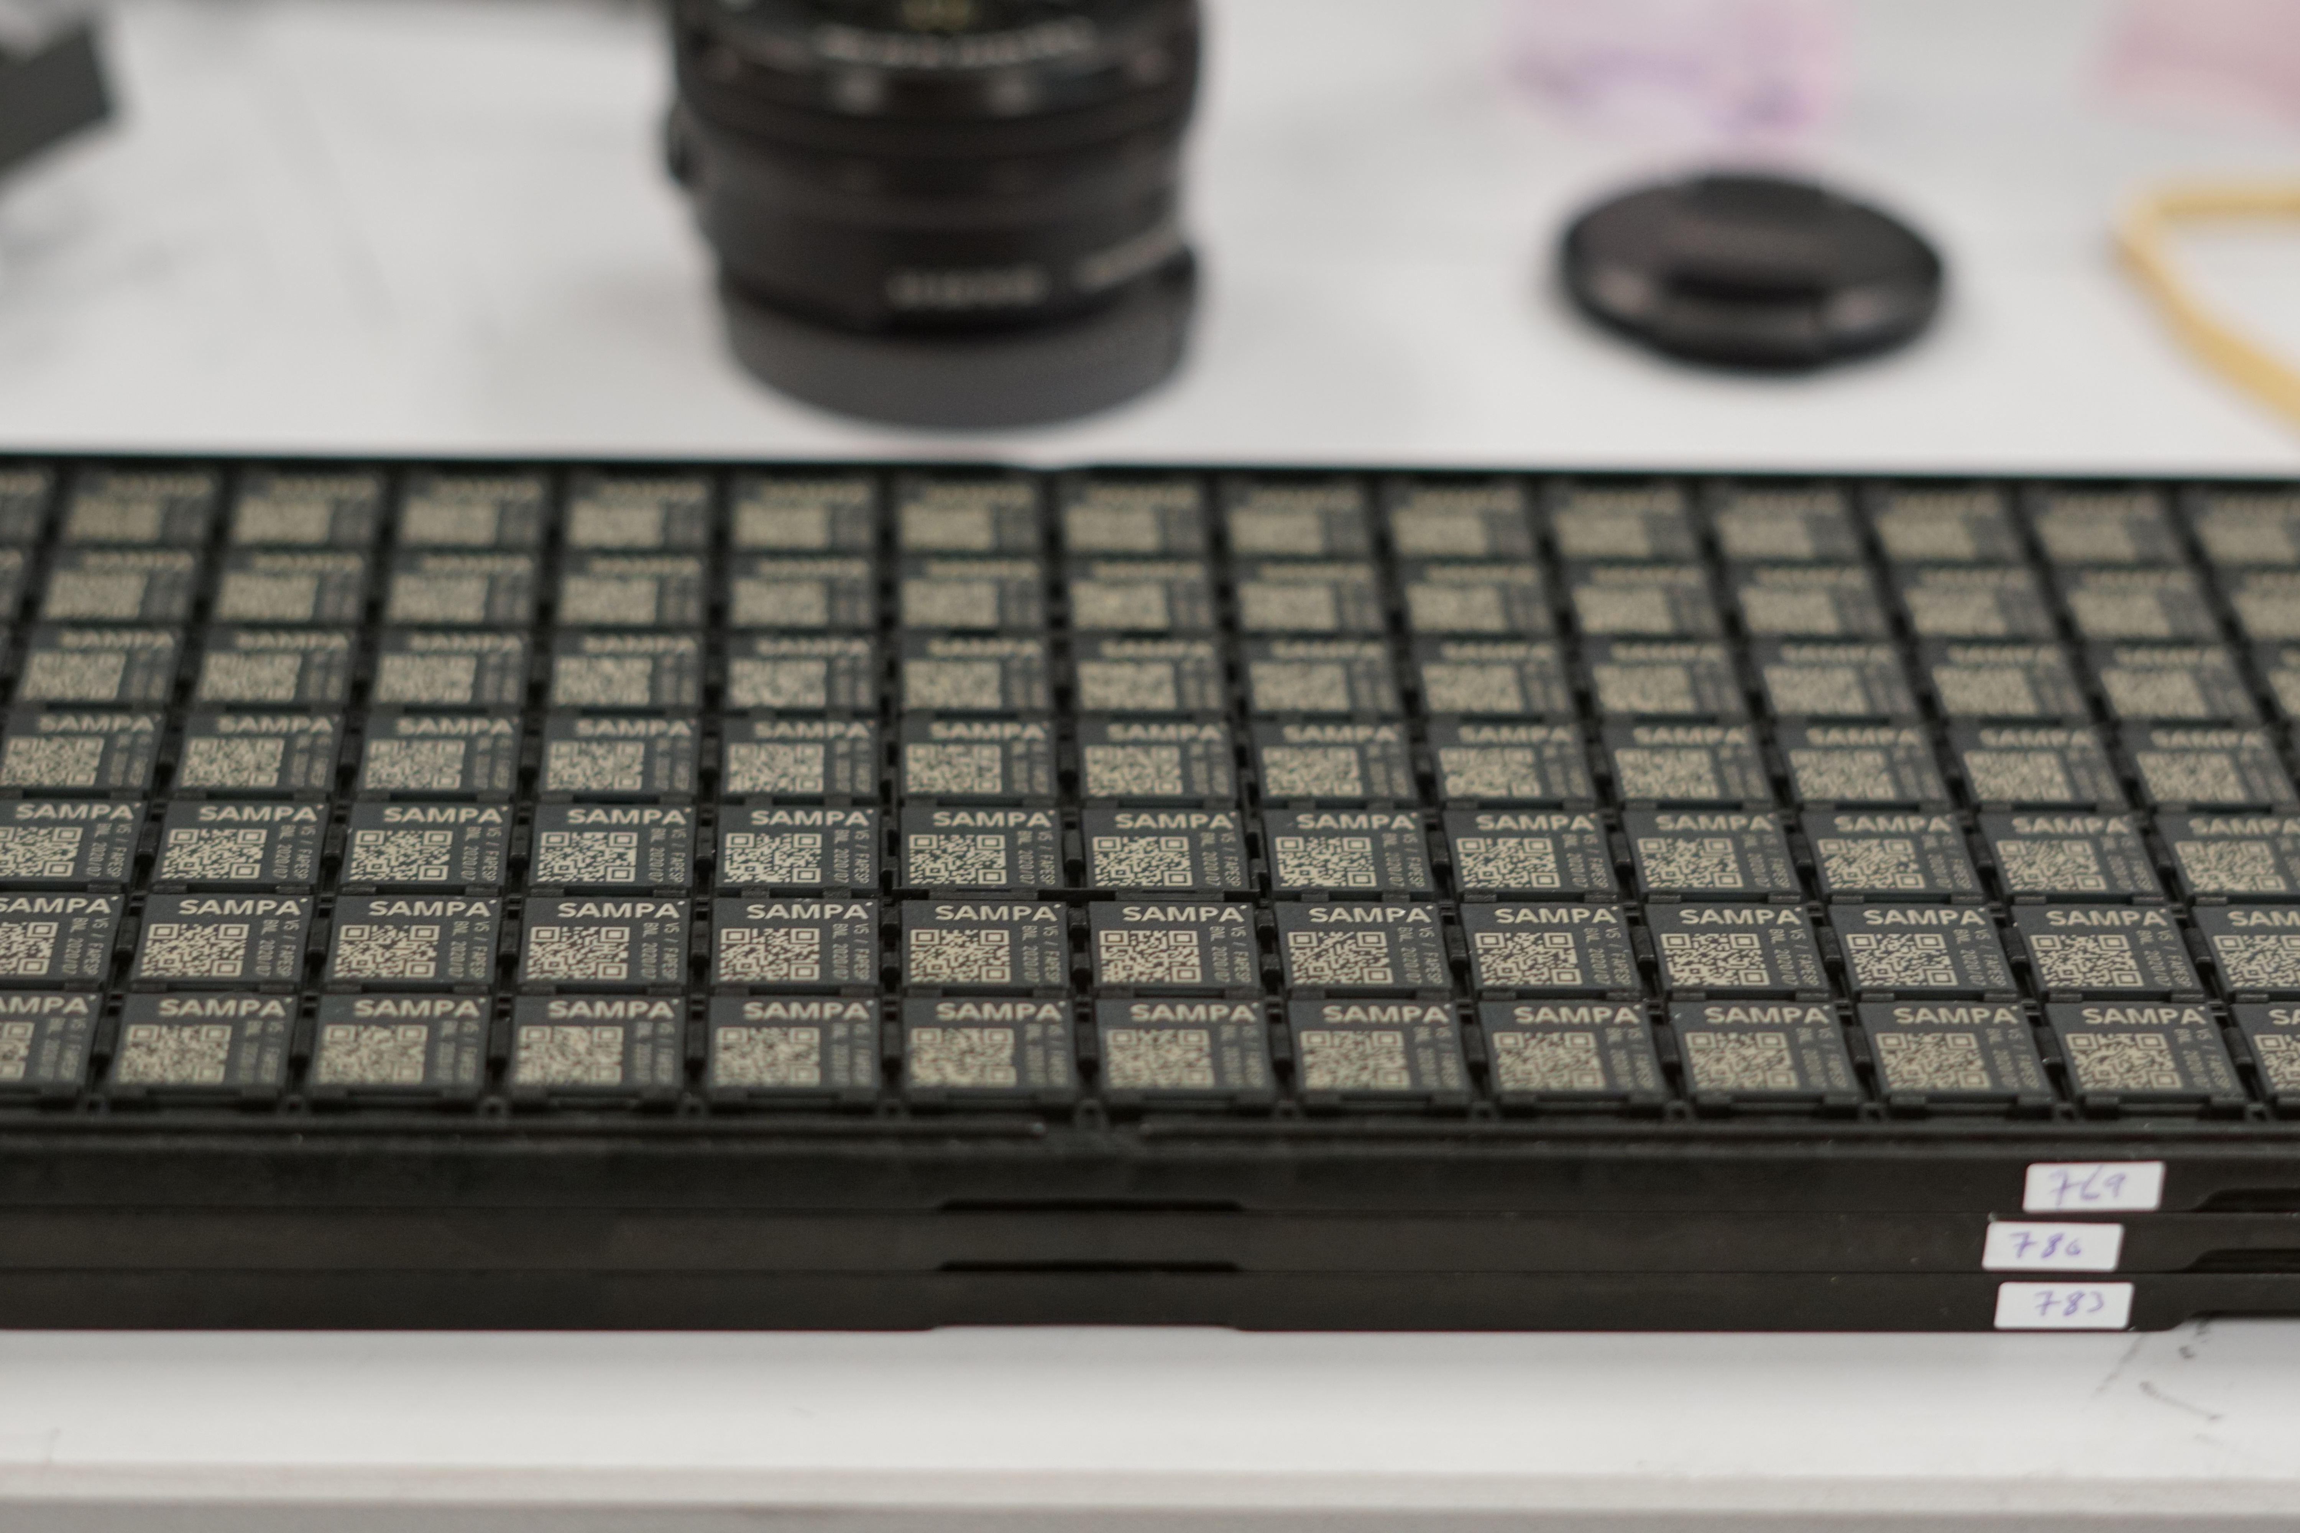
SAMPA v5 chips at BNL. Tested at Lund
Received 378 ASICs from LUND
6

Slide 7
EMCal Block Factory Production at UIUC
The UIUC EMCal block factory restarted May 4 after a pause starting March 23
Progress in fiber-filling, block potting and block testing at UIUC.
48 new blocks sent from UIUC to BNL last week.

Slide 8
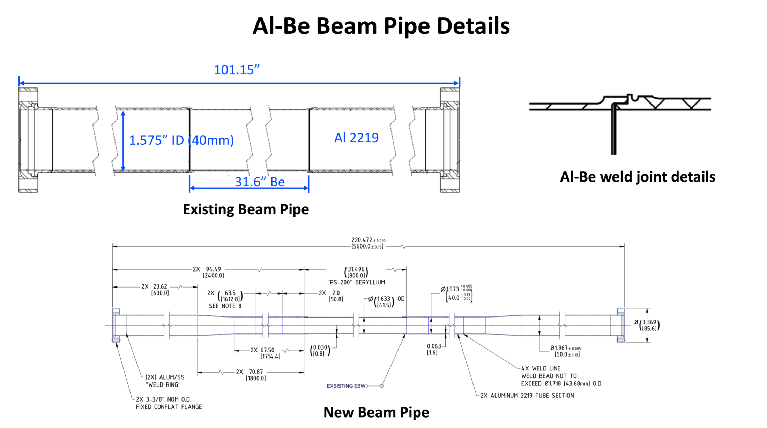
Revised Be Beam Pipe Design to Accommodate Si Detectors
Sumanta Nayak from CAD is leading this effort

Slide 9
FY20 Milestones Status (FY20 PEMP notable)
WBS | Milestone Name | Target Milestone Date | Actual Finish | Variance (in work days)
1.01.01 | Approve Project Baseline and Construction PD2/3 | 30-Sep-19 | 20-Sep-19 | 6
1.02.02.02 | Production Readiness Review - TPC Module Factories | 31-Dec-19 | 17-Dec-19 | 8
1.03.02.03.02 | EMCal Preproduction Sector 0 Assembled | 31-Dec-19 | 25-Nov-19 | 23
1.02.06.02 | Production Readiness Review - TPC DAM | 28-Feb-20 | 7-Feb-20 | 14
1.05.02.03 | HCal Preproduction FEE Complete | 30-Apr-20 | 22-Jan -20 | 70
1.05.02.01 | EMCal Electronics Preproduction Complete | 29-May-20
1.03.01.03.01 | EMCal W Powder Acquisition Complete | 30-Jun-20
1.03.02.03.03 | EMCal Prod Readiness Review Blocks/Modules/Sectors Complete | 31-Jul-20
1.02.05.03 | SAMPA ASIC Performance Accepted | 30-Sep-20
All the electronics at BNL. SiPM DB 1st article passed tests
Due at UIUC June 5
We must evaluate due date when BNL reopens
All internal tests passed. Review yesterday.

Slide 10
FY20 Milestones Details
EMCal preproduction electronics
All electronics for EMCal sectors 1-12 at BNL. All has been tested and shown to be good with the exception of the SiPM daughter cards for sectors 1-12. The first article (1 sector’s work) of SiPM DB tested good in Jan – Feb. However we have been unable to test the SiPM DBs for sectors 2-12 due to the COVID-19 pause. We have the all the DBs at BNL and can test them as soon as BNL reopens. Based on the fact that the first article boards tested good and all components that go into the assembled boards are tested and accepted by the manufacturer prior to assembly, we have concluded that we have met this milestone
SAMPA v5 chip
Tests performed at USP and Lund on the SAMPA v5 engineering run chips shows that the ASIC meets all performance specs. We held a PR review today and the committee agrees that we have a good chip. We have concluded that we have met this milestone.

Slide 11
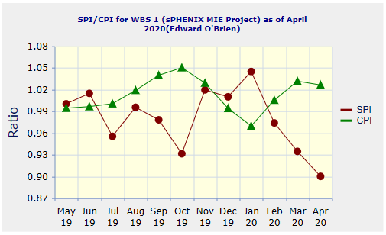
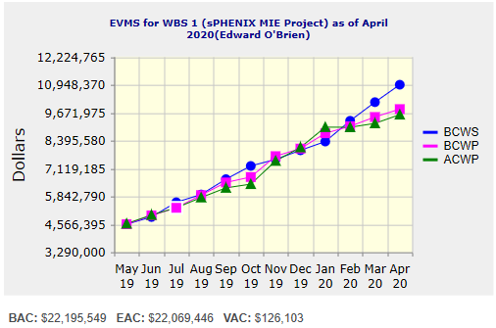
Performance Indices – sPHENIX MIE
Cumulative SPI | Cumulative CPI
0.90 | 1.03
Cumulative BCWS (Scheduled) | $10,954,574
Cumulative BCWP (Performed) | $9,838,781
Cumulative ACWP (Actual) | $9,585,800
DOE SPI or CPI Value Thresholds
0.90 to 1.15
0.85 to 0.89 or 1.16 to 1.25
<0.85 or >1.25

Slide 12
sPHENIX Cost Performance Report (CPR)
DOE SPI or CPI Value Thresholds
> 0.90
0.85 to 0.89
< 0.85 or > 1.25

Slide 13
Milestones Status – sPHENIX MIE
# | WBS | Milestone Name | Target Milestone Date | Forecast | Actual Finish | Variance (in work days) | Comments
1 | 1.01.01 | Approve Project Baseline and Construction PD2/3 | 30-Sep-19 | 20-Sep-19 A | 20-Sep-19 | 6
2 | 1.02.02.02 | Production Readiness Review - TPC Module Factories | 31-Dec-19 | 17-Dec-19 A | 17-Dec-19 | 8
3 | 1.03.02.03.02 | EMCal Preproduction Sector 0 Assembled | 31-Dec-19 | 25-Nov-19 A | 25-Nov-19 | 23
4 | 1.02.06.02 | Production Readiness Review - TPC DAM | 28-Feb-20 | 04-Feb-20 A | 4-Feb-20 | 16
5 | 1.05.02.03 | HCal Preproduction FEE Complete | 30-Apr-20 | 22-Jan-20 A | 22-Jan-20 | 70
6 | 1.05.02.01 | EMCal Electronics Preproduction Complete | 29-May-20 | 28-May-20 |  | 0
7 | 1.03.01.03.01 | EMCal W Powder Acquisition Complete | 30-Jun-20 | 15-Jun-20 |  | 11
8 | 1.03.02.03.03 | EMCal Production Readiness Review Blocks/Modules/Sectors Complete | 31-Jul-20 | 25-Jun-20 |  | 24
9 | 1.02.05.03 | SAMPA ASIC Performance Accepted | 30-Sep-20 | 1-Jun-20 |  | 84
10 | 1.05.01 | EMCal/HCal SiPM Sensor Procurement Complete | 30-Oct-20 | 28-Feb-20 A | 28-Feb-20 | 171
11 | 1.05.02.04 | HCal SiPM Boards Assembly Complete | 30-Nov-20 | 24-Jun-20 |  | 106
12 | 1.02.06.03 | TPC DAM Felix 2.0 Production Complete | 29-Jan-21 | 28-May-21 |  | -85
13 | 1.06.02.03 | Trigger LL1 Preproduction complete | 26-Feb-21 | 29-Jan-21 |  | 18
14 | 1.05.02.02 | EMCal SiPM Boards Production Complete | 31-Mar-21 | 17-Dec-20 |  | 69
15 | 1.04.04.02 | First Outer HCAL Sector and Splice Plates Ready to Install | 30-Apr-21 | 15-Sep-20 |  | 154
16 | 1.04.01 | Inner HCAL Support Structure Ready for Installation | 30-Apr-21 | 19-Mar-21 |  | 29
17 | 1.02.01.06 | GEM Production Complete | 31-May-21 | 19-Nov-20 |  | 130
18 | 1.03.01.03.01 | EMCal Scintillating Fiber Acquisition Complete | 31-May-21 | 5-Apr-21 |  | 39
19 | 1.06.01.03 | DAQ Production: DAQ Ready for Operation | 31-May-21 | 6-Oct-21 |  | -90
20 | 1.05.02.04 | HCal Electronics Complete: Production | 30-Jun-21 | 19-Jan-21 |  | 113
21 | 1.02.05.04 | TPC FEE Production Complete | 30-Jul-21 | 24-May-21 |  | 46
22 | 1.05.03.02 | Calorimeter Electronics Complete | 30-Jul-21 | 29-Jun-21 |  | 21
23 | 1.05.02.02 | EMCal Electronics Complete | 30-Jul-21 | 15-Mar-21 |  | 96
24 | 1.07 | MinBias Detector Ready to Install | 30-Sep-21 | 7-Oct-21 |  | -6
25 | 1.06.03.03 | GL1 Ready to Operate | 30-Sep-21 | 21-Oct-21 |  | -15
26 | 1.01.01 | Early Project Completion | 29-Oct-21 | 25-Oct-21* |  | 4
27 | 1.02.01.08 | TPC Ready to Install (Assembly Complete) | 29-Oct-21 | 3-Sep-21 |  | 37
28 | 1.02.06.03 | TPC DAM Production Complete | 29-Oct-21 | 6-Oct-21 |  | 15
29 | 1.03.02.03.03 | EMCal Ready to Install | 29-Oct-21 | 22-Oct-21 |  | 4
30 | 1.04.04.02 | Last Outer HCAL Sector Ready to Install | 29-Oct-21 | 7-May-21 |  | 120
31 | 1.06.02.04 | LL1 Trigger Production Complete | 29-Oct-21 | 19-Oct-21 |  | 7
32 | 1.06.02.04 | LL1 Ready to Operate | 29-Oct-21 | 19-Oct-21 |  | 7
33 | 1.01.01 | Approve Project Closeout PD-4 | 30-Dec-22 | 29-Dec-22* |  | 0

Slide 14
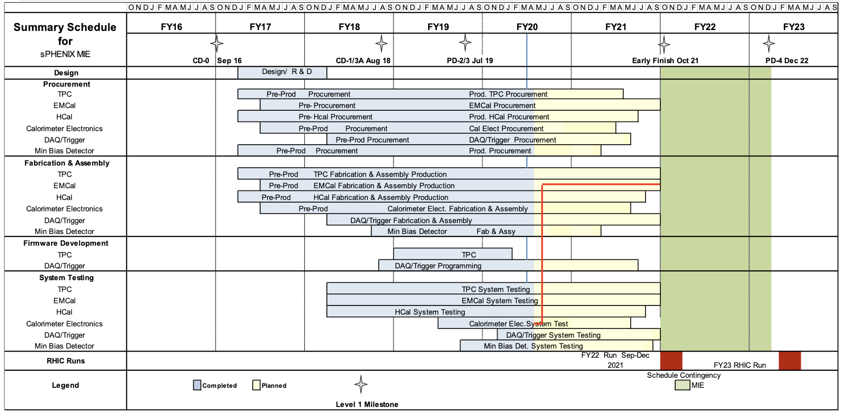
Summary Schedule

Slide 15
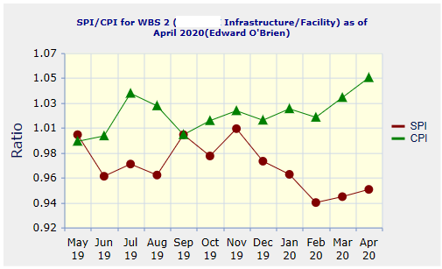
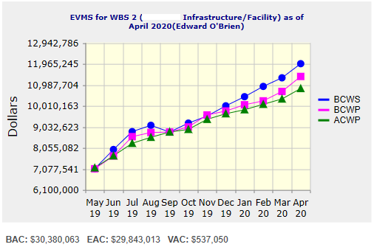
Performance Indices – 1008 Infra and Facility Upgrade
Cumulative SPI | Cumulative CPI
0.95 | 1.05
Cumulative BCWS (Scheduled) | $11,975,144
Cumulative BCWP (Performed) | $11,380,814
Cumulative ACWP (Actual) | $10,821,215
DOE SPI or CPI Value Thresholds
0.90 to 1.15
0.85 to 0.89 or 1.16 to 1.25
<0.85 or >1.25

Slide 16
Cost Performance Report (CPR) – 1008 Infra and Facility Upgrade
DOE SPI or CPI Value Thresholds
0.90 to 1.15
0.85 to 0.89 or 1.16 to 1.25
<0.85 or >1.25

Slide 17
Summary Schedule – sPHENIX MIE & 1008 Infra and Facility Upgrade

Slide 18
Milestones Status – 1008 Infra and Facility Upgrade
# | WBS | Milestone Name | Target Milestone Date | Forecast | Actual Finish | Variance (in work days) | Comments
1 | 2.03.03 | Completion of Outer HCAL Sector Mechanical Structure Procurement | 30-Sep-19 | 03-Sep-19 A | 3-Sep-19 | 19
2 | 2.02.03.04.01 | Completed - (Controls Hardware) Power distribution drawings | 31-Oct-20 | 25-Aug-20 |  | 46
3 | 2.03.01 | Completed - Steel Track Modifications | 30-Nov-20 | 8-Oct-20 |  | 32
4 | 2.03.02 | Magnet Supports Released for Production (Milestone) | 31-Jan-21 | 10-Feb-21 |  | -8
5 | 2.04.02.01 | Magnet cryo, electrical and control structural support components Ready for Installation | 31-Mar-21 | 5-Feb-21 |  | 36
6 | 2.03.02 | Inner HCal Support Tabs Components Ready for Installation | 31-Mar-21 | 8-Jun-21 |  | -49
7 | 2.05.04 | Outer HCal Sectors Ready for Installation | 30-Apr-21 | 15-Sep-20 |  | 154
8 | 2.03.01 | Carriage Cradle - Components Ready for Installation | 31-May-21 | 24-Feb-21 |  | 67
9 | 2.03.05 | CC Bridge, Mid Platforms & Access - Ready for Installation | 31-Oct-21 | 20-May-21 |  | 112
10 | 2.02.03.02.04.02 | Completed - Procure LN2 supply transfer line system - Phase 5 - Shipping - Delivery Acceptance | 30-Nov-21 | 1-Oct-21 |  | 37
11 | 2.05.05 | Completed - Install SC Magnet on Cradle | 30-Nov-21 | 17-Sep-21 |  | 47
12 | 2.04.02.06 | Assembly Hall Components Ready for Installation | 30-Nov-21 | 16-Sep-21 |  | 48
13 | 2.04.01.03 | Detector Electronics Racks and Rack generic support systems Components Ready for Installation | 30-Nov-21 | 6-Jan-22 |  | -26
14 | 2.04.01.05 | Detector Safety Subsystems Components Ready for Installation | 31-Dec-21 | 21-Dec-21 |  | 6
15 | 2.02.02 | Completed - Magnet and Solenoid Valvebox - Reinstall | 31-Jan-22 | 8-Nov-21 |  | 53
16 | 2.05.04 | Completed - Install Remainder of Outer HCal Sectors | 31-Jan-22 | 16-Nov-21 |  | 48
17 | 2.05.03 | Completed - Install platforms & access | 28-Feb-22 | 16-Dec-21 |  | 47
18 | 2.05.07 | Completed - Install EMCal Sectors | 31-Mar-22 | 6-Jan-22 |  | 57
19 | 2.05.03 | Completed - Install Pole Tips | 31-May-22 | 30-Mar-22 |  | 42
20 | 2.02.03.01.06 | RHIC Helium Interface - Installation complete | 30-Jun-22 | 4-May-22 |  | 39
21 | 2.02.03.04.03 | (Cryo Controls Hardware) Hardware Installed | 30-Jun-22 | 6-Apr-22 |  | 59
22 | 2.02.01.02 | Magnet is operational | 31-Jul-22 | 15-Jun-22 |  | 31
23 | 2.02.05.03 | Completed - Magnet Field Measurements: Map Magnetic Field of SC Magnet | 31-Aug-22 | 7-Jul-22 |  | 38
24 | 2.05.08 | Completed - Install TPC | 30-Sep-22 | 26-Jul-22 |  | 46
25 | 2.05.11 | Completed - Install Min Bias | 31-Oct-22 | 26-Aug-22 |  | 43
26 | 2.05.10 | Completed - Install MVTX | 30-Nov-22 | 4-Oct-22 |  | 36
27 | 2.05.12 | sPHENIX Ready for Operations | 30-Nov-22 | 12-Oct-22 |  | 31

Slide 19
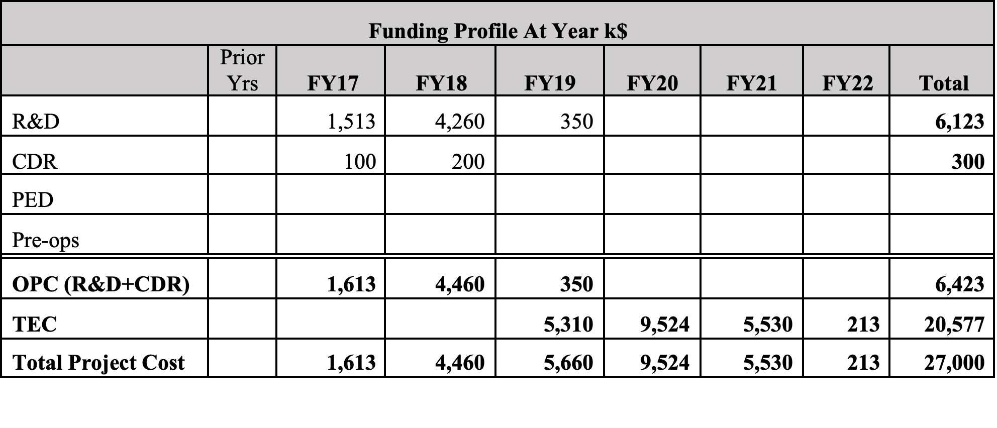
Baseline Budget Profile
100% of FY20 funds received

Slide 20
Plans for BNL Reopening
BNL has begun planning for gradual restart and increase in employees on site May 29 (at the earliest).
Start date will be linked to NYS approval to gradually reopen businesses in Suffolk county which is May 29.
The earliest we will likely be able to restart EMCal and HCal factories is phase -2 (mid June)
Aspects of the BNL restart will be:
Low density tech work in the labs
Required face coverings when outside of office or lab, or more than 1 worker.
Whenever possible maintain people working remotely
All meetings would continue to be remote
Current BNL Guidance on restart
BNL begins a methodical transition of critical staff returning to work throughout the months of June and July, with extended telework agreements remaining in place. At the macro-level, onsite staffing might resemble the following:
Up to May 29 – 250 FTEs (~10% of total FTEs)
Reopen Day 0 – 400 FTEs (~15% of total FTEs)
Reopen Day 15 – 500 FTEs (~20% of total FTEs)
Reopen Day 30 – 650 FTEs (~25% of total FTEs)
Reopen Day 45 – 1000 FTEs (~40% of total FTEs)
Reopen Day 60 – 1300 FTEs (~50% of Total FTEs)
All dates subject to change

Slide 21
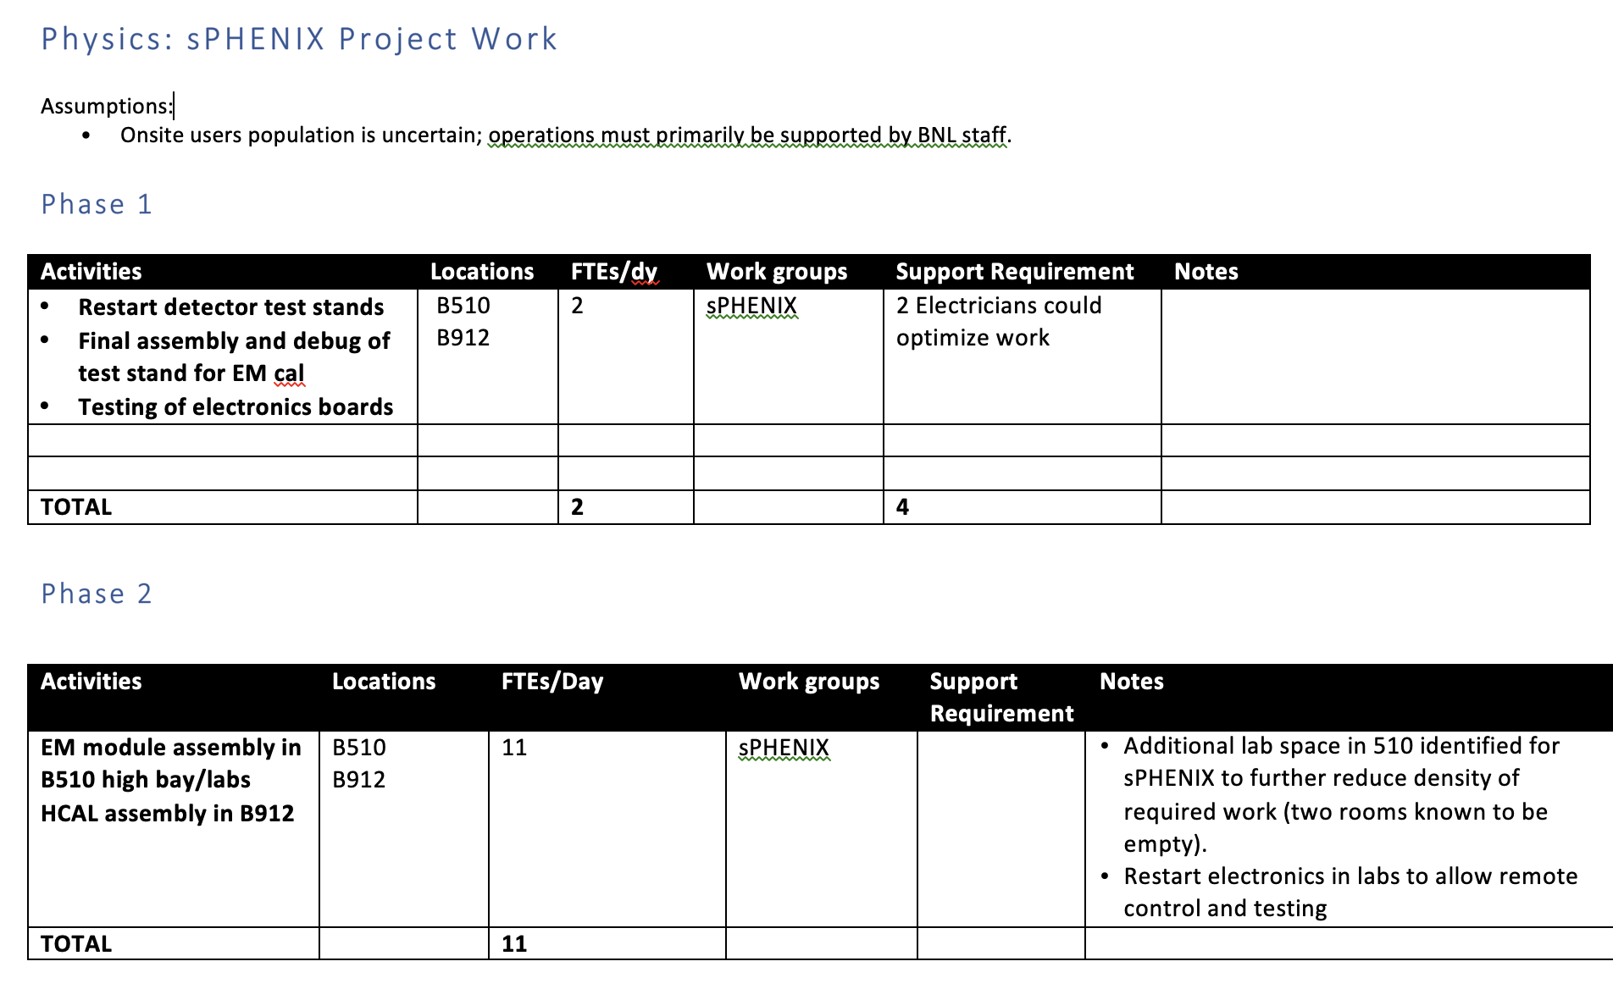
sPHENIX Restart Request

Slide 22
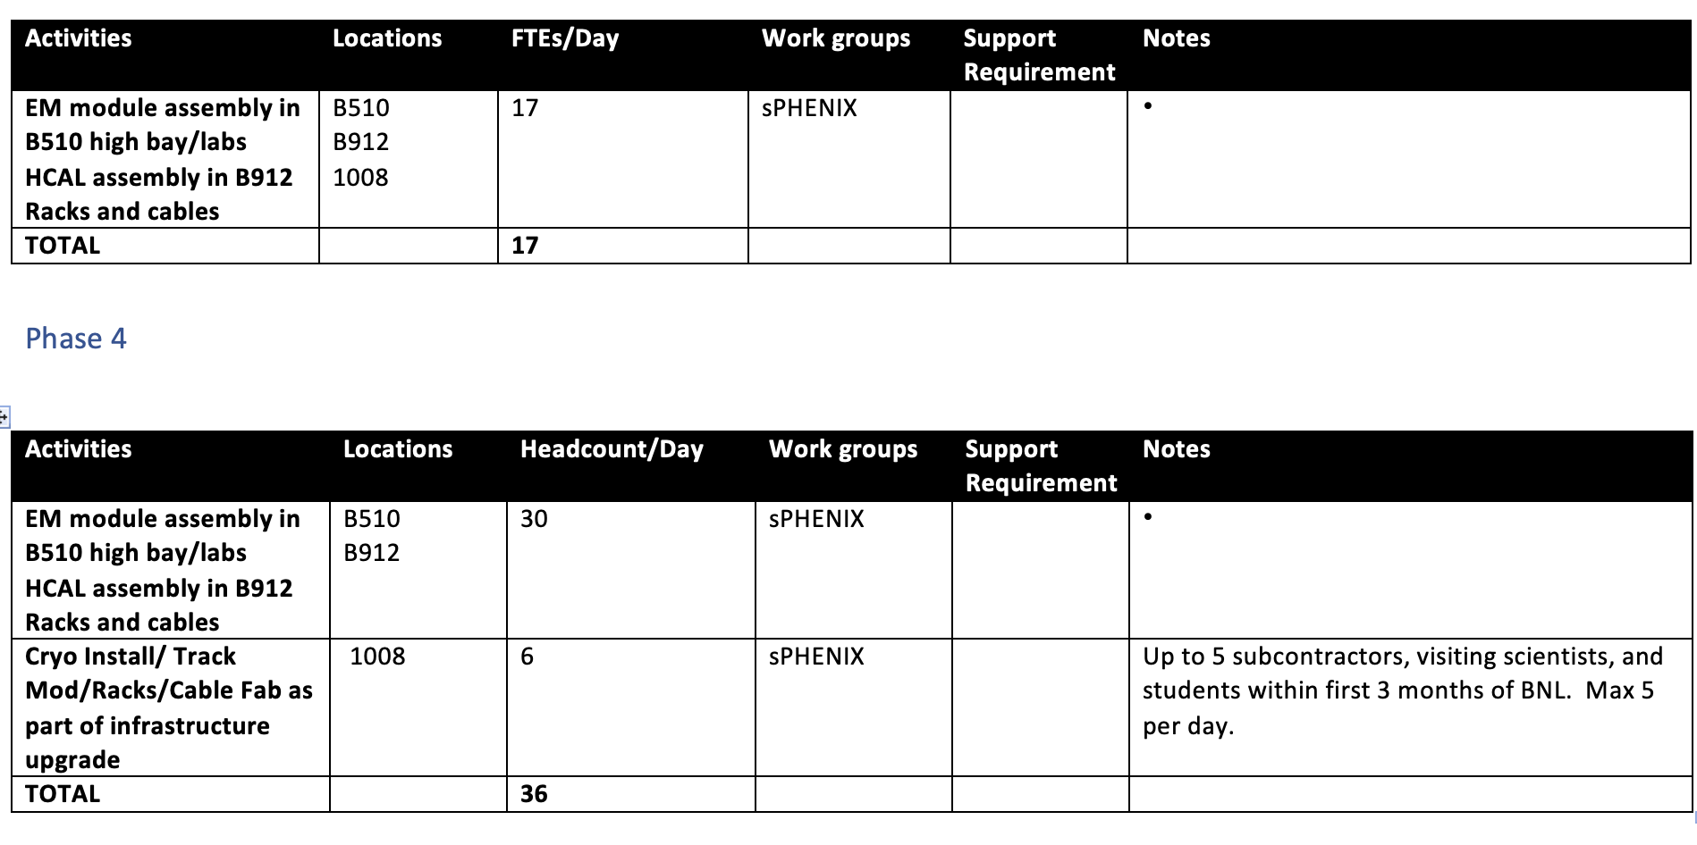
sPHENIX Restart Request
Phase 3

Slide 23
Plans for Continuation of RHIC 2020 Run
BNL has announced the final 12 weeks of the RHIC 2020 run will start as soon as practical. Tentative start date June 1 but could be delayed if BNL reopening is delayed. Driven by a use the RHIC Ops funds or lose them.
However this will impact time available for sPHENIX to work in the 1008 IR between now and 2023.
Tying in the He system in 1008B to RHIC 2021 shutdown ( 8 weeks)
Hanging the helium transfer lines on the 1008 west wall 2020 shutdown (12 weeks)
Installing cryo lines between 1008B and 1008 2020 shutdown (12 weeks)
Concrete work on 1008 IR tracks 2020 shutdown (12 weeks)
We have asked BNL Management for 34 weeks of access to the IR to complete these 4 tasks. The 34 weeks would include one contiguous 24 weeks period after the 2020 run, and 10 weeks between the 2021 and 2022 run.
Need to schedule a meeting with CAD for detailed scheduling of this work especially personnel assign to the work.

Slide 24
Where sPHENIX Can Use BNL Help
From April PMG:
Help us identify sources of a pulse of technical labor for the next 9-12 months to catch-up time lost due to COVID-19 (10-15 FTEs combined of technicians, engineers, designers and computer professionals). Ideally this would be from inside BNL but one could consider temporary hires or using people (perhaps remotely) from other parts of the SC complex.
Have:
In the past month, with Jamie and Jim Desmond’s agreement we have added 2.25 ME’s (1 yr) and opened reqs for 2 postdocs. The sPHENIX project team are advocating that the postdocs to have a strong software/det hardware skill set. We have started interviewing to fill a I/5-7 position.
Need:
The need for the next year is in 1008 for the cryo installation (mech techs and welders), track reinforcement (engineering oversight), 1 additional electrical tech for 1008 racks, 2 mech techs(possible jobshoppers) in the 510 EMCal factory to make up lost time during the pandemic work pause.
We are still light(1-2 FTEs) on DAQ/Computer skills with both John and Irina being full time management.

Slide 25
Summary
Work continues on sPHENIX at BNL and collaborating institutions though on site activities have stopped at BNL and many collaborating institutions due to the work- pause associated with the worldwide pandemic. sPHENIX design work, procurements, simulations, reviews, continue remotely.
We have a large team of engineers and designers working on the design of the sPHENIX MIE.
Some sPHENIX institutions have reopened (UIUC) or remained open (Lund) during the pandemic.
Many vendors are considered essential industries and continue to work and produce parts for sPHENIX.
Many critical parts continue to be produced in industry during the pandemic including OHCal tiles, electronics, mechanical components produced at machine shops, specialized plastics.
We will re-plan the project file (PCRs) once BNL and collaborating universities reopen. The early completion date remains unchanged for April but will likely slip by the May report.
PD-4 date of Dec 2022 will be unaffected due to the 14 months of float between early completion and PD-4.
We have an sPHENIX restart plan that will evolve as the BNL restart plan solidifies.
Once BNL is reopen and at Phase-4 an infusion of labor will help the schedule, particularly for the shutdown activities between the next RHIC runs.
sPHENIX continues to make good progress even with BNL and many universities and labs in a “work pause” mode. We are working efficiently in remote-work mode.

Slide 26
Back Up

Slide 27
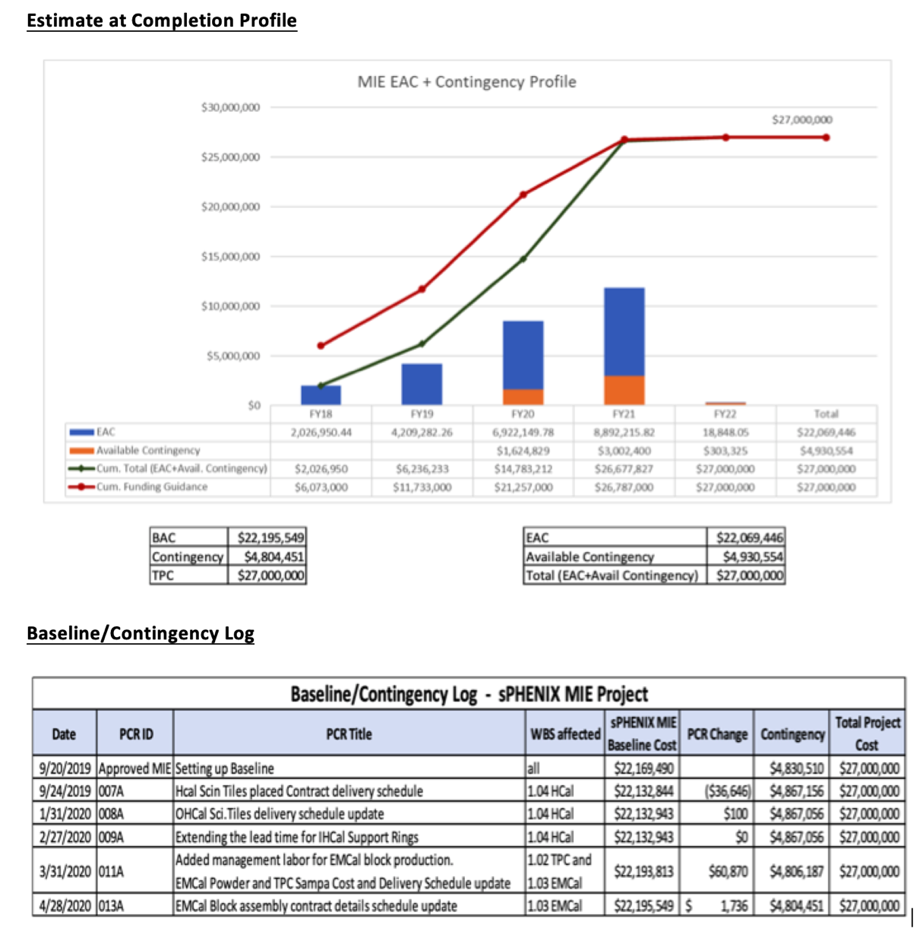
MIE: EAC Profile and PCR Log

Slide 28
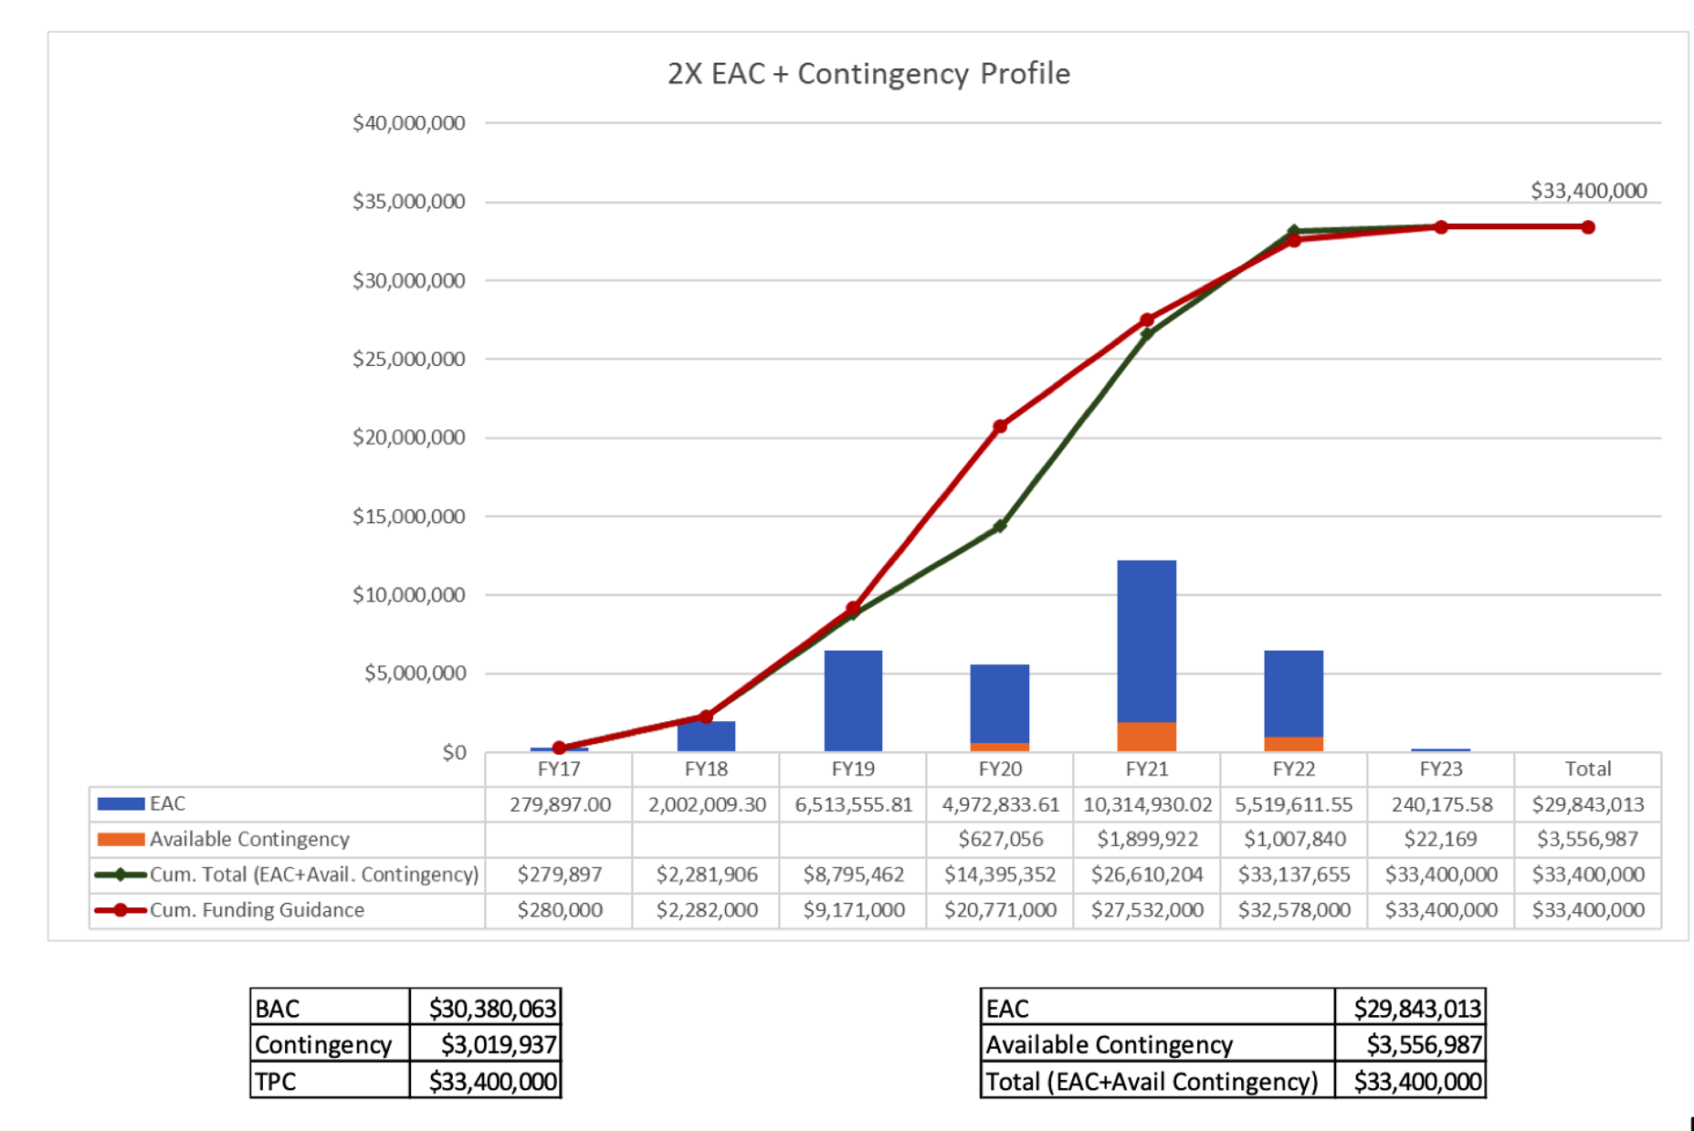
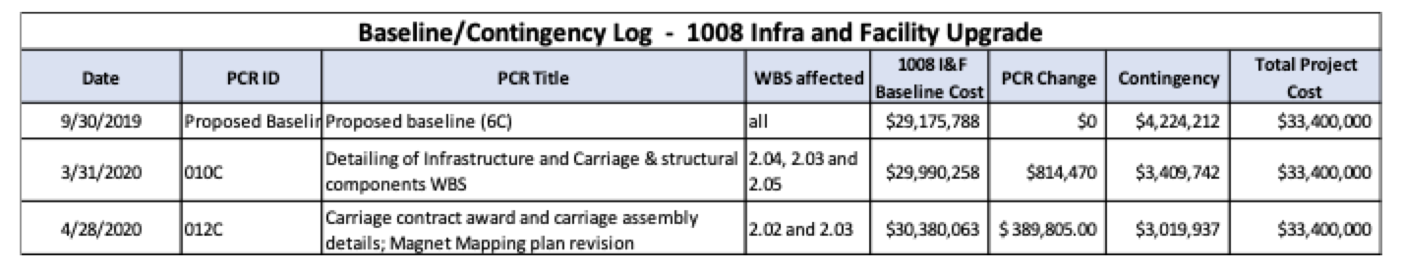
I&F: EAC Profile and PCR Log

Slide 29
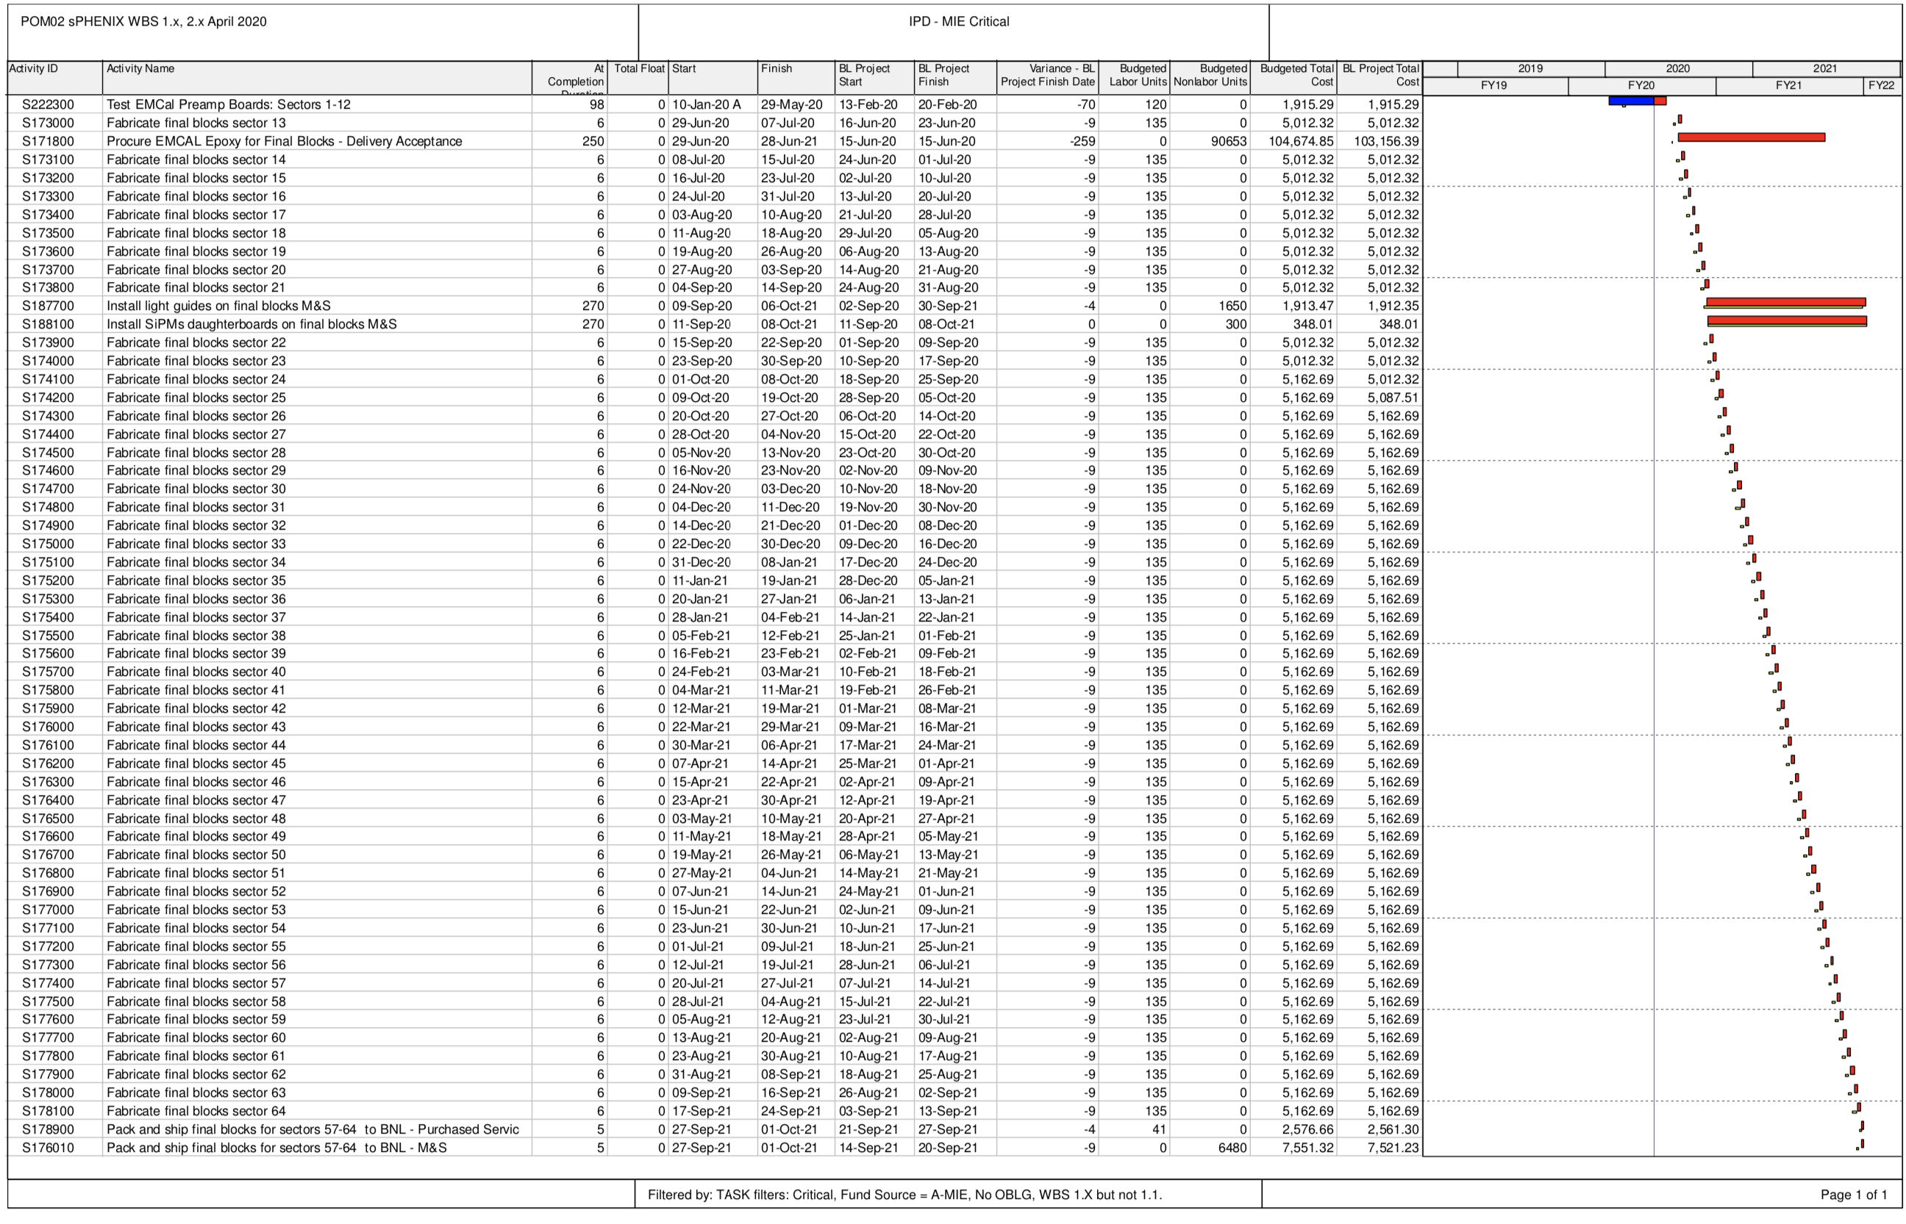
MIE Critical Path

Slide 30
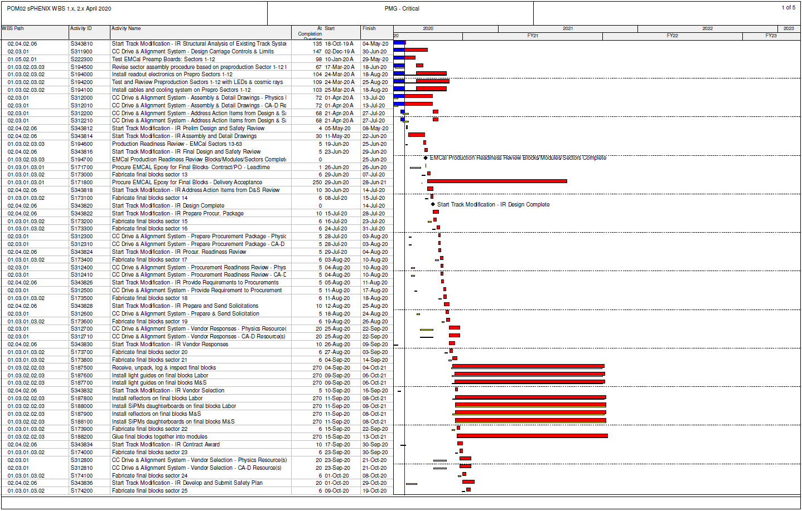
Critical Path (1x, 2x and 3x Combined)

Slide 31
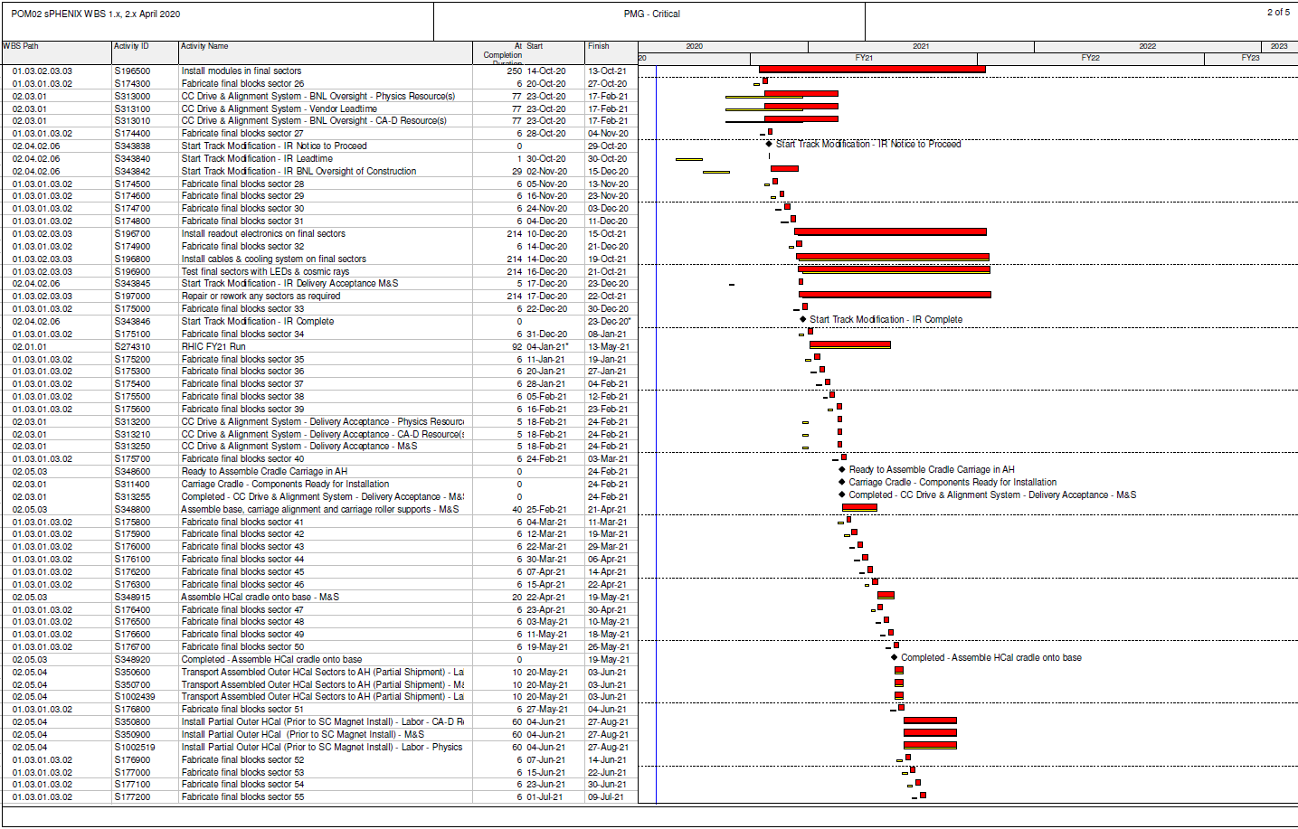
Critical Path (1x, 2x and 3x Combined)

Slide 32
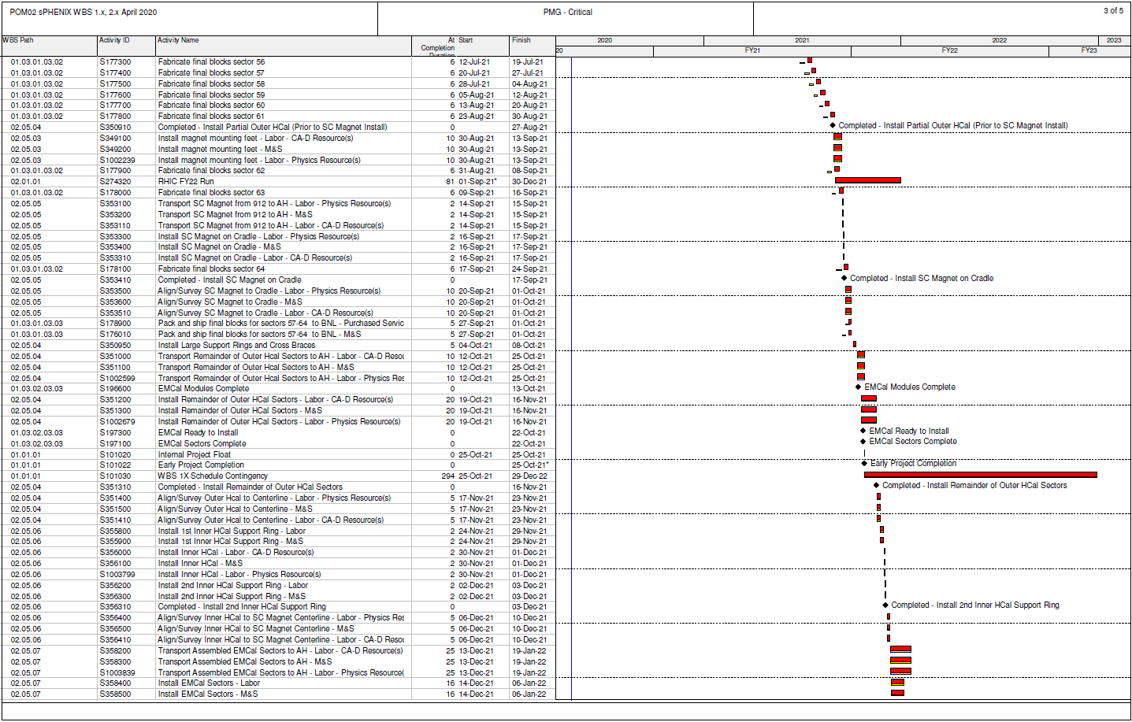
Critical Path (1x, 2x and 3x Combined)

Slide 33
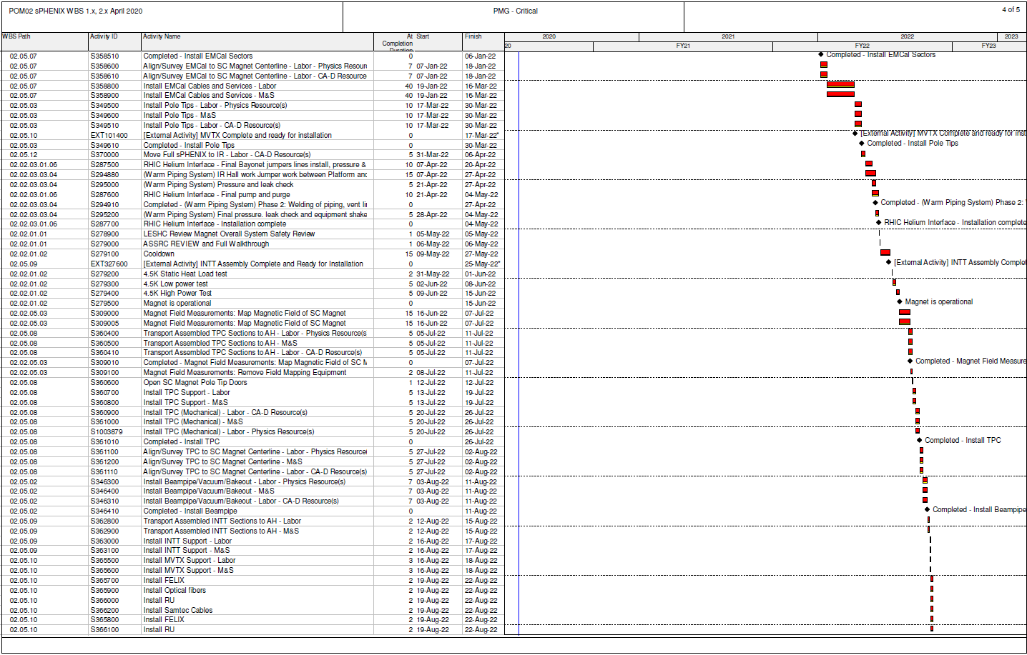
Critical Path (1x, 2x and 3x Combined)

Slide 34
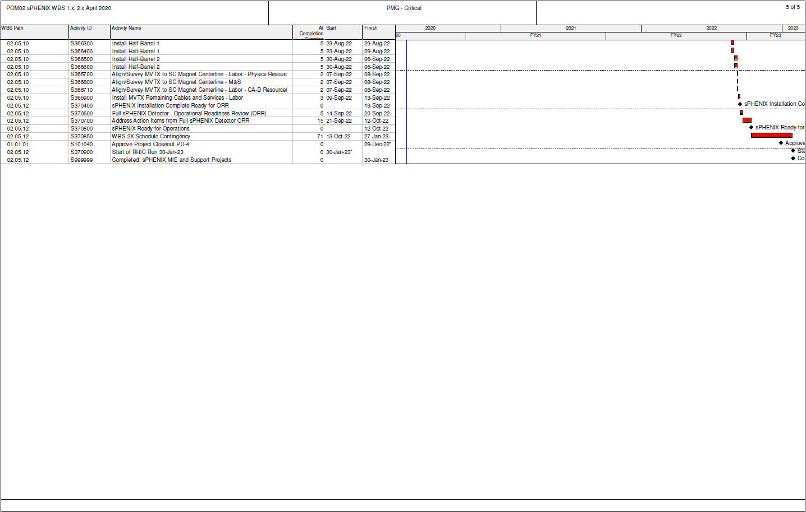
Critical Path (1x, 2x and 3x Combined)

Slide 35
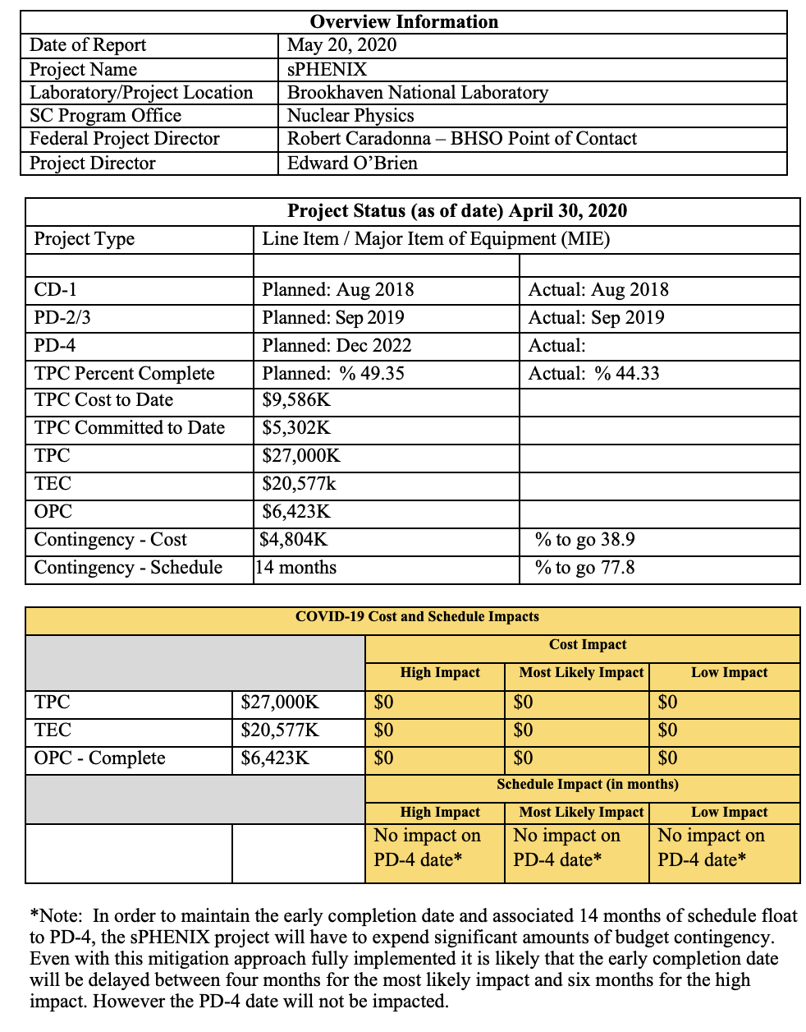
COVID-19 Impact Form

Slide 36
COVID-19 Impact Form- continued
What are the current site conditions? BNL is in min-safe. All sPHENIX work is remote.
Identify any potential Safeguards and Security and/or Environmental, Health and Safety concerns. None
What type of work continues to be performed, identify whether remote, or onsite? All work is remote from BNL. Work that continues to be performed includes remote engineering, design, procurement, documentation, project management and fabrication at vendors. Work at some university collaborating institutions and vendors is continuing.
What type of work has been stopped or delayed? What is the nature of the delay? All fabrication work at BNL and most work at universities has been stopped or delayed.
Are the delays beyond the control of the contractors or vendors in performing the work scope? Yes
Can the impacts be readily quantified (cost/schedule impacts)? No cost impacts except those associated with maintaining the early completion date. The schedule contingency will be used while BNL and collaborating universities remain closed if it is not possible to mitigate the delays with other approaches. Mitigation strategies are being developed to recover lost schedule time after BNL and the universities reopen. The early completion date has not yet been affected but it is anticipated that the early completion date will be delayed as the COVID-19 work pause continues at many sites where sPHENIX work is being performed.
What are the potential impacts to the contract (possible REAs/draws on contingency)? None
Are any delays resulting from supply chain disruption? Yes. Electronics and material deliveries have been delayed due to COVID-19.
Are overseas vendors being impacted? Yes. Overseas vendor deliveries have experienced delays due to COVID-19.
Has the contractor demobilized? Yes
If project is in stand-by / shut-down status, provide a summary of what will be required to restart activities. BNL must move from a min-safe mode to a low-density work mode. A graduated return to work is proposed by BNL to proceed in multiple steps, each increasing the workforce on site by approximately 5-10% of the total BNL workforce. Under this plan, additional personnel working on the sPHENIX project would return in each of the steps, and as they return sPHENIX production activities would restart at BNL.
Any additional impacts to the DOE/SC mission not considered above? None
Note: sPHENIX Project Management will do a full assessment of the impact of the COVID-19 pandemic on the project cost and schedule once the re-start schedule for BNL, collaborating universities and vendors is better determined.

