Slide 1
Slides exchanged with Slavic (LBNO)
Xin Qian
BNL

Slide 2
Motivation
We would like cross check LBNEO sensitivity
We would like to compare with LBNE sensitivity
We would like to validate claims from both LBNE and LBNO

Slide 3
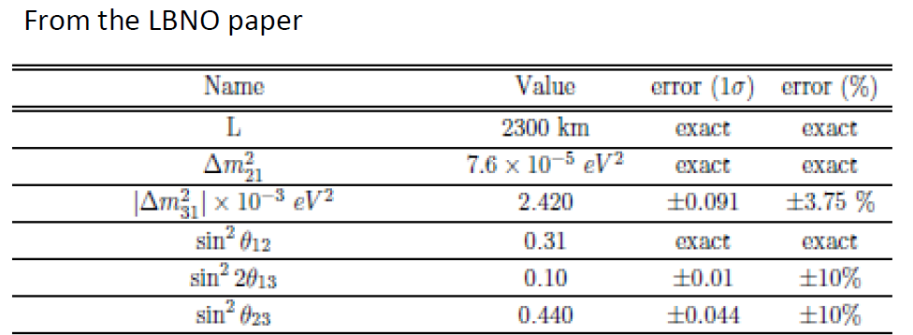
Conditions
LBNO Fluxes: HPPS and SPS fluxes from Slavic
Oscillation Parameters
3% measurement of sin22theta13 is assumed

Slide 4
Events Comparison
 | SPS Slavic | SPS Xin | HPPS Slavic | HPPS Xin
Neutrino signal | 693 | 696.5 | 922 | 924
Neutrino backgrounds | 121 | 145.3 | 300 | 264.6
Antineutrino signal | 40 | 47.4 | 48 | 52.8
Antineutrino backgrounds | 36 | 30.2 | 30 | 37.2
Total POT needed | 15e20 | 16.35e20 | 30e21 | 32.7e21
Xin: does not include the nu_tau background. I have to scale the POT by about 1.09 in order to match the Neutrino signal events

Slide 5
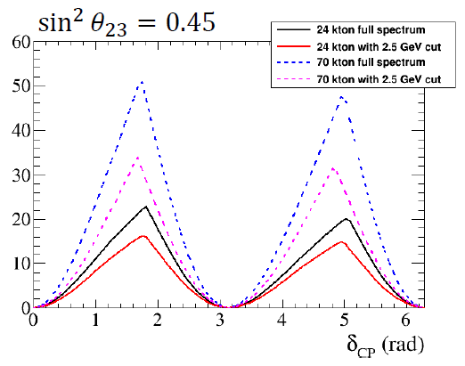
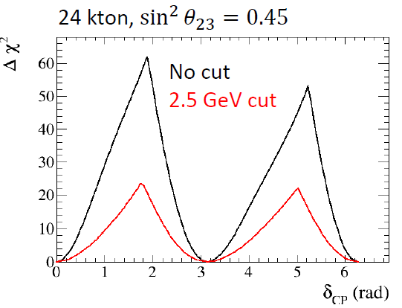
Sensitivity Comparison (Digitize these plots)
Sensitivity plots from Slavic
Left SPS beam, right HPPS beam, digitized with 24 kton detector

Slide 6
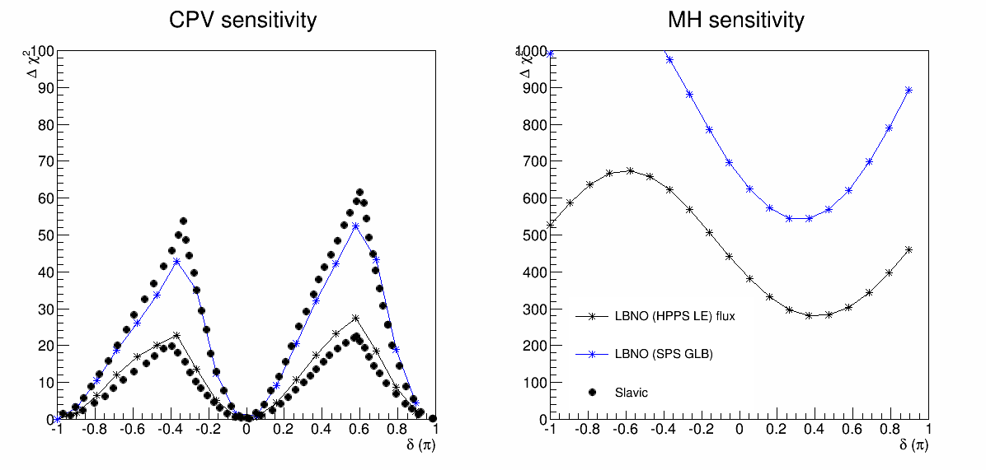
Sensitivity Comparison
Xin: Sensitivity was calculated according to LBNE style systematics: 1% signal + 5% systematics
There are small rate differences shown in slide 3
There are some differences in how to treat systematics between LBNO and LBNE calculation
Given these, the sensitivities are close enough. For this work (relative comparison), it is good enough. We are going to compare LBNE vs. LBNO sensitivity

Slide 7
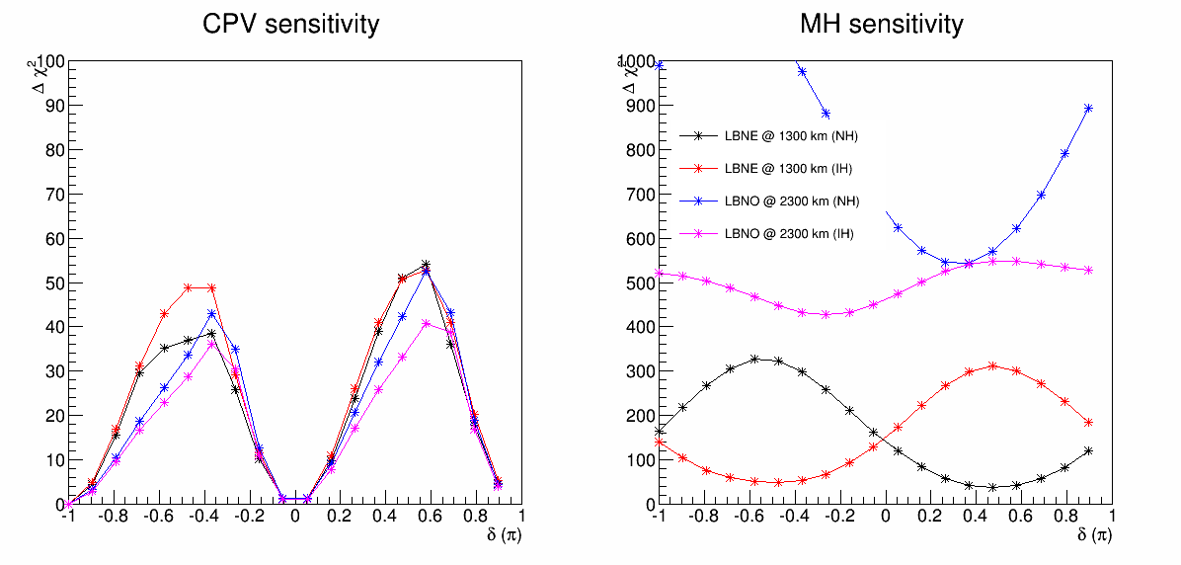
LBNO vs. LBNE Sensitivity (Both MH)
LBNO Sensitivity is calculated with
HPPS LE beam
50 GeV beam + 24 kt + 32.7e21 POT
Comparable CPV sensitivity in NH, slightly worse CPV sensitivity in IH
Better MH sensitivity at longer baseline
LBNE Sensitivity is calculated with
2010 beam
120 GeV beam + 34 kt + 8.6e21 POT
About 10% lower than the exposure than LBNO, as we scaled up LBNO rates to match the LBNO official rate

Slide 8
LBNE vs. LBNO Events Comparison
 | LBNE (NH) | LBNO (NH) | LBNE (IH) | LBNO (IH)
Neutrino signal | 1243.5 | 924 | 569.6 | 196.5
Neutrino backgrounds | 664.2 | 264.6 | 665.1 | 279.1
Antineutrino signal | 372.4 | 52.8 | 532.6 | 146.7
Antineutrino backgrounds | 400.4 | 37.2 | 396 | 36.3
Total POT needed | 8.6e21 @ 120 GeV | 32.7e21 @ 50 GeV HPPS LE | 8.6e21 @ 120 GeV | 32.7e21 @ 50 GeV HPPS LE

Slide 9
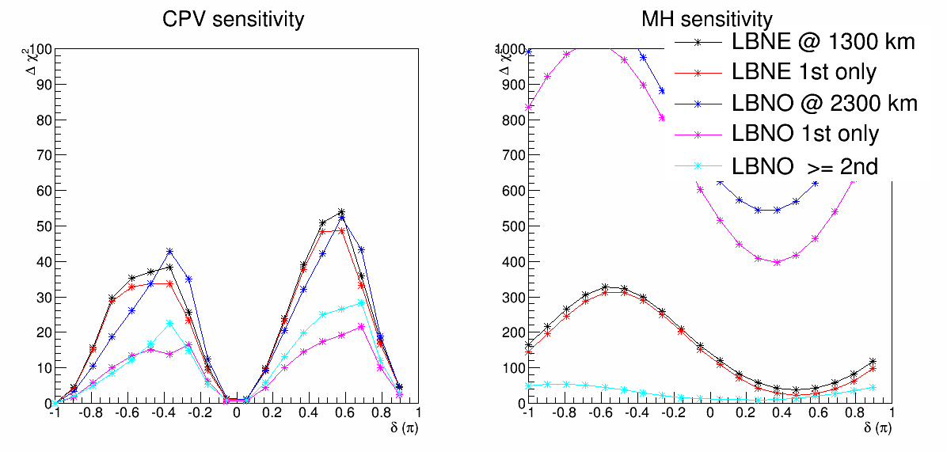
Importance of 2nd oscillation maxima
LBNO 2nd oscillation ends at 2.5 GeV, LBNE 2nd oscillation ends at 1.5 GeV
2nd oscillation in LBNE does not play an important role in CPV
2nd oscillation in LBNO does play an important role in CPV
Validate the claims from both LBNE and LBNO
Comparing 1st oscillation only, LBNO sensitivity is worse than LBNE, this is due to the imbalanced rate in neutrino vs. antineutrino mode at longer baseline

Slide 10
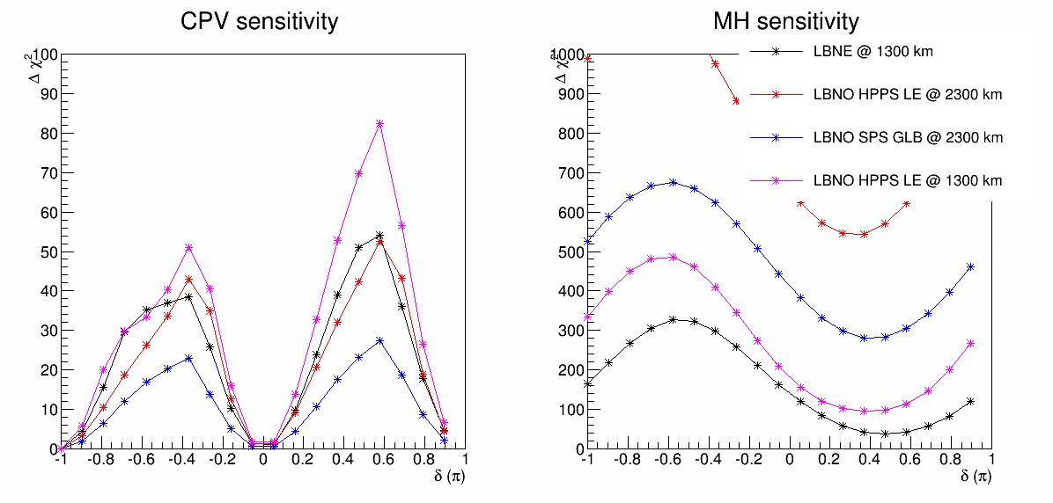
Use HPPS LE Optimization @ 1300 km
For CPV, LBNE and LBNO has similar sensitivities
With LBNO setup, but set the baseline to 1300 km, CPV sensitivity is enhanced.
Validate the claim of LBNE that shorter baseline is better for CPV
Also better LBNE MH sensitivity with HPPS LE beam ~ 100 for the worst delta region

Slide 11
Conclusion
We validate the following facts:
Roughly validate the LBNO sensitivity with LBNE globes framework
1%/5% LBNE systematic treatment similar as the LBNO style systematics
LBNO HPPS LE CPV sensitivity has similar performance as LBNE 2010 CPV sensitivity @ same exposure
Slightly worse in IH case
For CPV, 2nd oscillation maximum is crucial for LBNO, but not as crucial in LBNE
For 1st oscillation alone, the LBNO sensitivity is worse due to imbalanced neutrino/antineutrino rates
For 2nd oscillation alone, the LBNO sensitivity is better due to more events, and wider energy coverage
For CPV, 1300 km performs better than 2300 km
LBNO’s sensitivity @ 1300 km is better than LBNO sensitivity @ 2300 km
For MH, 2300 km performs better than 1300 km

Slide 12
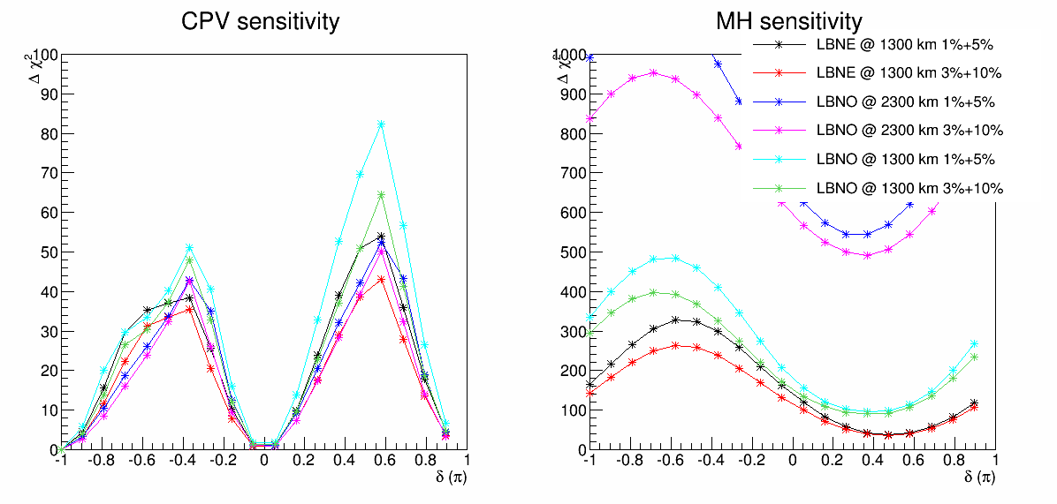
Systematic 3%+10%
With 3% signal uncertainties + 10% background uncertainties
1300 km baseline’s sensitivity decreases more than the 2300 km baseline
Presumably since 1st oscillation maxima is more sensitive to the signal uncertainties
2nd oscillation has larger asymmetries, more shape information

Slide 13
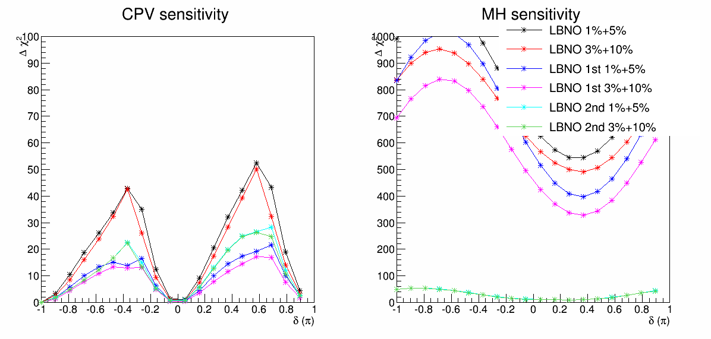
Breakdown 1st and 2nd oscillations
We confirm that the 1st oscillation is more sensitive to the systematic uncertainties relative to the 2nd oscillation maxima.

Slide 14
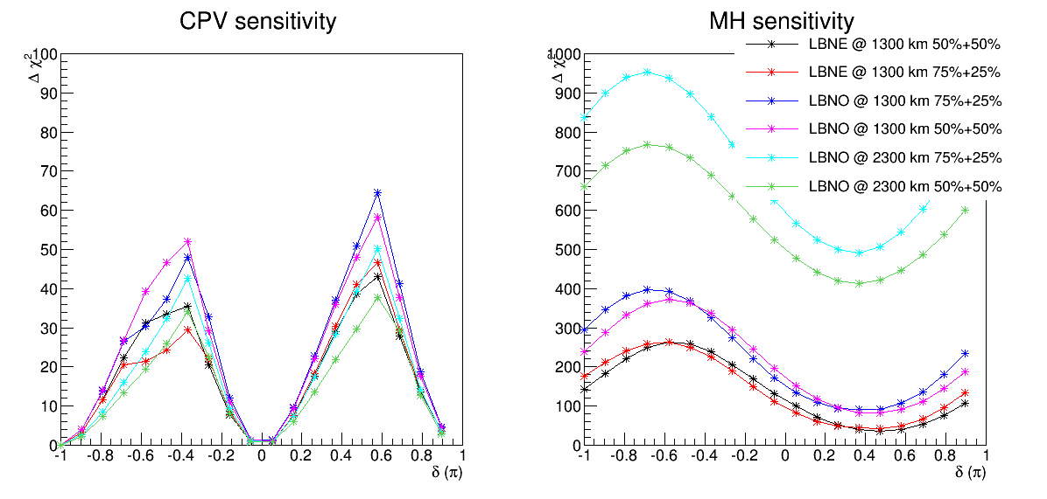
Running Time 50%+50% vs. 75%+25%
At 1300 km, 50% vs. 50% running is better than 75% + 25% running
At 2300 km 75% vs. 25% running is better than 50% + 50% running
This is mostly due to the imbalanced neutrino vs. antineutrino events

Slide 15
A few words about systematics
Current LBNE-style systematics only takes into account the normalizations
These uncertainties are uncorrelated among various samples
In reality, we would use the muon disappearances to calibrate the CPV (small effect of CPV)
For the appearance CPV, what matters is the relative uncertainties between appearance and disappearance
This is the main reason of 1% signal uncertainties
A 3% relative uncertainties between appearance and disappearance is conservative
Based on my DYB experience,
Relative uncertainties is the most dangerous ones (than the absolute uncertainties)
Uncorrelated uncertainties is more dangerous than the correlated uncertainties
Also need to consider energy scale, bin-2-bin uncertainties, near/far extrapolation → break some connections between 1st and 2nd oscillation maxima

Slide 16
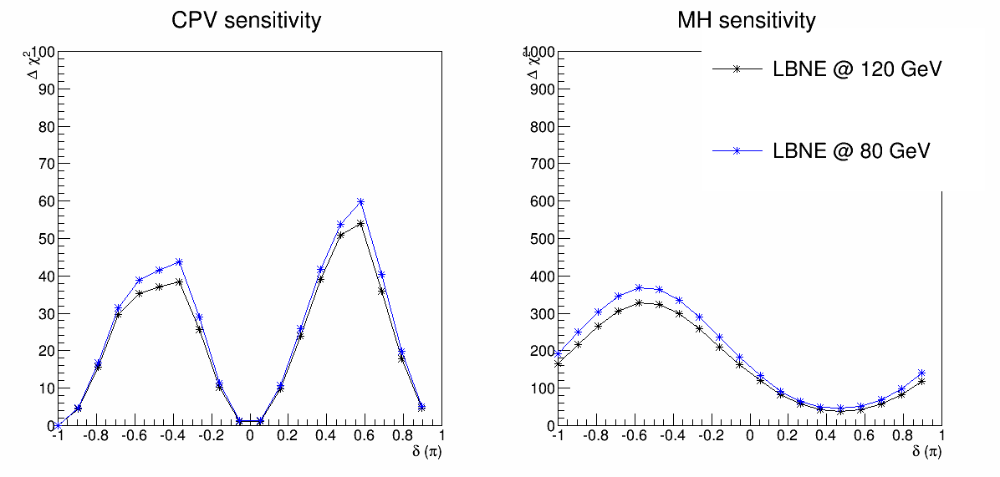
LBNE 80 vs. 120 GeV

Slide 17
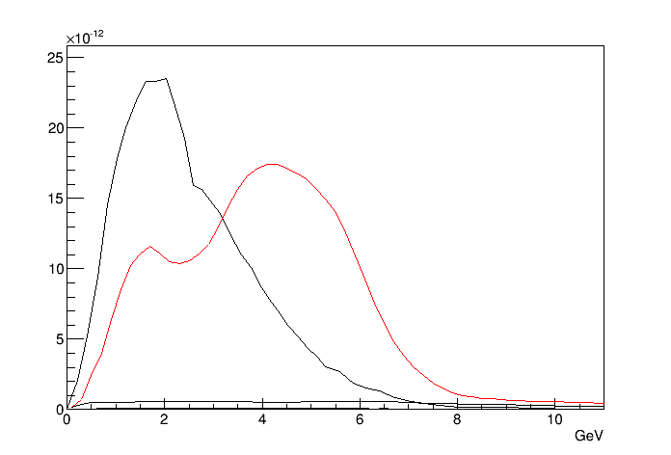
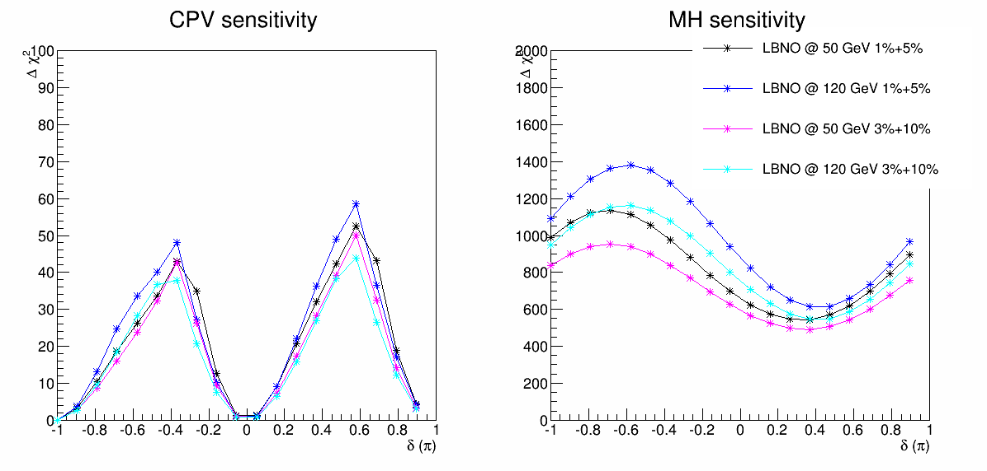
50 GeV vs. 120 GeV beam

Slide 18
