Slide 1
TUNL Contributions in the
US Nuclear Data Program
Nuclear Structure Data Evaluation Program
J.H. Kelley - USNDP Structure Group Leader: (5 months FTE),
J. Purcell (emeritus 0.1 FTE), and G. Sheu (Adm. Assist. 0.75 FTE)
(H.R. Weller & Kent Leung (post doc 0.5 FTE))
We are responsible for nuclear structure evaluation in the A=2-20 mass region
  Energy Levels of Light Nuclei reviews published in Nuclear Physics A
  ENSDF files for A=2-20
  XUNDL from A=2-20
Web interface for A=3-20 Information
This material is based upon work supported by the U.S. Department of Energy, Office of Science, Office of Nuclear Physics.

Slide 2

Evaluation Activities
Energy Levels of Light Nuclei
  Follow style of Fay Ajzenberg-Selove
  Broad scope of reactions is included – discussion format.
  Adopted levels/gammas, Energy Level Diagrams
ENSDF
  More rigorous information required
  Better documentation of original sources
  reaction data sets/decay data sets
  Adopted levels/gammas, decay widths, etc.

Slide 3
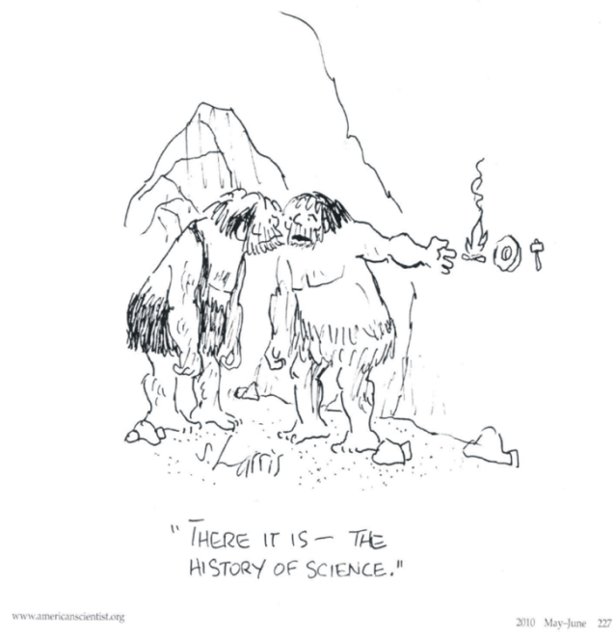
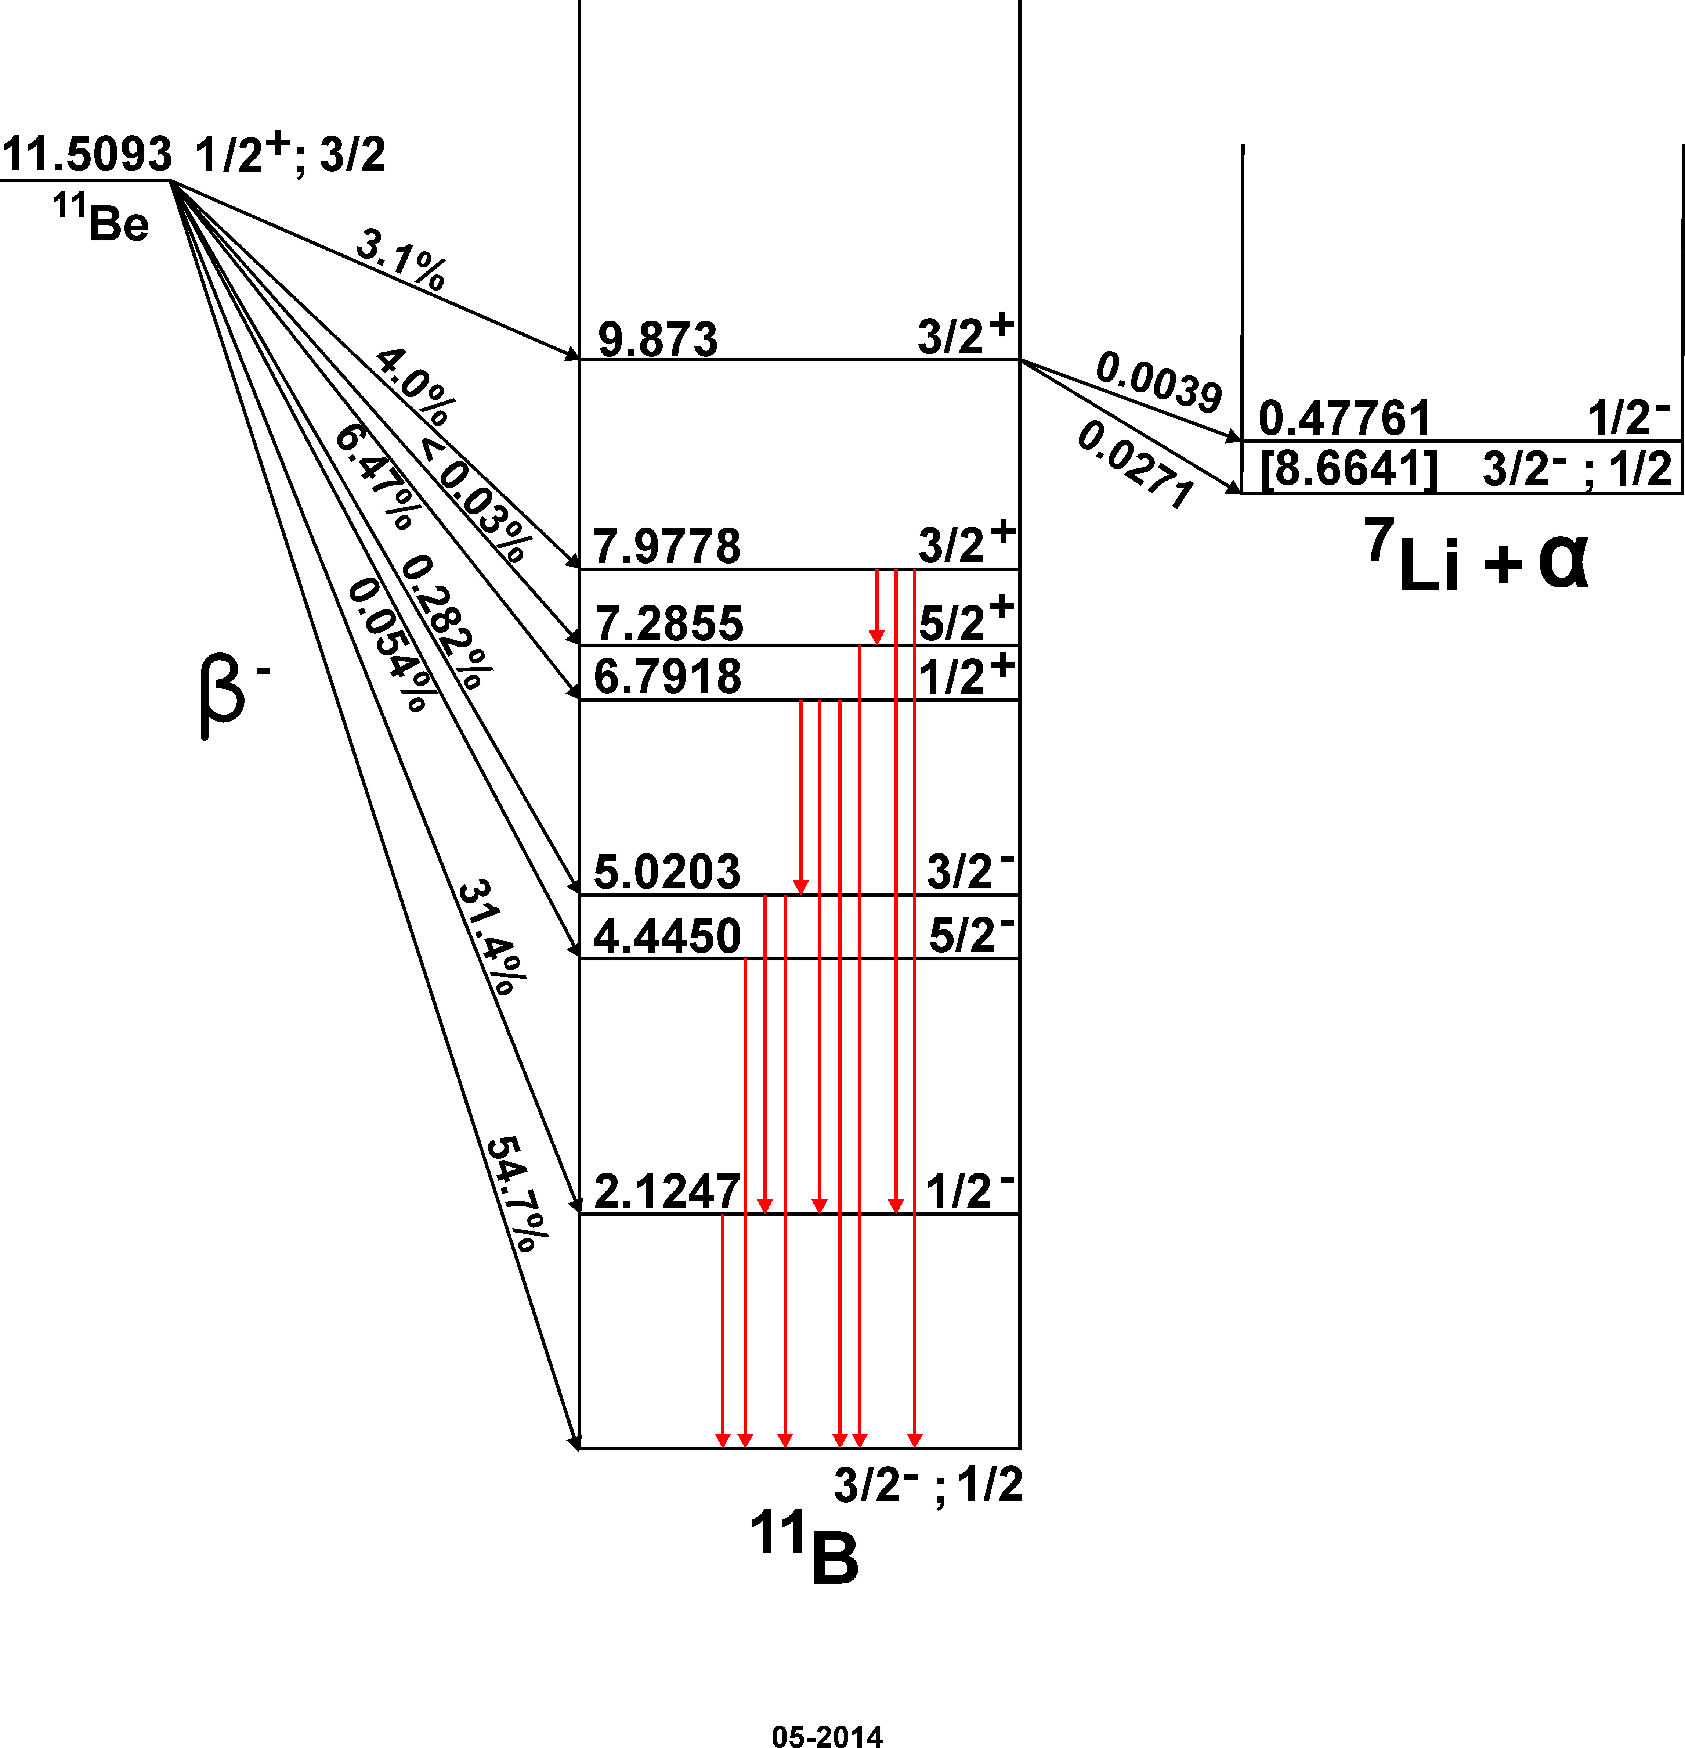
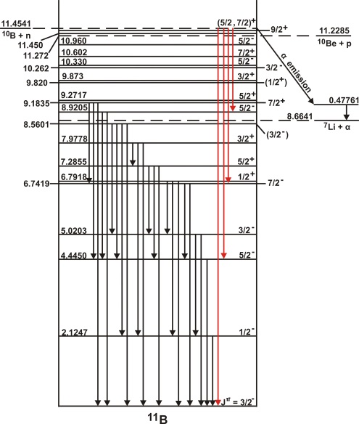
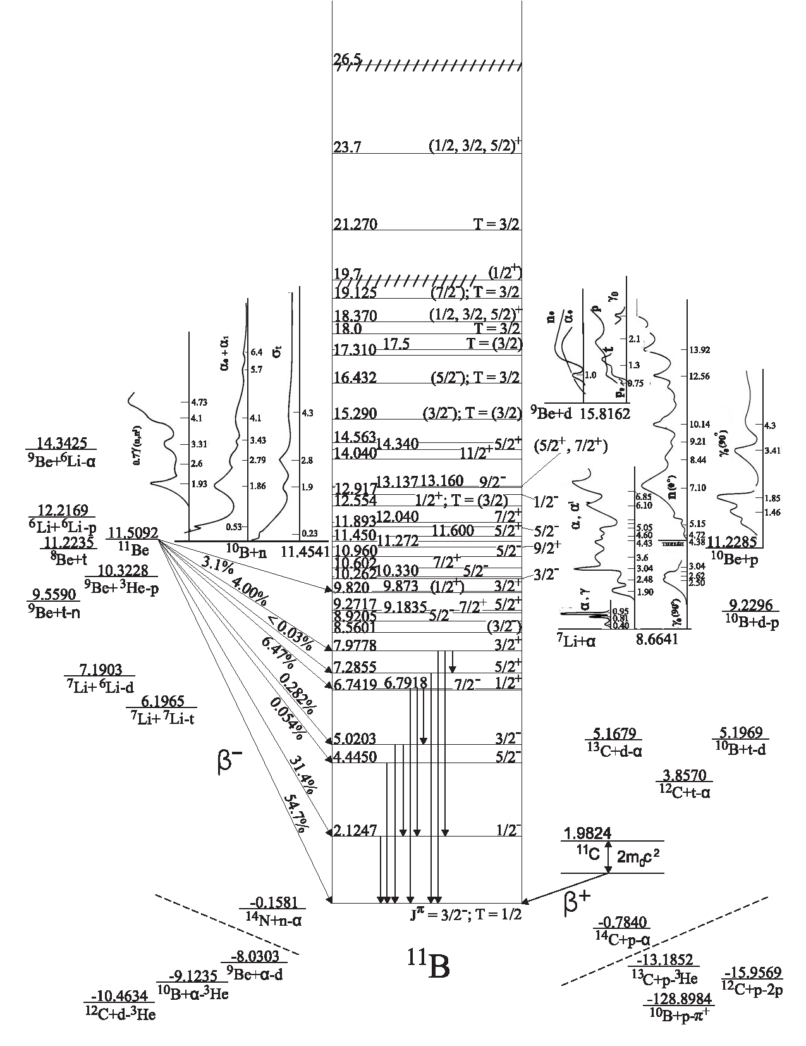
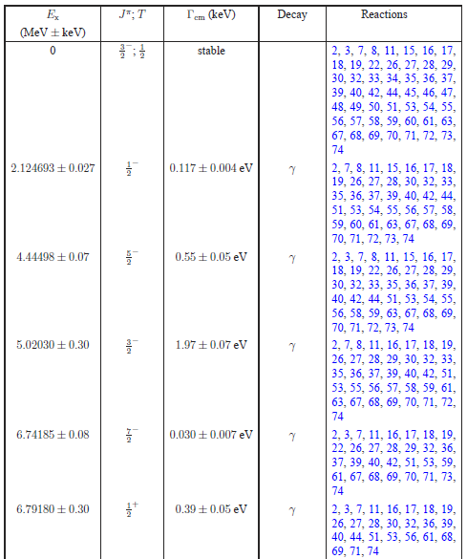
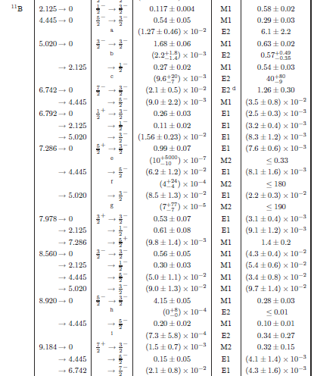
Adopted Levels
γ-ray transitions

Slide 4
Present Evaluation Activities
Published “Energy Levels of Light Nuclei: A=3”
  Nucl. Phys. A848 (2010) 1
“Energy Levels of Light Nuclei: A=11”
  Nucl. Phys. A880 (2012) 88 (ENSDF Updated)
Work in progress:
  A=12 Evaluation for “Energy Levels” (90+%)
  Preparing A=12 ENSDF file
  Preparing A=3 ENSDF file(Jim Purcell)
  Preparing A=2 ENSDF file(K. Leung & H.R. Weller)

Slide 5
Recent Evaluation Activities
Updated nuclides in ENSDF
  ⁶B, ⁷B, ¹⁴F, ¹⁵Ne, ¹⁸Mg, ¹⁹Mg, (¹⁵Be, ¹⁸Be)
Updated ENSDF Reaction Data sets
  β: ¹⁴Be, ¹⁴B, ¹⁹N, ²⁰N
  β-n: ¹²Be, ¹³B, ¹⁴Be, ¹⁴B, ¹⁵B, ¹⁶C, ¹⁷B, ¹⁷C, ¹⁷N, ¹⁸C, ¹⁸N, ¹⁹B, ¹⁹C, ¹⁹N, ²⁰C, ²⁰N
  β-p: ⁹C, ¹¹Be, ¹³O, ²⁰Mg
  β−α: ⁹C, ¹¹Be, ¹⁴Be, ¹⁷N, ¹⁸N, ²⁰Na
( All ENSDF Evaluation activities rely extensively on NSR compilations and key wording)

Slide 6
XUNDL
Compilation Activities
Experimental Unevaluated Nuclear Data Library
  Committed to A=2-20 since April 2009
  60-65 data sets/year (5-6/month) (53 in FY2014)
  Up-to-date structure data Library
  New articles added within 1-2 months
  Feedback loop between source and evaluator

Slide 7
Other Compilation Activities
Compilation of ground state decay & β-decay references and data
Compilation of (p,X) and (α,X) excitation functions
TUNL Dissertations-
  http://www.tunl.duke.edu/nucldata/Theses/TUNL_Theses.shtml

Slide 8
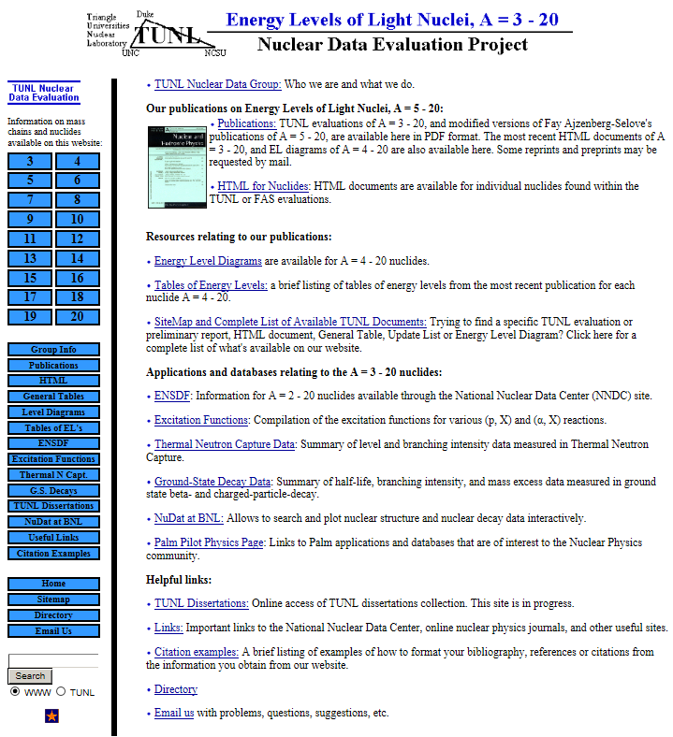

Slide 9
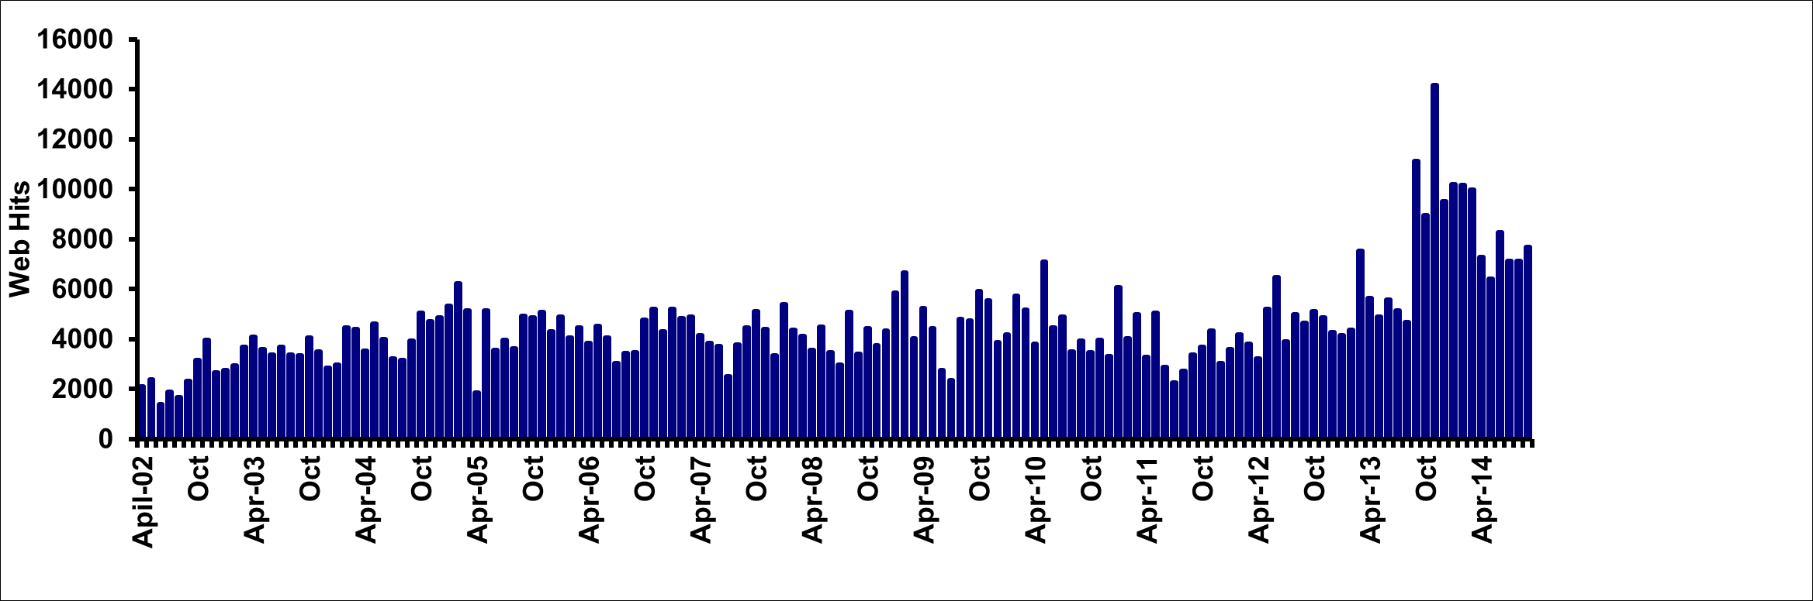
TUNL Website usage

Slide 10
FY14 Metrics Table
FY14 FTE Table
XUNDL Compilations | 53
ENSDF Evaluations submitted | 6
Disseminations (in thousands) | 107k
Articles | 0/ (9 expt.)
Reports | 1
Invited Talks
PhD Permanent | .6
PhD Temporary | .6
Tech. & Admin. | .75
Grad. Student
Total | 1.95

