Slide 1
Conclusions n+¹⁶O
Arjan Plompen
EC-JRC-IRMM, SN3S unit

Slide 2
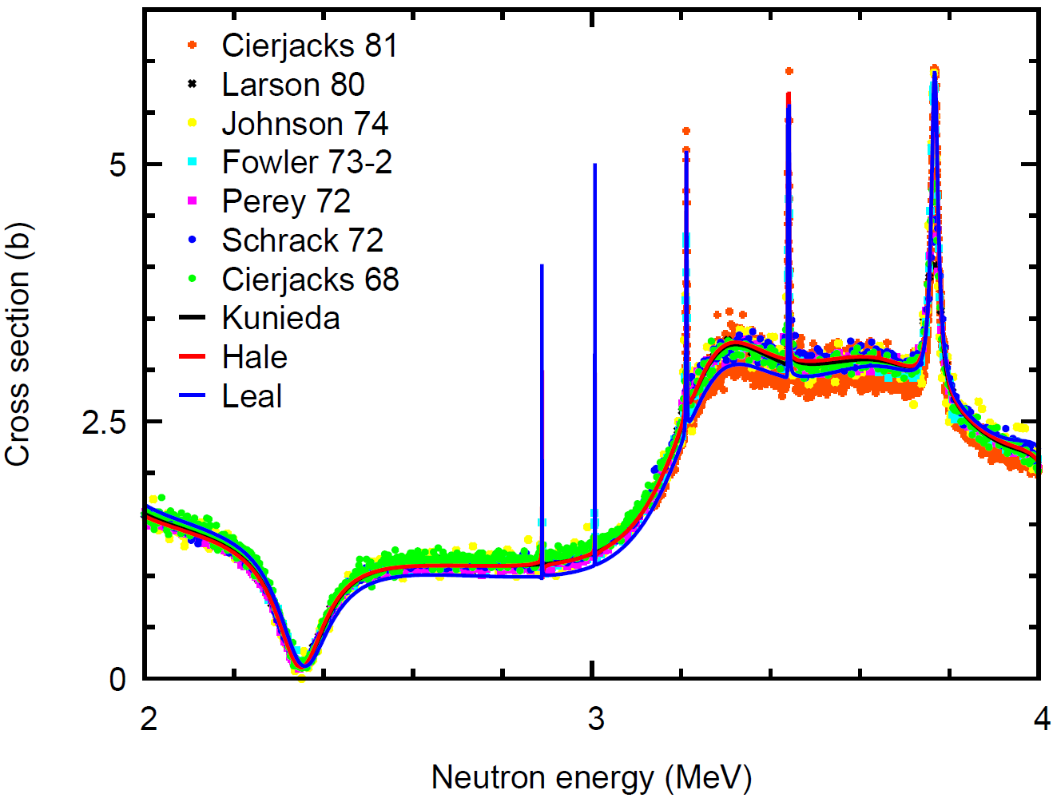
¹⁶O(n,tot)

Slide 3
Open points total cross section
Link low energy range to high energy range: 1 eV to 3 MeV
Tackle Ohkubo and Johnson problem at low energy.
Allows check of impact of negative resonance on the shape of the cross section and thereby the match with the 3.765(25) b recommendation.
Careful check of cross section in the plateau at 3.5 MeV.
Tackles discussion on agreement Cierjack-80 and most other measurements.
New data for the first resonance
Only 2 data sets available and both have an issue just below the resonance.

Slide 4
Open points total cross section
Needs accurate new measurements
High quality samples holding oxygen with careful choice of compensating sample. Several thicknesses are required.
Avoid water absorption and moisture or ice on the surface. Humidity and temperature control are required.
Control of and a low background are essential.
High resolution needed for the first resonance: non-saturating sample with all of the above.

Slide 5
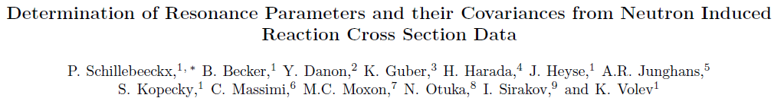
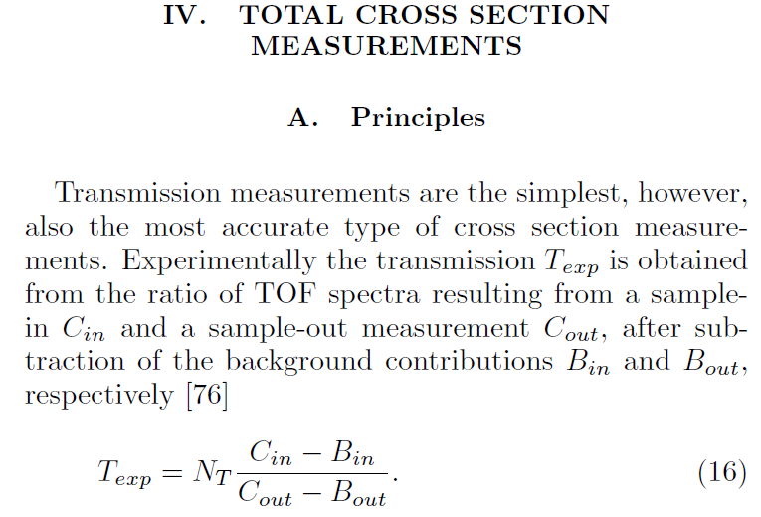
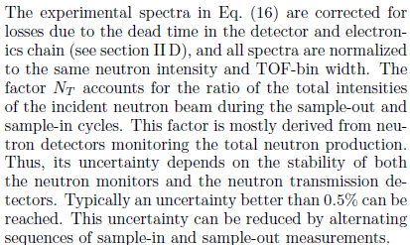

Experiments that allow accurate evaluations require significant care, both from the experimenter and from the evaluator.

Slide 6
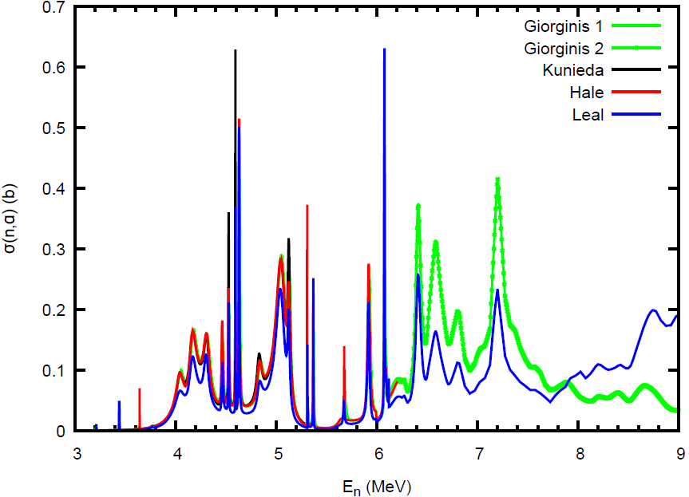
Open points ¹⁶O(n,a)
Giorginis recommendations vs Kunieda, Hale and Leal

Slide 7
Open points ¹⁶O(n,a) and ¹³C(a,n)
¹⁶O(n,a) measurement
Independent result needed for checking normalization.
Improved resolution compared to IRMM/IPPE.
¹³C(a,n) measurements
Existing results all have issues.
New measurement(s) needed to confirm conjectures.
They may be plausible conjectures, but that’s all they are.
Guard: ¹³C target quality during experiment, energy-dependent efficiency (detector model, angular distribution), reliable principles.

Slide 8
DICE sensitivities (Hill)
Apply to ¹⁶O(n,a) as well as ¹⁶O(n,tot)
Combine with evaluations?
Group sensitivity needs group cross section to evaluate impact. Is this possible?
Sort benchmarks by
  Sensitivity to the two oxygen cross sections.
  Relevance to CIELO.
Analyse impact of compensation options?

Slide 9
Trend of k with leakage.
Perceived to be the effect of changes to total and angular distribution.
Main difference Hale evaluation and B-VII.1 is ¹⁶O(n,a)!
Could it be a poorly understood absorption only effect?
Test by increasing nu-bar-thermal?
Trend still to be evaluated for Leal-RP with angular distributions from the RP.

Slide 10
There is new work for thermal scattering and more to come
Cullen problem solved with ENDF/B-VII.1.
Impact of the change on benchmarks not known. It should be checked if we want to learn about the impact of thermal scattering.
Large effects (up to 1000 pcm) demonstrated for heavy water benchmarks.
What is the impact of solutes on thermal scattering? Experimental and theoretical insights may shed light on importance for (discrepant) benchmarks.

Slide 11
More general benchmarking and the final file.
CIELO/A: Compensating effects from other CIELO nuclides should be investigated before solving potential problems on a nuclide-by-nuclide basis.
It is good to investigate the sensitivities that allow tweaking CIELO/A into CIELO/B with good performance a suite of benchmarks.
In doing point 2 above, avoid the confusion with CIELO/A files and preferably do the final tweaking as late as possible. Otherwise progress in understanding is limited and may even be lost altogether.

