Slide 1

Thermal Scattering Law Data
D. Brown, BNL
W. Haeck, IRSN

Slide 2
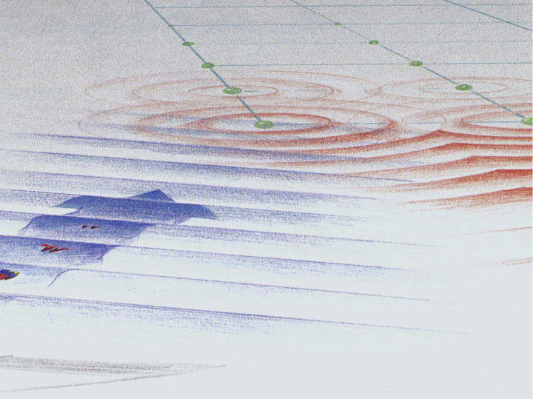

What is thermal scattering law data?
Figure from Roger Pynn “Neutron Scattering: a Primer”
Neutrons scattering off material with energy low
enough that their de Broglie wavelength bigger
than atomic spacing, allowing the neutron to
coherently or incoherently scatter off the surface

Slide 3
Thermal scattering law data lives at the intersection of nuclear and condensed matter physics
An overview of the type of data covered
  Data needed to transport a neutron, do I need to say more?
How is the data created?
  That’s a GOOD question…. we may need to dig into this!
How is the data used?
  Neutron transport
  Viewing
How might it be stored?
Where would it fit in the overall hierarchy?
Also, consider and comment any things in the design of the requirements that promote QA of the data, format, API, etc.

Slide 4
Supporting ENDF’s Thermal Scattering Law would be easy…
3 cases supported by ENDF:
  coherent elastic (off ordered substances)
  incoherent elastic (hydrogenous solids)
  incoherent inelastic (famous Sαβ data)
In all cases parameterized forms of dσ/dΩdE’, so use
  <dcrossSection_dOmega> (elastic) or
  <dcrossSection_dOmega_dE> (inelastic)
  Parameterizations for elastic cases in ENDF manual
  Parameterization for inelastic case sort of in ENDF manual

Slide 5
However, we were asked to support much more in the new format
Requested to support covariance data in TSL (WPEC TSL)
Alternate ways of storing TSL data
  Store data to generate S(α,β) using photon spectrum ρ(ω) of material and structure factor S(q) (LEAPR)
    Both ρ(ω) and S(q) are 2d tables that can have covariance
    Temperature dependence? As for as I know, people do a temperature interpolation on the phonon spectrum for LEAPR.
  Store experimental measurements directly: either S(q,ω) or S(α,β) directly without ENDF’s approximations
    Sαβ can be computed from S(q,ω) by applying a temperature dependent factor
    Can we store this (4d data set S,x,y,T) & what about covariance?
  Store the resulting dσ/dΩdE’ by itself (usefull during processing)

Slide 6
What about the temperature dependence?
The ENDF format gives a temperature interpolation flag but the procedures state that temperature interpolation is unreliable for S(α,β) data (ENDF 102, paragraph 7.4.2)

Slide 7
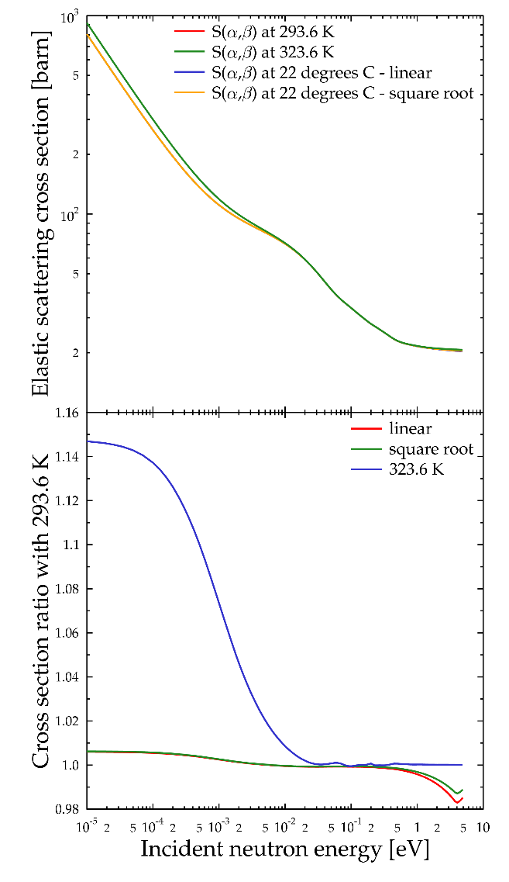
Manipulating the S(α,β) tables
Use interpolation to derive the correct S(α,β) table
  Using the raw S(α,β) data from the original ENDF file
  Interpolating the resulting differential cross section

Slide 8
What about the temperature dependence of thermal scattering data?
The ENDF format gives a temperature interpolation flag but the procedures state that temperature interpolation is unreliable for S(α,β) data (ENDF 102, paragraph 7.4.2)
Can an evaluator decide to give thermal scattering data for specific temperatures without temperature interpolation?
  for a 3D dataset S = f(α,β,T) can we say that there is to be no interpolation for T?
  for a 3D dataset S = f(q,ω,T) can we use a histogram for T (assuming a temperature independent S(q,ω) over the entire temperature range)?

Slide 9


Neutrons scattering off material in first Born approximation
Figure from Roger Pynn “Neutron Scattering: a Primer”
(distinct)
(self)

Slide 10


In general case, can break scattering kernel up to some extent, but not enough to help
Write

Slide 11

In general case, can break scattering kernel up to some extent, but not enough to help
Write
Just store these? Note S(κ,ω) is rewritten Sαβ so this is still huge

Slide 12




Main approximations in TSL treatments
Always have to do these in practice
First Born approximation
Lots of scatterers
Orientation average
Gaussian approximation
  coherent elastic
  incoherent
    elastic
    inelastic
      short collision time approximation
ENDF always assumes these, but it could be done better

Slide 13



In the incoherent Gaussian approximation, the scattering kernel is computed by LEAPR as follows
Phonon spectrum is sole input, rest is math, including the structure factor in ω➞0 limit

Slide 14
In the incoherent Gaussian approximation, the scattering kernel is computed by LEAPR as follows
In this approximation, only store ρ(ω) & its covariance
Phonon spectrum is sole input, rest is math, including the structure factor in ω➞0 limit

Slide 15


Slide 16
