Slide 1




Neutron Production Capabilities:
LBNL 88-Inch Cyclotron
UCB High Flux Neutron Generator
Leo Kirsch November 7, 2014
This work was performed under the auspices of the U.S. Department of Energy by Lawrence Livermore National Laboratory under contract DE-AC52-07NA27344. Lawrence Livermore National Security, LLC and the Lawrence Berkeley National Laboratory contract XXX and the University of California Office of the President

Slide 2


Who I am
I’m a 2nd year grad student at UCB, post-prelim, looking to start research
Working with Lee Bernstein in the Bay Area Nuclear Data Group funded by NA-22 and NSSC
The NSSC is a NNSA-funded $25 million grant to Seven Universities Coordinating Coursework and Experience from Student to Scientist in a Partnership for Identifying and Preparing Educated Laboratory-Integrated Nuclear Experts (SUCCESS PIPELINE)
I’ve worked on the development of the HFNG and most recently on measuring (n,n’𝛾)

Slide 3
Why we care about (n,n’𝛾)
Neutron transport and data for applications
  Extended-EGAF: partial (n,x𝛾_{i}) cross sections)
Nuclear Structure (ENSDF)
  Low lying states
Statistical Models
  Level densities, Radiative strength functions
  Highly excited states

Slide 4
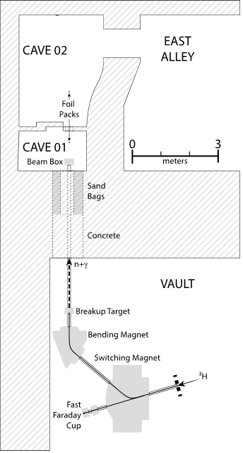
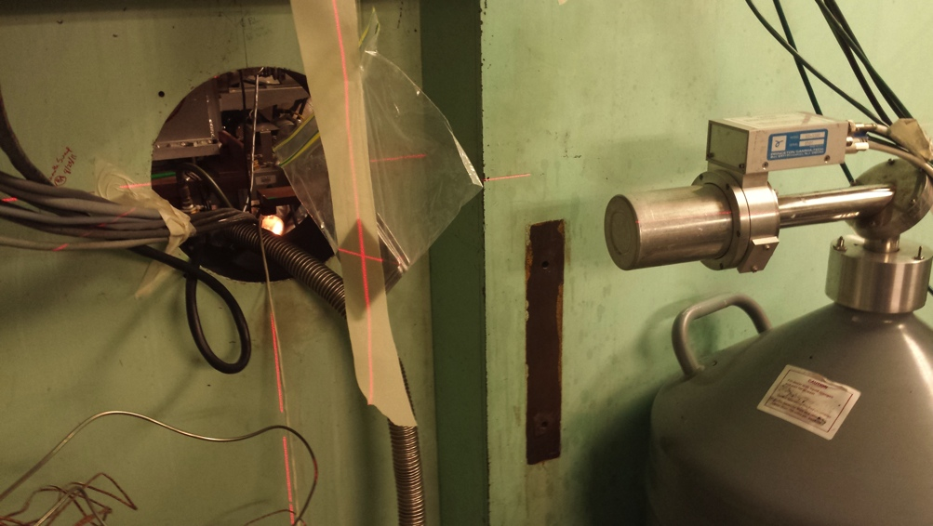
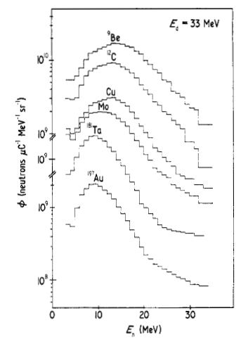
Deuteron Breakup n source at the 88-Inch cyclotron for 𝜎(n,n’𝛾)
Our plan is to evaluate (n,n’γ) cross sections and structure and fill in any deficiencies
Activated Foils (29MeV D on Ta)
Meulders et al, Phys. Med. Biol.,
1975, 20 (2), pp 235-243

Slide 5
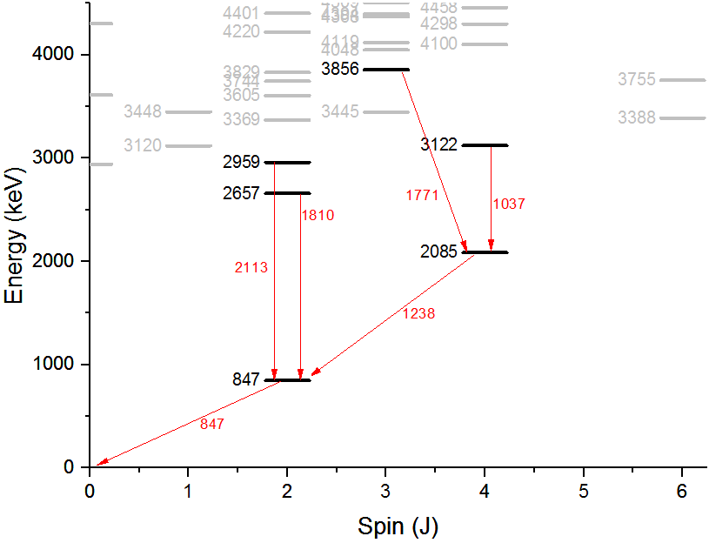
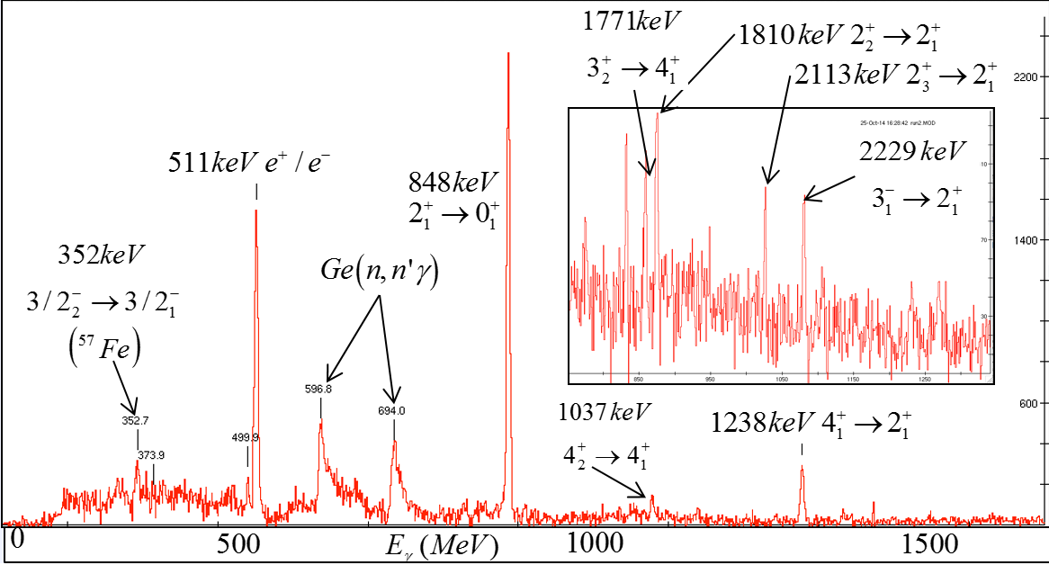
Iron spectrum
1 hour of data, 2uA
natural iron: 92% Fe⁵⁶; 2% Fe⁵⁷
Four clovers, up current to 20uA
64 “clean”𝛾/s /barn /1%N_{a}/cm²
Rushed analysis

Slide 6
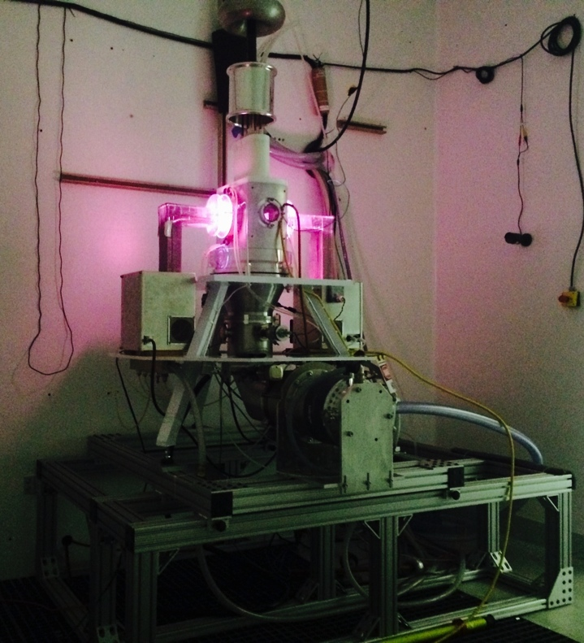
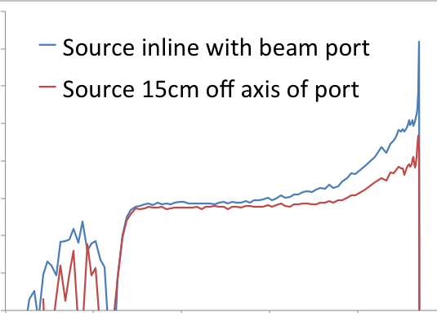
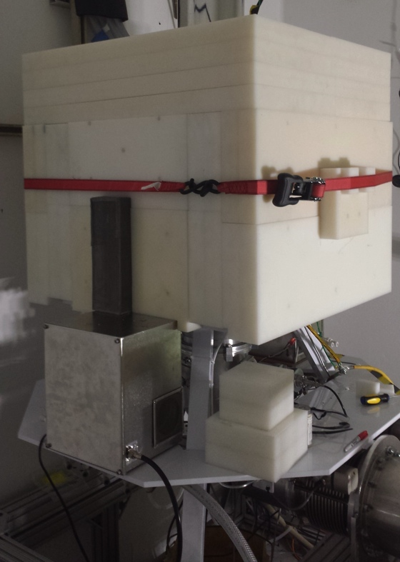
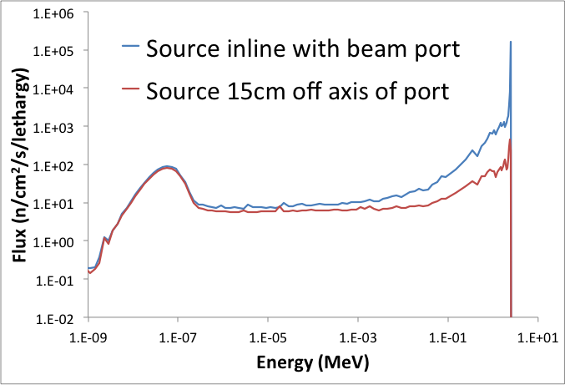
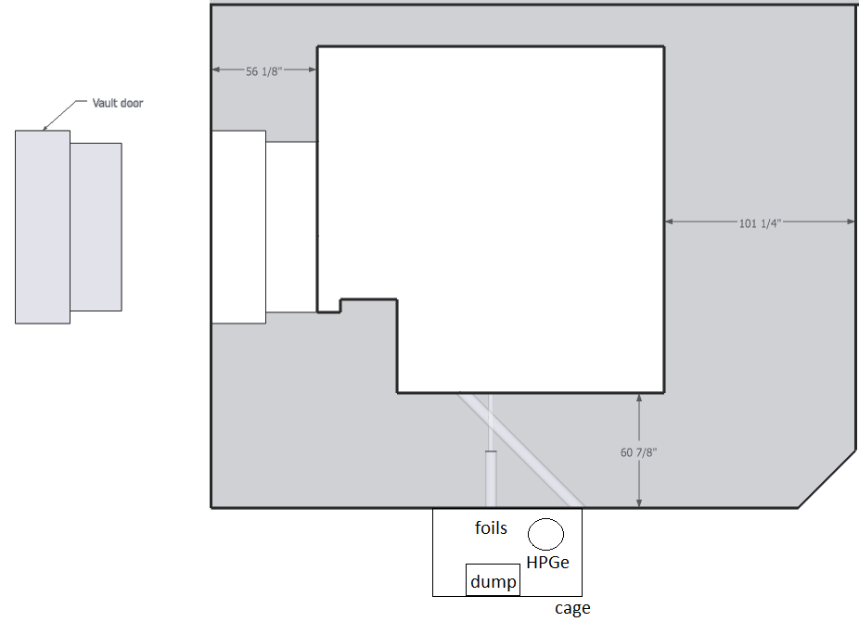
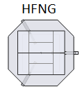
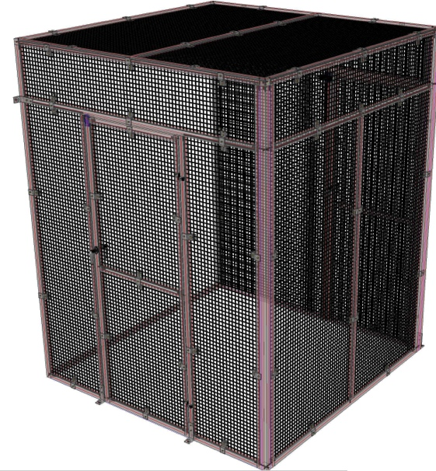
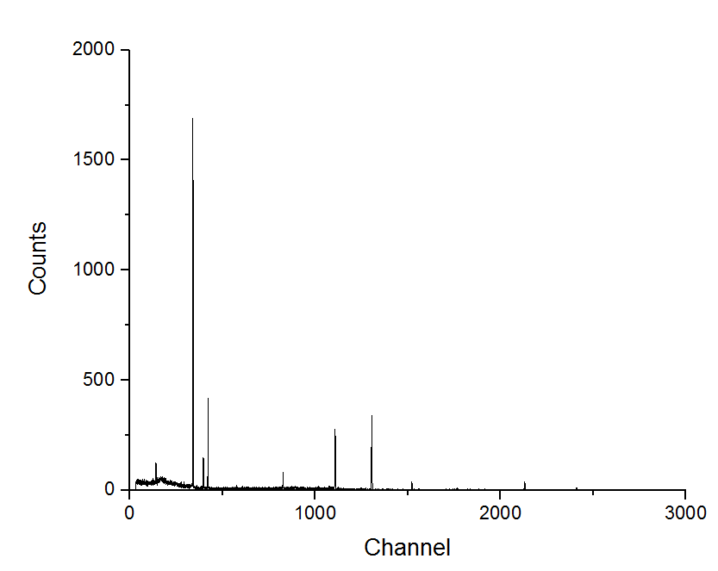
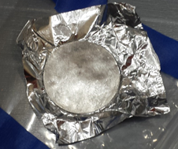
HFNG – what it does
Poly for Thermal Operation
10⁶
10⁴
10²
10⁰
(w/ 2mm Cd foil in vault)
10⁻⁹ 10⁻⁷ 10⁻⁵ 10⁻³ 10⁻¹ 10¹
Internal:
10⁸⁻¹⁰ n/s/cm²
July 25th Commissioning
Indium Foil (n,n’)
10⁸ n/s
Runs quietly
all the time
Monoenergetic Beam: 10⁴⁻⁶ n/s/cm²

Slide 7
Summary/What’s Next
Inelastic scattering capabilities at cyclotron
  Deuteron Breakup: 5MeV<E_{n}<60MeV
  10¹² n/s/cm² in situ; 10⁷ n/s/cm² beam
High Flux Neutron Generator at UCB with multiple operation modes
  Ion source based DD neutron source E_{n}=2.45MeV
  10⁸⁻¹⁰ n/s/cm² uniform flux in situ; 10⁴⁻⁶ n/s/cm² beam
  Moderation capabilities
  Rabbit system: shuttle time <1s
What’s Next at Cyclotron
  Chopper to improve nTOF measurements
  4 clover detectors (Clovershare)
  Neutron energy spectrum using scintillators
  Indium and Zirconium foil activation for fast fluence

Slide 8
Collaborators
M.S. Basunia², T. Becker⁴, L. A. Bernstein^{1,3}, J.A. Brown¹, R.B. Firestone², A M. Hurst², J. James, W. Kable¹, J. Labrum¹, K.N. Leung¹, P. Renne⁴, B. Sleaford³, K. Thayer¹,
K.A. Van Bibber¹, J. Vujic¹, C. Waltz¹
¹ U.C.-Berkeley Dept. of Nuclear Engineering
² Lawrence Berkeley National Laboratory – Nuclear Science Division
³ Lawrence Livermore National Laboratory
⁴ Berkeley Geochronology Center

Slide 9
Berkeley offers two complementary neutron sources
Thick target Deuteron Breakup Neutron Source (TTDBNS)
  Faraday cup in vault acts as breakup target
  1 < E_{n} (MeV) < 60
  Flux (in situ): ≥10¹² n/s/cm²
  Neutron beam flux: 10⁷ n/s/cm²
High Flux
Neutron Generator (HFNG)
  Ion-source based DD source
  Self-loading Titanium target
  E_{n} (MeV) =2.45 MeV & E_{thermal}
  Flux (in situ): 10⁸⁻¹⁰ n/s/cm²
  Neutron beam flux: 10⁴⁻⁶ n/s/cm²
  Rabbit System

Slide 10
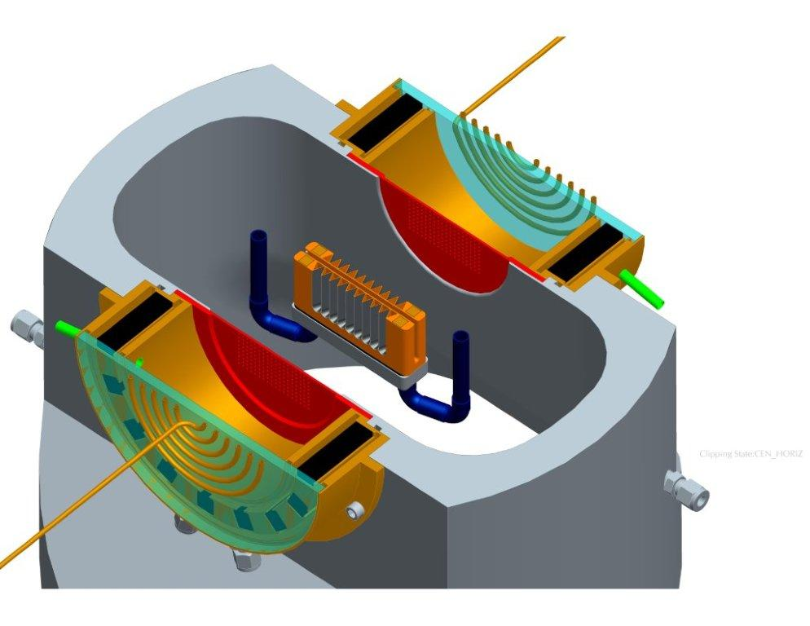
High Flux Neutron Generator at UCB
- how it works
RF
D Plasma
100kV
DD Fusion
2.45MeV neutrons
D beam
1-1000mA
Deuterium Gas
H₂O

Slide 11
The ⁵⁶Fe(n,n’γ_{2->0}) partial cross section was well-measured
using the GEANIE spectrometer

Slide 12
Neutron spectral characterization
Activation foils
Result of a constrained linear least-squares fit and non-linear 5-parameter functional fit to five thresholding activation reactions.
(29 MeV deuterons on tantalum)
Meulders et al, Phys. Med. Biol.,
1975, 20 (2), pp 235-243

Slide 13
Geochronology: K-Ar Dating Method
Rocks
We have some rocks. We want to know how old they are.
At formation, an initial fixed quantity of potassium is trapped in each rock.
Electron Capture Decay of ⁴⁰K to ⁴⁰Ar: half life of 1.2 billion years.
By measuring ⁴⁰K content versus ⁴⁰Ar content, can determine age of rock sample.
³⁹K
⁴⁰K
t_{1/2}=1.2 Gyr
⁴⁰Ar
Measure K Content
Determine Age
Measure Ar Content

Slide 14
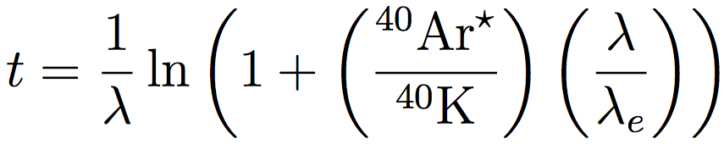
Geochronology: K-Ar Dating Method
Two Different Measurements Required to Determine Age:

Slide 15
Geochronology: ⁴⁰Ar/³⁹Ar Variant
Rocks
Enter nuclear physics: the ³⁹K(n,p)³⁹Ar reaction.
Neutron irradiation of K-containing samples will produce ³⁹Ar.
Comparison of measurement of two Ar isotopes determines age.
³⁹K
³⁹K(n,p)³⁹Ar
³⁹Ar
⁴⁰K
t_{1/2}=1.2 Gyr
⁴⁰Ar
Measure K Cotent
Determine Age
Measure Ar Content

Slide 16
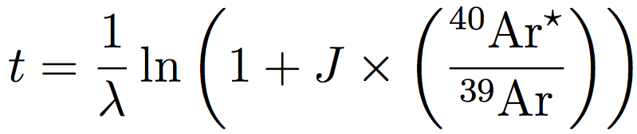
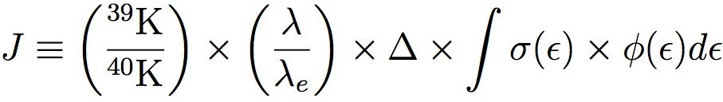
Geochronology: ⁴⁰Ar/³⁹Ar Variant
Single Measurement Required to Determine Age:
With neutron fluence parameter, J:

Slide 17
Neutron Fluence Parameter, J
Currently, J is determined from irradiating “standard” samples of “known” age. These standards are arrayed around the sample, and J is extrapolated between them.
Introduces uncertainty in age from standards and increased time spent irradiating and analyzing standards.
Solution: measure J. Use activation foils to measure the flux, and use a known quantity of potassium to measure the cross section.
Fixed
Fixed
Known
Unknown

