Slide 1
Present and Future of
BLIP-USNDP collaboration

Slide 2
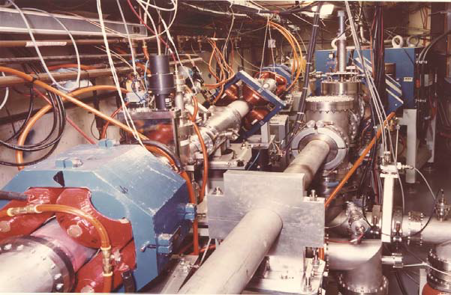
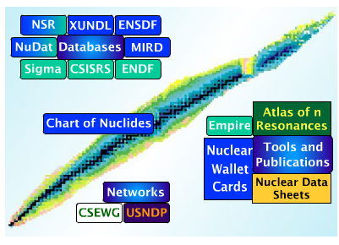
Isotope production
What is needed ?
Accelerator (or reactor)
Targetry
Handling
Chemistry
Decay data
Reaction cross sections
Nuclear spectroscopy
USNDP
BLIP
A BLIP-USNDP collaboration is in a unique position to combine two essential pieces of isotope production to improve quality and enable discovery

Slide 3

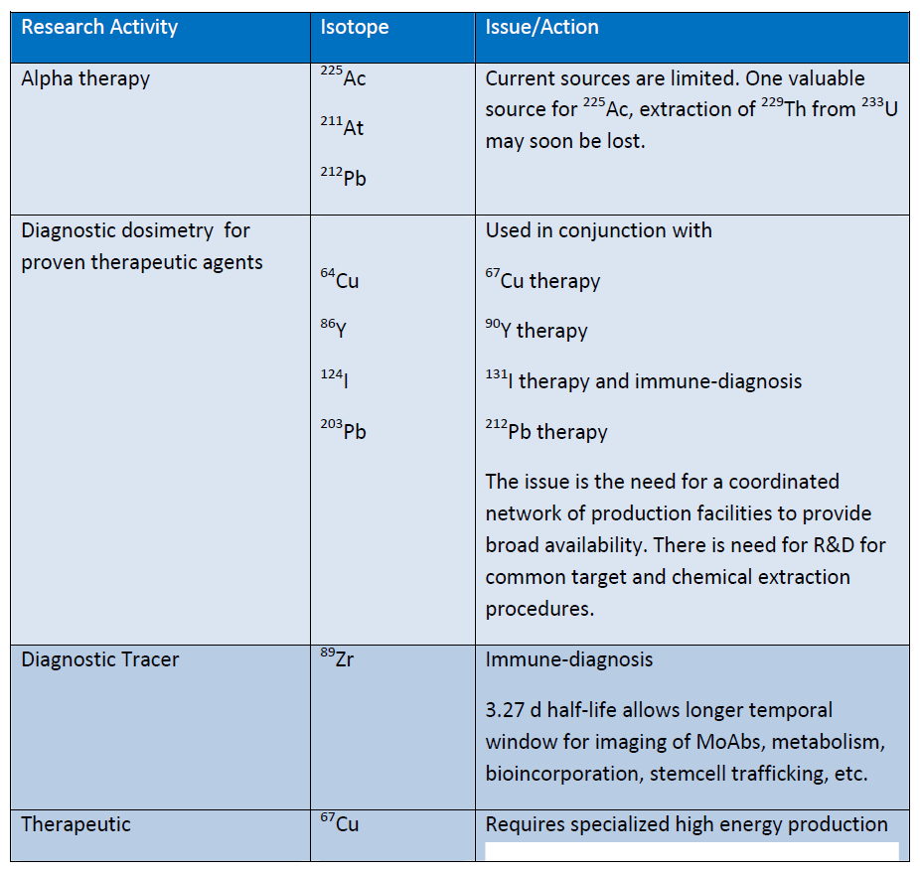
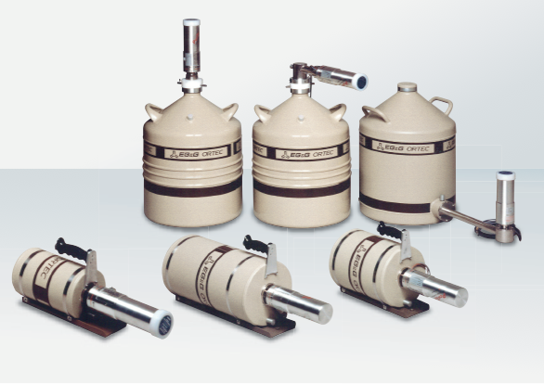
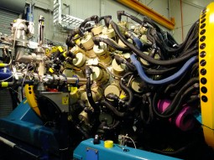
Decay Data
Essential for determining:
Overall dose
Specific dose
Imaging background
Production cross section
Over half were last studied >30 years ago !!
30 Years ago: 1-2 small detectors
Present: 10-100 detectors

Slide 4
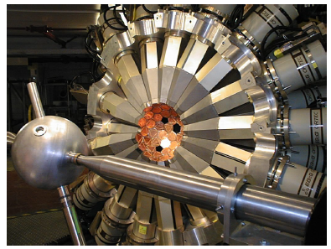
USNDP-BLIP Decay Data Collaboration
Important medical isotopes requiring new measurements of decay data produced at BLIP
Shipped to world’s largest γ-ray array Gammasphere (100 HPGe detectors) for high-precision γ-ray spectroscopy

Slide 5
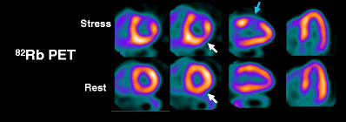
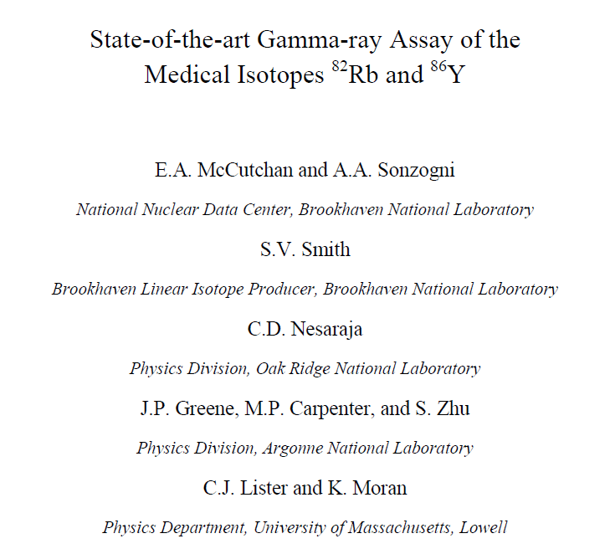
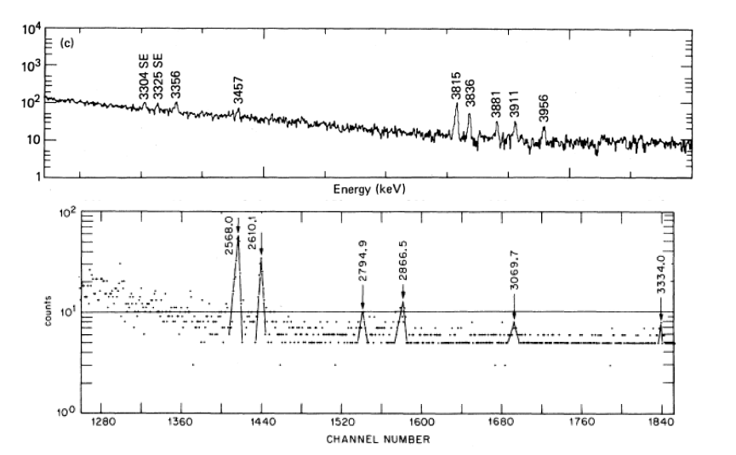
First steps
⁸²Rb for Cardiac PET: A BLIP standard
R.A. Meyer et al., Phys. Rev. C 27, 2217 (1983).
⁸⁶Y for PET:
A new high priority isotope
Accepted last ANL PAC for 14 days with Gammasphere
A.V. Ramayya et al., Phys. Rev. C 2, 2248 (1970).

Slide 6
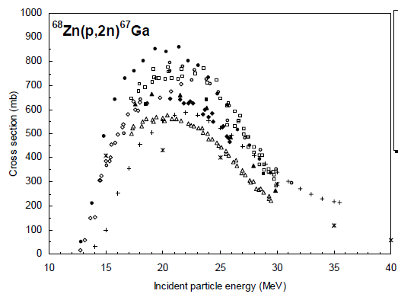
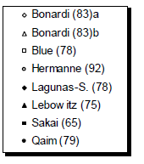
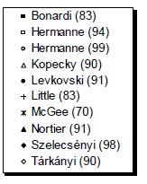
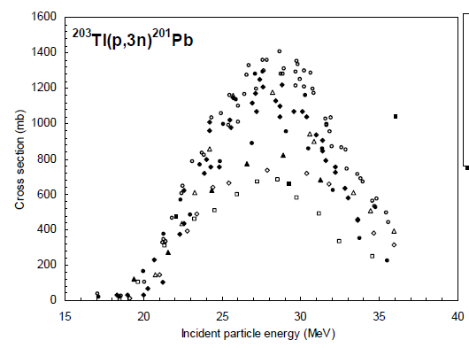
Many cross sections not well determined
Imaging
Cardiac Imaging
?
Cross Section
Very little data
Potential for discovery
100
150
200
Proton Energy (MeV)

Slide 7
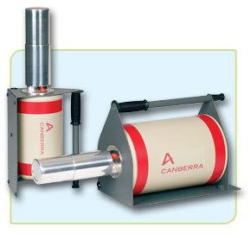
USNDP-BLIP Cross Section Collaboration
Source activation performed at BLIP
Samples sent to UMASS-Lowell
for counting
Cross section measurements performed on-site at BLIP
Loan a small array of Compton-suppressed HPGe from nearly facilities
γ-γ coincidences are essential !!!
“Rapid” potential for discovery science
New data could feed into improvements in EMPIRE
Several USNDP members have needed expertize
C. Nesaraja, A. Sonzongi and M. Herman: PhD theses on activation measurements (Nesaraja specifically medical isotope production)

Slide 8
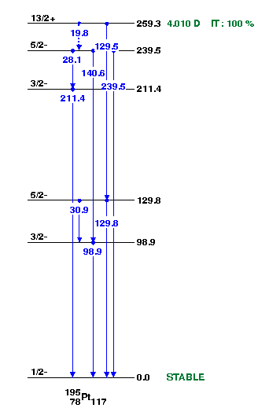
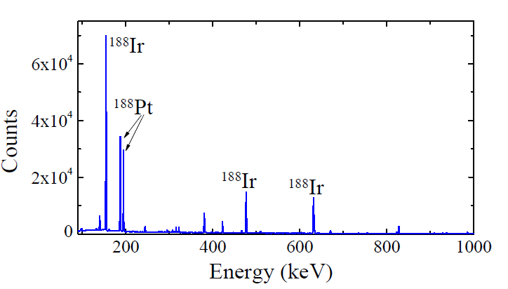
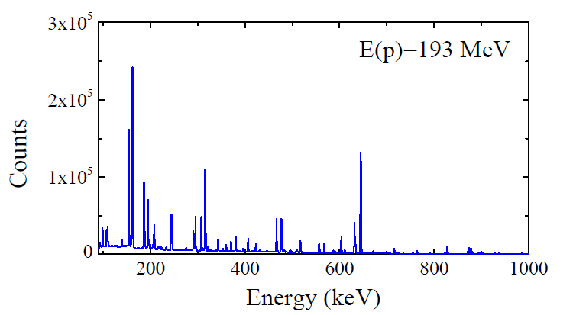
USNDP-BLIP-Lowell Collaboration
Long-lived Pt isomers show high potential for cancer therapy and labelling
Natural Pt samples irradiated at different beam energies and subject to chemical separation
Pt separation
No chemistry
Many thanks to Partha Chowdhury and Bobby Harding

Slide 9
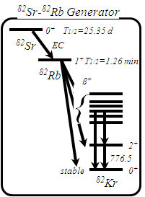
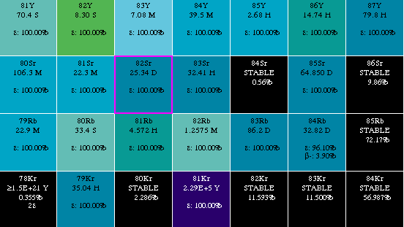
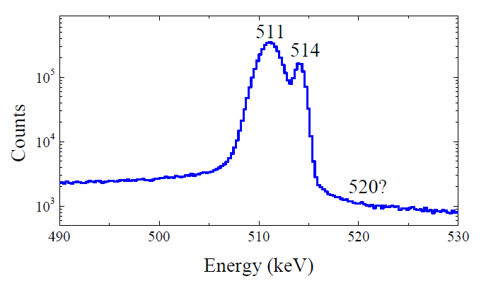
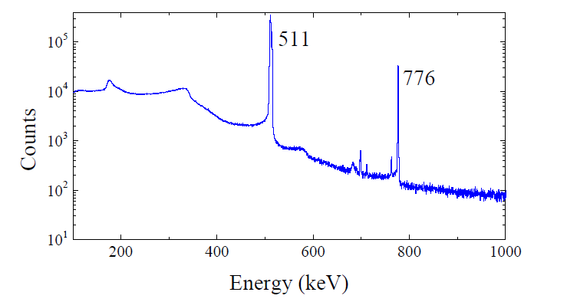
One thing leads to another
514γ
520γ

Slide 10
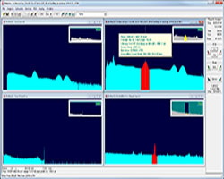
A new starting point
Proper quantification
Ensures quality
Meets regulatory compliance
Has real $$$ implications
Our “basic” spectroscopy tools can make a large impact
Well developed analysis software
Compton-suppression
Improved experimental setups
NaI
NaI
HPGe

Slide 11
Outlook
Initial projects are well underway
Benefits of a data-BLIP collaboration already emerging
USNDP has expertise to expand even further
Person-power is an issue

Slide 12
BACKUPS

Slide 13
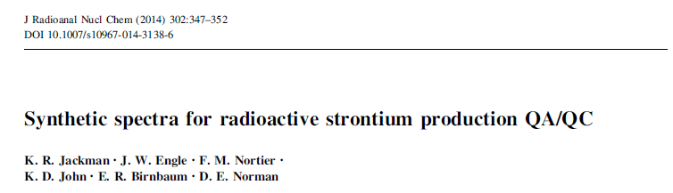

Slide 14
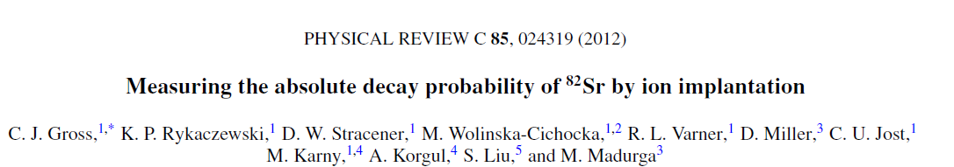
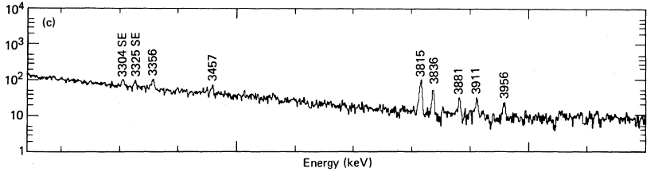
⁸²Rb for Cardiac PET: A BLIP standard
Another true story:
Intensity of 776 γ-ray used to count # of ⁸²Sr
Intensity / decay =
0.134(5) : 1987 Nucl. Data Sheets
0.134(5) : 1995 Nucl. Data Sheets
0.151(2) : 2003 Nucl. Data Sheets
(based on new data from 1987)
0.149(4)
2 Ge(Li) detectors
R.A. Meyer et al., Phys. Rev. C 27, 2217 (1983).

Slide 15
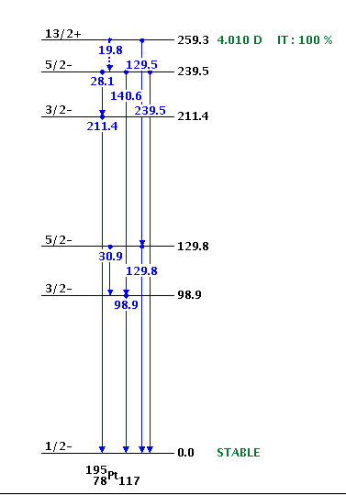
A promising new medical isotope: ^{195m}Pt
Optimizing chemotherapy
Pt compounds cisplatin or carbonplatin usually used
Label to determine tumor uptake
Cancer therapy
Very large Auger electron yield
Local dose of radiation to tumor
The Shocker…
1972 Private Communication
1967 Journal Article
Gamma-ray intensities differ by 10-20%

