Slide 1
CIELO Progress
Mark B. Chadwick
Program Director, Science Campaigns, ADX
Los Alamos National Laboratory
Overview:
Progress for O, Fe, Actinides – including brief summary from WPEC last May
CIELO A, B
Notes:
1) We have extended the Los Alamos (Madland-Nix) model of PFNS in various ways by introducing an anisotropy parameter to model the emission of neutrons from rotating fragments; different temperature distributions in the light and heavy fragments; modified the optical model potentials used to calculate the inverse cross-sections of neutron emissions from the fragments; etc.
2) We have performed an extensive and thorough analysis of experimental PFNS data, including MCNP simulations of several past experimental setups, often leading to significantly increased error bars and significantly more realistic correlation matrices.
3) Items 1) and 2) led to a much more robust evaluation of PFNS data for Pu239 at 0.5 MeV incident neutron energy.
4) This work is done in collaboration with Chi-Nu at LANSCE, and the IAEA (Roberto Capote)

Slide 2
Abstract
This talk summarizes progress made in the community in evaluating nuclear cross sections and fission product data. The Collaborative International Evaluation Library Organization (CIELO) is advancing our understanding of neutron reactions on 1H, ¹⁶O, ⁵⁶Fe, ^{235,8}U and ²³⁹Pu.
Notes:
1) We have extended the Los Alamos (Madland-Nix) model of PFNS in various ways by introducing an anisotropy parameter to model the emission of neutrons from rotating fragments; different temperature distributions in the light and heavy fragments; modified the optical model potentials used to calculate the inverse cross-sections of neutron emissions from the fragments; etc.
2) We have performed an extensive and thorough analysis of experimental PFNS data, including MCNP simulations of several past experimental setups, often leading to significantly increased error bars and significantly more realistic correlation matrices.
3) Items 1) and 2) led to a much more robust evaluation of PFNS data for Pu239 at 0.5 MeV incident neutron energy.
4) This work is done in collaboration with Chi-Nu at LANSCE, and the IAEA (Roberto Capote)

Slide 3

SUMMARY: CIELO Pilot progress, & joint SG39-40 meeting
Collaboration teams for ¹H, ¹⁶O, ⁵⁶Fe, ²³⁵U, ²³⁸U, ²³⁹Pu making good progress, and many starter-files have been made
¹H: standard is being extended from 20-200 MeV.
¹⁶O: changes to (n,a) and (n,tot); starter files coming
⁵⁶Fe: New LRF7 resonance analysis performing well.
Resonance region: excellent progress made by ORNL, Cadarache, Geel, and starter files made for ⁵⁶Fe, ^{235,8}U, ²³⁹Pu
Actinides: fast - focus on inelastic. New capture having impacts.
- Many PFNS issues remain open, though advances are being made
Sg40 collaboration involves attention to credible covariances, and feedback from adjustment results (e.g. ²³⁹Pu capture)
- caution re. adjustment feedback (except single-effect exp)
- convergence in ENDF, JENDL adjustment feedback is rare (Dupont talk).
Operated by Los Alamos National Security, LLC for NNSA

Slide 4
CIELO, like ENDF, JEFF, JENDL, … will serve many purposes
Most accurate understanding of certain reactions, cross sections
  Standards (IAEA, NEA, ENDF)
  Repository for our advancing knowledge
Usage in nuclear technologies, where predicting certain integral quantities accurately is essential
  Transport
  Criticality
  Energy deposition
  Activation
  …
Thus I propose that as we progress we create :
CIELO/A files – unadjusted, with corresponding covariances
CIELO/B files – may involve tweaks, and other judicial choices, again with appropriate covariances
CIELO/C etc – could be adjusted files from SG39 from a formal process, building on CIELO/A?
Notes:
1) We have extended the Los Alamos (Madland-Nix) model of PFNS in various ways by introducing an anisotropy parameter to model the emission of neutrons from rotating fragments; different temperature distributions in the light and heavy fragments; modified the optical model potentials used to calculate the inverse cross-sections of neutron emissions from the fragments; etc.
2) We have performed an extensive and thorough analysis of experimental PFNS data, including MCNP simulations of several past experimental setups, often leading to significantly increased error bars and significantly more realistic correlation matrices.
3) Items 1) and 2) led to a much more robust evaluation of PFNS data for Pu239 at 0.5 MeV incident neutron energy.
4) This work is done in collaboration with Chi-Nu at LANSCE, and the IAEA (Roberto Capote)

Slide 5
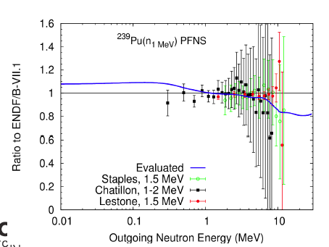
An example of CIELO progress and challenges: PFNS
Talk by Denise Neudecker
  A good representation of existing sectrum data
  But uncertainties exist, including in < 1MeV region and tail region
Performance in integral assessments of spectral indices in Jezebel
  238f/235f – measures n above ~ 1 MeV
  239Pu(n,2n)/239f - measures n above 5.5 MeV
MCNP C/E
239Pu(n,f)
238U(n,f)
239Pu(n2n)
237Np(n,f)
Skip Kahler calcs. – suggest a harder spec, more like VII.1
Av. Energy (MeV)
Notes:
1) We have extended the Los Alamos (Madland-Nix) model of PFNS in various ways by introducing an anisotropy parameter to model the emission of neutrons from rotating fragments; different temperature distributions in the light and heavy fragments; modified the optical model potentials used to calculate the inverse cross-sections of neutron emissions from the fragments; etc.
2) We have performed an extensive and thorough analysis of experimental PFNS data, including MCNP simulations of several past experimental setups, often leading to significantly increased error bars and significantly more realistic correlation matrices.
3) Items 1) and 2) led to a much more robust evaluation of PFNS data for Pu239 at 0.5 MeV incident neutron energy.
4) This work is done in collaboration with Chi-Nu at LANSCE, and the IAEA (Roberto Capote)

Slide 6
An example of CIELO progress and challenges: PFNS
In fact Denise’s evaluation peforms better at matching the high n2n energy spectra indices
  But these are viewed as more uncertain, and less important, than the 239Pu n2n index in Jezebel
169Tm(n,2n)
241Am(n2n)
191Ir(n,2n)
MCNP C/E
239Pu(n2n)
Av. Energy (MeV)
Evaluation decisions involve compromises in matching different data sets
Notes:
1) We have extended the Los Alamos (Madland-Nix) model of PFNS in various ways by introducing an anisotropy parameter to model the emission of neutrons from rotating fragments; different temperature distributions in the light and heavy fragments; modified the optical model potentials used to calculate the inverse cross-sections of neutron emissions from the fragments; etc.
2) We have performed an extensive and thorough analysis of experimental PFNS data, including MCNP simulations of several past experimental setups, often leading to significantly increased error bars and significantly more realistic correlation matrices.
3) Items 1) and 2) led to a much more robust evaluation of PFNS data for Pu239 at 0.5 MeV incident neutron energy.
4) This work is done in collaboration with Chi-Nu at LANSCE, and the IAEA (Roberto Capote)

Slide 7
¹H updated Standards - WPEC May 2014 report
Work by Hale, Paris (Los Alamos)
Builds on previous EDA R-matrix analysis used for ENDF & IAEA standards, but now:
  Has an enhanced measurement database
  Uses new data (e.g. from RPI, and from Ohio - 14.8 any diet)
  Being extended from 20 to 200 MeV
New file will be made later this year, including covariances
(Preliminary results suggest only very small changes compared to the existing Standards.

Slide 8
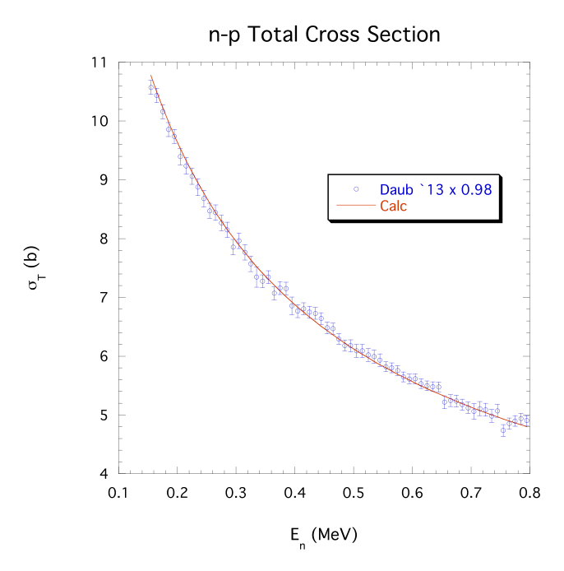
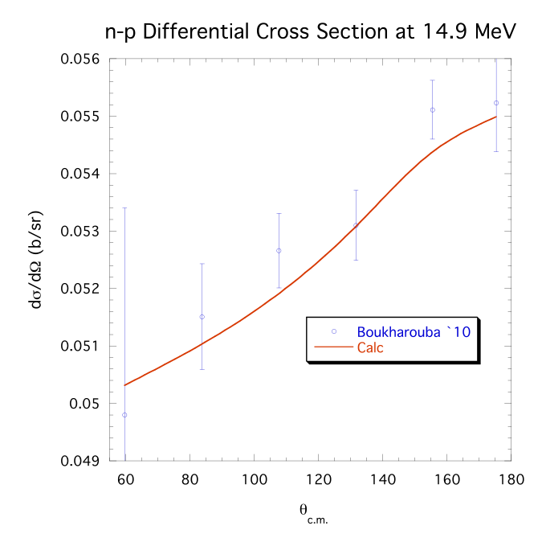

¹H recent data added to analysis
Operated by Los Alamos National Security, LLC for NNSA

Slide 9
¹⁶O - WPEC May 2014 report
Work by Plompen, Lubitz, Kunieda, Hale, Paris, Leal, etc
16O(n,alpha): Some in the R-matrix teams concluding a higher (n,alpha), more like ENDF/B-VI.8 is perhaps correct
  Given by R-matrix & unitarity
  Supported by newly-revised Geel (Georginis) data
At least 2 files will be tested (which will use ~3% lower total cross section at low energies, as concluded by Plompen, Lubitz, et al:
  Hale file, & a Lubitz - Leal file variant
New files for testing
  suite of key integral experiments and crits for data testing is being defined
  We will need to focus on scattering angular distributions
Operated by Los Alamos National Security, LLC for NNSA

Slide 10
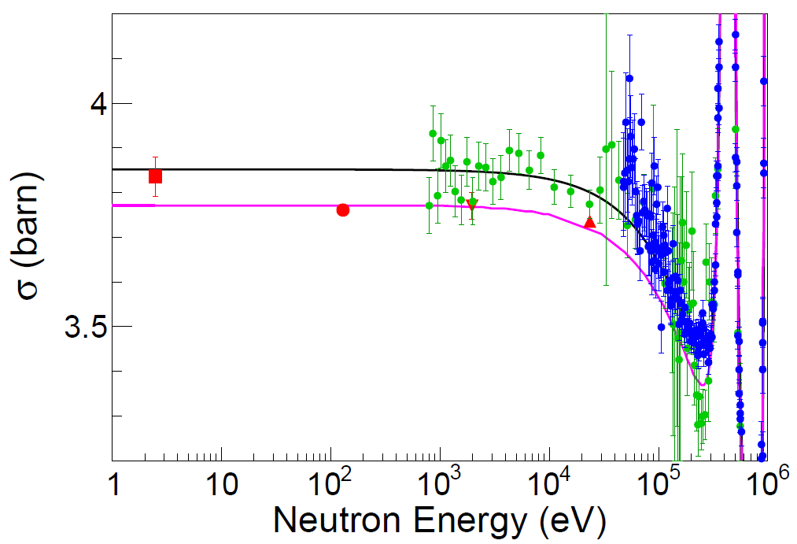
¹⁶O. Progress in Understanding Low-Energy Total Cross Section
Work from Kunieda, Plompen, Lubitz and team
Contributions of H in the sample were estimated by
R-matirx fitting to the experimental data.
Exp. | Factor to σ_{H}(E)
Johnson+ (1974) | 0.01665 (± 6.02%)
Ohkubo (1984) | 0.00988 (± 8.38%)
Moxon data biased by material effects?
Ohkubo, Johnson data biased by 1H content
Moxon74
Dilg71
Koester90
Block75
ENDF/B-VII.1
Present
Operated by Los Alamos National Security, LLC for NNSA

Slide 11
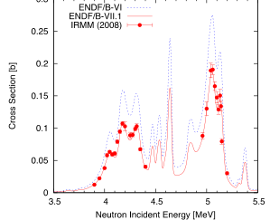
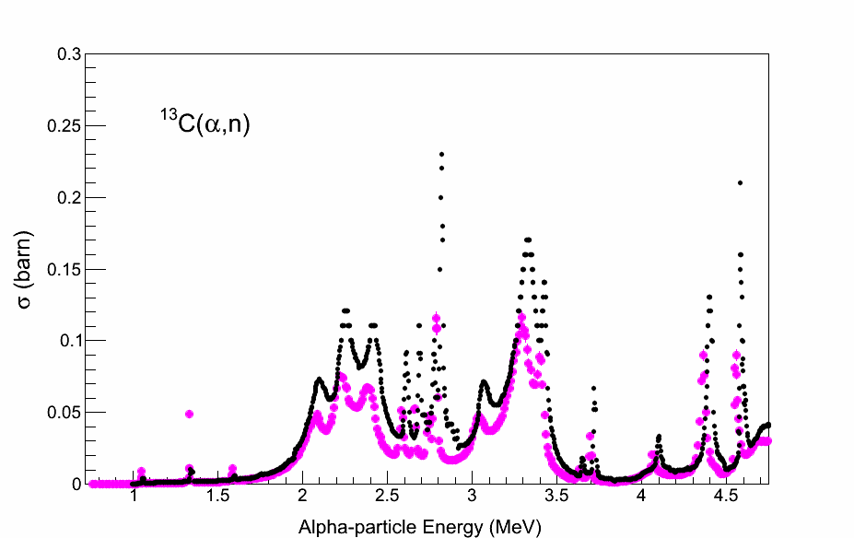
¹⁶O. Progress in Reconciling R-Matrix Theory & Data?
Longer Term - TPC experiment?
IRMM data now to be revised up by Georginis
evaluation likely to increase close to VI.8
Team thinks orig Bair & Haas correct
Harissopulos off by ~ 50% ?
Bair & Haas + (73)
¹³C(α,n)¹⁶O
Harissopulos+ (05)
σ (barn)
Alpha-particle Energy (MeV)
Operated by Los Alamos National Security, LLC for NNSA

Slide 12
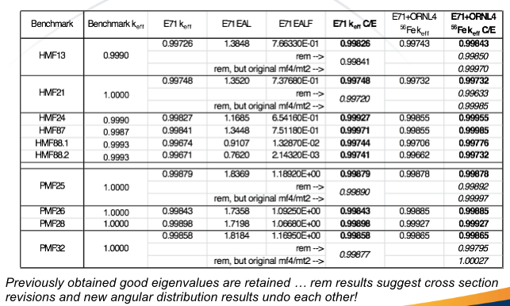
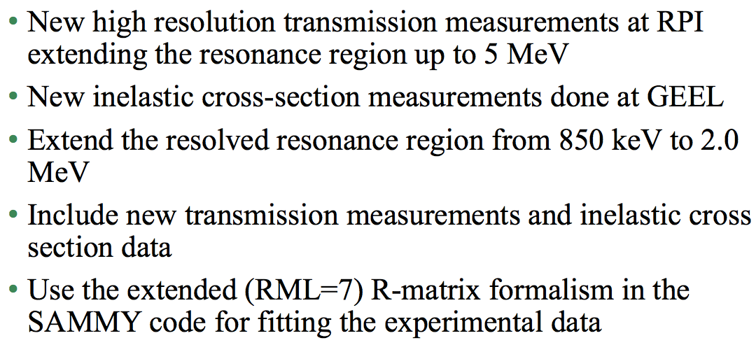
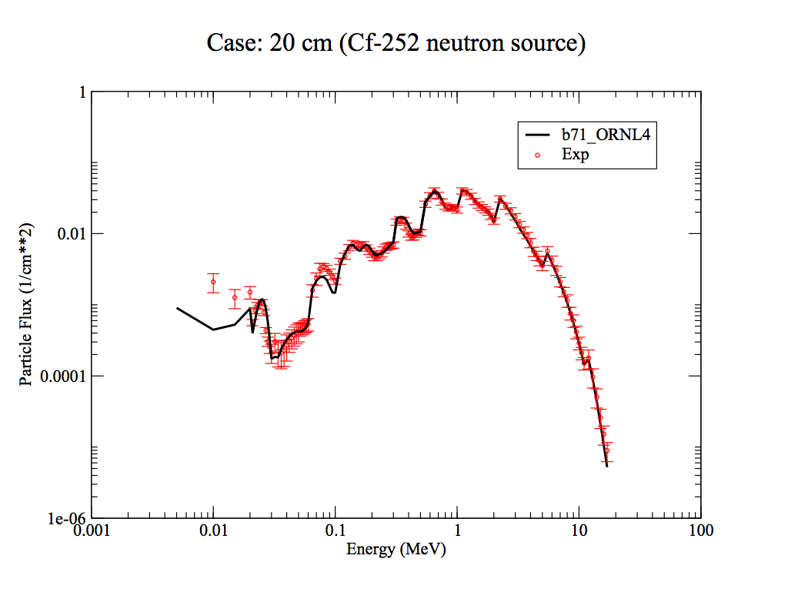
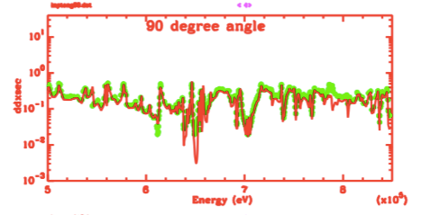
⁵⁶Fe: Resonance Analysis Progress up to 2 MeV
IPPE exp. (Ivanova)
Operated by Los Alamos National Security, LLC for NNSA

Slide 13
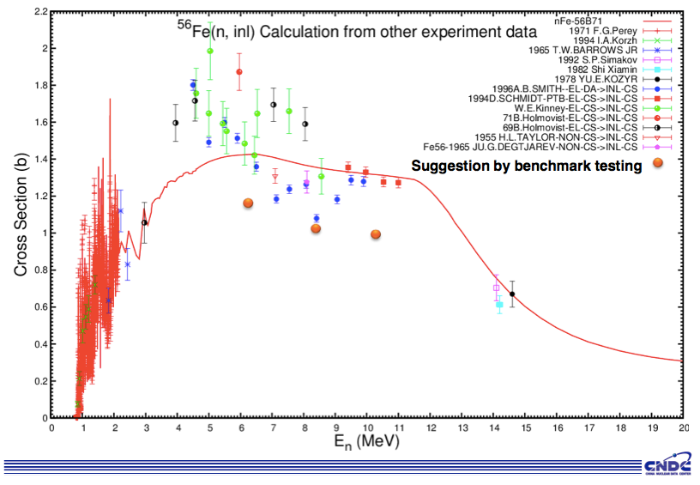
⁵⁶Fe: Fast Range - BNL and collaborators….
Many issues to work, as a new high energy evaluation is developed
Jing Qian: Conclusions from Ohio experiment on inelastic problematic?
Operated by Los Alamos National Security, LLC for NNSA

Slide 14
²³⁹Pu SG34 resonance analysis from Cadarache, Oak Ridge, Cadatache -
WPEC May 2014 report
SG34: new RR to 2.5 keV & covariances; a better n,gf understanding, with implications on nubar fluctuations; PFNS was studied too
Thermal values: cap 270.1, fiss 747.2, and nu-prompt=2.868. The SG 34=3.1.1 has a nubar slightly lower than ENDF, which was already one s.d. below the standard
New measurements are proposed - transmission for first 0.3 eV resonance; capture … (new IRRM fission, & Los Alamos capture data). There may be a need to extend the resolved range to higher energies owing to the fluctuating cross sections.
PFNS: Using Kornilov/Maslov decreases the mean energy, and increases the crits by 800/400 pcm.
Lubitz studying adjustments (Noguere notes this was done already by them!). Initial approach (on VII,1): incr. capture, decr, fission, decreasing nubar, hardening chi,but within ~13% of 1-sigma
  We’ll see other studies by Romano & Lubitz looking at just a thermal Chi adjustment
Operated by Los Alamos National Security, LLC for NNSA

Slide 15
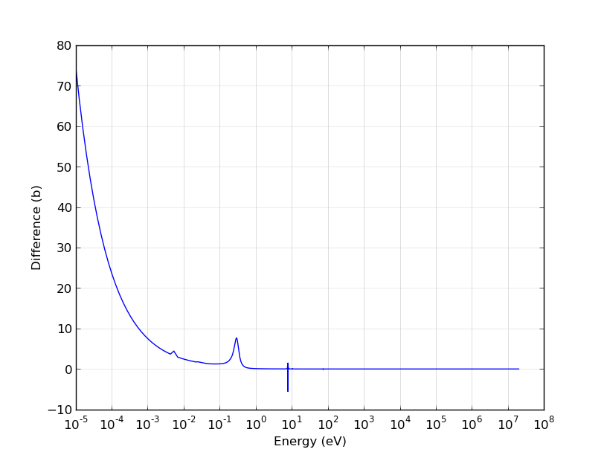
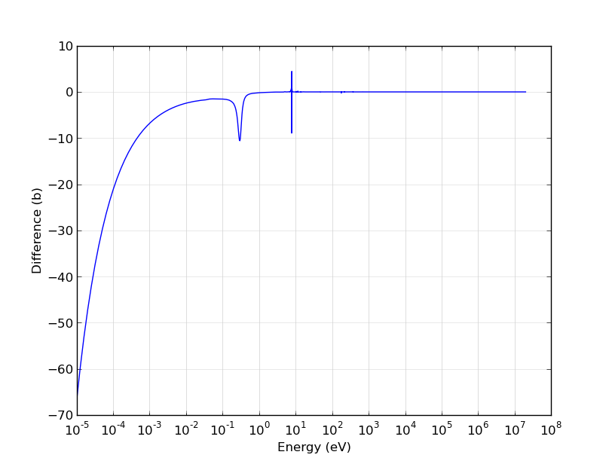
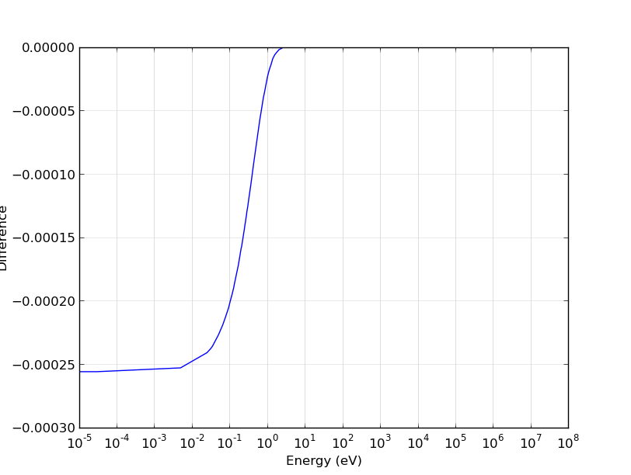
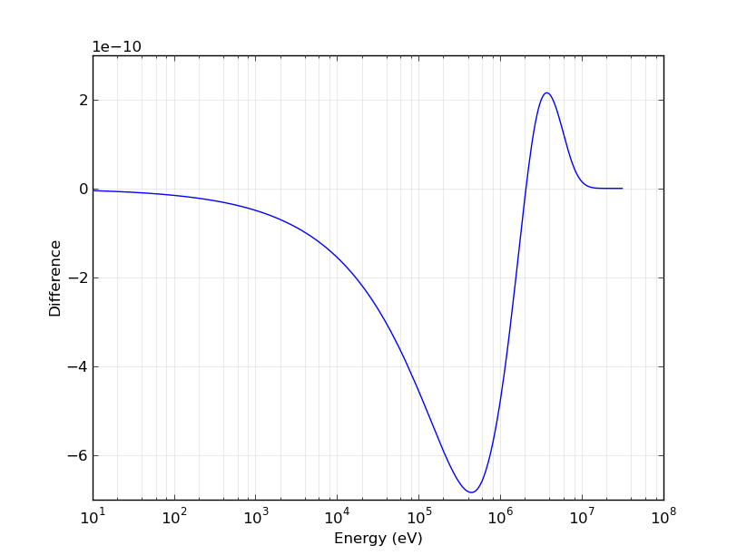
²³⁹Pu Adjustments from Cecil Lubitz & Paul Romano
(Study Based on VII.1. More Work is Planned here)
capture
fission
nubar
pfns - anti-maslovian!
We need SG34 team to interact with Lubitz on tweaks
Operated by Los Alamos National Security, LLC for NNSA

Slide 16
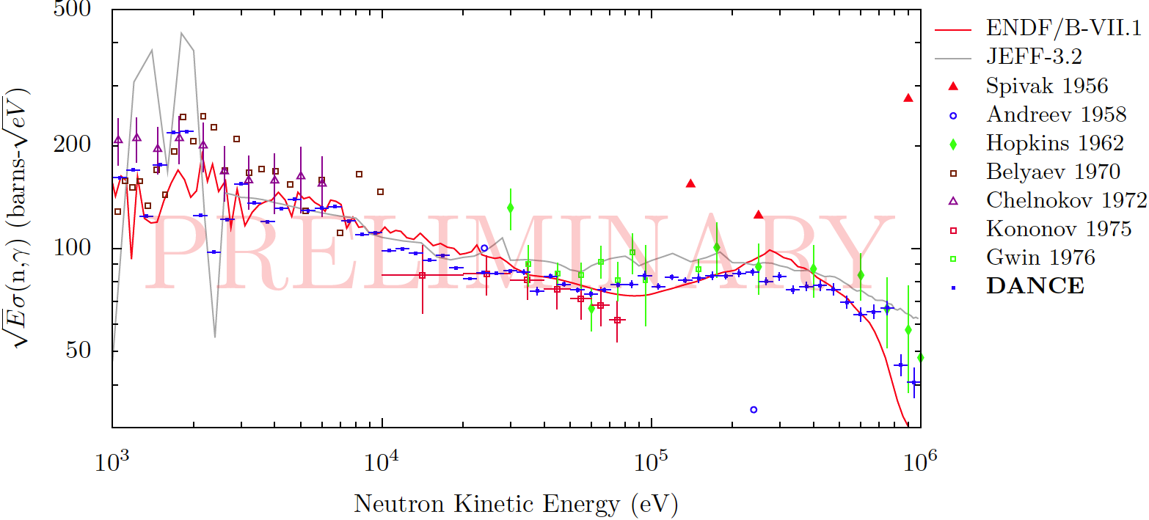
Preliminary LANL Results for ²³⁹Pu – finalized later this year. Sammy analysts should interact with Shea here.
Backgrounds still being investigated
Expect 4% uncertainty at 10 keV similar to Jandel work on U5

Slide 17
²³⁹Pu : Fast region, & testing. WPEC May 2014 report
Kawano has been focusing on Pu inelastic scattering, in collaboration with CEA, IAEA. We also have new 239Pu capture data from LosAlamos. A trial file will be made later this year.
CIELO starter file built that combines ENDF/B-VII.1 with SG34.
Kahler testing CIELO-version0 (=TK1a) as expected reproduces SG34 for thermal systems: improved performance for solution criticals.
Trial PFNS from Talou added for testing (version1=TK1). Thermals show a 100-400 pcm increase, reflecting something that is known, i.e. a softer thermal PFNS increases calculated criticality
To investigate the potential sensitivity of threshold dosimetry calculations to scattering cross sections, we will calculate results for JEFF3.1 (which has v. different inelastic cf. ENDF)
Operated by Los Alamos National Security, LLC for NNSA

Slide 18
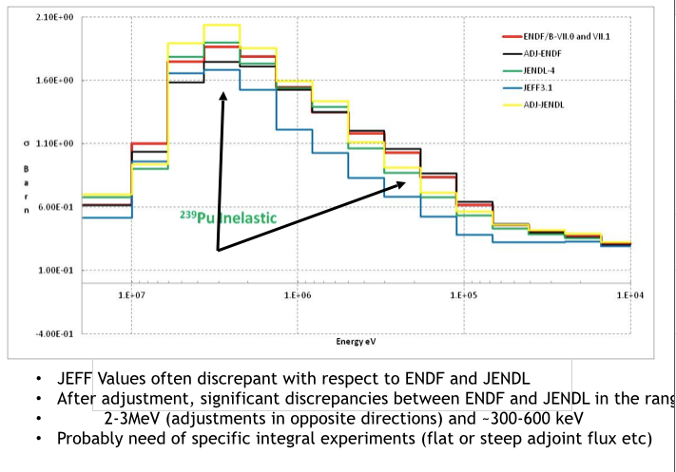
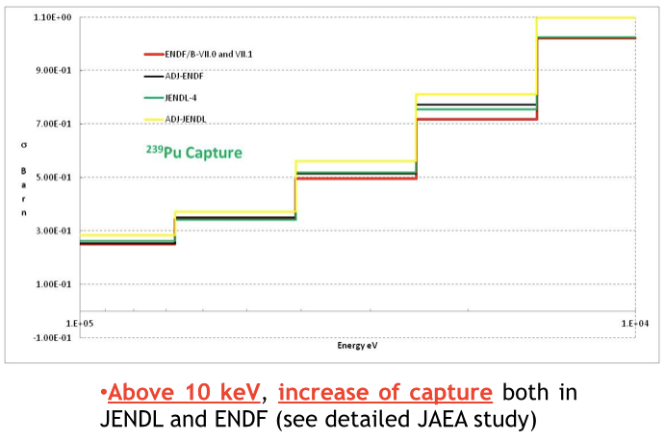
Examples of Feedback from SG39 Adjustment Project
(Results V. Sensitive to Starting Evaluated Cross Sections & Covariances ….)
Sometimes convergent feedback: e.g. 239Pu capture
sometimes divergence - e.g. inelastics diverged near 2-3 MeV
esp. valuable feedback from single-effect integral experiments, e.g. 239Pu(n,g)
Operated by Los Alamos National Security, LLC for NNSA

Slide 19
²³⁸U: resonance analysis from Geel - WPEC May 2014 report
Builds on previous work by Derrien et al, used in ENDF, JEFF, …
Uses new REFIT analysis of new data from:
  Geel (Capture from Geel, Transmission from Dresden)
  nTOF (BaF2 capture being worked, + C6D6 data used)
  LANSCE/DANCE
Uses much older data, e.g. from Oak Ridge
Attention is paid to the capture cross section Standard eval.
Unresolved data presently extends to 149 keV
A file for testing will be provided to Trkov, to be combined with the IAEA higher energy data, for testing
Operated by Los Alamos National Security, LLC for NNSA

Slide 20
²³⁸U fast analysis from IAEA - WPEC May 2014 report
A test file has been made by Capote and Trkov (building upon ENDF/B-VII.1) - ib33.
  overall, data testing looks encouraging.
  Reaction rate testing has been done, for validation
  Flattop-25 31P(n,p) & 235f ratios look pretty good - but they depend upon transport effect (i.e. 238U cross sections for transport have an effect on the results above 10-12 MeV, so one should be cautious in inferring information about PFNS there). Morgan White will motivate new flattop measurements.
Fast region will be merged with new Geel evaluation when ready
Operated by Los Alamos National Security, LLC for NNSA

Slide 21
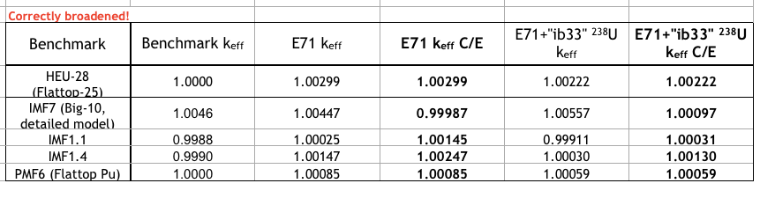
²³⁸U fast analysis from IAEA - Kahler/Trkov MCNP calks
Excellent performance
Operated by Los Alamos National Security, LLC for NNSA

Slide 22
²³⁵U: resonance analysis from Oak Ridge, Cadatache - WPEC May 2014 report
SAMMY analysis to 2.25 keV. Builds on WPEC sg. 29 findings (that ENDF capture should be reduced near 1 keV). Uses new:
  DANCE (Jandel) - lower resolution
  RPI - in 500 eV to 3 keV, lower than ENDF.
Fitting was also done for eta, and integral K1, Westcott factor, and capture resonance integral, into SAMMY
Benchmarks FCA, Zeus, support these changes, & HMI-1 with iron. Noguere has updated unres. res. 2.25-25 keV & Profil data.
IAEA working to make 235U thermal PFNS a standard; work will be needed to see if this can be accommodated with other tweaks.
A file for testing was made (fused with JENDL). We need to make merged file with ENDF, and with Romain’s new high energy file.
  Need to see performance for sodium-void Japanese expts
Operated by Los Alamos National Security, LLC for NNSA

Slide 23
²³⁵U fast analysis from CEA/BIII - WPEC May 2014 report
Collaboration meeting held on inelastic scattering at BIII (with Kawano, Capote) for all actinides, including Pu. Part of the difference was traced to JEFF having a higher total cross section for 239Pu. More work is needed still, though, since this does not explain the inelastic differences (a Morillon Pu chi was tried too - somewhat maslovian -).
235U inelastic is smaller than for ENDF, JENDL.
Capture is being worked on
Draft file will be available at the end of the summer.
(Preliminary testing of ORNL8 file shows some performance degradation (over-prediction) of poly-reflected HMF benchmarks, owing to the reduced capture below 2 keV. HST good performance in VII was preserved)
Operated by Los Alamos National Security, LLC for NNSA

Slide 24
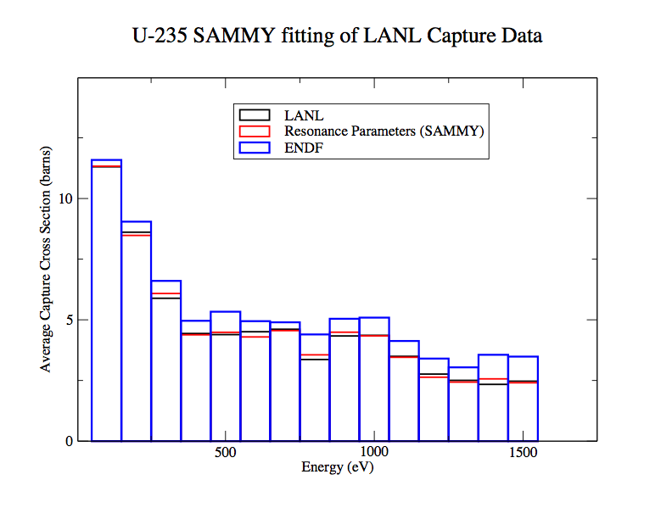
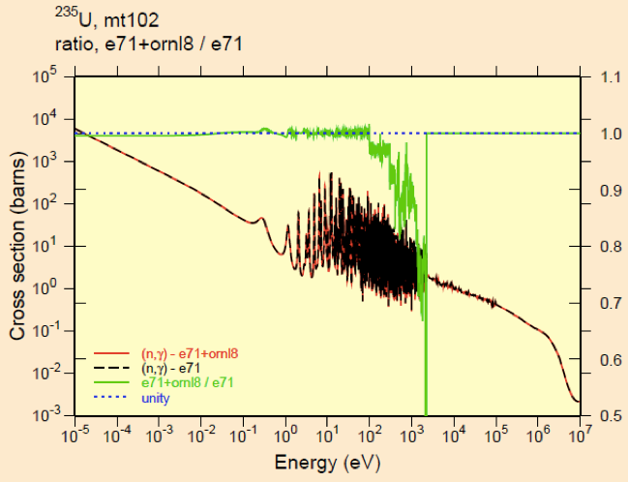
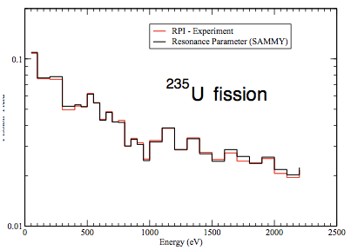
²³⁵U capture: New LANL/DANCE & RPI data impacting SAMMY
As Suggested by Japanese Colleagues
Previous problem in ENDF/B-VII
Sammy RR analysis (CIELO starter file)
Matches new DANCE and RPI data
Higher capture could have a big impact
But DANCE > VII.1 from 2.5 - ~80 keV
Operated by Los Alamos National Security, LLC for NNSA

Slide 25
JENDL adjustment feedback -239Pu
239Pu capture above 3 keV increased by 9%. this was influenced by ZPPR-9 (keff, C28/F49, F28/F49), [& adding Jezebel criticality does not prevent this adjustment, because other things then change]
  (the Profil feedback also suggesting a capture increase is a different study, from Palmiotti)
239Pu fission is adjusted with a decrease of 0.5%
elastic increased by 2%
inelastic - increased by 10% at maximum, and compensates the PFNS spectrum hardening adjustment
fission spectrum - hardened by 4% (at 10 MeV out 4% higher, and 0.1 MeV out, 4% lower) - just for fast systems
  (anti-maslovian effect)
Decreases prompt nubar by 0.2%
Operated by Los Alamos National Security, LLC for NNSA

Slide 26
ENDF adjustment feedback -239Pu (VII.0 +Commara 2.0 starting point)
Based on Fast Integral Experiments, incl COSMO, PROFIl, TRAPU reaction rate expos
5 More crit masses - ZPR34,53,54, cirano 2a,2b assemblies. Have chi for 5,8U unc from jendl and p1 leas
Inelastics 238U, 239Pu, reduced in the 1-5 MeV range; 235U doesn’t change
  especially at the peak of the inelastic
239Pu capture is increased by 5-10% from 1 keV-50 keV (Profil) - apparently confirming JENDL - a single effect experiment
239Pu fission covariances - smaller than variation in evaluations
235U capture doesn’t change much - but they didn’t have the FCA-type experiments from Japan that are sensitive to them
PFNS - unchanged really
Profil - 239Pu n2n increased ; 238U n2n reduced by a few percent
56Fe - inelastic lowered slightly; capture at 1.2 keV lowered slightly
New Mantra INL experiment (irradiating pure samples of many actinides) in ATR reactor. Samples in different spectra were made. Data coming out soon - analyzed with AMS at argonne, and also standard spectroscopy. Mantra-2 is planned.
Warning was given - of compensating errors that might bias conclusions, including weaknesses owing to missing experiments, and missing covariances: secondary energy distributions for inelastic scattering, P1 for elastic, etc.
Operated by Los Alamos National Security, LLC for NNSA

Slide 27
Dupont/NEA Comparison of SG39 Results
graphs made of prior and posterior cross section for INL and JAEA results
show posterior JAEA/INL to see where they ended up. More graphs will be made to see the extent to which they converged.
capture 239pu - jendl adjusted is higher by 5-10% in 20 keV- 200 keV (and lower at lower energies, 2-10 keV since JENDL did not include the PROFIL adjustment!)
Operated by Los Alamos National Security, LLC for NNSA

Slide 28
Salvatores Comparison of SG39 Results
238U inelastic: JEFF discrepant wrt ENDF and JENDL. Jeff higher near peak above a few MeV. Adjustments suggest ENDF decreased.
Not much evidence of convergence as one looks at posterior files for ENDF, JENDL, JEFF
PROFIL 235U capture data should be investigated with Profil and Mantra, to see how the updated Sammy (using DANCE, RPI data) perform. Profil had suggested a few-percent under prediction of ENDF. How does the result change? Mantar has at least 3 tailored spectra, including fast.
Profil drives 239Pu capture up in the say 1-10 keV region.
At 2 keV fission in 239Pu is quite a bit higher than JENDL (a fluctuation) - about a 10% difference in one bin near 2 keV!
Pu inelastic - JEFF a lot lower, and post-adjustment changes significant
Chi JENDL and ENDF differ significantly at the very high energies - at 20 MeV out, chi in JENDL one order of mag higher!
Need complete covariance data, including on secondary neutron energy distributions and angular distributions, as well as key correlations amongst reactions and isotopes (e.g. u5 fission impact)
Operated by Los Alamos National Security, LLC for NNSA

Slide 29
JENDL adjustment feedback -238U
238U captures - adjusted within 2%
mu-av decreased by 8%. Want to see convergence in the major libraries
elastic increased by 2%
Operated by Los Alamos National Security, LLC for NNSA

Slide 30
JENDL adjustment feedback -235U
235U captures - decreased near 1 keV (as in new CIELO, and in JENDL4)
fission - no feedback
Operated by Los Alamos National Security, LLC for NNSA

