Slide 1
Comments on RULER:
Contribution of branching ratio uncertainties ΔBR_{i} to reduced gamma-ray matrix elements uncertainty ΔB(σ_{λ})
N. NICA
TEXAS A&M UNIVERSITY
Reviewer’s comment on ¹⁴¹Pr :
“There are some problems with RULER calculations. In particular, ¹⁴¹Pr has many transitions strengths which need fixed (actually just the uncertainties)”
The dataset contained generally very large asymmetrical ΔT_{1/2} values known to produce problems;
also large ΔBR_{i} values

Slide 2
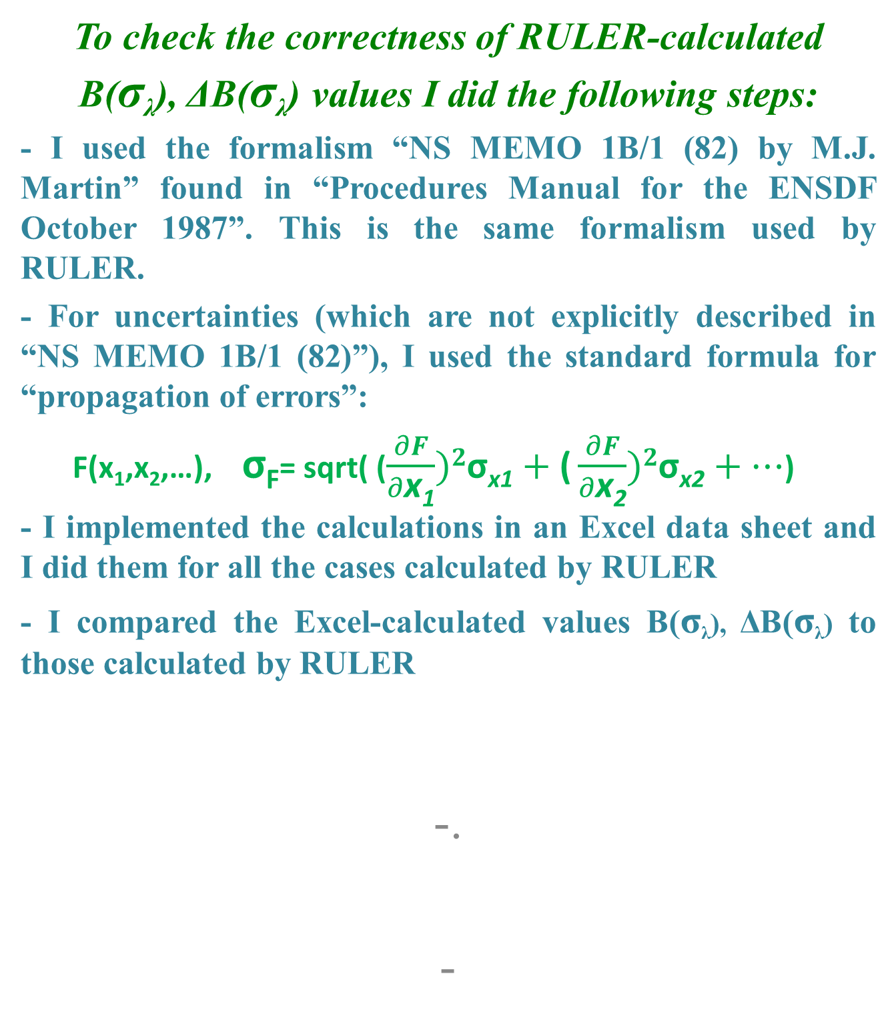
Comments on RULER: branching rations
To check the correctness of RULER-calculated B(σ_{λ}), ΔB(σ_{λ}) values I did the following steps:
- I used the formalism “NS MEMO 1B/1 (82) by M.J. Martin” found in “Procedures Manual for the ENSDF October 1987”. This is the same formalism used by RULER.
- For uncertainties (which are not explicitly described in “NS MEMO 1B/1 (82)”), I used the standard formula for “propagation of errors”:
F(x₁,x₂,…), σ_{F}= sqrt( ($\frac{∂F}{∂\text{x}\text{1}})2\text{σ}\text{x}\text{1}+\text{(}\frac{∂F}{∂\text{x}\text{2}})2\text{σ}\text{x}\text{2}+…$)
- I implemented the calculations in an Excel data sheet and I did them for all the cases calculated by RULER
- I compared the Excel-calculated values B(σ_{λ}), ΔB(σ_{λ}) to those calculated by RULER
-.
-

Slide 3
Comments on RULER: branching rations
- For all B(σ_{λ}) values I retrieved in Excel the same values as those calculated by RULER.
- For many of ΔB(σ_{λ}) cases I retrieved in Excel either the same values or very close values as those calculated by RULER:
- Either one or both ±ΔB(Eλ) values calculated with RULER and Excel differ by one unit of the last digit, with Ruler value higher than Excel value. That could result from slightly different numerical formats used by the two platforms (that by rounding off produce the difference). While this is rather hypothetical by now I would not consider these cases as incorrect but rather not (yet) relevant for the scope of comparison.
Examples: B(E2,2607.1γ), 0.9 +4-9 (RULER); 0.9 +4-8 (Excel)
B(E1,2603.1γ), 0.00040 +14-18 (RULER); 0.00040 +13-17 (Excel)

Slide 4
Comments on RULER: branching rations
- Some other cases result from the rounding off (by RULER) to multiples of ten; so equally rounding off the Excel values give the same results, which consequently are correct. Example: B(E2,559.0γ), 140 +60-140 (RULER); 144 +56-144 (Excel)

Slide 5
Comments on RULER: branching rations
- Some other cases result from the rounding off (by RULER) to multiples of ten; so equally rounding off the Excel values give the same results, which consequently are correct. Example: B(E2,559.0γ), 140 +60-140 (RULER); 144 +56-144 (Excel)
- There are 5 cases of a total of about 90 where the ΔB(E_{λ}) uncertainties differ by 2 or more units – those calculated by RULER being systematically higher than those calculated by Excel – that I considered definitely WRONG.
 | RULER | Excel
B(E1,2452.7γ)(W.u.) | 0.00083 +17-19 | 0.00083 +14-17
B(E1,2418.0γ)(W.u.) | 0.000106 +23-26 | 0.000105 +19-22
B(E2,1271.6γ)(W.u.) | 13 +10-11 | 13 +9-9
B(E2,2732.1γ)(W.u.) | 0.39 +20-24 | 0.39 +17-21
B(E1,2846.2γ)(W.u.) | 0.00012 +10-12 | 0.00012 +8-12

Slide 6
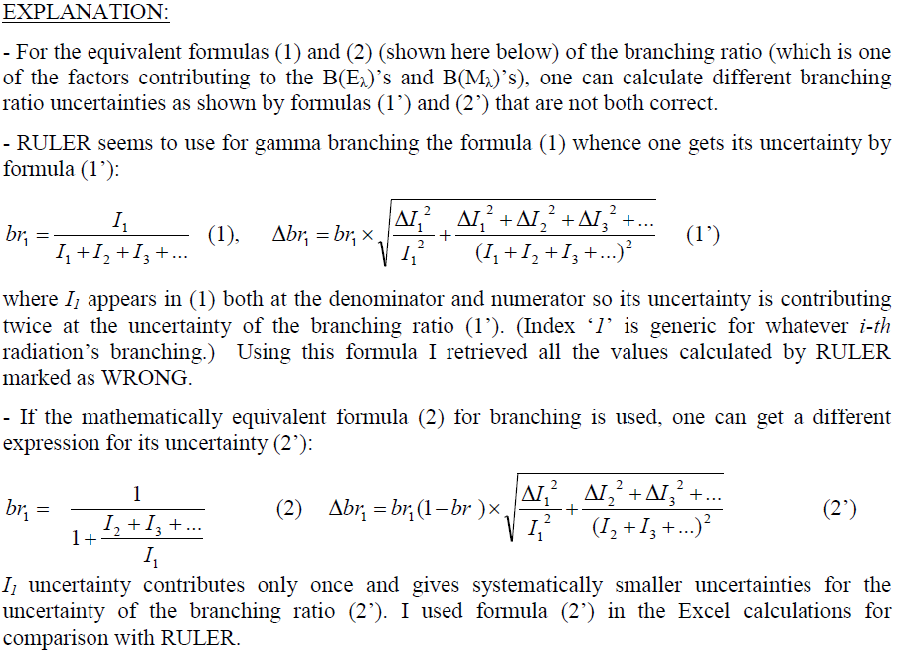

Slide 7

Comments on RULER: branching rations
0) $\frac{a}{b}, \%∆\left(\frac{a}{b}\right)=\sqrt{{(\frac{∆a}{a})}^{2}+{(\frac{∆b}{b})}^{2}}$

Slide 8

Comments on RULER: branching rations
0) $\frac{a}{b}, \%∆\left(\frac{a}{b}\right)=\sqrt{{(\frac{∆a}{a})}^{2}+{(\frac{∆b}{b})}^{2}}$
1) $\frac{a}{a}, \%∆\left(\frac{a}{a}\right)=\sqrt{{(\frac{∆a}{a})}^{2}+{(\frac{∆a}{a})}^{2}}=\frac{∆a}{a}\sqrt{2}$

Slide 9

Comments on RULER: branching rations
0) $\frac{a}{b}, \%∆\left(\frac{a}{b}\right)=\sqrt{{(\frac{∆a}{a})}^{2}+{(\frac{∆b}{b})}^{2}}$
1) $\frac{a}{a}, \%∆\left(\frac{a}{a}\right)=\sqrt{{(\frac{∆a}{a})}^{2}+{(\frac{∆a}{a})}^{2}}=\frac{∆a}{a}\sqrt{2}$
2) $\frac{a}{a}, \%∆\left(\frac{a}{a}\right)=∆\left(1\right)=0$

Slide 10
Comments on RULER: branching rations
Conclusions
On ΔBR:
- When the ΔBR values in the dataset were smaller, for most cases both formulas gave the same results (here including the one digit differences).
- Only when the ΔBR are quite big (more than 40-50%) one gets significant differences (2-3 digits).

Slide 11
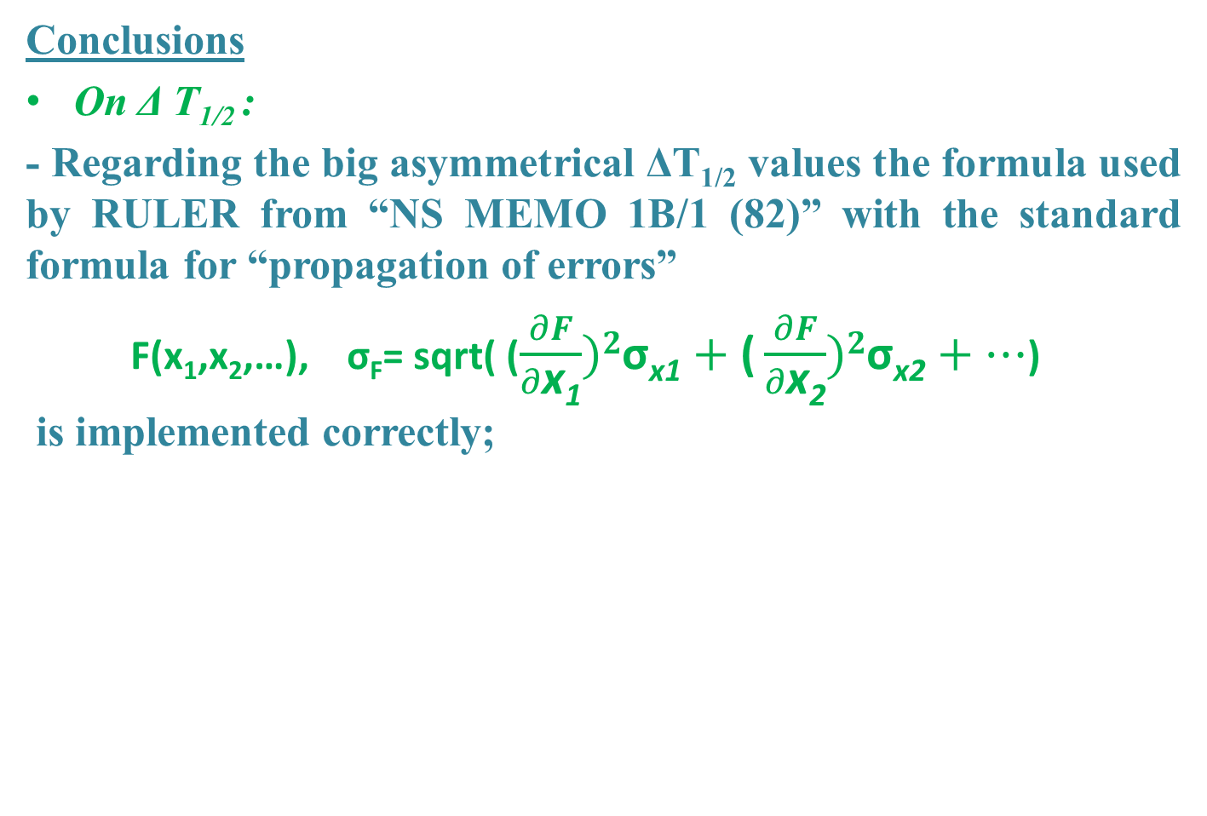
Comments on RULER: branching rations
Conclusions
On Δ T_{1/2} :
- Regarding the big asymmetrical ΔT_{1/2} values the formula used by RULER from “NS MEMO 1B/1 (82)” with the standard formula for “propagation of errors”
F(x₁,x₂,…), σ_{F}= sqrt( ($\frac{∂F}{∂\text{x}\text{1}})2\text{σ}\text{x}\text{1}+\text{(}\frac{∂F}{∂\text{x}\text{2}})2\text{σ}\text{x}\text{2}+…$)
is implemented correctly;

Slide 12
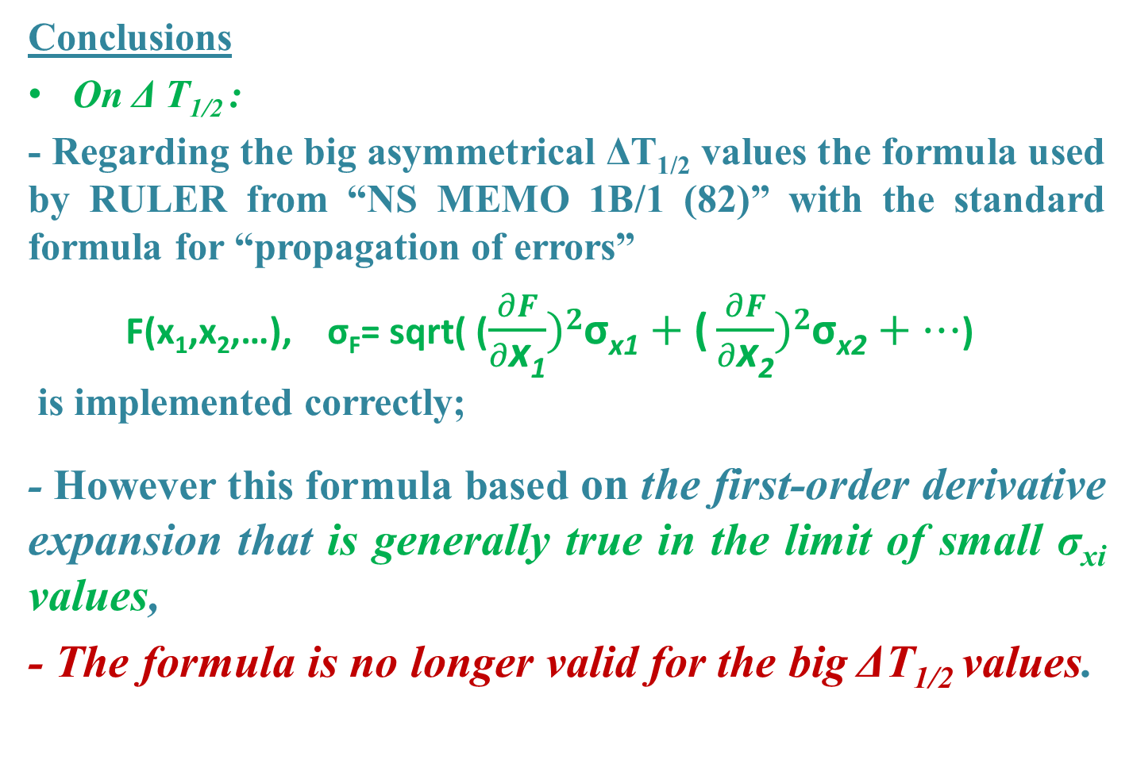
Comments on RULER: branching rations
Conclusions
On Δ T_{1/2} :
- Regarding the big asymmetrical ΔT_{1/2} values the formula used by RULER from “NS MEMO 1B/1 (82)” with the standard formula for “propagation of errors”
F(x₁,x₂,…), σ_{F}= sqrt( ($\frac{∂F}{∂\text{x}\text{1}})2\text{σ}\text{x}\text{1}+\text{(}\frac{∂F}{∂\text{x}\text{2}})2\text{σ}\text{x}\text{2}+…$)
is implemented correctly;
- However this formula based on the first-order derivative expansion that is generally true in the limit of small σ_{xi} values,
- The formula is no longer valid for the big ΔT_{1/2} values.

