Slide 1
NuDat and its uses
A.A. Sonzogni, T.D. Johnson, E.A. McCutchan,
National Nuclear Data Center

Slide 2
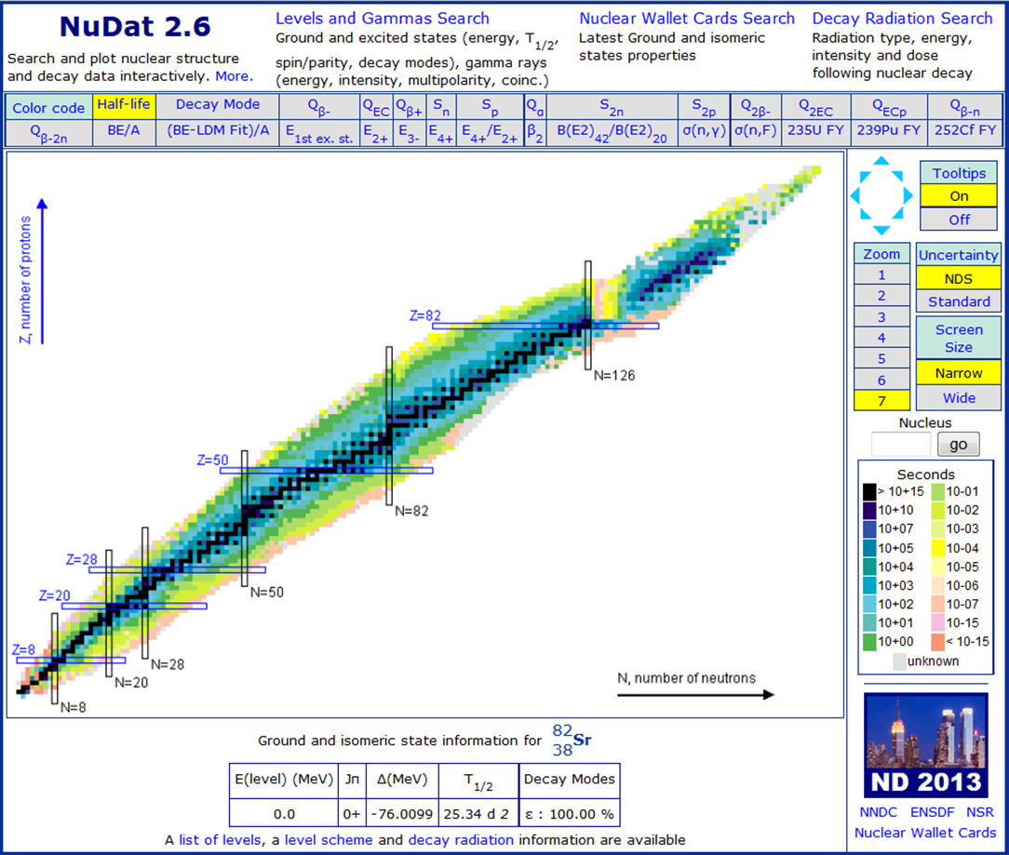
NuDat, the friendly face of ENSDF
2.422 M retrievals in FY 14 (+14.6%)
One use: Extensive search of Half-life and decay mode data

Slide 3
Half-life frequency distribution
In the 1000 to 108 seconds range, there is a factor of ~0.6 drop per decade
Can we understand this behavior?

Slide 4
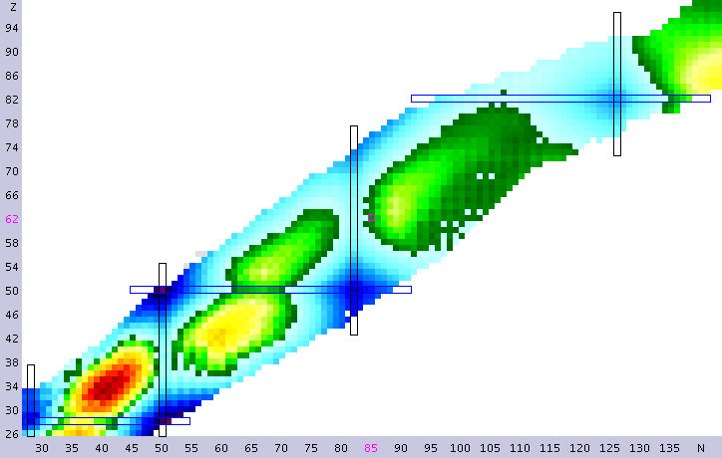
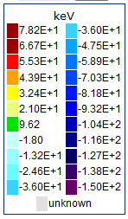
We’ll try to model the behavior of T_{1/2} frequency distributions.
We start with a Liquid Drop Model fit to the 2012 masses.

Slide 5
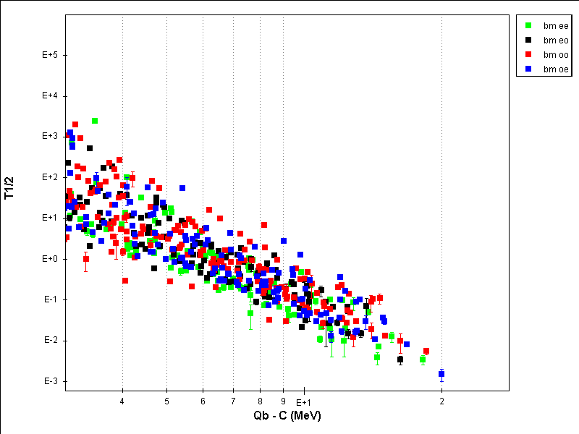
For EC+b+ and b-, we fit all available T1/2 data using a Kratz-Hermann type of dependence.
T_{1/2}=b (Qβ-C)ª

Slide 6
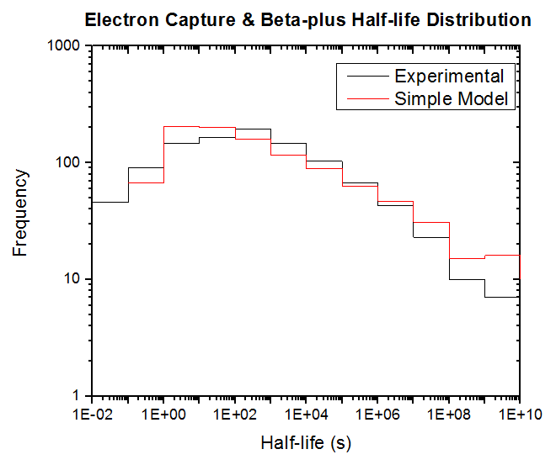
With the LDM and K-H parameters, we calculate T1/2 distributions for all nuclides that are nucleon bound.
Most of the proton bound EC+β+ nuclides have been discovered

Slide 7
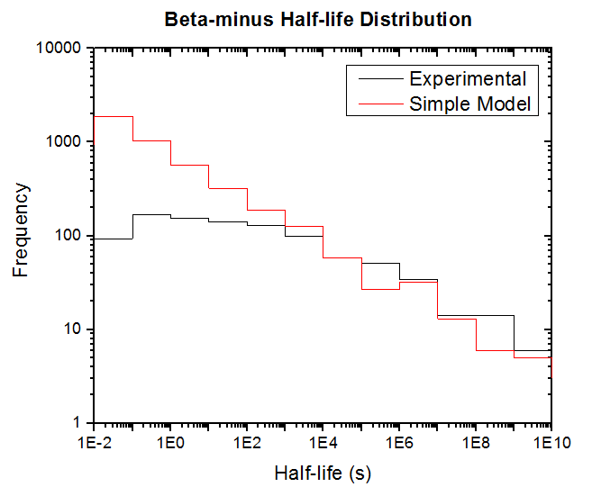
Neutron bound nuclides to be discovered

Slide 8
Alpha Half-life distributions
Experimental alpha partial half-lives have branching ratios larger than 1%, requiring this on the simple model gives a better agreement.

Slide 9
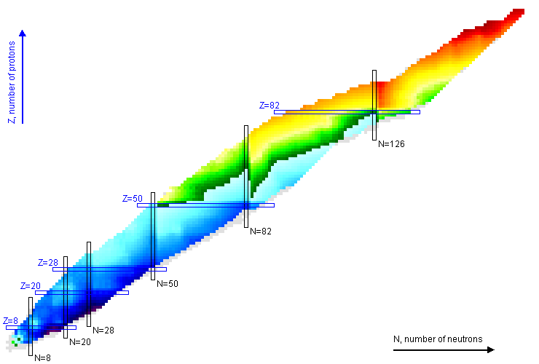
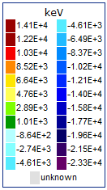
Chart of Nuclides colored according to Qα
Many α emitters also decay by EC/β+

Slide 10
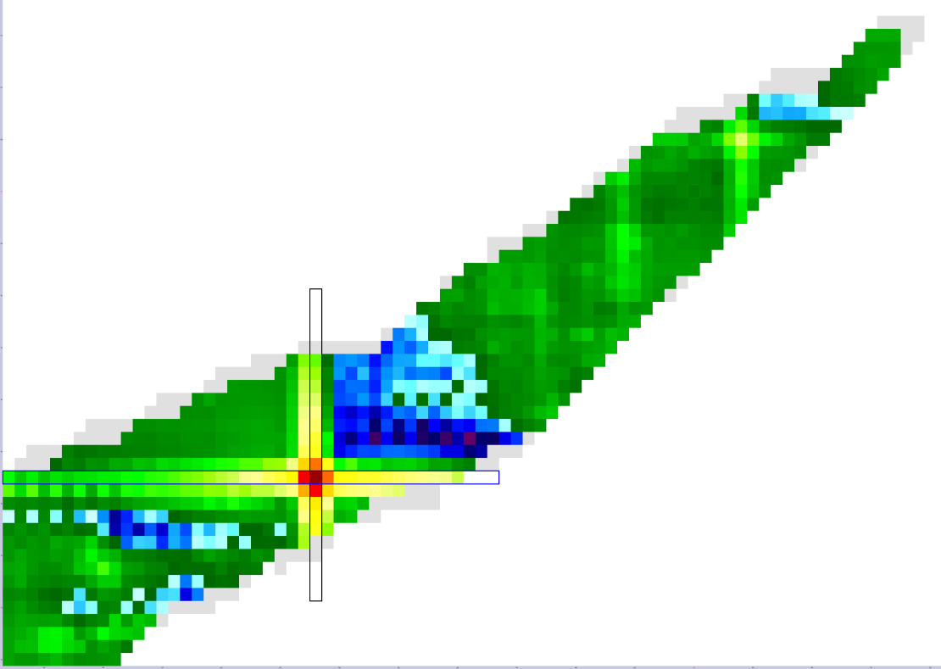
Using alpha energies to see shell effects in Z=108, N=162
254U
0.5*( Qα(Z+2,N+2)-Qα(Z,N) )

Slide 11
Conclusions
A simple model, LDM plus Kratz-Herrmann or Viola-Seaborg can account for half-life distributions.
For β- and EC+β+, the power law dependence of the T_{1/2} distribution can be explained by the dependence of the Q-value with (Z-N), as well as the Fermi function.
For alpha decay, the shape of the distribution is related to the branching ratio.

