Slide 1
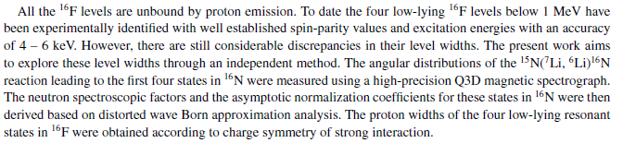
Mirror Nuclei Studies
XUNDL/ENSDF
J.H. Kelley
This material is based upon work supported by the U.S. Department of Energy, Office of Science, Office of Nuclear Physics.

Slide 2
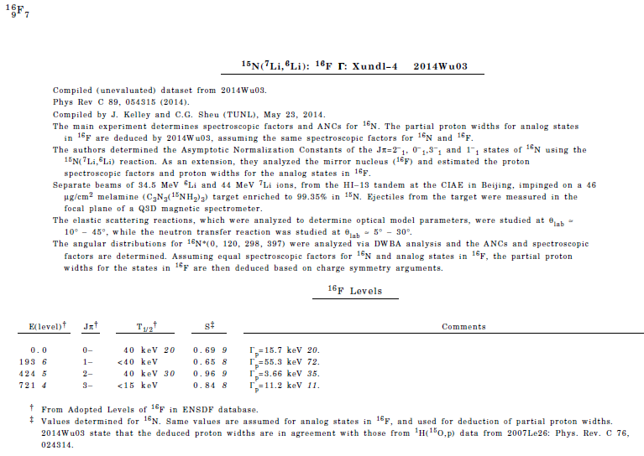

Slide 3
Such indirect approaches are becoming common.
Is there a general policy?

