Slide 1


Benchmark Testing of CIELO ⁵⁶Fe Evaluation
Bechtel Marine Propulsion Corporation
Knolls Atomic Power Laboratory
P. O. Box 1072
Schenectady, NY 12301-1072
TH Trumbull & PK Romano
Knolls Atomic Power Laboratory
CIELO/CSEWG Meeting
Brookhaven National Laboratory
Nov. 3 – 5, 2014

Slide 2
⁵⁶Fe Validation Testing
Suite of 120 ICSBEP Models run using ENDF/B-VII.1 as the base case for cross section libraries.
Separate runs made substituting ⁵⁶Fe evaluation from ORNL (Leal). Results compared back to ENDF/B-VII.1:
  Population-average eigenvalue C/E and standard deviation, Goodness-of-Fit parameters,
  Changes in C/E examined for fast, intermediate, and thermal spectrum models.
  Eigenvalue C/E Trend analysis using ATLF & ATFF spectral indices, and ⁵⁶Fe absorption fractions.
  Iron-Streaming calculations performed using fund_ippe_vdg_multi_trans_001 benchmark.
Calculations performed with the MC21 Monte Carlo code.
  ENDF files processed locally using NJOY and NDEX to create MC21 data libraries.
  NJOY2012.32x used to produce ESADs from resonance parameters in Leal’s evaluation.
Notes:
(Read slide)

Slide 3
Evaluation Tested
$Rev:: $ $Date:: $ 1 0 0 0
2.605600+4 5.545443+1 1 0 0 42631 1451 1
0.000000+0 0.000000+0 0 0 0 62631 1451 2
1.000000+0 1.500000+8 8 0 10 72631 1451 3
0.000000+0 0.000000+0 0 0 412 1682631 1451 4
_________________________________________________________________ 2631 1451 5
26-Fe- 56 CIELO for testing 2631 1451 6
DIST - APRIL2014 2631 1451 7
2631 1451 8
This Fe-56 library was created for testing benchmark results in 2631 1451 9
criticality, shielding, etc calculations. It uses ENDF/B-VII.1 as 2631 1451 10
template. A resonance evaluation was performed at ORNL (Leal) 2631 1451 11
from 1.0e-5 eV to 2 MeV using transmission data taken at the RPI 2631 1451 12
LINAC (Danon) and inelastic cross section measurements done at 2631 1451 13
GEEL (Plompen). 2631 1451 14
Again, this library is for testing purpose for the WPEC/CIELO 2631 1451 15
effort. We refer to this lib as ORNL4. 2631 1451 16
2631 1451 17
L. C. Leal 2631 1451 18
Notes:
Note that eval was down loaded from the NNDC Gforge server CIELO branch.

Slide 4
Cross Section Comparisons - I
All cross sections broadened to 293.6 K
Notes:
Large numbers of differences in the RRR, but difficult to infer any trend to the differences or what the effect might be.
Increase in elastic scattering RI might decrease absorption and increase leakage for some problems.

Slide 5
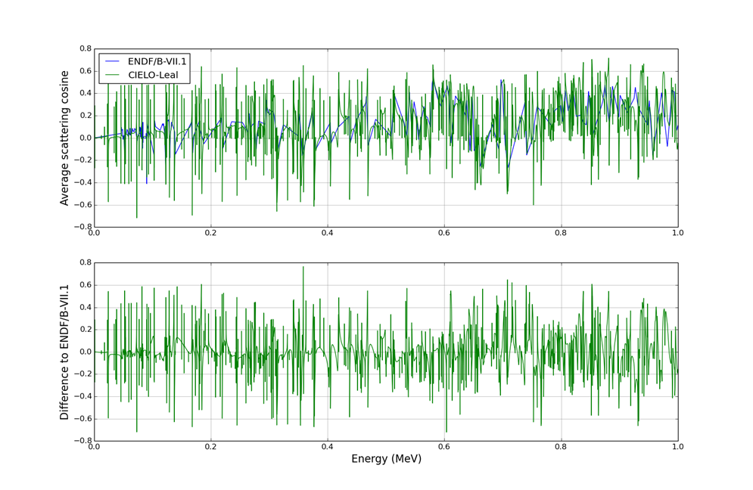
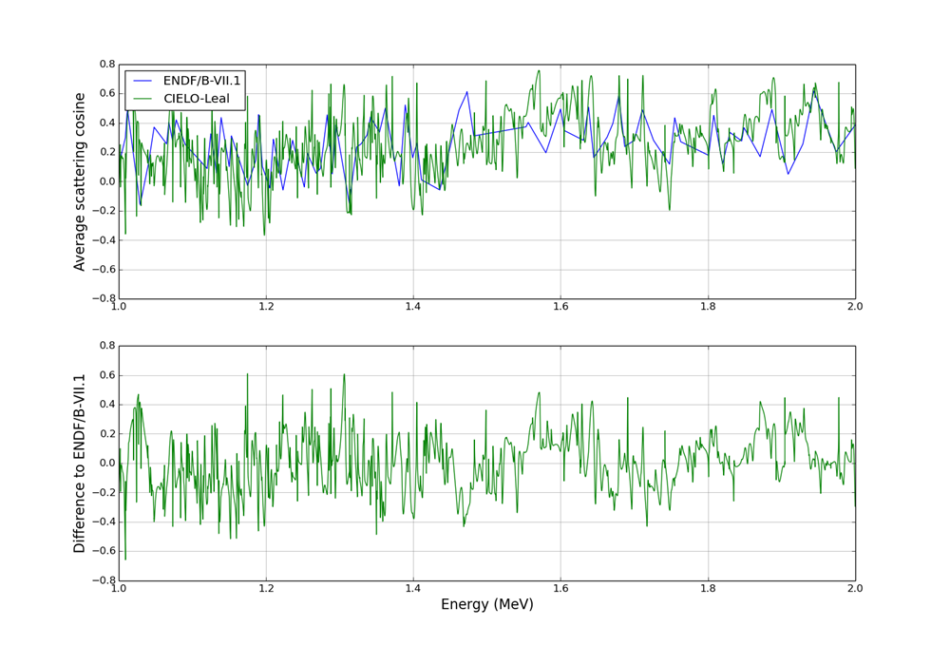
Cross Section Comparisons - II
Differences in Elastic Scattering Average Scattering Cosine
for 0-1 MeV (Left) and 1-2 MeV (right)
Notes:
Much more detail in the CIELO evaluation due to the processing of ESADs from Res. Params, but impossible to tell if there are significant differences.

Slide 6
Cross Section Comparisons - III
Notes:
Large relative differences in the RRR capture. Difficult to say what direction and what effect it may have on the benchmarks.

Slide 7
ICSBEP Suite Models
ISCBEP Suite focused on thermal spectrum, LEU/HEU fuel systems with a handful of PU, Mixed, and ²³³U benchmarks:
Notes:
The table on the left shows the list of 120 benchmark models included in the KAPL validation testing, based on the models that contain appreciable amounts of iron.
The majority of the models are uranium fueled, with a selection of Pu and U233 fueled systems added to the mix.
The majority of the models have thermal neutron spectra. However, a sampling of fast and intermediate spectra are also included, as shown in the table on the right.

Slide 8
Population C/E: ENDF/B-VII.1 vs. Leal
Considering the entire population:
Leal average C/E is 7 pcm closer to 1.0, and Std. dev. and χ² are very similar.
Library | Average | Std. Dev. | χ²
ENDF/B-VII.1 | 0.99988 | 0.00522 | 0.00705
Leal | 0.99995 | 0.00524 | 0.00708
Goodness-of-fit calculated using:
NOTE: Error bars are removed for clarity. The 95% Confidence Intervals on calculated eigenvalues are ~10-20 pcm (Experimental uncertainties are typically several times that).
Notes:
See a very slight improvement in ensemble C/E using the ORNL4 evaluation, but tough to say for sure.

Slide 9
Reactivity Effects – Fast Spectrum Models
Model | Change in C/E (pcm) | Attributes:
HMF_021_01 | -58 | Steel-reflected sphere of HEU
HMF_034_03 | +96 | Stacked disks of HEU-Poly-Steel
IMF_005 | -50 | Steel-reflected sphere of IEU
MMF_011_21B | +115 | ZPPR-21B with SS steel drawers, plates, cladding.
MMF_011_21C | +110 | ZPPR-21C with SS steel drawers, plates, cladding.
Notes:
Some definite effects on fast models.
“Red” are changes that move C/E further from 1.0, “Green” are changes that move C/E closer to 1.0.
Large changes move 4 of the 5 models closer to C/E=1.0.

Slide 10
Neutron Balance – Fast Spectrum Models
Steel Reflector Models
Steel Internal to Core Models
Notes:
External Reflector Models: Reduced FE56 abs. and increased leakage leads to reduced U235 abs. in the reflector models.
Iron In-Core Models: Reduced leakage in core leads to increased U235 abs.

Slide 11
Reactivity Effects – Intermediate Spectrum Models
Model | Change in C/E (pcm) | Attributes:
HCI_003_04 | +154 | Depleted Uranium (outer) and Steel-reflected (inner) assy. of HEU
Notes:
Interesting that it goes opposite of fast spectrum steel reflector models: leakage, FE56 abs, U238 abs all reduced, leading to U235 abs. increase.

Slide 12
Reactivity Effects – HST Models
Model | Change in C/E (pcm) | Attributes:
HST_001_01 | +36 | Steel tank , no reflector, 45% leakage.
HST_032_01 | -20 | Aluminum tank (very low amounts of iron), no reflector, 7% leakage.
HST_042_06 | -21 | Steel tank, no reflector, 3% leakage.
Source | Avg. (C/E-1)
ENDF/B-VII.1 | -0.00030
CIELO | -0.00028
In general, the HST models show a small net-negative effects as a result of changes in the ⁵⁶Fe cross section.
Notes:
In general, the HST models show a small net-negative effects as a result of changes in the ⁵⁶Fe cross section.
Pretty much a “wash,” although some “improvement” in the HST_001_01 and HST_042_06 models.

Slide 13
Reactivity Effects – LST Models
Source | Avg. (C/E-1)
ENDF/B-VII.1 | 0.00072
CIELO | 0.00077
The LST models show a small net positive effect as a result of changes in the ⁵⁶Fe cross section.
Notes:
The LST models show a small net positive effect as a result of changes in the ⁵⁶Fe cross section.
Pretty much a “wash.”

Slide 14
Reactivity Effects – LCT Models
Source | Avg. (C/E-1)
ENDF/B-VII.1 | 0.00027
CIELO | 0.00026
The LCT models show very slight effects with changes in the ⁵⁶Fe cross section.
Notes:
The LCT models show very slight effects with changes in the ⁵⁶Fe cross section.

Slide 15
Trend Analysis
Very slight reduction in ATLF trend with CIELO iron, but not statistically significant.
No trend differences for ATFF.
Same trend for ⁵⁶Fe Absorption fraction.
Notes:
Trend analysis doesn’t show any significant difference between the ENDF/B-VII.1 and CIELO Fe-56 evaluations.

Slide 16
Iron Streaming Analysis
FUND_IPPE_VDG_MULTI_TRANS_001:
  Transmission measurements for a collimated neutron beam incident on iron samples of various thicknesses:
    1.62 cm, 4.81 cm, 9.57 cm, 19.09 cm, 31.74 cm, 44.44 cm.
    Uniform in energy from 100 keV to 4 MeV.
    Tallies binned for 6 energy groups: 100 keV, 200 keV, 400 keV, 800 keV, 1.4 MeV, 2.5 MeV, 4.0 MeV.
  Compared results for ENDF/B-VII.1 and CIELO ⁵⁶Fe to experiment.
    Also considered JEFF-3.1.2 Iron performance.

Slide 17
Transmission Results - I
JEFF-3.1.2 outperforms both ENDF/B-VII.1 and CIELO ⁵⁶Fe.
ENDF/B-VII.1 performs better than CIELO up to the 400 keV energy range.
Some improvement using CIELO ⁵⁶Fe in the 400-800 keV region.
Notes:
JEFF-3.1.1 outperforms both ENDF/B-VII.1 and CIELO ⁵⁶Fe.
ENDF/B-VII.1 performs better than CIELO up to the 400 keV energy range.
Some improvement using CIELO ⁵⁶Fe in the 400-800 keV region.

Slide 18
Transmission Results - II
JEFF-3.1.2 outperforms both ENDF/B-VII.1 and CIELO ⁵⁶Fe.
CIELO better than ENDF/B-VII.1 for 800-1400 keV range.
CIELO and ENDF/B-VII.1 data are the same for E > 2.0 MeV.
Notes:
JEFF-3.1.1 outperforms both ENDF/B-VII.1 and CIELO ⁵⁶Fe.
CIELO better than ENDF/B-VII.1 for 800-1400 keV range.
CIELO and ENDF/B-VII.1 data are the same for E > 2.0 MeV.

Slide 19
Conclusions
For the integral benchmarks, the CIELO ⁵⁶Fe evaluation appears to be a slight improvement over the ENDF/B-VII.1 evaluation:
  Fast benchmarks show some improvement,
  No significant changes in C/E vs. ATLF, ATFF or ABS trends,
  Thermal benchmarks are largely unchanged.
The streaming benchmark shows some problems with both ENDF/B-VII.1 and CIELO ⁵⁶Fe transmission:
  JEFF 3.1.2 Iron evaluation outperforms both over the entire energy range investigated.
  Some improvement in the CIELO ⁵⁶Fe transmission over the 400-800 keV and 800-1400 keV region vs. ENDF/B-VII.1.
Results from this study support adopting the CIELO evaluation, but further investigation into the streaming benchmark and JEFF-3.1.2 evaluation is warranted.

