Slide 1
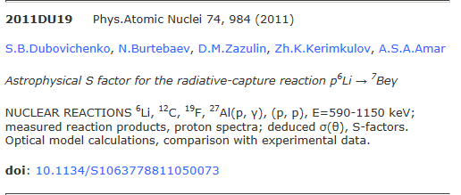
NSR
Restraint in key wording?
J.H. Kelley
This material is based upon work supported by the U.S. Department of Energy, Office of Science, Office of Nuclear Physics.

Slide 3
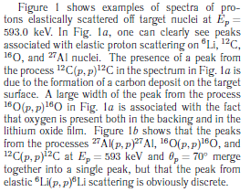
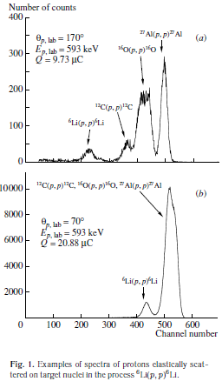


¹²C(p,p) is cited as background
No substantive comments on ¹²C, ¹⁶O or ²⁷Al.

