Slide 1
Fe-56 Evaluation Work at KAERI
Young-Sik Cho
KAERI
CSEWG 2014, 11/3/2014

Slide 2
Reproductions of the resonance-like structure (1)
Fe-56
Object
  Get the analytic form of a function which fits to the fluctuations, thus allowing the numerical integration
Method
  Lease-squares fit to the Lorentzian distribution using the gradient search method
  Peak points are automatically selected according to the pre-defined rules

Slide 3
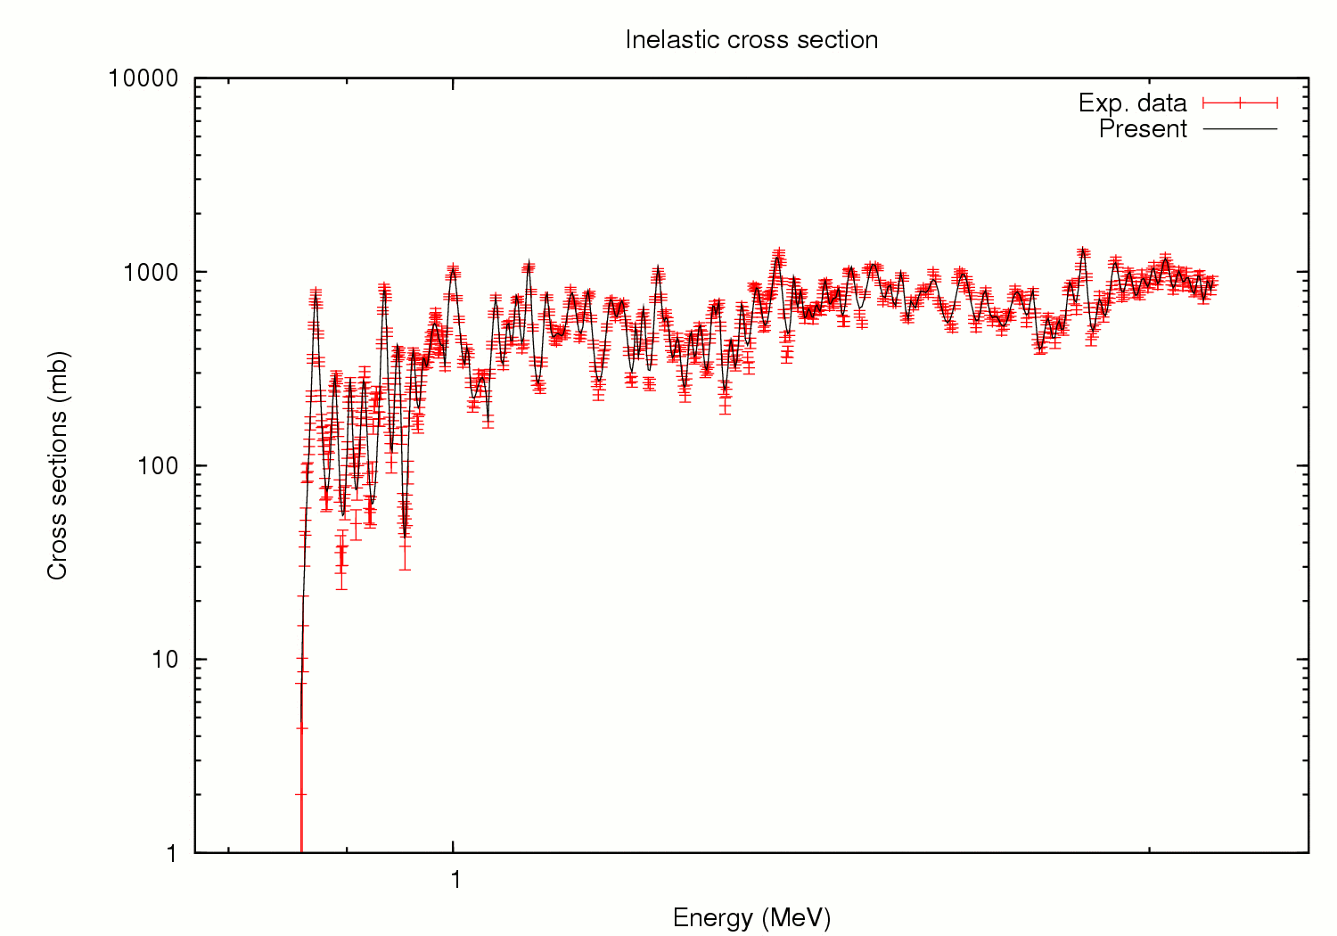
Reproductions of the resonance-like structure (2)
Fe-56

Slide 4
Above the resonance-like structure (1)
Fe-56
Start
Code
  Empire 3.2
Tool
  EmpireTuner using MPI to carry out the calculations in parallel
Adjust parameters
using gradient search,
Calc.
Meet criteria ?
Candidate
Adjust parameters
Randomly,
Calc.
Meet criteria ?
New
parameter set
Parameter set adjustments
OMP parameter set for angular distribution
OMP parameter set and other parameters for all reactions
No
Meet criteria?
Create an input, Run and Wait until the tool produces the final results
Yes
Final
parameter set
Terminate

Slide 5
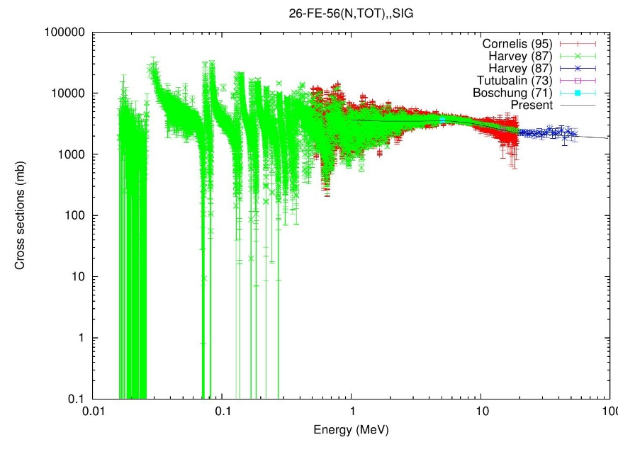
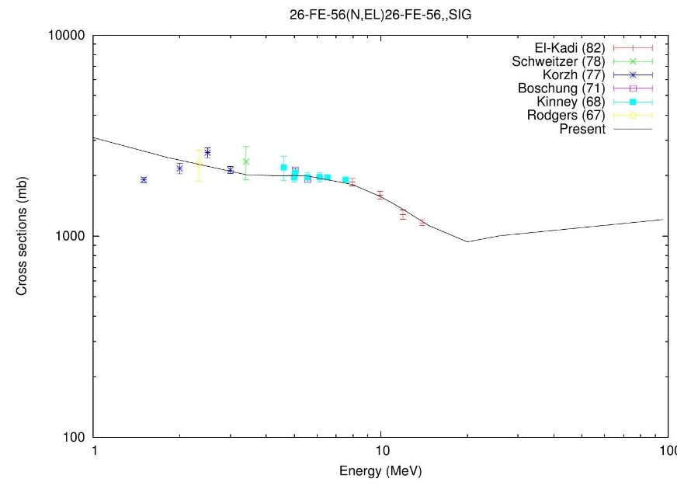
Above the resonance-like structure (2)
Fe-56

Slide 6
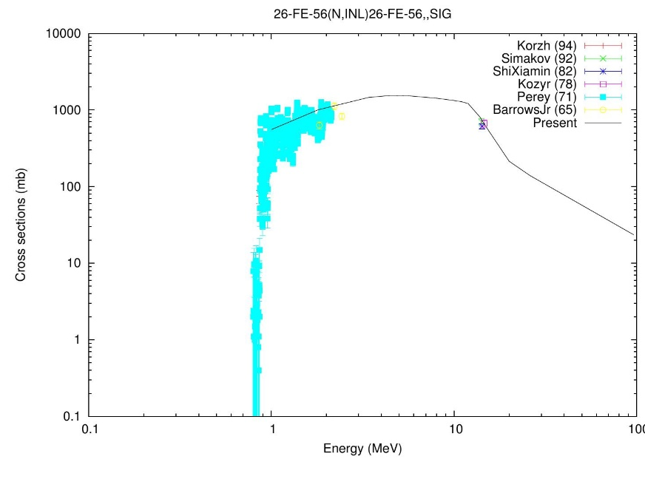
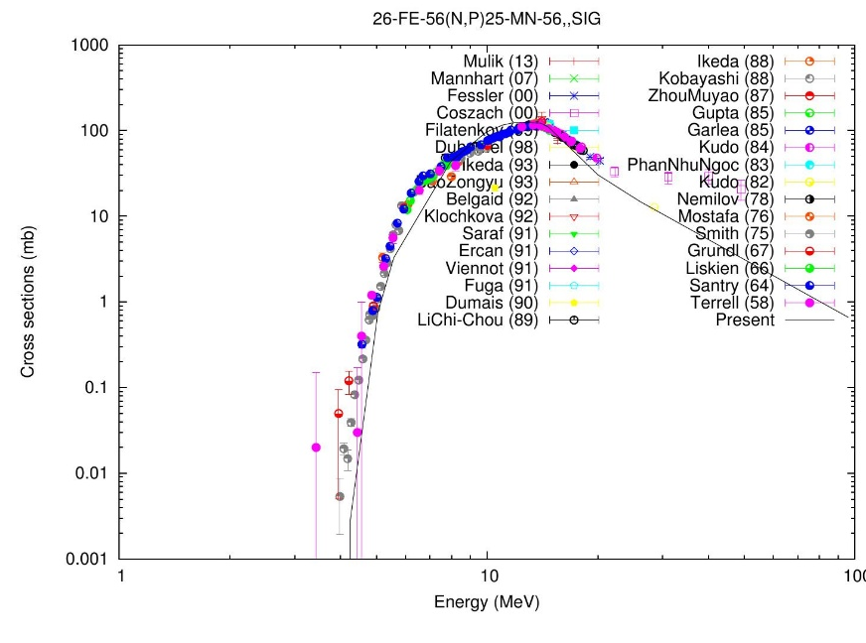
Above the resonance-like structure (3)
Fe-56

Slide 7
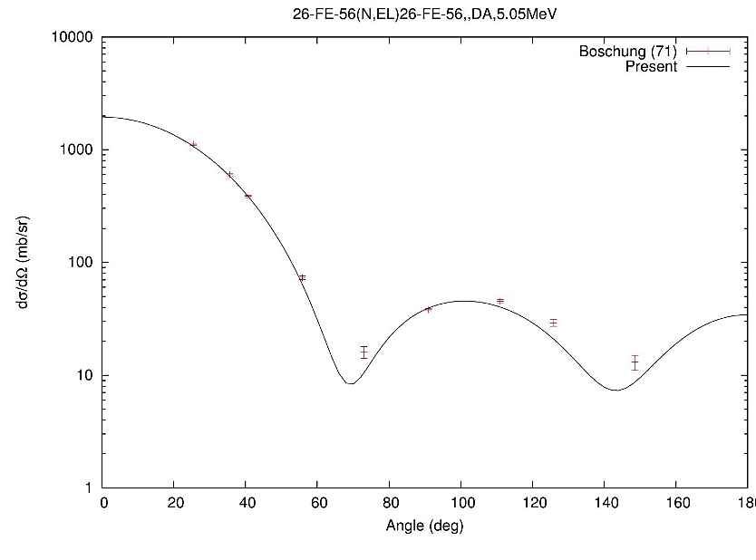
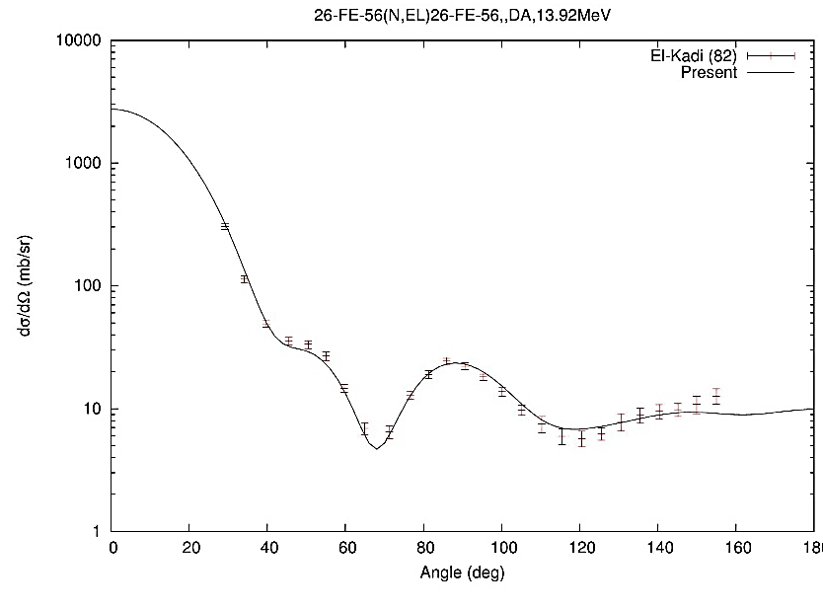
Above the resonance-like structure (4)
Fe-56

Slide 8
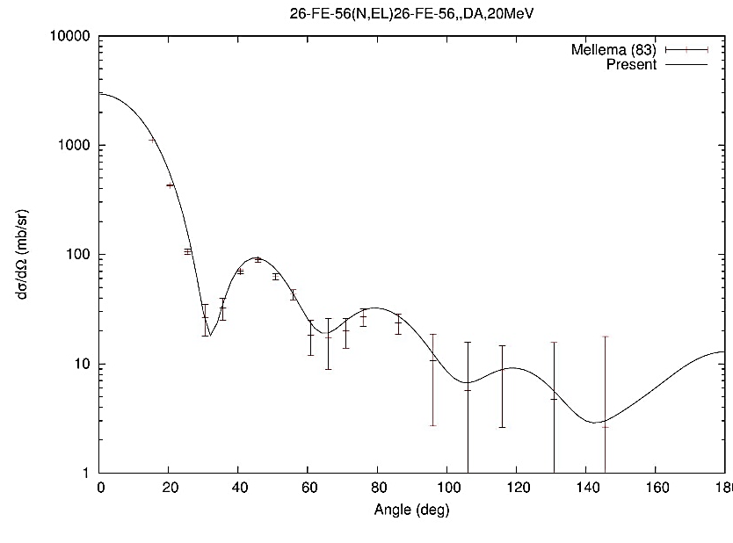
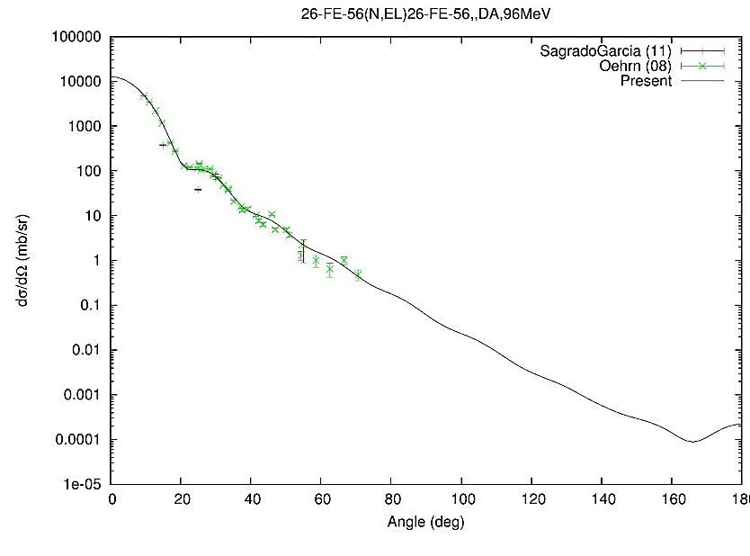
Above the resonance-like structure (5)
Fe-56

