Slide 1
Summary of the progress for n+¹⁶O
Arjan Plompen
EC-JRC-IRMM, SN3S unit

Slide 2
Overview
Introduction
¹⁶O(n,a) Giorginis analysis, Bair & Haas data
Capture (details by Firestone)
ENDF files Hale and Leal
Benchmarking
Next steps
Outlook

Slide 3
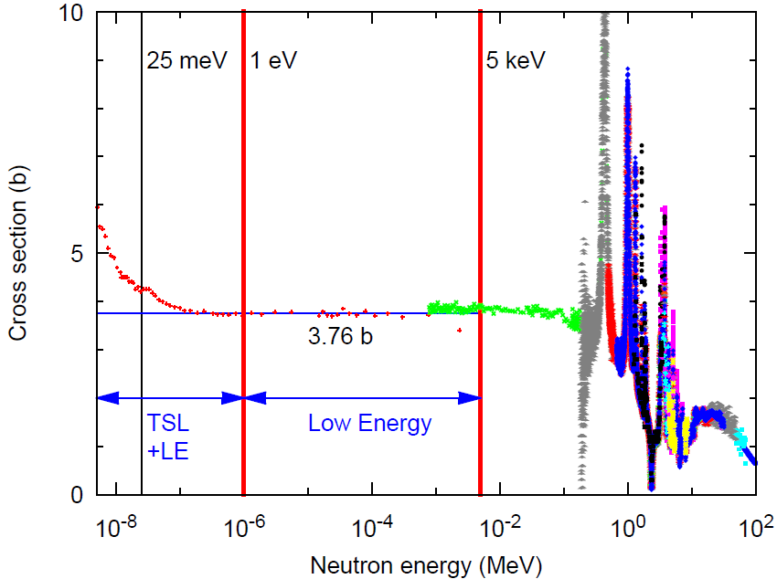
Energy ranges

Slide 4
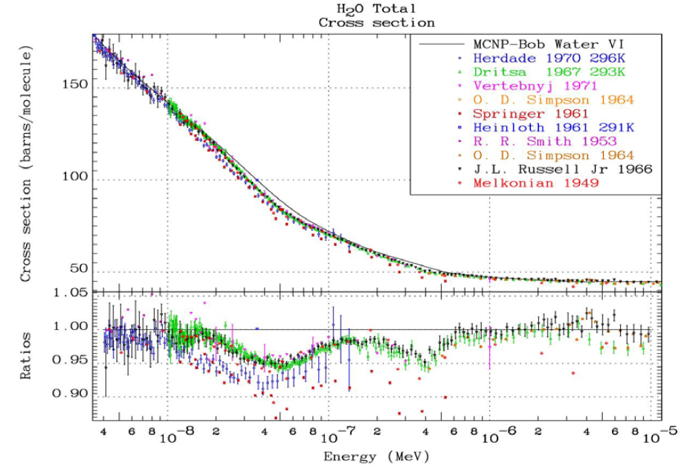
Thermal scattering
Contribution Sublet
UCRL-TR-220605
“How Accurately Can We Calculate Neutrons Slowing Down In Water?”
Cullen et al. (2006)
|E/C-1|> 2-6% in range
20-70 meV
For our discussion not a small effect
“It is clear that the experimental data should be used if we are to be successful in calculating thermal critical assemblies.
… experimental data should not be ignored and replaced
by model calculations, particularly if the two do not agree.”

Slide 5
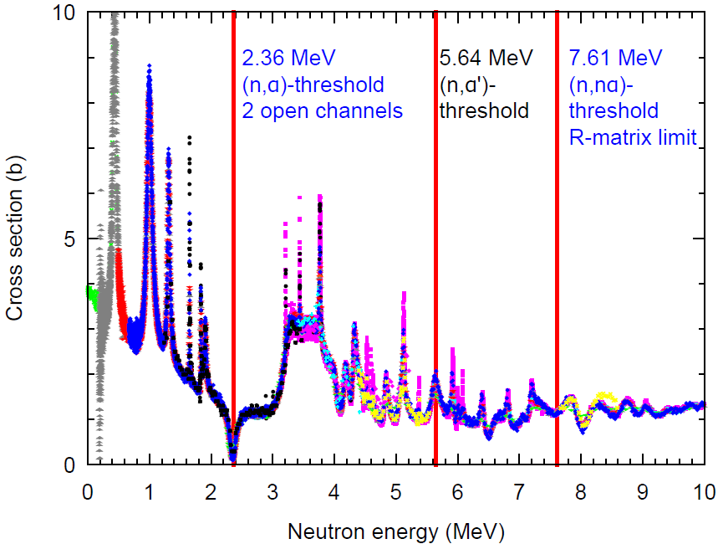
Energy ranges

Slide 6

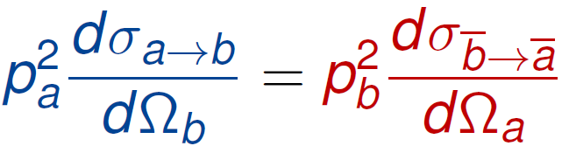
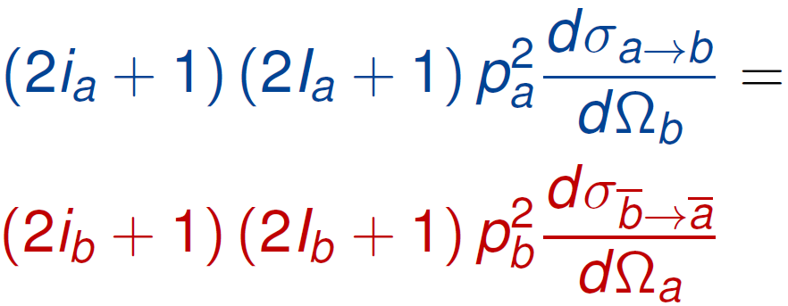
¹⁶O(n,α)¹³C and
¹³C(α,n)¹⁶O
Absorption
A
B
a
+
+
b
+
¹⁶O
¹³C
+
α
n
E_{n} > 2.36 MeV
¹⁶O(n, γ)¹⁷O is negligible
Microscopic reversibility
Principle of Detailed Balance
(Reciprocity theorem)
+
¹⁶O
¹³C
+
α
n
i_{a}
I_{A}
I_{B}
i_{b}
½
0
½
0
Up to threshold ¹⁶O(n,α’)¹³C*
2.36 MeV < E_{n} < 5.64 MeV
Up to threshold ¹³C(a,n’)¹⁶O*
E_{α} < 5.01 MeV
6.36 MeV < E_{x}(¹⁷O) < 9.45 MeV

Slide 7
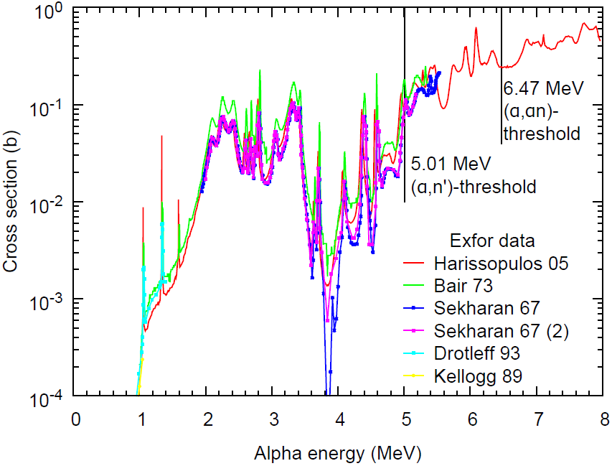
Issues
R-matrix puzzle
(n,tot) vs (n,a)
Discrepancies & errors data
¹³C(a,n)¹⁶O

Slide 8
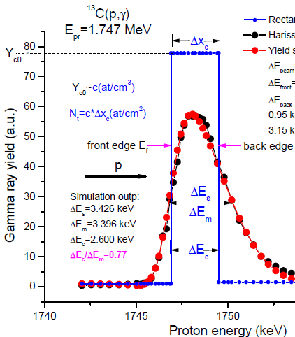
Progress 2014
Gerry Hale submitted the Bair & Haas data obtained from Duane Larson to EXFOR and to CIELO
They are now available as subentry 2 of entry C0489 (EXFOR database).
Georgios Giorginis provided convincing evidence of the importance of sputtering on α+¹³C measurements.
        showed that Harrisopulos data could be strongly affected.
        +30% can easily be, given literature on sputtering
        Counters need for TTY based downwards renormalization of Bair and Haas on basis of later Bair paper and sputtering.

Slide 9
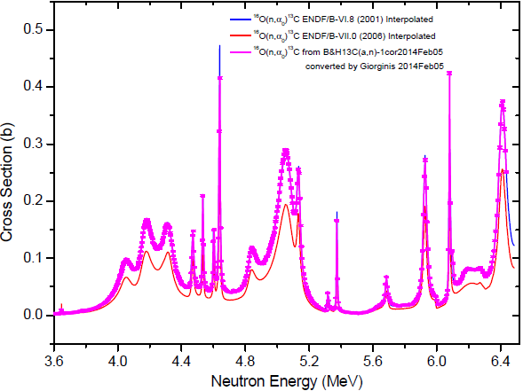
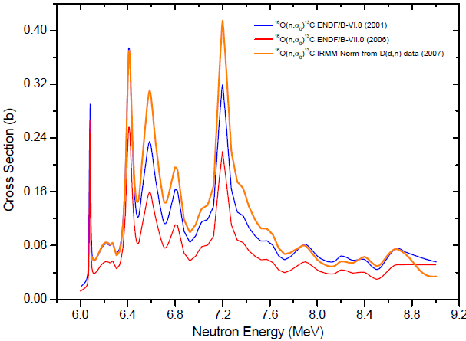
Progress 2014
Giorginis provides a recommendation of the cross section on the basis of his analysis of the Bair & Haas, Harissopulos and Heil data sets.
This recommendation includes interpretations and renormalizations of the ¹⁶O(n,α) data sets measured by the IRMM/IPPE collaboration.
Giorginis proposals are available as excel table.
Blue ENDF/B-VI.8
Red ENDF/B-VII.0
Orange GG recommendation

Slide 10
Progress 2014
Evaluations of Gerry Hale and Luiz Leal available in ENDF format.
Converted to ACE files by David Brown.
Used for first benchmarking by Steven van der Marck, Ivo Kodeli, Paul Romano and Andrej Trkov.
Angular distribution of the Leal evaluation replaced by that of ENDF/B-VII.1 evaluation due to processing limitations.

Slide 11
Comparisons of Hale and Leal evaluations.
Graphs by Paul Romano (3 Oct. 2014)
  Elastic below 100 keV (w. Kopecky-Plompen recomm.)
  Elastic cs and ratio to B-VII.1 up to 6.5 MeV
  Angular distributions (th, 10, 100 keV, 1, 5 MeV)
  (n,a) cs 2.5-6.5 MeV
  Comments Plompen
  Elastic is essentially total, except above the (n,a) threshold – where total may be 10% higher than elastic.
  See slides for others.

Slide 12
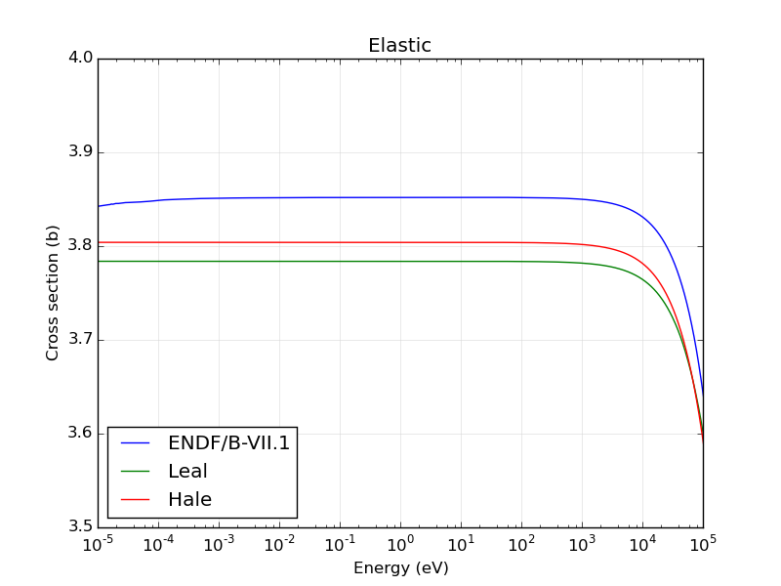
Leal's evaluation within 1s from our recommendation
Hale's evaluation within 2s
The reductions compared to B-VII.1 will increase mfp below 100 keV.
For oxygen in water the fractional contribution of the change in cs and hence mfp is 0.13% (recommendation vs B-VII.1).
For UO2 it is 2-3% (very approximate).
Kopecky-Plompen recommendation

Slide 13
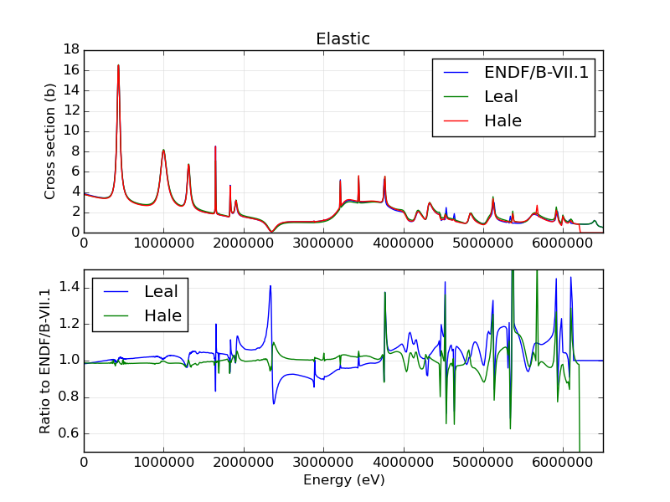
Below 3.5 MeV (n,a) is so small that elastic is total.
Above 3.5 MeV total is about 10% larger than elastic.
Differences appear large for Leal's evaluation.
Averaged over fission spectrum this should be strongly damped.
Averaged over fast component of benchmark spectra this should be less so.
To the extent that the mfp is reduced (fast spectrum component) this reduces leakage.
This reduces the impact of increased loss due to increased (n,a).
With Hale's evaluation there should be a slightly longer mfp, so more leakage, 'reinforcing' the extra loss from the increased (n,a) for benchmarks where leakage is important.

Slide 14
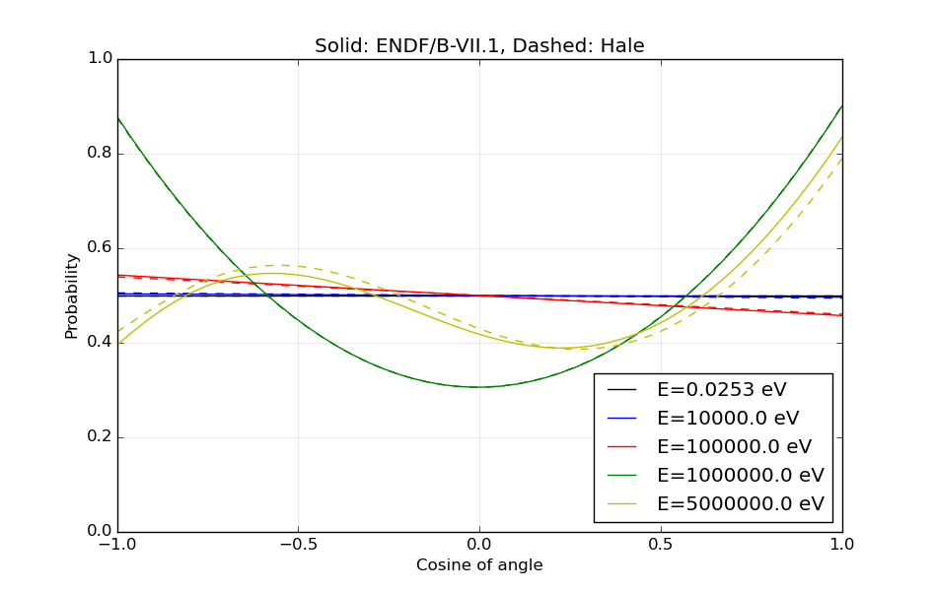
Leal's angular distribution equals ENDF/B-VII.1
Hale's angular distribution is very close to ENDF/B-VII.1
No impact on benchmarks expected.

Slide 15
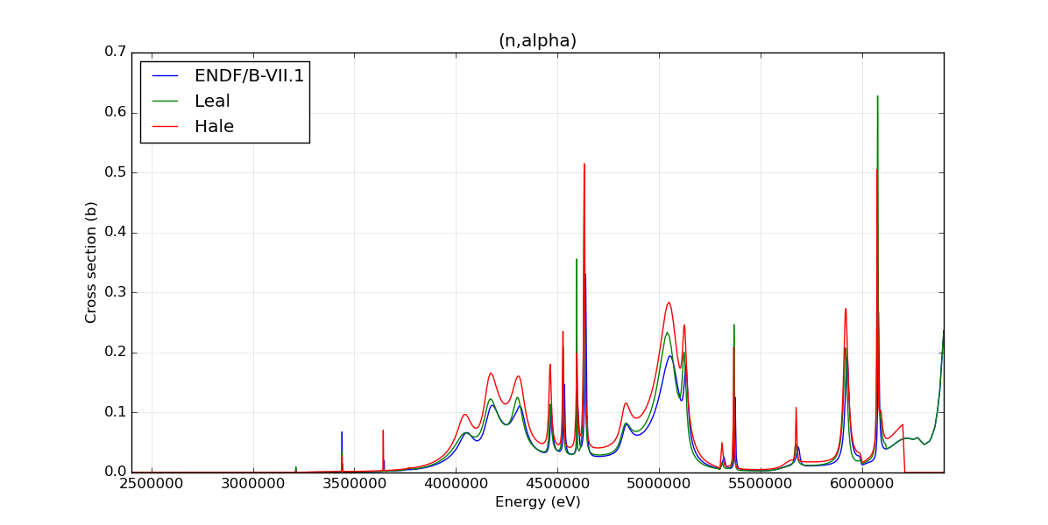
Good to have this on linear scale. Clearly shows (n,a) only absorbs in tail of fission spectrum.
Leal's evaluation for this cs should make only a small difference compared with ENDF/B-VII.1 for the benchmarks.
Hale's evaluation is about 50% larger than ENDF/B-VII.1.
For a given spectrum it would then increase capture on oxygen by 50%.
For Leal's evaluation this is roughly 5-10% more capture.
As a secondary effect increased (n,a) softens the spectrum in the fast range (in principle; quantitatively?).

Slide 16
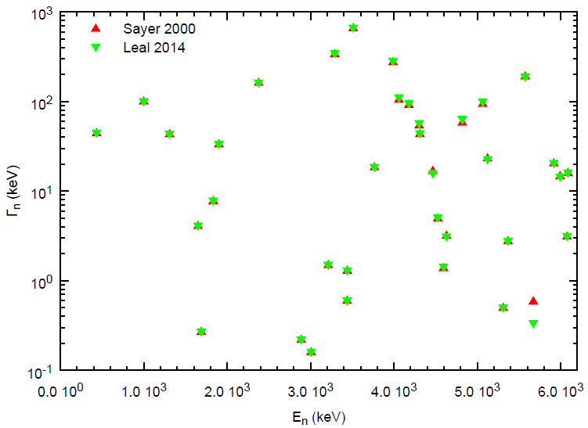
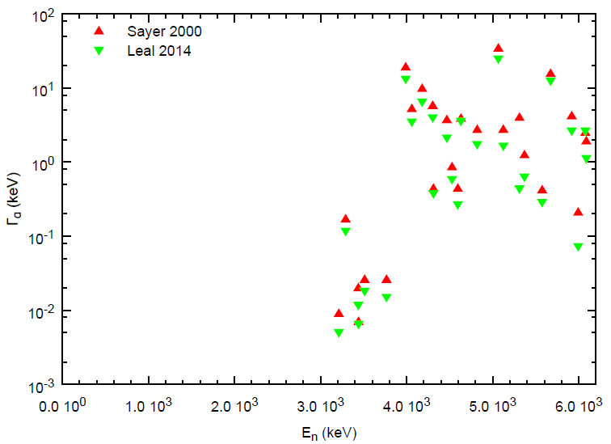
Royce Sayer, ORNL/TM-2000/212 (Bair-Haas)
Luiz Leal, CIELO-ENDF file July 2014 (Harissopulos)
Identical spins and parities
Small changes in Γ_{n} (few changes and mostly less than 10%)
About 30% less Γ_{α} for Luiz than for Royce.

Slide 17
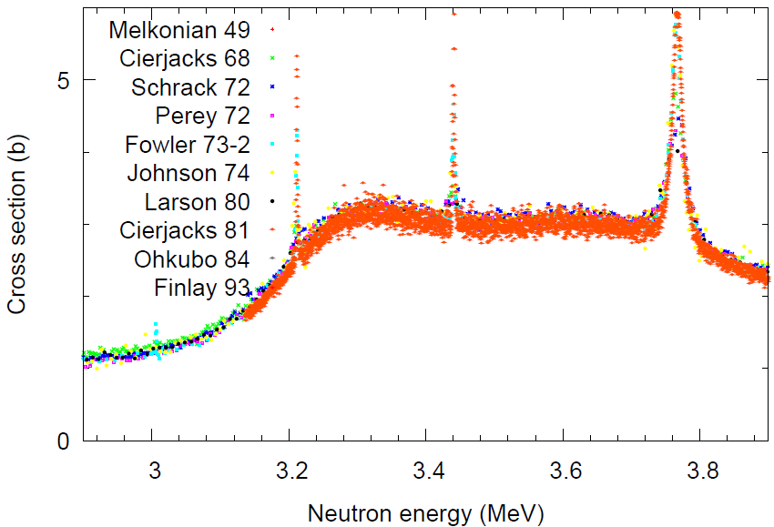
Selected Data Total n+¹⁶O
Debate Cece:
All other normalizations should come to Cierjacks 81.
Cierjacks 81 best resolution
Cierjacks 81 normalization is floating
Fix normalization around 3.3 or 3.6 MeV to Ci68,Sc72,Fo73,Jo74,La80.
E.g. Sayer: 1.034 x to match Jo74

Slide 18
New thermal capture measurement
Richard Firestone will explain.
Self-normalizing experiment.
Capture is a small cross section, not bound to contribute much to benchmarks.

Slide 19
First benchmarking

Slide 20
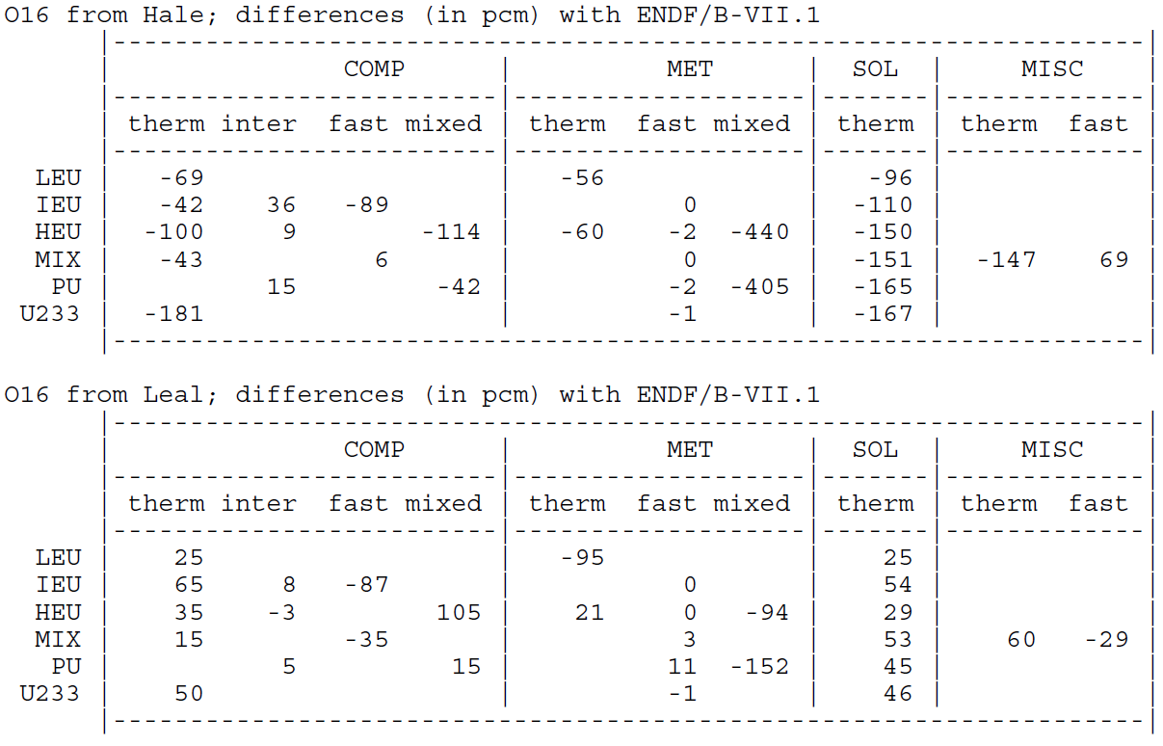
Steven ENDF/B-VII.1 van der Marck with Hale and Leal ¹⁶O
Table summarizes 2031 cases.
Graphs show largely homogeneous changes over categories.
Clearest effects for thermal-comp and thermal-sol.
Hale-eval: -150 pcm for sol, -50 to -100 for comp
Leal-eval: +50 pcm for sol and +15/+65 for comp.
Metal fast
Benchmarks
not relevant.
Comp-inter/fast
and misc-fast:
small differences
(ignore?).

Slide 21
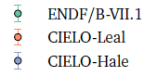
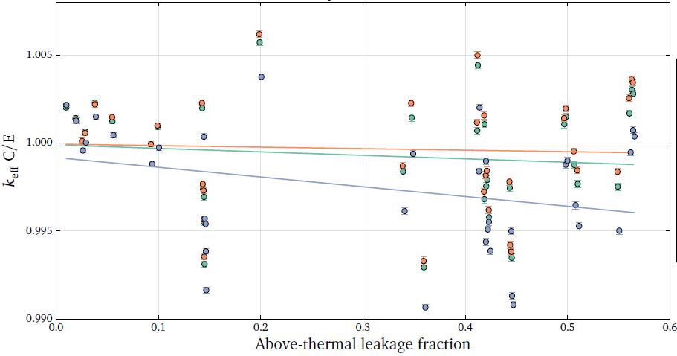
Paul Romano HEU-SOL-THERM
Trend with leakage for Hale’s evaluation,
but main difference is absorption above 3 MeV ?
HST004+020 (D₂O): very large decreases in reactivity for Leal and Hale.

Slide 22
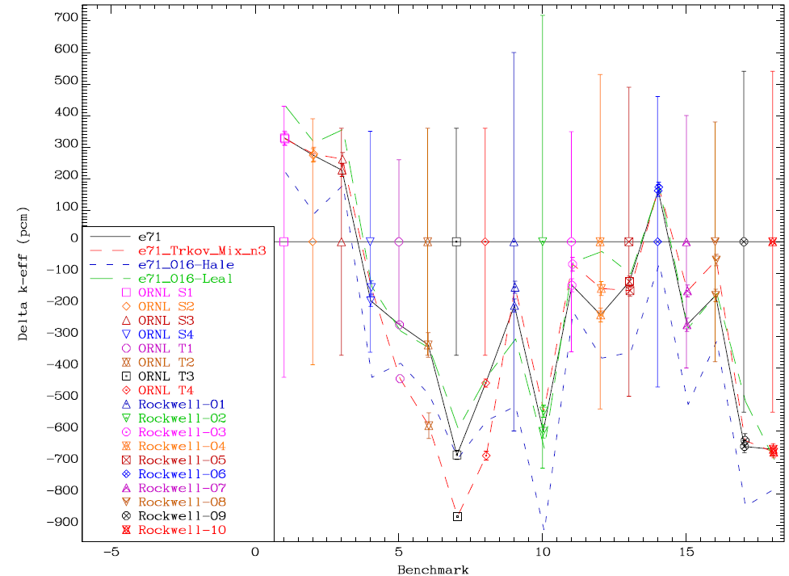
Andrej Trkov HEU-SOL-THERM
Same game with selected benchmarks
Highlights role of PFNS and nu-bar
Lower T was compensated by lower nu-bar
2.03 -> 2.00 MeV
Gwin nu-bar
Not applied yet to
compensating ¹⁶O
trends.
E71
E71-Trkov-mix-3
E71-Hale-O16
E71-Leal0O16
HST-1 Rockwell-n
HST-9 ORNL-SN
HST-13 ORNL-TN

Slide 23
Skip Kahler
Runs were being made.

Slide 24
Nubar
Current nu-bar for ENDF/B-VII.1, JEFF-3.1 and JENDL-4.0 very close to standards and Axton.
Slight increase possible, leeway small: 1s is 0.1, 0.2%.
 | Axton '86 | Standards | B-VII.1 | B-VII.1-stds
U-235 | 2.4334(36) | 2.4355(23) | 2.4367 | 0.0012
Pu-239 | 2.8822(51) | 2.8836(47) | 2.8789 | -0.0047

Slide 25
Thermal fission cross section
Current thermal fission cross sections for ENDF/B-VII.1, JEFF-3.1, JENDL-4.0 close to standards, less close to Axton.
They appear pushed upwards already (VII.1 vs standards and standards vs Axton). To push them more …
 | Axton '86 (b) | Standards (b) | B-VII.1 (b) | B-VII.1-stds (b)
U-235 | 582.8(1.1) | 584.3(1.0) | 585.5 | +1.2
Pu-239 | 747.6(2.0) | 750.0(1.8) | 751.3 | +1.3

Slide 26
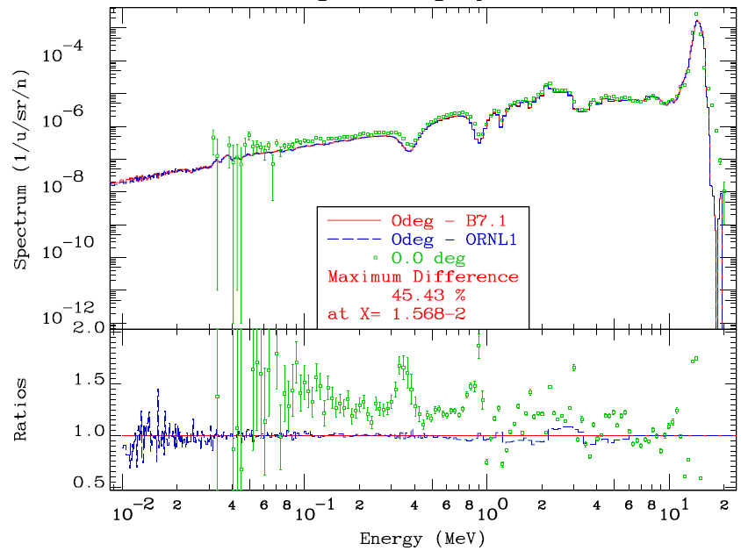
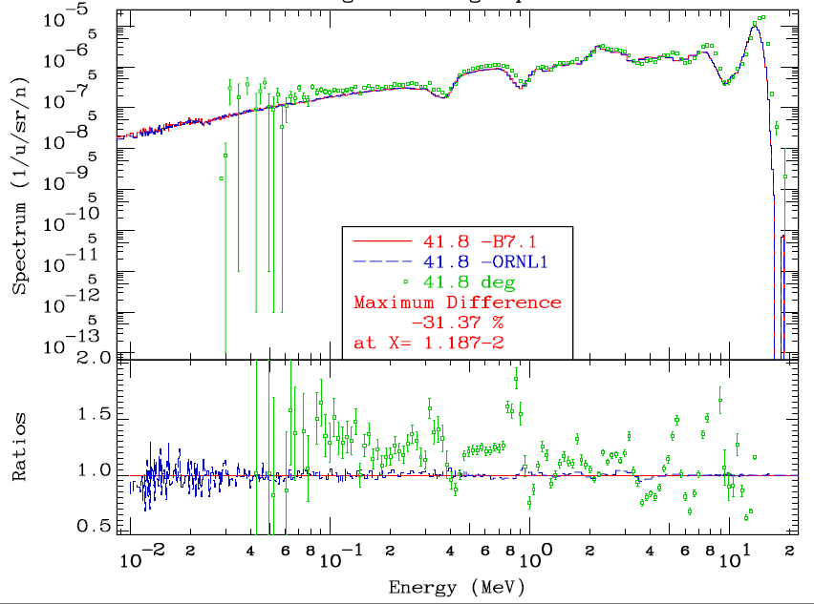
Ivo Kodeli FNS oxygen benchmark
20 cm ‘oxygen block’
Transmission 14 MeV neutrons
5 angles, time-of-flight
Hale and Leal evaluations very much closer to each other than to the data.

Slide 27
Ian Hill Dice and sensitivities
Dice can be used to obtain benchmark sensitivities.
  by cross section for an isotope
  by energy category (fast, intermediate, thermal)
Example given ¹⁶O total cross section (excel sheet)
Selected 550 most sensitive benchmarks
Of these 550 I distill the following table of 14.
U-233 cases are excluded.

Slide 28
Ian Hill Dice and sensitivities
benchmark | 1-group |  | thermal |  | intermediate |  | fast
 | min | max | min | max | min | max | min | max
HMT-27 | 0.35 | 0.45 | 0.02 | 0.14 | 0.16 | 0.21 | 0.09 | 0.13
HMI-10-1 |  | 0.35 |  | 0.01 |  | 0.2 |  | 0.14
PMI-1 | 0.33 | 0.33 | 0.01 | 0.01 | 0.2 | 0.22 | 0.13 | 0.14
HST-20 | 0.22 | 0.25 | 0.01 | 0.06 | 0.14 | 0.17 | 0.04 | 0.05
HST-4 | 0.2 | 0.25 | 0.01 | 0.03 | 0.14 | 0.16 | 0.05 | 0.05
PMM-1 |  | 0.24 |  |  |  | 0.12 |  | 0.13
HSI-1 | 0.19 | 0.2 |  |  | 0.03 | 0.03 | 0.1 | 0.1
HCT-17 | 0.1 | 0.16 | 0.04 | 0.07 | 0.04 | 0.09 | 0.01 | 0.03
PST-8 | 0.11 | 0.15 |  | 0 | 0.03 | 0.04 | 0.08 | 0.11
HST-1 | 0.11 | 0.15 |  | 0 | 0.03 | 0.04 | 0.08 | 0.10
HST-49 | 0.10 | 0.14 |  | 0 | 0.02 | 0.03 | 0.08 | 0.10
PST-33 | 0.10 | 0.13 | -0.01 | 0.01 | 0.01 | 0.04 | 0.08 | 0.11
HST-48 | 0.10 | 0.13 |  | 0 | 0.02 | 0.04 | 0.07 | 0.10
HST-28 | 0.10 | 0.13 |  | 0 | 0.02 | 0.03 | 0.08 | 0.10

Slide 29
Conclusion and next steps
Establish
a) Benchmarks sensitive to ¹⁶O starting
b) Correlation other nuclides, starting
c) Role of thermal scattering: who ?
Data to analyze
a) Total cross section. Good shape.
A new measurement would be good
to confirm/reject opinions.
b) (n,a) new recommendation.
New measurement needed to
confirm the new opinion.
c) a.d. (neutrons, alphas)
impact transport
d) (n,g) new data
impact may be small.
Opportunity to make a clean start taking advantage of experience √
Combine available data, expertise experiments, modeling, benchmarks √

