Slide 1
Criticality and Reaction Rate Calculations with CIELO “Starter” Files
A.C. (Skip) Kahler
Los Alamos National Laboratory
Cross Section Evaluation Working Group
November 4-6, 2014

Slide 2
ABSTRACT We summarize criticality calculations with ICSBEP benchmarks performed with a selection of CIELO “starter” files, including ¹⁶O, ⁵⁶Fe, ^{235,238}U and ²³⁹Pu.

Slide 3
CIELO Nuclides
¹H
¹⁶O
  Preliminary files from ORNL (Leal) and LANL (Hale).
⁵⁶Fe
  A joint ORNL/BNL effort; “ORNL4_e1LevelFixes_4.11.2014.endf”.
²³⁵U
  Revised RR (ORNL, Leal) inserted into JENDL-4 and ENDF/B-VII.1.
²³⁸U
  IAEA “ib33”.
²³⁹Pu
  Build upon SG34 (Toshihiko Kawano); pfns by Denise Neudecker.

Slide 4
CIELO Nuclides
NJOY Processing
  ACE Files created by NJOY2012.
  ¹⁶O and ⁵⁶Fe contain LRF=7 Resolved Resonance data
    NJOY patch by Bob MacFarlane can create scattering angular distributions based upon these RR data (a work-in-progress).
    LANL has shared this patch on an “as-is” basis.
  ²³⁵U
    Revised resonance parameters inserted into JENDL-4.0 and ENDF/B-VII.1 files.
  ²³⁸U
    A mix of sections with data to 20 MeV or 30 MeV.
    LANL arbitrarily deleted 20+ MeV data to overcome NJOY processing issues.
  ²³⁹Pu
    Build upon SG34 work; contains either the ENDF/B-VII.1 PFNS or a modified PFNS (see Neudecker).

Slide 5
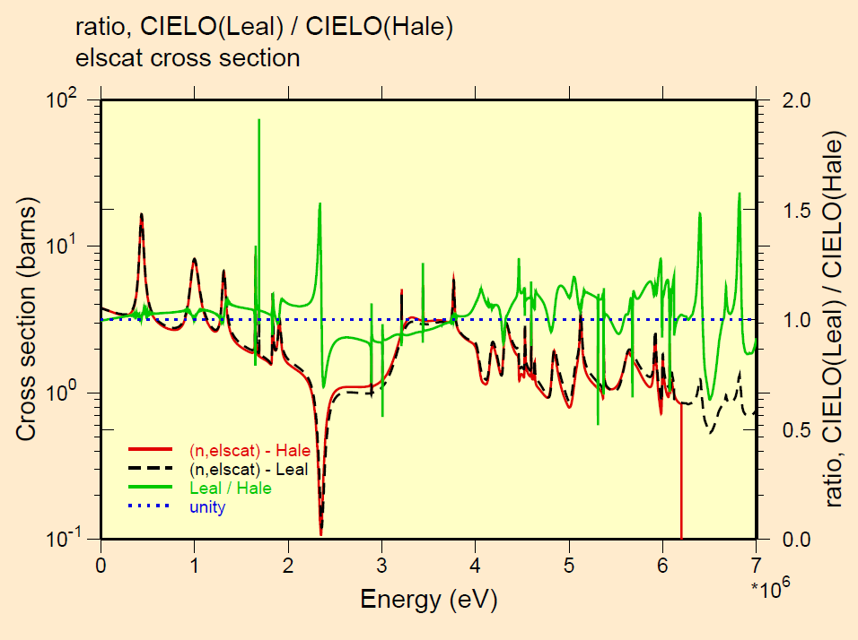
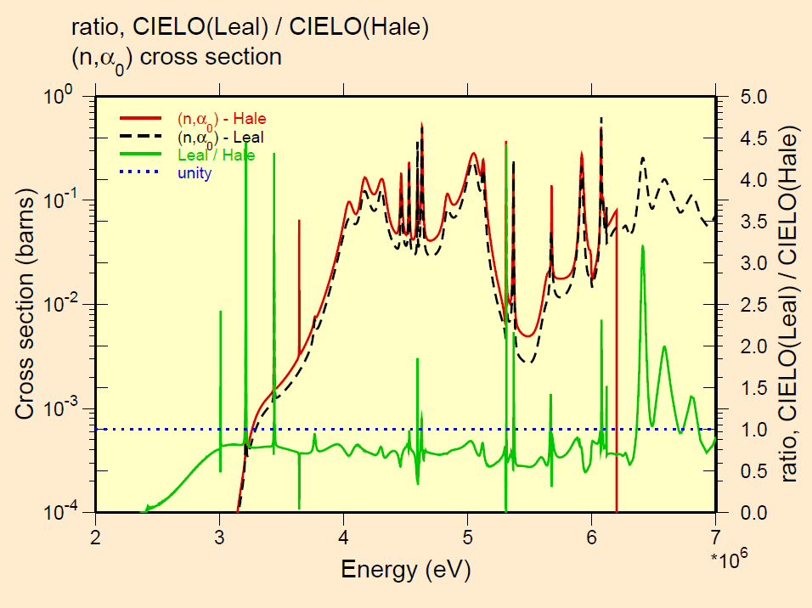
¹⁶O Results
Comparison of Leal and Hale ¹⁶O elastic scattering and (n,α₀) cross sections.

Slide 6
¹⁶O Results
LCT7.x, cases 1 through 4, vary the rod pitch … undermoderated to overmoderated. Revised ¹⁶O files cause a ~30 to more than 100 pcm decrease in calculated eigenvalues, but this difference is of questionable statistical significance. The “Leal” file includes resonance parameter calculated angular distributions.
Much of the ¹⁶O absorption occurs in water regions far removed from the fuel assembly, hence the Hale eigenvalues are not expected to change significantly when this file is upgraded.

Slide 7
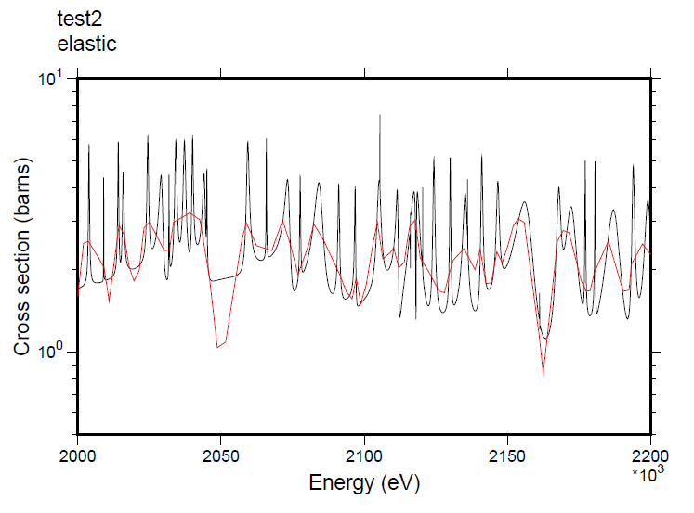
⁵⁶Fe Results
Comparison of ENDF/B-VII.1 ⁵⁶Fe MF3/MT2 with that calculated by NJOY2012 from a pre-ORNL4 file (⁵⁶Fe file by Leal/ORNL; NJOY plot by Bob MacFarlane).

Slide 8
⁵⁶Fe Results
Comparison of ENDF/B-VII.1 ⁵⁶Fe MF4/MT2 Legendre Coefficients with those calculated by NJOY2012 from a pre-ORNL4 file (⁵⁶Fe file by Leal/ORNL; NJOY plot by Bob MacFarlane).

Slide 9
ICSBEP Benchmarks with Iron
HMF13 – Spherical HEU assembly with 3.65 cm thick steel
HMF21 – Spherical HEU assembly with 9.7 cm thick steel
HMF24 – Spherical HEU assembly with 0.8 cm thick steel & 9.65 cm thick polyethylene
HMF87 - HEU cylindrical assembly with interstitial steel
HMF88 – HEU cylindrical assembly with interstitial steel or steel & polyethylene plus a polyethylene radial/axial reflector
PMF25 – Spherical ²³⁹Pu assembly with 1.55 cm thick steel
PMF26 – Spherical ²³⁹Pu assembly with 11.9 cm thick steel
PMF28 – Steel (19.65 cm thick) reflected ²³⁹Pu spherical assembly
PMF32 – Steel (4.49 cm thick) reflected ²³⁹Pu spherical assembly

Slide 10
⁵⁶Fe Results
Previously obtained good eigenvalues are retained … rem results suggest cross section revisions and new angular distribution results undo each other!

Slide 11
ICSBEP Benchmarks
Used for ²³⁹Pu Testing
PMF1 – Jezebel, a spherical ²³⁹Pu assembly
  Also central region spectral indices ²³⁸U_{f}/²³⁵U_{f}; ²³⁷Np_{f}/²³⁵U_{f}; ²³⁹Pu_{f}/²³⁵U_{f} plus selected (n,2n) ratios
PMF6 – Flattop-Pu, a spherical ²³⁹Pu core plus a ^{nat}U reflector
PSTxx – A subset of 8 PST critical assemblies used during SG34 data testing

Slide 12
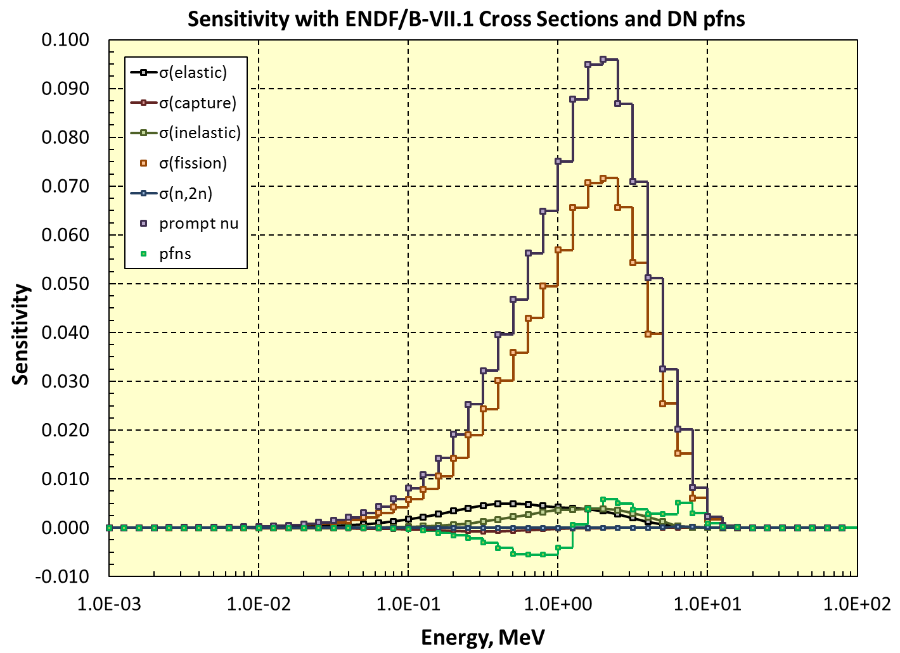
²³⁹Pu Results
Jezebel eigenvalue sensitivity … prompt ν, fission cross section, pfns, …

Slide 13
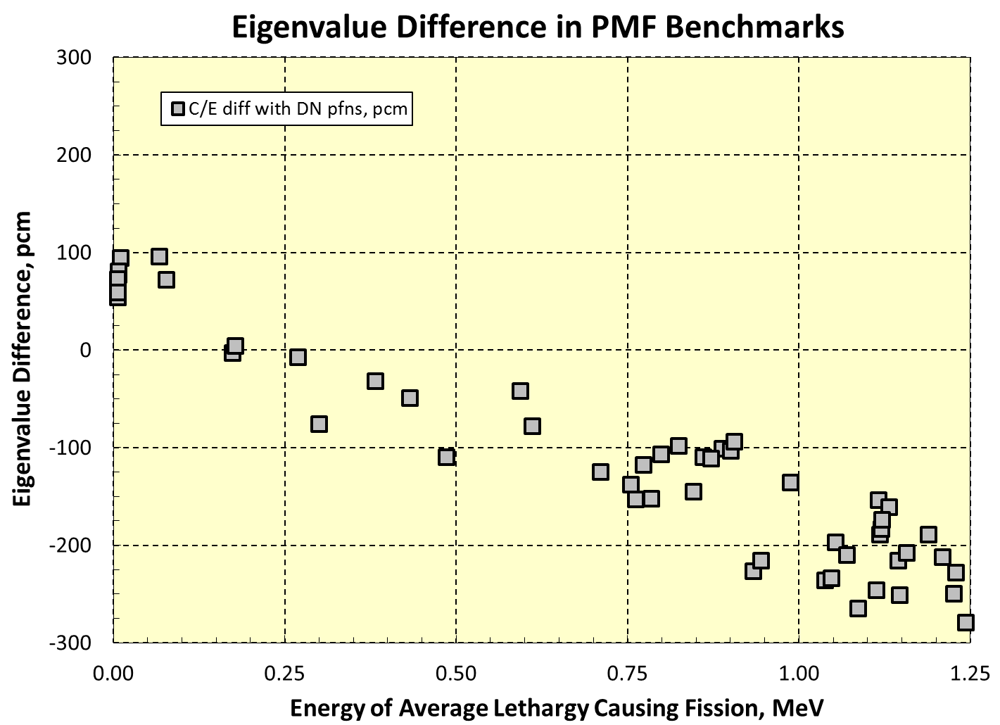
²³⁹Pu Results

Slide 14
²³⁹Pu Results
Benchmark | E71 (w/fixed ²³⁹Pu) | E71 + SG34 ²³⁹Pu | E71 + TK1+DN ²³⁹Pu
PMF1 (Jezebel, rev3) | 1.00079 | 1.00037 | 0.99821
PMF6 (Flattop-Pu) | 1.00106 | 1.00054 | 0.99849
PST1.4 | 1.00500 | 1.00199 | 1.00932
PST4.1 | 1.00389 | 1.00044 | 1.00683
PST9 | 1.01939 | 1.01543 | 1.01695
PST12.10 | 1.00402 | 1.00083 | 1.00475
PST12.13 | 1.00970 | 1.00611 | 1.00757
PST18.6 | 1.00462 | 1.00202 | 1.00461
PST34.4 | 1.00254 | 0.99922 | 1.00320
PST34.15 | 0.99731 | 0.99679 | 0.99988
PST average: | 1.00581 | 1.00285 | 1.00664
TK1 = e71 plus SG34 RR, SG34 prompt nu to 650 eV; “DN” = Neudecker pfns.

Slide 15
²³⁹Pu Results
Reaction | ²³⁸U_{f}/²³⁵U_{f} | ²³⁷Np_{f}/²³⁵U_{f} | ²³⁹Pu_{f}/²³⁵U_{f}
Experiment | 0.2121 | 0.9730 | 1.4300
E71 "Big Paper" | 0.2085 | 0.9708 | 1.4242
E71 "Big Paper" C/E | 0.983 | 0.998 | 0.996
E71 + DN pfns | 0.2038 | 0.9582 | 1.4206
E71+TK1+DN pfns C/E | 0.961 | 0.985 | 0.993
Reaction | ²³⁸U(n,2n) | ¹⁶⁹Tm(n,2n) | ¹⁹¹Ir(n,2n)^{x}190Ir
Experiment | 1.0580E-02 | 3.1250E-03 | 3.2060E-03
<E>, MeV | 8.5 | 10.7 | 10.7
E71 Calc | 1.3259E-02 | 3.6774E-03 | 3.6439E-03
E71 Calc C/E | 1.253 | 1.177 | 1.137
E71+TK1+DN Calc | 1.2127E-02 | 3.2047E-03 | 3.1748E-03
E71+TK1+DN Calc C/E | 1.146 | 1.026 | 0.990
TK1 = e71 plus SG34 RR, SG34 prompt nu to 650 eV; “DN” = Neudecker pfns.

Slide 16
²³⁵U Results
GODIVA (HEU-MET-FAST-001)
Cross Section Set | Benchmark k_{eff} | k_{calc}
ENDF/B-VII.1 | 1.000(1) | 0.99983(3)
E71 + ORNL8 |  | 0.99985(2)
J4 + ORNL8 |  | 0.99757(2)
Flattop-25 (HEU-MET-FAST-028)
ENDF/B-VII.1 | 1.0000(16) | 1.00285(2)
JENDL-4.0 |  | 0.99779(9)
E71 + ORNL8 |  | 1.00300(13)
J4 + ORNL8 |  | 0.99899(13)
Big-10 (IMF7, detailed model)
ENDF/B-VII.1 | 1.0045(7) | 1.00443(2)
JENDL-4.0 |  | 0.99710(7)
E71 + ORNL8 |  | 1.00471(8)
J4 + ORNL8 |  | 0.99764(11)
JENDL-4.0 + ORNL FAST benchmark results are generally worse than those obtained with ENDF/B-VII.1 + ORNL, but …

Slide 17
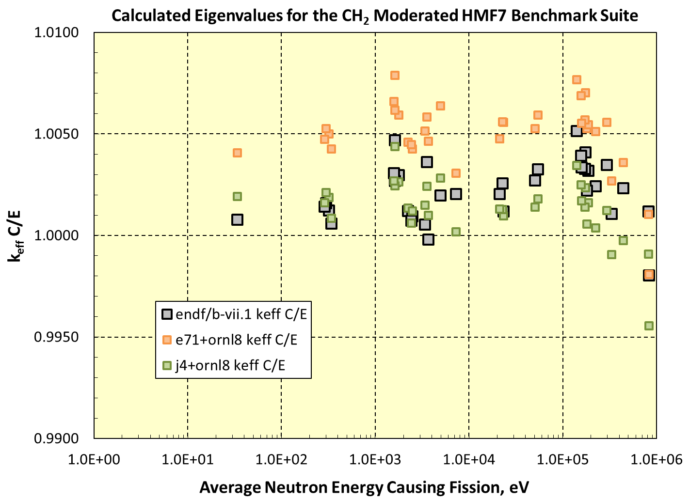
²³⁵U Results
but …
JENDL-4 + ORNL calculated eigenvalues are more accurate than ENDF/B-VII.1 + ORNL.

Slide 18
ICSBEP Benchmarks
Used for ²³⁸U (IAEA “ib33”) Testing
HMF28 – Flattop-25 (HEU core and ^{nat}U reflector)
IMF7 – Big-10 (detailed model). A large heterogeneous assembly of uranium plates
IMF1 – Cases 1 and 4 (“Jemima” plates)
PMF6 – Flattop-Pu (Pu core and ^{nat}U reflector)

Slide 19
²³⁸U Results
Calculated eigenvalues with the “ib33” file are often closer to unity than those obtained with pure ENDF/B-VII.1 cross sections.

Slide 20
Concluding Observations
LANL data testing to date has been limited to a few ICSBEP critical benchmarks
  There is much more testing needed!
“Starter” files (yes plural!) exist for ¹⁶O, ⁵⁶Fe, ^{235,238}U and ²³⁹Pu … but we expect there will be numerous additional iterations.
Testing with replacement of a single data set will always yield a worse result when compared to a “tuned” library.
Integrated testing with multiple new files has not been performed (yet!).

