Slide 1
OPEN ITEMS IN CIELO-O AND BIG3
Cecil Lubitz
Contact: clubitz@nycap.rr.com
CSEWG-CIELO MEETING
NOVEMBER 3-5, 2014

Slide 2
This Talk is About ...
Technical issues not yet finalized
An implicit request for participation (aka collaboration) by any CIELO members having time to do some work on anything :-)
There are "extra" slides in here with more detail, for the interested reader.

Slide 3
Angular Distributions in ENDF-102
LRF=7 R-Matrix Limited Format I
Angular distributions are determined by the resonance parameters which define the cross sections.
The evaluator may use them or substitute other data but should state which and provide tabulated data in File 4. It is important to have a uniquely-defined data set for each evaluation because it affects reactivity.
File 4 should be the primary source.
NJOY can reconstruct the values from the parameters, but should be fixed so that the moments can be supplied on a reasonable mesh rather than at every energy point.

Slide 4
Angular Distributions in the ENDF-102
LRF=7 R-Matrix Limited Format II
SKIP
There is nothing special about LRF=7. It is Reich-Moore (LRF=3) with an added capability to use Coulomb penetrabilities to handle the (n,α) reaction.
The angular distributions in ENDF/B-VII.1 below the alpha threshold were calculated from the parameters by the KAPL code "OPTIC" which is why they look similar to what Luiz gets now from SAMMY.

Slide 5
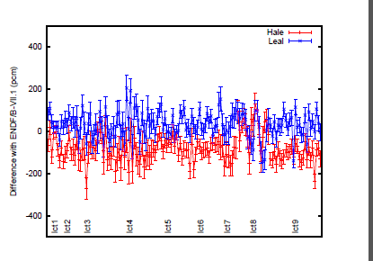
Integral Benchmarking I
HALE and LEAL new evaluations in July.
van der Marck plot showing their differences with ENDF/B-VII.1
Since ENDF/B-VII.1 was adjusted to give <Keff> ≈ 1, Leal looks "good", while Hale shows the same deficit as earlier ENDF/B-VI releases.

Slide 6
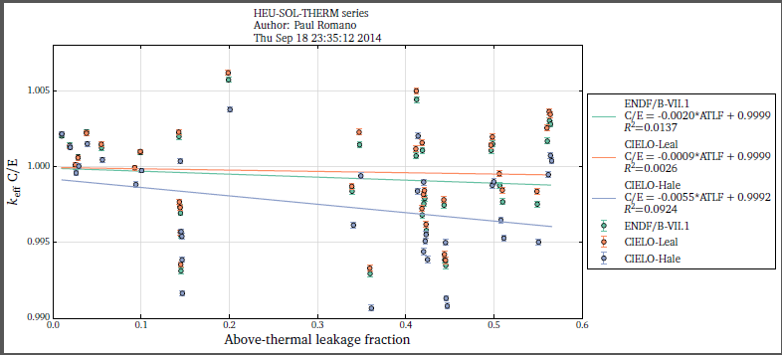
Integral Benchmarking II
Paul Romano's trend with leakage says something is absorbing too much. At zero leakage the effect is ~100 pcm. As leakage increases, the over-absorption steals more from the fission and k goes down
The only Hale-Leal absorption process is nalpha

Slide 7
Integral Benchmarking III
trkov points out that if we go to a softer fission spectrum it will make hale look better. it's equivalent to saying that tweaking the nalpha is as effective as reducing nubar. we should examine that hypothesis in detail. trends with leakage and absorption anyone?
We need agreed-upon, shared lists of standard benchmarks. Having each expert use his own list is a source of unwanted "noise".

Slide 8
Doppler or Hydrogen? I
There is now general agreement that the current O16 thermal scattering data files are ~3% too high, but there are two hypotheses as to the cause.
The Doppler hypothesis invokes the known ratio at 0.0253 eV, 1.0315. The following observations support it:
The average of the 1 MeV resonance peak height in SAYER2000 and JENDL4.0, both unitary limits, is 8.174 b. The value of the Cierjacks 1968 peak is 8.430. The ratio is 1.0313.
The Cierjacks 1968 total at 3.5 MeV is 3.0491 b, the Cierjacks 1980 is 2.9533. The ratio is 1.0324. They published the 1980 data but not the 1968 data.

Slide 9
Doppler or Hydrogen? II
The ORNL evaluation, SAYER2000, fit a collection of ORNL and other data, plus Cierjacks 1980 normalized up by 3.5%. They were above the 4 low-energy measured points Schneider, Dilg, Koester, Block, and the 2.35 MeV window. A least-squares normalization of their total cross section to those 5 points gave the result that they were high by a factor of 1.0314.
These examples support the hypothesis that the 3% over-estimate extends into the MeV region.

Slide 10
Doppler or Hydrogen? III
The water-contamination hypothesis instead blames an unsuspected moisture content in the Ohkubo data.
Because the Ohkubo data are the primary determinants of the transition from low to high energy, it is only necessary to retroactively subtract enough hydrogen to get the low end down by 3%.
Because the hydrogen cross section drops above 100 keV, the MeV Ohkubo data remain high.
In the current Hale and Leal evaluations, which represent "hydrogen" vs "Doppler", the total cross sections near the (n,α) threshold differ by 10%.

Slide 11
The "Empty-channel" error

Slide 15
Doppler or Hydrogen? IV
Considering that fact, together with the fact that the (n,α) cross section has been measured or evaluated over a range of a factor of two, and the angular distributions are also available in many different flavors, here is my opinion, based on two assumptions:
1. The only important goal is the integral benchmark performance.
2. Despite the disagreements at the few percent level, we actually have a pretty good idea of what the xygen cross section looks like

Slide 16
Doppler or Hydrogen? V
The criteria for the evaluated data set we adopt are
1. It has to have a credible basis in the differential data.
2. It has to produce an average <Keff> close to 1.00 over a credible collection of bencmarks.
3. It has to have no trend with leakage.
4. It has to have no trend with oxygen absortption.

Slide 17
What are the codes actually fitting
We all agree that starting from the same data is essential, but that still leaves the internal adjustments, and those from the man behind the curtain, unknown, yet they determine what the code is really fitting

Slide 18
Resolved or Unresolved?
The use of resolved resonances should be minimized by restricting them to energies where they are actually known and have a reactivity impact.
Wherever possible they should be replaced by LSSF=1 dilute averages and probability tables.
Extension to higher energies using fictitious resonances generated from the known distribution laws captures the same information that probability tables do, but they make it much more difficult to analyze and fix cross section errors.
The test for whether a region should be represented by resolved or unresolved resonances is whether integarl benchmarks can detect the difference or not

Slide 19
Is Silicon the Dog or the Tail?
x

Slide 20
What is the Uncertainty in Dilg?
One of the four low-energy measurements is by

Slide 21
The Information Content of Fictitious Resolved Resonances
x

Slide 22
Shielding Benchmarks
The oxygen Broomstick could give an independent estimate of the window bottom and the value at 3.5 MeV if we could get it running.
Ivo Kodeli's ... ?? did not seem to be precise enough and he is working on it.
I CAN'T FIND SHIELDING BENCHMARKS

Slide 23
X
Hi Luiz,
The data needed are SAMMY's best estimate f the "true" measured cross
sections. I would think you would want them for quality control.
Admittedly, what SAMMY does is complicated, but nevertheless it must keep
track of the one-time resolution unbroadening and multiple-scattering
correction in each reaction-iteration, and the (possibly multiple?)
normalizations. It's the latter that we want. Can you start at the first
iteration and step through to the final one (final output parameters) , and
accumulate the successive normalizations for each data set? Those "total
normalization" factors would then be applied to each data set as it looked
after the resolution-unbroadening had been done. That would be SAMMY's best guess at the true cross sections.
Cece
x

Slide 24
WE NEED A CIELO-DB
"DB" means "Database.
CIELO-DB would be devoted exclusively to the organized storage and retrieval of the data generated by the other Cielo groups.
It will be a lot of data, and our ability to make sense of it will depend in part on how easily and accurately we can retrieve the data we want.
It could be a match wih SG38.

Slide 25
X
x

Slide 26
X
x

Slide 27
X
x

Slide 28
X
x

Slide 29
Formatting notes
title calibri H 36
body calibri 24
to view slides at maximum magnification drag the left column of ppt slide thumbnails to the left monitor and adjust height to its maximum (or hide the slides by clicking on the hide button ???), zoom to 72% to see the top and bottom edges of the paper.
x
x

