Slide 1
OUTLINE OF A NEW O16 FILE
Cecil Lubitz, Paul Romano, Tim Trumbull
Contact: clubitz@nycap.rr.com
CSEWG-CIELO MEETING
NOVEMBER 3-5, 2014

Slide 2
Summary of Main Points I
There are two hypotheses about the O16 cross sections: "High" and "Low". They have four main differences:
1. High favors unreduced Bair & Haas (n,α) "UBH". Low favors reduced "RBH".
2. High favors a thermal scattering value influenced by high-energy measurements in the MeV region. Low favors a value based entirely on low-energy measurements.

Slide 3
Summary of Main Points II
3. High favors angular distributions based on normal R-Matrix hard-sphere phase shifts. Low favors distributions based on optical model phase shifts.
4. High ascribes the widespread 3% thermal discrepancy to a water contaminant in a single experiment by Ohkubo. Low ascribes it to a widespread mishandling of the 1/v "scattering- tail" below 2 eV.

Slide 4
What are the consequences of these differences? I
UBH increases absorption and lowers Keff. RBH lowers absorption and raises Keff. The indicators are the average benchmark C/E and the trend with oxygen absorption. <Keff> should be ~1.0 and TWOA should be flat.
Three percent in thermal scattering has a small effect on benchmarks.. larger in heavy water cores. Difficult to isolate by benchmarking. (It went unnoticed for 22 years). It is almost certainly between 3.765 and 3.785 barns. That's 0.5%.

Slide 5
What are the consequences of these differences? II
The optical model has higher P1, more forward scattering, higher leakage, and lower reactivity than the hard-sphere. The indicator is the trend with leakage. ATLF should be flat. (TWOL, the trend with simple total leakage, should be just as good an indicator ??)
The Ohkubo-hydrogen scenario reduces the cross sections up to about 100 keV, above which they remain where they always have been. The Doppler scenario brings them down over all energies.

Slide 6
Where do we stand at present? I
We consider four recent versions of O16 (JENDL4.0 should be included going forward.)
1. ENDF/B-VII.1 "E71".
2. Hale. The current "Iter1" file.
3. Leal-RP. The "ORNL1" file with resonance parameter angular distributions.
4. Leal-E71. The "ORNL1" file with E71 optical-model angular distributions. These were run inadvertently but serendipitously.

Slide 7
Exhibit A. Average C/E <Keff>. E71 0.99961 (-39).
Leal-RP 0.99894 (-106). Hale 0.99849 (-151).

Slide 8
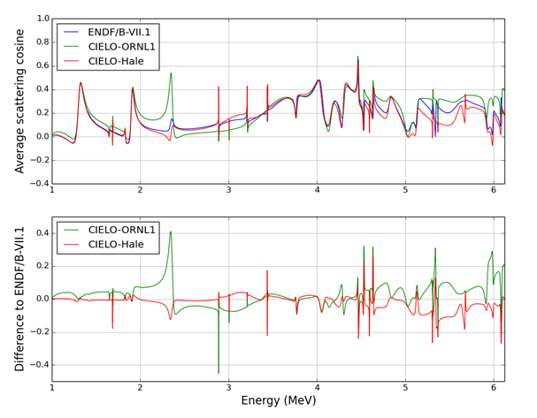
Exhibit B. Leal-RP P1 moment is higher than E71.
That will make it lower in reactivity.

Slide 9
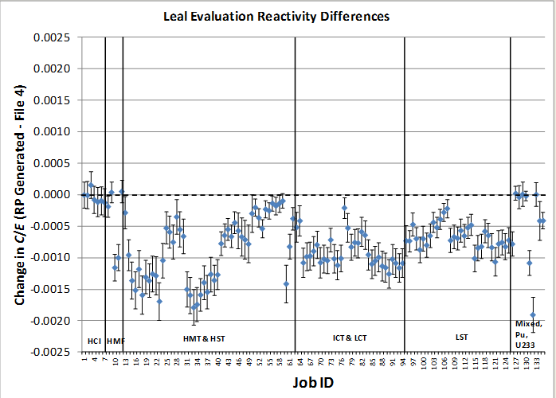
Exhibit C. Leal-E71 is about 100 pcm higher than Leal-RP so has <Keff> about 1.000

Slide 10
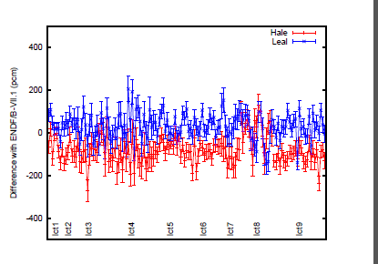
van der Marck Benchmarks
HALE and LEAL-E71.
plot showing their differences with ENDF/B-VII.1
Confirms the previous calculation which puts <Keff> for Leal-E71 close to unity

Slide 11
Leal-E71 trends with leakage and absorption not available when this was written

Slide 12
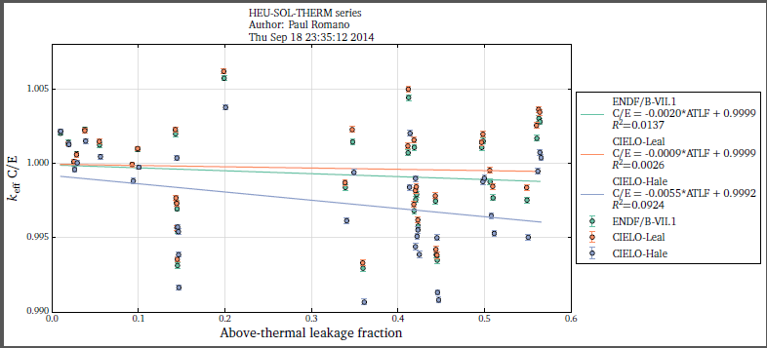
Trend with leakage for E71, Leal-RP, and Hale
Paul Romano's trend with leakage says something is absorbing too much. At zero leakage the effect is ~100 pcm
The only Hale-Leal absorption process is nalpha

Slide 13
Analysis of leakage trends
E60-67 had a rising trend with leakage. It was fixed by the E68-71 O.M. phase shifts which increased P1 and leakage.
This figure shows decreasing trends for all three. The Leal-RP and E71 are very close and very low so we may find an OK trend for the hybrid Leal-E71.

