Slide 1
Targeted adjustment of ²³⁹Pu cross sections
Cecil Lubitz and Paul Romano

Slide 2
Purpose...
Targeted adjustment (TA) of key quantities to lower the average C/E of PST benchmarks to 1.0
and a disclaimer...
It is not an "improvement" to the existing file... Just a stochastically-equivalent data set with <Keff>=1 for a particular set of benchmarks. There are an infinite number of such sets.
Previous use of the method on ²³⁵U, and to a lesser extent ²³⁸U, has proven to be satisfactory.

Slide 3
The Rationale for TA...
If we knew what was wrong we would fix it.
But we don't, and at least part of the reason is that there is no smoking gun.
If the <Keff> "error" is due to the cumulative effect of several small errors, it is not unreasonable to fix it the same way.
Forcing the changes to all be the same fraction of their uncertainties minimizes the maximum change to each of the adjusted quantities.
There are an infinite number of ways to do it, and they are stochastically-indistinguishable.

Slide 4
Quantities targeted
0.3 eV resonance radiation/fission widths
7.8 eV resonance radiation/fission widths
2200 m/s fission and capture cross sections
  Adjusted via negative energy resonances
2200 m/s nubar
Average energy of PFNS

Slide 5
Mechanics of adjustments
Determine a value, x, by which all quantities are modified. The size of the change is x times the uncertainty of the quantity.
Fudge code used to make changes to ENDF file for successive "iterations" on x. Each iteration requires a benchmark calculation to determine <Keff> for that value of x. Close to <Keff>=1 it's quite "linear".

Slide 6
0.3/7.8 eV resonance widths
Uncertainties from Gilles Noguerre
  E=0.296 eV
    Γ _{g} = 39.82 +/- 1.26 meV (3.4%)
    Γ _{n} = 79.47 +/- 1.62 μeV (2%)
    Γ _{fa} = 56.20 +/- 0.95 meV
  E=7.816 eV
    Γ _{g} = 38.60 +/- 2.10 meV (5.4%)
    Γ _{n} = 0.806 +/- 0.035 meV (4.3%)
    Γ _{fa} = -44.74 +/-1.85 meV (4.1%)
Directly modify resonance parameters using uncertainties (no "inner" iteration required )

Slide 7
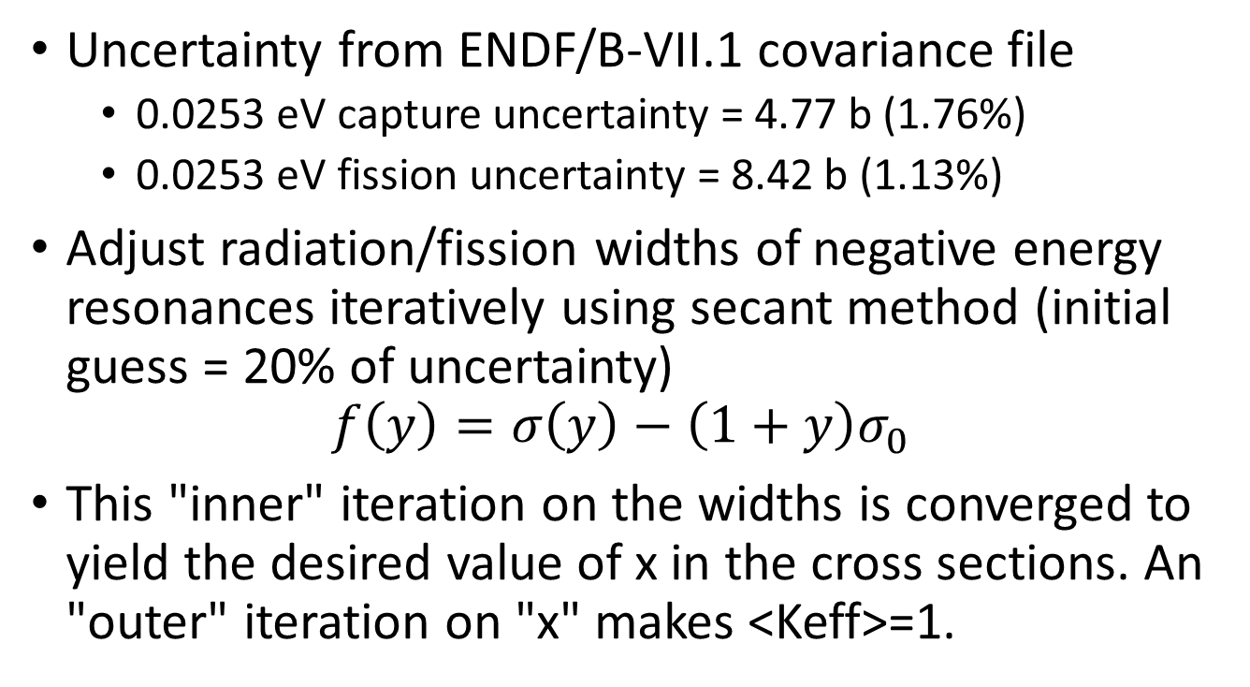
2200 m/s cross sections
Uncertainty from ENDF/B-VII.1 covariance file
  0.0253 eV capture uncertainty = 4.77 b (1.76%)
  0.0253 eV fission uncertainty = 8.42 b (1.13%)
Adjust radiation/fission widths of negative energy resonances iteratively using secant method (initial guess = 20% of uncertainty)
$$f\left(y\right)=σ\left(y\right)−\left(1+y\right)σ_{0}$$
This "inner" iteration on the widths is converged to yield the desired value of x in the cross sections. An "outer" iteration on "x" makes <Keff>=1.

Slide 8
2200 m/s nubar
Uncertainty from ENDF/B-VII.1 covariance file = 0.005 (0.0053%)
Use simple exponential to modify low-energy behavior
  Constants A and B determined by requiring bracketed term is 1.0 at 0.0253 eV and 0.01 at 2 eV.
  At E=0, the change is 6%
  No "inner" iteration required.

Slide 9
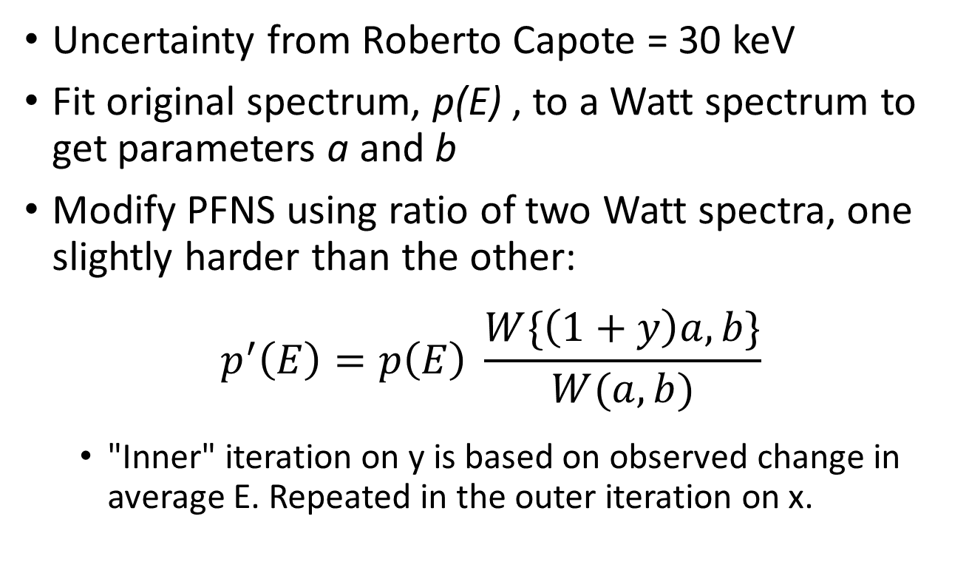
Average energy of PFNS
Uncertainty from Roberto Capote = 30 keV
Fit original spectrum, p(E) , to a Watt spectrum to get parameters a and b
Modify PFNS using ratio of two Watt spectra, one slightly harder than the other:
$$p^{′}\left(E\right)=p\left(E\right) \frac{W\{\left(1+y\right)a,b\}}{W(a,b)}$$
  "Inner" iteration on y is based on observed change in average E. Repeated in the outer iteration on x.

Slide 10
Mechanics of benchmarking
Modified ENDF file processed through NJOY to create ACE
OpenMC 0.6.0 used to simulate benchmark suite
  50 inactive generations
  550 active generations
  5000 particles/generation
Benchmark suite includes 118 PSTs and a handful of others (PMF, etc.)

Slide 11
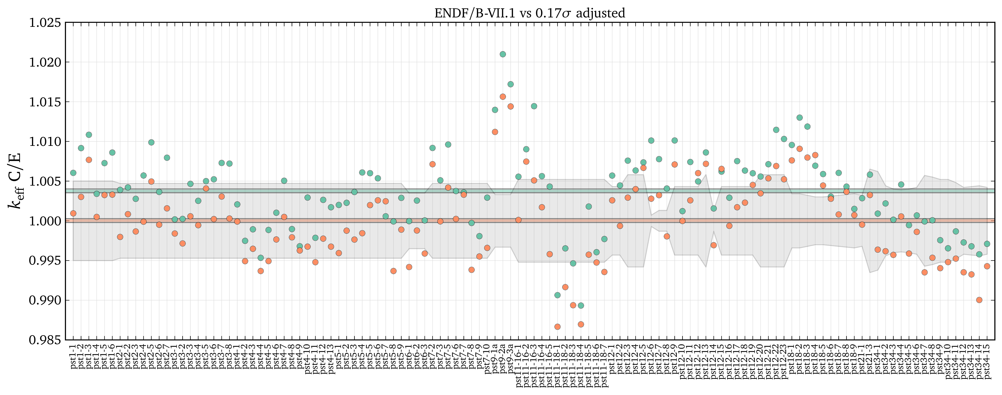
Results: ENDF/B-VII.1 vary all 7
Original C/E: 1.00387 ± 0.00012 (standard dev. = 0.00508)
Adjustment: 17% of uncertainties
Adjusted C/E: 1.00003 ± 0.00012 (standard dev. = 0.00519)

Slide 12
Results: ENDF/B-VII.1 vary all 7
Quantity | Original Value | Uncertainty | Final Value | Difference | Difference (1/uncertainty) | Difference in average k | Change to get k=1 (1/uncertainty)
0.3 eV capture width (eV) | 0.03930 | 0.00130 | 0.03952 | 0.00022 | 0.17 | -0.00098 | 0.65
0.3 eV fission width (eV) | 0.05738 | 0.00095 | 0.05722 | -0.00016 | -0.17 | -0.00061 | -1.05
7.8 eV capture width (eV) | 0.03775 | 0.00210 | 0.03811 | 0.00036 | 0.17 | 0.00000 | 151.80
7.8 eV fission width (eV) | -0.04475 | 0.00185 | -0.04506 | -0.00031 | -0.17 | -0.00011 | -6.00
Negative energy resonances |  |  |  |  |  | -0.00121
Neutrons per fission |  |  |  |  |  | 0.00006
PFNS average energy (eV) | 2.1112E+06 | 3.00E+04 | 2.1163E+06 | 5.0761E+03 | 0.17 | -0.00034 | 1.89
Original average k | 1.00378 |  | Adjusted average k | 1.00003

Slide 13
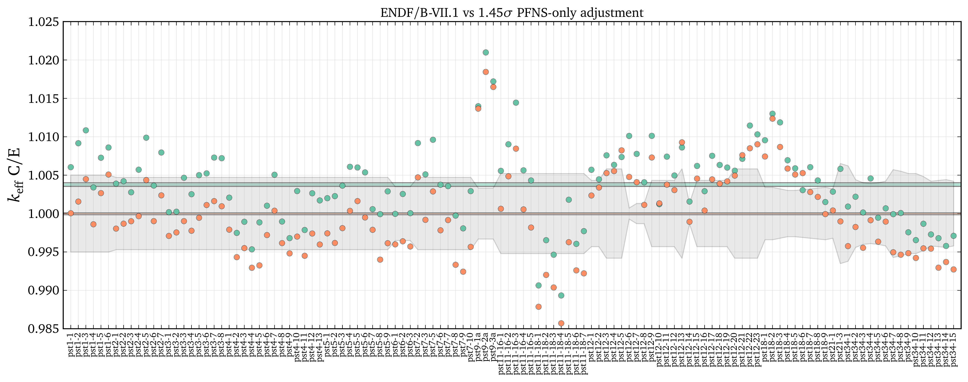
Results: ENDF/B-VII.1 vary only PFNS
Original C/E: 1.00387 ± 0.00012 (standard dev. = 0.00508)
Adjustment: 145% of PFNS average energy uncertainty
Adjusted C/E: 0.99997 ± 0.00006 (standard dev. = 0.00557)

Slide 14
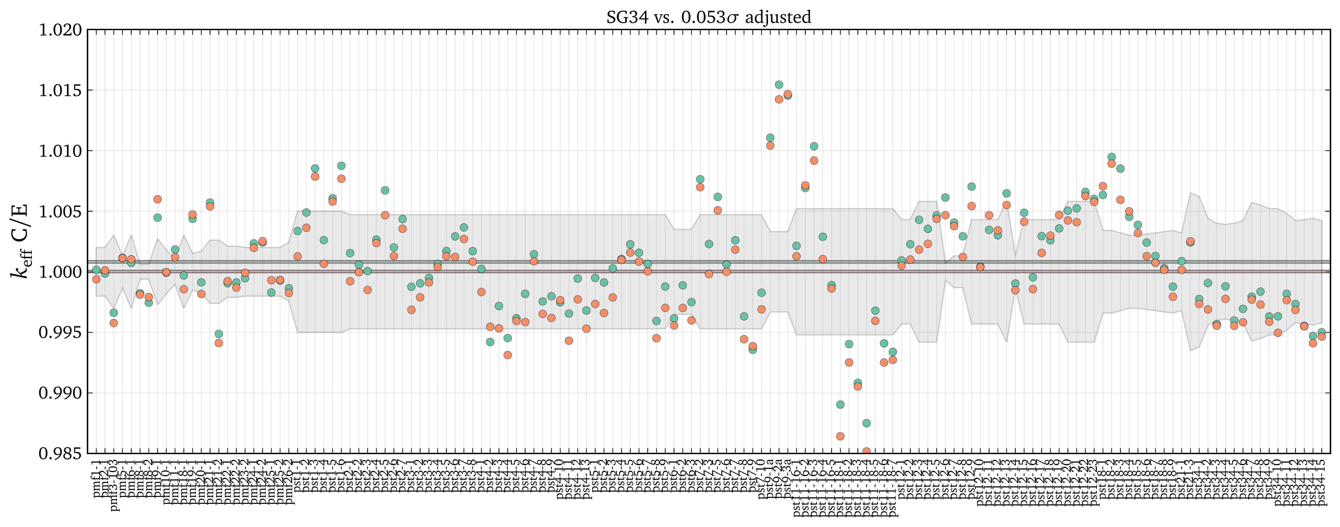
Results: SG34 vary all 7
Original C/E: 1.00081 ± 0.00005 (standard dev. = 0.00449)
Adjustment: 5.3% of uncertainties
Adjusted C/E: 1.00001 ± 0.00005 (standard dev. = 0.00465)

Slide 15
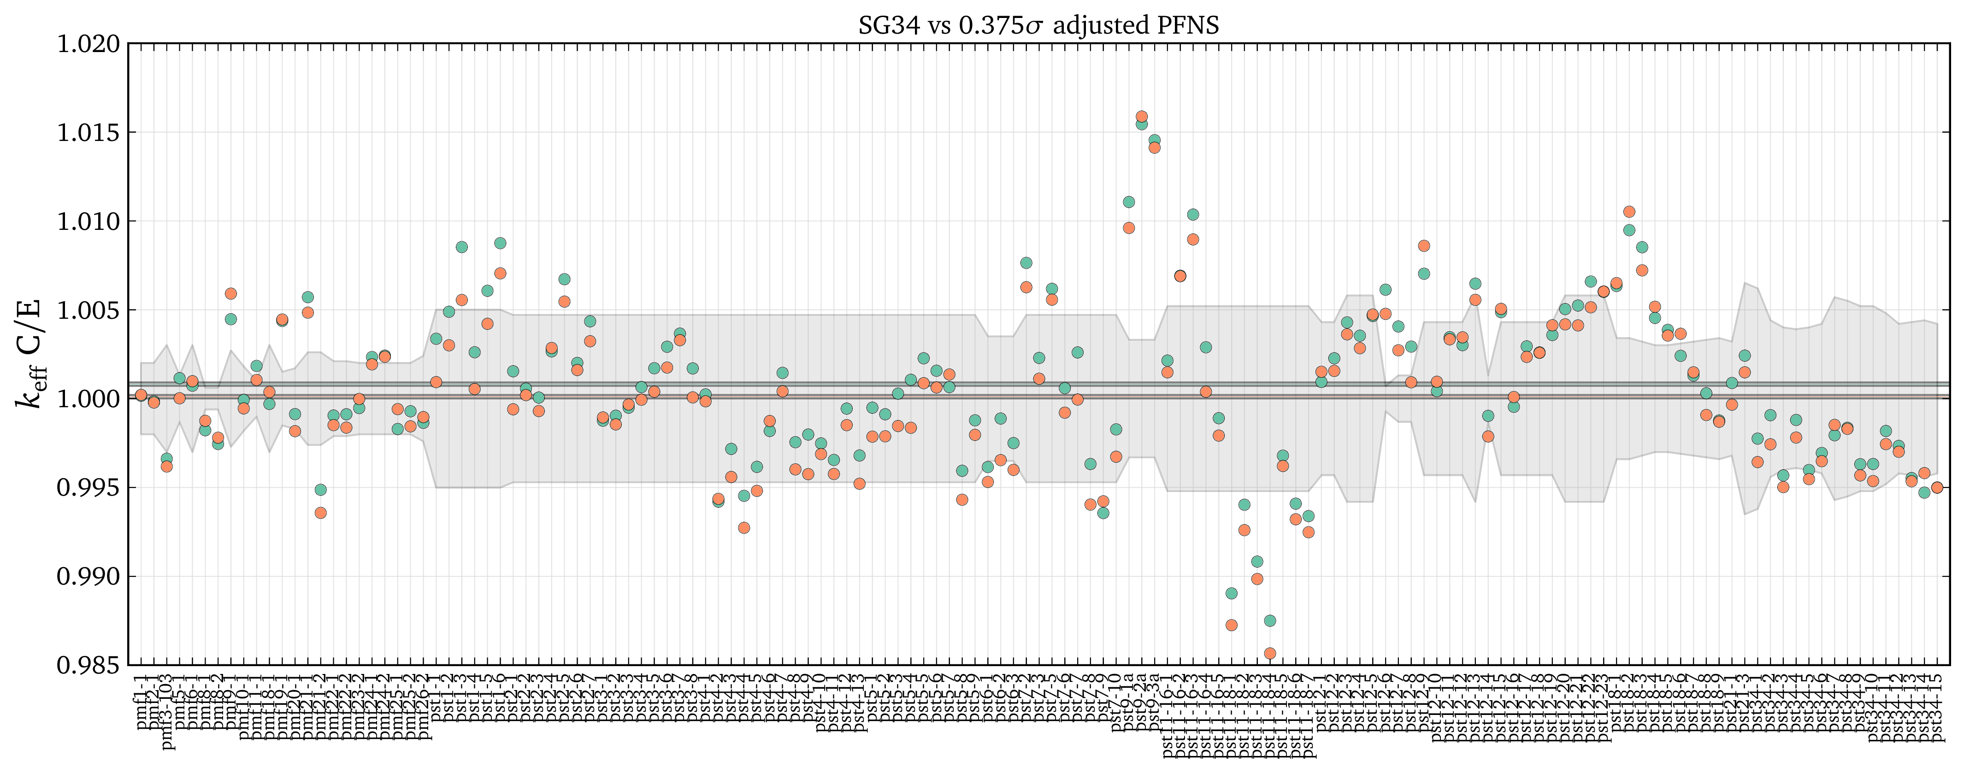
Results: SG34 vary only PFNS
Original C/E: 1.00081 ± 0.00005 (standard dev. = 0.00449)
Adjustment: 37.5% of PFNS average energy uncertainty
Adjusted C/E: 1.00010 ± 0.00005 (standard dev. = 0.00462)

Slide 16
Conclusions
Targeted adjustment can "fix" the bias in PST average C/E by altering 8 thermally-sensitive quantities by a fraction of each one's uncertainty.
Since SG34 performs better than ENDF/B-VII.1, the adjustments needed are smaller
As changes by CIELO to other cross sections change <Keff>, e.g. O-16, it would be feasible to repeat the TA process, so that at any given stage we have <Keff>=1. But for that we need a really representative set of benchmarks.

