Slide 1


Benchmark Testing of CIELO ¹⁶O Evaluations
Bechtel Marine Propulsion Corporation
Knolls Atomic Power Laboratory
P. O. Box 1072
Schenectady, NY 12301-1072
TH Trumbull & PK Romano
Knolls Atomic Power Laboratory
CIELO/CSEWG Meeting
Brookhaven National Laboratory
Nov. 3 – 5, 2014

Slide 2
¹⁶O Validation Testing
Suite of 135 ICSBEP Models run using ENDF/B-VII.1 as the base case for cross section libraries.
Separate runs made substituting ¹⁶O evaluations from ORNL (Leal) and LANL (Hale). Results compared back to ENDF/B-VII.1:
  Population-average eigenvalue C/E and standard deviation, Goodness-of-Fit parameters,
  Changes in C/E examined for fast, intermediate, and thermal spectrum models.
  Eigenvalue C/E Trend analysis using ATLF & ATFF spectral indices, and ¹⁶O absorption fractions.
Most calculations performed with the MC21 Monte Carlo code.
  ENDF files processed locally using NJOY and NDEX to create MC21 data libraries.
  NJOY2012.32x used to produce ESADs from resonance parameters in Leal’s evaluation.
Calculations for PST benchmarks performed with OpenMC
Notes:
(read slide)

Slide 3
Evaluations Tested
Retrieved by E4-Web: 2012/11/15,11:20:09 1 0 0 0
8.016000+3 1.585751+1 1 0 0 4 825 1451 1
0.000000+0 0.000000+0 0 0 0 6 825 1451 2
1.000000+0 1.500000+8 1 0 10 7 825 1451 3
0.000000+0 0.000000+0 0 0 953 192 825 1451 4
8-O - 16 LANL EVAL-DEC05 Hale,Young,Chadwick,Caro,Lubitz 825 1451 5
CH96AB,CA98,Ch99,Yo01 DIST-DEC06 20111222 825 1451 6
----ENDF/B-VII.1 MATERIAL 825 825 1451 7
-----INCIDENT NEUTRON DATA 825 1451 8
------ENDF-6 FORMAT 825 1451 9
825 1451 10
_________________________________________________________________ 825 1451 11
8-O - 16 CIELO for testing 825 1451 12
DIST - JULY2014 825 1451 13
825 1451 14
This O-16 evaluation was created for testing benchmark results in 825 1451 15
criticality, shielding, etc calculations. It uses ENDF/B-VII.1 as 825 1451 16
the template. A resonance re-evaluation was performed at ORNL 825 1451 17
from 1e-5 eV to 6.12 MeV. The evaluation uses the resonance 825 1451 18
parameters derived by Royce Sayer as the inital input for SAMMY. 825 1451 19
The evaluation uses the LRF=7 ENDF representation. The (n,alpha) 825 1451 20
channel, angular data for (n,n) and (n,alapha) are generated from 825 1451 21
the resonance parameters (the latest NJOY version may be needed in 825 1451 22
order to process the evaluation). 825 1451 23
Coherent scattering length was derived from the resonance 825 1451 24
parameters together with the effective radius R'. 825 1451 25
825 1451 26
825 1451 27
The evaluation combines differential and integral data using the 825 1451 28
codes SAMMY and SAMINT. 825 1451 29
825 1451 30
The library is for testing purpose for the WPEC/CIELO effort. 825 1451 31
We will refer to this library as ORNL1. 825 1451 32
825 1451 33
L. C. Leal 825 1451 34
1 0 0 0
8.016000+3 1.585751+1 0 0 0 3 825 1451 1
0.000000+0 0.000000+0 0 0 0 6 825 1451 2
1.000000+0 6.200000+6 8 0 10 7 825 1451 3
0.000000+0 0.000000+0 0 0 34 7 825 1451 4
8-O - 16 LANL EVAL-JUN14 Hale,Paris 825 1451 5
CH96AB,CA98,Ch99,Yo01 DIST-JUL14 825 1451 6
----ENDF/B-VII MATERIAL 825 825 1451 7
-----INCIDENT NEUTRON DATA 825 1451 8
------ENDF-6 FORMAT 825 1451 9
825 1451 10
****************************************************************** 825 1451 11
Preliminary CIELO evaluation for 16O taken entirely from an R- 825 1451 12
matrix analysis of the 17O system that included data up to 7 MeV. 825 1451 13
Experimental neutron total cross sections included over this range 825 1451 14
were those of Dilg, Koester, Block, Ohkubo (corrected for 1H con- 825 1451 15
tent), Johnson, Fowler, Cierjacks, and Schrack. The latter 5 mea- 825 1451 16
surements were allowed to re-normalize, the largest being for Cier-825 1451 17
jacks' data, upward by about 4%. n+16O differential elastic scatt-825 1451 18
ering cross sections from several sources were included in the fit,825 1451 19
as were a few polarization measurements. For the 13C(alpha,n) 825 1451 20
reaction, we included angular distributions measured by Walton, 825 1451 21
and the integrated cross sections of Bair and Haas, which were re- 825 1451 22
normalized downward only slightly by the fit. The (alpha,n) data 825 1451 23
of Drotleff, Heil, and Kellogg were included at lower energies. 825 1451 24
alpha+13C elastic scattering differential cross sections 825 1451 25
measured by Barnes, Kerr, and Heil were also included in the fit. 825 1451 26
Overall, the fitted R-matrix parameters gave a reasonable descrip- 825 1451 27
tion of all the data included. The fit is considered preliminary 825 1451 28
because we wish to add new measurements of the (n,alpha) inte- 825 1451 29
grated cross section at the IRMM in Geel and at the IPPE in 825 1451 30
Obninsk, and possibly other corrected data as well. 825 1451 31
R-matrix calculations are given for the total (MT=1), elastic 825 1451 32
(MT=2), and (n,alpha) (MT=800) cross sections at energies up to 825 1451 33
6.2 MeV. Legendre coefficients for the angular distributions are 825 1451 34
given in file 4 for MT=2 and MT=800 at energies up to 6.2 MeV. 825 1451 35
Notes:
Note that both eval’s were down loaded from the NNDC Gforge server CIELO branch.

Slide 4
Cross Section Comparisons - I
All cross sections broadened to 293.6 K
Notes:
Low energy elastic scattering cross sections see a reduction of 1.8 to 1.2% in the CIELO candidates, relative to ENDF?B-VII.1
Cross sections above 6.2 MeV are carried to 20.0 MeV as constant in Hale’s file.
Larger numbers of differences in the fast region. Interesting RI values for Hale’s MT=107 values…

Slide 5
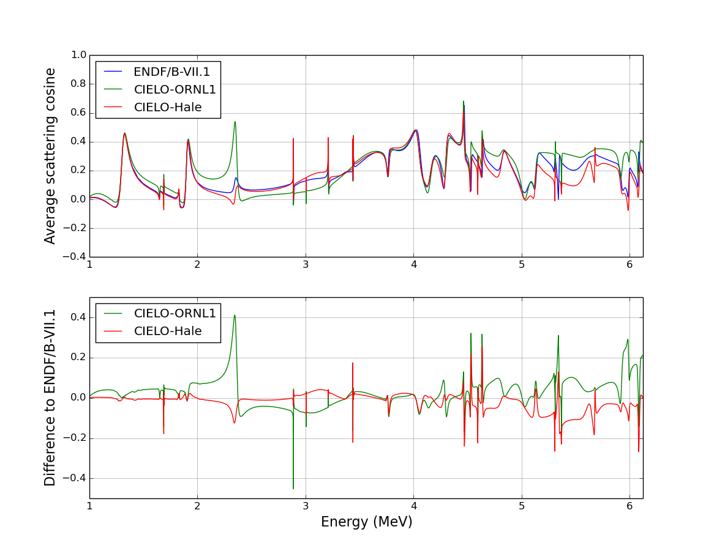
Cross Section Comparisons - II
Notes:
Differences in fast elastic scattering angular distributions are shown above (thermal region differences are negligible).
Leal evaluation looks slightly more forward-peaked, on average.

Slide 6
Cross Section Comparisons - III
Notes:
Here are the comparison of the (n,alpha) cross sections.
Can see Hale’s value running higher, for the most part, as expected. Leal’s values are also generally higher than ENDF/B-VII.1.

Slide 7
ICSBEP Suite Models
ISCBEP Suite focused on thermal spectrum, LEU/HEU fuel systems with a handful of PU, Mixed, and ²³³U benchmarks:
Notes:
The table on the left shows the list of 135 benchmark models included in the KAPL validation testing that have appreciable amounts of O-16:
The majority of the models are uranium fueled, with a selection of 8 Pu and 6 U233 fueled systems added to the mix.
Greater than half of the models have thermal neutron spectra. However, a sampling of fast and intermediate spectra are also included, as shown in the table on the right.

Slide 8
Population C/E: ENDF/B-VII.1 vs. Leal and Hale
Considering the entire population:
Leal average C/E is 68 pcm lower,
Hale average C/E is 113 pcm lower.
Std. dev. and χ² are very similar.
Library | Average | Std. Dev. | χ²
ENDF/B-VII.1 | 0.99961 | 0.00507 | 0.0051
Leal | 0.99894 | 0.00528 | 0.0051
Hale | 0.99849 | 0.00527 | 0.0053
Goodness-of-fit calculated using:
NOTE: Error bars are removed for clarity. The 95% Confidence Intervals on calculated eigenvalues are ~10-20 pcm (Experimental uncertainties are typically several times that).
Notes:
No obvious improvements in ensemble C/E using the CIELO candidates.
On average, Leal is lower than ENDF/B-VII.1, Hale is lower than Leal.

Slide 9
Effect of Using RP Generated ESADs (Leal)
Notes:
Here are the effects of using the ESADs from the resonance parameters (NJOY2012.32x) vs. the ESADs tabulated in the ORNL evaluation file 4. They are substantial.
Here we need to be extremely careful how we proceed with this approach to generating ESADs. Clear guidance must be provided in the ENDF-102 manual on how to specify that the RPs should be used in lieu of the tabulated data. A “flag” in the file 4 data indicating that the evaluator expects the processing code to generate the data from the LRF=7 resonance parameters is needed. Even better would be to have the evaluator supply the tabulated File 4 without having to rely on NJOY (or other processing codes).

Slide 10
Reactivity Effects – Fast Spectrum Models
Only the three water-reflected fast spectrum benchmarks (HMF_004_01, HMF_004_01(1d), and PMF_011) show a statistically significant effect (30 – 55 pcm) from changes in the ¹⁶O cross section.
Notes:
Only the three water-reflected fast spectrum benchmarks (HMF_004_01, HMF_004_01(1d), and PMF_011) show a statistically significant effect (30 – 55 pcm) from changes in the ¹⁶O cross section.
C/E’s improve for the HMF_004 models, but not for PMF_011.

Slide 11
Reactivity Effects – Intermediate Spectrum Models
The ²³³U solution model shows the most sensitivity to changes in ¹⁶O cross section, with the Hale evaluation leading to an ~55 pcm loss in reactivity.
Notes:
The ²³³U solution model shows the most sensitivity to changes in ¹⁶O cross section, with the Hale evaluation leading to an ~55 pcm loss in reactivity, which drives the C/E for this model further from 1.0.

Slide 12
Reactivity Effects – HST Models
The HST models show significant effects as a result of changes in the ¹⁶O cross section.
Models with higher leakage tend to show greater effects: 50 – 100 pcm (Leal) and 100 – 200 pcm (Hale).
Source | Avg. (C/E-1)
ENDF/B-VII.1 | -0.00074
Leal | -0.00129
Hale | -0.00193
Notes:
The HST models show significant effects as a result of changes in the ¹⁶O cross section.
Models with higher leakage tend to show greater effects: 50 – 100 pcm (Leal) and 100 – 200 pcm (Hale).
Average C/E for this family of models gets worse using the Leal evaluation (55 pcm) or Hale’s (120 pcm).

Slide 13
Neutron Balance for HST Models
Higher Leakage HST (39% Leakage)
Lower Leakage HST (5%)
More leakage and higher ¹⁶O absorptions occur, causing a reduction in the ²³⁵U and H-H₂O absorptions.
¹⁶O absorptions are notably higher with the Hale evaluation.
Leakage differences are greatly reduced, but higher ¹⁶O absorptions occur, causing a reduction in the ²³⁵U and H-H₂O absorptions.
¹⁶O absorptions are notably higher with the Hale evaluation.
Notes:
(Read the slide bullets for the two cases)

Slide 14
Reactivity Effects – LST Models
In general, the LST models also show significant effects as a result of changes in the ¹⁶O cross section: about 50 pcm (Leal) and 100 pcm (Hale). Leal’s evaluation performs better on average.
Source | Avg. (C/E-1)
ENDF/B-VII.1 | 0.00026
Leal | -0.00009
Hale | -0.00076
Notes:
In general, the LST models also show significant effects as a result of changes in the ¹⁶O cross section: about 50 pcm (Leal) and 100 pcm (Hale). Leal’s evaluation performs better on average.

Slide 15
Reactivity Effects – LCT Models
The LCT models show similar effects as with the LST models with changes in the ¹⁶O cross section: about 25-100 pcm (Leal) and 50-150 pcm (Hale).
Source | Avg. (C/E-1)
ENDF/B-VII.1 | 0.00026
Leal | -0.00033
Hale | -0.00079
Notes:
The LCT models show similar effects as with the LST models with changes in the ¹⁶O cross section: about 25-100 pcm (Leal) and 50-150 pcm (Hale).
There is no improvement in using the CIELO candidate evaluations.

Slide 16
Neutron Balance for LST & LCT Models
Similar to the HST models, there is increased leakage and ¹⁶O absorptions causing a reduction in ²³⁵U absorptions.
¹⁶O absorptions are notably higher with the Hale evaluation.
Notes:
Similar to the HST models, there is increased leakage and ¹⁶O absorptions causing a reduction in ²³⁵U absorptions.
¹⁶O absorptions are notably higher with the Hale evaluation.

Slide 17
HST+LST Above Thermal Leakage Trend Analysis
Notes:
CIELO candidate evaluations result in slight increases in negative trend of C/E with ATLF for HST+LST models.

Slide 18
HST, LST, LCT Above Thermal Fission Trend Analysis
Notes:
CIELO candidate evaluations introduce slight negative trends of C/E with ATFF for HST, LST, LCT models.
Also, a slight reduction intercept is noted with the CIELO candidate evaluations.

Slide 19
HST, LST, LCT ¹⁶O Absorption Trend Analysis
Notes:
Generally the same positive trend of C/E with O16 absorption, but CIELO candidates push curves to the right (higher absorption fractions)
This leads to the overall reduction in intercept for the CIELO candidate evaluations.

Slide 20
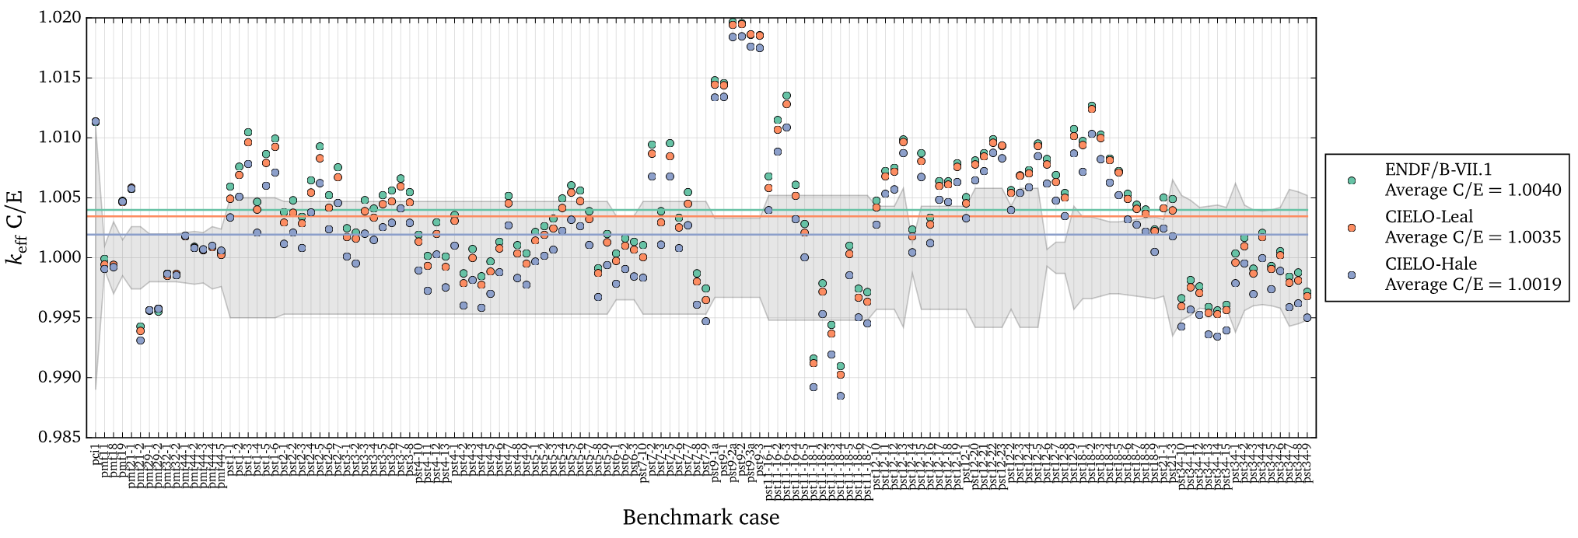
Reactivity Effects – PST Models
PST models show significant effects as a result of changes in the ¹⁶O cross section: about 0-100 pcm (Leal) and 150-300 pcm (Hale).
Notes:
An interesting result of the candidate evaluations was the effect on the PST model bias.
Both candidates, but Hale’s in particular, significantly move the PST benchmark C/E values closer to 1.0.

Slide 21
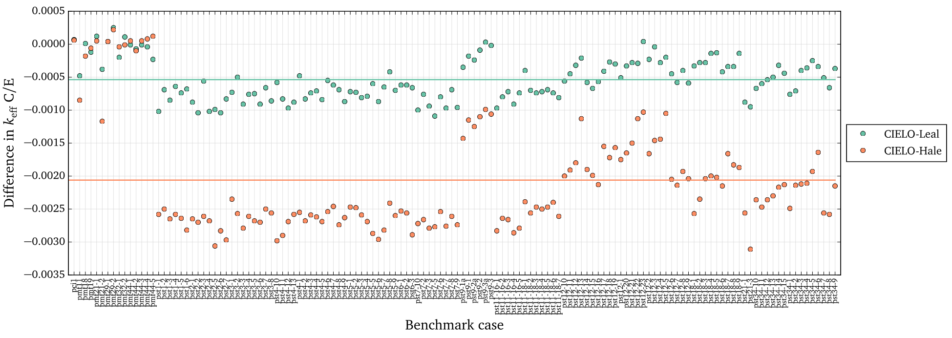
Reactivity Effects – PST Models
Combination of Hale ¹⁶O and SG34 ²³⁹Pu may reduce PST bias to < 100 pcm. New ¹⁶O evaluations need to be considered for ongoing Big3 work.
Notes:
Combination of Hale ¹⁶O and SG34 ²³⁹Pu may reduce PST bias to < 100 pcm. New ¹⁶O evaluations need to be considered for ongoing Big3 work.

Slide 22
Conclusions
Based on the collection of benchmarks used in this study:
  Both the Leal and Hale evaluations generally cause increased ¹⁶O absorption and leakage.
    These increases are larger for the Hale evaluation.
  Relative to ENDF/B-VII.1, both Leal and Hale introduce slightly negative C/E trends with ATLF & ATFF.
    There is also a consistent positive trend of C/E with ¹⁶O absorptions that should be considered.
  Excluding the PST benchmarks, there are no notable improvements in average C/E using either Leal’s or Hale’s evaluation.
Results from this study do not support adopting either evaluation in lieu of the current ENDF/B-VII.1 evaluation:
  Although the improvement in C/E for the PST models with Hale’s evaluation needs further investigation.

