Slide 1
Nuclear Structure Insights on Reactor Antineutrino Spectra
A.A. Sonzogni, E.A. McCutchan, T.D. Johnson
National Nuclear Data Center

Slide 2
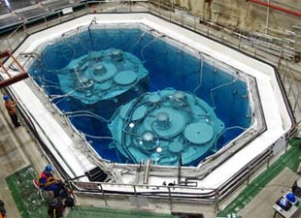
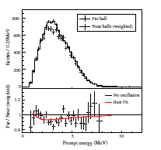
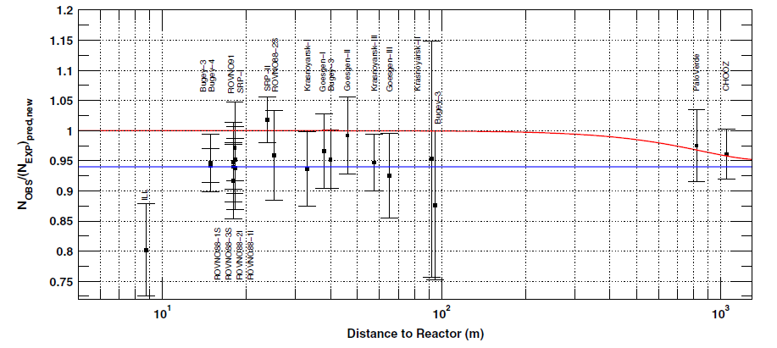
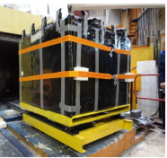
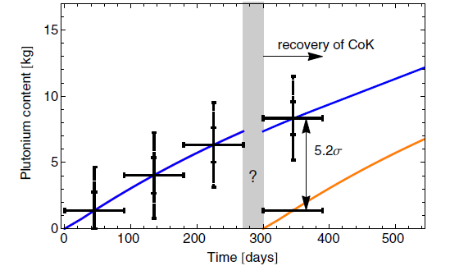
Antineutrinos from reactors
A “hot” topic …
Reactor Anomaly
Daya Bay
Applications
Physics beyond the standard model
4th sterile neutrino
New results for θ₁₃
Non-proliferation
F.P. Ann et al., PRL 108, 171803 (2012)
E. Christensen et al.,
PRL 113, 042503 (2014)
G. Mention et al., PRD 83, 073006 (2011).

Slide 3

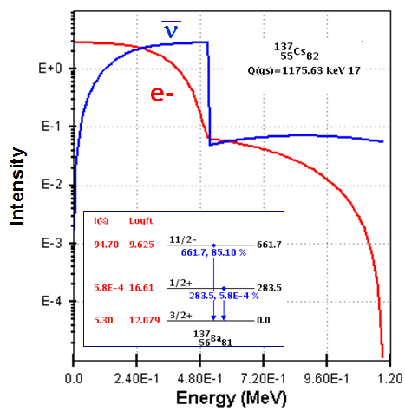
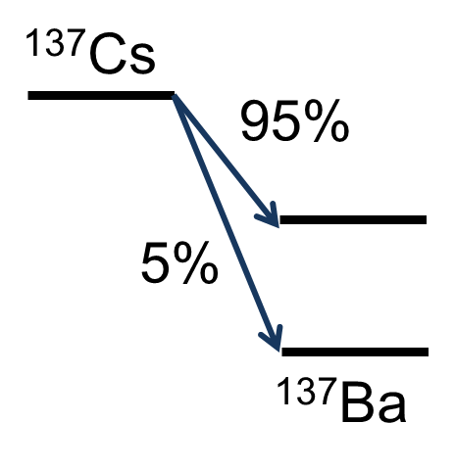

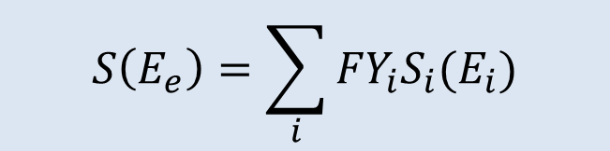
Connection to ENSDF
Summation method
(or ab-initio method)
Benefits
Links ENSDF to another basic science community
Provides integral measurements (check on ENSDF)
Spurs new measurements which will improve ENSDF
Single nucleus – sum β branches*intensity
Total – sum β spectrum*fission yield
$$S\left(E_{e}\right)=\sum_{i}{{FY}_{i}S_{i}(E_{i})}$$

Slide 4
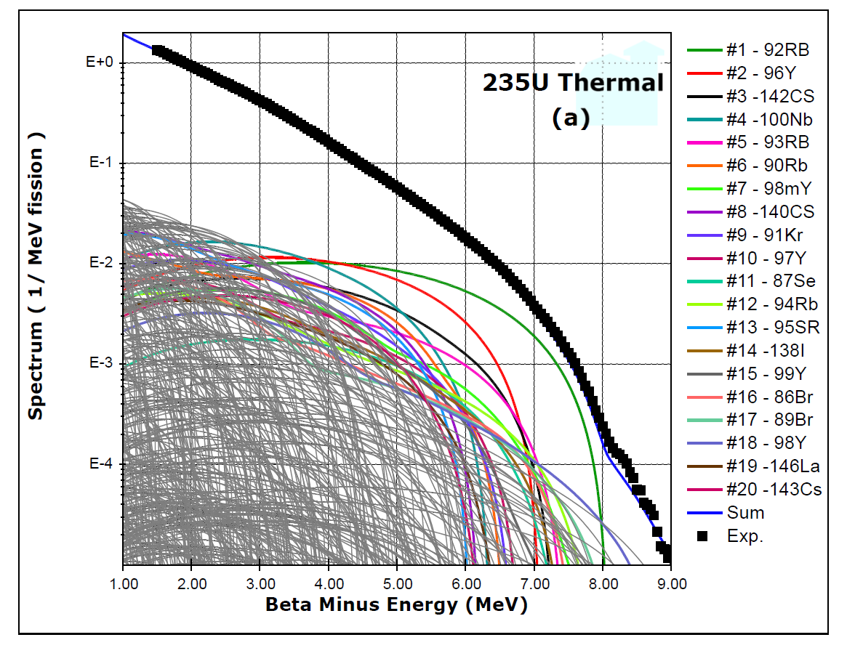
Summation for ²³⁵U

Slide 5
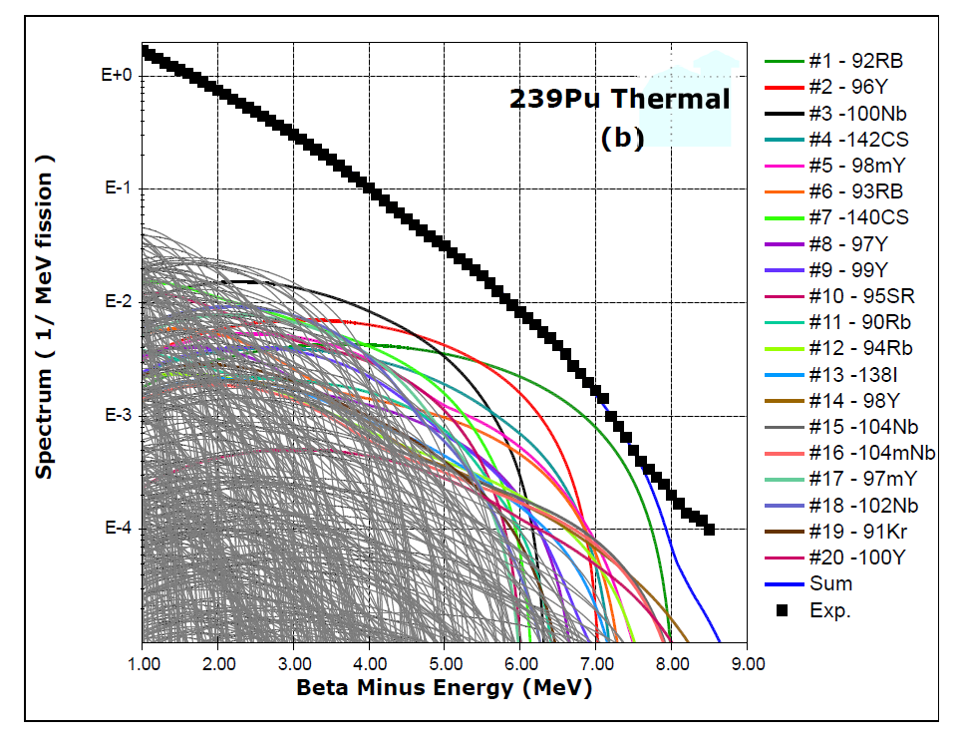
Summation for ²³⁹Pu

Slide 6
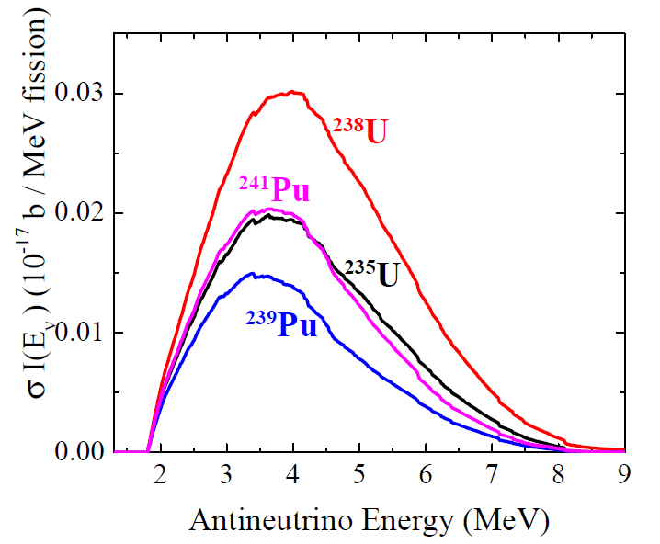
Daya Bay signal shape = spectrum × cross section
²³⁵U signal has a shoulder at around 6 MeV

Slide 7
Main Contributors at ~5 MeV
235U
37-Rb-92
39-Y-96
41-Nb–100
55-Cs-142
37-Rb-90
55-Cs-140
52-Te –135
38-Sr-95
239Pu
41-Nb-100
39-Y-96
37-Rb–92
55-Cs-140
55-Cs-142
38-Sr-95
52-Te-135
39-Y- 98m
241Pu
39-Y-96
41-Nb-100
55-Cs – 142
52-Te- 135
37-Rb-92
55-Cs- 140
53-I- 137
39-Y-99
238U
39-Y-96
37-Rb-92
41-Nb –100
55-Cs-142
52-Te-135
39-Y-99
55-Cs-143
53-I-138
These top 8 contribute 30%-40% to the overall spectrum

Slide 8
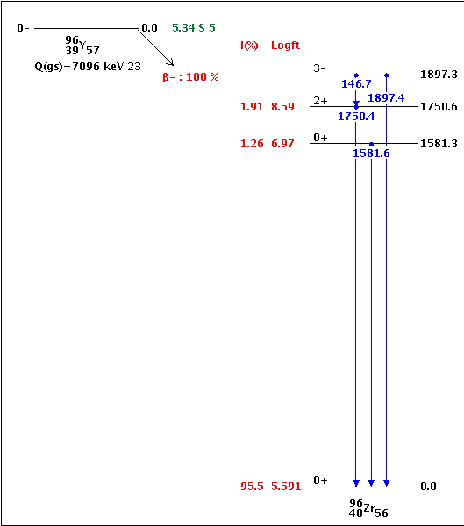
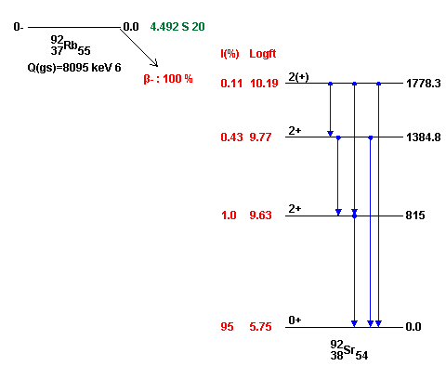
What do these have in common?
First forbidden non-unique, ground-state to ground-state transition accounting for 95% of beta intensity
Need precise measurements of g.s. to g.s. (or g.s. to low-lying states) β intensity

Slide 9
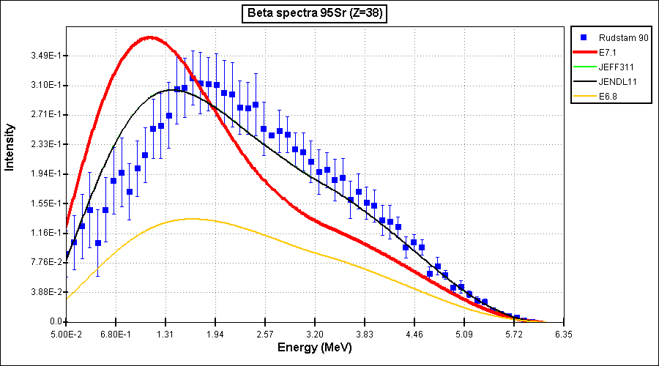
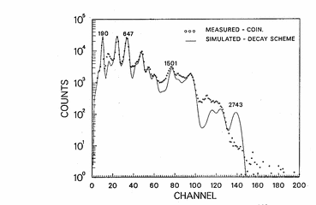
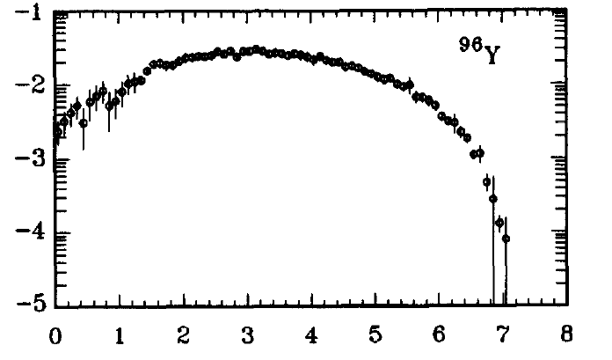
Complete data trumps all
Total Absorption Gamma-ray Spectroscopy (TAGS)
Direct Beta-Spectrum Measurements
Greenwood et al., + few Valencia
Rudstam et al., At.Data Nucl.Data Tables 45, 239 (1990)
TAGS
Rudstam

Slide 10
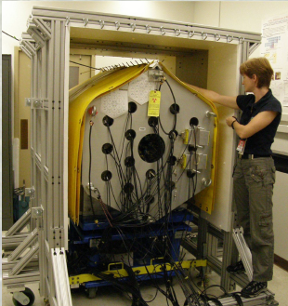
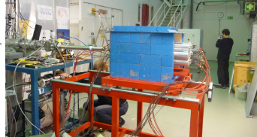
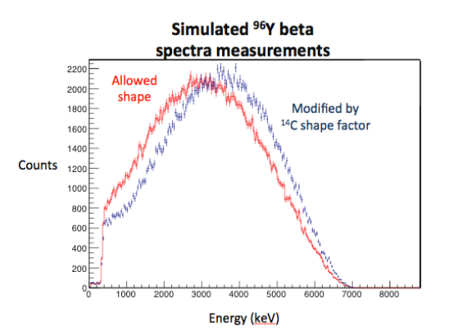
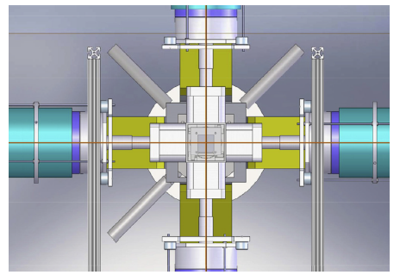
New measurements on the horizon
TAGS:
ORNL and Valencia/Jyvaskyla
Beta-Spectrum + discrete γ’s
LLNL – BNL led collaboration
Proposal on ⁹²Rb and ⁹⁶Y accepted at last ANL PAC

Slide 11
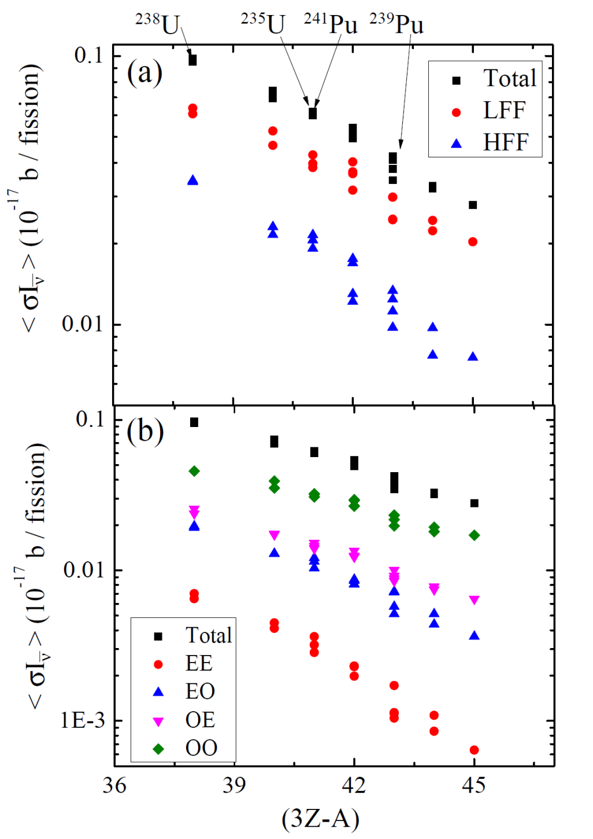
Systematics of all fissioning systems
Important quantity is integral of Daya Bay signal
Link to delayed neutron yield commonly parameterized by
3Z-A

Slide 12
A continually evolving topic
November 2013 – Workshop on Reactor Antineutrinos at INT, Seattle. Co-organized by A.A. Sonzogni
January 2015 – Follow up Workshop in Nantes, France
Methods to compute
Nuclear physics inputs
New measurements
Theoretical developments
Surprising findings from Daya Bay

Slide 13
BACKUPS

Slide 14
What is the “Reactor Anomaly”?
Survey of 19 short baseline (<100 m) reactor antineutrino experiments
Number of Observed/Predicted = 0.943 ± 0.023
(Deviation from 1.0 at 98.6 % C.L.)
G. Mention et al., Phys. Rev. D 83, 073006 (2011).
Result confirmed (1.4σ from 1.0)
in C. Zhang et al., Phys. Rev. D 87, 073018 (2013).

Slide 15
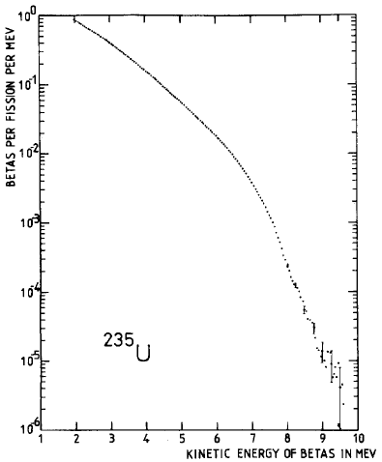
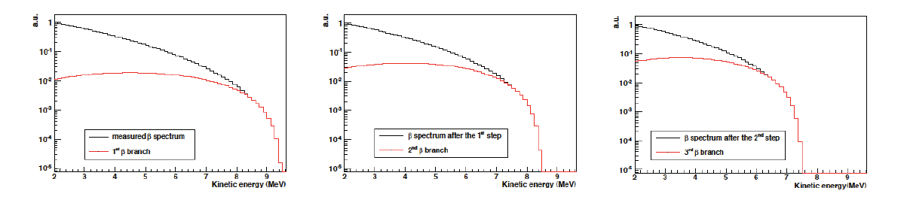
How to determine “predicted”?
Conversion method
Total β spectrum measured in 1980’s
at ILL for ²³⁵U, ²³⁹Pu, ²⁴¹Pu
Fit using ~30 “virtual” branches

Slide 16
What are the implications?
Many possible explanations
Predicted Antineutrino spectrum is incorrect
Experimental bias in all 19 experiments
New physics at short baselines
Existence of a 4th sterile neutrino
Would impact θ₁₃ results

Slide 17
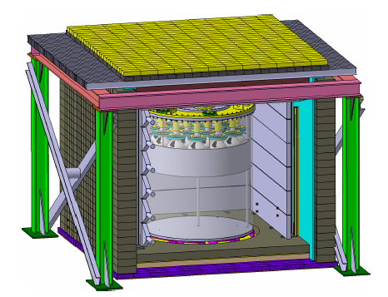
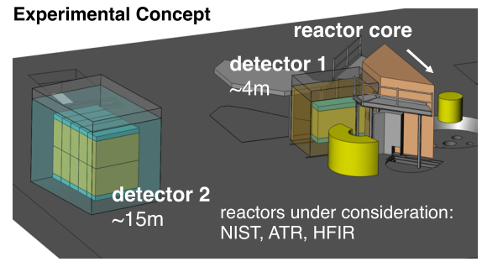
Efforts by the Neutrino Community
Numerous Very Short Baseline Experiments ranging from operating to planning stages
Nucifer, France
Neutrino-4, Russia
PROSPECT, USA
Operational, D=7m
Nearly Operational, D=6-13m
Conceptual
CORMORAD – Italy, PANDA – Japan, SOLiD - France

Slide 18
What can our community contribute ?

Slide 19
Main Contributors at 4.5 MeV
235U
37-Rb-92
39-Y-96
41-Nb–100
55-Cs-142
37-Rb-90
55-Cs-140
52-Te –135
38-Sr-95
239Pu
41-Nb-100
39-Y-96
37-Rb–92
55-Cs-140
55-Cs-142
38-Sr-95
52-Te-135
39-Y- 98m
241Pu
39-Y-96
41-Nb-100
55-Cs – 142
52-Te- 135
37-Rb-92
55-Cs- 140
53-I- 137
39-Y-99
238U
39-Y-96
37-Rb-92
41-Nb –100
55-Cs-142
52-Te-135
39-Y-99
55-Cs-143
53-I-138
These top 8 contribute 30%-40% to the overall spectrum

Slide 20
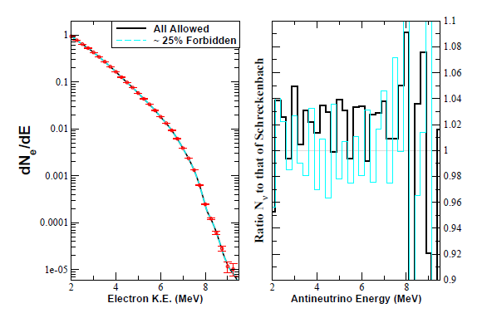
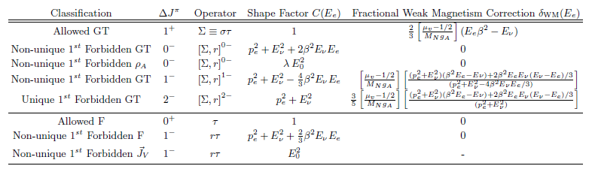
Allowed versus Forbidden Transitions
A.C. Hayes et al., arXiv:1309.4146v3
Again, see talk by Nick Scielzo in next session

Slide 21
Summary
Reactor anomaly provides nice link between neutrino physics and nuclear structure physics
Neutrino community investing significant time and effort but they need our help to sort out all the pieces
CARIBU is well suited both in beams and detector systems to address the main issues
Problem is difficult but not impossible

Slide 22
Main Contributors at 6 MeV
235U
37-Rb-92
39-Y-96
55-Cs – 142
37-Rb- 93
39-Y-98m
37-Rb- 94
35-Br – 86
39-Y-98
239Pu
37-Rb-92
39-Y-96
55-Cs – 142
39-Y-98m
37-Rb- 93
41-Nb- 104m
41-Nb- 104
37-Rb- 94
241Pu
37-Rb-92
39-Y-96
55-Cs – 142
41-Nb- 104
39-Y-98m
37-Rb- 93
41-Nb- 104m
53-I-138
238U
37-Rb-92
39-Y-96
55-Cs – 142
37-Rb- 93
39-Y-100
51-Sb- 135
37-Rb- 94
50-Sn-133

Slide 23
Why these?
Large Q value
Large cumulative fission yield
Large beta-feeding to low-lying states
235U
37-Rb-92
39-Y-96
55-Cs – 142
37-Rb- 93
39-Y-98m
37-Rb- 94
35-Br – 86
39-Y-98
<beta> (MeV)
3.887
3.205
2.924
2.155
2.530
2.020
1.944
2.996
FY
0.048 (0.048)
0.047 (0.060)
0.029 (0.027)
0.035 (0.036)
0.019 (0.011)
0.015 (0.016)
0.019 (0.016)
0.011 (0.019)
FY * <beta>
0.19 (0.19)
0.15 (0.19)
0.085 (0.079)
0.075 (0.078)
0.048 (0.028)
0.030 (0.032)
0.037 (0.031)
0.033 (0.057)

Slide 24
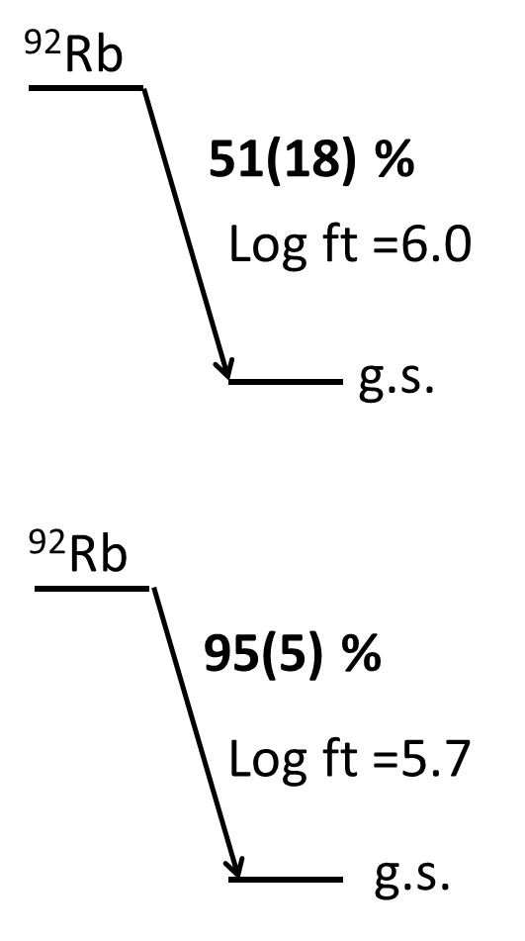
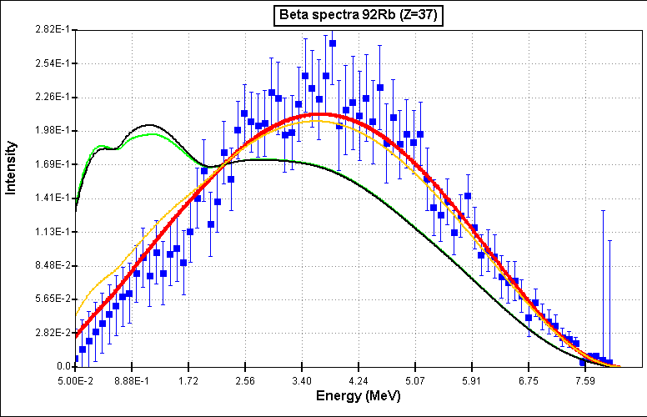
Conflicting Results on ⁹²Rb decay
50%
95%

Slide 25
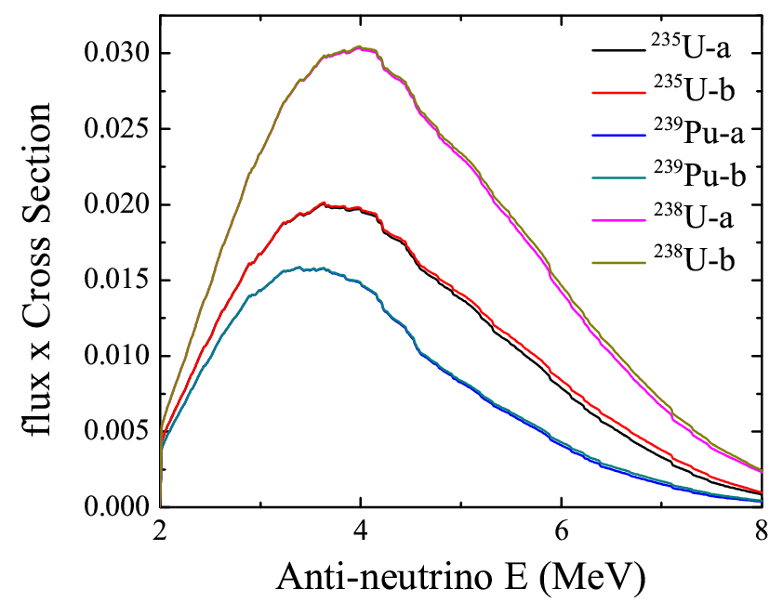
One small nucleus, one big effect
⁹²Rb
a) 2000 ENSDF
51(18) %
g.s.
b) Update with
new data
⁹²Rb
95(5) %
g.s.

Slide 26
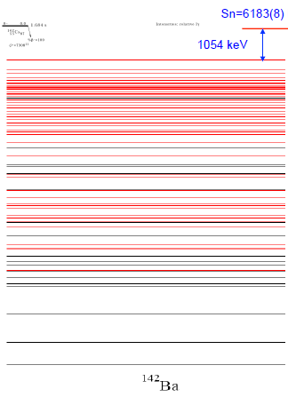
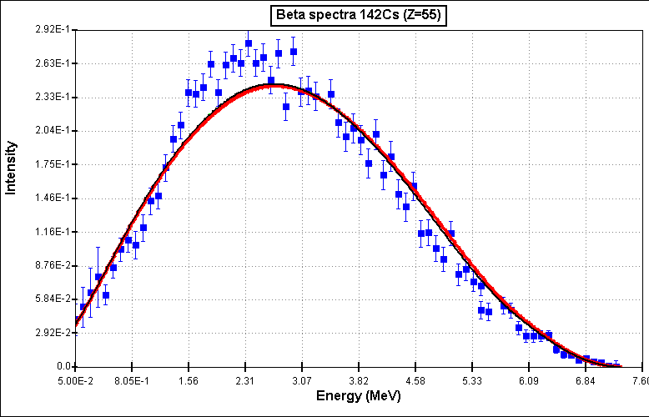
¹⁴²Cs decay: Case closed
Reasonable agreement between discrete line data and Rudstam
71 Levels
217 placed gamma’s
20 Levels
~30 placed gamma’s
~80 unplaced gamma’s
Courtesy of S. Zhu -ANL

Slide 27
Main Contributors at 6 MeV
235U
37-Rb-92
39-Y-96
55-Cs – 142
37-Rb- 93
39-Y-98m
37-Rb- 94
35-Br – 86
39-Y-98
239Pu
37-Rb-92
39-Y-96
55-Cs – 142
39-Y-98m
37-Rb- 93
41-Nb- 104m
41-Nb- 104
37-Rb- 94
241Pu
37-Rb-92
39-Y-96
55-Cs – 142
41-Nb- 104
39-Y-98m
37-Rb- 93
41-Nb- 104m
53-I-138
238U
37-Rb-92
39-Y-96
55-Cs – 142
37-Rb- 93
39-Y-100
51-Sb- 135
37-Rb- 94
50-Sn-133

Slide 28
Closer look at ^{104,104m}Nb
No Rudstam data
No TAGS data
No discrete line data !!!
(γ’s from mixed source, no β feedings could be determined)
Beta-spectra are from CGM calculation

Slide 29
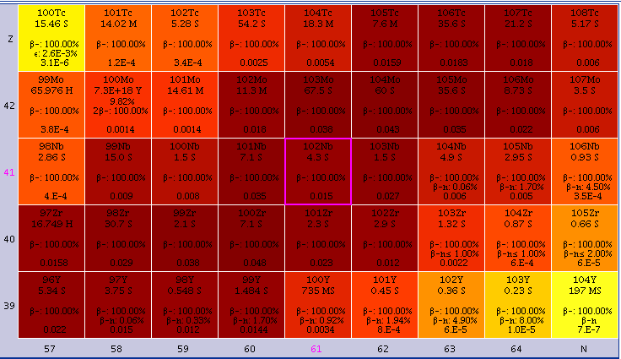
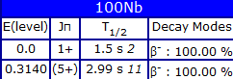
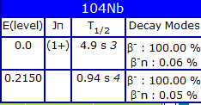
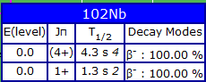
Neutron-rich Nb’s
Q=6384
CFY=0.057
Q=7210
CFY=0.028
Q=8100
CFY=0.0036
²³⁹Pu:

Slide 30
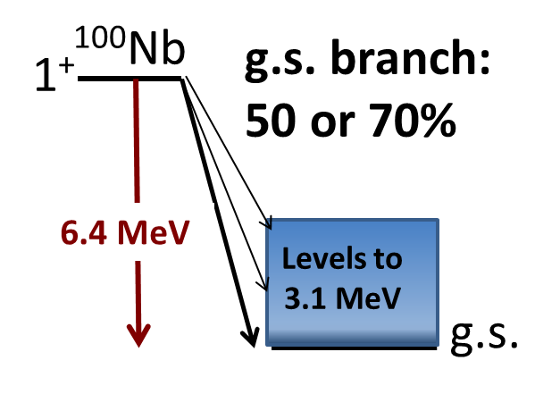
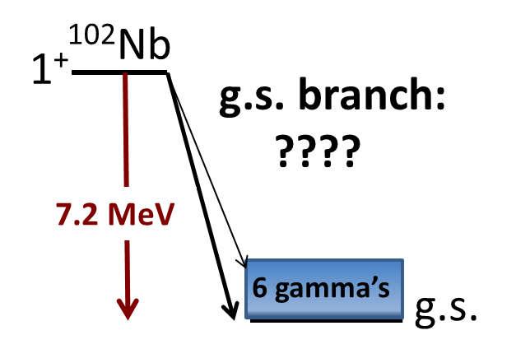
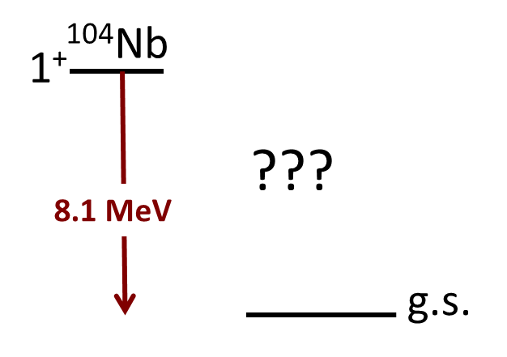
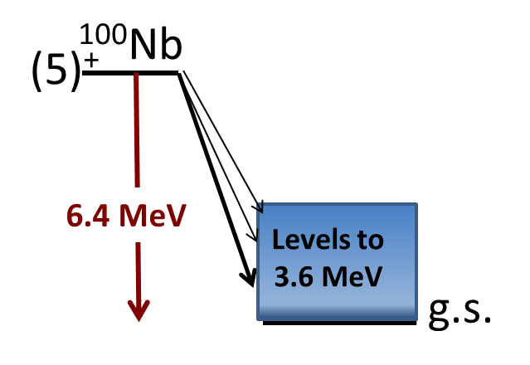
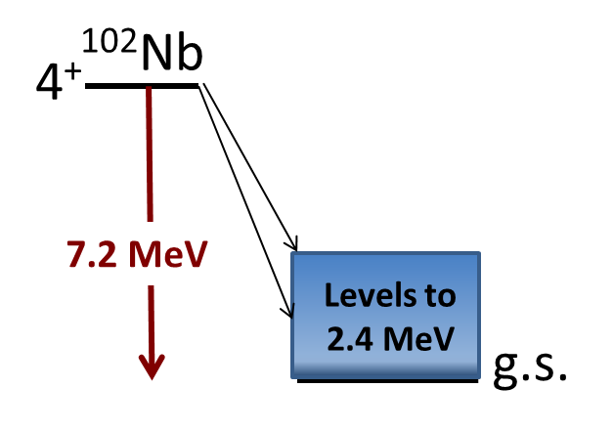
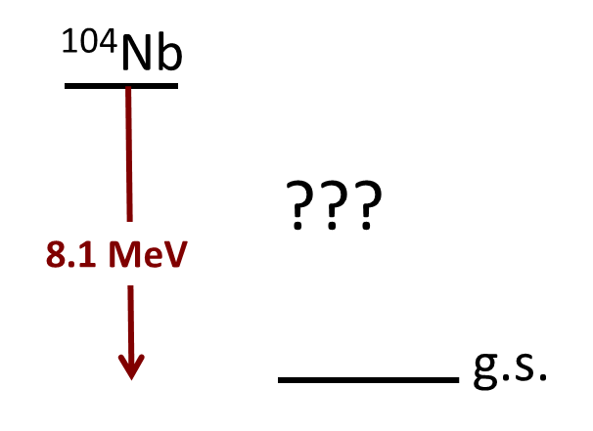
Very limited data
 | EEM | ELP | EEM | ELP | EEM | ELP
1+ | 0.79 | 2.55 | 2.4 | 2.4 | 3.06 | 2.46
4+/5+ | 2.21 | 2.01 | 2.1 | 2.3 | 3.06 | 2.46

Slide 31
Main Contributors at 6 MeV
235U
37-Rb-92
39-Y-96
55-Cs – 142
37-Rb- 93
39-Y-98m
37-Rb- 94
35-Br – 86
39-Y-98
239Pu
37-Rb-92
39-Y-96
55-Cs – 142
39-Y-98m
37-Rb- 93
41-Nb- 104m
41-Nb- 104
37-Rb- 94
241Pu
37-Rb-92
39-Y-96
55-Cs – 142
41-Nb- 104
39-Y-98m
37-Rb- 93
41-Nb- 104m
53-I-138
238U
37-Rb-92
39-Y-96
55-Cs – 142
37-Rb- 93
39-Y-100
51-Sb- 135
37-Rb- 94
50-Sn-133

Slide 32
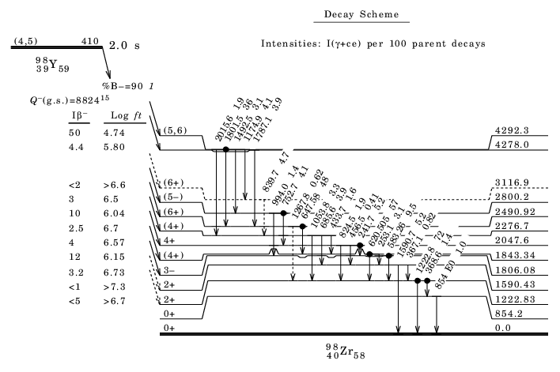
Beware of “false positives”

Slide 33
Other energy regions of the spectrum
²³⁵U main contributors to anti-neutrino spectra
Nucleus | % at 3 MeV
54-Xe-137 | 3.519
55-Cs-139 | 3.259
39-Y - 94 | 3.120
40-Zr- 99 | 3.010
41-Nb-100 | 2.916
41-Nb- 98 | 2.830
39-Y – 92 | 2.812
41-Nb-101 | 2.654
Nucleus | % at 4 MeV
41-Nb-100 | 4.872
37-Rb- 92 | 3.694
39-Y - 96 | 3.545
52-Te-135 | 2.994
39-Y - 94 | 2.897
55-Cs-140 | 2.780
39-Y - 95 | 2.646
54-Xe-139 | 2.606
Nucleus | % at 5 MeV
37-Rb- 92 | 9.171
39-Y - 96 | 7.475
41-Nb-100 | 6.592
55-Cs-142 | 4.585
55-Cs-140 | 4.153
52-Te-135 | 3.636
39-Y - 99 | 3.460
38-Sr- 95 | 3.435
“Top three”
Rudstam γ’s
Rudstam β’s and/or TAGS
“High priority”
Reminder : There are others that don’t even make the list !!

Slide 34
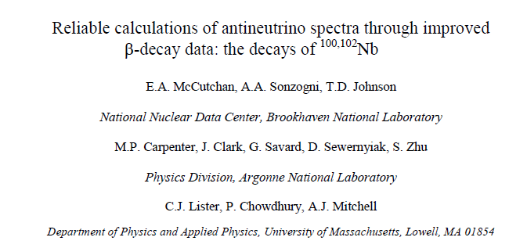
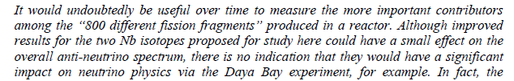
How to “fit in” with nuclear structure
Nucleus | % at 4 MeV
41-Nb-100 | 4.872
37-Rb- 92 | 3.694
39-Y - 96 | 3.545
52-Te-135 | 2.994
39-Y - 94 | 2.897
55-Cs-140 | 2.780
39-Y - 95 | 2.646
54-Xe-139 | 2.606
Nucleus | % at 5 MeV
37-Rb- 92 | 9.171
39-Y - 96 | 7.475
41-Nb-100 | 6.592
55-Cs-142 | 4.585
55-Cs-140 | 4.153
52-Te-135 | 3.636
39-Y - 99 | 3.460
38-Sr- 95 | 3.435

Slide 35
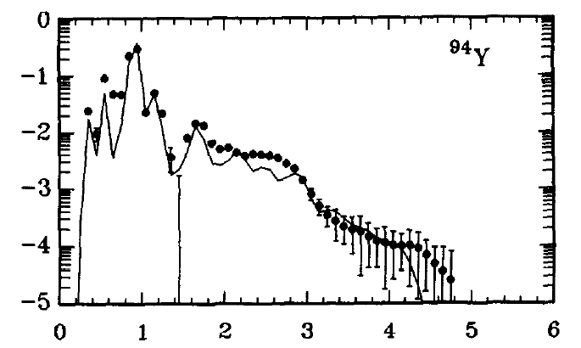
Rudstam’s data
Measured beta and gamma single spectra for the decay of 80+ fission products
Betas
Plastic (ΔE) + HPGe(E), high E
Si(Li) with Plastic (veto), low E
Gammas
NaI(Tl) crystal
The obtained mean energies are very useful for decay heat calculations
Rudstam et al., At.Data Nucl.Data Tables 45, 239 (1990)

