Slide 1
Heavy Uranium Isotopes in ENSDF
A.A. Sonzogni, T.D. Johnson, E.A. McCutchan,
National Nuclear Data Center

Slide 2
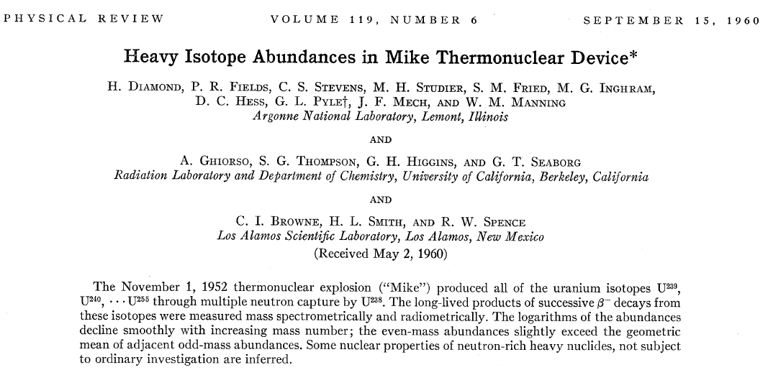
Motivation

Slide 3
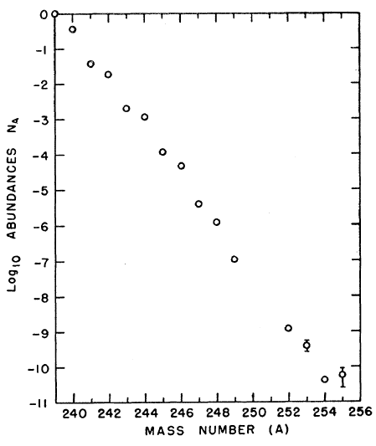
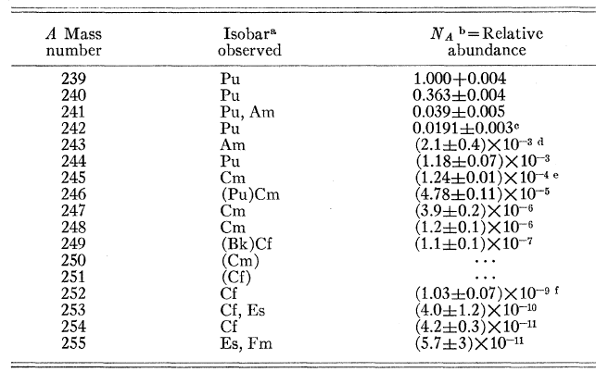
Results

Slide 4
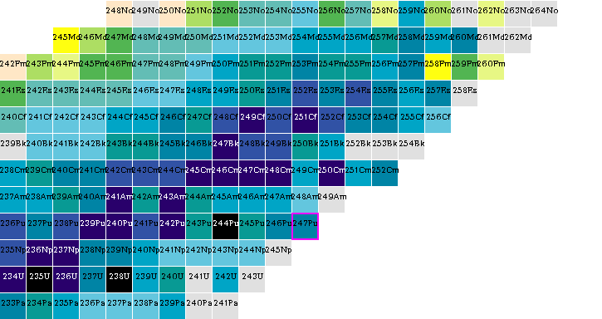
Chart of nuclides
β-
n
244U - 255U

Slide 5
Nucleus | Qβ (MeV) Moller 97 | T1/2 (S) Moller 97 | Qβ LDM fit | T1/2 (S) Kratz-Hermann | Qβn (MeV) LDM
244U | 1.49 | > 100 | 1.51 | 430 | -3.16
245U | 3.47 | 14.03 | 2.61 | 205 | -3.51
246U | 2.70 | 20.07 | 2.14 | 89 | -2.30
247U | 4.34 | 2.27 | 3.23 | 52.7 | -2.65
248U | 3.14 | 9.863 | 2.76 | 28.2 | -1.45
249U | 4.50 | 11.4 | 3.85 | 18.8 | -1.81
250U | 3.44 | 5.64 | 3.38 | 11.4 | -0.624
251U | 4.86 | 4.23 | 4.45 | 8.24 | -9.89
252U | 3.81 | 2.93 | 3.98 | 5.46 | 0.190
253U | 5.33 | 1.86 | 5.05 | 4.15 | -0.179
254U | 4.38 | 1.28 | 4.58 | 2.92 | 0.991
255U | 6.08 | 0.957 | 5.64 | 2.92 | 0.617

Slide 6
Conclusions
Should we add 244-255U nuclides in ENSDF?
The information that they were produced in a test should be included as well as estimates of Qb and T1/2.
All in comments? How to code the source? 238U(multiple n,G)?
How about the daughters following β- decay?
Note: Diamond’s article is not in NSR and these nuclides were not included in Thoennessen compilation

