Slide 1
Translation ENDF-6 data to GND under ENDF Web retrieval system: implementation and problems
Viktor Zerkin
International Atomic Energy Agency, Nuclear Data Section
WPEC Subgroup-38 Meeting, NNDC, BNL, USA
Brookhaven, 29-31 October 2014

Slide 2
Topics:
Tasks
Implementation: MAT to GND by Fudge
Errors and feed back
Problems
Concluding remarks

Slide 3
1. Tasks
To implement online ENDF-6 data translation to GND
under ENDF retrieval system
To make evaluated data in GND format available for Web users
To find out general problems if any
To find mistakes and unfinished features in translation program
Provide users’ feedback to translation program developers (LLNL)

Slide 4
2. Implementation
NNDC: http://www.nndc.bnl.gov/endf
IAEA: http://www-nds.iaea.org/endf
ENDF
database
ENDF Web Retrieval System
ENDF-6 file
fudge/bin/rePrint.py
gnd.xsl
.endf6.xml
xsltproc
.endf6.xml.html
Other files
Internet
Users

Slide 5

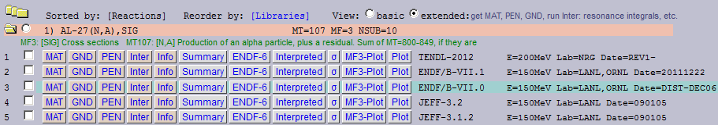
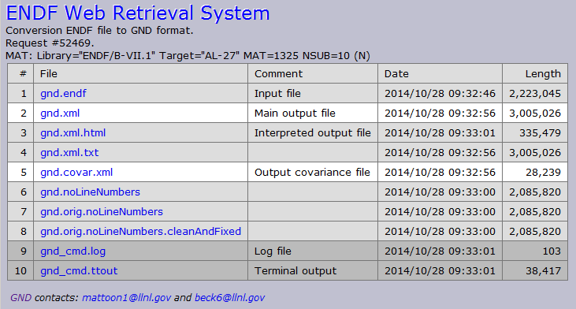
Retrieval steps
Extended View

Slide 6
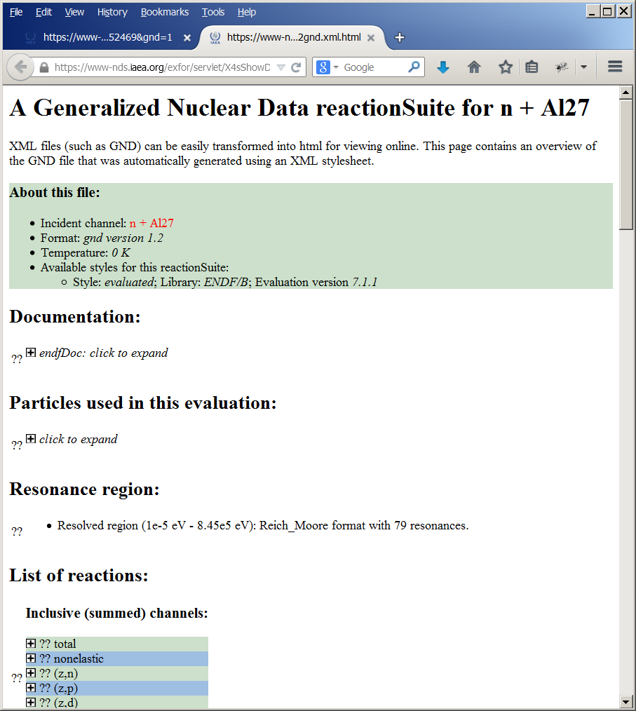
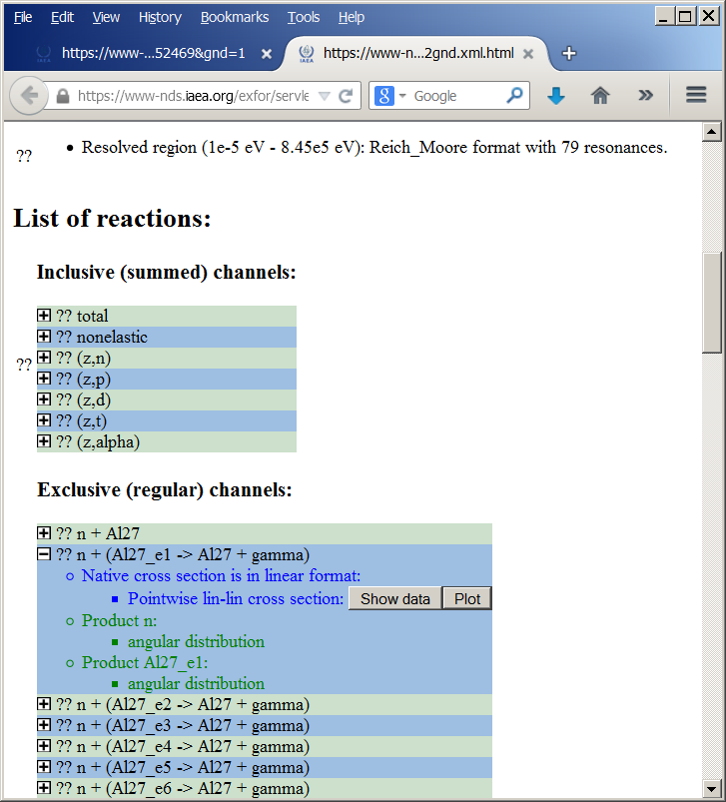
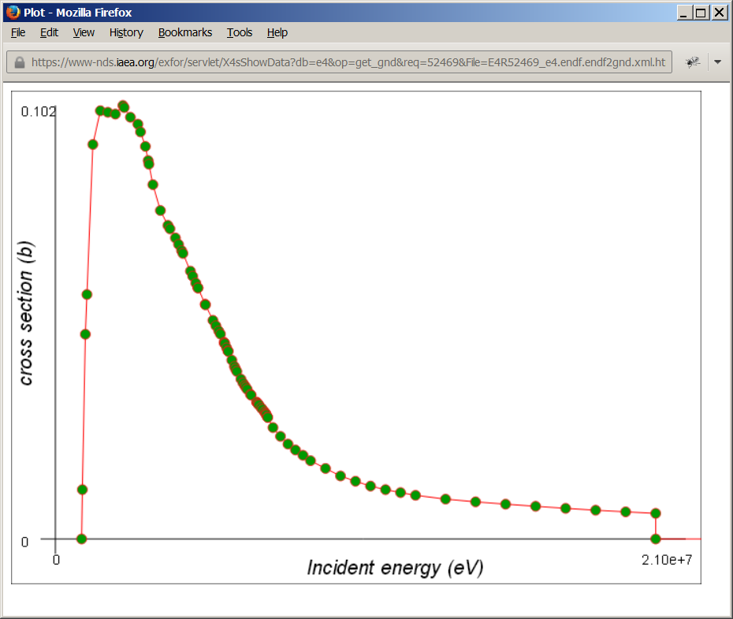
Display GND output via html

Slide 7
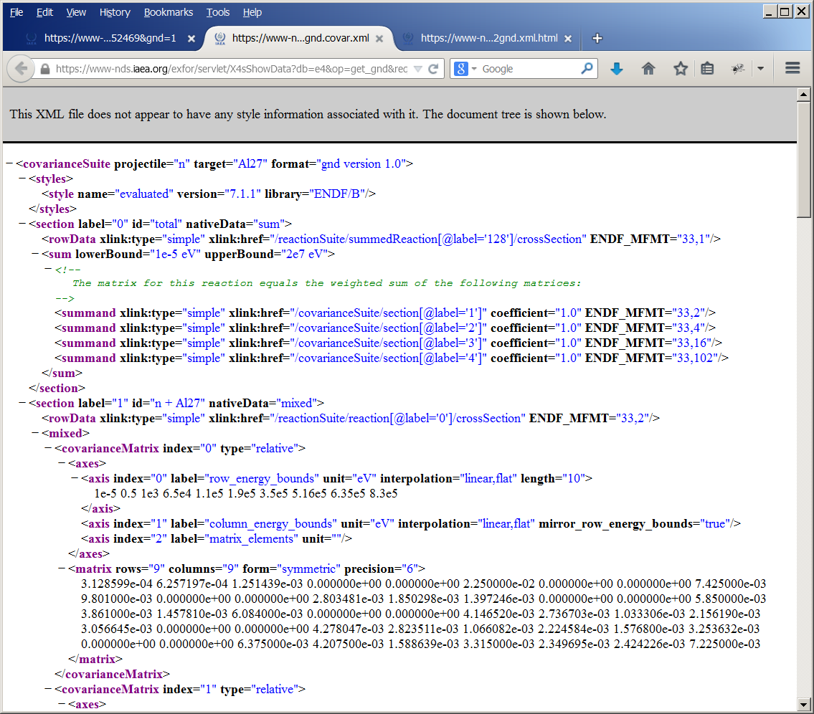
Display gnd.coval.xml via web browser

Slide 8
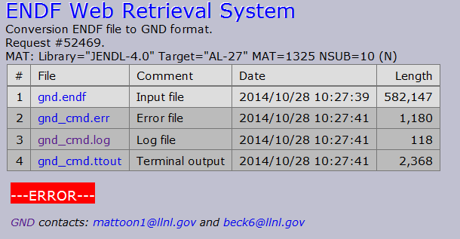

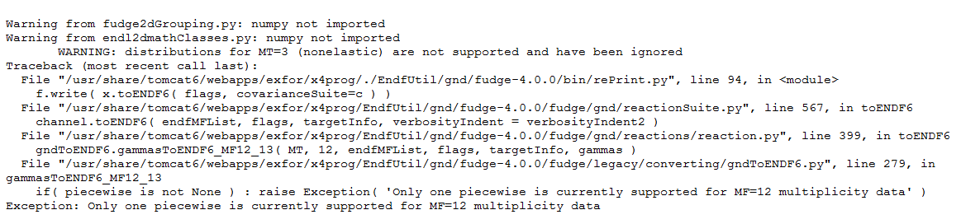
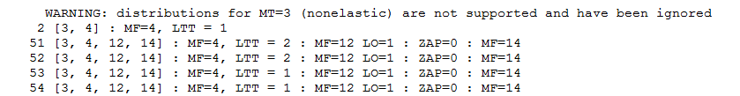
3. Errors and feedback
gnd_cmd.log
gnd_cmd.err
Feedback
gnd_cmd.ttout

Slide 9
4. Problems
Translation ENDF to GND works only for ONE material in input file. (Legal ENDF-6 data file can contain several materials from several sub-libraries and even libraries)
Translation program produces TWO output XML files: data file and covariance file. Schema and translation program should have an option to generate single GND file from one ENDF-6 file.
(Discussion point: this problem might be inherited from the decision to store data in schema MAT-MT-MF as it is done in ENDL, but not MAT-MF-MT as it is done in ENDF)
Translation program fails on PEN file (i.e. ENDF-6 file from PREPRO chain including FIXUP)

Slide 10
5. Concluding remarks
Schema and translation program should have an option to generate single GND file from one ENDF-6 file which may include many materials, sub-libraries and libraries
Problem of MT-MF vs. MF-MF should be discussed and fixed
Errors in the endf2gnd translation program should be fixed as time permits
Data display and plotting is not operational with Microsoft Internet Explorer

Slide 11
Thank you
Citing of the materials of this presentation should be done with proper acknowledgement of the IAEA and author.

