Slide 1
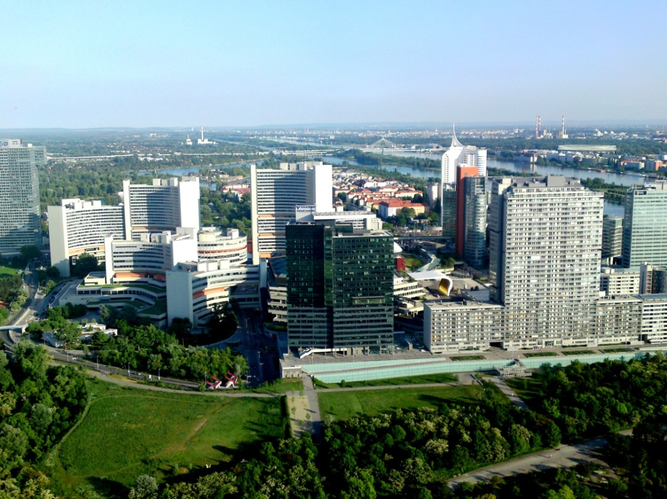

Prompt fission neutron spectra of U-235, integral reaction rates & U-238 cross sections
Andrej Trkov and Roberto Capote
NAPC - Nuclear Data Section, IAEA, Austria

Slide 2
OUTLINE
Update of U-238 after ib33: (n,2n)
Validation of integral measurements of reaction rates and fission spectra – Cf-252/U-235 ratios
IAEA Projects (PFNS CRP & Standards DDP)
  Selection of experimental data
  Initial scaling of experimental data
  Generalised least-squares fit with GANDR
  Impact on integral benchmarks
Conclusions

Slide 3
U-238 Starter File
ib25 + physics → inelastic up, (n,2n) down →ib33
IRDFF-v1.05 ²³⁸U(n,2n) close to ib25
PROFIL experiment → requires (n,2n) up
SPA (PFNS U-235) → requires (n,2n) up but
SPA (SF Cf-252) close to ib25
New ib34: changes to (n,n’), (n,2n)
See:” https://www-nds.iaea.org/CIELO_U238/”

Slide 4
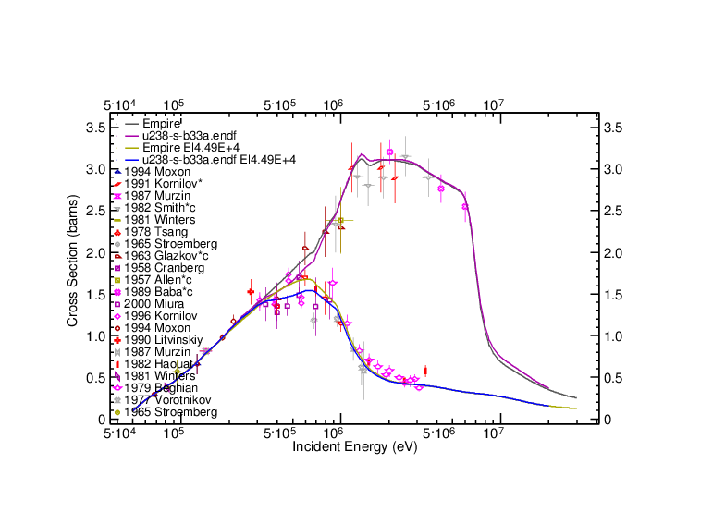
²³⁸U(n,n’) evaluations

Slide 5
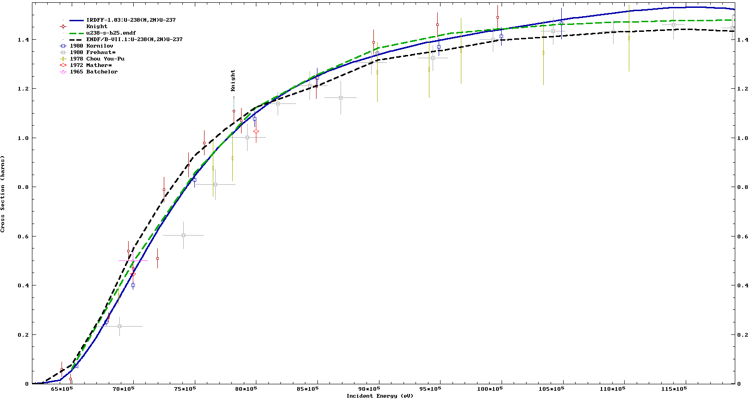

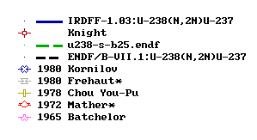
²³⁸U(n,2n) evaluations
SPA XS in ²⁵²Cf(sf) PFNS
IRDFF-1.03 20.607
ENDF-B/VII.1 21.363
Blinov et al, 20.61 ± 2.02
7 8 9 10 11
Incident Energy (MeV)

Slide 6
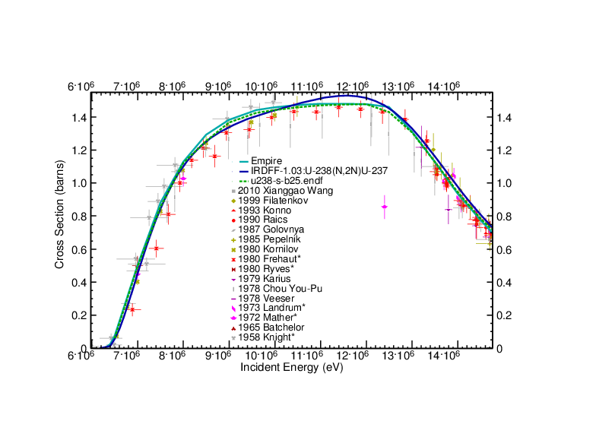
²³⁸U(n,2n) evaluations
²³⁸U(n,2n) evaluations
SPA XS in ²⁵²Cf(sf) PFNS
IRDFF-1.03 20.607
ENDF-B/VII.1 21.363
Blinov et al, 20.61 ± 2.02

Slide 7
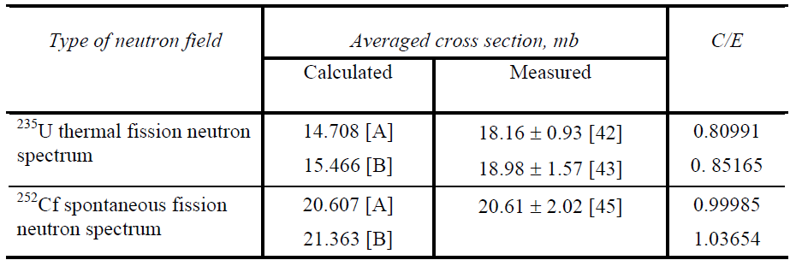

IRDFF-v1.05: ²³⁸U(n,2n)
(Corrected to new monitors from IRDFF)
[42] Kobayashi et al, YAYOI reactor core FNS, EXFOR 20693015
[43] Hashimoto et al, KUR reactor core FNS, EXFOR 20810002
[45] Blinov et al, ²⁵²Cf(sf) PFNS, EXFOR 40996002,

Slide 8
Possible sources of error in (n,2n)
Many measurements were made inside the reactor core
→ Strong gamma field
Possible impact of (γ,n) reactions (K. Zolotarev)
All (n,2n) reactions may be affected
Implications for the PROFIL and SPA measurements
(γ,n) contribution needs to be determined

Slide 9
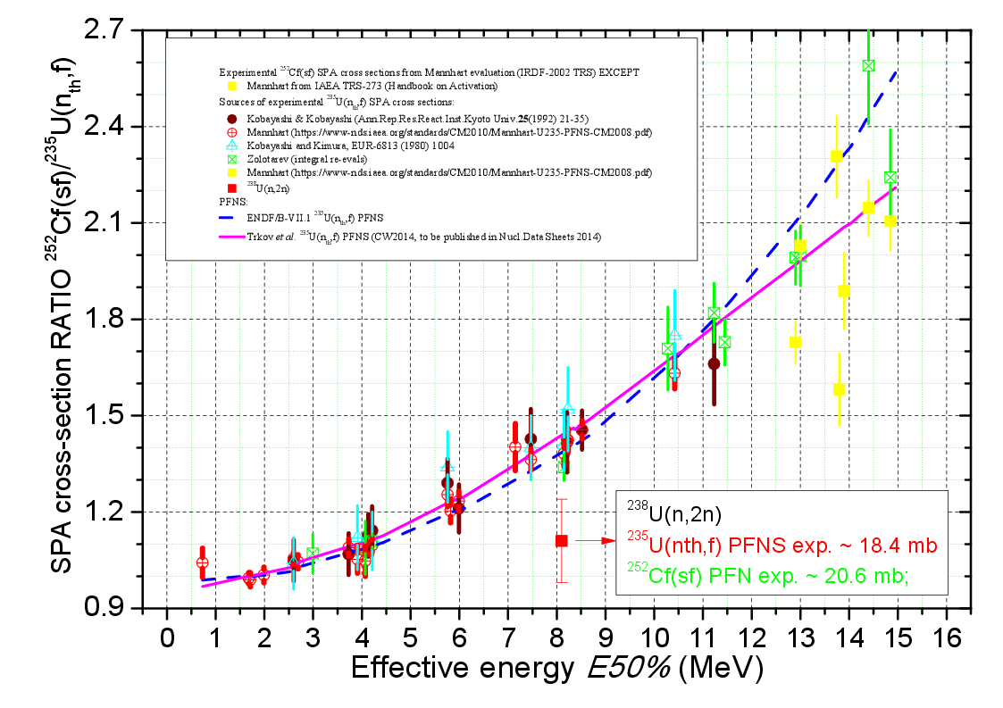

Slide 10
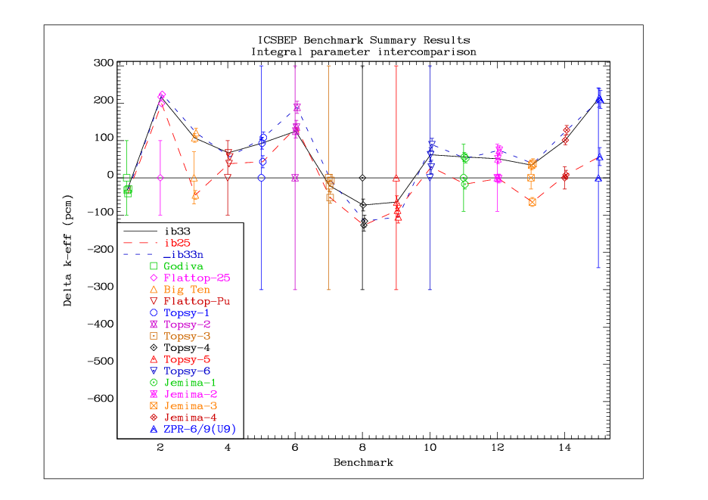
U-238 impact on benchmarks

Slide 11
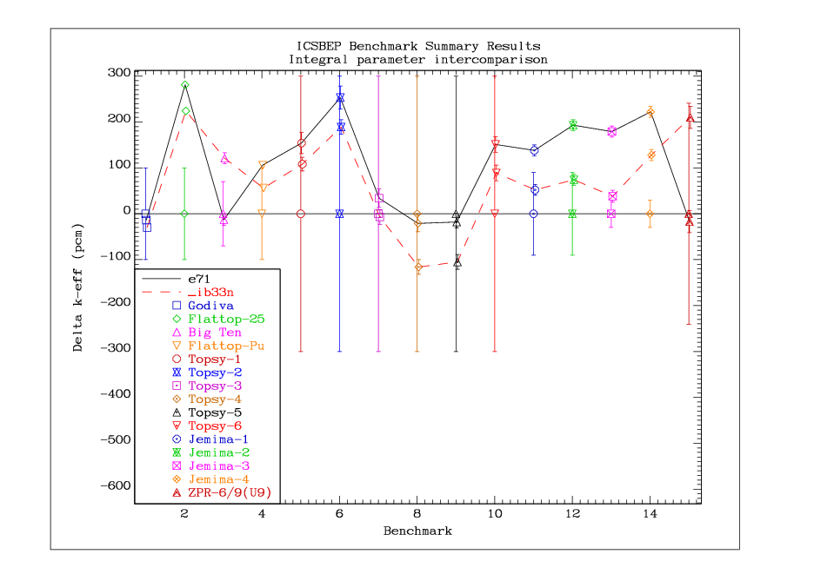

Slide 12
Information from SPA cross section ratio ²⁵²Cf (sf)/²³⁵U(n_{th},f)
Check consistency between SPA cross sections measured in ²⁵²Cf (sf) and ²³⁵U(n_{th},f) fields for E50% < 11 MeV (good PFNS measurements)
Determine ²⁵²Cf (sf)/ ²³⁵U(n_{th},f) spectrum ratio at E50% >11 MeV (poor PFNS measurements)
  May define the ²³⁵U(n_{th},f) PFNS in that energy range, but
  SPA experimental data not consistent

Slide 13
Desired new measurements
²³⁸U(n,2n) in ²³⁵U(n_{th},f) PFNS (behind fission plate, careful room-return correction by MC simulation, (γ,n) expected to be small)
²⁷Al(n,2n) precision measurement by AMS (mass spectrometry) after irradiation in PFNS of ²⁵²Cf (sf) and ²³⁵U(n_{th},f) (behind fission plate)
²⁷Al(n,2n) E50% ~ 16 MeV
²⁷Al(n,2n) differential cross section already measured by AMS (Wallner et al) up to 19 MeV

Slide 14

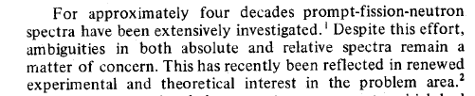
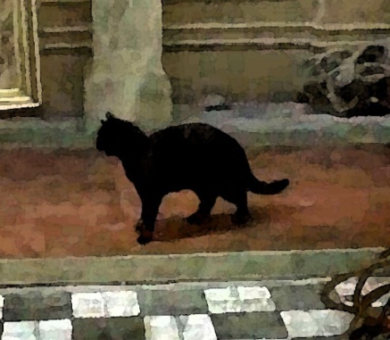
IAEA CRP on PFNS evaluation (2008-2014)
INDC(NDS)-0541, RC et al, Summary Report of the Consultants’ Meeting on Prompt Fission Neutron Spectra of Major Actinides, Nov. 2008
Déjà vu
Matrix ©
A. Smith, P. Guenther, G. Winkler, D.L. Smith, NSE 76(1980) 357

Slide 15
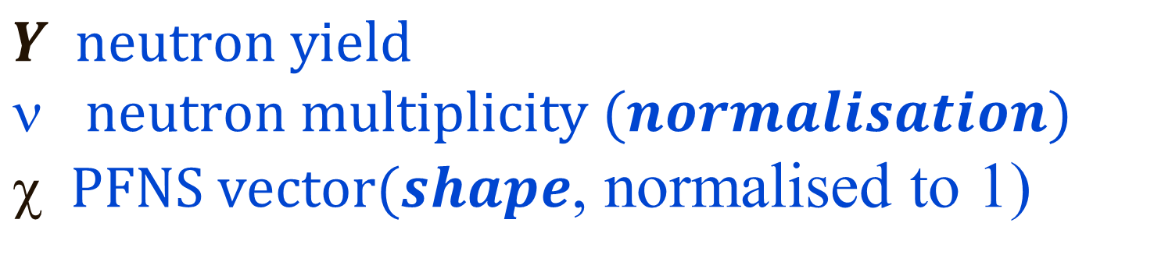

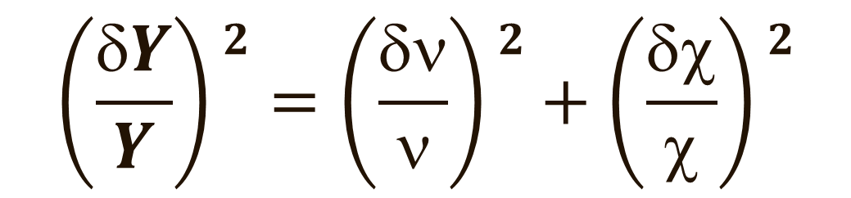
What to evaluate? PFNS or Yield?
Without loss of generality (ENDF-6 PFNS representation):
$$Y=$$
$$Y neutron yield$$
$neutron multiplicity (normalisation)$
$ PFNS vector(shape$, normalised to 1)
$$\left(\frac{δY}{Y}\right)2=\left(\frac{δν}{ν}\right)2+\left(\frac{δχ}{χ}\right)2$$

Slide 16
Definition of (ND) Evaluation
A properly weighted combination of selected experimental data (and modelling information).
Evaluation approaches (WPEC SG24)
“Non-model” LSQ fit (Neutron standards)
Model prior + GLSQ fit of experimental data
(in the “parameter” or “data” space)
Stochastic: BFMC, FMC, TMC, UMC, UMC+TMC, …
Experimental data and uncertainty analysis

Slide 17
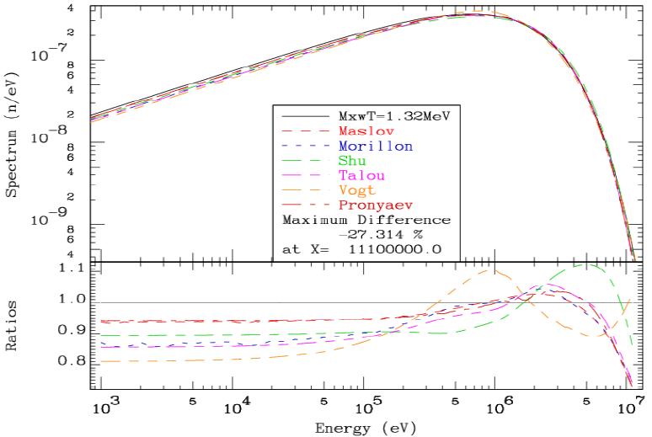
²³⁵U(n_{th},f) PFNS, IAEA CRP, 6 years later
E_{aver}[MeV]
_{Maxw 1.98 (T=1.32)}
_{Maslov 1.96 Semi-empirical}
_{Morillon 1.97 LANL model}
Shu 2.08 Semi-empirical
_{Talou 2.00 LANL model}
_{Vogt 1.91 MC Freya}
_{Pronyaev 2.00}
_{ENDF-B/VI 2.03}
_{Eval. 2.000(9)}
Ratio to
Maxw.(T=1.32)

Slide 18
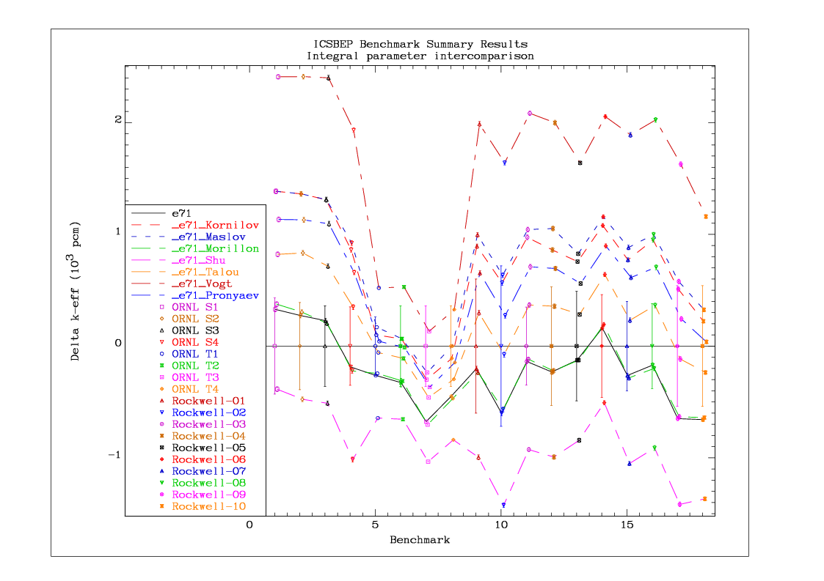
Sensitivity to high-leakage solution benchmarks from ICSBEP

Slide 19
DDP on
Neutron Cross Section Standards
²³⁵U(n_{th},f) PFNS candidate for secondary standard (in addition to ²⁵²Cf (sf) PFNS)
Primarily based on differential data
Preference for non-model evaluations – WHY?
  Because models may introduce a bias (shown later)!

Slide 20
PFNS evaluation: Current Experience
All data used as “shape data”; systematic errors are accounted in the normalisation uncertainty (i.e. nu-bar)
nu-bar is measured by independent experiments with much smaller uncertainty

Slide 21
PFNS evaluation: Procedures
Identify a (reliable) data set that overlaps with all others (→ reference data set)
Scale all other measurements to the reference in the overlapping region (suitable scaling)
Scaled union of all data sets covers a broad energy range → apply normalisation (minimum uncertainty due to broad E-range)
Proceed with GLSQ fitting

Slide 22
PFNS ²³⁵U(n_{th},f): Data selection
Lead Author | EXFOR Entry No. | Comment
B.I.Starostov,ET.AL. (85) | 40930006(4) | Flag 4 only, others = ratio
A.Lajtai,ET.AL. (85) | 30704003 | E < 0.16 MeV (Li glass eff)
N.Kornilov*,ET.AL. (10) | 31692006 | Ratio to Cf-252(sf)
Wang Yufeng,ET.AL. (89) | 32587002 | E > 1.3 MeV
V.N.Nefedov1*,ET.AL. (83) | 40871011 | Ratio to Cf-252(sf)
V.N.Nefedov2*,ET.AL. (83) | 40871012 | Ratio to Cf-252(sf)
B.I.Starostov*,ET.AL.(83) | 40872007 | Ratio to Cf-252(sf)
A.S.Vorobyev*,ET.AL. (13) | 41597002 | Ratio to Cf-252(sf)

Slide 23
Model Fit (Examples)
SCALE Method (single parameter, scaling the energy = E_av; ref.: N. Kornilov)
WM Basis Function Method (linear combination of Watt and Maxwellian distributions, four parameters)

Slide 24
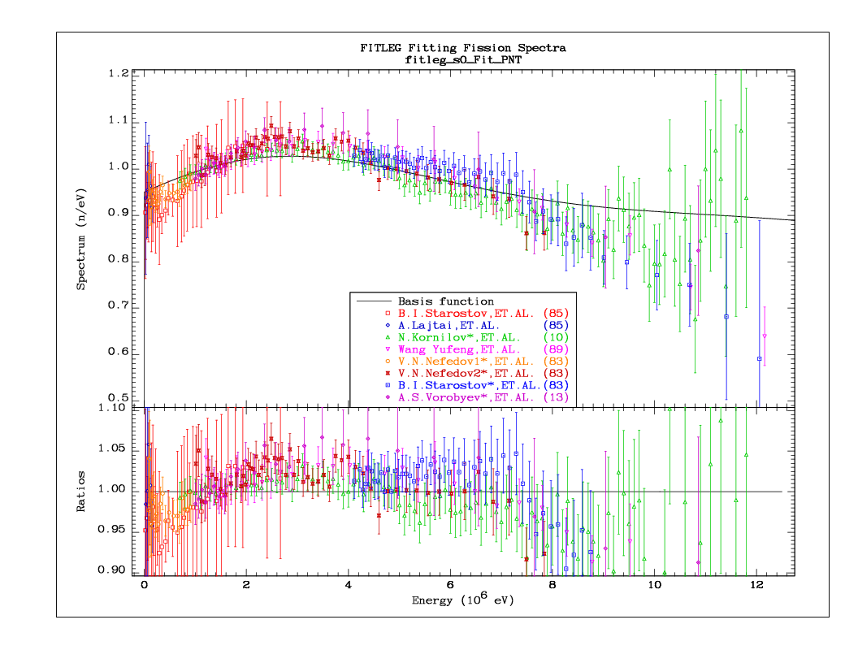
SCALE_0 (fixed data) normalisation)

Slide 25
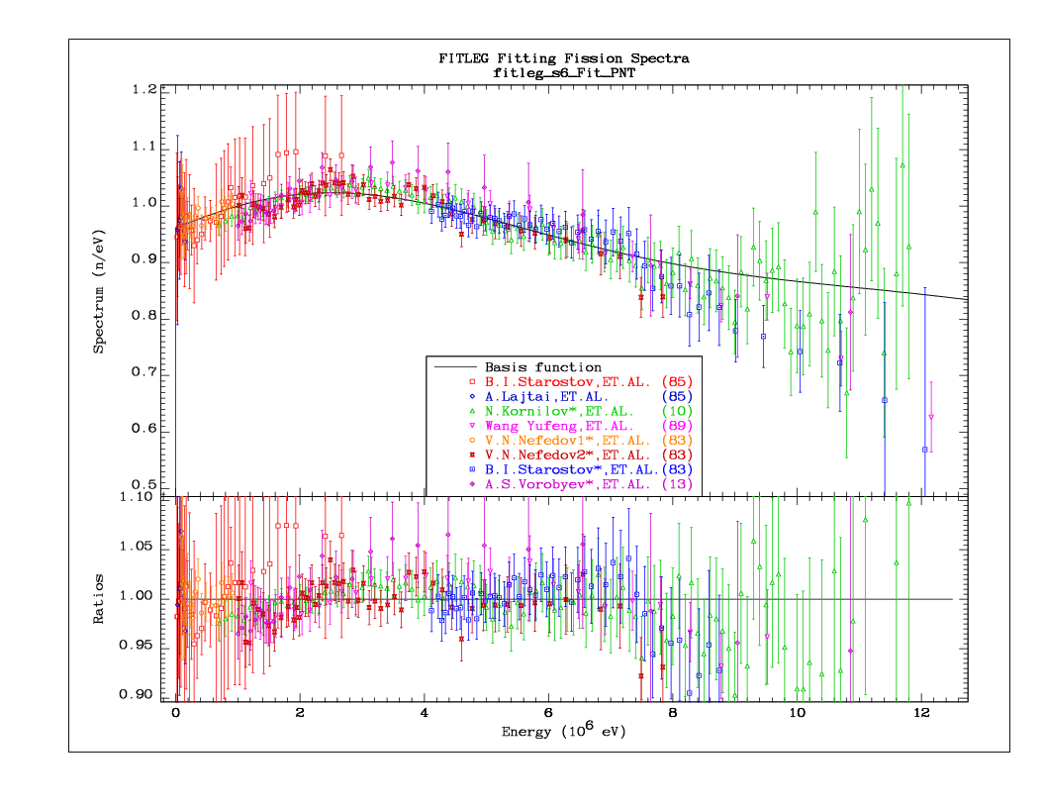
SCALE_6 (iterated solution)

Slide 26
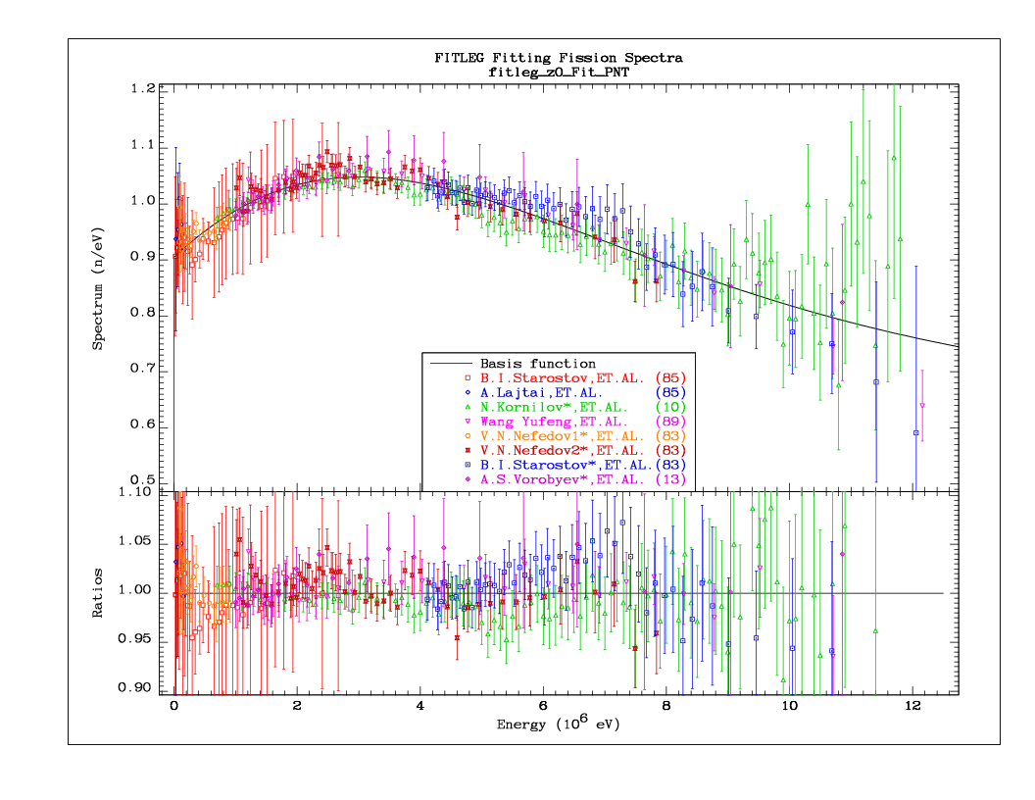
Basis (PNT_0, fixed norm.) for compar.

Slide 27
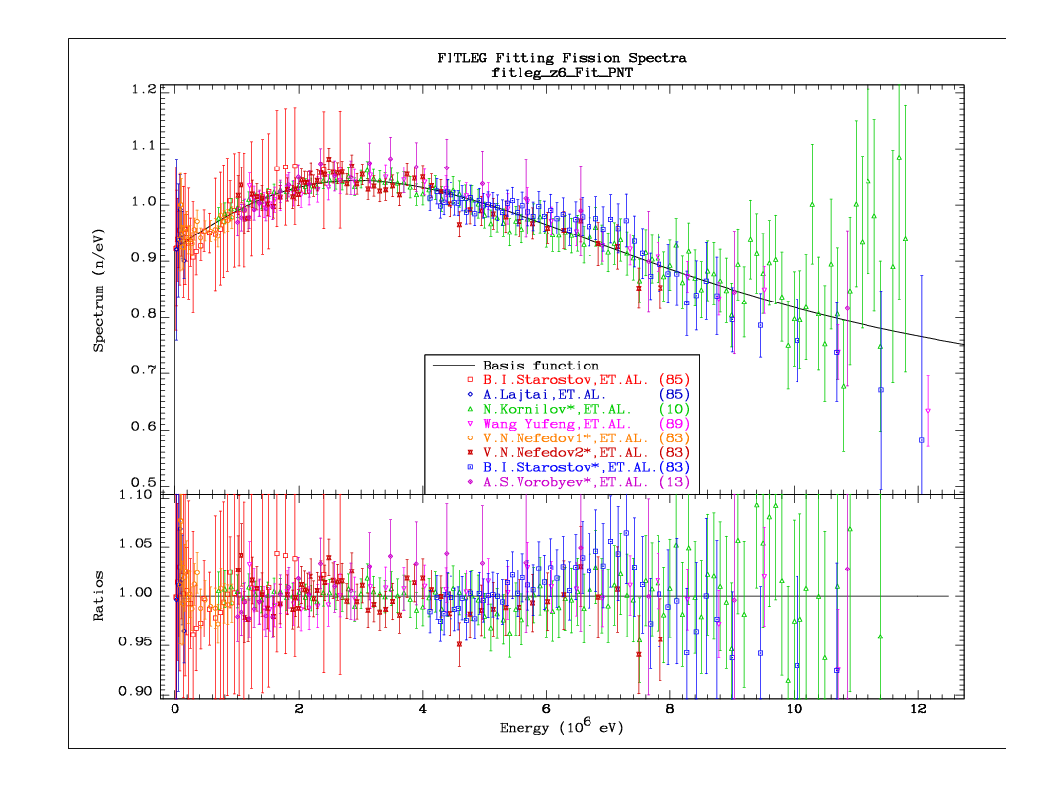
Basis (PNT_6, iterated) for compar.

Slide 29
Non-Model Fitting
Scaled & normalised data fitted by GLSQ procedure with GANDR
Use non-informative prior (100% uncorr. Unc.)
Assumptions for a further step:
  No single experiment dominates the fit
  Fit is a better approximation to the truth
  →Use fitted curve to rescale (and renormalise) experimental data
  Redo the fitting and iterate to convergence

Slide 30
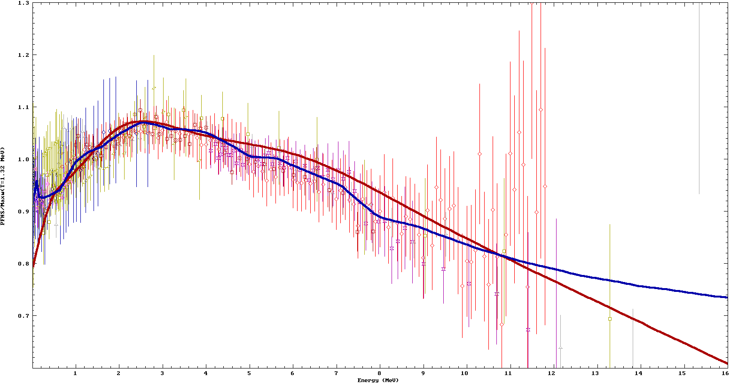
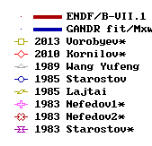
²³⁵U(n_{th},f) PFNS GANDR fit (lin E)
PFNS ²³⁵U (n,f)/Maxw(T=1.32 MeV)
E_{aver}(GANDR)= 2.000(9)
E_{aver}(B/VII.1) = 2.03
non-model evaluation for STD (GANDR)

Slide 31
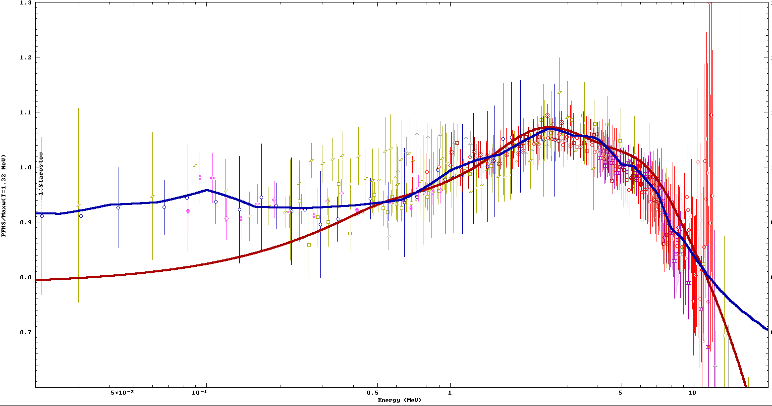
²³⁵U(n_{th},f) PFNS GANDR fit (log E)
PFNS ²³⁵U (n,f)/Maxw(T=1.32 MeV)
E_{aver}(GANDR)= 2.000(9)
E_{aver}(B/VII.1) = 2.03
non-model evaluation for STD (GANDR)

Slide 32
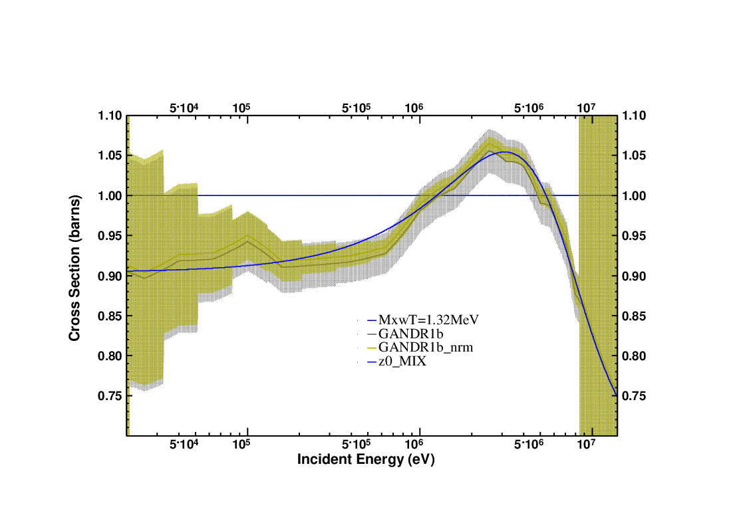
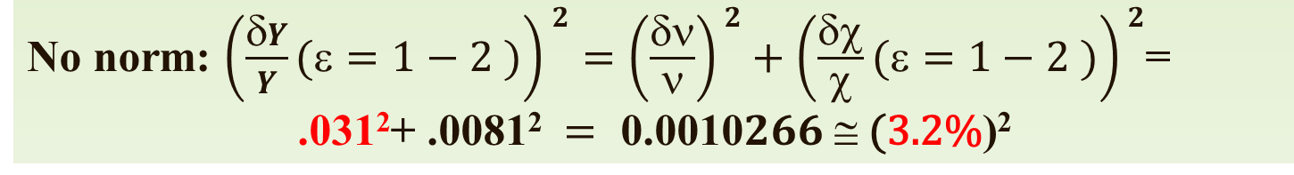
GANDR fit without normalisation
6.4%
²³⁵U(n,f)/Tmaxw(1.32 MeV)
No norm: $\left(\frac{δY}{Y}(ε=1−2 )\right)2=\left(\frac{δν}{ν}\right)2+\left(\frac{δχ}{χ}(ε=1−2 )\right)2\text{=}$
$$\text{.}\text{0}\text{31}\text{2}\text{+ .}\text{0}\text{081}\text{2} = \text{0}\text{.}\text{0010}266 ≅ \text{(}\text{3}\text{.}\text{2}\text{\%}\text{)}\text{2}$$

Slide 33
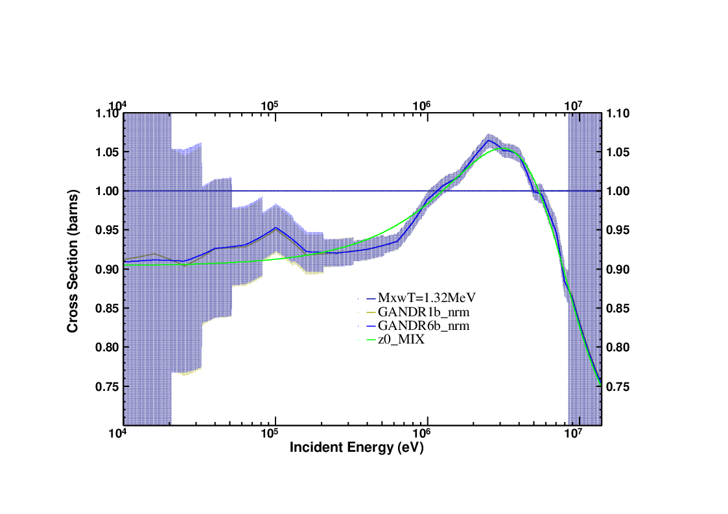
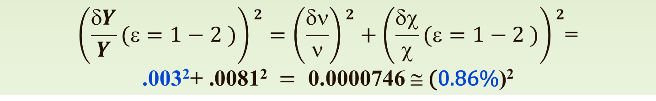
Iterated GANDR fit with normalisation
1.72%
²³⁵U(n,f)/Tmaxw(1.32 MeV)
__ Maxw. (T=1.32)
--- GANDR (1 iter., normal.)
--- GANDR (6 iter., normal.)
__ PNT fit (z0_MIX)
$$\left(\frac{δY}{Y}(ε=1−2 )\right)2=\left(\frac{δν}{ν}\right)2+\left(\frac{δχ}{χ}(ε=1−2 )\right)2\text{=}$$
$$\text{.}\text{0}\text{0}\text{3}\text{2}\text{+ .}\text{0}\text{081}\text{2} = \text{0}\text{.}\text{0000746} ≅ \text{(}\text{0}\text{.}\text{86}\text{\%}\text{)}\text{2}$$

Slide 34
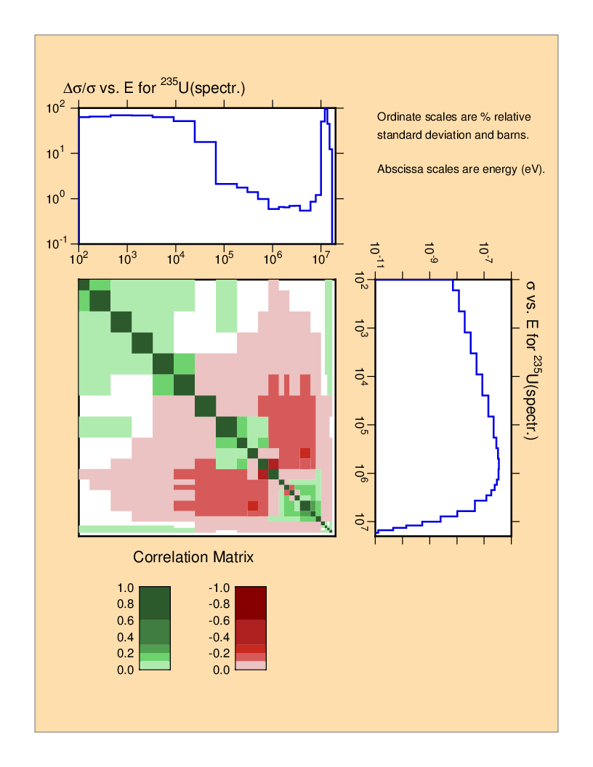
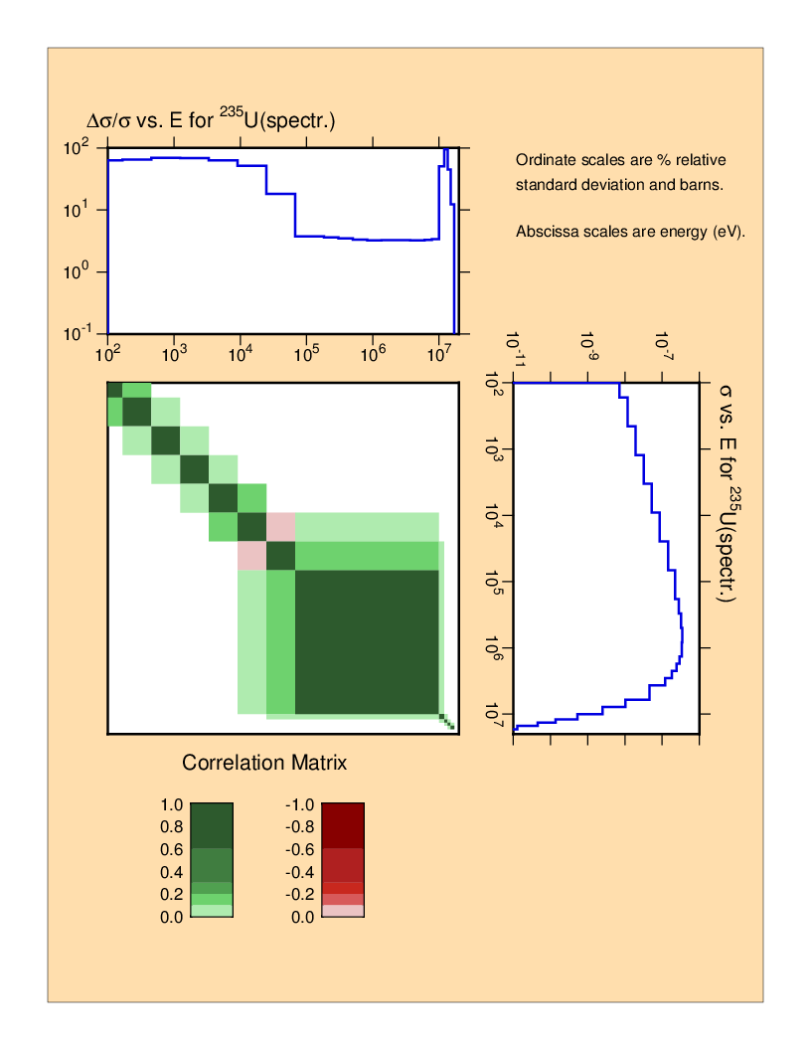
GANDR normalisation: Uncert. analysis
0.8% unc.
consistent exper. data

Slide 35
Features of the GANDR fit
Little change with iterations
Minimum PFNS uncertainty 0.8% almost equal to the minimum yield uncertainty
In the tails the PFNS uncertainty is equal to the prior (no measured data, no model correlations)

Slide 36
Spectrum fit for incident fast neutrons
Data selected for incident neutrons in the range 0.5 MeV to 2 MeV
The same procedure was followed
Narrower data range, fewer data sets, larger scattering
Slight increase in the average energy (+8 keV)

Slide 37
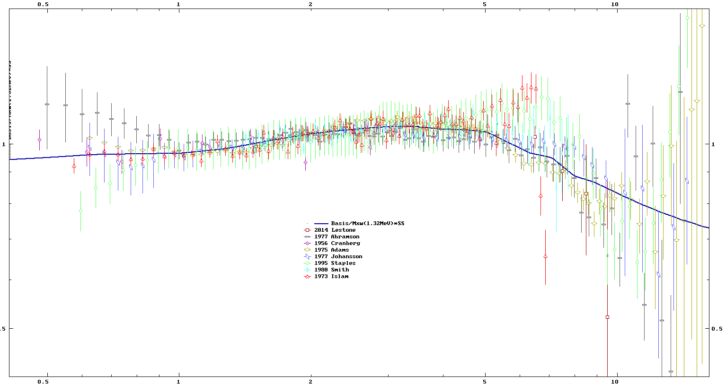
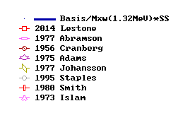
²³⁵U(n_{fast},f) PFNS GANDR fit (log E)
PFNS ²³⁵U (n,f)/Maxw(T=1.32 MeV)
0.5 1 2 5 10
Outgoing neutron energy (MeV)

Slide 38
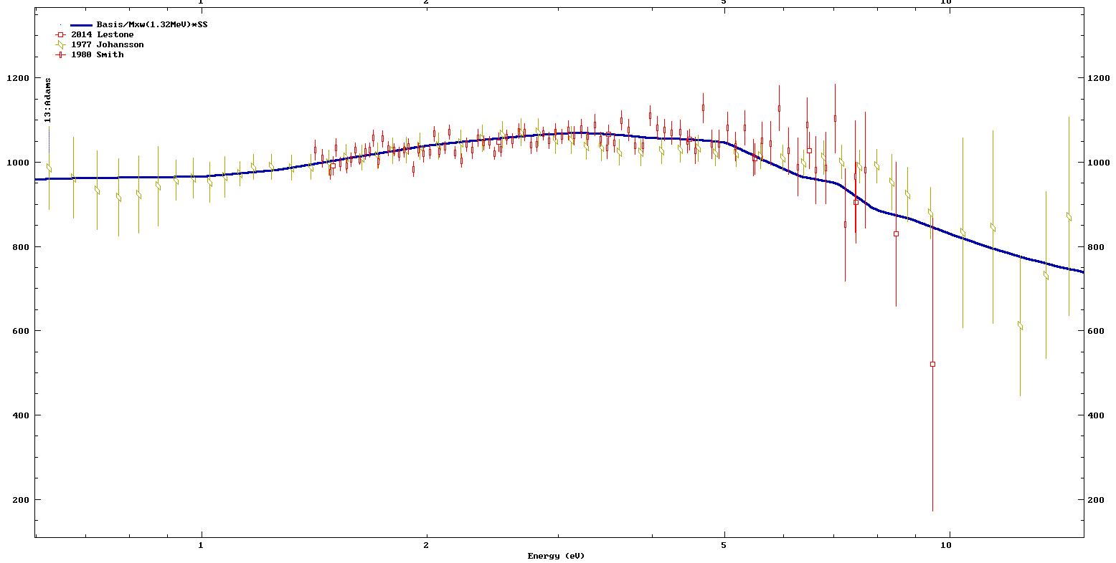

²³⁵U(n_{fast},f) PFNS GANDR fit (selected)
1 2 5 10
PFNS ²³⁵U (n,f)*100/Maxw(T=1.32 MeV)
1 2 5 10
Outgoing neutron energy (MeV)

Slide 39
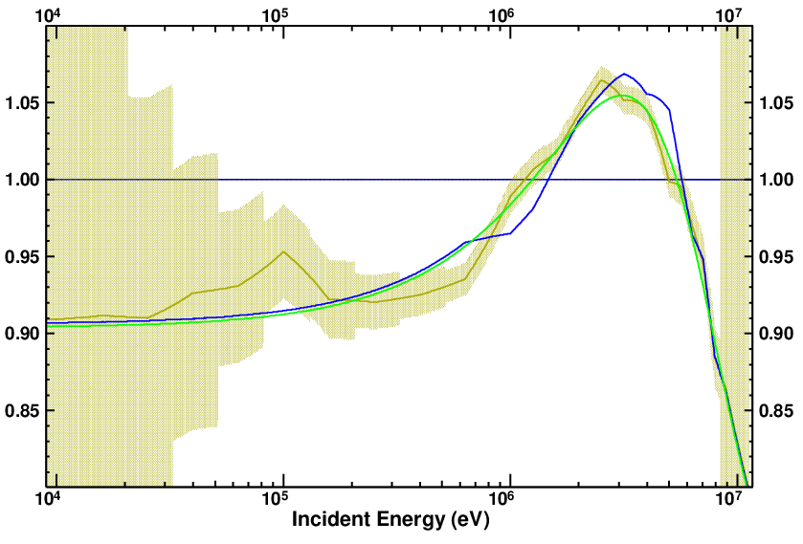
GANDR fit thermal & fast
fast
thermal

Slide 40
Integral effects
ICSBEP Benchmarks were analysed
Increase in reactivity of high-leakage thermal solutions partly compensated by Hale’s O-16 evaluation or by a decrease of nu-bar
Decrease in reactivity of fast assemblies partly compensated by U-238 – overall improvement

Slide 41
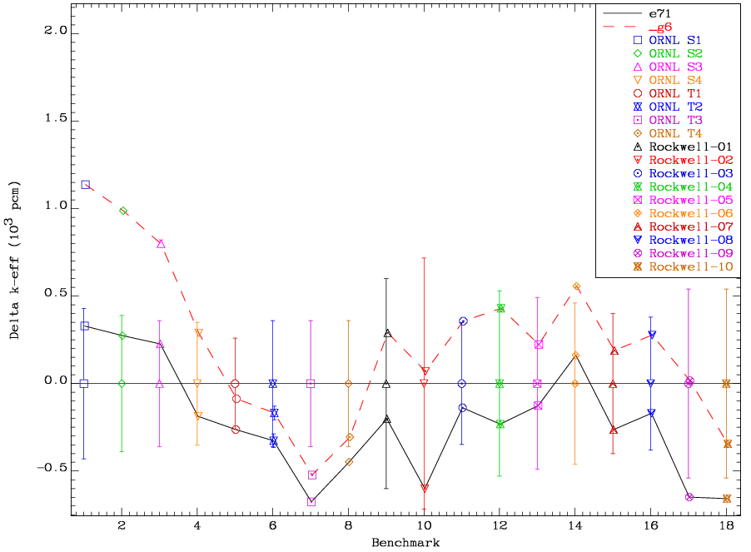
²³⁵U(n,f) PFNS (thermal solutions)

Slide 42
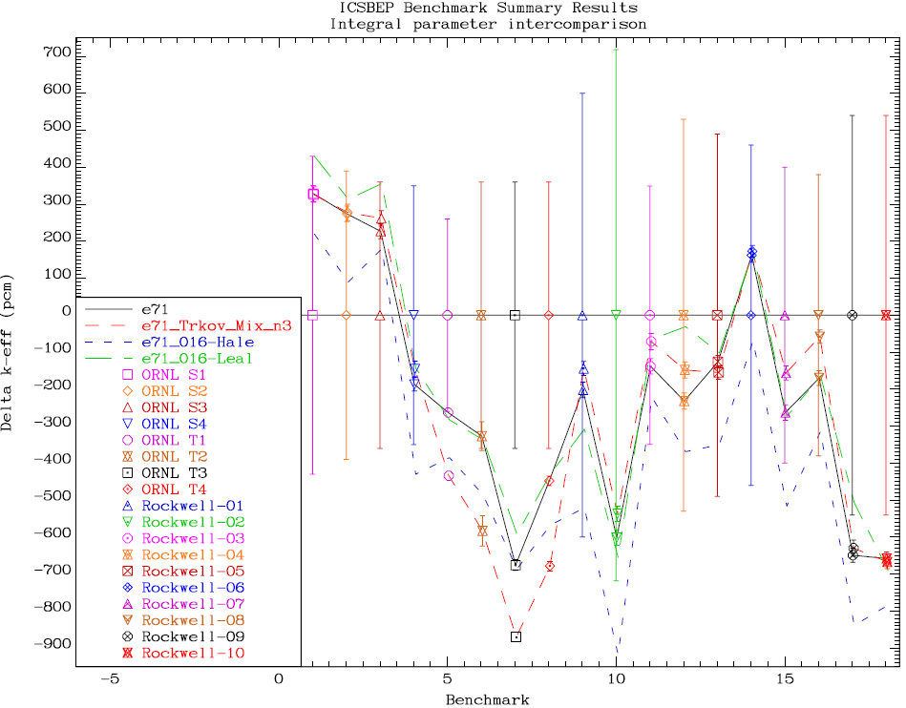
²³⁵U(n,f) PFNS, ¹⁶O (thermal solutions)
PRELIMINARY!

Slide 43
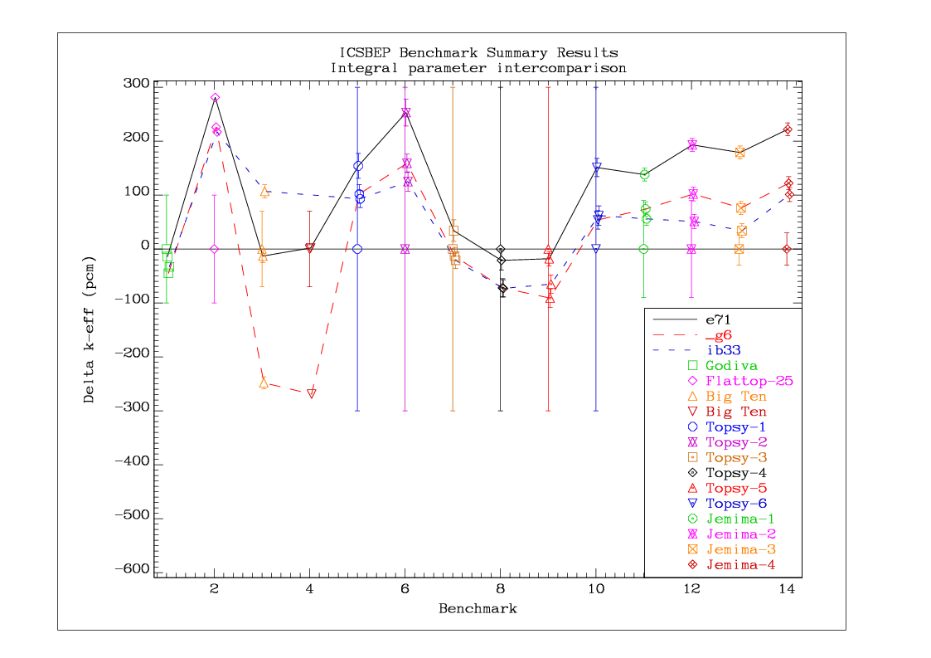
²³⁵U(n,f) PFNS, ²³⁸U (fast assemblies)

Slide 44
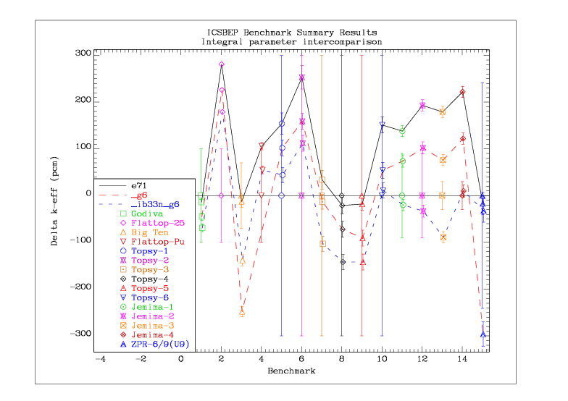
Combined ²³⁵U(n,f) PFNS, ²³⁸U

Slide 45
Labels legend
e71 ENDF/B-VII.1 (reerence)
ib25 Older version of U-238
ib33 U-238 CIELO starter file
ib33n ib33 with updated (n,2n) from IRDFF
g6 U-235 PFNS GANDR fit
ib33n_g6 combined (as above)

Slide 46
Conclusions U-238
No major revision to ib33 starter file
(n,2n) reaction investigated (IRDFF-v1.05)
Uncertainties in integral measurements to be clarified
Contribution of (γ,n) to be determined

Slide 47
Conclusions U-235
Non-model fit of U-235 PFNS thermal and fast
Average energy lower than ENDF/B-VII.1
Reactivity increase for high-leakage thermal solutions, decrease for fast assemblies
Possible compensating effects were studied, namely new O-16 data, nu-bar, new U-238

Slide 48
ADDITIONAL SLIDES

Slide 49
Measured PFNS data normalisation
Kornilov et al (IRMM) data taken as reference
All data converted to ²⁵²Cf/²³⁵U or ²³⁵U/Mxw(1.32MeV) ratios
²⁵²Cf/²³⁵U or ²³⁵U/Mxw(1.32MeV) ratios integrated over the overlapping interval for each experiment
Upper energy cut-off 10 MeV
Measured data normalised to match integrals over the overlapping regions
REALLY independent of ANY model

Slide 50
Union of all data (PNT_raw)
All data converted to ²³⁵U/Mxw(1.32MeV) ratios
Union of all data in the ratio space prepared
Data converted back to spectrum
Integral of the spectrum normalised to one – all data re-normalised with same normalisation factor (0.8% correction)
Average energy of raw data spectrum is 1.998 MeV
(uncertainty can not be estimated by this method)
Notes:
Added note on the contribution of extrapolated spectrum to the integral, 11-Aug-2014

Slide 51
Fitting the data – simple model (PNT)
Initial work
Basis function: linear combination of a Watt function and a Maxwellian function (4 free parameters).
Chi-square minimisation to determine optimal parameters
Check influence of removing datasets (e.g. Starostov data, etc.)
Extended work
Assume fitted function is a better approximation to the true spectrum – normalise the data to the fitted function (model dependence ?)
Repeat the fitting,
Iterate to convergence

Slide 52
Results (PNT = microscopic data only)
The average energy is 2.000(9) for all data
The average energy is 1.986(9) without Vorobyev
Convergence is rapid (very little change to Chi-squared after the first renormalisation of data)
Iterations slightly change the shape, but not the average energy

Slide 53
Convergence of Basis Function (PNT)

Slide 54
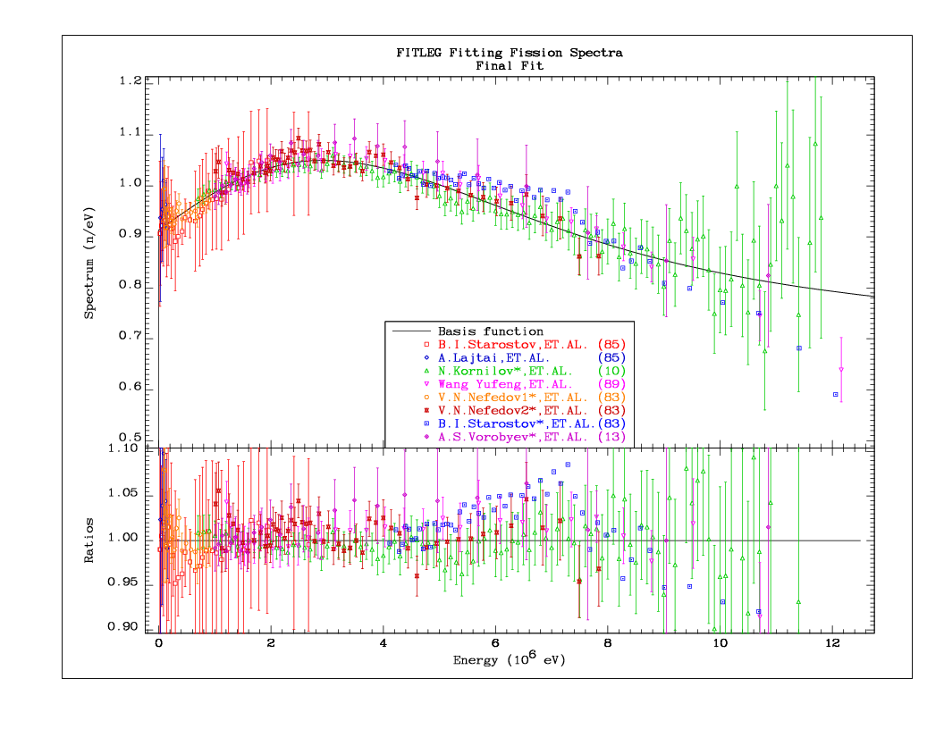
Starostov data excluded (lin scale)

Slide 55
Starostov data included (PNT_0 lin scale)

Slide 56
Iterated solution (PNT_6, linear scale)

Slide 57
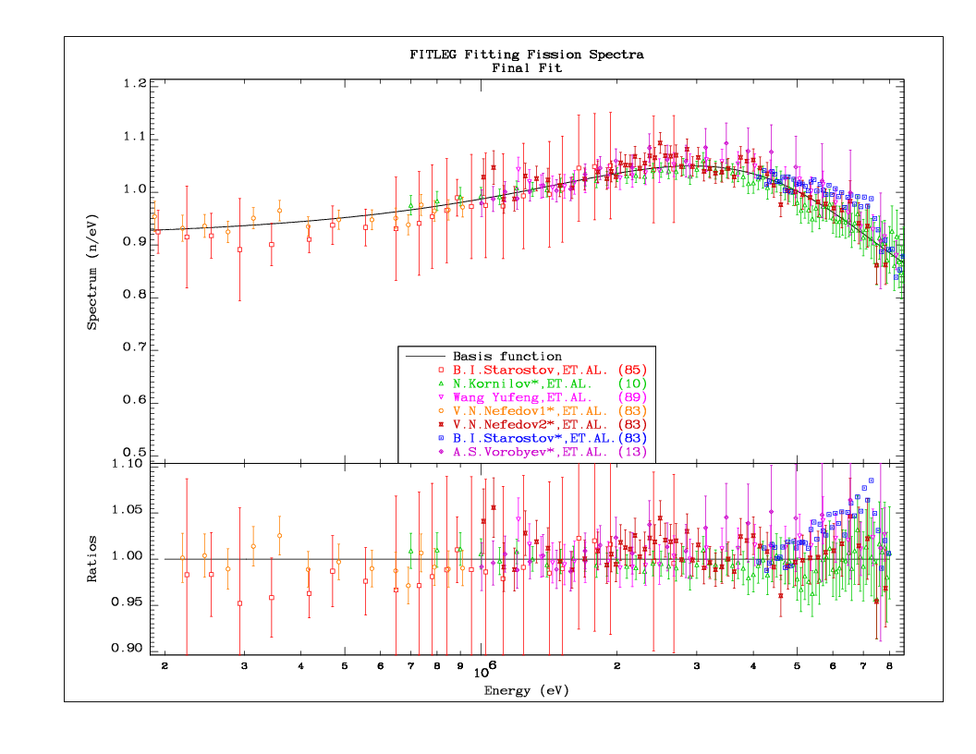
Starostov data excluded (log scale)

Slide 58
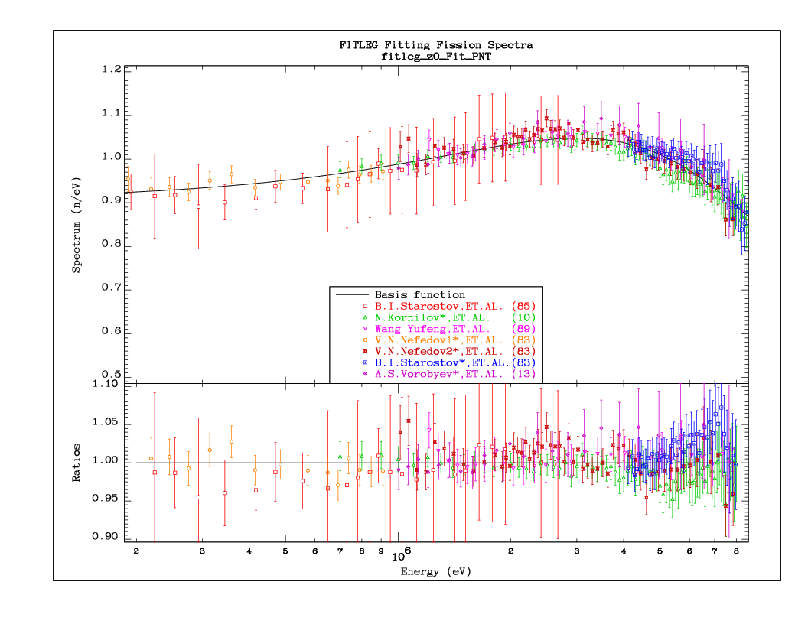
Starostov data included (PNT_0 log scale)

Slide 59
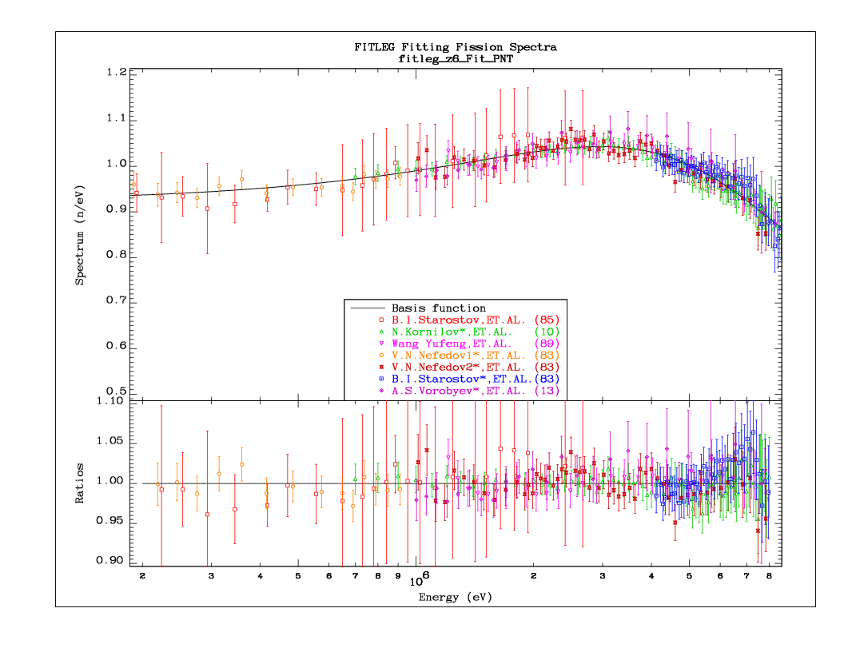
Iterated solution (PNT_6, log scale)

Slide 60
Fitting the data (SCALE)
Method by Kornilov (NSE 169, p.295, 2011)
Parameter a_{s}=E_{av}(²³⁵U) ← identity
Assumption: PFNS shape equals ²⁵²Cf s.f. shape with linear transformation of the energy axis (Eq.4)
With fixed data normalisation, E_{av}(²³⁵U) is the only free parameter, giving E_{av}(²³⁵U)=1.980MeV
Improvement of fit requires distortion of data normalisation
After iterations, E_{av}(²³⁵U)=1.973MeV

Slide 61
Convergence of Basis Function (SCALE)

Slide 62
SCALE_0 (fixed data) normalisation)

Slide 63
SCALE_6 (iterated solution)

Slide 64
Basis (PNT_0, fixed norm.) for compar.

Slide 65
Basis (PNT_6, iterated) for compar.

Slide 66
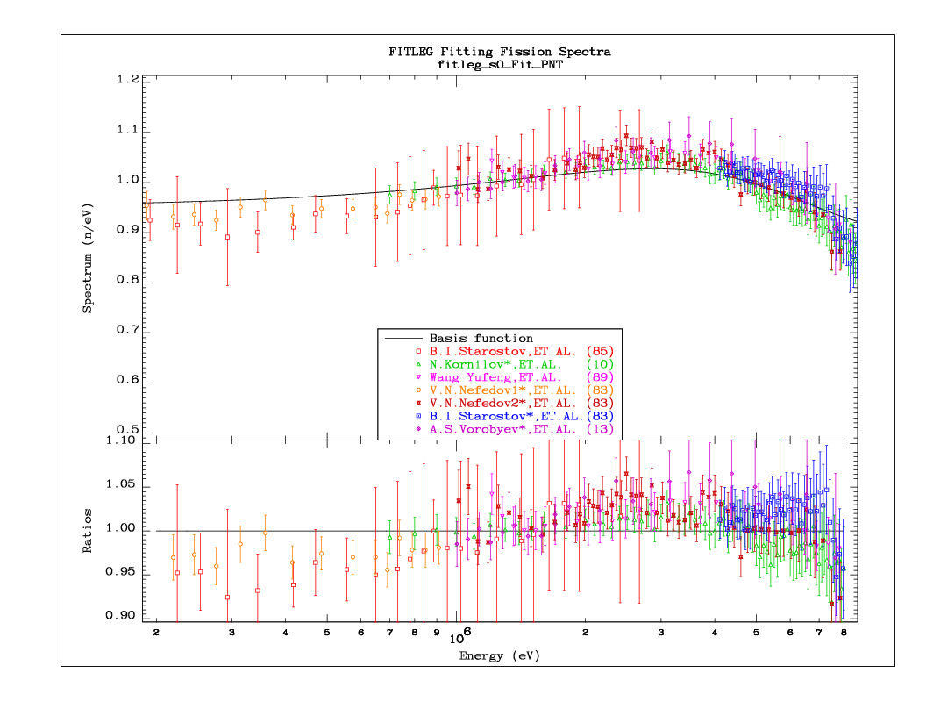
SCALE_0 (fixed data normalisation, log)

Slide 67
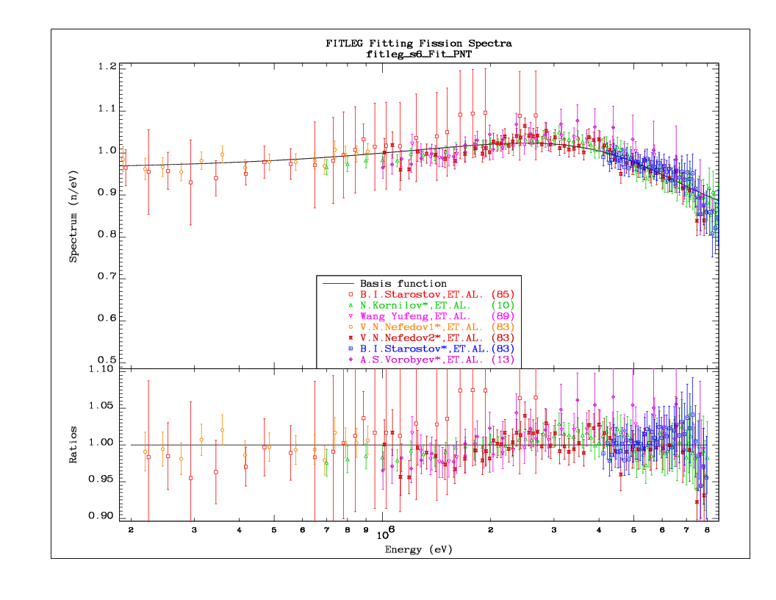
SCALE_6 (iterated solution, log)

Slide 68
GANDR GLSQ solution
Start with some initial normalisation
Perform GLSQ fit with GANDR
Normalise the spectrum
Re-scale the data to the new spectrum
Redo the GANDR fit (iterate)
Solution is equivalent to including data scaling factors as fitting parameters in GLSQ fit

Slide 69
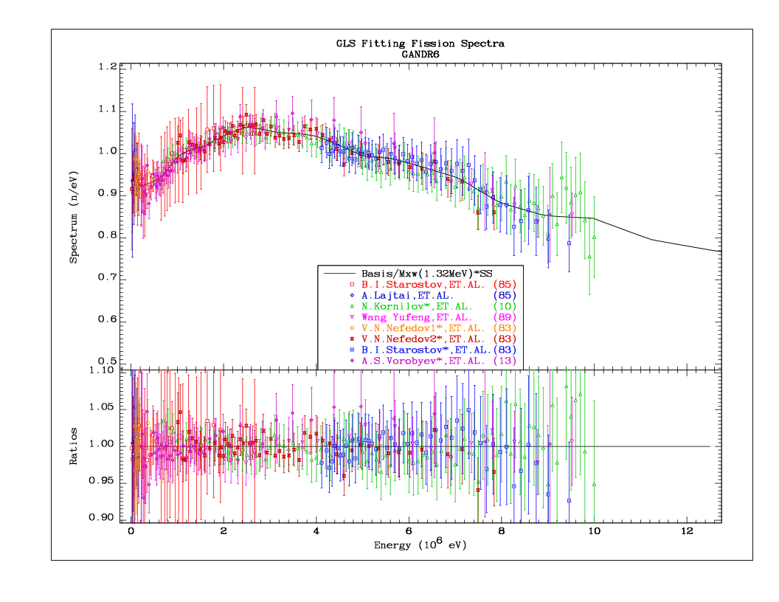
GANDR fit – 6 iterations

Slide 70
Basis (PNT_6, iterated) for comparison

Slide 71
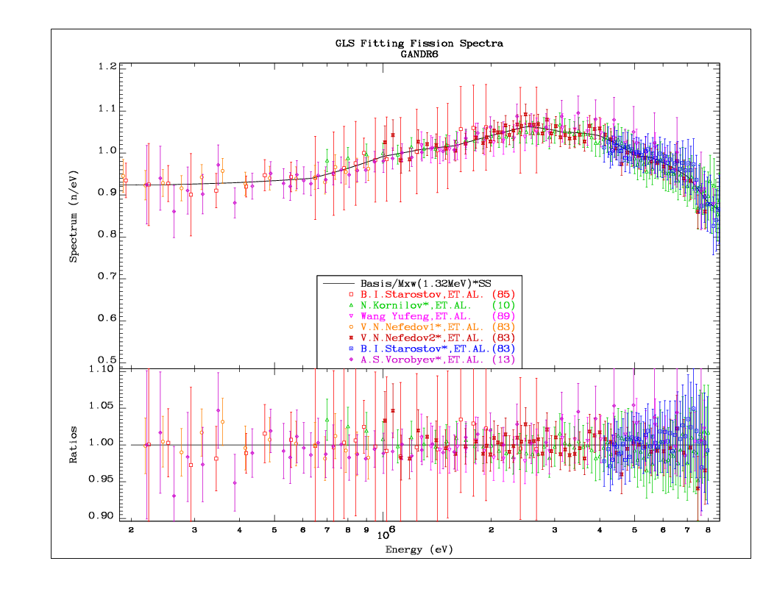
GANDR fit – log scale

Slide 72
Iterated solution (PNT_6, log scale)

Slide 73
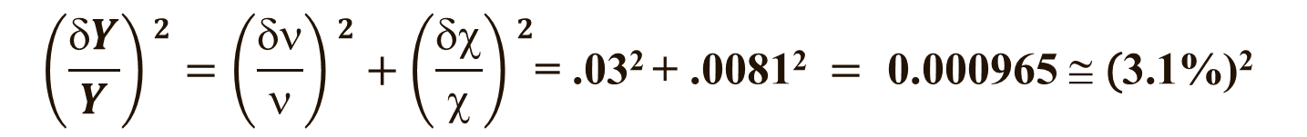
GANDR Normalisation
Fitting performed without normalisation constraint
Total uncertainty in spectrum normalisation is about 3%
Uncertainty in the average energy is about the same
The minimum uncertainty is about 3% at 2 MeV
Minimum uncertainty in the PFNS is 0.81%
Covariance matrix is strongly correlated in the range where data are available
$$\left(\frac{δY}{Y}\right)2=\left(\frac{δν}{ν}\right)2+\left(\frac{δχ}{χ}\right)2\text{= }\text{.}\text{032} \text{+ .}\text{0}\text{081}\text{2} = \text{0}\text{.}\text{000965} ≅ \text{(}\text{3}\text{.}\text{1}\text{\%)}\text{2}$$

Slide 74
GANDR fit (no normalis.) – covariances
~3% unc
corr>0

Slide 75
GANDR normalisation (Cont.)
Normalisation of the spectrum is trivial
Normalisation uncertainty is removed from the covariance matrix using Eq. 35.2 from the ENDF Manual
Uncertainty in the normalisation is zero by definition
Uncertainty in the (norm.PFNS) average energy is 0.45%
Minimum uncertainty in the norm.spectrum is 0.81%
Covariance matrix shows discrete structure in the range where data are available

Slide 76
GANDR normalisation (Cont.)
0.8% unc
anticorr

Slide 77
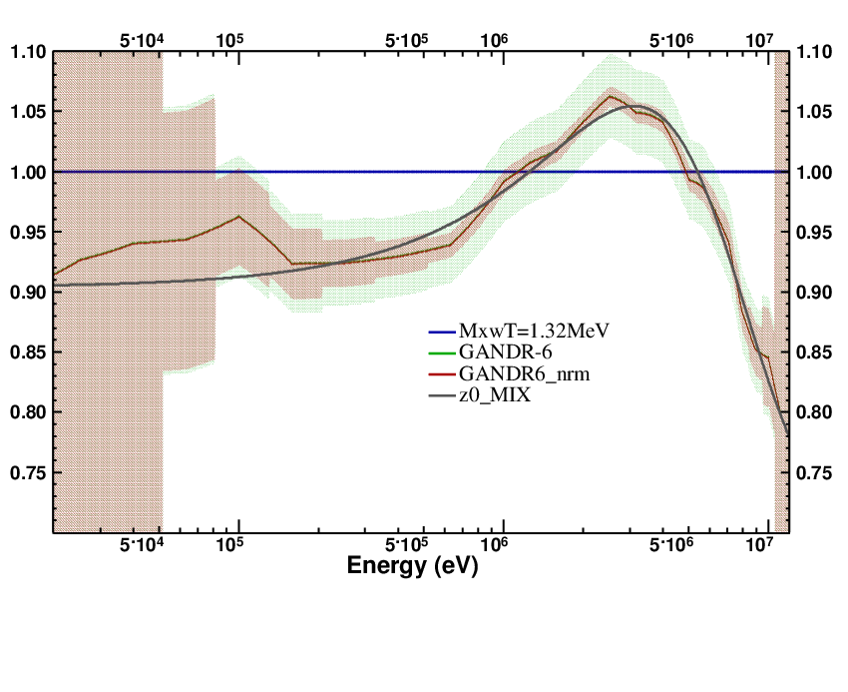
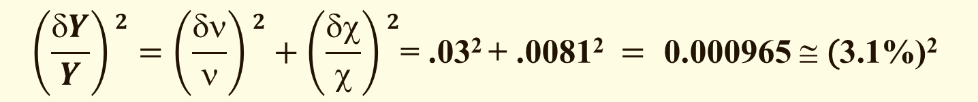
GANDR normal. Vs no-normalisation
Ratio to
Maxw.(T=1.32)
--- Maxw. (T=1.32)
--- GANDR (no norm)
--- GANDR (normal.)
--- PNT fit
$$\left(\frac{δY}{Y}\right)2=\left(\frac{δν}{ν}\right)2+\left(\frac{δχ}{χ}\right)2\text{= }\text{.}\text{032} \text{+ .}\text{0}\text{081}\text{2} = \text{0}\text{.}\text{000965} ≅ \text{(}\text{3}\text{.}\text{1}\text{\%)}\text{2}$$

Slide 78
²³⁵U(n,f) PFNS, ²³⁸U (thermal solutions)

Slide 79
Conclusions (Methodology)
PFNS are SHAPE data (no absolute data needed)
Evaluated neutron yield consistent with measured
No need to (adhoc) increase of the PFNS uncertainty
SCALE method is a remarkably good first order approximation to PFNS spectrum, BUT
One adjustable parameter is not sufficient to accurately fit arbitrary measured data, slightly distorted spectra
PFNS evaluation results of the PNT_raw, PNT and GANDR fits in excellent agreement

Slide 80
PFNS average neutron energy
E-bar [MeV] | Case
1.998 | PNT_raw
1.998 | PNT_0_no_Starostov
2.001 | PNT_0
1.993 1.986 | PNT_6 (iterated) PNT_6_no_Vorobyev
1.985 | SCALE_0_no_Starostov
1.988 | SCALE_0
1.973 | SCALE_6 (iterated)
1.974 | SCALE_6_no_Starostov
2.004 | GANDR_6(iterated)
Notes:
PNT_raw typo corrected (1.999 → 1.998, 11 Aug 2014)

Slide 81
Conclusions (average neutron energy)
The most likely average neutron energy is 2.000(9) MeV
If Vorobyev data excluded – 1.986(9) MeV
The SCALE method underestimates the average energy due to inherent assumptions about the shape of the spectrum (1.974 MeV, Kornilov NSE 169 (2011) 290 )
THANKS FOR YOUR ATTENTION !

