Slide 1









Evaluation of EGAF Neutron Cross Sections for CIELO and Beyond
Richard B. Firestone
Lawrence Berkeley National Laboratory and the University of California, Berkeley, CA 94720

Slide 2
Outline
CIELO thermal neutron cross section measurements
    Methodology
    ²H
    ¹⁶⁻¹⁸O
    ⁵⁶Fe
    ^{235,238}U
EGAF Publication Status
EGAF thermal neutron cross sections in progress
    ¹⁸⁰W
    ²³⁷Np, ²⁴²Pu, ²⁴¹Am
    ⁸⁹Y, ⁹³Nb, ¹³⁹La, ¹⁸⁵Re
High energy neutron measurements
    ⁵⁶Fe photon strengths - Oslo Cyclotron
    ⁵⁶Fe(n,n’γ) – LBNL Cyclotron
Future plans

Slide 3
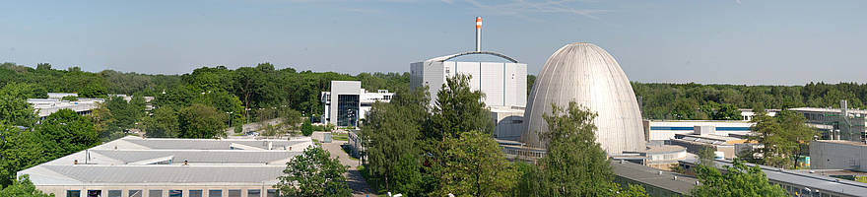
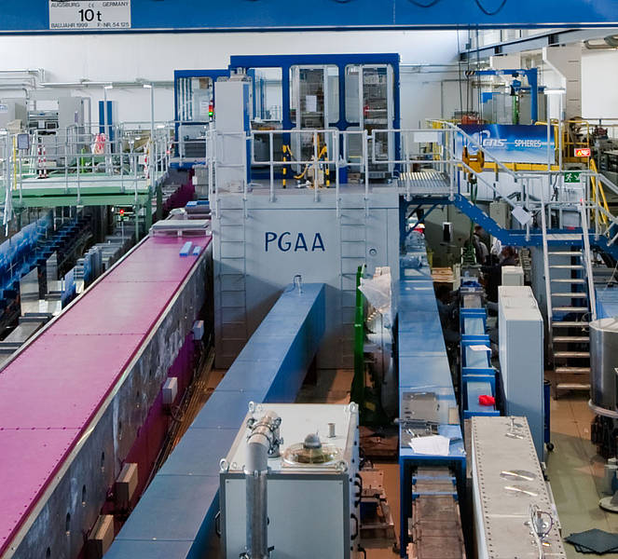
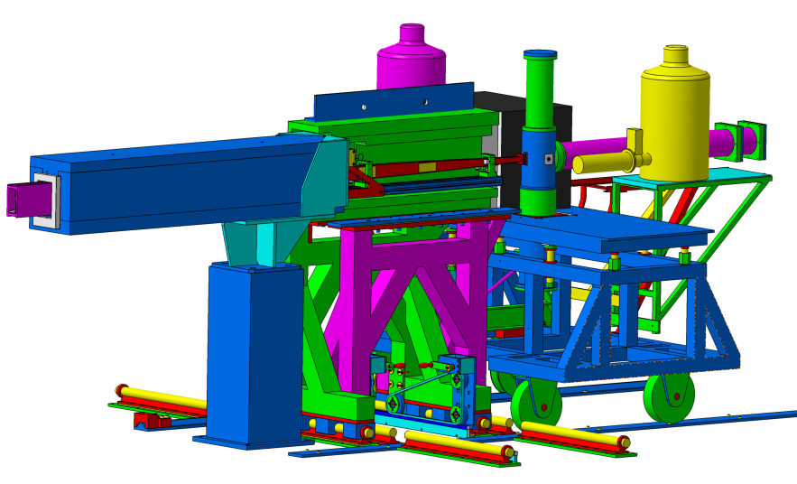
FRM II Reactor (Garching/Munich)
(HPGe) detector surrounded by an Compton suppression annulus (8 BGO scintillators). Lead collimator was placed in front of the detector to focus only γ-rays from the target.
20-MW FRM II Reactor guide hall. PGAA target is 51 m from reactor core. Flux=6×10⁹ n/cm²s, 25°K.

Slide 4
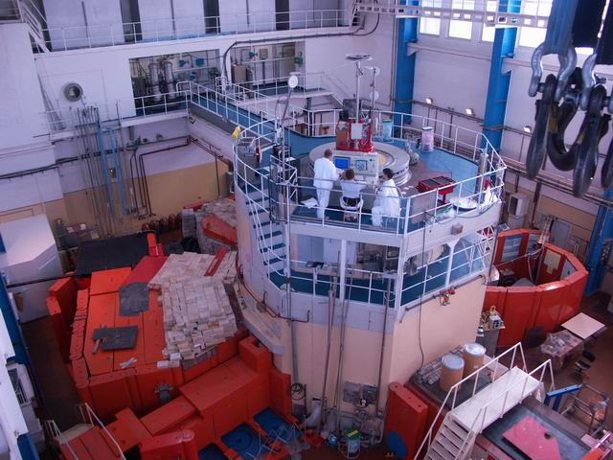
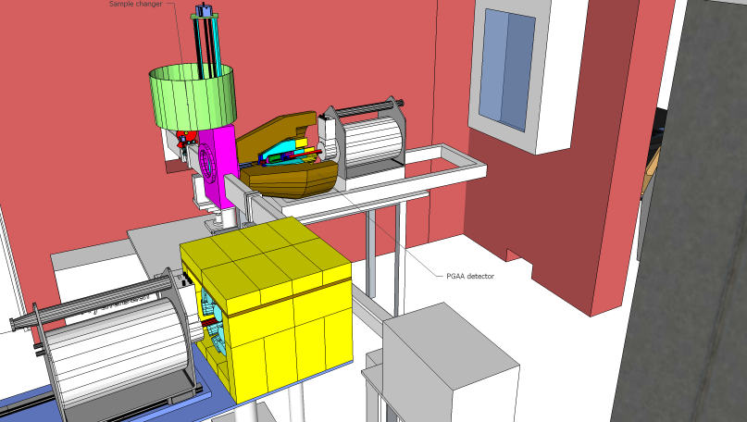
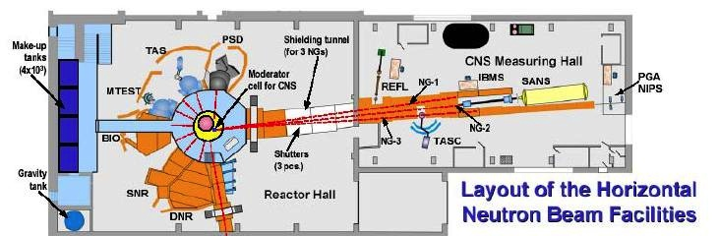
Budapest Reactor
25% HPGe detector with BGO Compton suppression. Lead collimator.
10 MW reactor, Flux=1.2×10⁸ n/cm²s, 140°K, target station 35 m from the reactor.

Slide 5
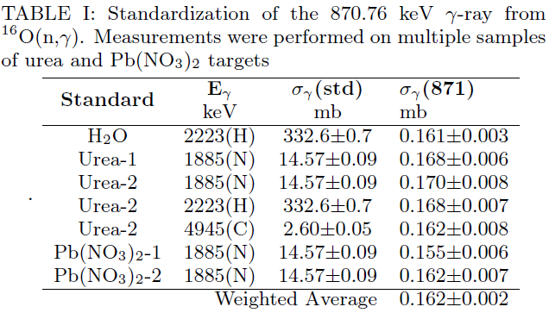
Standardization
All cross section measurements are internally standardized using stoichiometric compounds and mixtures containing standard γ-rays from H, B, N, Cl, ….
  Independent of neutron flux and target mass
  No corrections for neutron spectrum (1/v isotopes only) or fast neutrons
  Repeatable variety of calibration standards
  Superior to previous methods
χ²/f=0.71

Slide 6
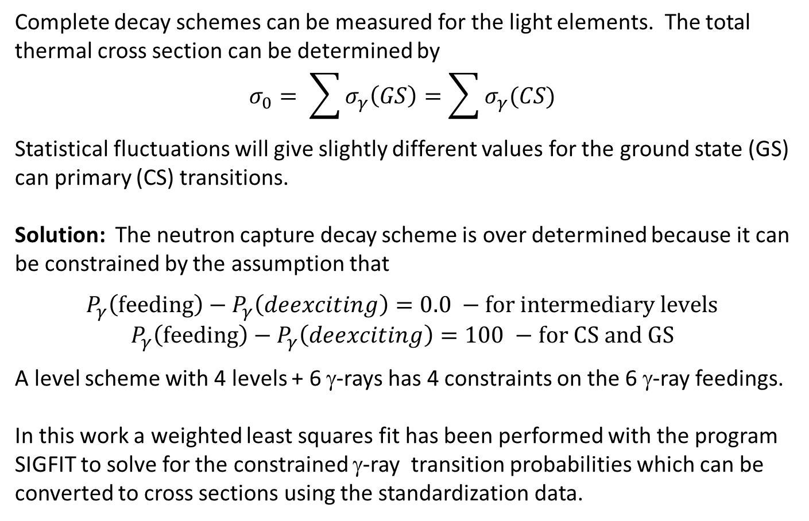
Statistical Analysis
Complete decay schemes can be measured for the light elements. The total thermal cross section can be determined by
$$σ_{0}= \sum{σ_{γ}\left(GS\right)=\sum{σ_{γ}(CS)}}$$
Statistical fluctuations will give slightly different values for the ground state (GS) can primary (CS) transitions.
Solution: The neutron capture decay scheme is over determined because it can be constrained by the assumption that
$$P_{γ}\left(feeding\right)−P_{γ}\left(deexciting\right)=0.0 −for intermediary levels$$
$$P_{γ}\left(feeding\right)−P_{γ}\left(deexciting\right)=100 −for CS and GS$$
A level scheme with 4 levels + 6 γ-rays has 4 constraints on the 6 γ-ray feedings.
In this work a weighted least squares fit has been performed with the program SIGFIT to solve for the constrained γ-ray transition probabilities which can be converted to cross sections using the standardization data.

Slide 7
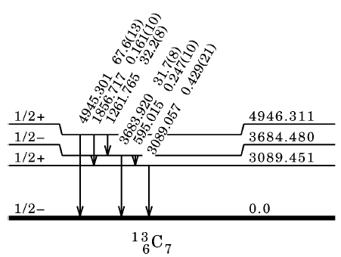
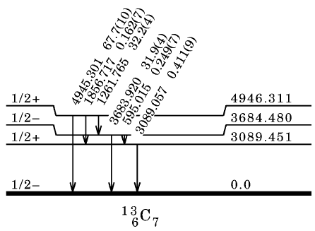
Statistic Analysis Example ¹²C(n,γ)
P_{γ}(in) P_{γ}(out) ΔP_{γ}
--- 99.7(15) ---
32.2(8) 31.9(9) 0.3(11)
0.408(14) 0.429(21) 0.021(25)
100.0(15) --- ---
Input data
Fitted data
P_{γ}(in) P_{γ}(out) ΔP_{γ}
--- 100.0(12) ---
32.6(6) 32.6(6) 0.000(8)
0.411(16) 0.411(11) 0.0(19)
100.0(12) --- ---
σ₀(¹²C)=3.89(9) mb from standardization and natural abundance

Slide 8
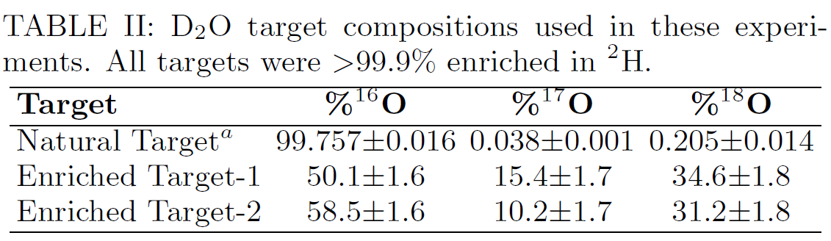
²H,^{16,17,18}O Cross Sections
R.B. Firestone and Zs. Revay

Slide 9
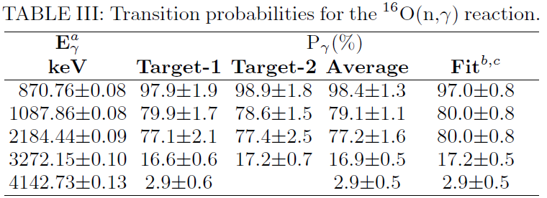
¹⁶O(n,γ)
Reference σ₀(mb)
Jurney (1963) 0.178(25)
McDonald (1973) 0.185(26)*
Wuest(1977) 0.187(10)
This work 0.167(3)
*Recalibrated to new standard

Slide 10
¹⁷O(n,γ)
Reference σ₀(mb)
Lone (1978) 0.54(6)
This work 0.66(6)

Slide 11
¹⁸O(n,γ)
Reference σ₀(mb)
Seren (1947) 0.22(4)
Blaser (1971) 0.16(1)
Ohsaki(2002) 0.156(16)
Nagai(2007) 0.153(10)*
This work (prompt) 0.139(3)
This work (Activation) 0.139(5)
*Recalibrated to new standard
S_{n}=3955.6(26) keV (AME)
S_{n}=3963.18(19) keV (This work)

Slide 12
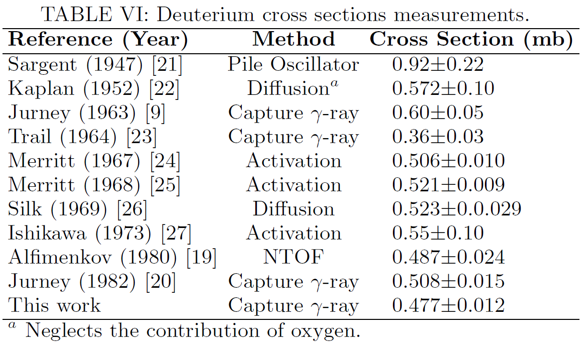
²H(n,γ)

Slide 13
⁵⁶Fe(n,γ)
R.B.Firestone, T. Belgya, M. Krticka, L. Szentmilosi, Zs. Revay, and F. Gunsing
(n,γ) singles spectrum – Budapest Reactor
(n,γ) coincidence data - LVR-15 Reactor (Prague)
Fe₂(SO₄)₃ standardization – S comparator (840 keV)

Slide 14
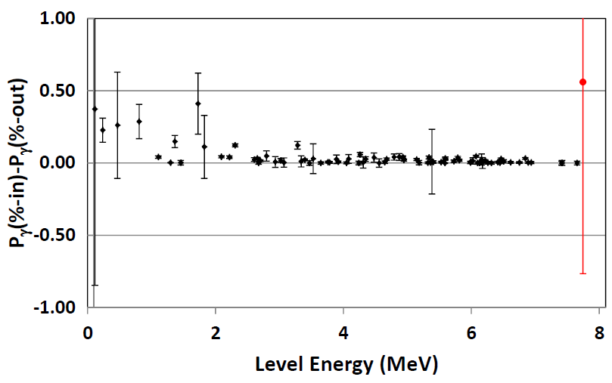
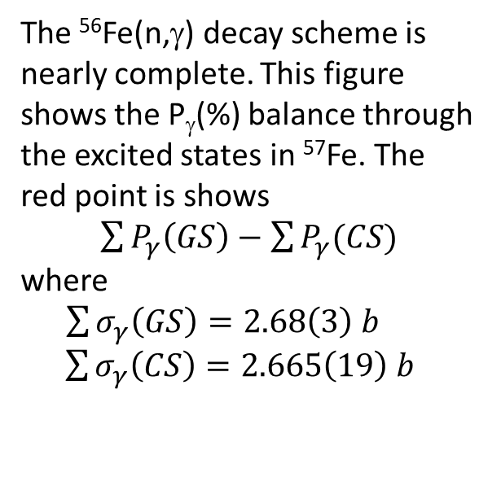
⁵⁶Fe(n,γ)
The ⁵⁶Fe(n,γ) decay scheme is nearly complete. This figure shows the P_{γ}(%) balance through the excited states in ⁵⁷Fe. The red point is shows
$\sum{P_{γ}\left(GS\right)−\sum{P_{γ}(CS)}}$
where
$\sum{σ_{γ}\left(GS\right)=2.68\left(3\right) b}$
$\sum{σ_{γ}\left(CS\right)=2.665\left(19\right) b}$
411 γ-rays have been placed deexciting 87 levels in 57Fe on the basis of γγ-coincidence data and energy sums.
Statistical model calculations with DICEBOX to estimate the unobserved continuum may increase the cross section by about 1%.

Slide 15
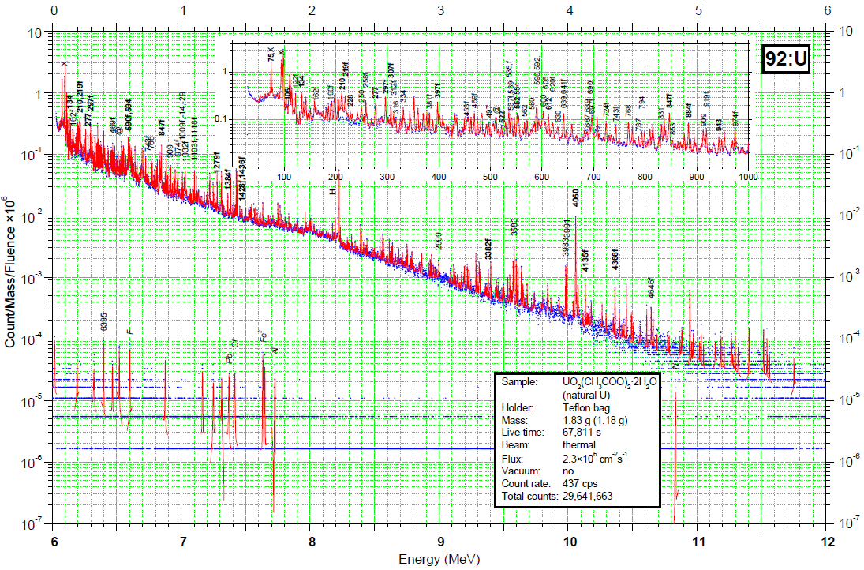
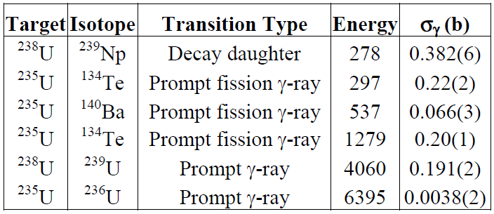
^{235,238}U(n,γ)

Slide 16
EGAF Publications to Date
IAEA Coordinated Research Project
  Handbook of Prompt Gamma Activation Analysis with Neutron Beams, Zs. Revay, T. Belgya, R.M. Lindstrom, Ch. Yonezawa, D.L. Anderson, Zs. Kasztovsky, and R.B. Firestone, edited by G.L. Molnar (Kluwer Publishers, 2004).
  Database of Prompt Gamma Rays from Slow Neutron Capture for Elemental Analysis, R.B. Firestone, H.D. Choi, R.M. Lindstrom, G.L. Molnar, S.F. Mughabghab, R. Paviotti-Corcuera, Zs. Revay, V. Zerkin, and C.M. Zhou, IAEA STI/PUB/1263, 251 pp (2007).
Journal Publications
  Thermal neutron capture cross sections of the Palladium isotopes, M. Krticka,R.B. Firestone, D.P. McNabb, B. Sleaford, U. Agvaanluvsan, T. Belgya, and Z.S. Revay, Phys. Rev. C 77, 054615 (2008).
  Comparison of IUPAC k0 Values and Neutron Cross Sections to Determine a Self-consistent Set of Data for Neutron Activation Analysis, R.B. Firestone and Zs. Revay, Radiochim. Acta 1, 305–312 (2011).
  Thermal neutron capture cross sections of the Potassium isotopes, Phys. Rev, C 87, 024605 (2013).

Slide 17
EGAF Publications to Date
Thermal neutron capture cross sections and neutron separation energies for ²³Na(n,γ), R.B. Firestone, Zs. Revay, and T. Belgya, Phys. Rev. C 89, 014617 (2014).
Radiative Capture Cross Sections of ^{155,157}Gd for Thermal Neutrons, H. D. Choi, R. B. Firestone, M. S. Basunia, A. Hurst, B. Sleaford, N. Summers, J. E. Escher, Zs. Revay, L. Szentmiklosi, T. Belgya, and M. Krticka, Nucl. Sci. Eng. 177, 219–232 (2014).
Investigation of the tungsten isotopes via thermal neutron capture, A. M. Hurst, R. B. Firestone, B. W. Sleaford, N. C. Summers, Zs. Revay, L. Szentmiklosi, M. S. Basunia, T. Belgya, J. E. Escher, and M. Krticka, Phys. Rev. C 89, 014606 (2014).
Determination of the ¹⁵¹Eu(n,γ)^{152m1,g}Eu and ¹⁵³Eu(n,γ)¹⁵⁴Eu Reaction Cross Sections at Thermal Neutron Energy, M.S. Basunia, R.B. Firestone, Zs. Revay, H.D. Choi T. Belgya J.E. Escher, A.M. Hurst, M. Krticka, L. Szentmiklosi, B. Sleaford, and N.C. Summers, Nucl. Data Sheets 119, 88 (2014).
EGAF: Measurement and Analysis of Gamma-ray Cross Sections, R.B. Firestone, K. Abusaleem, M.S. Basunia, F. Bečvář, T. Belgya, L.A. Bernstein, H.D. Choi, J.E. Escher, C. Genreith, A.M. Hurst, M. Krtička, P.R. Renne, Zs. Révay, A.M. Rogers, M. Rossbach, S. Siem, B. Sleaford, N.C. Summers, L. Szentmiklosi, K. van Bibber, M. Wiedeking, et al., Nucl. Data Sheets, 119, 78 (2014).

Slide 18
Summary of Published Cross Sections
Isotope σ₀ (Atlas) σ₀ (EGAF) Isotope σ₀ (Atlas) σ₀ (EGAF)_
⁶Li 44.8±0.3 mb 52.6±2.2 mb ³¹P 165±3 mb 169±5 mb
⁷Li 45.2±1.4 mb 46.3±1.3 mb ³²S 518±14 mb 532±7 mb
⁹Be 8.5±0.3 mb 8.8±0.6 mb ³³S 454±20 mb 449±7 mb
¹⁰B 3.05±0.16 mb 3.90±0.11 mb ³⁴S 256±9 mb 285±8 mb
¹¹B 5.5±3.3 mb 9.06±0.20 mb ³⁵Cl 43.6±0.4 b 44.0±0.2 b
¹²C 3.53±0.07 mb 3.89±0.06 mb ³⁷Cl 433±6 mb 500±8 mb
¹³C 1.37±0.04 mb 1.51±0.03 mb ³⁹K 2.1±0.2 b 2.28±0.04 b
¹⁴N 80.1±0.6 mb 78.5±0.7 mb ⁴⁰K 30±8 b 90±7 b
¹⁵N 24±8 μb 39±3 μb ¹⁰²Pd 1.6±0.2 b 1.1±0.4 b
¹⁹F 9.51±0.09 mb 9.63±0.16 mb ¹⁰⁴Pd 0.65±0.30 b 0.75±0.26 b
²³Na 517±4 mb 541±3 mb ¹⁰⁵Pd 21.0±1.5 b 21.7±0.5 b
²⁴Mg 538±13 mb 535±20 mb ¹⁰⁶Pd 0.30±0.03 b 0.36±0.10 b
²⁵Mg 199±3 mb 196±8 mb ¹⁰⁸Pd^{g} 7.6±0.5 b 7.2±0.5
²⁶Mg 38.4±0.6 mb 38.8±1.4 mb ¹⁰⁸Pd^{m} 0.185±0.010 b 0.185±0.011 b
²⁷Al 231±3 mb 232.2±1.7 mb ¹¹⁰Pd 0.70±0.07 b 0.34±0.10 b
²⁸Si 171±3 mb 186±2 mb
²⁹Si 119±3 mb 128±4 mb
³⁰Si 107±2 mb 112±6 mb

Slide 19
Summary of Published Cross Sections
Isotope σ₀ (Atlas) σ₀ (EGAF)____
¹⁵¹Eu^{g} 5900±200 b 7060±400 b
¹⁵¹Eu^{m} 3300±200 b 2345±220 b
¹⁵¹Eu^{m+g} 9200±100 b 9405±460 b
¹⁵⁵Gd 60,900±500 b 56,700±2100 b
¹⁵⁷Gd 254,000±815 b 239,000±6000 b
¹⁸²W^{g} 19.9±0.3 b 20.5±1.4 b
¹⁸²W^{m} 177±18 mb
¹⁸³W^{g} 10.4±0.2 b 9.4±0.4 b
¹⁸³W^{m} 25±6 mb
¹⁸⁴W^{g} 1.7±0.1 b 1.43±0.10 b
¹⁸⁴W^{m} 2.0±1.0 mb 6.2±1.6 mb
¹⁸⁶W^{g} 38.1±0.5 b 33.3±0.6 b
¹⁸⁶W^{m} 400±16 mb
46 EGAF isotopic cross sections have been published.
21 measurements were found to be discrepant.

Slide 20
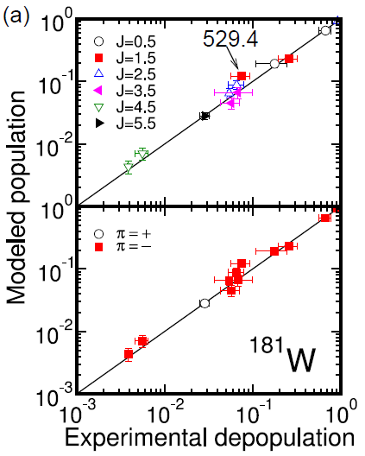
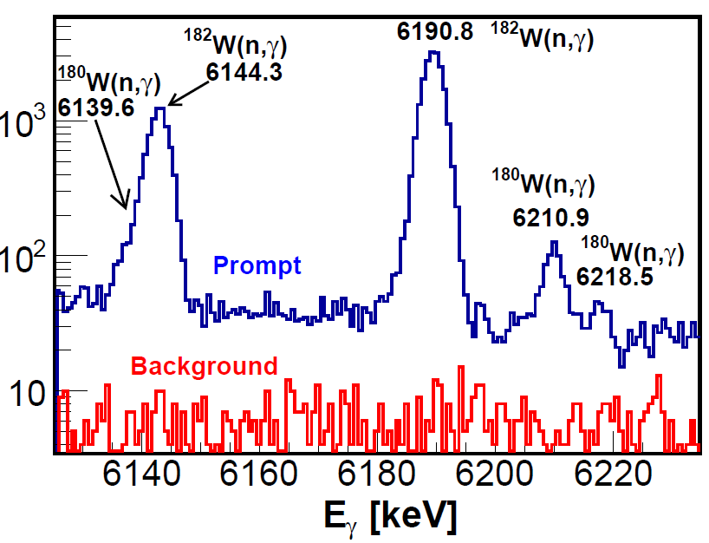
¹⁸⁰W(n,γ) Evaluation in Progress
¹⁸⁰W(n,γ) – A. Hurst et al, ¹⁸⁰W(0.12%) target enriched to 11.35%
Reference σ₀ (b)
Pomerance (1952) <150
Kang (2007) 22.6±1.7
Vorona (200*) 36.3±2.4
This work 24.7±0.8
^{181m}W(14.6 μs) 6.8±0.9
S_{n}=6686±5 keV AME
S_{n}=6668.79±20 keV This work

Slide 21
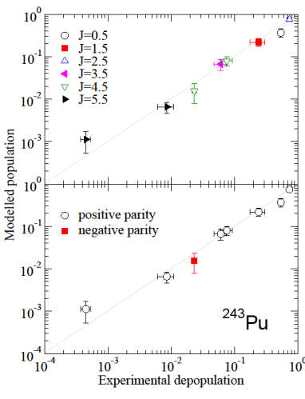
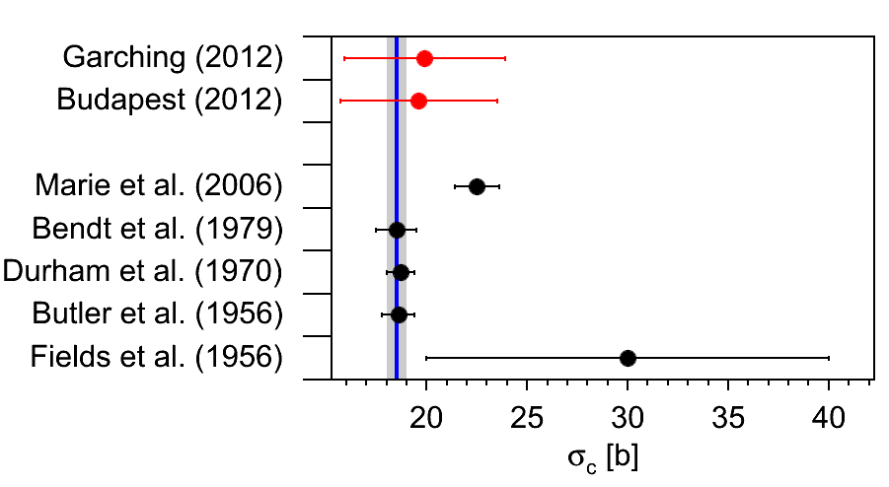
TANDEM* Evaluations in Progress
²³⁷Np(n,γ), ²⁴²Pu(n,γ), ²⁴¹Am(n,γ) – C. Genreith et al, Julich
    σ₀=18.5±0.5 b Atlas
    σ₀=22.4±1.5 b This work
*Transuranium Actinide Nuclear Data: Evaluation and Measurement (TANDEM collaboration).
  Research Centre Jülich GmbH
  Technsiche Universität München
  Hungarian Academy of Sciences
  Lawrence Berkeley National Laboratory
  Lawrence Livermore National Laboratory

Slide 22
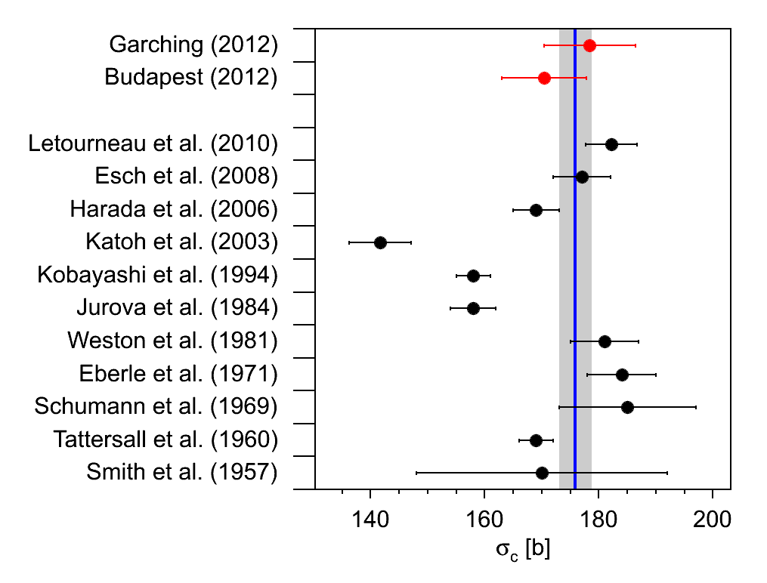
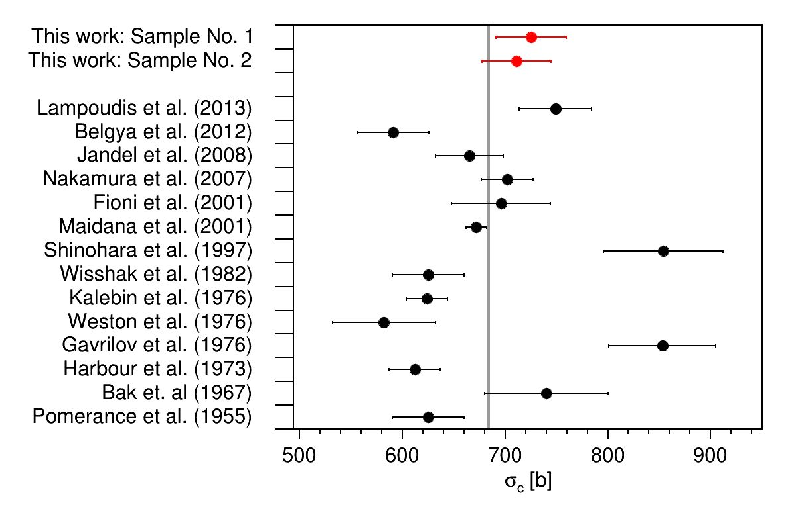
TANDEM Evaluations in Progress
²³⁷Np(n,γ) ²⁴¹Am(n,γ)

Slide 23
Additional EGAF Cross Section Evaluations in Progress
Isotope CS composition σ₀(this work) σ₀(Atlas) Lead researcher
⁹⁰Y(2⁻) 99.75%-1⁻, 0.25%-0⁻ 1.34±0.03 b 1.28±0.02 b Abusaleem (Jordan)
⁹⁰Y (7⁺) 7+ 1.9±0.3 mb 1.0±0.2 mb Abusaleem (Jordan)
⁹⁴Nb(6⁺) 85%-4+, 15%-5+ 1.27±0.08 b 1.15±0.05 b Turkoghu (Ohio State)
¹⁴⁰La(3⁻) 0.9%-3⁺, 99.1% 4⁺ 8.5±0.4 b 9.04±0.04 b Ureche (UC Berkeley)
¹⁸⁶Re(1⁻) 47.4%-2⁺, 52.6% 3⁺ 84±6 b 112±2 b Lerch (US Army)

Slide 24
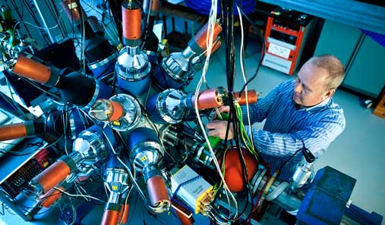
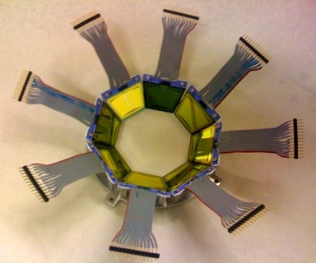
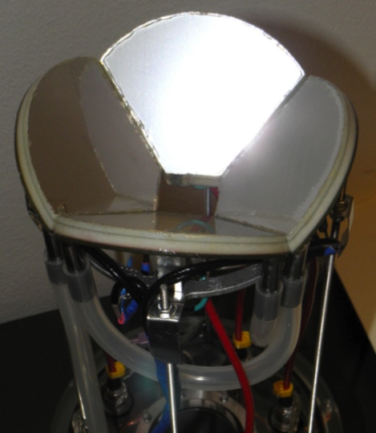
Oslo Cyclotron Experiments
“Oslo” Method³
CACTUS NaI spectrometer
E_{x}-indexed γ-ray spectra created using particle-γ coincident data are fit* to simultaneously determine both ρ(E_{γ}) and f(E_{γ})
Particle-fission coincident data are used for surrogate (n,f) measurements
Experiments performed in 2014 include ^{239,242}Pu(d,pγ)/(d,pf) and ¹⁸⁶Os(d,pγ)
“SiRi” Silicon Ring
Particle Detector
PPAC Fission
Fragment Detector
Future experiment: LD & RSF in ⁵⁶Mn from ⁵⁵Mn(d,p)
*A. Schiller et al., NIM A 447 (2000) 498

Slide 25
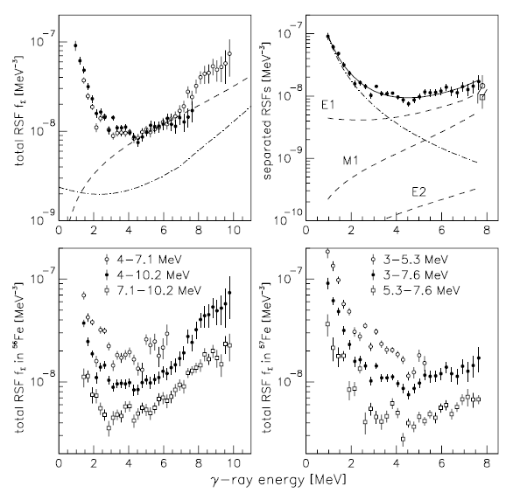
⁵⁷Fe(³He,αγ)⁵⁶Fe and ⁵⁷Fe(³He,³He’γ)⁵⁷Fe
Upper left panel: Total RSF f of ^{57,56}Fe (solid and open circles, respectively); Lorentzian (dashed line) and KMF model (dash-dotted line) descriptions of the GEDR.
Upper right panel: Fit (solid line) to ⁵⁷Fe data and decomposition into the renormalized E1 KMF model, Lorentzian M1 and E2 models (all dashed lines), and a power law to model the large enhancement for low energies (dash-dotted line). Open symbols are estimates of the E1 (circle) and M1 (square) RSF from
hard primary- rays [21].
Lower panels: Total RSF in ⁵⁶Fe (left)
and ⁵⁷Fe (right) for different excitation-energy windows indicated
in the figure. Open circles and squares are offset by a factor of 2 and 0.5 with respect to their true values.
Voinev et al, Phys. Rev. Lett. 93, 142504 (2004).

Slide 26
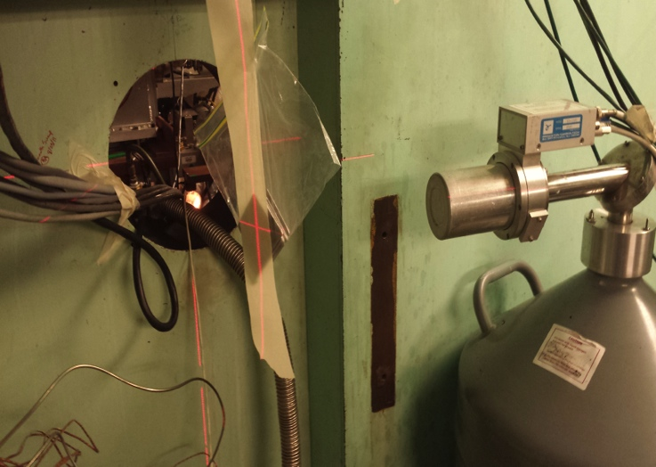
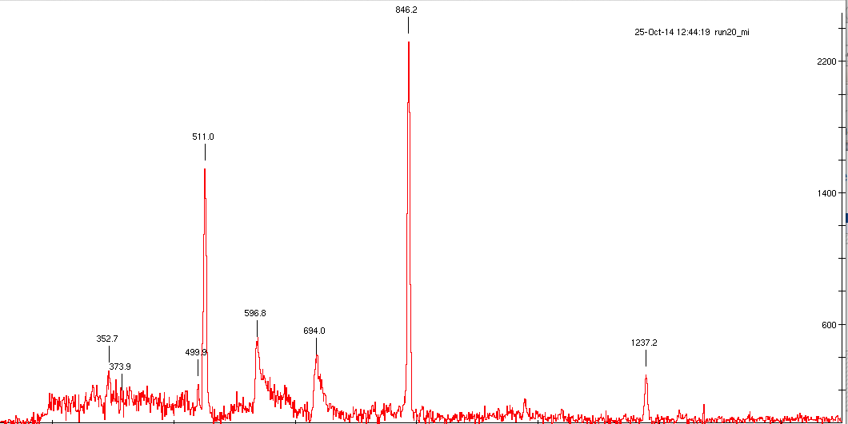
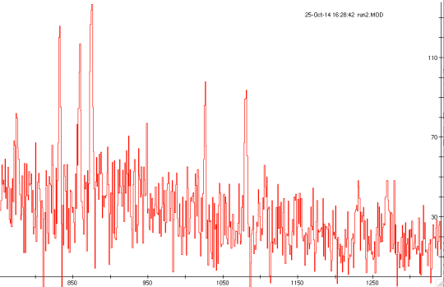
LBNL Cyclotron ^{56,57}Fe(n,n’γ)
First measurement of (n,n’γ) cross sections at the LBNL Cyclotron.
UCB neutron generator experiments in 2015.
^{nat}Fe target
s
20% HPGe
1 hour of data with 1 cm thick ^{nat}Fe at I_{d}=2 µA. E_{n}≈3-4 MeV, ≈5000 n/cm²s.

Slide 27
EGAF Future Plans
Evaluation of P_{γ}, σ_{γ} for all (n,xγ) reactions up to 20 MeV
  eV Resonance (n,γ)
  Average Resonance Capture (ARC)
  (n,n’γ) – update the Bagdad Atlas
Evaluation of ENSDF Adopted Levels, Gammas for all (n,γ) isotopes
  Evaluated (n,xγ) datasets
  Updated activation datasets
  Updated Adopted Levels
  RIPL file development
Evaluation of continuum γ-ray data (IAEA Collaboration)
  Photonuclear
  Reaction
  Photon strengths and level densities
  Development of ENSDF formats

Slide 28
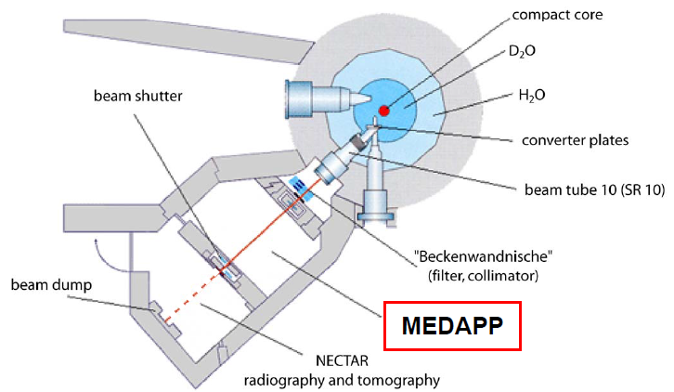
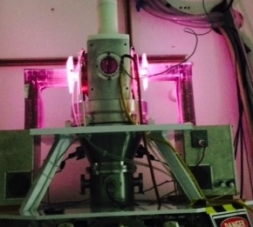
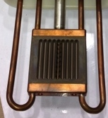
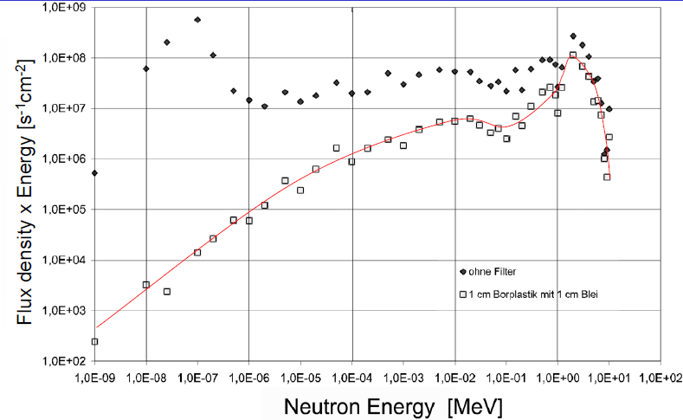
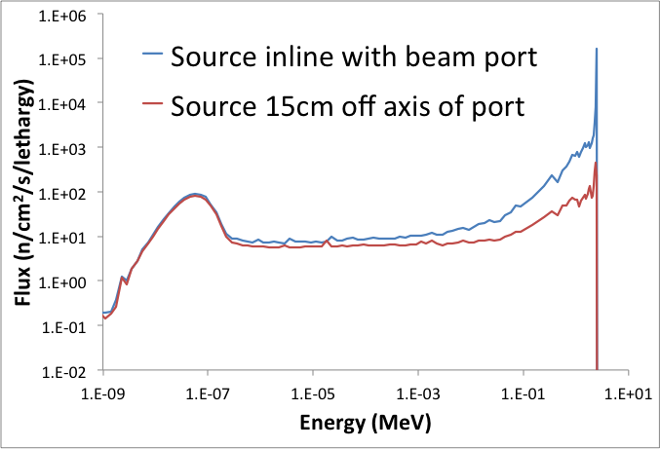
New Experimental Facilities
²³⁵U`
FRM-II
HFNG
MCNP simulations
10⁶
10⁴
10²
10⁰
10⁻⁹ 10⁻⁷ 10⁻⁵ 10⁻³ 10⁻¹ 10¹

Slide 29
Evaluation of X(n,γ) Isotopes
(n,xγ), … Experiments
Updated Literature
EGAF
DICEBOX
ENSDF
Adopted Levels, γ’s
(n,γ), P_{γ}, σ_{γ}, σ₀, S_{n}
AMDC
RIPL
Physical Review
ENDF

Slide 30
EGAF Collaboration
LBNL – R.B. Firestone, S. Basunia, A. Hurst
FRM II – Zs. Revay, P. Kudejova
Budapest – T. Belgya, L. Szentmiklosi
LLNL – B. Sleaford, N. Summers, J. Escher
Julich – C. Genreith, M. Rossbach
Prague – M. Krticka, F. Becvar
Ohio State U.– D. Turkoghu
Army ACS – A. Lerch, J. Carroll
UC Berkeley – L. Bernstein, , A. Ureche, L. Kirsch, K. van Bibber, K.N. Leung, J. Vujic
iThemba – M. Wiedekind
nTOF – F. Gunsing
Jordan – K. Abusaleem
IAEA – V. Zerkin, P. Dimitriou, R. Capote
  * Students are indicated in red
  Volunteers are welcome. Too much data, too little time.

