Slide 1
Comparison of Calculations of Neutron Cross Sections on Deformed Nuclei Between Hauser-Feshbach and Deformed Hauser-Feshbach Models
S. M. Grimes
Ohio University

Slide 2
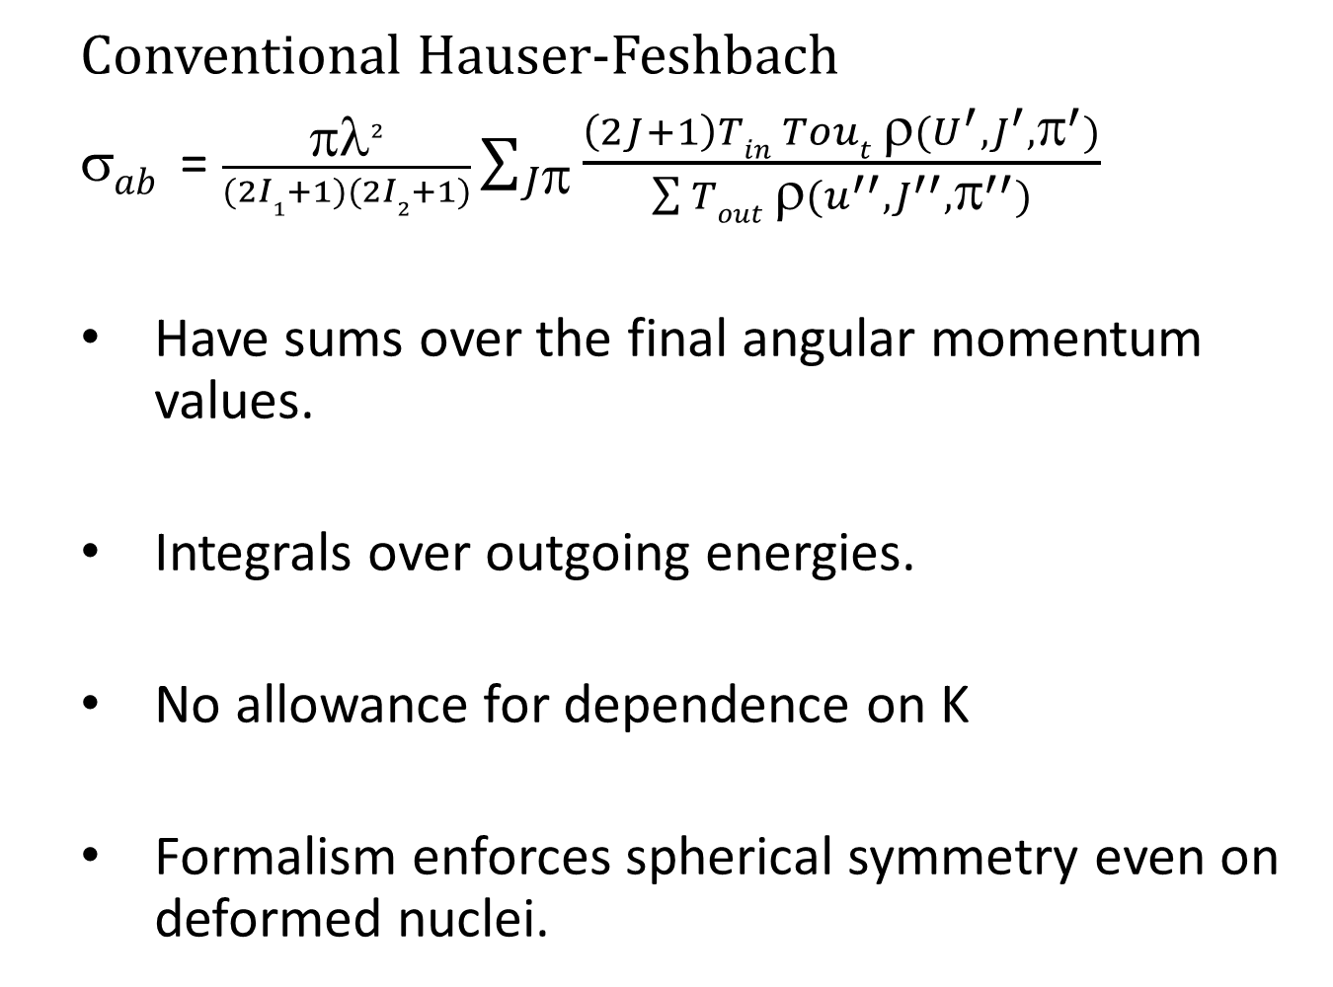
  Conventional Hauser-Feshbach
  $ab$ = $\frac{πλ2}{(2I1+1)(2I2+1)}\sum_{Jπ}{\frac{\left(2J+1\right)Tin Tout ρ(U^{′},J^{′},π^{′})}{\sum{Tout }ρ(u^{′′},J^{′′},π^{′′})}}$
  Have sums over the final angular momentum values.
  Integrals over outgoing energies.
  No allowance for dependence on K
  Formalism enforces spherical symmetry even on deformed nuclei.

Slide 3
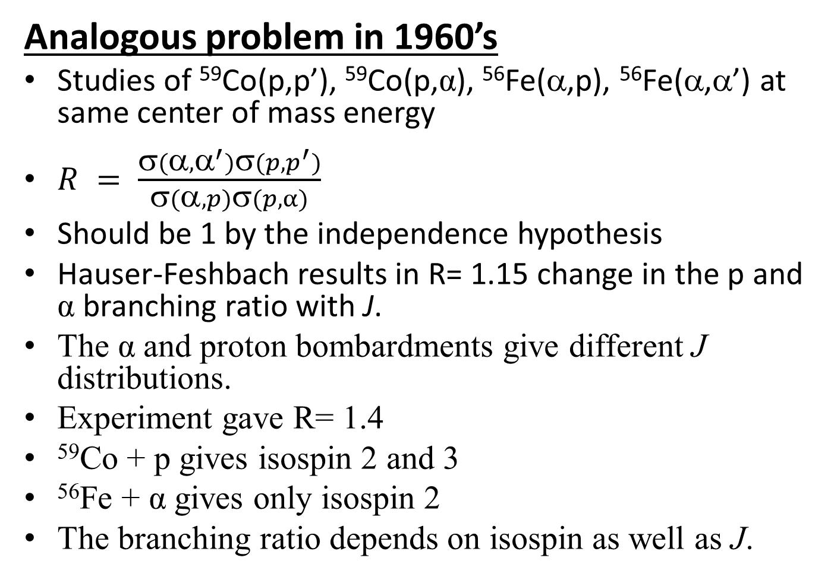
Analogous problem in 1960’s
Studies of ⁵⁹Co(p,p’), ⁵⁹Co(p,α), ⁵⁶Fe(α,p), ⁵⁶Fe(α,α’) at same center of mass energy
$R = \frac{σ(α,α^{′})σ(p,p^{′})}{σ(α,p)σ(p,α)}$
Should be 1 by the independence hypothesis
Hauser-Feshbach results in R= 1.15 change in the p and α branching ratio with J.
The α and proton bombardments give different J distributions.
Experiment gave R= 1.4
⁵⁹Co + p gives isospin 2 and 3
⁵⁶Fe + α gives only isospin 2
The branching ratio depends on isospin as well as J.

Slide 4
A New HF Formulation
Add sum over T_{I} (Compound Nucleus).
Make final level densities a function of final T_{I}
Sum over Final T_{I}
Replace Transmission Coefficients with
τ = T<T_{I1} T_{I1Z} T_{I2} T_{I2Z} | T_{I3} T_{I3Z}>²
Result: R=1.65
Can reproduce experimental R= 1.4 by invoking isospin mixing

Slide 5

Density of T_{I} levels is much larger than T_{I+1} mixing is one way.
$0 ≤ μ ≤1$ μ = 1 recovers the no isospin result.

Slide 6
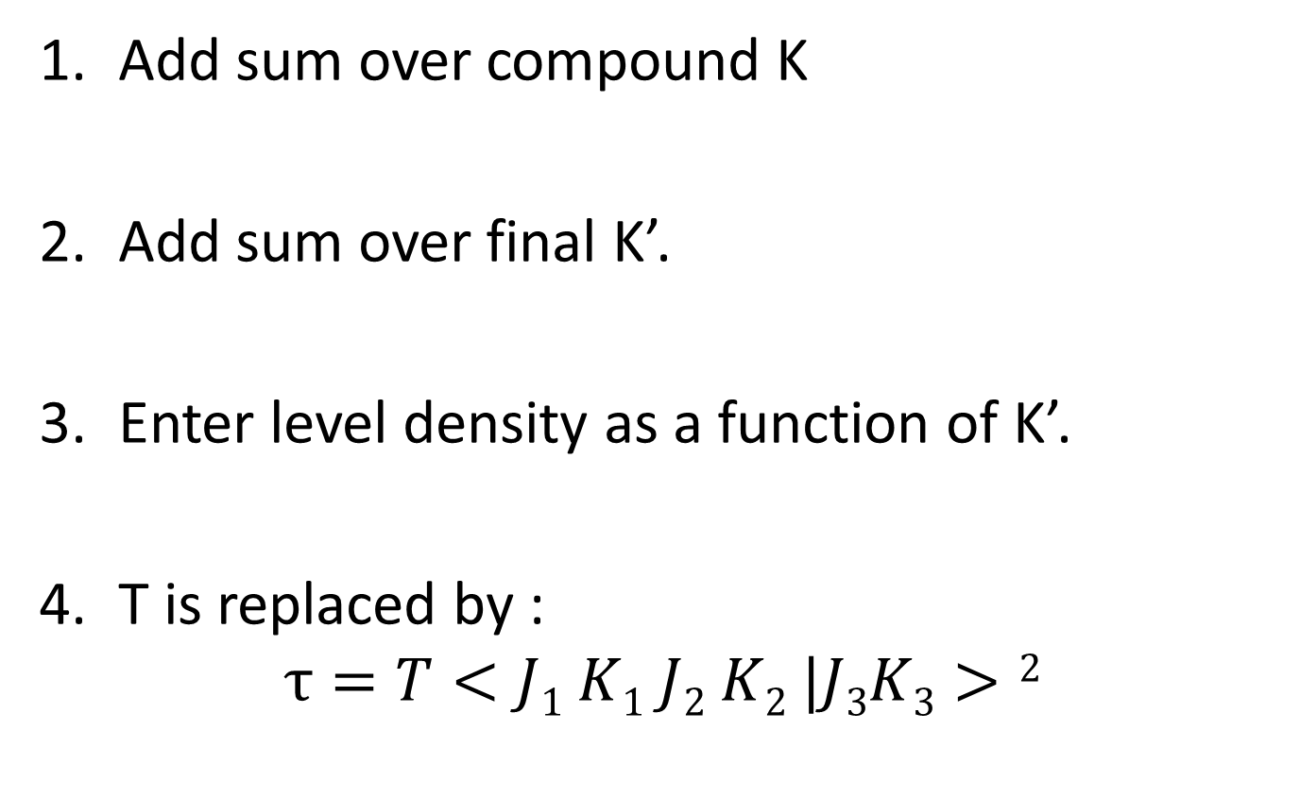
Analogous Situation for K
Add sum over compound K
Add sum over final K’.
Enter level density as a function of K’.
T is replaced by :
$$τ=T<J1 K1 J2 K2 |J3K3>2$$

Slide 7
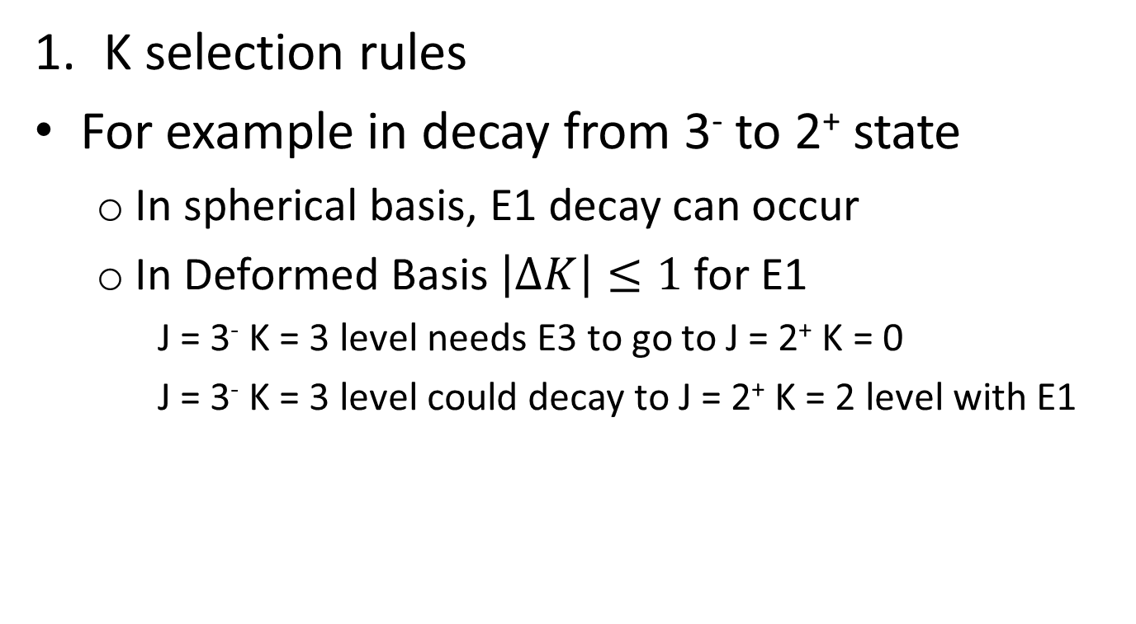
Results can be understood to be consequences of:
K selection rules
For example in decay from 3⁻ to 2⁺ state
  In spherical basis, E1 decay can occur
  In Deformed Basis $\left|ΔK\right|≤1$ for E1
    J = 3⁻ K = 3 level needs E3 to go to J = 2⁺ K = 0
    J = 3⁻ K = 3 level could decay to J = 2⁺ K = 2 level with E1

Slide 8
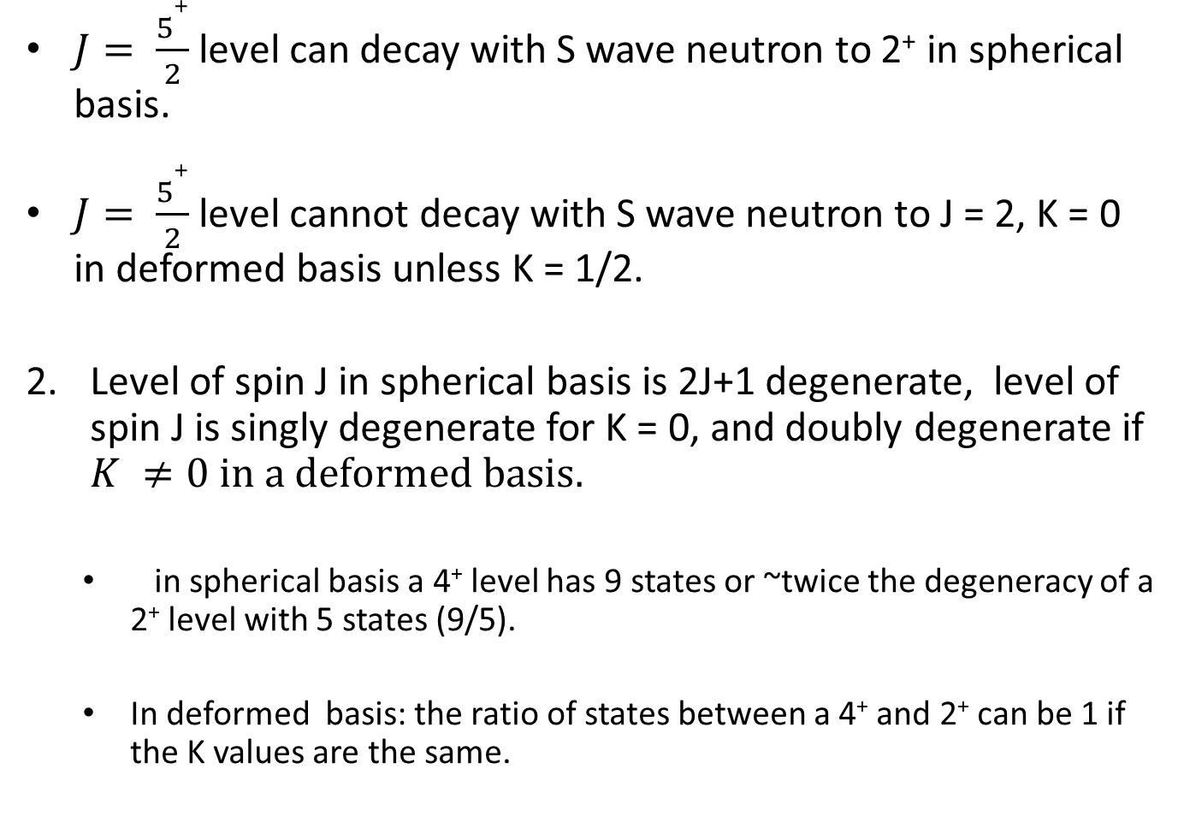
    $J= \frac{5+}{2}$level can decay with S wave neutron to 2⁺ in spherical basis.
$J= \frac{5+}{2}$ level cannot decay with S wave neutron to J = 2, K = 0 in deformed basis unless K = 1/2.
Level of spin J in spherical basis is 2J+1 degenerate, level of spin J is singly degenerate for K = 0, and doubly degenerate if $K ≠0 in a deformed basis.$
  in spherical basis a 4⁺ level has 9 states or ~twice the degeneracy of a 2⁺ level with 5 states (9/5).
  In deformed basis: the ratio of states between a 4⁺ and 2⁺ can be 1 if the K values are the same.

Slide 9
Ratio can be 2 if for 4⁺, K ≠ 0 and 2⁺, K= 0
Ratio can be 0.5 if for 4⁺, K = 0 and 2⁺, K ≠ 0
Cross sections for nearby levels of same J^{π} can differ by a factor of 2 if one has K = 0 and the other has K ≠ 0.
For odd A, K = 0 is not allowed. All degeneracies are equal!

Slide 10

Calculations have been done for:
n+ ¹⁶⁸Er
n + ¹⁸³W
n + ¹⁸²W
n + ²⁵Mg
α + ²²Ne
For:
  0.5 MeV $≤E_{n}≤$ 15 MeV and
  $3 MeV≤E_{α }≤15 MeV$

Slide 11
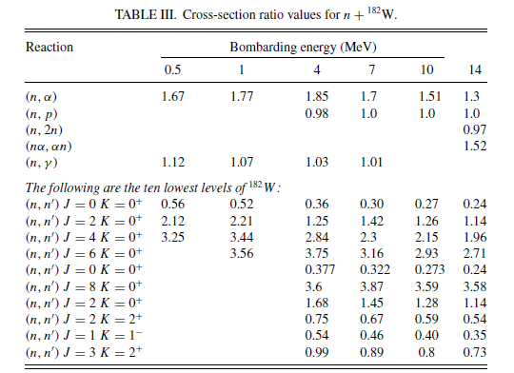

Slide 12
General Trends
Continuum effects small on shape and magnitude.
Average J of continuum states changes by 20-30%
Large J resolved states reduced.
Small J states enhanced.

Slide 13
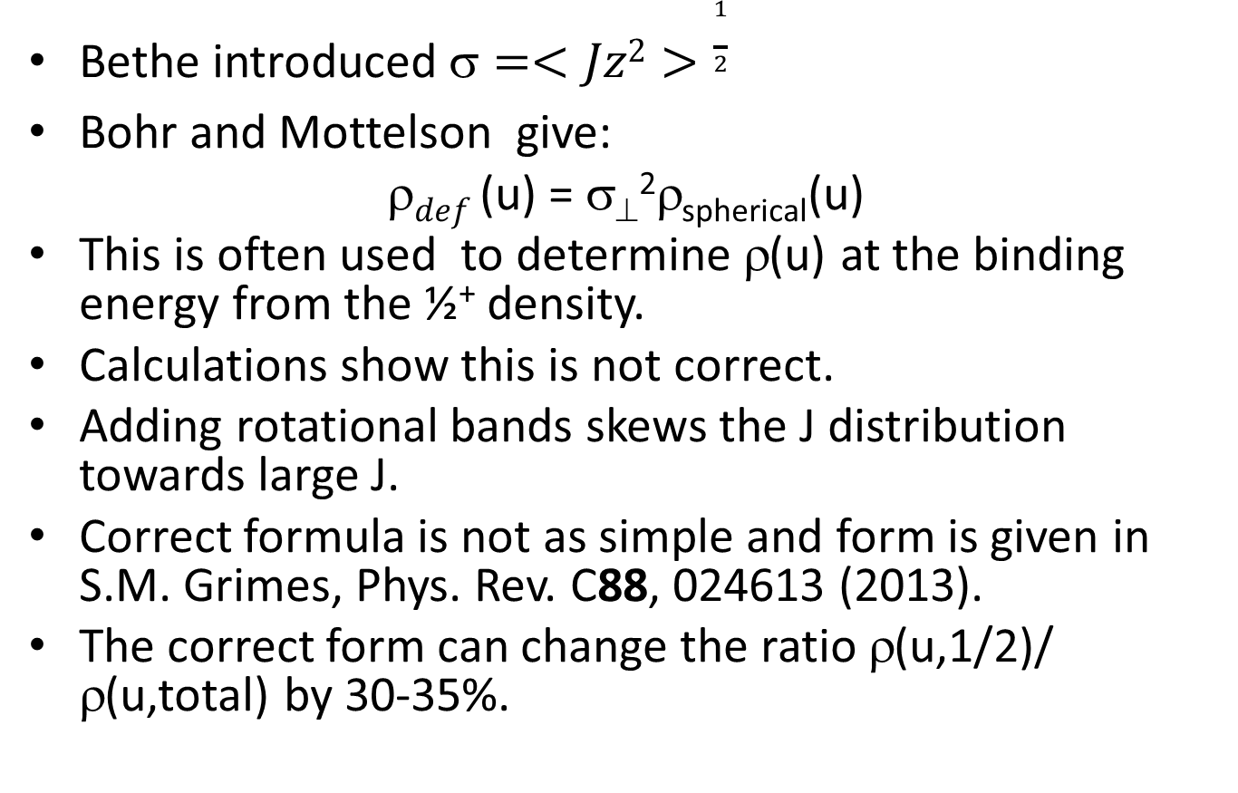
Additional Discovery
Bethe introduced $=<Jz2>\frac{1}{2}$
Bohr and Mottelson give:
$def$ (u) = σ⊥²ρ_{spherical}(u)
This is often used to determine ρ(u) at the binding energy from the ½⁺ density.
Calculations show this is not correct.
Adding rotational bands skews the J distribution towards large J.
Correct formula is not as simple and form is given in S.M. Grimes, Phys. Rev. C88, 024613 (2013).
The correct form can change the ratio ρ(u,1/2)/ ρ(u,total) by 30-35%.

Slide 14
Comparison of results with no K mixing, moderate K mixing and complete K mixing shows low sensitivity to mixing.
Complete K mixing does not restore results to traditional Hauser-Feshbach .
No calculations have been made yet for fissionable nuclei.

