Slide 1
A study of the Absorption Cross Section of Iron using Two Techniques
S. M. Grimes
Ohio University

Slide 2
Pulsed Sphere
  A pair of iron spheres were pulsed with 1, 6 , 8, and 10 MeV neutrons.
  Output Neutrons measured at 8 angles from 0º to 135º .
  Due to Multiple scattering the flight path is uncertain.
  A Monte Carlo code and cross section library are used to calculate the arrival time of the neutrons.

Slide 3
Two types of information:
  Pass through peak
    Good statistics
    Depends on the nonelastic cross section
    Some have one elastic scattering.
  Have lower energy continuum resulting from (n,n’), (n,2n), (n,pn), (n,αn).

Slide 4
Situation Simple at 14 MeV
Cross Section for T(d,n) almost isotropic
Energy almost independent of angle
Very small production of neutrons with E_{n} < 14 MeV

Slide 5
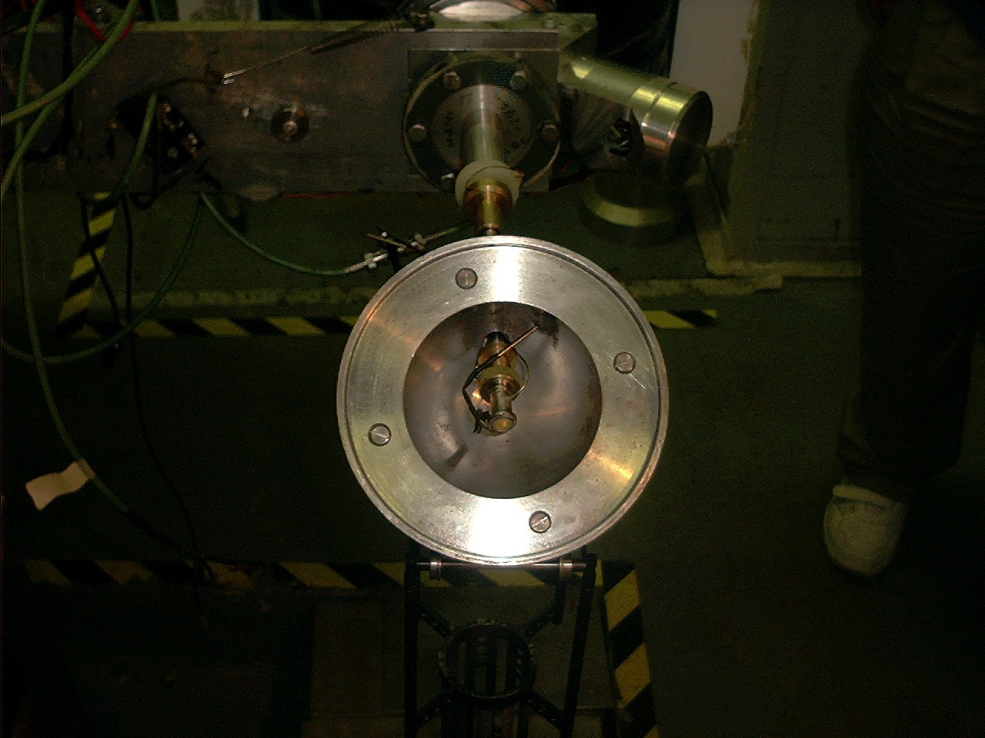

Slide 6
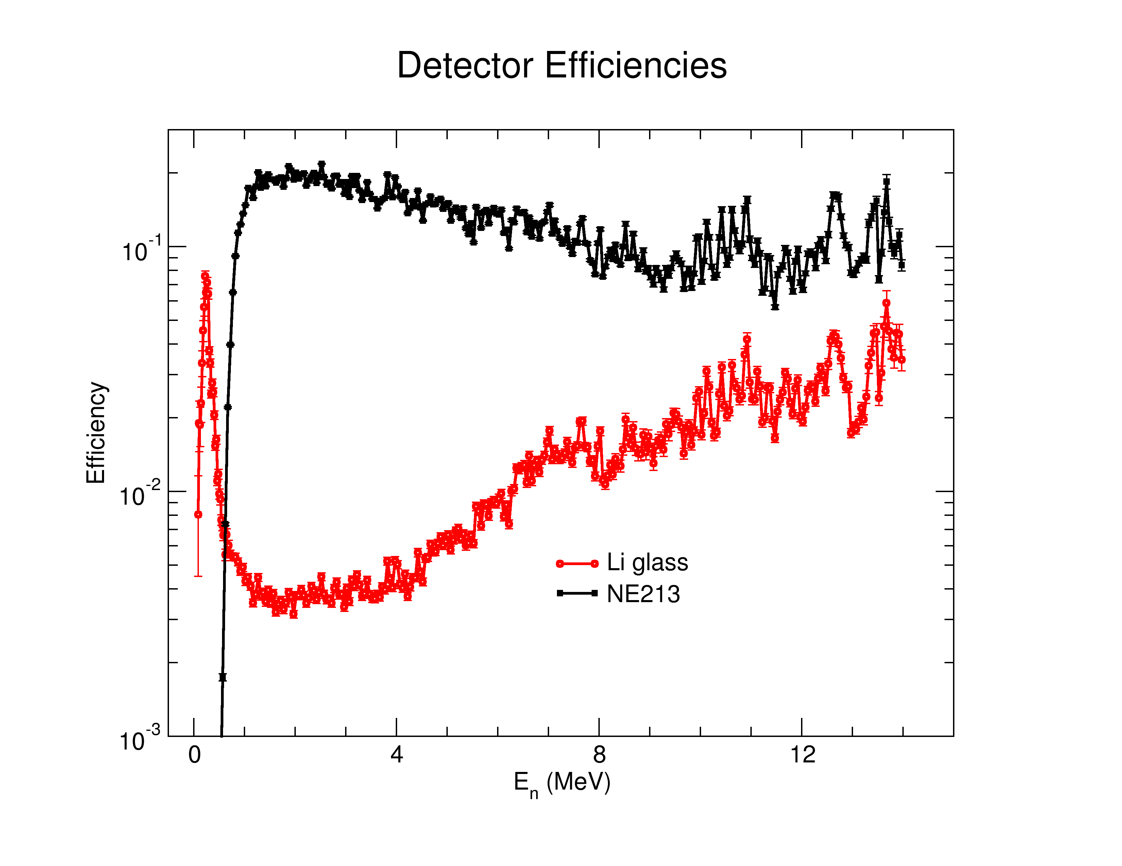

Slide 7
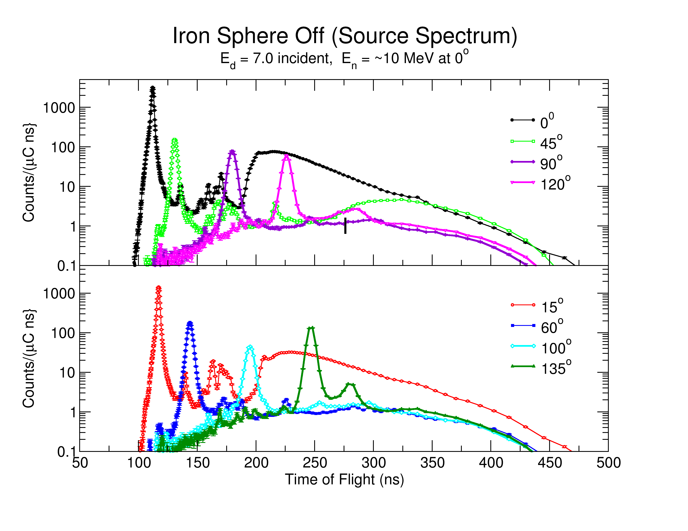

Slide 8
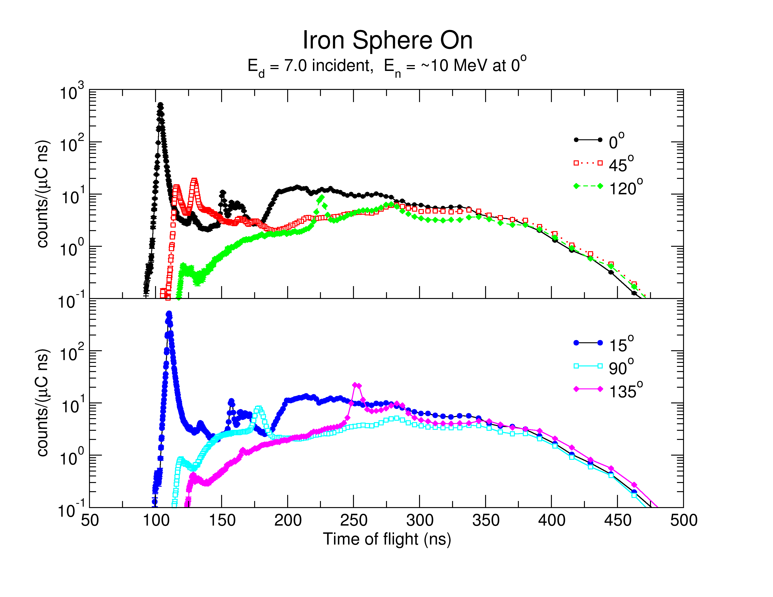

Slide 9
Present Results
1 MeV: used ¹⁵N(p,n) small cross section except for primary peak.
6, 8, 10 MeV: used D(d,n) source
  large change in σ with angle,
  large change in E_{n} with angle,
  significant break-up in forward direction,
  Sphere Off (source spectrum) measured for 12 angles.

Slide 10
Present Results: continued
  Subsequently found angular interpolation method not unambiguous,
  Needed more angles on sphere off or better physics ,
  Makes “inelastic” comparison more uncertain
  Does not have substantial effect on pass-through peak,
  Range of energies tested is substantial,
  For 10 MeV, range was from 2.5 MeV (back angles) to 10 MeV 0º .

Slide 11
Findings:
The description good for 1 MeV, only has elastic and 2⁺ inelastic.
Capture small (n,p) and (n,α) small or zero
Description poor at 6, 8 and 10 MeV.
Indicates need to lower σ_{abs} for Fe by more than 10%.
Measurements are being repeated with more detailed Sphere-Off (source spectra) characterization.

Slide 12
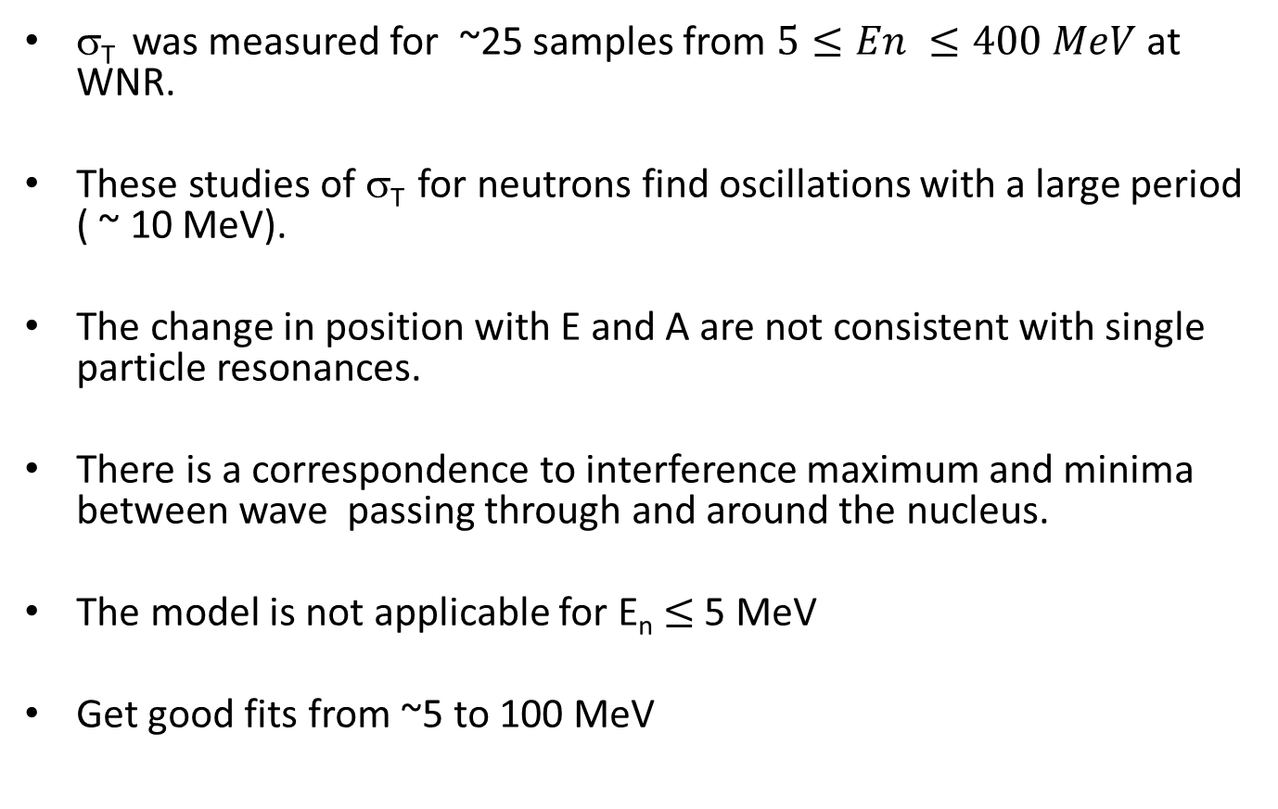
Ramsauer Analysis
σ_{T} was measured for ~25 samples from $5≤En ≤400 MeV$ at WNR.
These studies of σ_{T} for neutrons find oscillations with a large period ( ~ 10 MeV).
The change in position with E and A are not consistent with single particle resonances.
There is a correspondence to interference maximum and minima between wave passing through and around the nucleus.
The model is not applicable for E_{n} $≤$ 5 MeV
Get good fits from ~5 to 100 MeV

Slide 13
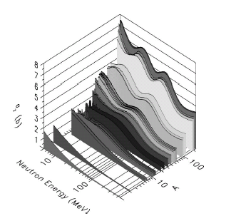
Total Cross Sections at WNR

Slide 14
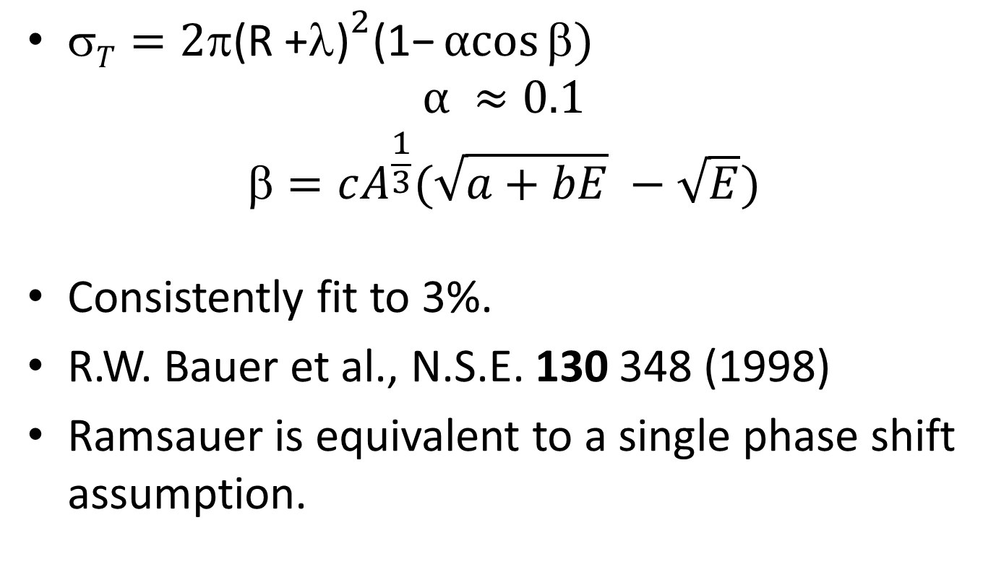
Ramsauer Form
$T=2π{\text{(}\text{R}\text{ +}λ\text{)}}^{2}\text{(1−}αcos{β})$
$$α ≈0.1$$
$$=cA_{}^{\frac{1}{3}}(\sqrt{a+bE} −\sqrt{E})$$
Consistently fit to 3%.
R.W. Bauer et al., N.S.E. 130 348 (1998)
Ramsauer is equivalent to a single phase shift assumption.

Slide 15
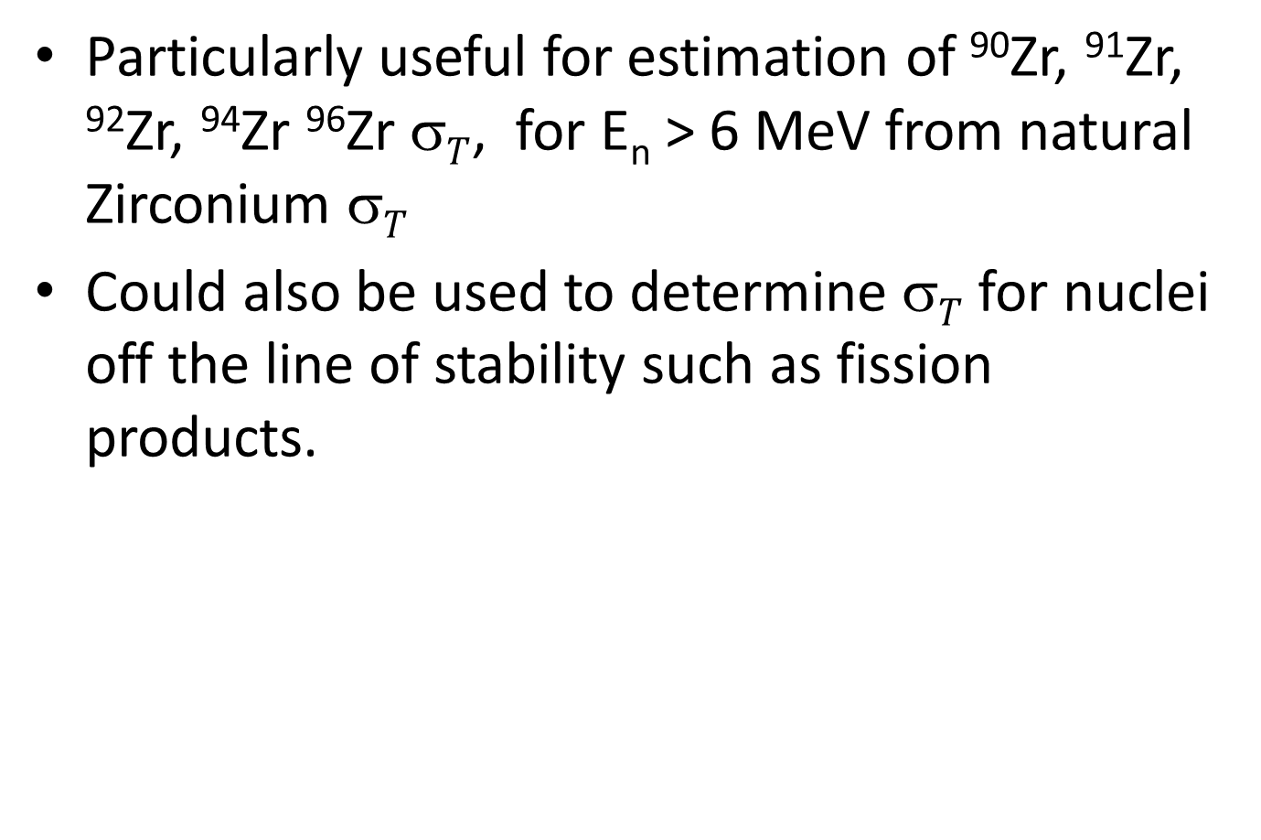
Particularly useful for estimation of ⁹⁰Zr, ⁹¹Zr, ⁹²Zr, ⁹⁴Zr ⁹⁶Zr $T$, for E_{n} > 6 MeV from natural Zirconium $T$
Could also be used to determine $T$ for nuclei off the line of stability such as fission products.

Slide 16
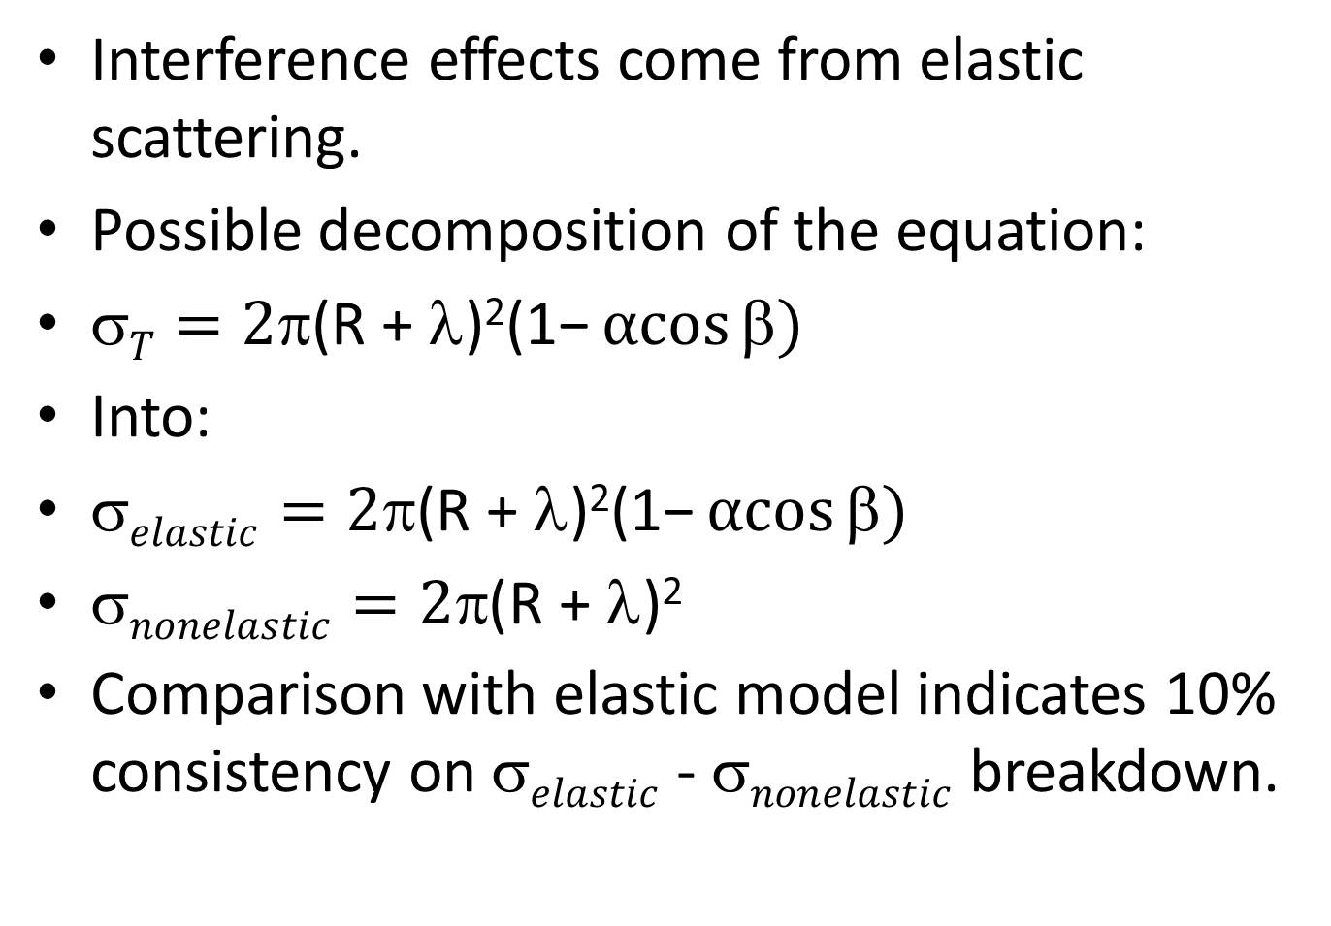
Interference effects come from elastic scattering.
Possible decomposition of the equation:
$T=2π\text{(}\text{R}\text{ + }λ\text{)}\text{2}\text{(}\text{1−}αcos{β})$
Into:
$elastic=2π\text{(}\text{R}\text{ + }λ\text{)}\text{2}\text{(}\text{1−}αcos{β})$
$nonelastic=2π\text{(}\text{R}\text{ + }λ\text{)}\text{2}$
Comparison with elastic model indicates 10% consistency on $elastic$ - $nonelastic$ breakdown.

Slide 17
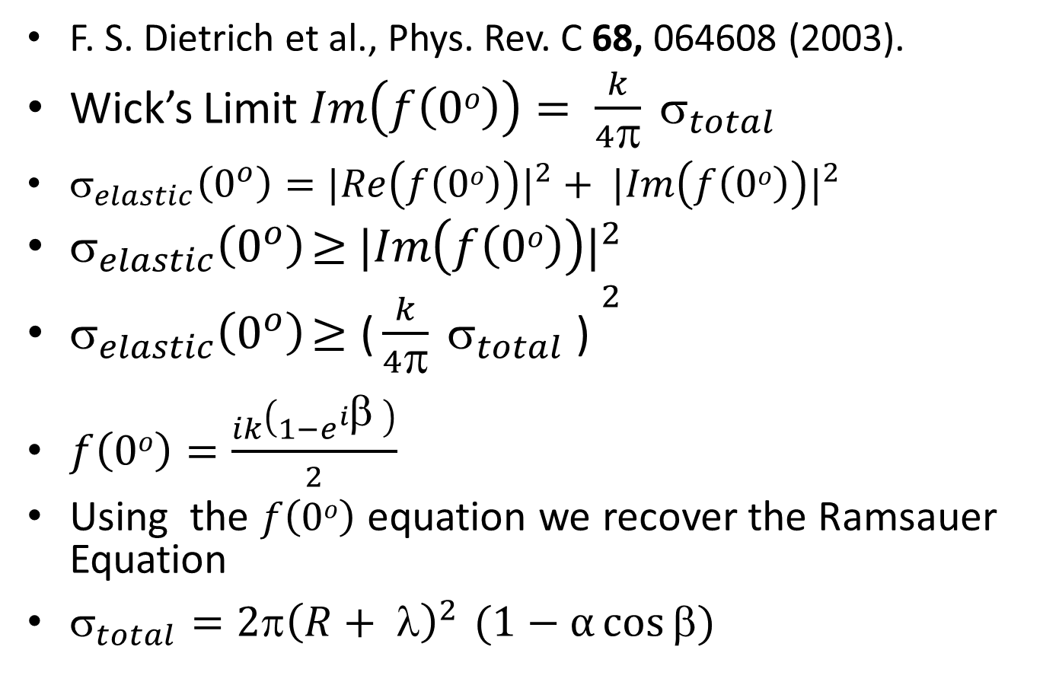
Alternate Method
F. S. Dietrich et al., Phys. Rev. C 68, 064608 (2003).
Wick’s Limit $Im\left(f\left(0o\right)\right)= \frac{k}{4π} σ_{total}$
$_{elastic}\left(0^{o}\right)={|Re\left(f\left(0o\right)\right)|}^{2}+ {|Im\left(f\left(0o\right)\right)|}^{2}$
$_{elastic}\left(0^{o}\right)$ $≥$ ${|Im\left(f\left(0o\right)\right)|}^{2}$
$_{elastic}\left(0^{o}\right)$ $≥{\text{(}\frac{k}{4π} σ_{total}\text{ ) }}^{2}$
$f\left(0o\right)=\frac{ik\left(1−e^{iβ} \right)}{2}$
Using the $f\left(0o\right)$ equation we recover the Ramsauer Equation
$_{total}=2π{\left(R+ λ\right)}^{2 }(1−α\cos{β)}$

Slide 18
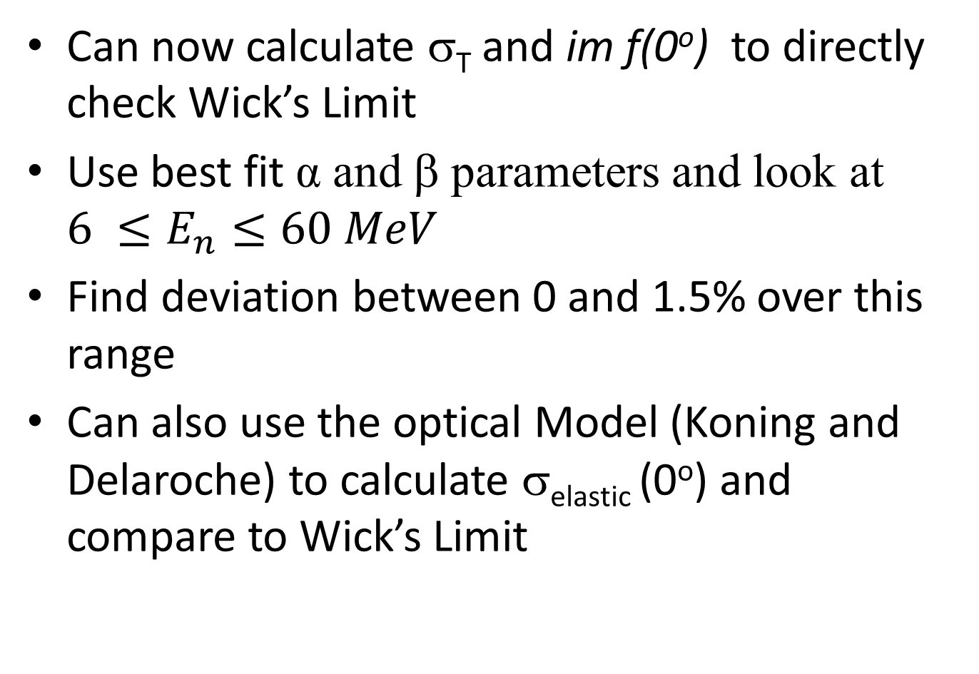
Can now calculate σ_{T} and im f(0º) to directly check Wick’s Limit
Use best fit α and β parameters and look at $6 ≤E_{n}≤60 MeV$
Find deviation between 0 and 1.5% over this range
Can also use the optical Model (Koning and Delaroche) to calculate σ_{elastic} (0º) and compare to Wick’s Limit

Slide 19
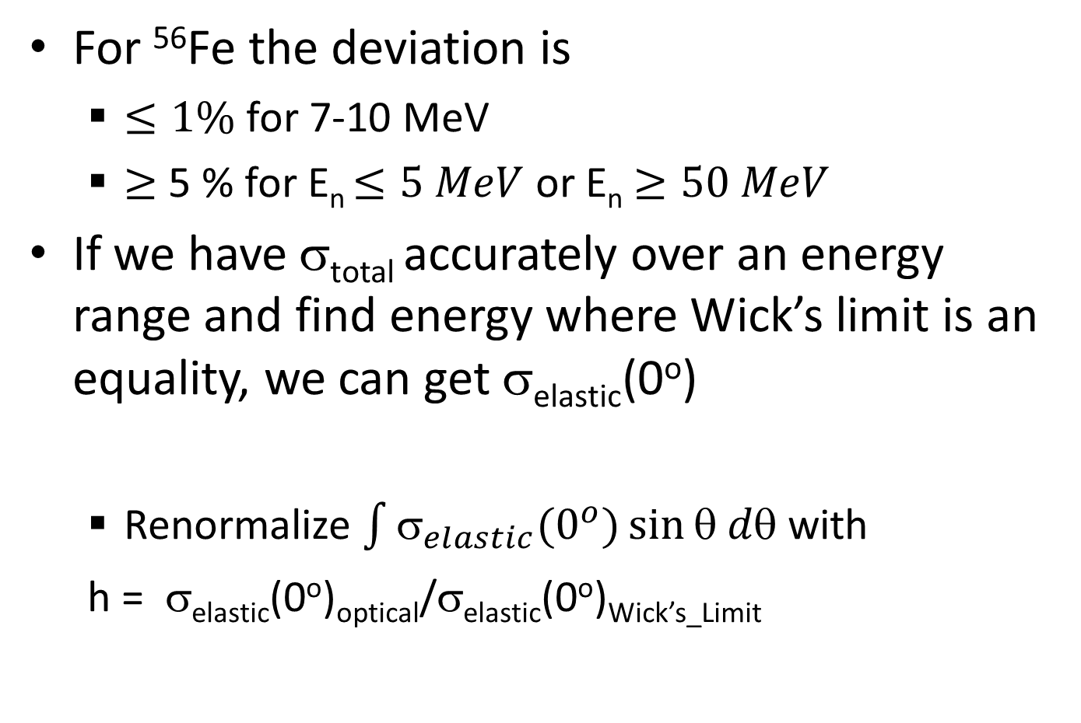
For ⁵⁶Fe the deviation is
  $≤1\%$ for 7-10 MeV
  $≥$ 5 % for E_{n} $≤5 MeV$ or E_{n} $≥50 MeV$
If we have σ_{total} accurately over an energy range and find energy where Wick’s limit is an equality, we can get σ_{elastic}(0º)
  Renormalize $\int{σ_{elastic}(0^{o}})\sin{θ dθ}$ with
  h = σ_{elastic}(0º)_{optical}/σ_{elastic}(0º)_{Wick’s_Limit}

Slide 20

Conclusion
Now get
$_{abs}= _{total} −h{elastic}_{}^{optical}$
This value is lower than $_{abs }$from ENDFB/VII by approximately 10% for 6 $≤$ E_{n} $≤$ 10 MeV.

Slide 21
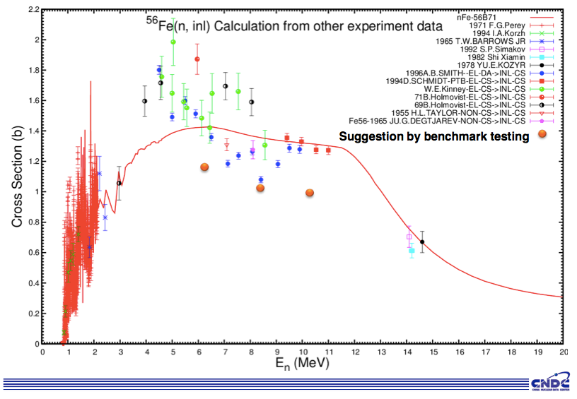


⁵⁶Fe: Fast Range - BNL and collaborators….
Many issues to work, as a new high energy evaluation is developed
Jing Qian: Conclusions from Ohio experiment on inelastic problematic?
Operated by Los Alamos National Security, LLC for NNSA

Slide 23
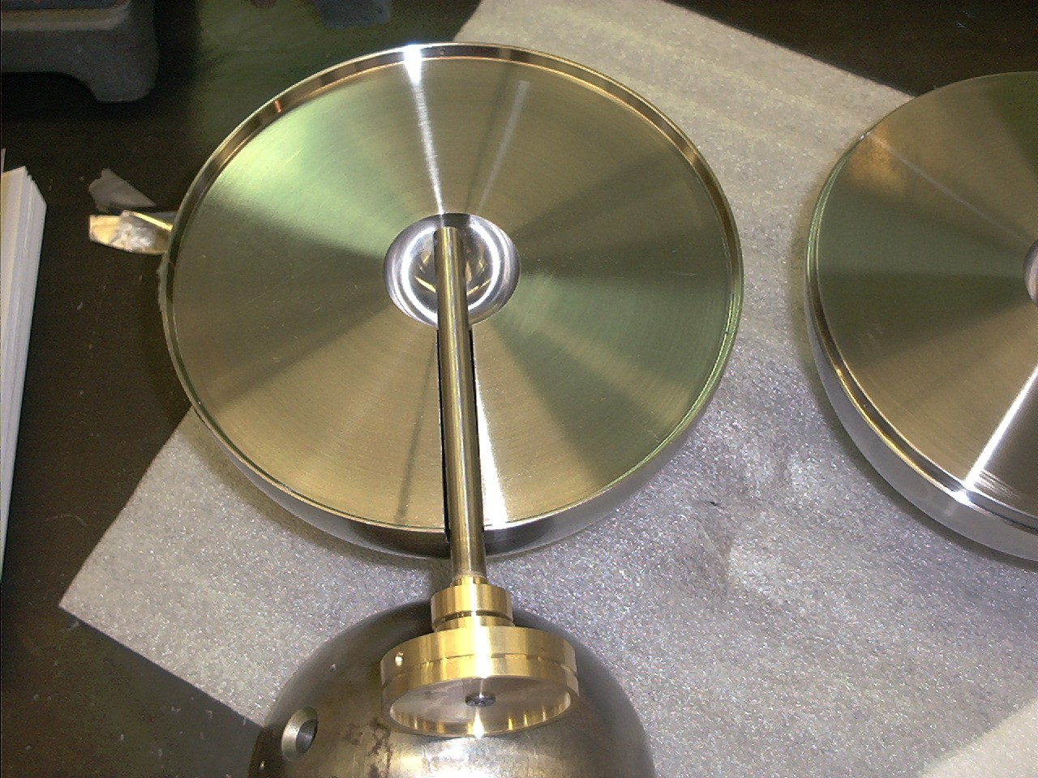

Slide 27
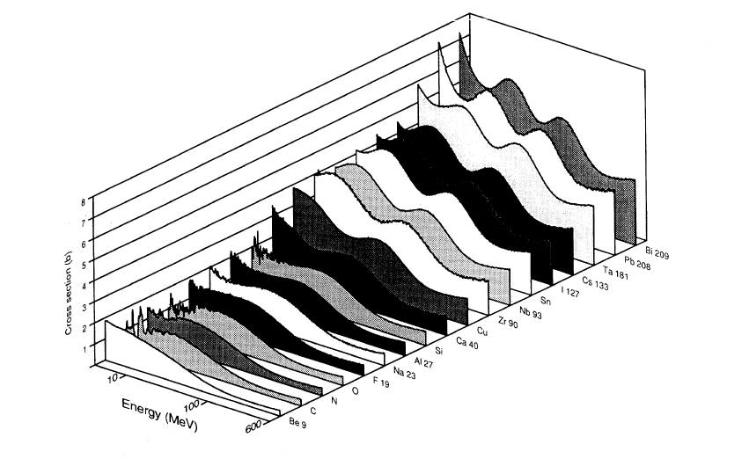
High accuracy total cross section measurements.
R. W. Finlay et al., PRC 47, 237(1993)

Slide 28
Total Cross Sections at WNR

