Slide 1




CSEWG Meeting, Nov 3-5, 2014
Nuclear Data Sheets:
10 Years of Special Issues on Nuclear Reaction Data
Pavel Obložinský
SAS Bratislava and
Brookhaven National Laboratory
Brookhaven Science Associates

Slide 2
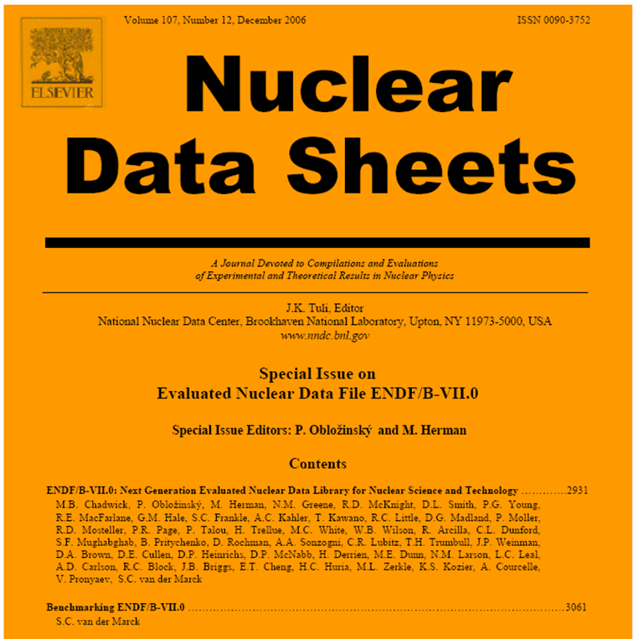
Nuclear Data Sheets
What happened in 2006?
ENDF/B-VII.0 release was underway, desire to document new library in the refereed journal, initial thoughts were to try NSE or PRC, later replaced by innovative idea to publish in Nuclear Data Sheets.
Stormy CSEWG-USNDP session
in Nov 2006, decision was made
to replace Dec issues on NSR by
Special Issues on Nuclear Reaction
Data.
1-st issue published in Dec 2006,
very first paper was „Big paper“
on ENDF/B-VII.0, by far the most
cited paper in the whole series.

Slide 3
Special Issues of Nuclear Data Sheets
Profile and modus operandi
We publish one issue per year, typically 250 pages. Papers are prepared in LaTeX using NDS template, publishing format is dense.
Space for extensive, in-depth reference papers (often > 100 pages) or collection of papers on selected topic of considerable interest.
Basic policy: „papers by invitation only“, with potential for considerable impact, selection consulted with leading members of the community, approved by the CSEWG Executive Committee.
Careful editorial process (editor follows preparation of extensive papers closely, all papers are pre-reviewed before official submittal).
Careful refereeing process (critical review by 1-3 referees depending on paper complexity, due time for iterations with the authors, virtually every paper is revised before acceptance → takes 2-4 months).
Photo-ready issue is assembled by the NNDC, inspected and checked by the editor and other people, then submitted to Elsevier.

Slide 4
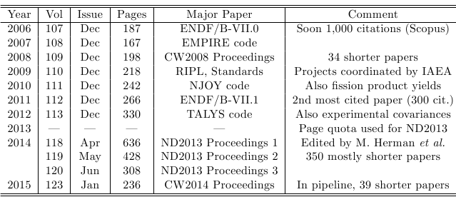
10 years of NDS Special Issues
Major papers

Slide 5
10 years of NDS Special Issues
Major topics
Evaluated libraries & evaluations
(ENDF/B-VII.0, ENDF/B-VII.1, RIPL, Standards, U-
evaluations, …)
Evaluation methods & tools
(EMPIRE, TALYS, NJOY, Covariance methodology, …)
Proceedings of important US meetings
(CW2008, ND2013, CW2014)
Specific hot topics
  Fission product yields (M. Chadwick et al, 2010)
  Experimental covariances (D. Smith et al, 2012)

Slide 6
Most cited papers (Scopus)
Papers can be put into 5 broad categories:
ENDF/B-VII.0 library (Chadwick, 2006) 955 citations
ENDF/B-VII.1 library (Chadwick, 2011) 280
RIPL library (Capote, 2009) 260
EMPIRE code (Herman, 2007) 230
NJOY code (MacFarlane, 2010) 70
Standards library (Carlson, 2009) 66
ENDF/B-VII.0 testing (vd Marck, 2006) 41
Low-fi covariances (Little, 2008) 31
ENDF/B-VII.1 testing (Kahler, 2011) 31
SCALE-6 covariances (Williams, 2008) 30
TALYS code (Koning, 2012) 26
Other papers <15

Slide 7
Status and future plans
Jan 2015: CW2014 Proceedings – in pipeline (processing of papers completed, contents finalized, issue being assembled)
Jan 2016: major topic fission – potential papers under discussion, to be blessed by CSEWG, submittal of papers in summer 2015
CRP results on PFNS, lead R. Capote, 70 pages, confirmed
GEF code for fission observables, lead KH Schmidt
Bruyeres-le-Chatel actinide evaluations, lead P. Romain
CCONE code, lead O. Iwamoto, 25 pages
Chi-Nu experimental analysis, lead D. Neudecker, 25 pages
TUNL FPY measurements, ...
Jan 2017: major topic CIELO – papers on evaluations and testing

Slide 8
Conclusions
In 10 years Nuclear Data Sheets established itself as respected publishing medium for nuclear reaction data community.
We have solid plans for near future. Longer perspective is under questionmark due to considerable decline in ENSDF evaluations which threatens the very existence of NDS.
Before we move into the 2nd decade, broader discussion about NDS Special Issues (profile, publishing policy, one issue per year, ...) would be useful.
Acknowledgements: Support and assistance of the NNDC staff (J.Tuli, M.Herman, B.Pritychenko,...) is appreciated.

