Slide 1
Jets and Heavy Flavor WG Meeting
June 22, 2020
Talk by Joe Osborne - update on jet substructure and
hadronization studies
2. Talk by Haitao Li – transverse energy-energy correlators in DIS, a new observable
3. Post Pavia discussion – collection of kinematic maps, virtual Miami meeting, YR outline
4. DNP Fall meeting, EIC mini-symposium

Slide 2
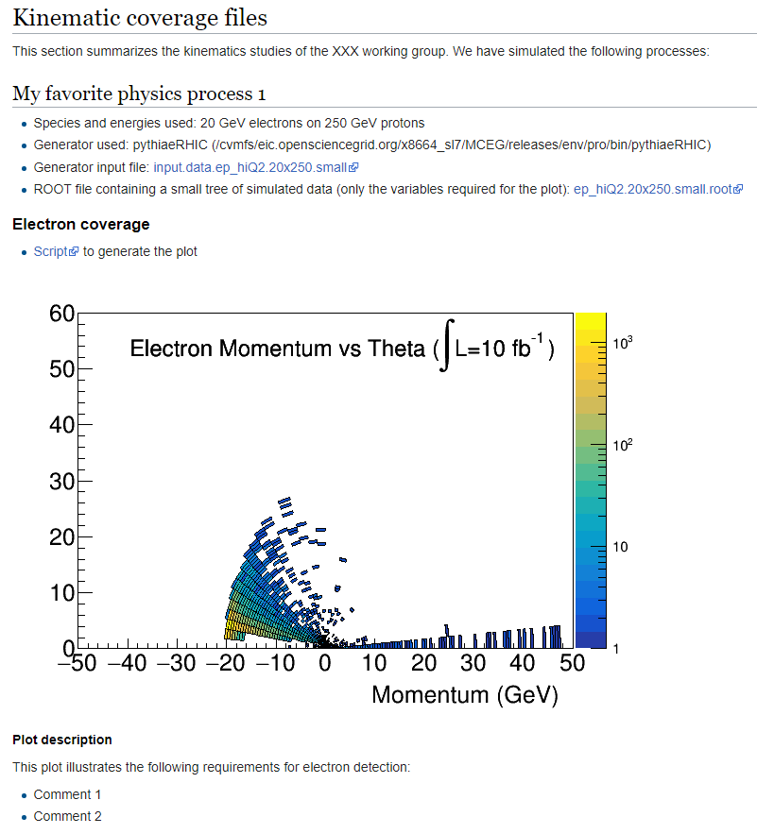
Post Pavia Activities
For kinematic maps
provide
Wiki-page template at:
https://wiki.bnl.gov/eicug/index.php/Yellow_Report_Physics_Common#Kinematic_coverage_files
Species and energies used
Generator used
(location if available)
Generator input file
ROOT file with tree to produce plots
Scripts to produce kinematic plots
Had discussion of difficulties of producing such plots uniformly

Slide 3
Some Developments
Software - guidance
During our April 15 meeting, the use of a single tool was requested by the different WGs EICsmear was favored within the PWG
The Software WG is fully supporting EICsmear,cwith documentation, and (soon) versioning according to the DWG detector matrix
Backgrounds – suggestions needed
How are backgrounds being considered/simulated at the moment ? Suggestions/ideas for a global strategy ?
Detector complementarity – care must be taken in defining the needs
Optimal detector requirements: coverage, resolution, PID...
Minimum detector requirements: when does physics “break”?
What will be driving your systematics

Slide 4
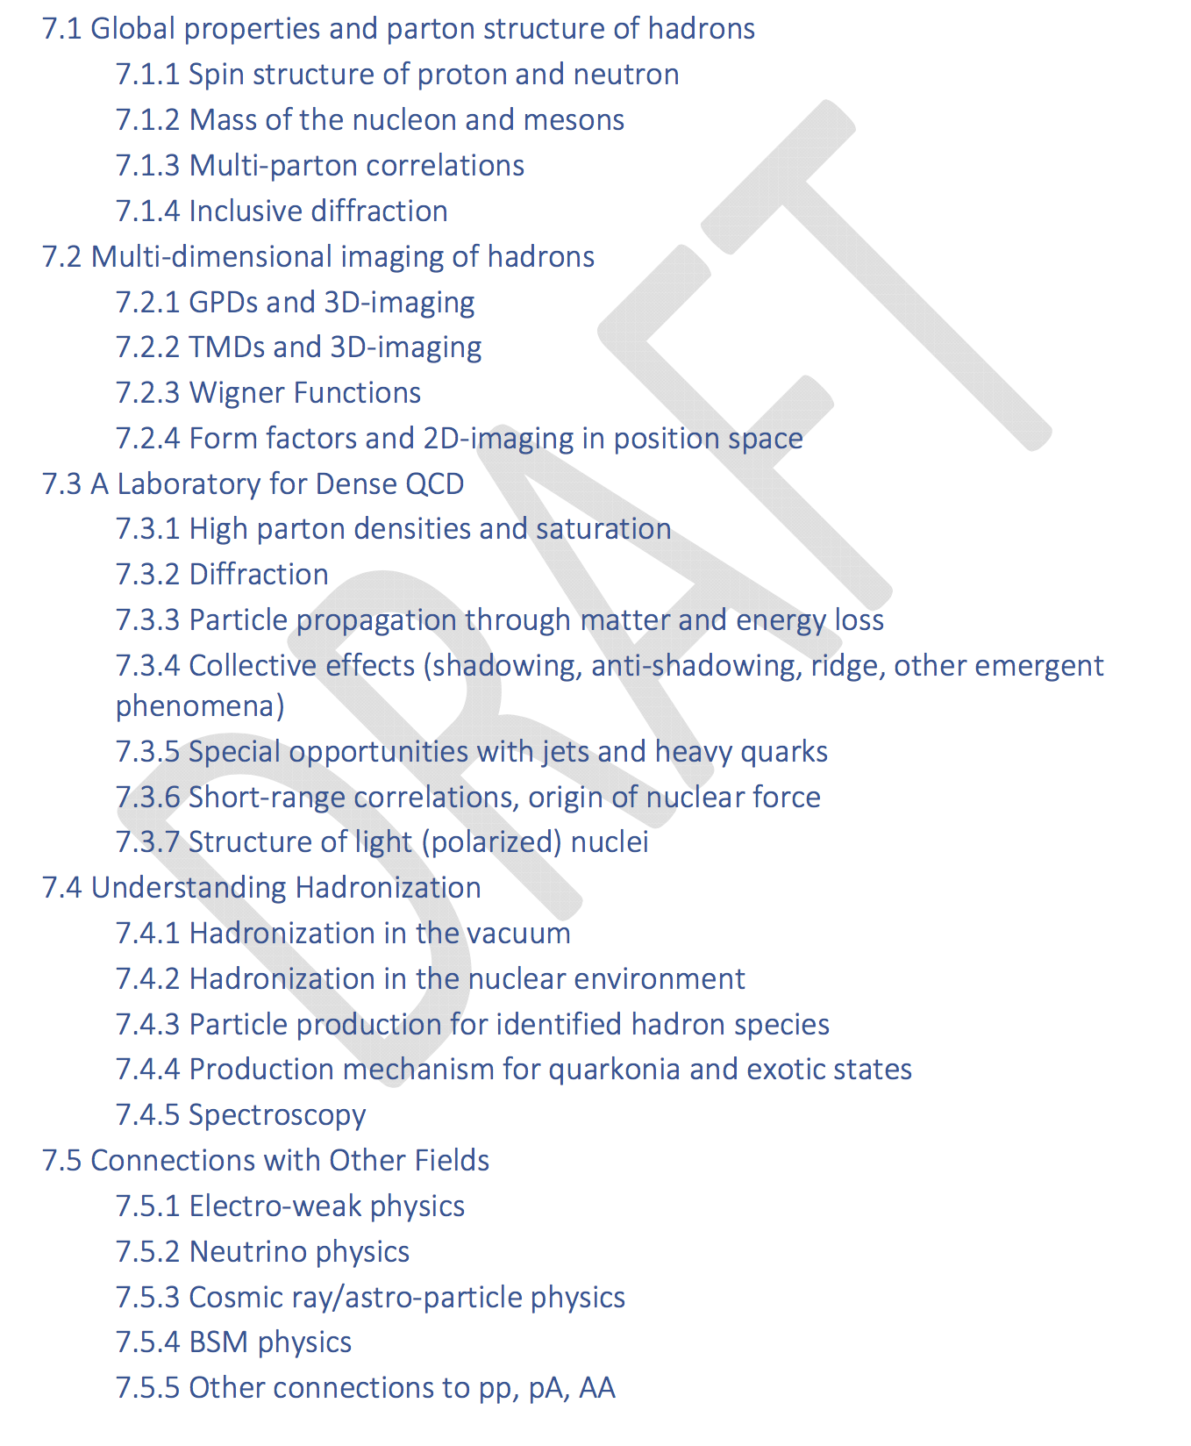
YR Outline
Outline exists on the YR website
PWG conveners informed us that they will provide some templates

Slide 5
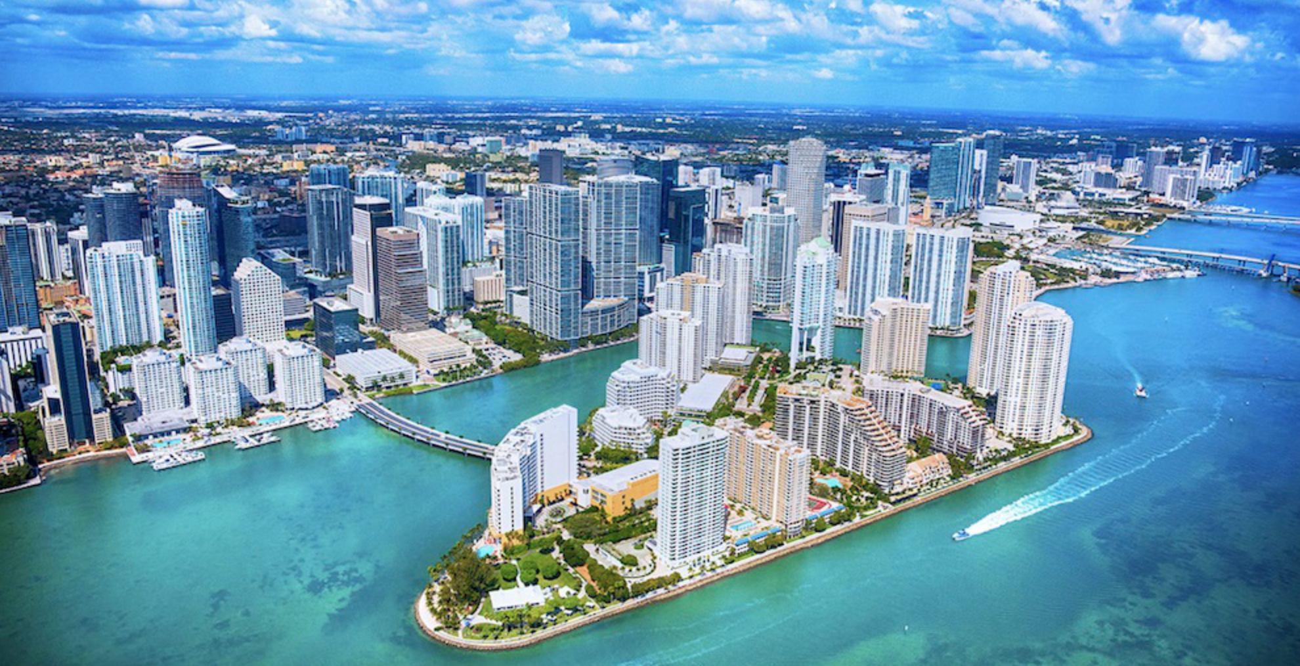
Miami Meeting
On-line meeting – mimics YR meetings,
“Miami Summer Meeting July 15-17
https://indico.bnl.gov/event/7352/
Day 1 – Plenary
Day 2 – Institutional board session (10AM-12PM EDT)
Day 3 – Yellow Report Updates
Morning: 9AM-12PM / 3h
Welcome / Status update EICUG / Science
Funding agency presentation: DOE / NSF
Countries / Funding agency representatives: Poland, Germany, Czech Republic, India
Afternoon: 1-4 PM / 3h
Project update
Machine
IB news and updates – C. Aidala and A. Bressan
Call for Expressions of Interest: Q&A
Expressions of Interest: Contributed presentations
from IB representatives
Towards formation of experimental collaborations
Updates from different WGs
Joint PWG+DWG sessions
Discussion on the YR outline

Slide 6
DNP Fall meeting
2020 Fall Meeting of the APS Division of Nuclear Physics
October 29-November 1, 2020
Mini-Symposium: A US-based Electron-Ion Collider (EIC): Physics and Detectors
Abstract submission:
June 26, 2020 - Abstract submission deadline!

