Slide 1
sPHENIX Project Calendar
  PRR Inner HCal Sector Assemblies and End Rings Jun 11
  PRR End Cap/Pole Tip Review Jun 15
  PDR AC/DC Power Distribution Jun 17
  PRR Cryo Deck Engineering Review Jun 19
  DOE Monthly Jun 24
  POB Jun 26
  Practice for MIE Annual Review Jul 10
  FDR Large support rings, Magnet Install & Support, EMCal Install fixture Jul 22
  sPHENIX MIE Annual review Wk of Jul 27
    Expect to have an annual MVTX review in September
    Also anticipate annual I&F review in October/November.
  IHCal Assembly and install fixtures mid-late Aug

Slide 2
sPHENIX Status
sPHENIX Personnel back on-site to work today
UIUC reopened May for EMCal block factory. New blocks have been sent to BNL this month.
SBU research (TPC) opened last week.
Vanderbilt (TPC) open
Wayne State Univ (TPC) open
Weizmann Inst Science (TPC) open
GSU research (HCal tile testing) reopened June 15
EMCal W powder delivered to UIUC June 5. Milestone tied to PEMP notable
  100% of MIE tungsten powder received.
  100% of SiPM received
  67% of OHCal tiles received. Balance due at GSU by end of July.
  61% of scintillating fiber received

Slide 3
sPHENIX Status - continued
MVTX stave production has restarted at CERN.
Preparations underway to ship all 60 MVTX Readout units from CERN to BNL.
Plan to place the sPHENIX beam pipe order before the end of June.
We will continue to hold remote reviews for major orders
Continue monthly status, EV, PCR for both 1.X and 2.X
The April status showed no change in the early completion dates of the 1.X or 2.X 1008. Both the 1.X and 2.X show the early completion dates slip in initial May status report.
I-5/7 job search continues

Slide 4
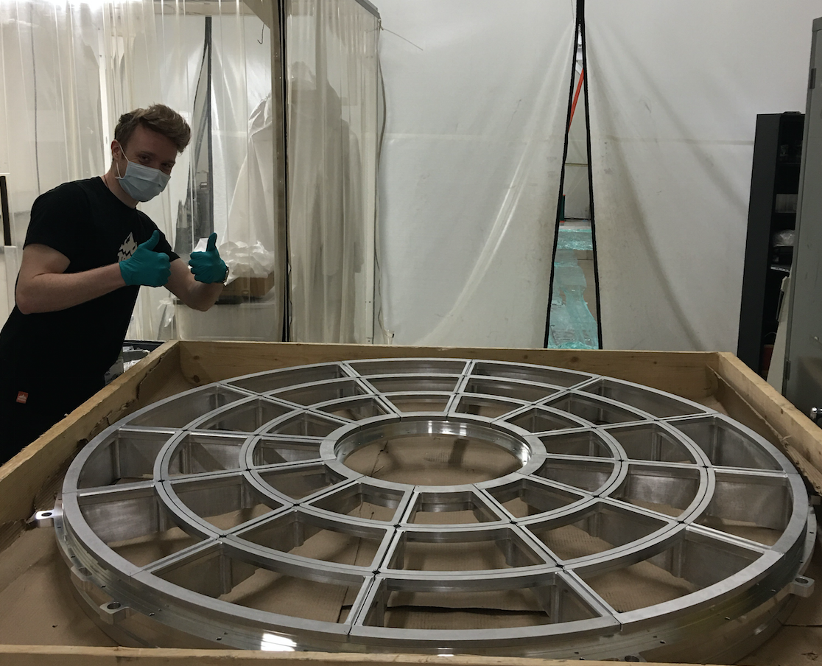
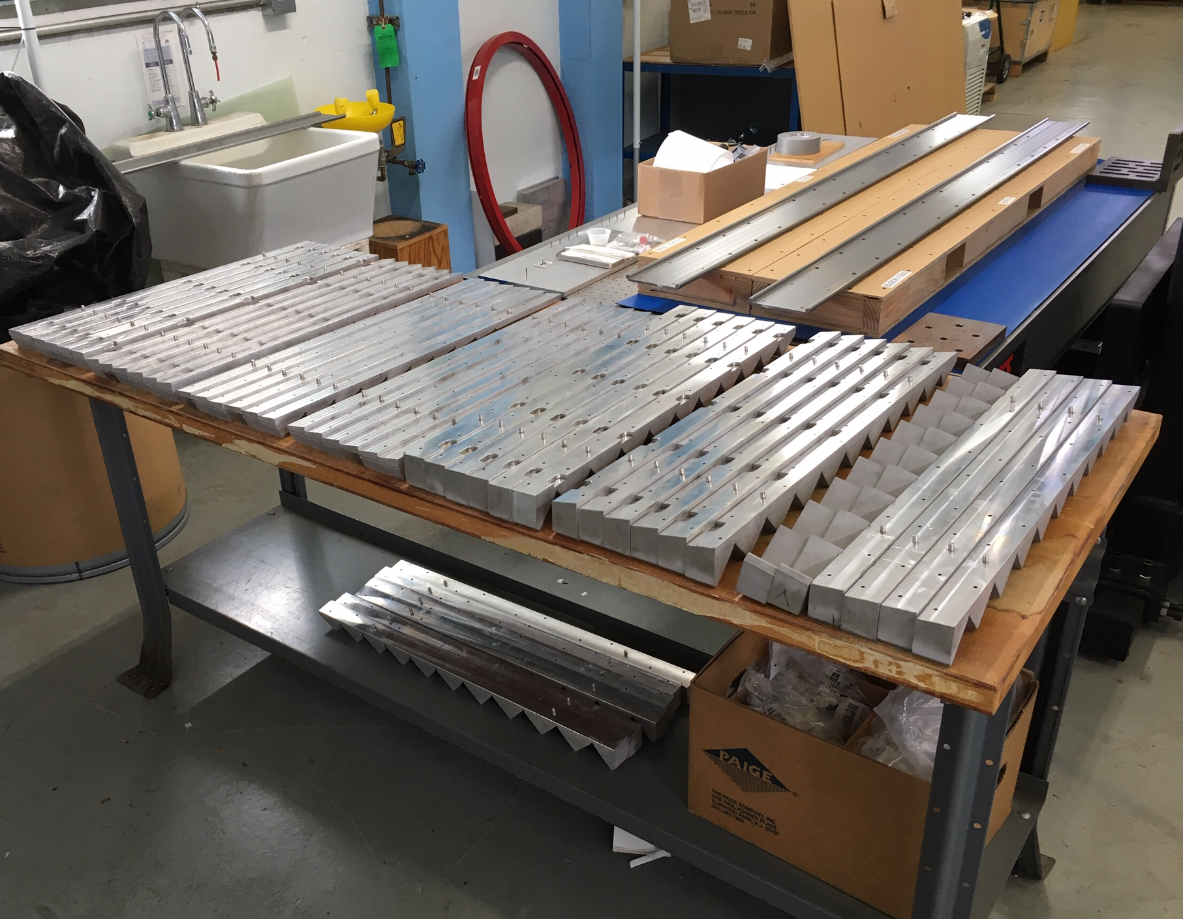
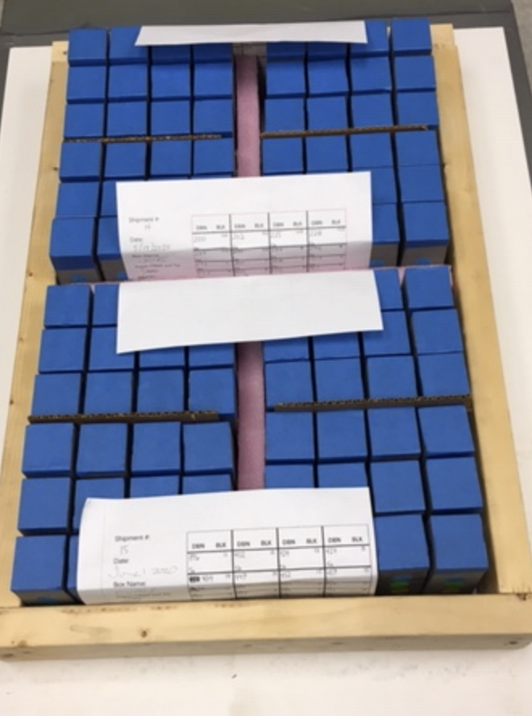
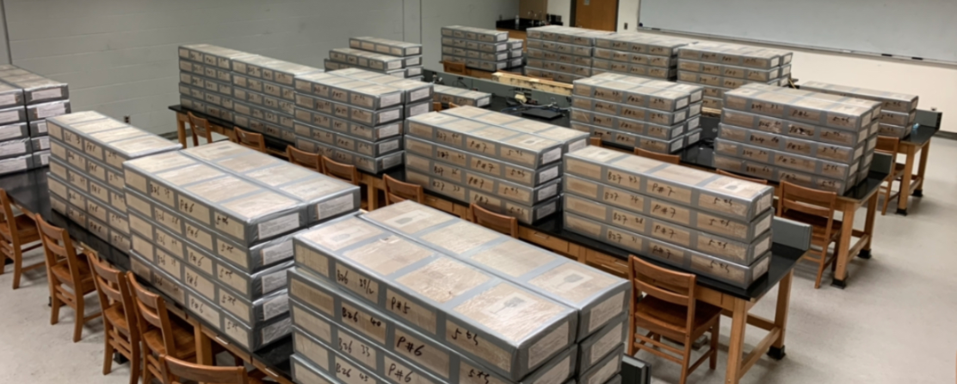
sPHENIX Accomplishments – in pictures
Mechanics for 1st 12 EMCal sectors
TPC Big Wheel w/ all GEM strongbacks
Mechanics for 1st 12 EMCal sectors
1 of 3240 new SiPM daughter boards
96 new EMCal blocks from UIUC
1300 New OHCal tiles at GSU

Slide 5
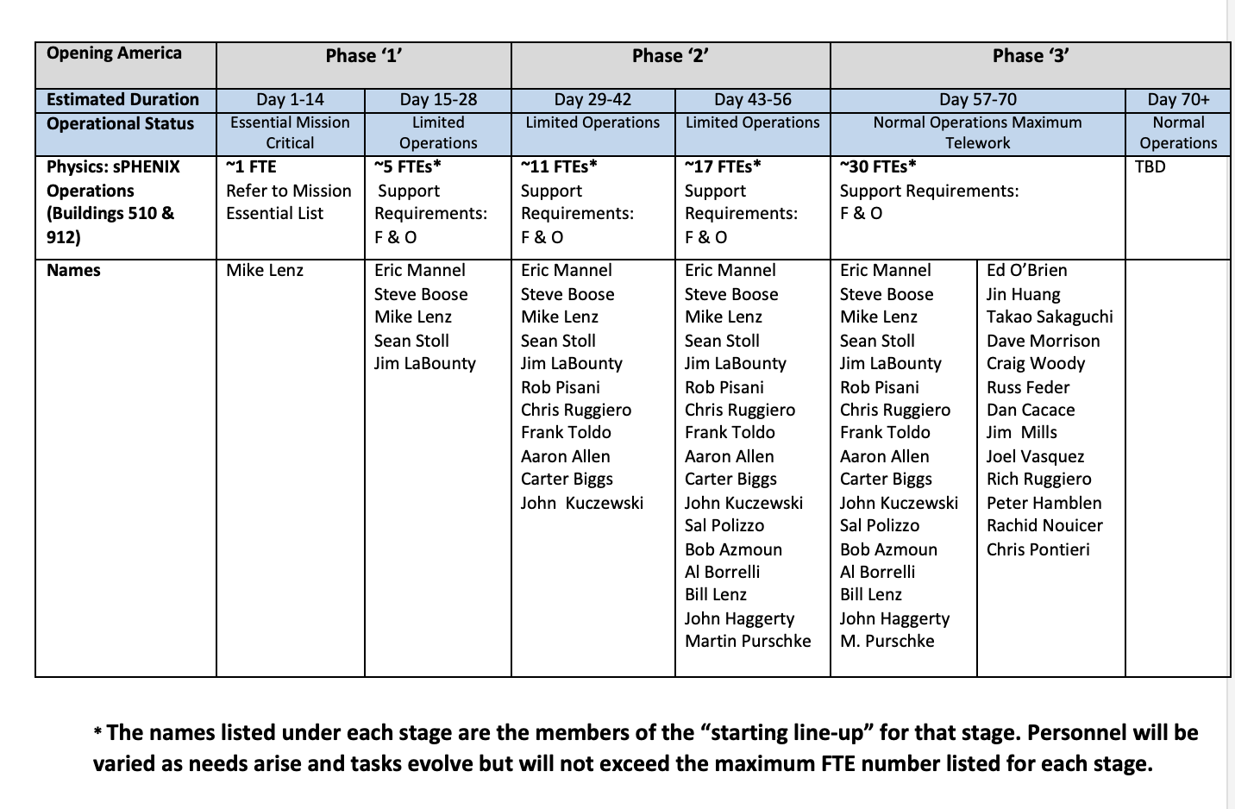
sPHENIX Plans for BNL Reopening
Day 1 = June 4
Day 15= June 18
Day 29 = July 2
Day 43 = July 16
Day 57 = July 30
Day 71 = Aug 13

Slide 6
sPHENIX Restart
sPHENIX will get 5 FTEs on site as part of the phase-1 stage-2 re-start, today, Thurs June 18.
Our priority upon BNL reopening is:
  Phase-1, Stage-2
  Testing of electronics, especially the EMCal SiPM daughter cards
  Restart of the EMCal factory.
  Phase-2, Stage-1
  Restart of the HCal factory
  TPC cooling tests, TPC electronics tests
  Phase-2, Stage-2
  DAQ/Trigger tests
  Cable production, build prototype crates
  Phase -3
  Even if most of the group is allowed access to BNL, most will be encouraged to work remotely whenever possible.

Slide 7
Plans for Continuation of RHIC 2020 Run
RHIC Run2020B is starting this week
Expect Run2020B to last until mid to late September.
  This will impact time available for sPHENIX to work in the 1008 IR between now and 2023.
    Tying in the He system in 1008B to RHIC 2021 shutdown ( 8 weeks)
    Hanging the helium transfer lines on the 1008 west wall 2020 shutdown (12 weeks)
    Installing cryo lines between 1008B and 1008 2020 shutdown (12 weeks)
    Concrete work on 1008 IR tracks 2020 shutdown (12 weeks)
  Recent assessment by independent engineering firm is that the reinforcement of the IR and assembly hall tracks will take 24 weeks. This makes the optimization of the schedule and work plan to enable cryo installation and track reinforcement to go on in parallel even more imperative.
We have asked BNL Management for 34 weeks of access to the IR to complete these 4 tasks. The 34 weeks would include one contiguous 24 weeks period after the 2020 run, and 10 weeks between the 2021 and 2022 run.
Need to set the Run 2020B, 2021, 2022 schedule with CAD and ALD

Slide 8
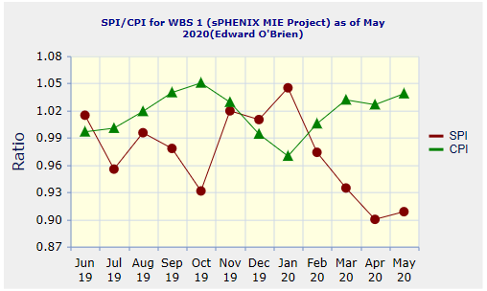
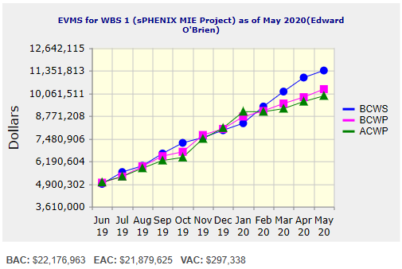
Performance Indices – sPHENIX MIE
Cumulative SPI | Cumulative CPI
0.91 | 1.04
Cumulative BCWS (Scheduled) | $11,355,488
Cumulative BCWP (Performed) | $10,296,583
Cumulative ACWP (Actual) | $9,912,716
DOE SPI or CPI Value Thresholds
0.90 to 1.15
0.85 to 0.89 or 1.16 to 1.25
<0.85 or >1.25
Despite the multi-month pandemic shutdown, the MIE early completion date has only slipped 1 month as of the May close. There remains 13 months schedule contingency to PD-4

Slide 9
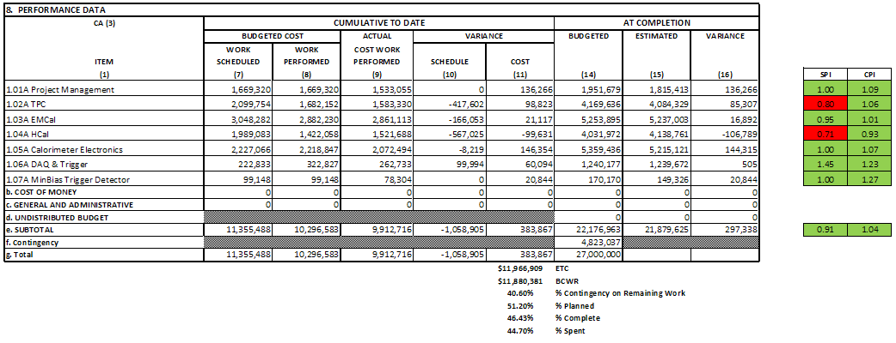
Cost Performance Report (CPR) – sPHENIX MIE
DOE SPI or CPI Value Thresholds
0.90 to 1.15
0.85 to 0.89 or 1.16 to 1.25
<0.85 or >1.25

Slide 10
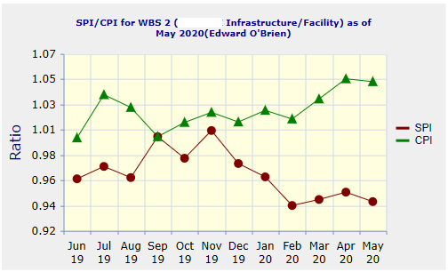
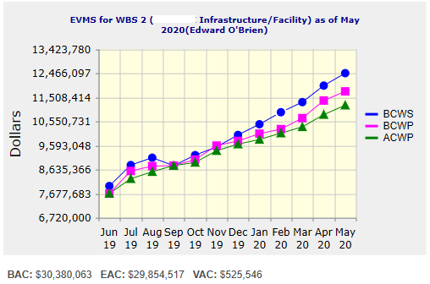
Performance Indices – 1008 Infra and Facility Upgrade
Cumulative SPI | Cumulative CPI
0.94 | 1.05
Cumulative BCWS (Scheduled) | $12,469,843
Cumulative BCWP (Performed) | $11,745,215
Cumulative ACWP (Actual) | $11,194,750
DOE SPI or CPI Value Thresholds
0.90 to 1.15
0.85 to 0.89 or 1.16 to 1.25
<0.85 or >1.25
Despite the multi-month pandemic shutdown, the 1008 I&F early completion date has not slipped as of the May close. There remains 3.5 months schedule contingency to the nominal start of the RHIC 2023 run

Slide 11
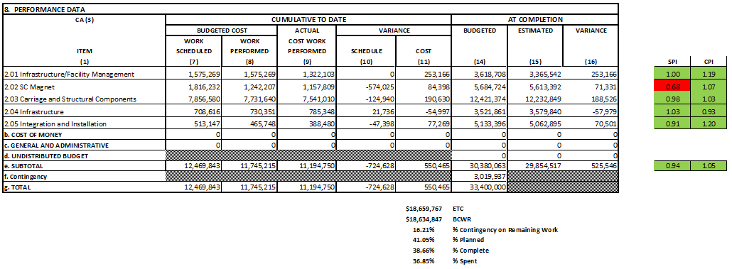
Cost Performance Report (CPR) – 1008 Infra and Facility Upgrade
DOE SPI or CPI Value Thresholds
0.90 to 1.15
0.85 to 0.89 or 1.16 to 1.25
<0.85 or >1.25

Slide 12
Milestones Status – sPHENIX MIE
# | WBS | Milestone Name | Target Milestone Date | Forecast | Actual Finish | Variance (in work days) | Comments
1 | 1.01.01 | Approve Project Baseline and Construction PD2/3 | 30-Sep-19 | 20-Sep-19 A | 20-Sep-19 | 6
2 | 1.02.02.02 | Production Readiness Review - TPC Module Factories | 31-Dec-19 | 17-Dec-19 A | 17-Dec-19 | 8
3 | 1.03.02.03.02 | EMCal Preproduction Sector 0 Assembled | 31-Dec-19 | 25-Nov-19 A | 25-Nov-19 | 23
4 | 1.02.06.02 | Production Readiness Review - TPC DAM | 28-Feb-20 | 04-Feb-20 A | 4-Feb-20 | 16
5 | 1.05.02.03 | HCal Preproduction FEE Complete | 30-Apr-20 | 22-Jan-20 A | 22-Jan-20 | 70
6 | 1.05.02.01 | EMCal Electronics Preproduction Complete | 29-May-20 | 28-May-20 A | 28-May-20 | 0
7 | 1.03.01.03.01 | EMCal W Powder Acquisition Complete | 30-Jun-20 | 15-Jun-20 |  | 11
8 | 1.03.02.03.03 | EMCal Production Readiness Review Blocks/Modules/Sectors Complete | 31-Jul-20 | 22-Jul-20 |  | 6
9 | 1.02.05.03 | SAMPA ASIC Performance Accepted | 30-Sep-20 | 29-May-20 A | 29-May-20 | 86
10 | 1.05.01 | EMCal/HCal SiPM Sensor Procurement Complete | 30-Oct-20 | 28-Feb-20 A | 28-Feb-20 | 171
11 | 1.05.02.04 | HCal SiPM Boards Assembly Complete | 30-Nov-20 | 22-Jul-20 |  | 87
12 | 1.02.06.03 | TPC DAM Felix 2.0 Production Complete | 29-Jan-21 | 28-May-21 |  | -85
13 | 1.06.02.03 | Trigger LL1 Preproduction complete | 26-Feb-21 | 1-Mar-21 |  | -2
14 | 1.05.02.02 | EMCal SiPM Boards Production Complete | 31-Mar-21 | 9-Sep-20 |  | 136
15 | 1.04.04.02 | First Outer HCAL Sector and Splice Plates Ready to Install | 30-Apr-21 | 14-Oct-20 |  | 134
16 | 1.04.01 | Inner HCAL Support Structure Ready for Installation | 30-Apr-21 | 5-Mar-21 |  | 39
17 | 1.02.01.06 | GEM Production Complete | 31-May-21 | 19-Nov-20 |  | 130
18 | 1.03.01.03.01 | EMCal Scintillating Fiber Acquisition Complete | 31-May-21 | 1-Mar-21 |  | 64
19 | 1.06.01.03 | DAQ Production: DAQ Ready for Operation | 31-May-21 | 8-Oct-21 |  | -92
20 | 1.05.02.04 | HCal Electronics Complete: Production | 30-Jun-21 | 16-Feb-21 |  | 94
21 | 1.02.05.04 | TPC FEE Production Complete | 30-Jul-21 | 16-Jun-21 |  | 30
22 | 1.05.03.02 | Calorimeter Electronics Complete | 30-Jul-21 | 29-Mar-21 |  | 86
23 | 1.05.02.02 | EMCal Electronics Complete | 30-Jul-21 | 15-Mar-21 |  | 96
24 | 1.07 | MinBias Detector Ready to Install | 30-Sep-21 | 8-Oct-21 |  | -7
25 | 1.06.03.03 | GL1 Ready to Operate | 30-Sep-21 | 14-Oct-21 |  | -10
26 | 1.01.01 | Early Project Completion | 29-Oct-21 | 19-Nov-21 |  | -15
27 | 1.02.01.08 | TPC Ready to Install (Assembly Complete) | 29-Oct-21 | 28-Sep-21 |  | 21
28 | 1.02.06.03 | TPC DAM Production Complete | 29-Oct-21 | 6-Oct-21 |  | 15
29 | 1.03.02.03.03 | EMCal Ready to Install | 29-Oct-21 | 18-Nov-21 |  | -14
30 | 1.04.04.02 | Last Outer HCAL Sector Ready to Install | 29-Oct-21 | 30-Apr-21 |  | 125
31 | 1.06.02.04 | LL1 Trigger Production Complete | 29-Oct-21 | 19-Oct-21 |  | 7
32 | 1.06.02.04 | LL1 Ready to Operate | 29-Oct-21 | 19-Oct-21 |  | 7
33 | 1.01.01 | Approve Project Closeout PD-4 | 30-Dec-22 | 30-Dec-22* |  | -1

Slide 13
Milestones Status – 1008 Infra and Facility Upgrade
# | WBS | Milestone Name | Target Milestone Date | Forecast | Actual Finish | Variance (in work days) | Comments
1 | 2.03.03 | Completion of Outer HCAL Sector Mechanical Structure Procurement | 30-Sep-19 | 03-Sep-19 A | 3-Sep-19 | 19
2 | 2.02.03.04.01 | Completed - (Controls Hardware) Power distribution drawings | 31-Oct-20 | 29-Sep-20 |  | 22
3 | 2.03.01 | Completed - Steel Track Modifications | 30-Nov-20 | 8-Oct-20 |  | 32
4 | 2.03.02 | Magnet Supports Released for Production (Milestone) | 31-Jan-21 | 23-Nov-20 |  | 44
5 | 2.04.02.01 | Magnet cryo, electrical and control structural support components Ready for Installation | 31-Mar-21 | 10-Mar-21 |  | 14
6 | 2.03.02 | Inner HCal Support Tabs Components Ready for Installation | 31-Mar-21 | 8-Jun-21 |  | -49
7 | 2.05.04 | Outer HCal Sectors Ready for Installation | 30-Apr-21 | 14-Oct-20 |  | 134
8 | 2.03.01 | Carriage Cradle - Components Ready for Installation | 31-May-21 | 24-Feb-21 |  | 67
9 | 2.03.05 | CC Bridge, Mid Platforms & Access - Ready for Installation | 31-Oct-21 | 20-May-21 |  | 112
10 | 2.02.03.02.04.02 | Completed - Procure LN2 supply transfer line system - Phase 5 - Shipping - Delivery Acceptance | 30-Nov-21 | 2-Nov-21 |  | 16
11 | 2.05.05 | Completed - Install SC Magnet on Cradle | 30-Nov-21 | 17-Sep-21 |  | 47
12 | 2.04.02.06 | Assembly Hall Components Ready for Installation | 30-Nov-21 | 16-Sep-21 |  | 48
13 | 2.04.01.03 | Detector Electronics Racks and Rack generic support systems Components Ready for Installation | 30-Nov-21 | 6-Jan-22 |  | -26
14 | 2.04.01.05 | Detector Safety Subsystems Components Ready for Installation | 31-Dec-21 | 21-Dec-21 |  | 6
15 | 2.02.02 | Completed - Magnet and Solenoid Valvebox - Reinstall | 31-Jan-22 | 8-Nov-21 |  | 53
16 | 2.05.04 | Completed - Install Remainder of Outer HCal Sectors | 31-Jan-22 | 16-Nov-21 |  | 48
17 | 2.05.03 | Completed - Install platforms & access | 28-Feb-22 | 16-Dec-21 |  | 47
18 | 2.05.07 | Completed - Install EMCal Sectors | 31-Mar-22 | 6-Jan-22 |  | 57
19 | 2.05.03 | Completed - Install Pole Tips | 31-May-22 | 30-Mar-22 |  | 42
20 | 2.02.03.01.06 | RHIC Helium Interface - Installation complete | 30-Jun-22 | 4-May-22 |  | 39
21 | 2.02.03.04.03 | (Cryo Controls Hardware) Hardware Installed | 30-Jun-22 | 6-Apr-22 |  | 59
22 | 2.02.01.02 | Magnet is operational | 31-Jul-22 | 15-Jun-22 |  | 31
23 | 2.02.05.03 | Completed - Magnet Field Measurements: Map Magnetic Field of SC Magnet | 31-Aug-22 | 7-Jul-22 |  | 38
24 | 2.05.08 | Completed - Install TPC | 30-Sep-22 | 26-Jul-22 |  | 46
25 | 2.05.11 | Completed - Install Min Bias | 31-Oct-22 | 26-Aug-22 |  | 43
26 | 2.05.10 | Completed - Install MVTX | 30-Nov-22 | 4-Oct-22 |  | 36
27 | 2.05.12 | sPHENIX Ready for Operations | 30-Nov-22 | 12-Oct-22 |  | 31

Slide 14
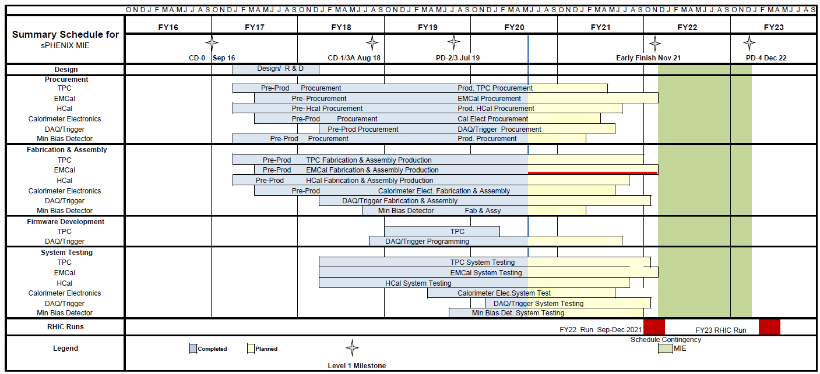
Summary Schedule – sPHENIX MIE
MIE Critical path is through the EMCal Block and Sector assembly

Slide 15
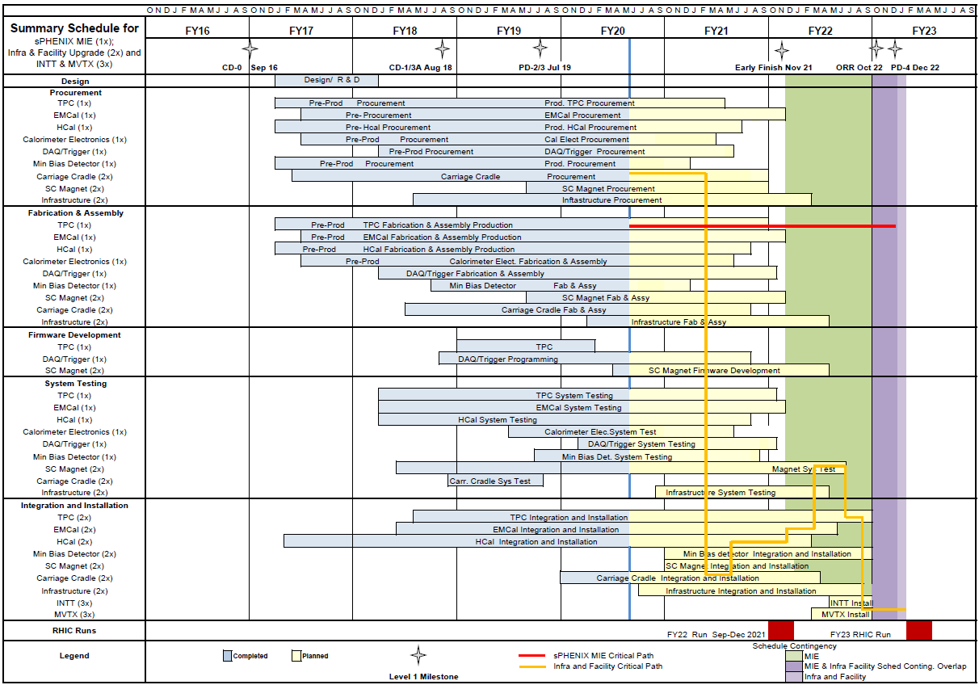
Summary Schedule – sPHENIX MIE/1008 Infra & Facility Upgrade
I&F Critical path is fab and assembly of the Carriage/Cradle followed by the serial installation of the detector

Slide 16
Issues
The buyer assigned to sPHENIX, Emily Mastronardi, has been assigned a significant amount of contract work associated with Discovery Park construction. There is a concern that PPM will move her over to that project. She has been working on sPHENIX for over 2.5 years. We meet with her weekly and she is very knowledgeable about our current and future procurement plans. We want to keep our assigned buyer for the duration of the procurement phase of the MIE and I&F Upgrade, ~ 18 months and are concerned that any change in the person assigned at this critical point in the project would be disruptive.

Slide 17
Summary
Work continues on sPHENIX at BNL and collaborating institutions though the COVID pandemic paused work at BNL and many collaborating institutions.
We have a large team of engineers and designers working remotely on the design of the sPHENIX MIE.
Many sPHENIX institutions have reopened or are about to reopen in June.
Many vendors are considered essential industries and continue to work and produce parts for sPHENIX.
  Many critical parts continue to be produced in industry during the pandemic including OHCal tiles, electronics, mechanical components produced at machine shops, specialized plastics.
  Parts continue to come in and orders continue to be placed.
We will re-plan the project file (PCRs) once BNL and collaborating universities reopen. The MIE early completion lost a month in May. The 1008 I&F early completion date did not change.
  We will look at ways to regain time to maintain the early completion date. Additional labor or two shifts.
PD-4 date of Dec 2022 will be unaffected due to the 13 months of float between early completion and PD-4.

Slide 18
Back Up

Slide 19
FY20 Milestones Status (FY20 PEMP notable)
WBS | Milestone Name | Target Milestone Date | Actual Finish | Variance (in work days)
1.01.01 | Approve Project Baseline and Construction PD2/3 | 30-Sep-19 | 20-Sep-19 | 6
1.02.02.02 | Production Readiness Review - TPC Module Factories | 31-Dec-19 | 17-Dec-19 | 8
1.03.02.03.02 | EMCal Preproduction Sector 0 Assembled | 31-Dec-19 | 25-Nov-19 | 23
1.02.06.02 | Production Readiness Review - TPC DAM | 28-Feb-20 | 7-Feb-20 | 14
1.05.02.03 | HCal Preproduction FEE Complete | 30-Apr-20 | 22-Jan -20 | 70
1.05.02.01 | EMCal Electronics Preproduction Complete | 29-May-20 | 28-May-20 | 1
1.03.01.03.01 | EMCal W Powder Acquisition Complete | 30-Jun-20 | 5-Jun-20 | 17
1.03.02.03.03 | EMCal Prod Readiness Review Blocks/Modules/Sectors Complete | 31-Jul-20
1.02.05.03 | SAMPA ASIC Performance Accepted | 30-Sep-20 | 27-My-20 | 88
Will evaluate due date when BNL reopens

Slide 20
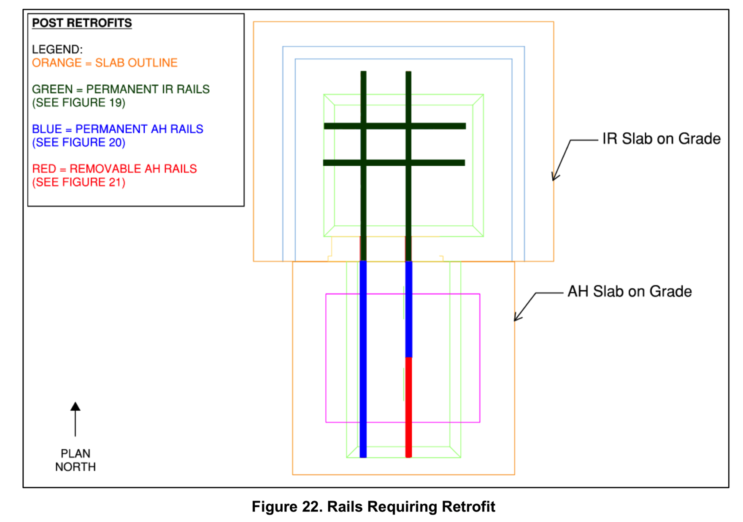
Where the 1008 Tracks Need Help

