Slide 1
Jira at RACF/SDCC An Overview
John Steven De Stefano Jr RACF/SDCC at BNL 18 Jun 2020

Slide 2
What is it?
A family of products built to help teams manage their work
A platform for work planning, assignment, tracking, reporting, and management
Integration of agile software development and customer support aspects into a single platform

Slide 3
Jira product options

Slide 4
Jira hosting options

Slide 5
Jira concepts
Issue A single work item of any type or size that is tracked from creation to completion (i.e., request, ticket, task)
Project A collection of issues related by a single purpose or context
Workflow A sequential path that an issue follows from inception to completion

Slide 6
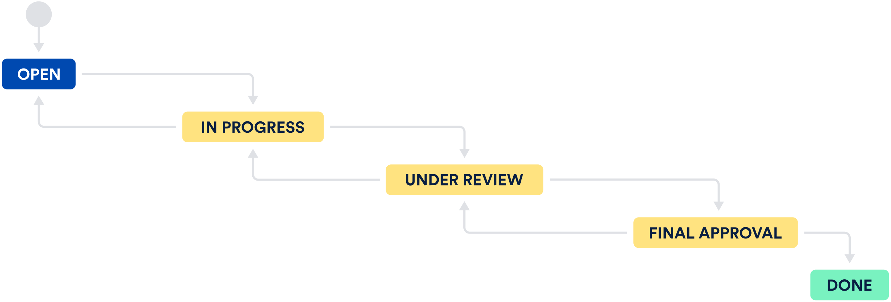
Sample Jira issue workflow

Slide 7
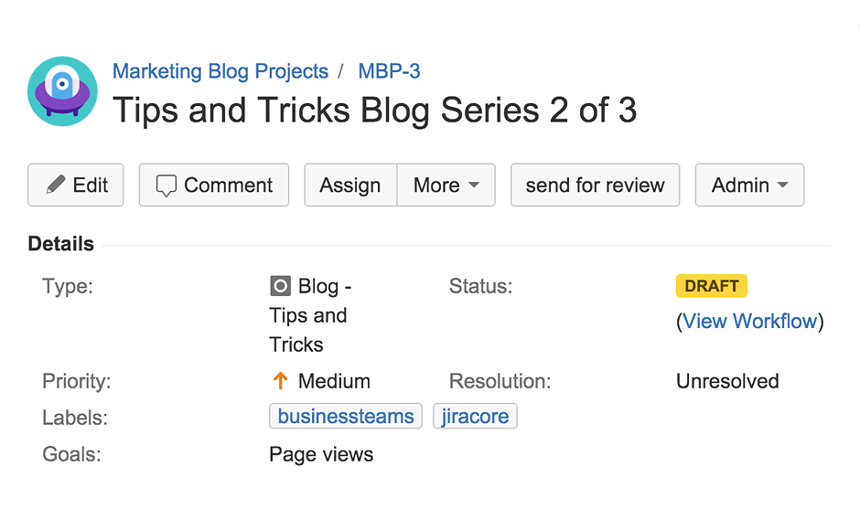
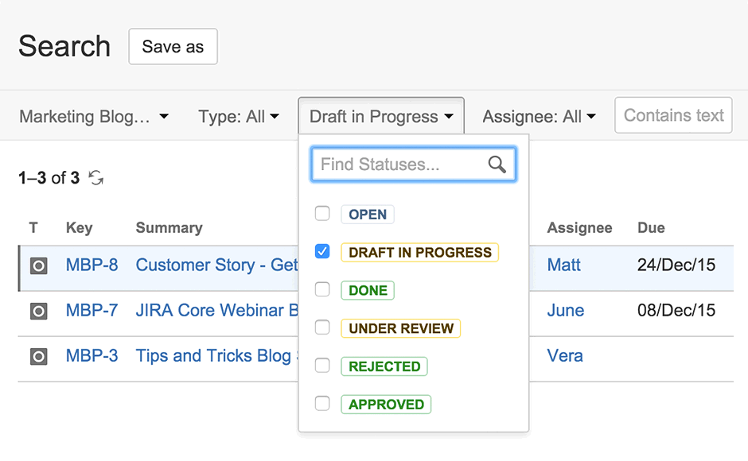
Jira Core features
The details of every issue, plus comments, attachments, and due dates, are stored in one place
@user targets a specific team member with detailed notifications
Search for issue specifics: a due date, last update, or outstanding tasks

Slide 8
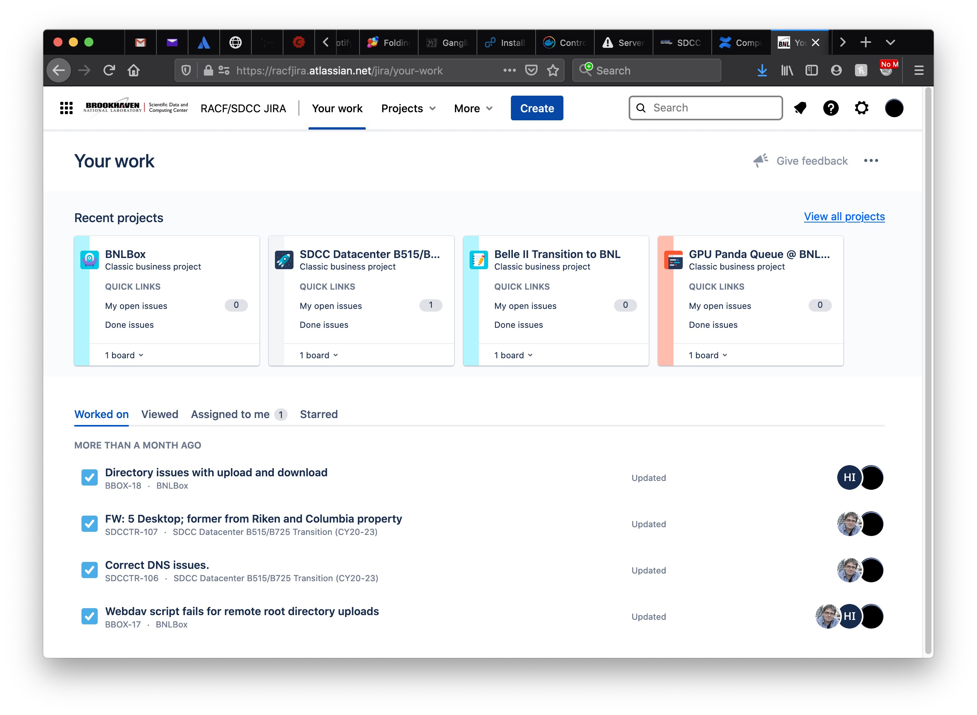
Jira Core in practice at RACF/SDCC
1669 issues/tasks/subtasks in 48 projects

Slide 9
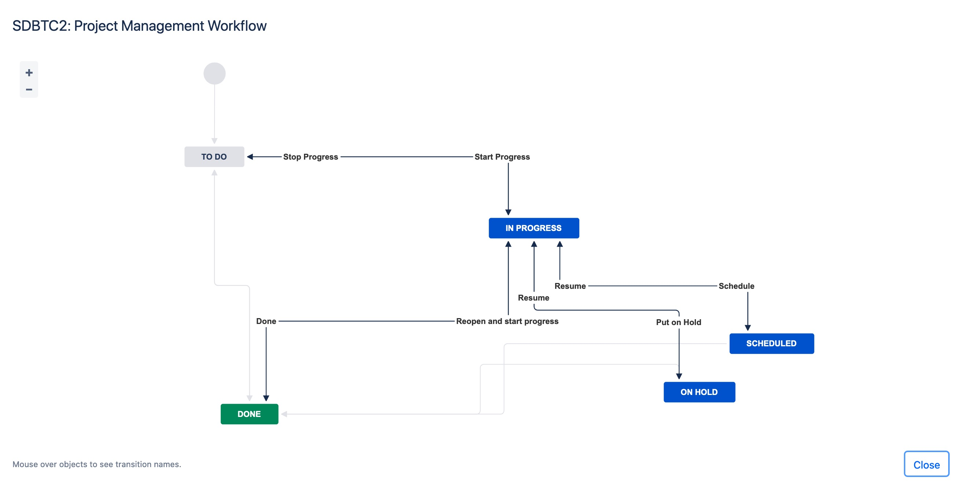
Jira Core in practice at RACF/SDCC
Alexandr Zaytsev, SDCC Datacenter B515/B725 Transition (CY20-23)

Slide 10
More information
Atlassian’s Jira Core page https://www.atlassian.com/software/jira/core
RACF/SDCC Jira instance (protected) https://racfjira.atlassian.net
Request an RACF/SDCC Jira account Please create a Help Request: https://www.racf.bnl.gov/docs/rt in the UserAccounts queue: RT-RACF-UserAccounts@bnl.gov

