Slide 1
PID WG: Path Forward
Thomas K. Hemmick
Patrizia Rossi
PID WG bi-weekly meeting - June 19, 2020

Slide 2
Requests by the Conveners: to All
Review material from PWGs presented at the Pavia meeting. Document the requirements relevant to your group and any concerns or missing information and present it at our June 15 meeting
Document the current status of yourworking group, e.g. based on the Pavia meeting summaries in the DWG Wiki by June 15
Start thinking about the outline for your YR section and present a scheme at our June 15 meeting
List all suitable technologies for all applicable regions of the detector in the DWG Wiki by June15.
Information to be Delivered by Wiki…

Slide 3
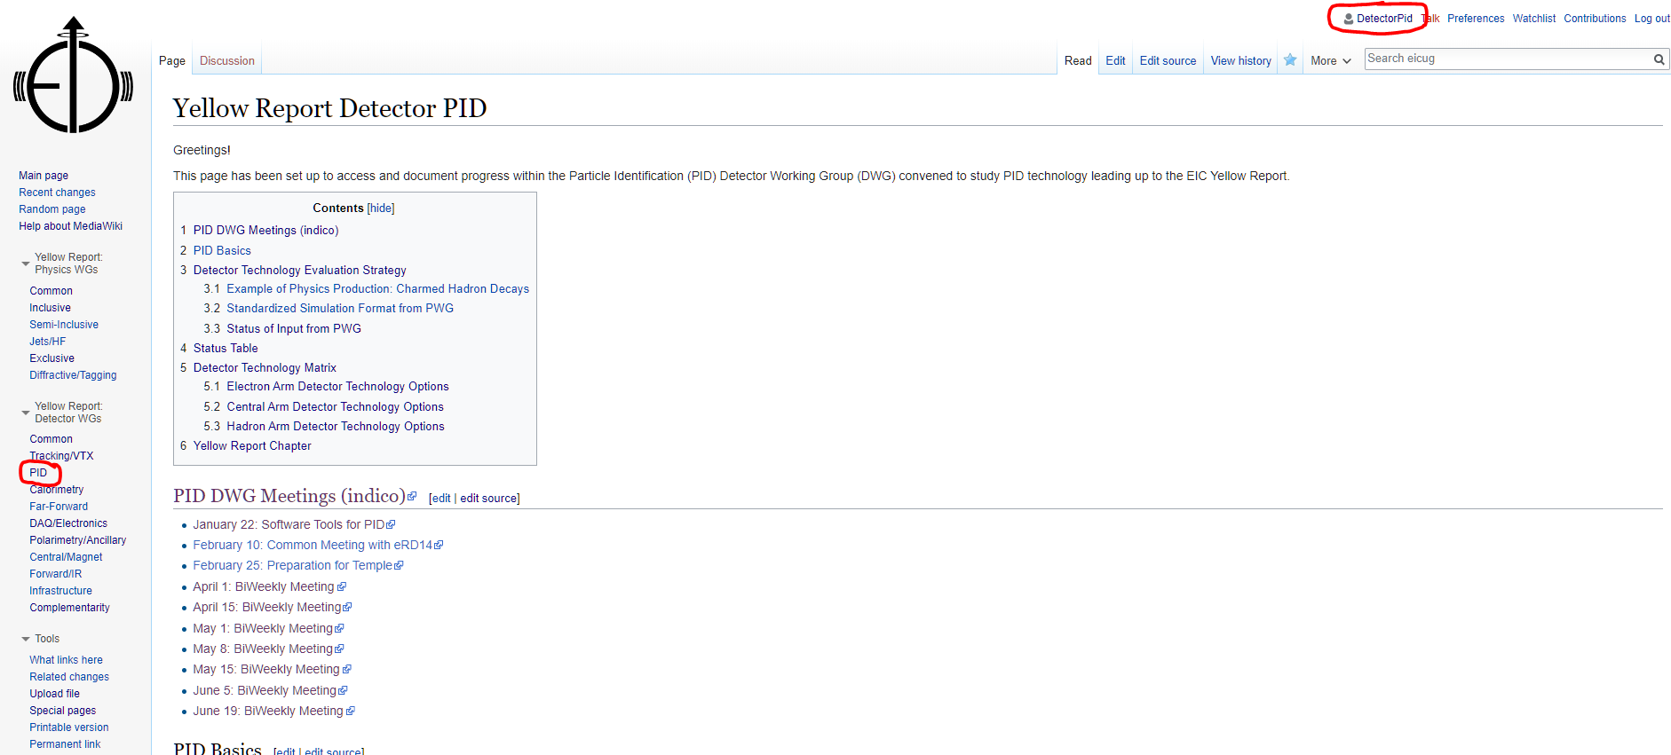
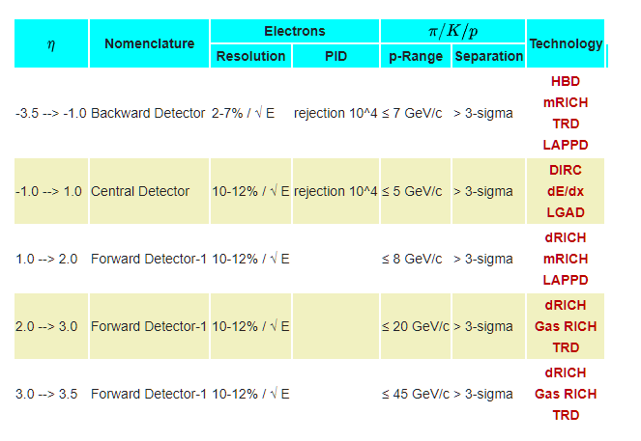
PID Group Wiki (…a good start…)
https://wiki.bnl.gov/eicug/index.php/Yellow_Report_Detector_PID
Empty page links.
Experts: please fill in these pages!
Switch to live overview…

Slide 4
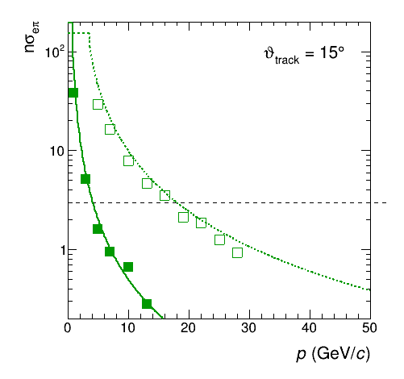
Requests by the Conveners : to PID
Continue work in the direction chosen addressing e-pi separation and PID detector space requirements
Evaluate alternative readout options to minimize the impact on electron detection in the electron endcap
Determine the impact on electron identification in the central region if there is no help from dE/dx in an all silicon-vertex tracker scenario
Estimate quantitatively benefit of vertex shift for technology selection with limited space. Evaluate the cases of additional longitudinal space +25cm, +50cm, and +100cm and the cases of less longitudinal space -25cm.
Determine, as much as possible, the power generated by the readout for all PID technologies
dRICH
Status updates?

Slide 5
Addressing eID
Proposal
Proposal:
Integration meeting with calorimetry on June 24 July 8.

Slide 6
News of Importance to Us
Cover of the Rolling Stone

Slide 7
Delphes
A few PID afficionados have been migrating some of our parameterization code to Delphes.
We should know a little more about this:
Understand what it is about.
Is this a complement or competitor to other frameworks?
Invite Delphes contact to future meeting.

