Slide 1

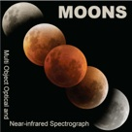
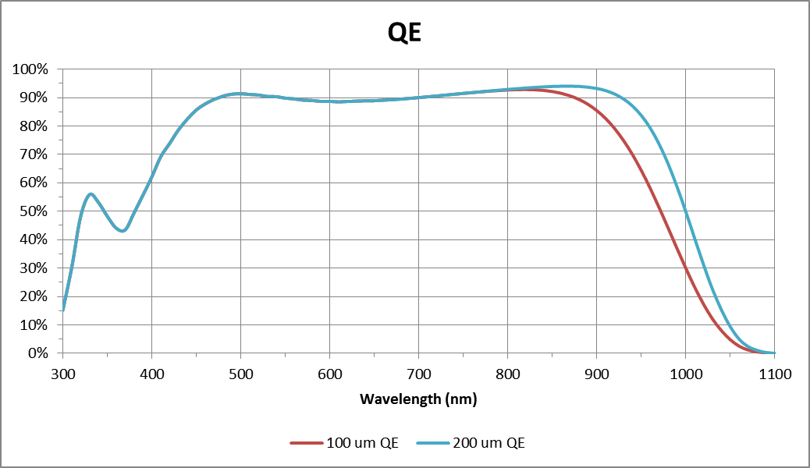

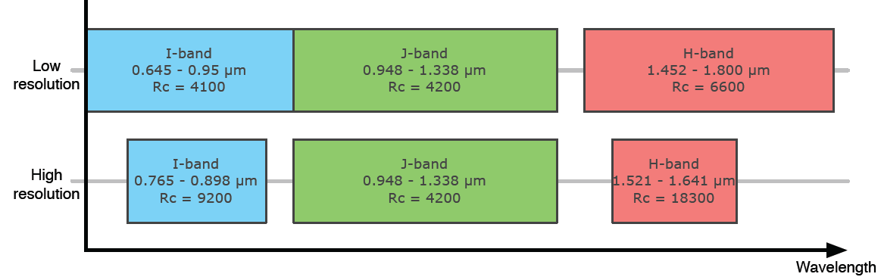
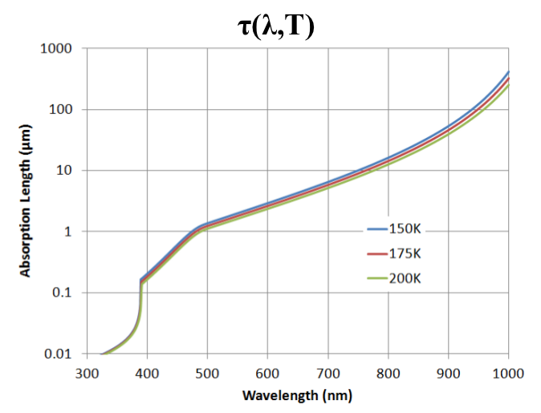
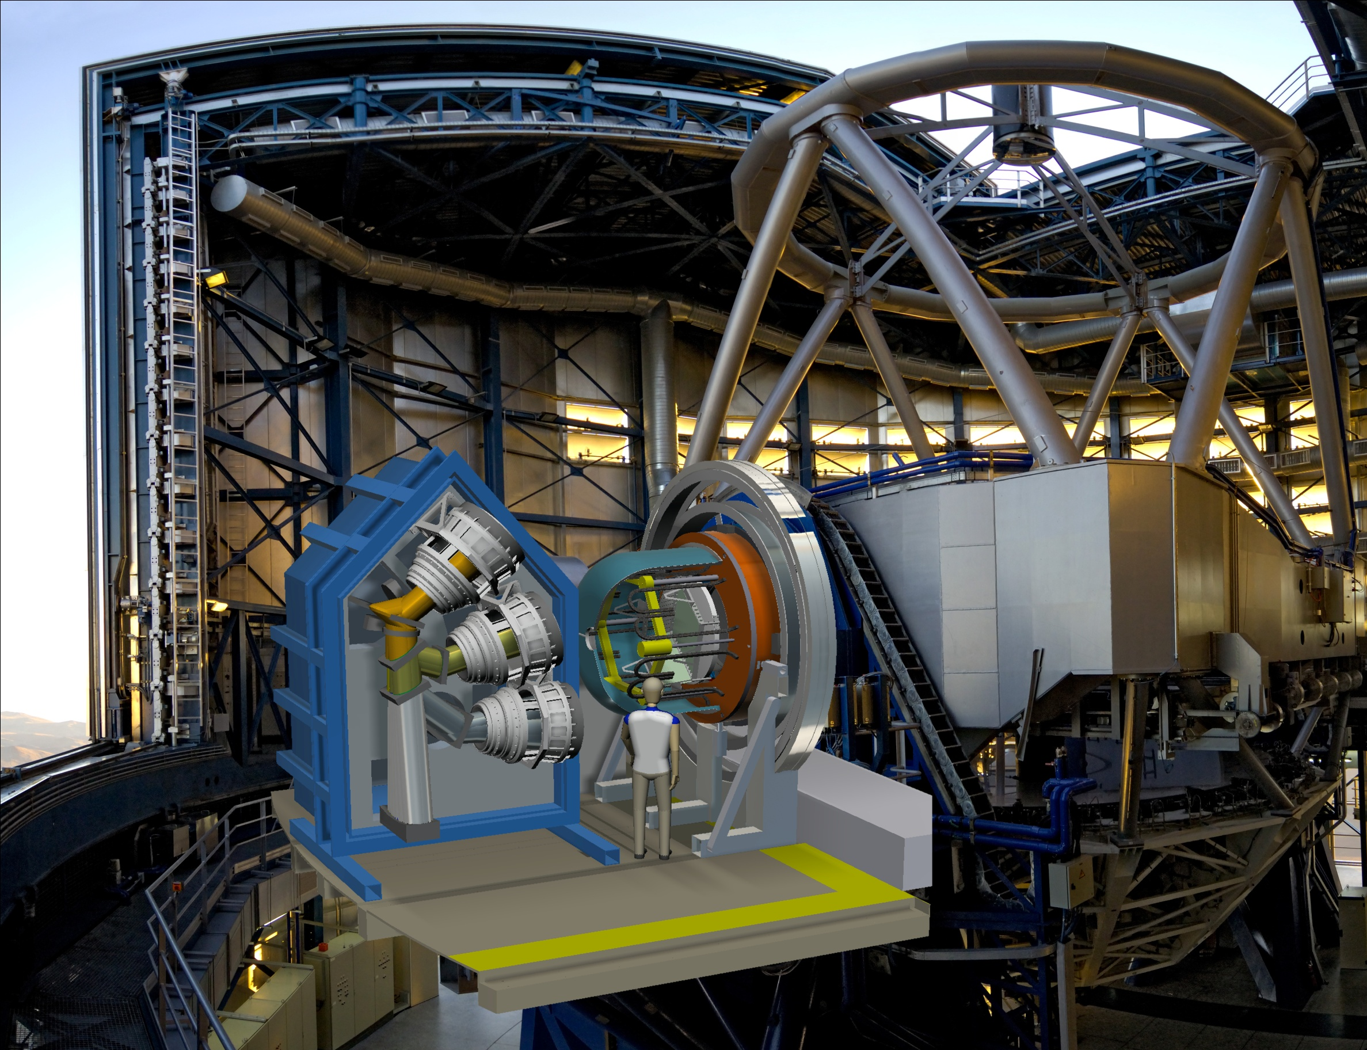
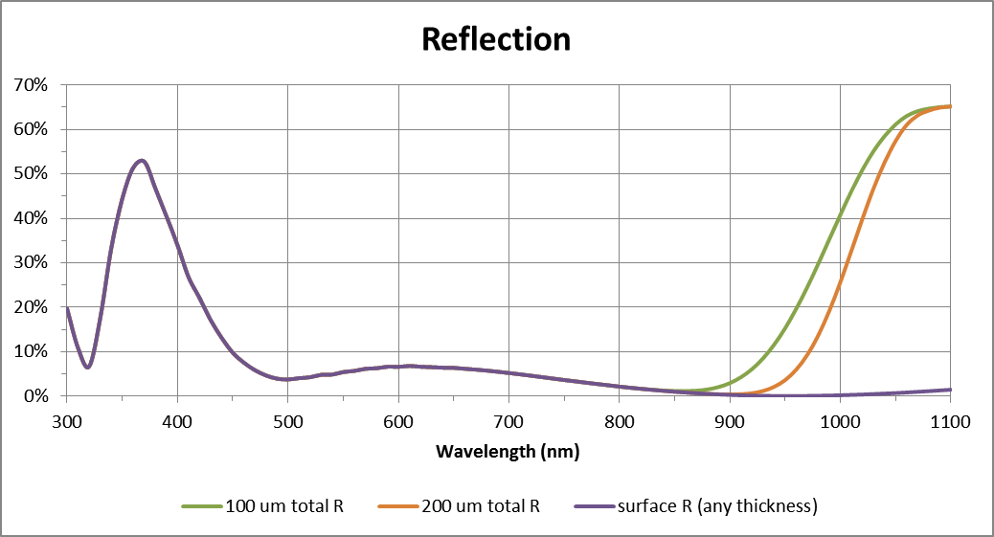
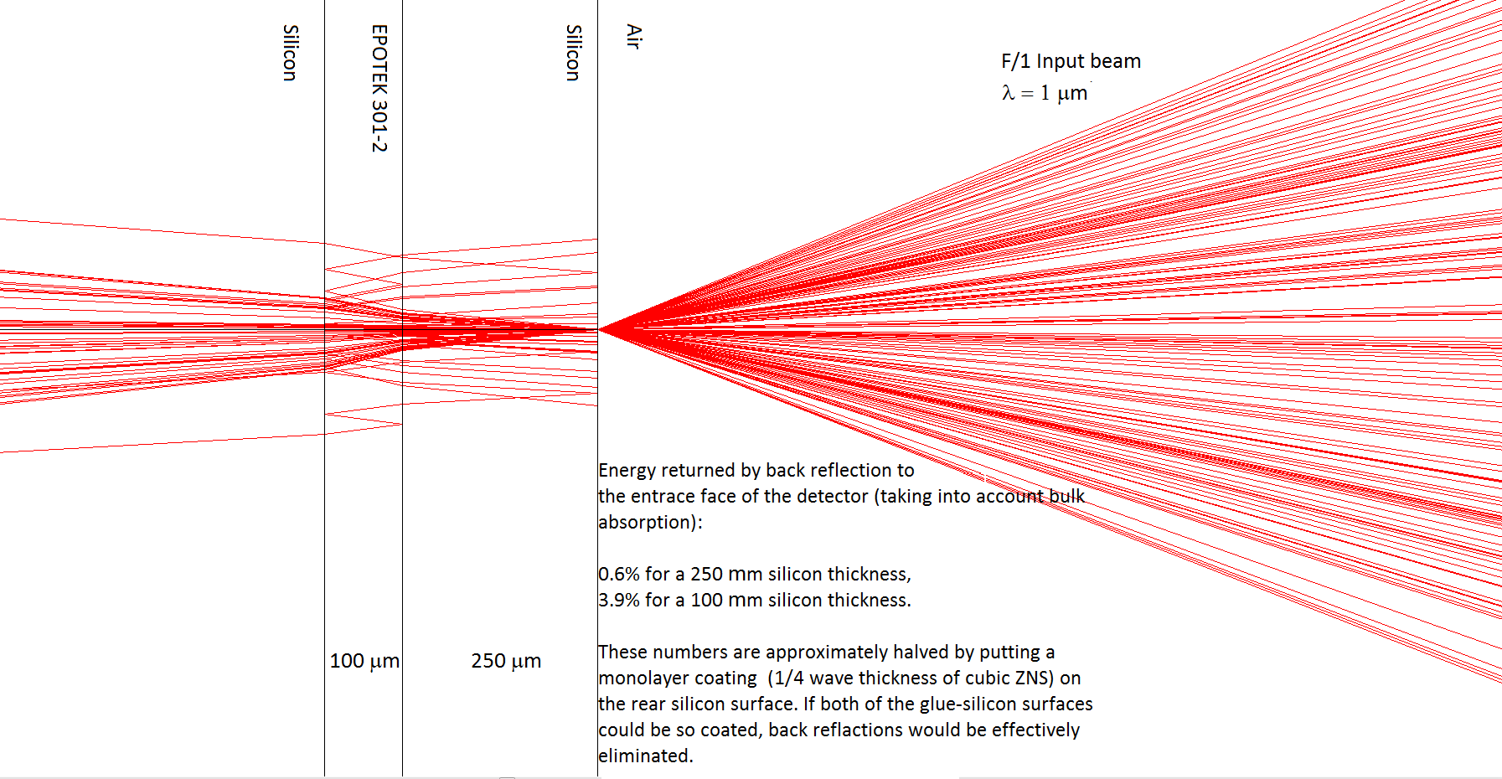
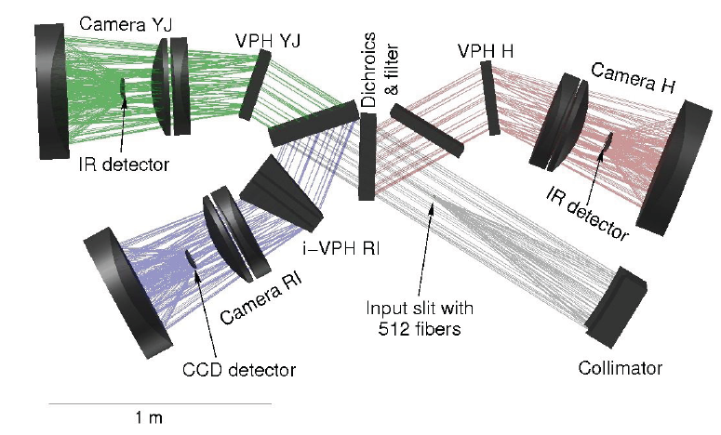
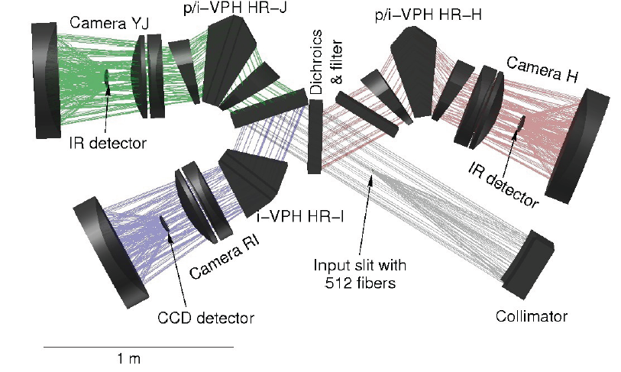
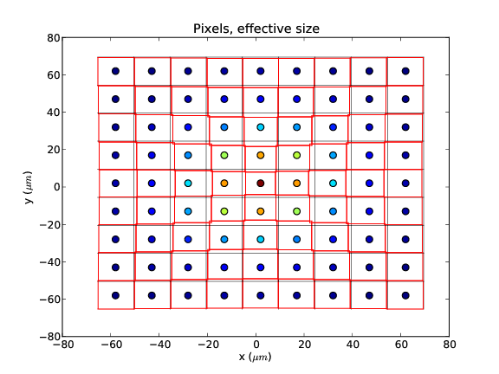
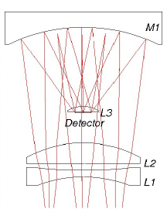
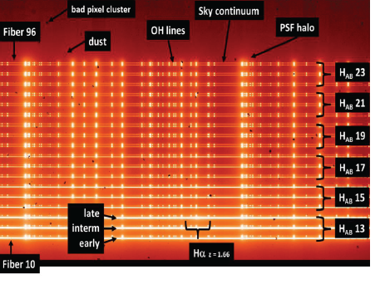
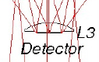
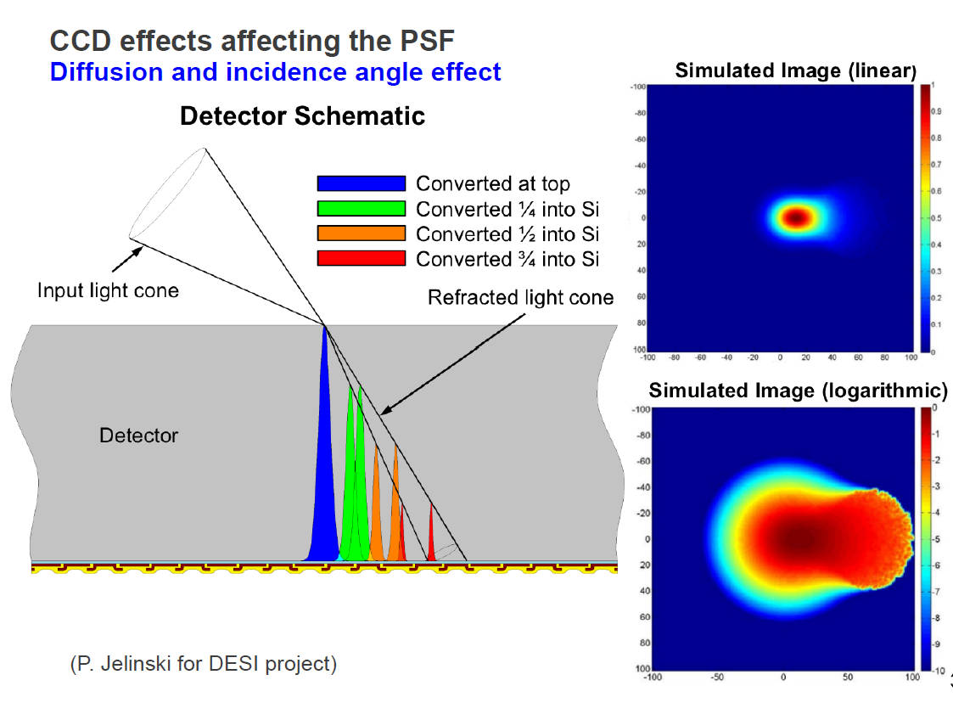
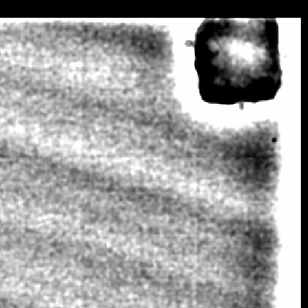
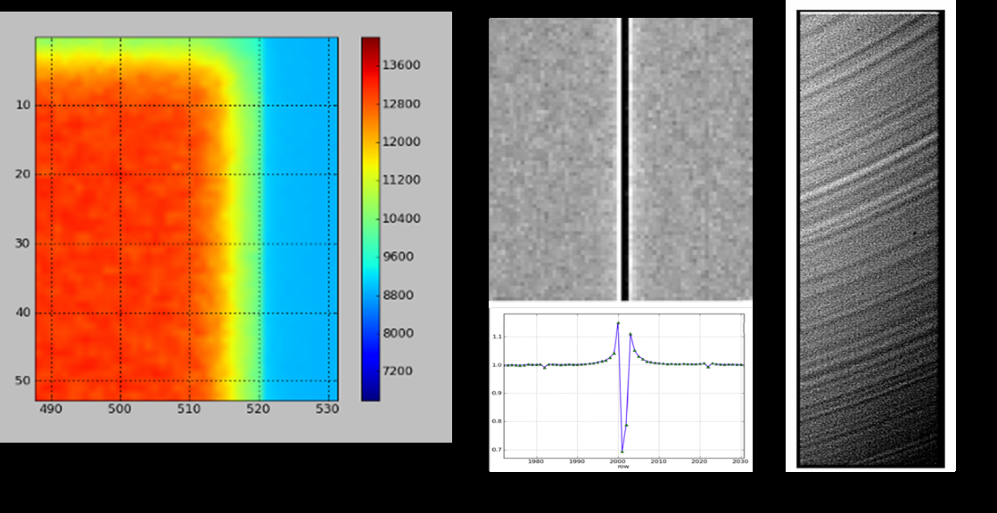
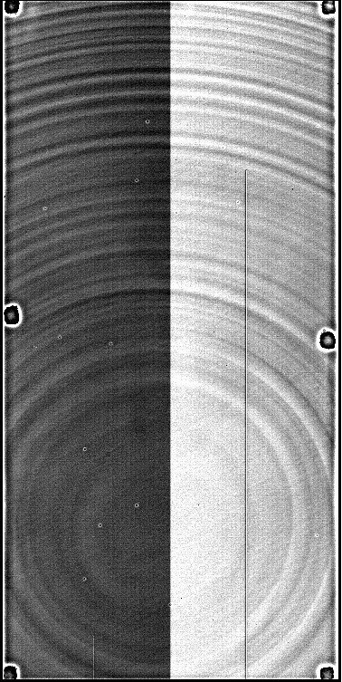
The MOONS quest for the best red sensitive optical detector, illuminated by an F1 optics
Olaf Iwert, European Southern Observatory (ESO), Karl-Schwarzschild-Str. 2, 85748 Garching, Germany
ABSTRACT
The MOONS instrument [1] features spectrographs with simultaneous wavelength coverage between 0.64 and 1.8 µm.
To achieve the highest sensitivity in the red wavelength range of 0.64 to 0.95 µm, optical CCDs will be used to complement the infrared detectors.
This paper describes critical points and some open questions on the quest for the best available (fully depleted) detector, which is required to have the following key parameters:
a.) format of 4k x 4k pixels with 15 µm pixelsize;
b.) illuminated by an F1 camera optics;
c.) flat to less than 10 µm (peak to valley);
d.) operate at around 143 K to minimize radiation;
e.) have an RON of less than 3 e-, preferably even lower;
f.) optimized PSF properties such that charge diffusion is minimized;
g.) reflectivity of less than 2%; and
h.) minimized side effects with respect to conventional detectors
Feedback of the audience is appreciated to contribute to this selection and the associated trade-offs, especially in view of optical divergence of the F1 beam in thick silicon and electrical effects intrinsic to fully depleted CCDs.
Figure 1: Expected QE difference
between 100 and 200 µm thick
devices [2]
THE MOONS SPECTROGRAPH AT THE VLT
(3rd Gen. Instrumentation)
SIDE-EFFECTS OF FULLY DEPLETED CCDs and OPEN QUESTIONS FOR MOONS (Spectroscopy)
Absorption depth / Optimum thickness of MOONS detector ?
The requirement for very high QE at 950 nm implies
the use of a detector with 100 to 250 µm thickness
and full depletion (with / without backside voltage).
Which parameters are decisive for the optimum thickness ?
What are negative side effects of the backside bias voltage ?
Figure 2:
(Top) MOONS features simultaneous spectroscopy in low/medium and high resolution in the sketched wavelength bands with optical CCDs up to 950 nm.
Infrared detectors serve the upper bands.
(Right) Artistic Impression of the
MOONS instrument on
the VLT [3]
PSF versus backside bias voltage
Figure 5: Absorption Depth
Can the “normal” PSF degradation of fully depleted CCDs for shorter wavelengths always be compensated by a sufficient backside bias voltage ?
Internal Reflection on front-side components of fully depleted detector, (but spec. < 2 %)
MOONS Optical Layout
Figure 6:
Simplified ESO simulation at 1000 nm:
14 % for 100 µm silicon thickness
6 % for 250 µm silicon thickness
[2]
How to minimize reflection on the device frontside to help the internal straylight / PSF ? Or is this an effect which is “welcome” to increase the QE ?
Has anyone experimented with frontside coatings or different glues to prevent long wavelengths to pass through the 100um / 250 µm thick CCD and being bounced off by the glue or the substrate wafer ?
Is there a relation to the brighter / fatter effect ?
Figure 3: Medium-resolution spectrograph [4] High-resolution spectrograph
Brighter fatter effect / effective change in pixelsize and PSF
How important is this effect in spectroscopy versus direct imaging ?
Would a subtraction of calibration data in spectroscopy lead to similar problems ?
Correction for spectroscopy ?
Schmidt Camera Light incidence Example Spectrum
angle on detector
600 nm << >> 1000 nm
for the optical channels
[7]
[8]
Figure 7: Brighter fatter effect: Effective Pixelgrid / Correlation
Light incidence angle, wavelength dependent conversion depth, collection and wavelength dependent focussing
Difference for PSF between imaging and spectrosopy ?
What is the practical experience as function of wavelength ?
Is the detector always ‘telling’ us the optimum focusing itself ?
Can the wavelength range of a spectrograph be covered with identical focus ?
Figure 4: (Left) Schmidt Camera with detector [5]; (Middle) Scaled-up light incidence angle on detector; (Right) Simulation of a MOONS spectrum on the detector, spectra are dispersed in horizontal direction (three CCD lines per fibre signal with five lines gap to the next). [6]
Optical Detector Candidates / Operational Aspects
[9]
Figure 8: Incidence Angle and wavelength dependent collection
2k x 4k or 4k x 4k detectors of suppliers (alphabetical order):
e2v, Hamamatsu, LBNL, MIT, STA of 100 to 250 µm thickness with and without backside bias voltage
Mosaic versus monolithic ? (flatness spec.)
n versus p material ?
Voltage ranges ?
Increased vulnerability to ESD ?
Damage through over – illumination ?
3
Tape bumps / Edge glow & rolloff / Useful area / Midline Effects
Edge Roll-off versus Edge glowing ?
Are all the edge effects tolerable, if
the useful area is limited to a smaller
detector format than physically
available ?
How are midline effects generated /
suppressed ?
? Any feedback for our detector selection ?
? Which side-effects of fully depleted CCDs have I overlooked for spectroscopy ?
? Which ones would you like to eliminate for spectroscopy from a user point of view ?
? Which ones do not matter for spectroscopy, or can be easily calibrated out ?
? What about a thick HyViSi Detector in comparison ?
Please contact: oiwert@eso.org
Figure 9: [10] [11] [11]
Tape bumps / glowing edge;. Edge roll-off; Midline Effect
Tree-ring effect
Is this effect always removable through flat-fielding ?
Do tree-rings matter for spectroscopy ?
[10]
Figure 10:
Tree-ring effect
References:
[1] http://www.roe.ac.uk/~ciras/MOONS/VLT-MOONS.html
[2] Data provided by e2v: Q.E. curves modeled, reflection data especially for frontside modeled only preliminary
[3] Credit STFC
[4] M. Cirasuolo et al.: “MOONS: the Multi-Object Optical and Near-infrared Spectrograph for the VLT”, SPIE Vol. 9147, 2014
[5] E. Oliva et al.: “Updated optical design and trade-off study for MOONS, the Multi-Object Optical and Near-infrared spectrometer for the VLT”, SPIE Vol. 9147, 2014
[6] G. Li Causi et al.: “Virtual MOONS, a focal plane simulator for the MOONS thousand –fiber NIR spectrograph”, SPIE Vol. 9147, 2014
[7] P. Astier et al.: “The brighter fatter effect and pixel correlations”, BNL Workshop Nov. 2013
[8] A. Rasmussen: “LSST Sensors: How will dark energy be constrained with lensed photo-conversions ?”, BNL Workshop Nov. 2013
[9] J. Guy, “Spectral extraction of BOSS fully depleted CCD data”, BNL Workshop Nov. 2013
[10] A. Malagon, “Transverse Electric Field effects in DECam devices”, BNL Workshop Nov. 2013
[11] P. O’Connor, “Spot Scan Probe of Edge and Midline Effects in Fully-Depleted CCDs”, BNL Workshop Nov. 2013
ACKNOWLEDGMENTS
This poster would have not been possible without the
requirements of the MOONS system, as well as the
experience and material developed by the referenced
experts.

