Slide 1

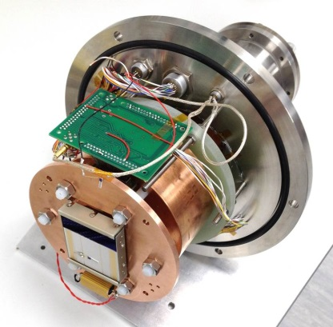

Neil Murray Comparison of PSF in p- and n-channel CCDs
With thanks to Edgar Allanwood, Ben Dryer, Daniel Weatherill, Konstantin Stefanov and David Smith

Slide 2
Outline
Charge redistribution in red-enhanced CCDs
  Flat-field charge sharing
  Recommendations for further study
  Strange Behaviour observed in ‘single’ pixel PTCs
  Line redistribution experiments at OU and ESA
Test equipment and devices
PSF measurements in p- and n-channel CCD
Aspect ratio measurements
Optimising signal dependant PSF through biasing
  Volts
  Electrodes
Optimising signal dependant PSF through device design
- Nov 2012
- Jan 2013
- Aug 2013
- Aug 2014
- Nov 2014

Slide 3

Signal Linear, Response Non-Linear in thick CCDs??
(Nov 2012)
M. Downing SPIE 2006, 2009
[ADU]²
Image area response under flat-field illumination does not follow shot noise for signal > 40 ke-
Effect is independent of wavelength – not charge diffusion
Parallel binning in some cases can mitigate the effect, suggesting a columnar charge sharing mechanism
Are potential wells collapsing under high signal, or is there some electrostatic repulsion that is smoothening out the shot noise arising from pixel boundaries, leading to a reduced gradient in the Mean Variance curve?
As this seems to be dominate in the column direction, could such an effect impose a bias to the PSF, leading to elipticity as a function of signal? Perhaps we are already seeing this in BI-CCD273 PSF/MTF measurements and may also be concealing the expected wavelength dependence of such measurements?

Slide 4
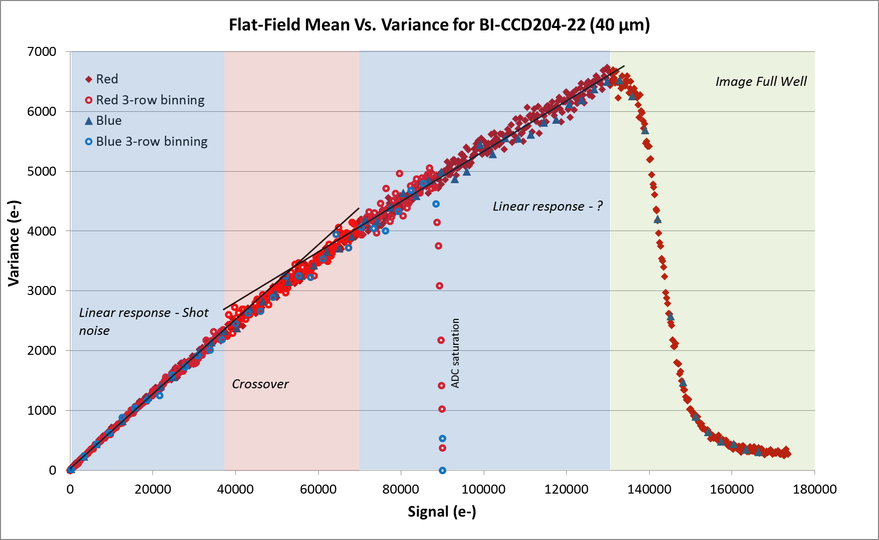
Open University Measurement
(Nov 2012)
(N-channel)
Since then we understand effect is continuous across the dynamic range. Stefanov 2014, “A statistical model for signal-dependent charge sharing in image sensors” IEEE

Slide 5
Impact on PSF
(Nov 2012)
In some data it appears it can be corrected by binning (3-phase devices so far)
Is there a mechanism occurring during collection that allows wells to collect some charge otherwise meant for their higher signal neighbour? i.e. a well collapse that smoothens out the positional shot noise, leading to a smaller gradient in the Mean Variance curve.
However a Simple Silvaco model does not support this theory – we only a 2 μm reduction and depletion at full well.
Could such an effect impose a bias to the PSF, leading to elipticity?
Effect appears to be independent of wavelength. However such an effect may be dominating PSF measurements subduing the wavelength dependence.

Slide 6
Suggested Experiments to
LSST Group
(Nov 2012)
Measure both the flat-field and single pixel response as a function of signal, wavelength and configuration of integration clock phases.
Additionally check for any elipticity in the PSF by measuring both the horizontal and vertical dimension of the PSF using the virtual knife edge technique, again as a function of signal, wavelength and integrating clocks.
Flat-field Mean vs. Variance
Spot Mean vs. Variance
Shot noise
Vertical elipticity function ??
Horizontal elipticity function ??
Variance (e⁻)
Elipticity
Full Well
Signal (e⁻)

Slide 7
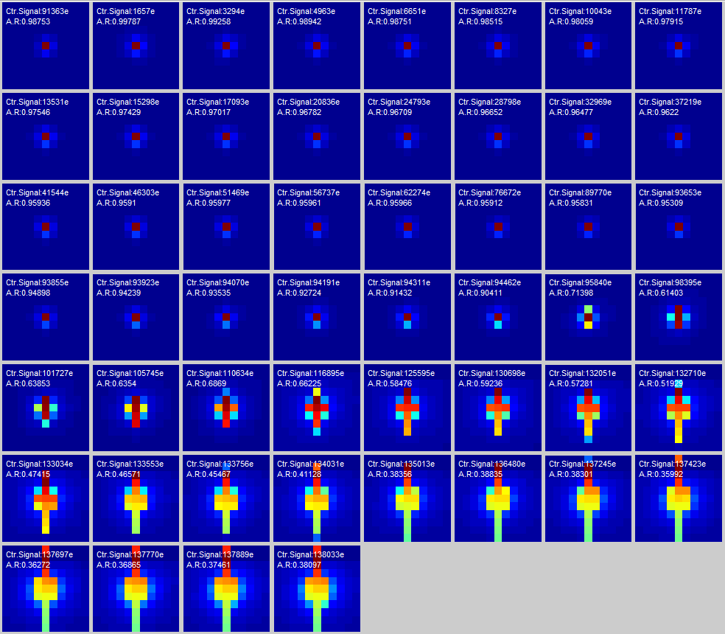
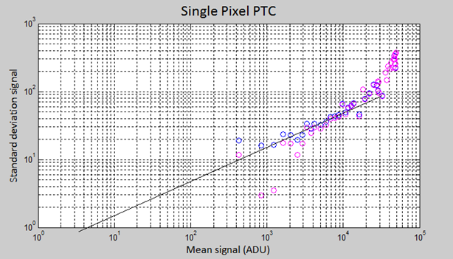
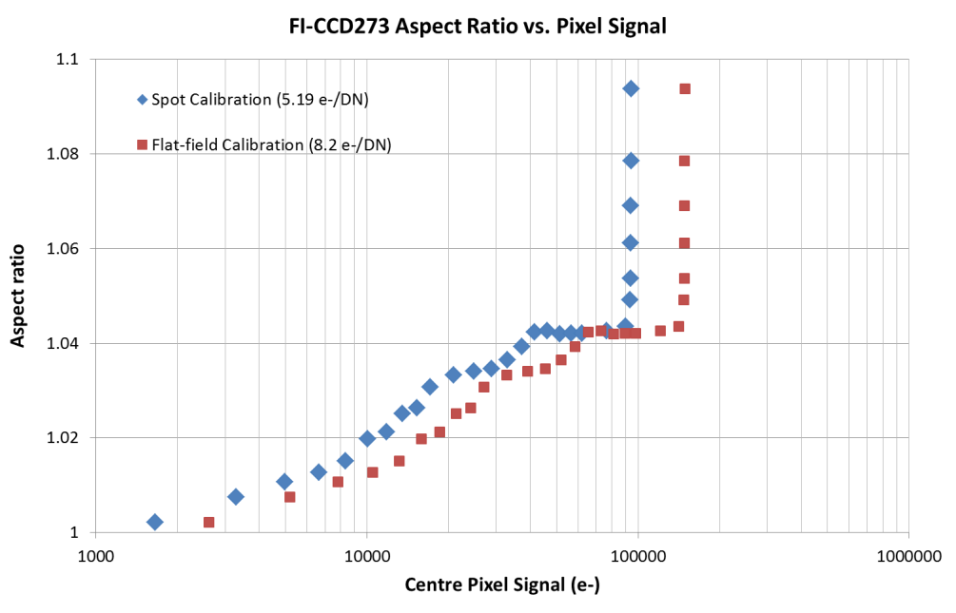
Aspect ratio evolution with signal in e2v FI-CCD273
(Jan 2013)
Here FI-CCD273 response to spot projection is shown at many signal levels. The aspect ratio begins to become visibly altered at ~95 ke⁻, however our PTC is clearly not demonstrating signs of full well.

Slide 8
Is charge sharing reducing the variance?
(Jan 2013)
Is there a mechanism occurring during collection that allows wells to collect some charge otherwise meant for their higher signal neighbour? i.e. smoothening out the sampled positional shot noise, leading to a reduced gradient in the Mean Variance curve.
Could such an effect impose a bias to the PSF leading to elipticity?
A4
A3
A2
A1
A4
A3
A2
A1
A4
A3
A2
A1
A4
A3
A2
A1
A4
A3
A2
A1
~36 µm depletion
Variance a
Variance b
~36 µm depletion

Slide 9


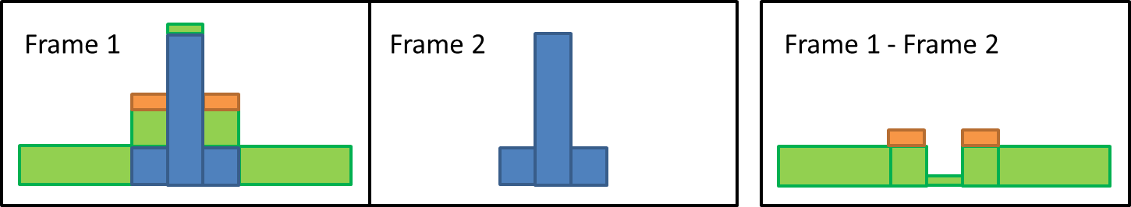
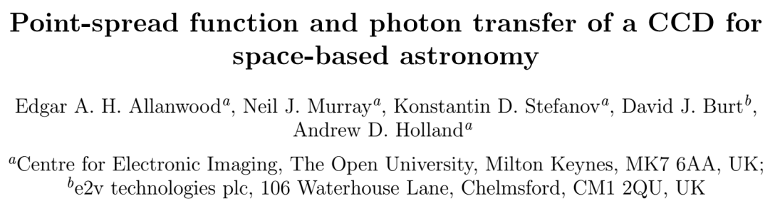
Charge Redistribution in CCDs
Edgar Allanwood, SPIE 2013
(Aug 2013)
A line of charge created by forward-clocking a flat field until the last row, then back clocking (first image) followed by a subsequent LED illumination (second image).
Line inserted midway into CCD imaging array using line injection technique.
Same line – with subsequent flat field. Charge is being redistributed from line!
Also shown at SDW2013 by Andrew Holland

Slide 10
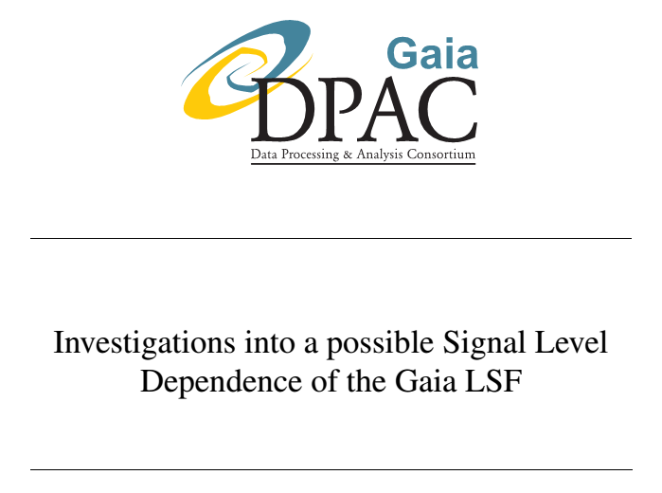
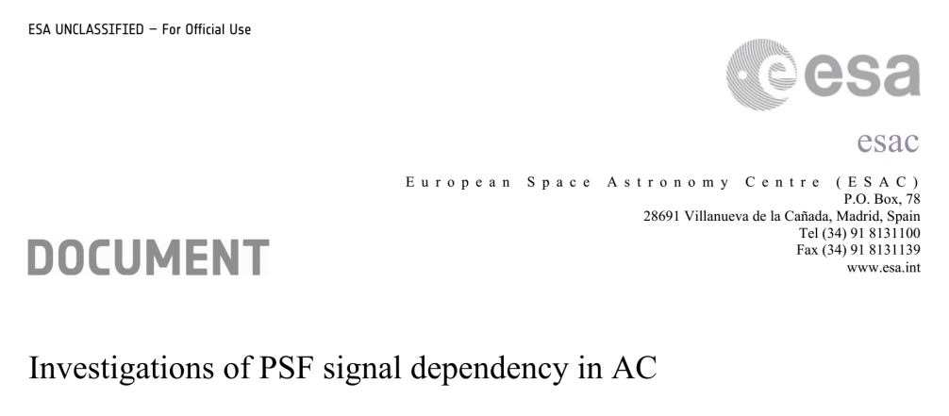
Knowledge Transfer – ESA ESAC
Charge redistribution also observed in GAIA-type laboratory devices by Ralf Kohley
September 2013
November 2013

Slide 11
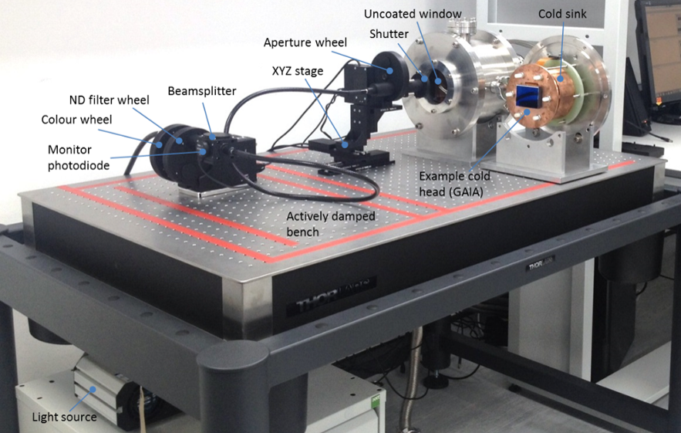
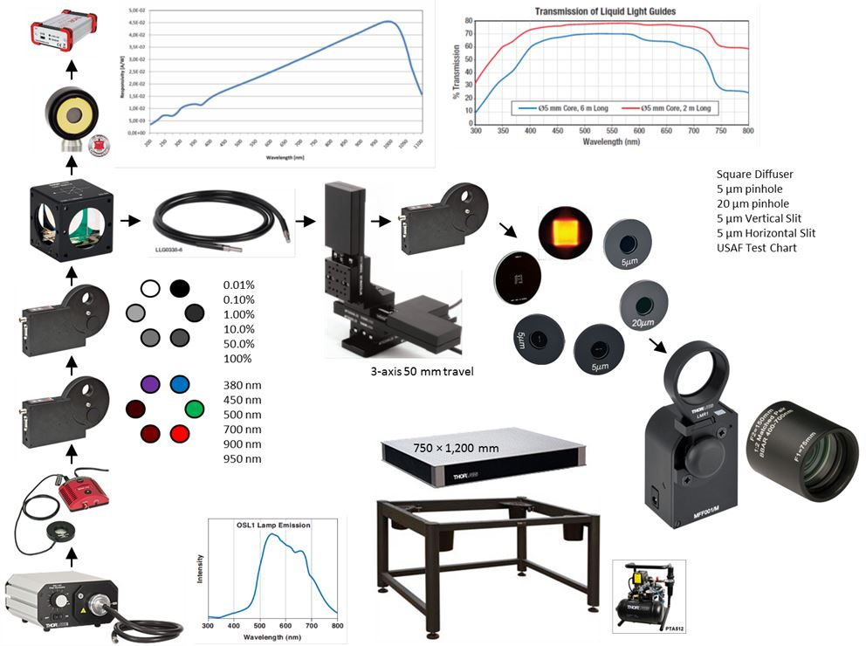
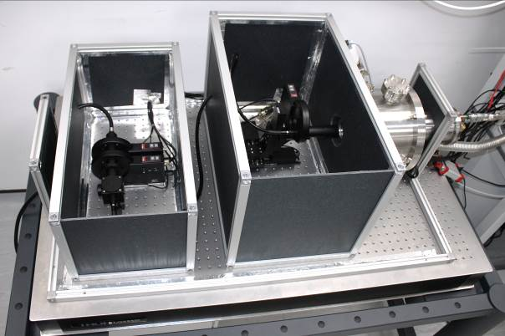
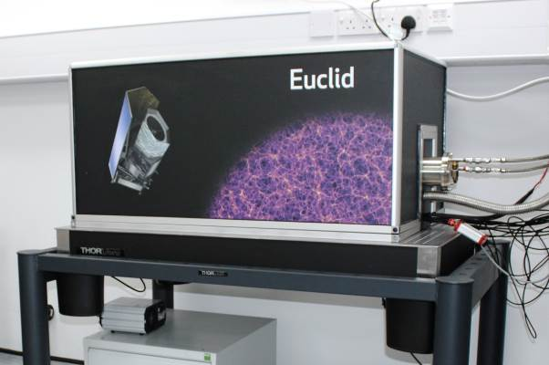
Low Cost Test Equipment – $76k ex. CCD!

Slide 12
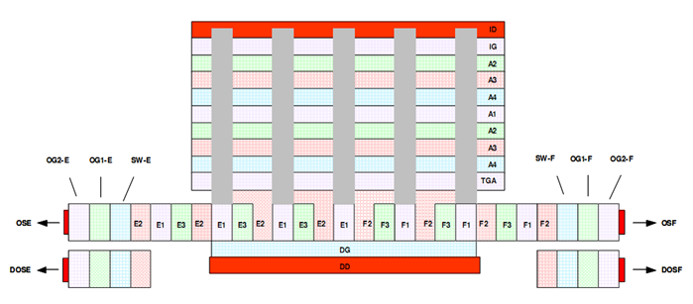
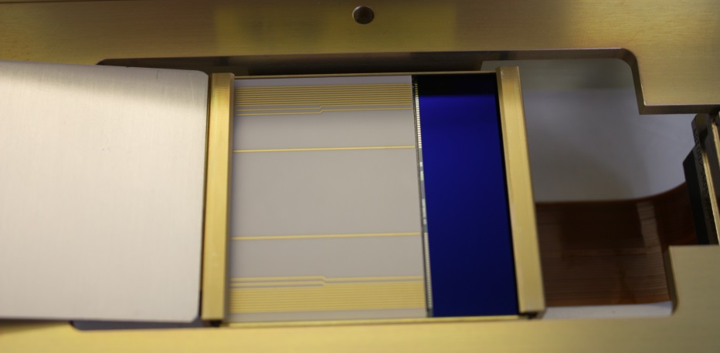
PSF Test Devices – e2v CCD204-22
Full frame 4,096 × 1,064 (49.2 × 12.8 mm)
12 µm square pixels (4+2+4+2 µm)
Back illuminated, thinned to 70 µm/40 µm
Low noise output (8 e⁻ r.m.s. @ 1MHz)
Gated dump drain from serial register
Parallel charge-injection structure
50 µm buried channel in serial register
8 µm buried channel in imaging area
Typically 230 mW during readout @ 1MHz
Split serial register to two, 2-stage outputs with dummies
Summing Wells and register elements sized to allow 2×2 binning
Fabricated on bulk n⁻ Si (>5,000 ohm-cm)/epitaxial p⁺ Si (1,500 ohm-cm)
p-/n-
Device architecture
n-channel CCD204, BI, red-enhanced coating
p-channel CCD204, BI, red-enhanced coating

Slide 13
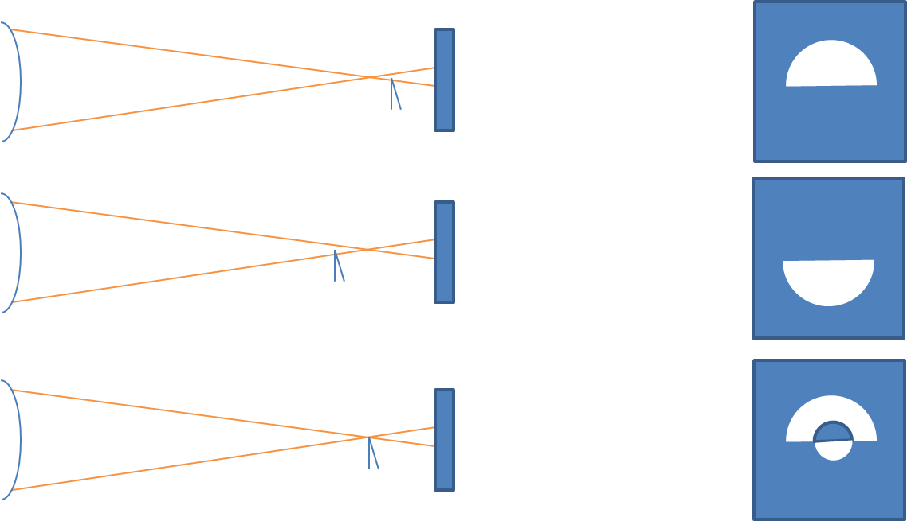
Point Spread Function – PSF_{O} Measurement
The Point Spread Function (PSF) is the response of an imaging system to a point source.
PSF_{OD} – Total system PSF sampled by the CCD
PSF_{O} – Optical component of PSF, including projection and vacuum chamber window
PSF_{D} – Charge diffusion component of PSF introduced by the CCD
Measurements were taken for incident light of 450 nm and 700 nm to assess the wavelength dependence.
Edge after focus
Edge before focus
Edge at focus

Slide 14
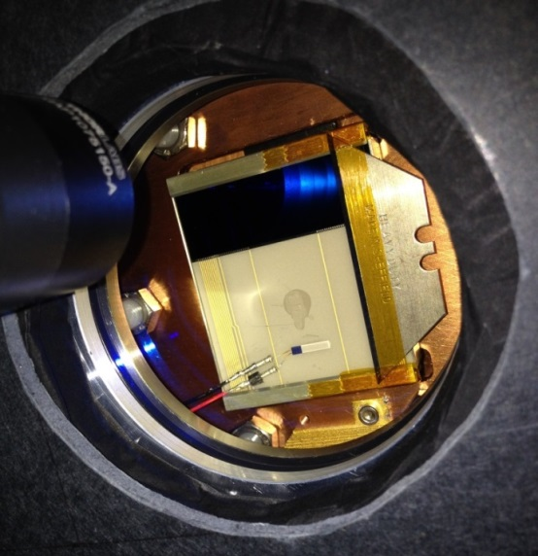
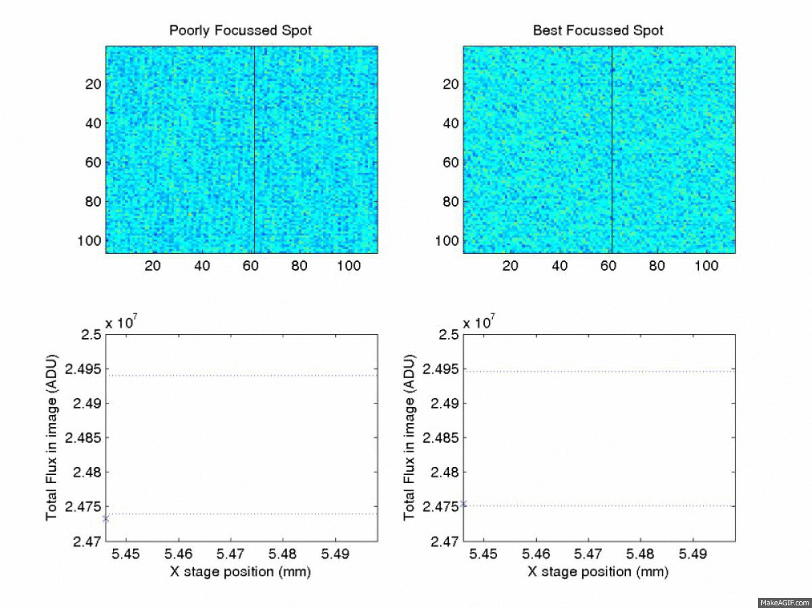
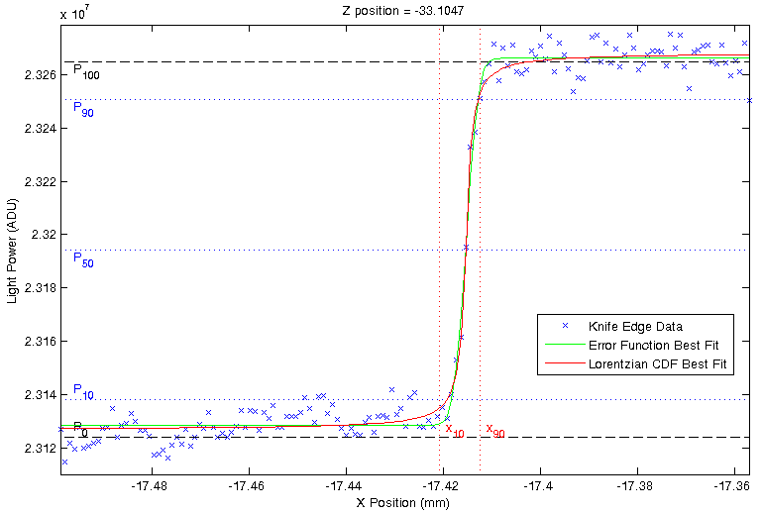
Point Spread Function – PSF_{O} Measurement
The beam is translated over the knife edge in known steps and total flux seen in the CCD is
measured, this gives the optical PSF.
Knife edge beyond beam waist
Knife edge at beam waist

Slide 15
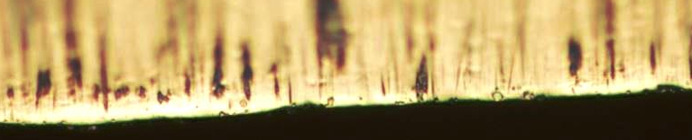
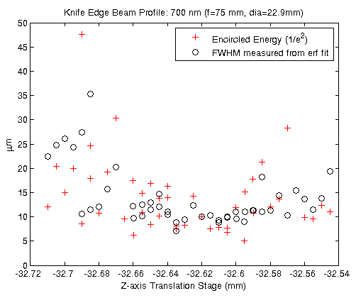
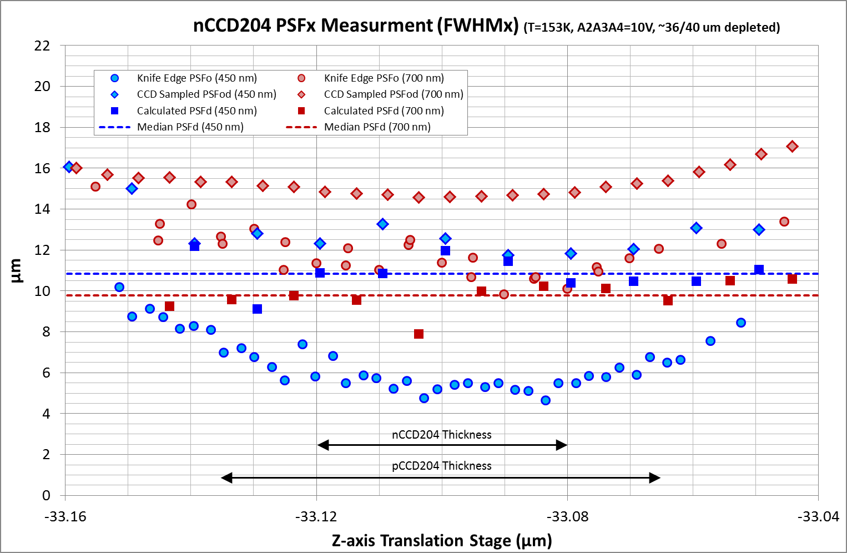
Point Spread Function – PSF_{O} Measurement
Example of knife edge
PSF_{OD} Y-axis measurement
8 µm
Example measurement at z=-33.104 mm
PSF_{O}450nm = 5.6 µm FWHM (σ = 0.2 pix)
PSF_{O}700nm = 10.5 µm FWHM (σ = 0.37 pix)

Slide 16
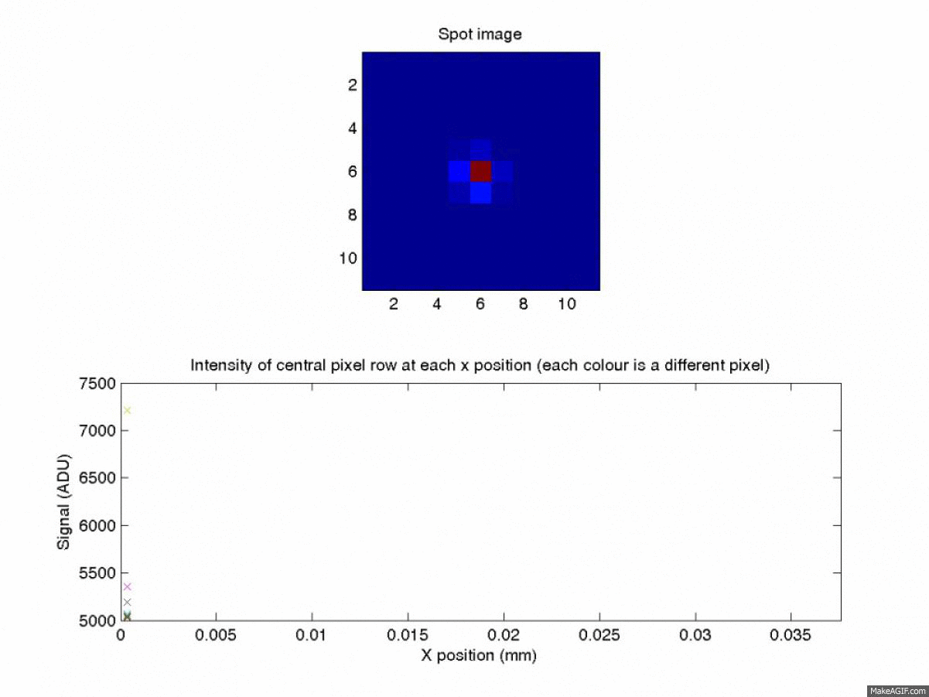

Point Spread Function – PSF_{OD} Measurement
A spot is scanned in x and y in known steps, using the flux seen in each pixel either binned in x or y, we sample the PSF_{OD} as seen by multiple pixels, resulting in a highly sampled measurement
Also using this technique to measure effective pixel pitch within stitch blocks
– could this be used to measure tree ring distortions?

Slide 17
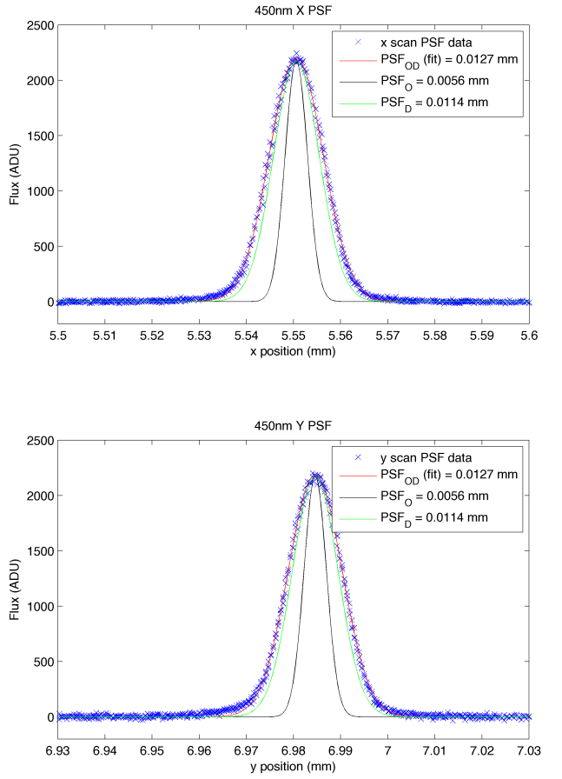
Point Spread Function – PSF_{D} Calculation
λ (nm) | CCD | Direction | PSF_{D} (FWHM) | PSF_{D} (σ_{PIX})
450 | N- | Column | 11.4 µm | 0.40
450 | N- | Row | 11.4 µm | 0.40
450 | P- | Column | 12.3 µm | 0.44
450 | P- | Row | 9.11 µm | 0.32
700 | N- | Column | 9.4 µm | 0.33
700 | N- | Row | 9.9 µm | 0.35
Measured at ~10k e⁻/h⁺

Slide 18
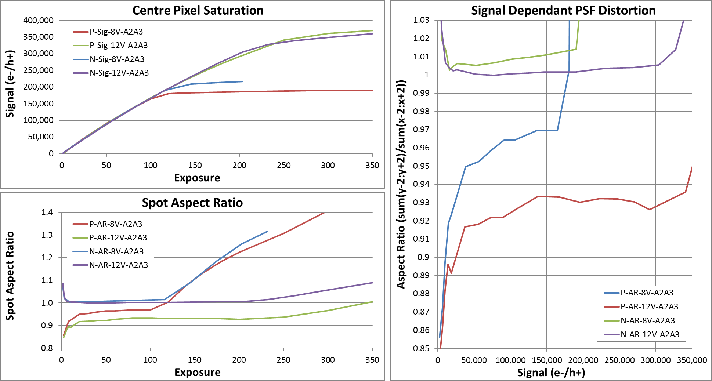
Spot Aspect Ratios

Slide 19
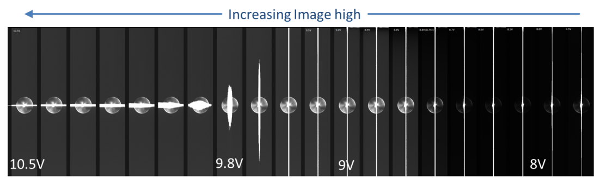
Mitigation Strategies
Model it and ‘correct’ for in software
Optimise the pixel architecture
  Gates biased during integration
    4-phase (+9 options)
    3-phase (5 options)
  Gate bias levels during integration (previous slide)
  Investigate alternate pixel designs

Slide 20
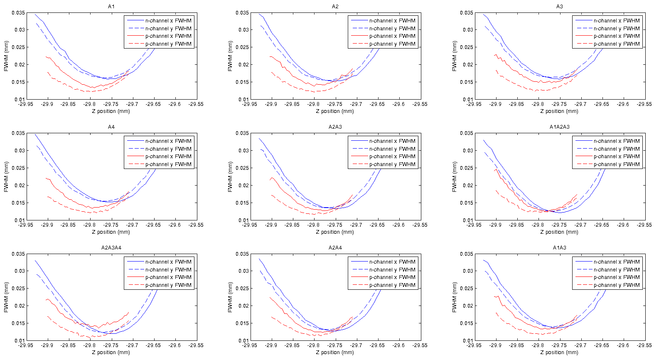
N- vs. P-channel PSF_{OD} vs. Gate Bias
~10k e-/h+ in centre pixel

Slide 21
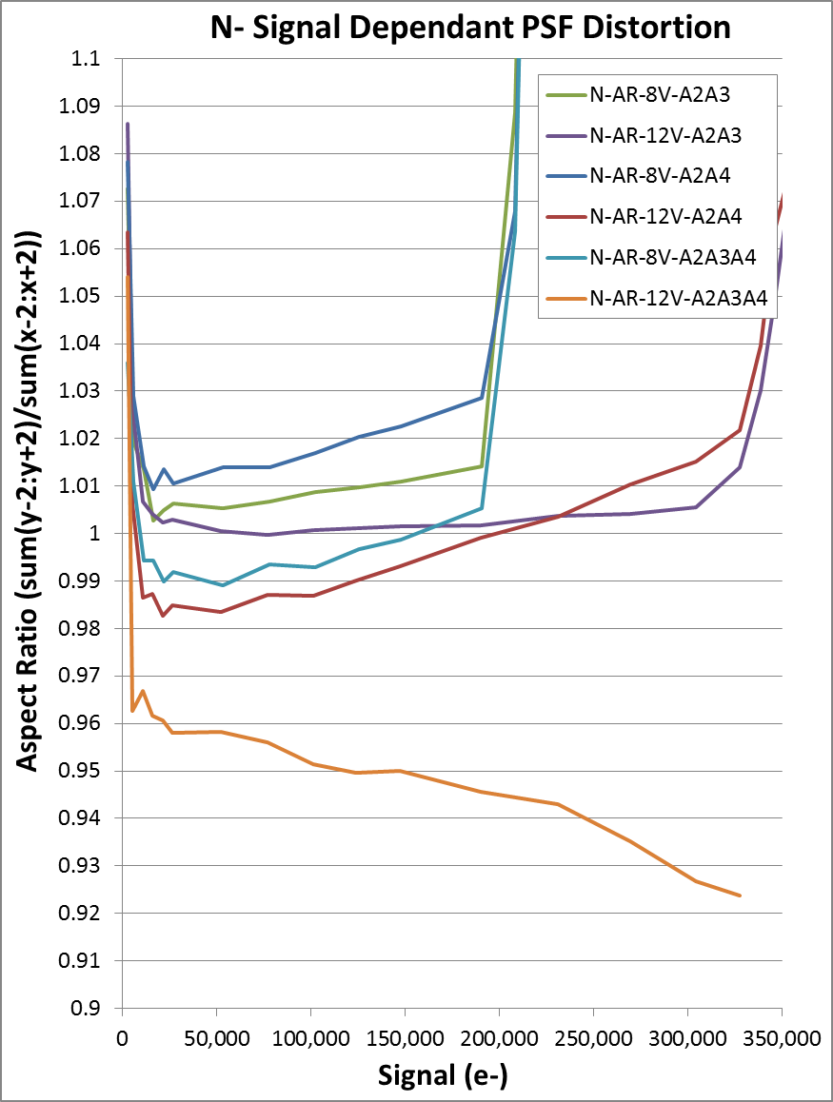
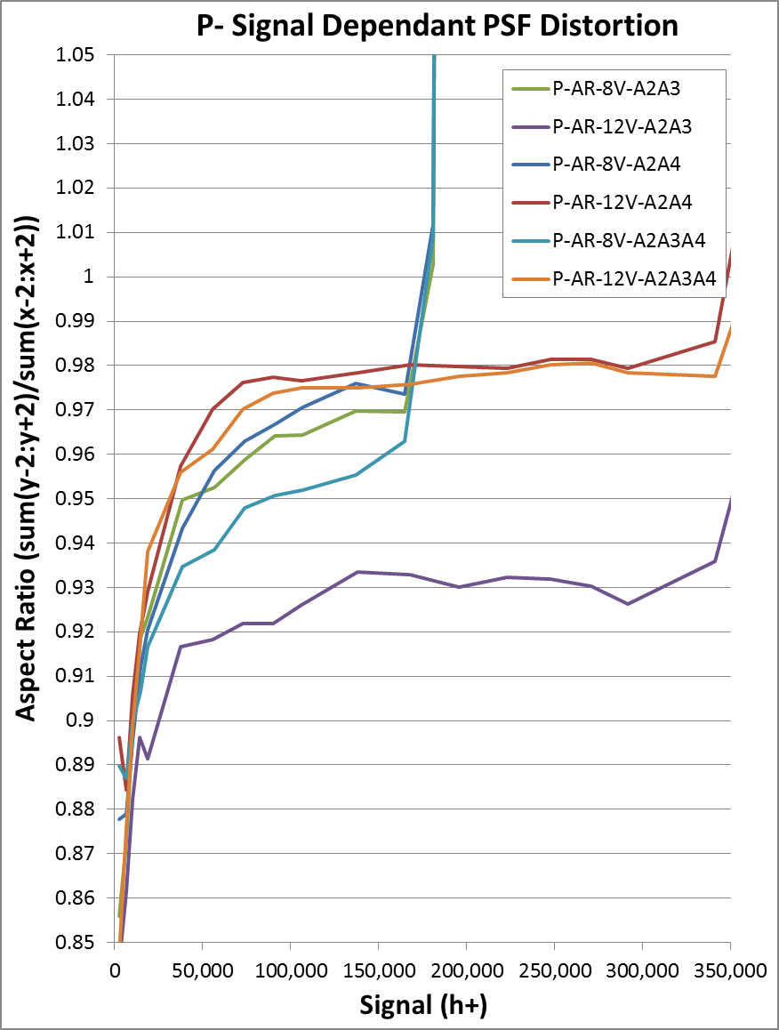
Spot Aspect Ratios vs. Gate Biases

Slide 22
Optimising Pixel Design
‘Typical’ Pixel Design
Proposed Pixel Design
Column Gates
Column isolations
Isolation islands
A1 = 0 V
A2 = 8 V
A3 = 8 V
A4 = 8 V
A1 = 0 V
Pixels

Slide 23
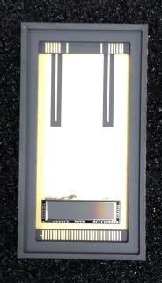
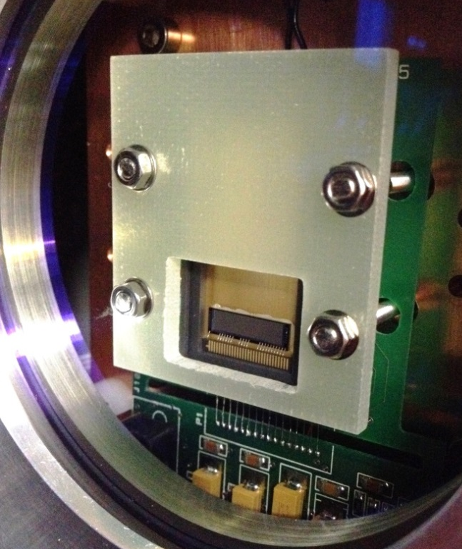
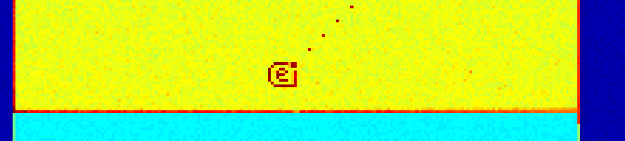
e2v Test Structures
Two variants at Open University
15 µm wide × 10 µm high pixels
200 × 1,200 pixels (3 mm × 12 mm)
Type A – 70 ke⁻ well capacity (+10 V)
Type B – 45 ke⁻ well capacity (+10 V)
Charge injection structure
Cooled to 173K
Proton irradiation in Jan 2015
“High-rho-able design”
Devices only received 14th November – limited data so far!
Image with charge injection at room temperature

Slide 24
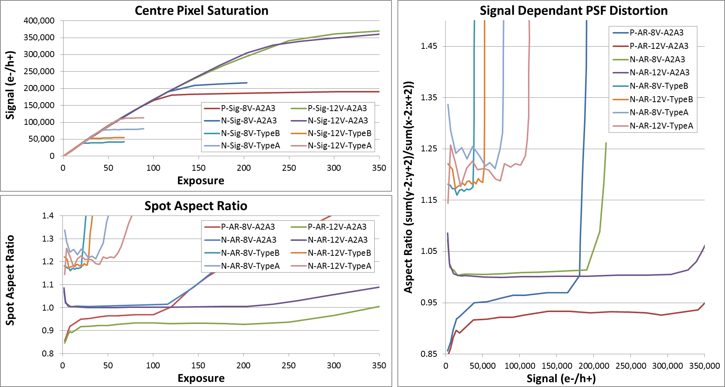
Spot Aspect Ratio Comparison
1 Sample – manual
10 Samples – ATE

Slide 25
Summary
1. Achromatic behaviour in PTC – take care with what signal level you test PRNU
2. Signal dependence of PSF shape observed in n- and p-channel CCDs
    Greater in the column direction than the row
    Can mask wavelength dependence of PSF/MTF – also take care what signal level you test at
    Higher the gate bias, deeper the well, lower the effect – but can lead to other problems i.e. persistence
3. May be possible to correlate tree rings in flats to physical distortion through spot-scans
4. More electrically uniform pixel CCDs are available for study for use in future applications

