Slide 1
Dream and other Saclay chips
O. Gevin
IRFU, CEA, Université Paris-Saclay.
Slides from I. Mandavidze, P. Baron,
F. Bouyjou, F. Guilloux, E. Delagnes...

Slide 2
Introduction
  The goal of this presentation is to give an overview of the (families of) ASICs and stand alone building blocks of ASICs developed by Saclay group that may be helpful.
  Focus on versatile low noise front-end for solid state and gaseous detectors: the DREAM family
  Brief description of other existing chips and/or building blocks*
  Parallel ADC
  High speed digital sampler
  Fast TDC
  ...
  *Future dedicated talk on a specific ASIC can be given if needed.

Slide 3























ASIC ROADMAP at SACLAY
Past
Present
IDefX E
(SVOM
mission)
IDef-X BD
(Solar Orbiter)
IDef-X HD BD
FEANICS
IDef-X HD
(Solar Orbiter)
OBW1
D2R1
Low noise frontends for capacitive detectors
ANR
CMS
CATIA
(CMS-ECAL)
CATIA 2
PEPITA
Monacal(CMS)
IDef-X D2R2
ATHED
(SPIRAL)
AFTER (T2K)
DREAM (CLAS12)
AGET (Spiral2)
ASTRE
New generation ASICs for gaseous detectors
Analog memories
mass productions and test with PACMAN robot
NECTAR (CTA)
NECTAR 2(CTA)
CTA Production+ test
SAM (HESS-2)
SAMPIC
HAMAC
(ATLAS)
Picosecond
timing
CMS
SAMPIC-2
CMS-HGCAL
(Omega, CERN...)
CMS-HGCAL V2
(Omega, CERN...)
Monolithic pixel sensors (MAPS)
HGCROC3(CMS)
ALICE MFT
Production management
MIMOSA8
(IPHC)
PIXAM
P-ALPIDE V3&4 (CERN…)
MIMOSA26
(IPHC)
R&T
HV Maps, timing
Cryogenic electronics
(CrAsics!)
CryoCanal1
LFCPIX 1
(CPPM, Bonn)
CACTUS
(CPPM, Bonn)
RoBo
Electronics for
bolometer matrixes
BBOP
CryoCom1
Eclipse-750(ESA mission)
Collaboration
Under test
CHIPNAME(collaboration) (Experiment)
DMILL 0.8
AMS 0.8
AMS 0.35
AMS 0.35 SiGe
AMS 0.18
X-FAB 0.18
Tower Jazz 0.18
IBM 0.13
Lfoundry 0.15
TSMC 0.13

Slide 4
ASIC ROADMAP at Saclay
Past
Present
IDefX E
(SVOM
mission)
IDef-X BD
(Solar Orbiter)
IDef-X HD BD
FEANICS
IDef-X HD
(Solar Orbiter)
OBW1
D2R1
Low noise frontends for capacitive detectors
ANR
CMS
CATIA
(CMS-ECAL)
CATIA 2
PEPITA
Monacal(CMS)
IDef-X D2R2
ATHED
(SPIRAL)
AFTER (T2K)
DREAM (CLAS12)
AGET (Spiral2)
ASTRE
New generation ASICs for gaseous detectors
Analog memories
mass productions and test with PACMAN robot
NECTAR (CTA)
NECTAR 2(CTA)
CTA Production+ test
SAM (HESS-2)
SAMPIC
HAMAC
(ATLAS)
Picosecond
timing
CMS
SAMPIC-2
CMS-HGCAL
(Omega, CERN...)
CMS-HGCAL V2
(Omega, CERN...)
Monolithic pixel sensors (MAPS)
HGCROC3(CMS)
ALICE MFT
Production management
MIMOSA8
(IPHC)
PIXAM
P-ALPIDE V3&4 (CERN…)
MIMOSA26
(IPHC)
R&T
HV Maps, timing
Cryogenic electronics
(CrAsics!)
CryoCanal1
LFCPIX 1
(CPPM, Bonn)
CACTUS
(CPPM, Bonn)
RoBo
Electronics for
bolometer matrixes
BBOP
CryoCom1
Eclipse-750(ESA mission)
Collaboration
Under test
CHIPNAME(collaboration) (Experiment)
DMILL 0.8
AMS 0.8
AMS 0.35
AMS 0.35 SiGe
AMS 0.18
X-FAB 0.18
Tower Jazz 0.18
IBM 0.13
Lfoundry 0.15
TSMC 0.13

Slide 5
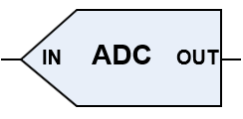
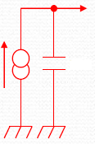
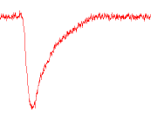
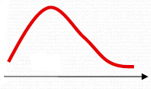
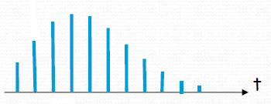
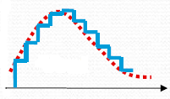
Dream and its family
  FE-SCA type ASIC: designed for gaseous detectors and semi-conductor detector for high dynamic range.
Typical architecture
  Multi-channel architecture with, for each channel:
  CSA (multi-gain) + Filter (multi peaking time) + Sampling Capacitor Array (analog memory)
  This channel memorizes for each event (validated by internal or external trigger) the waveform of the output of the filter:
ASIC
C
C
R
R
C
Trigger
CSA
Filtering / shaping
SCA

Slide 6
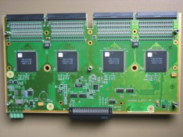
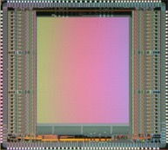
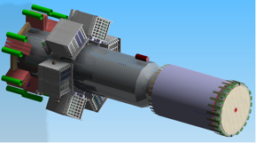
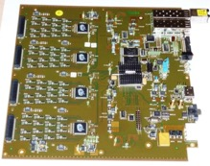
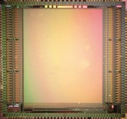
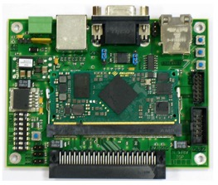
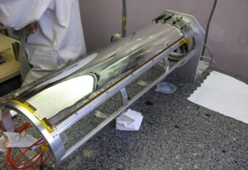
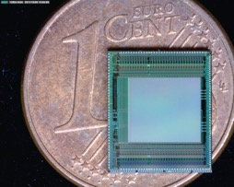
Dream and its family
  FE-SCA type ASIC: designed for gaseous detectors and semi-conductor detector for high dynamic range.
  Different flavors:
    Dynamic range (10 pC max)
    Peaking time range (50ns-8µs)
    Scaling to detectors (up to 1nF input capacitor)
    External/internal trigger
    Readout strategy, dead time
  Typical applications:
  Readout of gaseous detectors and silicon detectors.
1.5m
2m
AFTER ASIC for T2K in 2007 and recently for the upgrade
AGET ASIC on FEMINOS
DREAM ASIC for CLAS12

Slide 7
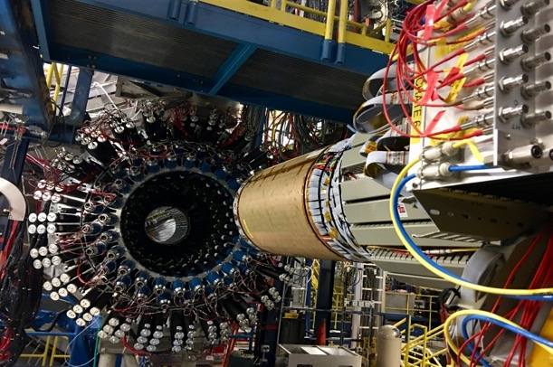

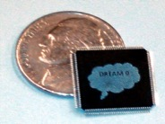

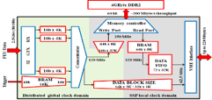
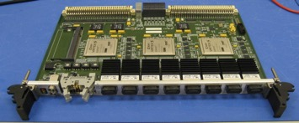
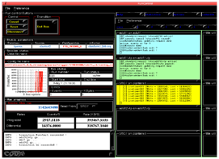
Micromegas Vertex Tracker for
CLas12 project at JLAB
350 units of 64-channel 1.5-2m long
micro-coaxial low 70 pF capacitance cables
384 64-channel Dream ASICs on
48 512-channel frontend units FEU
6 cylindrical layers & 6 forward disks
  60 to 120 pF strips
~20 000 channels
~20 MHz background w/ ~20 kHz hit rate
~20 kHz trigger rate w/ 16 µs pipeline
Off-detector frontend electronics
ENC=2500e- at Cin=200 pF
3 backend units based on Jlab fast-electronics with firmware adaptation
Software integration in CODA framework

Slide 8


Dream asic: architecture
  AMS CMOS 350nm
  64 analog channels : CSA, Filter, SCA (512 cells), Discriminator
  Auto triggering : discriminator + threshold (7 bits+ polarity DAC)
  Multiplicity signal : LVDS level; 8 levels of multiplicity
  SPI link for Slow Control
  SCA readout mode
  triggered cells of the 64 channels
  4 Gains/channel
  50 fC; 100 fC; 200 fC;600 fC
  16 peaking time values
  50 ns to 900 ns
  Fsampling
  1 MHz to 50 MHz
  Fread
  20 MHz [ # 33 MHz]
  Input current polarity
  positive or negative
  Possibility to bypass the CSA
  enter directly into the RC2 filter or SCA inputs
DREAM
1 channel
Σ 64 discri.
+
-
Discri
Hit pulse
Hit signal
Charge range
inhibit
FILTER
SCA
64
1
CSA
ADC
512 cells
x64
tpeak
BUFFER
TEST
SLOW CONTROL
SCA & Readout Control
In Test
Serial Interface
Write
Read
Trigger
CKw
CKr

Slide 9
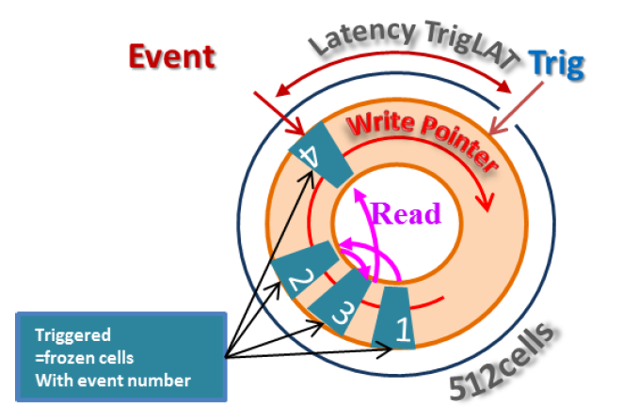
Dream asic: sca management
Sampling
  For DREAM, the signals are continuously sampled in the SCA without interrupt
Trigger signal is send to the chip with a fix latency time
  N samples on all SCA channels are frozen for each triggered event
  (N = TRIGGERwidth/Tcksampling; Latency time = Slow Control register 9-bit)
Readout
  After readout, the frozen cells of the 64 channels are reused for sampling
  Several triggered events can be stored in the SCA waiting for readout
  Event number is joined with analog data

Slide 10
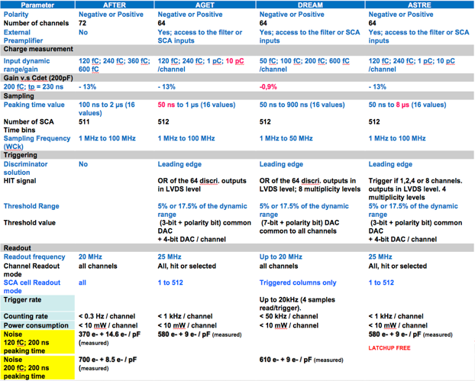
Summary

Slide 11
Bricks for Evolution

Slide 12
GO TO DIGITAL
ASIC
C
C
R
R
C
Trigger
CSA
Filtering / shaping
SCA
ASIC
C
C
R
R
C
Trigger
CSA
Filtering / shaping
SCA

Slide 13
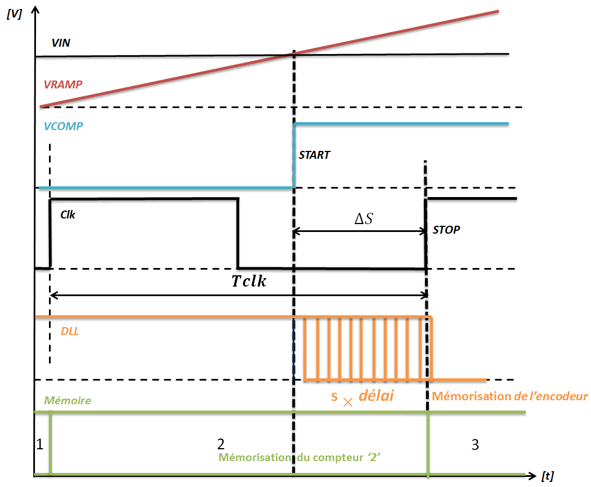
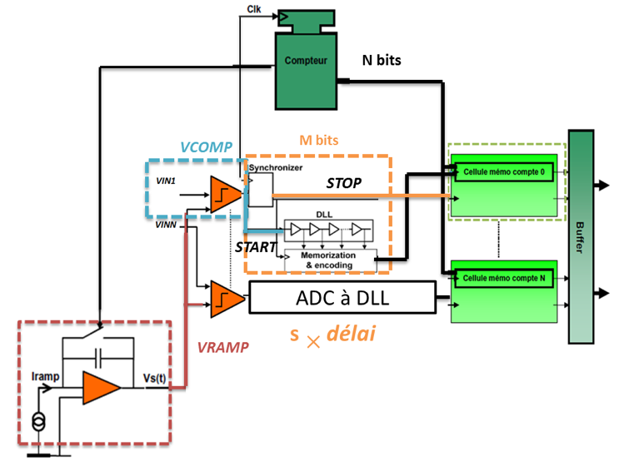


GO TO DIGITAL
OWB-1: 32-channel 13-bits Wilkinson ADC
Architecture Wilnkinson with DLL (delay-locked loop)
$$Time max : 2,56 µs$$
$$100MHz$$
Wilkinson: T_{code}= 2^{n} x T_{clk}
Wilkinson + DLL: T_{code}= 2^{n} x T_{clk} /N_{DLL}
Error ∆t =1/FDLL
= 312,5 ps
Wilkinson ➔ 8 bits
For the same speed :
Wilkinson + DLL ➔ 13 bits : 32 x more accurate !

Slide 14
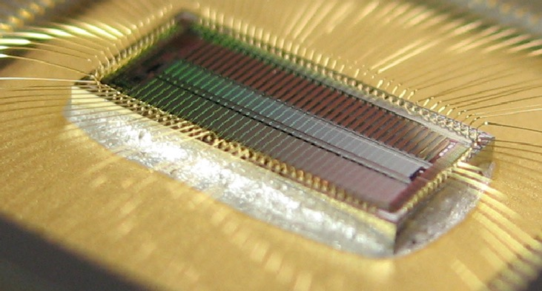
GO TO DIGITAL
OWB-1: 32-channel 13-bits Wilkinson ADC
OWB-1: Main features
Technology: CMOS AMS 350 nm
Die : 50 *2000 µm
TOTAL : 18 mm²
32 channels
13 bits
Max sampling rate:
370 kHz (13 bits) to 1.28 MHz (11 bits)
Noise: 0.3 to 0.9 LSB (end of dynamic)
SEU flag
Power consumption : < 1mW / channel
Total chip power: 36,6 mW
SPI : Programming registers
Configuration modes
Data read : // and serial
Alim-on or off
Mask channel
Adjustable Ramp : DAC
Adjustable ADC resolusion : 13 to 10 bits
Input DC shifter
Temperature compensation system
PLL (1MHz->100MHz)
…
6,2 x 2,8 mm

Slide 15
Increase the Dynamic range / Noise ratio
ASIC
C
C
R
R
C
Trigger
CSA
Filtering / shaping
SCA
C
Automatic
ASIC
CSA
C
C
R
R
C
Trigger
CSA
Filtering / shaping
SCA

Slide 16

Increase the Dynamic range / Noise ratio
FEANICS CHIP
FEANICS: Automatic gain for high resolution and high dynamic range
SATURATION
Signal over low gain range =>
Desaturation mode
(discharge capacitor)
Large capacitor C_{LG}
EN_{LG}
EN_{LG}
CSA_output (t)
LG_threshold
Detector + cable
capacitor
Small capacitor C_{HG}
CSA_output (t)
- A
I_{D}
C_{D}
-
+
t
LG_threshold
Cmd_LG
Logic bloc
EN_{LG}
t
2 ranges in the same amplifier and the same time :
1 HER : High energy resolution (High gain) from 80fC to 3.7pC
1 HDR : High dynamic range (low gain) from 5.5pC to 40pC

Slide 17
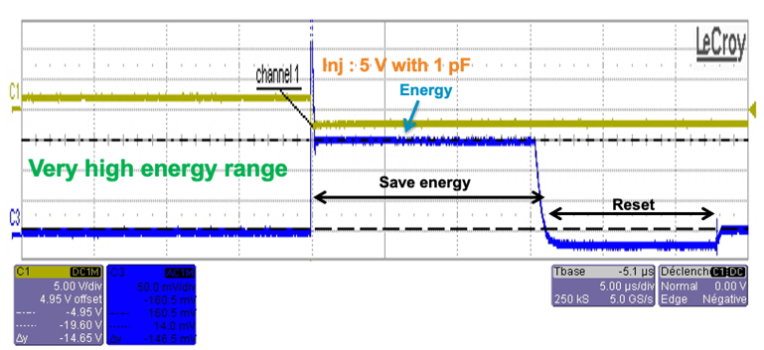
Increase the Dynamic range / Noise ratio
FEANICS CHIP
Typical Waveform in CSA-only mode (no shaper)
Transfer function
Quasi square shape : Multisampling
Polarity both : same in negative
Automatic switching between High and low gain
CSA_output (V)
CSA_output (t)
Low gain threshold (t)
Low gain threshold
Automatic switching
Adjust threshold
High gain
Low gain
Adjust baseline
t
Si energy (eV)
Adjust duration
< 20 keV 2 MeV
600 MeV
Modification via Slow Control :
Thresholds, baseline (11 bits internal DAC)
Gains (High & Low) (4 bits)
Signal duration (10 ns to 10 ms)
Shaping Output – Shaping time (60 ns -10 µs)
Differential / Single Ended,
Saturation detection
…

Slide 18
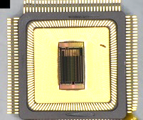
Increase the Dynamic range / Noise ratio
FEANICS CHIP
 | FPCSA | FEANICS
Techno | AMS CMOS 0.35 | AMS CMOS 0.35
Channel | 2 | 16
Architecture | CSA + Buffer | CSA + Shaper (optional) + Buffer
CSA (Dual-polarity can read both anode or cathode) | Dual-polarity (passive noisy) Semigaussien shape | Dual-polarity (active with less noise) Quasi square shape (easy for digitization)
3 gain modes: | Permanent High gain ➔ High Energy Resolution (HER) Permanent Low gain ➔ High Dynamic Range (HDR) Automatic switching between High and low gain ➔ HER + HDR
Output buffer | Differential | Single or differential with Baseline adjustment for versatility
Shaper | NO | Variable peaking time (60ns to 10µs) in shaper mode for ENC optimization
Trigger reference | External | Internal fine tuned threshold (11 bis DAC)
Temperature range -40 to 40°C : | 6 % error | 0.1 % error Compensation self-calibration circuits (Bandgap, OFFSETS compensation)
Output interface | 2 CMOS / channel | 4 LVDS for all the chip
Other |  | Anti-saturation circuit for cross talk reduction, SPI interface Power & Reset, temperature probe …
CQFP 128

Slide 19
FAST DIGITAL SamplER: analog memory + ADC//

Slide 20
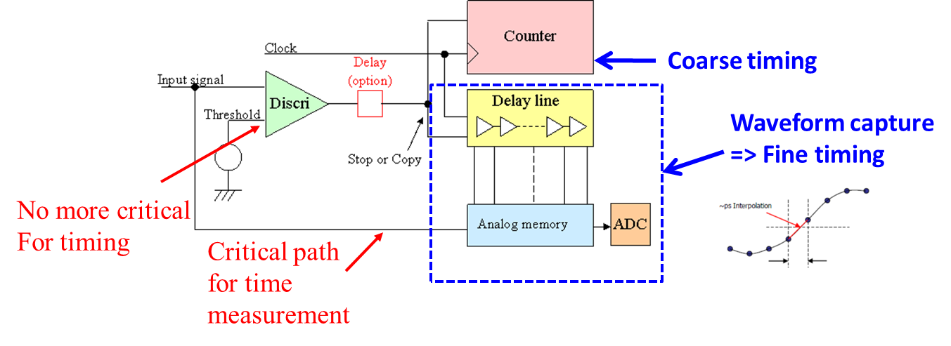
High speed digital sampler
  “Recent” achievements: SAMPIC: waveform TDC
  The Waveform TDC : a new concept based on an original principle
  Association of : Analog Memory + Discriminator + Counter + DLL + ADC
  Time Given by :
  - Coarse = Timestamp Gray Counter ( ~6 ns step)
  - Middle = DLL locked on the clock to define Region of interest (150ps step)
  - Fine = few samples in the ZOI of the waveform (interpolation will give a precision of a few ps rms)
  Digitized Waveform Shape, Charge and Amplitude are available
  Discriminator used only for triggering, not for timing
12 bits in the chip
+ 20 bits in FPGA
Middle timing

Slide 21
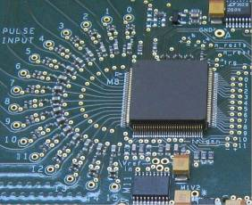
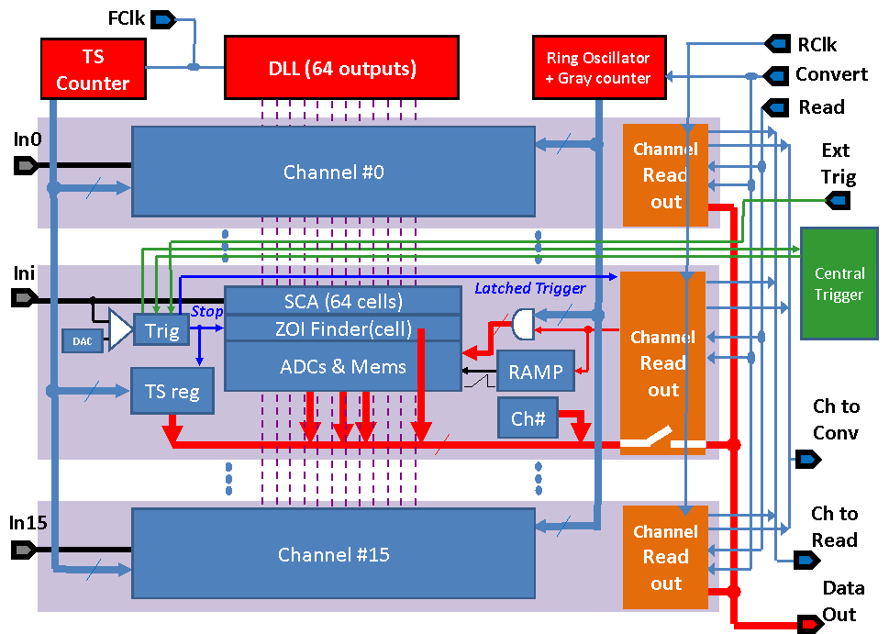
High speed digital sampler
  “Recent” achievements: SAMPIC: waveform TDC
Techno: CMOS 0.18µ
Size: 7 mm2
Prototyping cost: only 10 k€
Package: 128-pin QFP, pitch of 0.4mm
16 single-ended channels:
  Self triggerable (or Central OR Trigger, or External Trigger)
  Independent channels
  64 analog sampling cells/ch
  One 11-bit ADC/ cell (total : 64 x 16 = 1024 on-chip ADCs)
One common 12-bit Gray counter (@160MHz) for coarse timestamping.
One common servo-controlled DLL: (from 1 to 10 GS/s) used for medium precision timing & analog sampling
One common 11-bit Gray counter running @ 1.3GHz and used for the massively parallel Wilkinson analog to digital conversion. (1.6us for 11bits, 400ns for 9bits)
12-bit LVDS readout bus (potentially running up to 400 MHz)
SPI Link for Slow Control configuration

Slide 22
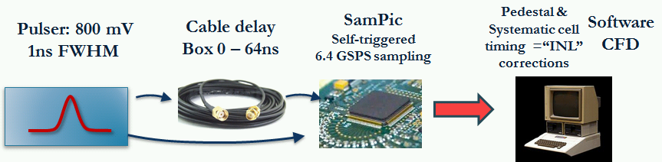
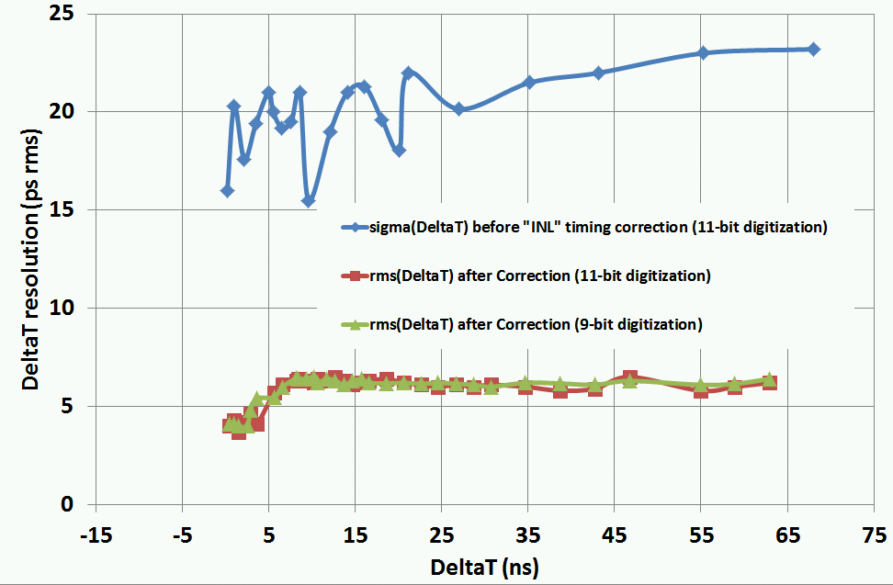
High speed digital sampler
  “Recent” achievements: SAMPIC: waveform TDC
Digital CFD
<15 ps RMS = (22/√2) single pulse timing resolution without any timing calibration (short DLLs)
<5 ps RMS timing resolution on single pulse after timing “INL” correction
Resolution vs ΔT is FLAT after 10ns
Same results in 9-bit/400ns mode

Slide 23
Useful(?) building blocks

Slide 24
ASIC ROADMAP at IRFU
Past
Present
IDefX E
(SVOM
mission)
IDef-X BD
(Solar Orbiter)
IDef-X HD BD
FEANICS
IDef-X HD
(Solar Orbiter)
OBW1
D2R1
Low noise frontends for capacitive detectors
ANR
CMS
CATIA
(CMS-ECAL)
CATIA 2
PEPITA
Monacal(CMS)
D2R2
ATHED
(SPIRAL)
AFTER (T2K)
DREAM (CLAS12)
AGET (Spiral2)
ASTRE
New generation ASICs for gaseous detectors
Analog memories
mass productions and test with PACMAN robot
NECTAR (CTA)
NECTAR 2(CTA)
CTA Production+ test
SAM (HESS-2)
SAMPIC
HAMAC
(ATLAS)
Picosecond
timing
CMS
SAMPIC-2
CMS-HGCAL
(Omega, CERN...)
CMS-HGCAL V2
(Omega, CERN...)
Monolithic pixel sensors (MAPS)
HGCROC3(CMS)
ALICE MFT
Production management
MIMOSA8
(IPHC)
PIXAM
P-ALPIDE V3&4 (CERN…)
MIMOSA26
(IPHC)
R&T
HV Maps
Cryogenic electronics
(CrAsics!)
CryoCanal1
LFCPIX 1
(CPPM, Bonn)
CACTUS
(CPPM, Bonn)
RoBo
Electronics for
bolometer matrixes
BBOP
CryoCom1
Eclipse-750: ESA mission
Collaboration
Under test
CHIPNAME(collaboration) (Experiment)
DMILL 0.8
AMS 0.8
AMS 0.35
AMS 0.35 SiGe
AMS 0.18
X-FAB 0.18
Tower Jazz 0.18
IBM 0.13
Lfoundry 0.15
TSMC 0.13

Slide 25

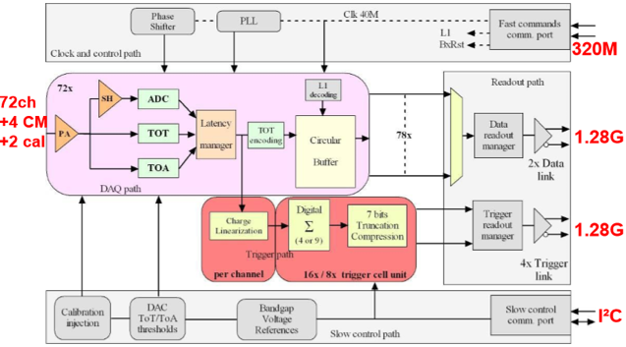
HGCROC: CMS high granularity calmorimeter readout Chip
72-channel ASIC in 130 nm TSMC technology
  Charge measurement
    10-bit 40 MHz ADC: 0.2 fC resolution
    12-bit time over threshold TDC: 2.5 fC resolution
  Time of arrival measurement
    10-bit TDC: 25 ps resolution
  Trigger path over four 1.28 Gb/s links
    4 (9) channel sums
  Data path over two 1.28 Gb/s links
    512-deep DRAM circular buffer
Final V3 version to be submitted in Q4 2020
  100 000 units to be produced starting from 2022
IRFU: PLL and TDC IPs for ~40ps timing
TDC
Resolution | 24.4 / 12.2 ps
Bits | 10 / 11 bits (over 25 ns)
Conversion rate | 10-bit - 90 MHz 11-bit - 60 MHz
Linearity | DNL < 1 LSB and INL < 2 LSB
Power consumption | Conversion 2.2 mW; static 10 µW
Calibration | Internal
Area | 250 µm x 160 µm
Technology | TSMC 130 nm
Temperature | -40 / 40 °C
Radiation hardness | > 100 Mrad; SEU tolerant
PLL
Input frequency | 40 MHz (Bunch clock)
Output frequency | 160, 320, 640, 1280 MHz
Jitter | 9 ps rms
Power consumption | 1.9 mW
Area | 515 µm x 141 µm
Technology | TSMC 130 µm
Temperature | -40 and 40 °C
Radiation hardness | > 100 Mrad

Slide 26
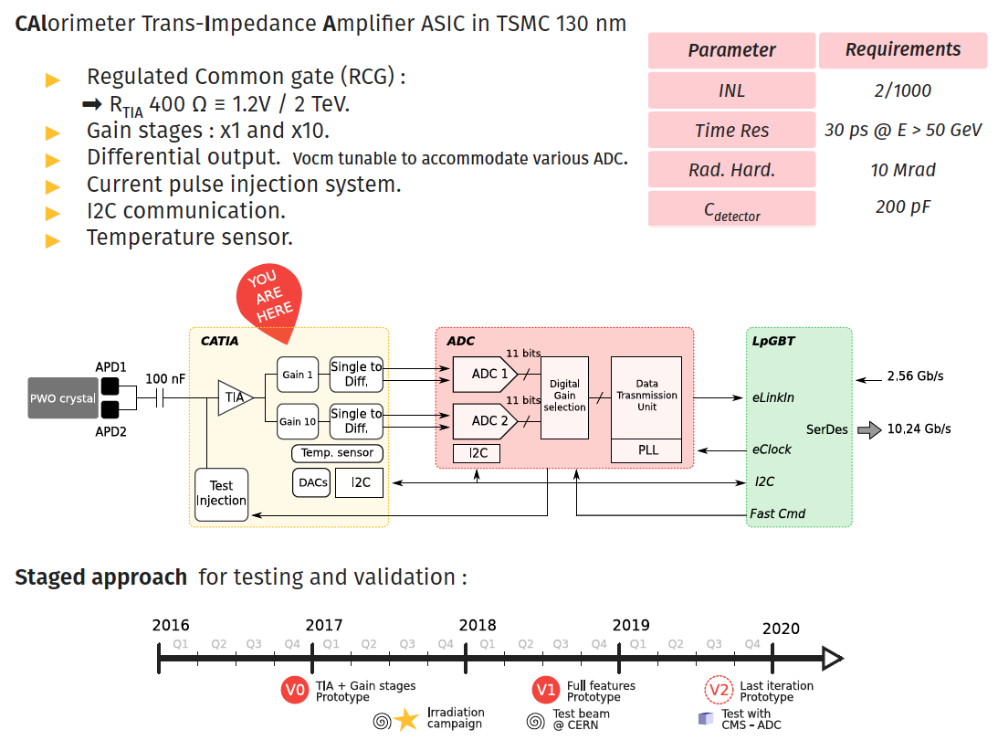
CATIA: CMS ECAL upgrade

Slide 27
Conclusion
  No chip a priori suited for EIC but know how and ASICs based on:
  front-end (csa+shaper)
  front end + analog memory
  analog memory + ADC//
  ADC//
  Potentially useful building blocks:
  Radiation hard PLL
  Radiation hard TDC
  SEU tolerant (TMR) I²C
  Low noise CSAs, Shaper, Bandgaps, 12 bits DACs, fast digital drivers, Temperature sensors...

Slide 28

Increase the Dynamic range / Noise ratio
FEANICS CHIP
FEANICS: Automatic gain for high resolution and high dynamic range
Channel core architecture additional optional functionalities: Saturation controller, Event trigger, gain controller, Shaper and offset cancellation…
V_{TH_SAT}
Saturation control
En_SC
Saturation
gain
reset
V_{TH_LG}
Gain control
En_GC
Gain
H/L gain
Multi gain CSA
Pulse Shaper
Output Buffer
V_{OUT_N}
I_{D}
V_{OUT_CSA}
V_{OUT_P}
C_{D}
V_{TH_EVENT}
En_PS
V_{CM}
reset
Event Trigger
En_ET
Trigger
Delay

Slide 29
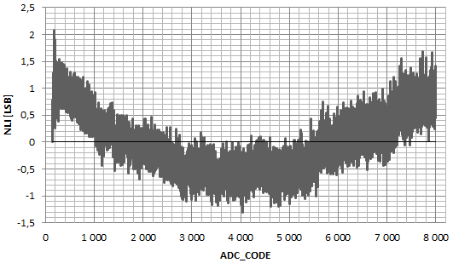
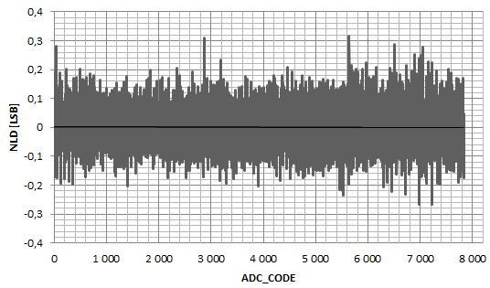
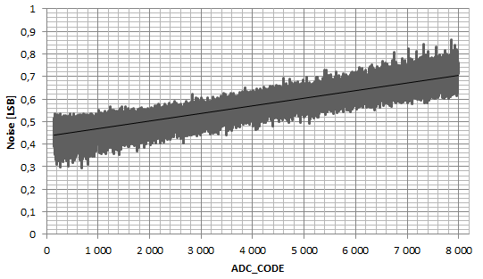
OWB-1: 32-channel High SPEED
Wilkinson ADC
INL : Integral Non Linearity
DNL : Differential Non Linearity
Measurement : 512 acquisitions/16 bits input DAC :
OWB-1 : Error of 0,01 %
OWB-1
DNL= +0,3 to -0,3 LSB
INL = +2,1 to -1,3 LSB
Standard deviation for 512 acquisitions/input DAC
Noise= +0.3 to 0.9 LSB

Slide 30
Measured ENC_{(Cin,tp)} in the 50 fC range for Icsa = 1.2 mA
Measured ENC_{(Cin,tp)} in the 100 fC range for Icsa = 1.2 mA
Measured ENC_{(Cin,tp)} in the 200 fC range for Icsa = 1.2 mA
Measured ENC_{(Cin,tp)} in the 600 fC range for Icsa = 1.2 mA

