Slide 1
Radiative Corrections in MC for EIC

Slide 2
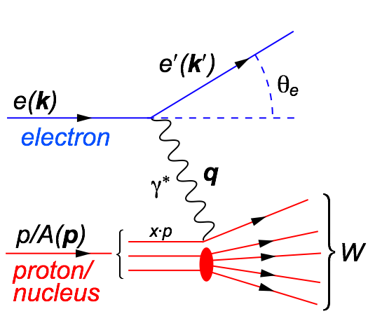

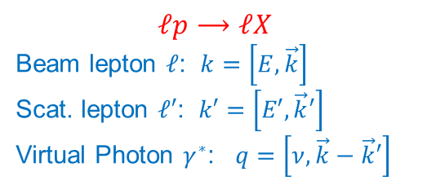
Kinematics of Deep Inelastic Scattering
DIS variables:
$s={\left(k+P\right)}^{2}≃2k∙P+m_{P}^{2}$
$Q^{2}=−q^{2}=−{\left(k−k^{′}\right)}^{2}≃2k∙k^{′}$
$x=\frac{Q^{2}}{2P∙q}$
$y=\frac{P∙q}{P∙k}$
$W^{2}={\left(P+q\right)}^{2}=P^{2}−Q^{2}+2P∙q$
SIDIS variables:
$z_{h}=\frac{P∙P_{h}}{P∙q}$
$$ℓp⟶ℓX$$
Beam lepton $ℓ$: $k=\left[E,\vec{k}\right]$
Scat. lepton $ℓ′$: $k′=\left[E′,\vec{k}′\right]$
Virtual Photon $γ^{∗}$: $q=\left[ν,\vec{k}−\vec{k}′\right]$

Slide 3
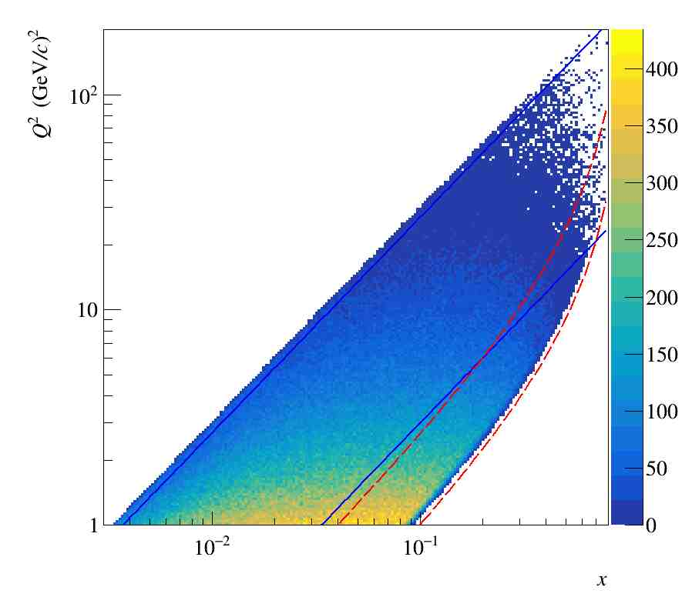
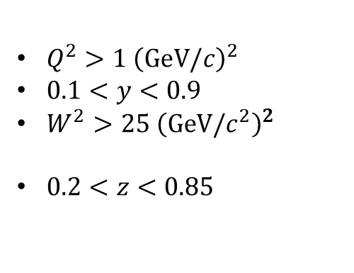
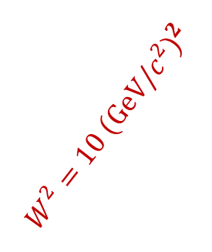




Standard Cuts @ $\sqrt{s}\sim 17$ GeV
DIS cuts:
$Q^{2}>1 {\left(GeV/c\right)}^{2}$
$0.1<y<0.9$
$W^{2}>25 {\left(GeV/c^{2}\right)}^{2}$
SIDIS cuts:
$0.2<z<0.85$
$$W^{2}=25 {\left(GeV/c^{2}\right)}^{2}$$
$$W^{2}=10 {\left(GeV/c^{2}\right)}^{2}$$
$$y=0.9$$
$$y=0.1$$

Slide 4
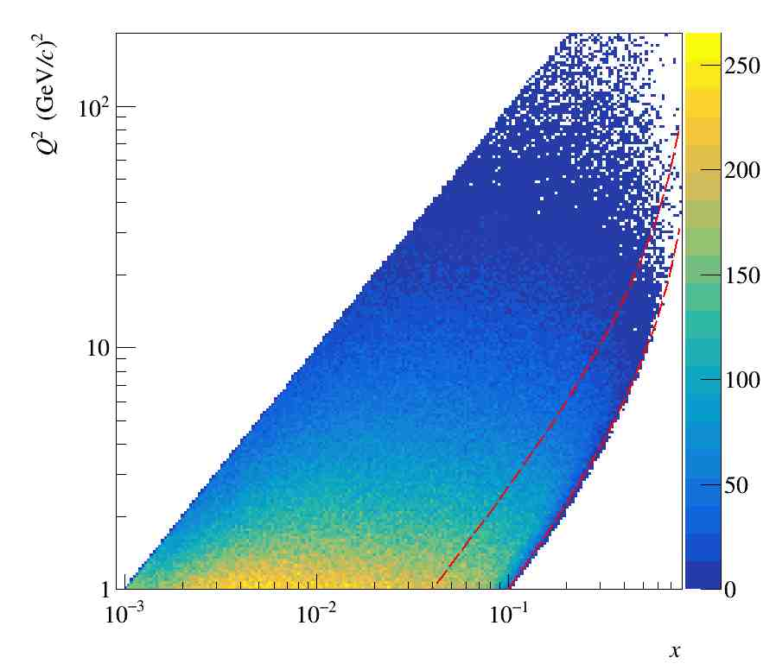

Phase space for a $\sqrt{s}\sim 22$ GeV

Slide 5
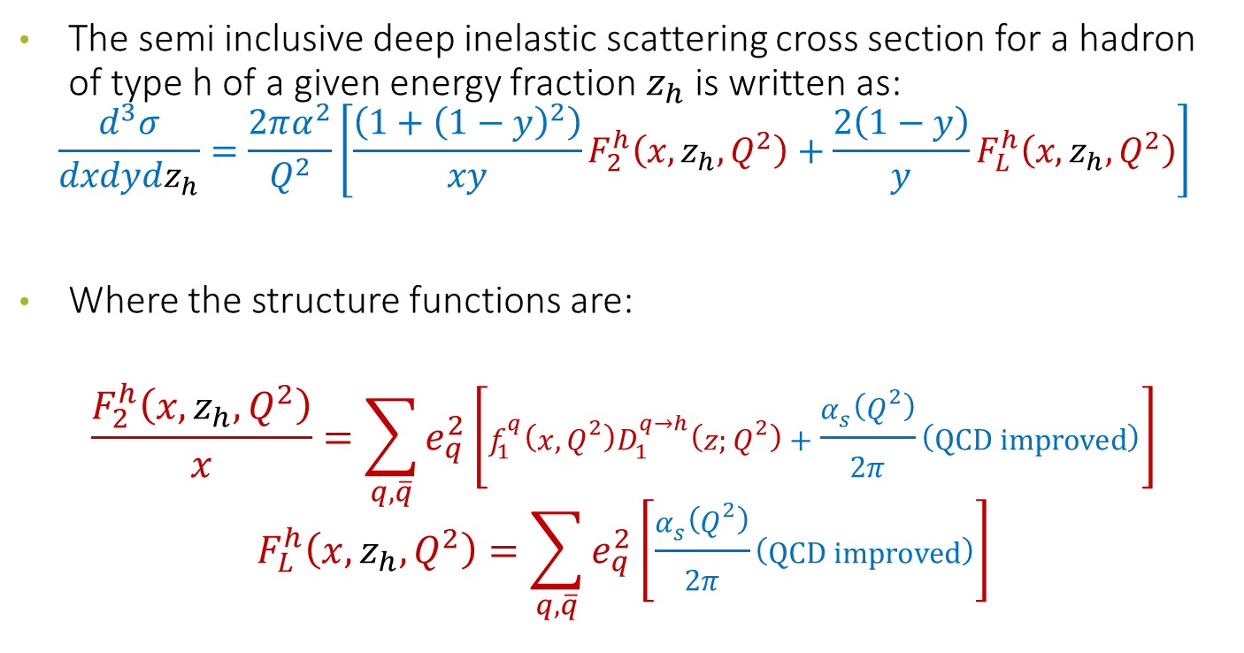
Semi Inclusive Deep Inelastic Scattering
The semi inclusive deep inelastic scattering cross section for a hadron of type h of a given energy fraction $z_{h}$ is written as:
$$\frac{d^{3}σ}{dxdydz_{h}}=\frac{2πα^{2}}{Q^{2}}\left[\frac{\left(1+{\left(1−y\right)}^{2}\right)}{xy}F_{2}^{h}\left(x,z_{h},Q^{2}\right)+\frac{2\left(1−y\right)}{y}F_{L}^{h}\left(x,z_{h},Q^{2}\right)\right]$$
Where the structure functions are:
$$\frac{F_{2}^{h}\left(x,z_{h},Q^{2}\right)}{x}=\sum_{q,\overline{q}}{e_{q}^{2}\left[f_{1}^{q}\left(x,Q^{2}\right)D_{1}^{q→h}\left(z;Q^{2}\right)+\frac{α_{s}\left(Q^{2}\right)}{2π}\left(QCD improved\right)\right]}$$
$$F_{L}^{h}\left(x,z_{h},Q^{2}\right)=\sum_{q,\overline{q}}{e_{q}^{2}\left[\frac{α_{s}\left(Q^{2}\right)}{2π}\left(QCD improved\right)\right]}$$

Slide 6
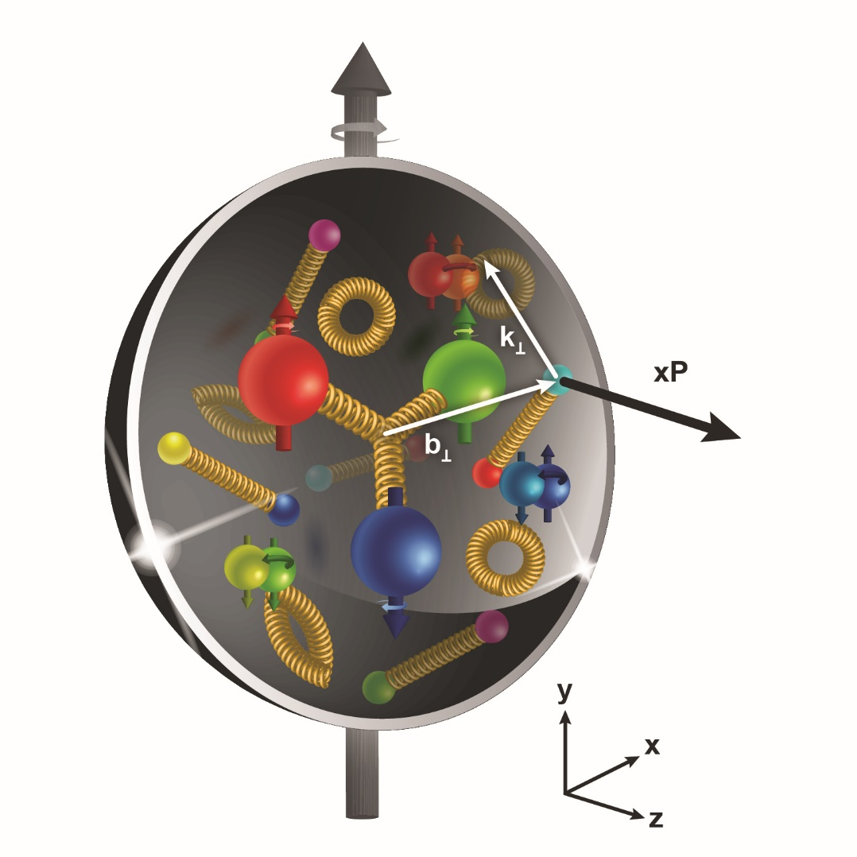
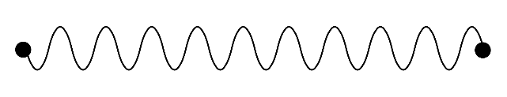
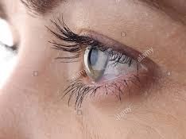
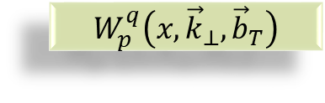


Transverse structure of the Nucleon
Confinement Scale
$$W_{p}^{q}\left(x,{\vec{k}}_{⊥},{\vec{b}}_{T}\right)$$
Transverse momentum
Longitudinal momentum
Transverse position
$$ℓ′$$
Photon Virtuality Q²
$$ℓ$$
Hard Scale
High Energy Probe

Slide 7
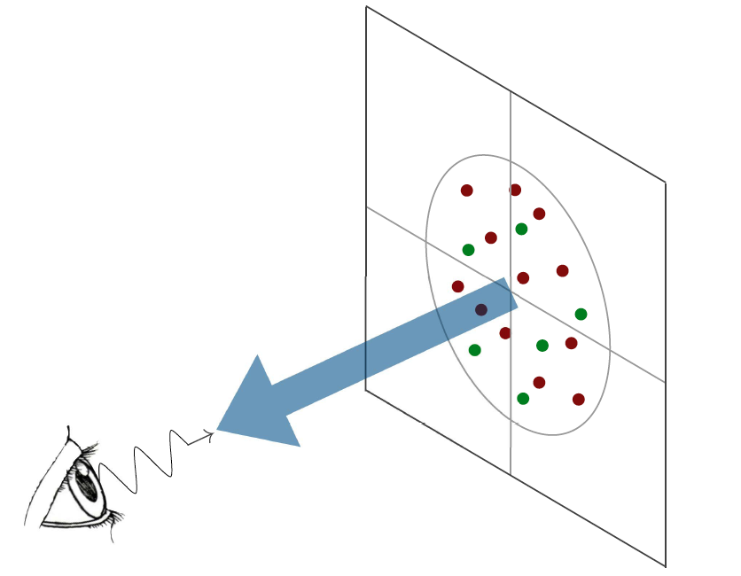

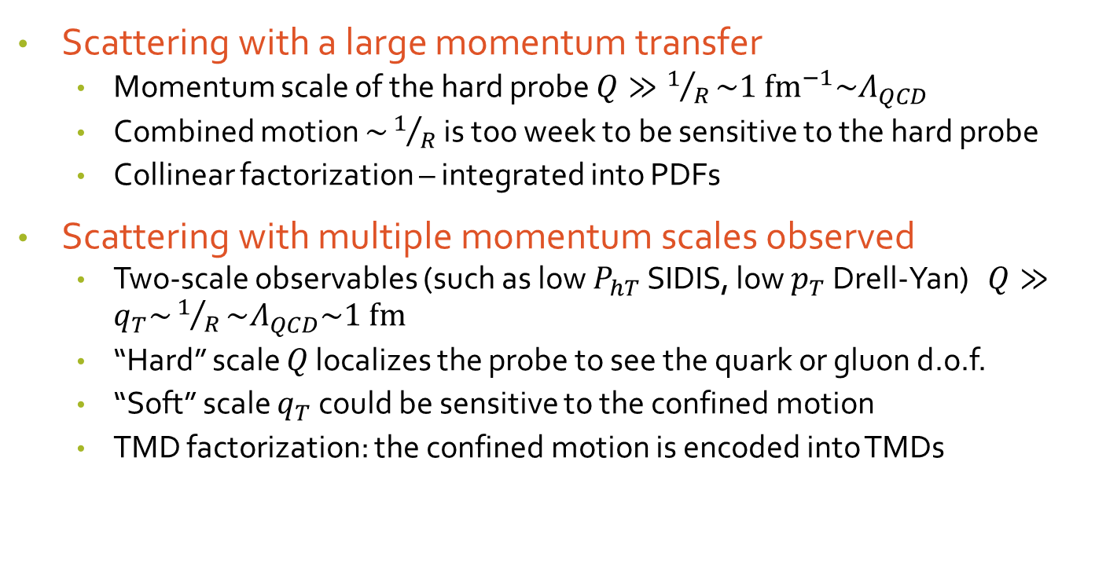

Confined parton motion in a hadron
Scattering with a large momentum transfer
  Momentum scale of the hard probe $Q≫1/R\sim {1 {fm}^{−1}\sim Λ}_{QCD}$
  Combined motion $\sim 1/R$ is too week to be sensitive to the hard probe
  Collinear factorization – integrated into PDFs
Scattering with multiple momentum scales observed
  Two-scale observables (such as low $P_{hT}$ SIDIS, low $p_{T}$ Drell-Yan) $Q≫q_{T}\sim 1/R\sim Λ_{QCD}\sim 1 fm$
  “Hard” scale $Q$ localizes the probe to see the quark or gluon d.o.f.
  “Soft” scale $q_{T}$ could be sensitive to the confined motion
  TMD factorization: the confined motion is encoded into TMDs
$${\vec{k}}_{⊥}$$
$${\vec{b}}_{T}$$

Slide 8
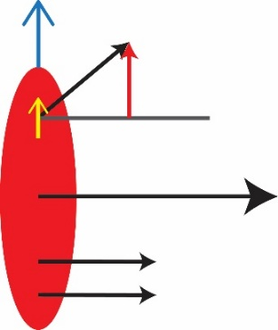
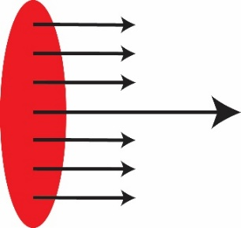

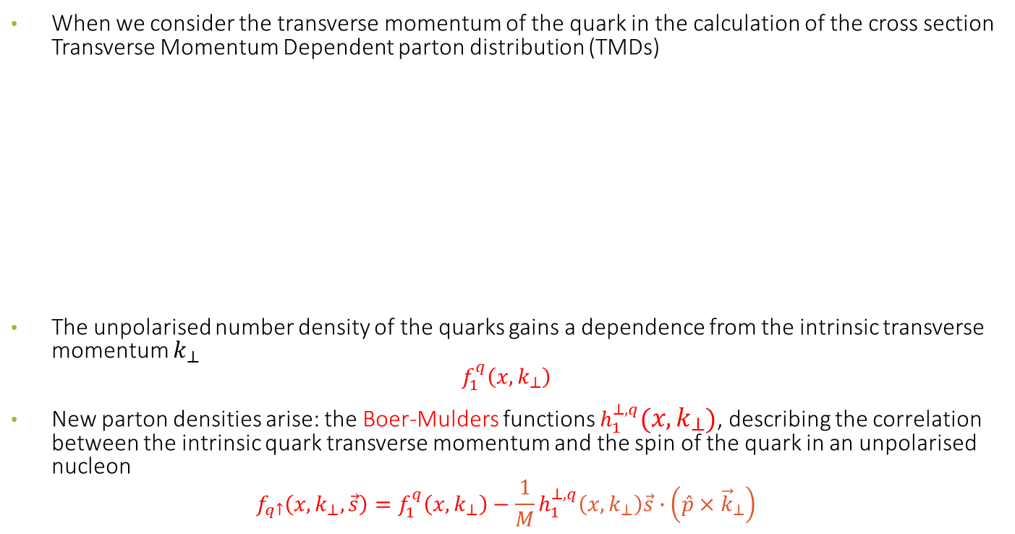



Unpolarised Transverse Momentum dependent PDFs
When we consider the transverse momentum of the quark in the calculation of the cross section Transverse Momentum Dependent parton distribution (TMDs)
The unpolarised number density of the quarks gains a dependence from the intrinsic transverse momentum $k_{⊥}$
$$f_{1}^{q}\left(x,k_{⊥}\right)$$
New parton densities arise: the Boer-Mulders functions $h_{1}^{⊥,q}\left(x,k_{⊥}\right)$, describing the correlation between the intrinsic quark transverse momentum and the spin of the quark in an unpolarised nucleon
$$f_{q↑}\left(x,k_{⊥}, \vec{s}\right)=f_{1}^{q}\left(x,k_{⊥}\right)−\frac{1}{M}h_{1}^{⊥,q}\left(x,k_{⊥}\right)\vec{s}∙\left(\hat{p}×{\vec{k}}_{⊥}\right)$$
$$k_{⊥}$$
$$p_{q}≈xP$$
$$f\left(x\right)$$
$$f\left(x,k_{⊥}\right)$$
Longitudinal motion only
Longitudinal + transverse motion

Slide 9
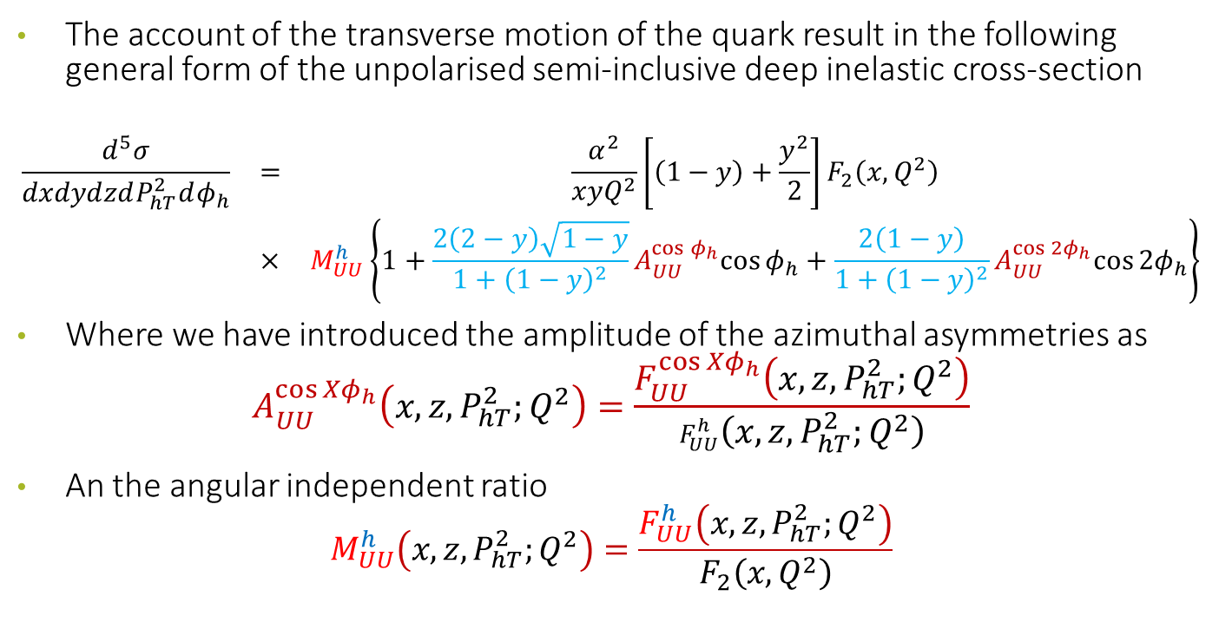
Semi Inclusive unpolarised DIS Cross Section
The account of the transverse motion of the quark result in the following general form of the unpolarised semi-inclusive deep inelastic cross-section
$$\begin{matrix}\frac{d^{5}σ}{dxdydzdP_{hT}^{2}dφ_{h}} & = & \frac{α^{2}}{xyQ^{2}}\left[\left(1−y\right)+\frac{y^{2}}{2}\right]F_{2}\left(x,Q^{2}\right) \\ & × & M_{UU}^{h}\left\{1+\frac{2\left(2−y\right)\sqrt{1−y}}{1+{\left(1−y\right)}^{2}}A_{UU}^{\cos{φ_{h}}}cos{φ_{h}}+\frac{2\left(1−y\right)}{1+{\left(1−y\right)}^{2}}A_{UU}^{\cos{{2φ}_{h}}}cos{{2φ}_{h}}\right\}\end{matrix}$$
Where we have introduced the amplitude of the azimuthal asymmetries as
$$A_{UU}^{\cos{{Xφ}_{h}}}\left(x,z,P_{hT}^{2};Q^{2}\right)=\frac{F_{UU}^{\cos{{Xφ}_{h}}}\left(x,z,P_{hT}^{2};Q^{2}\right)}{F_{UU}^{h}\left(x,z,P_{hT}^{2};Q^{2}\right)}$$
An the angular independent ratio
$$M_{UU}^{h}\left(x,z,P_{hT}^{2};Q^{2}\right)=\frac{F_{UU}^{h}\left(x,z,P_{hT}^{2};Q^{2}\right)}{F_{2}\left(x,Q^{2}\right)}$$

Slide 10
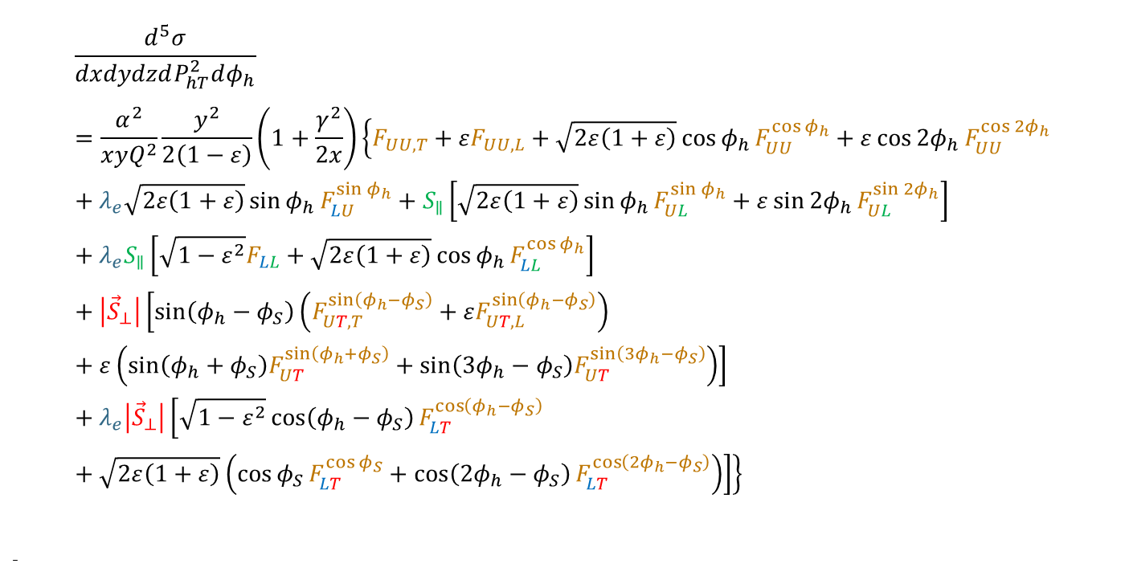
Semi Inclusive DIS full Cross Section
$$\frac{d^{5}σ}{dxdydzdP_{hT}^{2}dφ_{h}}=\frac{α^{2}}{xyQ^{2}}\frac{y^{2}}{2\left(1−ε\right)}\left(1+\frac{γ^{2}}{2x}\right)\left\{F_{UU,T}+εF_{UU,L}+\sqrt{2ε\left(1+ε\right)}\cos{φ_{h}}F_{UU}^{\cos{φ_{h}}}+ε\cos{{2φ}_{h}}F_{UU}^{\cos{{2φ}_{h}}}+λ_{e}\sqrt{2ε\left(1+ε\right)}\sin{φ_{h}}F_{LU}^{\sin{φ_{h}}}+S_{∥}\left[\sqrt{2ε\left(1+ε\right)}\sin{φ_{h}}F_{UL}^{\sin{φ_{h}}}+ε\sin{{2φ}_{h}}F_{UL}^{\sin{{2φ}_{h}}}\right]+λ_{e}S_{∥}\left[\sqrt{1−ε^{2}}F_{LL}+\sqrt{2ε\left(1+ε\right)}\cos{φ_{h}}F_{LL}^{\cos{φ_{h}}}\right]+\left|{\vec{S}}_{⊥}\right|\left[\sin\left(φ_{h}−φ_{S}\right)\left(F_{UT,T}^{\sin\left(φ_{h}−φ_{S}\right)}+εF_{UT,L}^{\sin\left(φ_{h}−φ_{S}\right)}\right)+ε\left(\sin\left(φ_{h}+φ_{S}\right)F_{UT}^{\sin\left(φ_{h}+φ_{S}\right)}+\sin\left(3φ_{h}−φ_{S}\right)F_{UT}^{\sin\left(3φ_{h}−φ_{S}\right)}\right)\right]+λ_{e}\left|{\vec{S}}_{⊥}\right|\left[\sqrt{1−ε^{2}}\cos\left(φ_{h}−φ_{S}\right)F_{LT}^{\cos\left(φ_{h}−φ_{S}\right)}+\sqrt{2ε\left(1+ε\right)}\left(\cos{φ_{S}}F_{LT}^{\cos{φ_{S}}}+\cos\left(2φ_{h}−φ_{S}\right)F_{LT}^{\cos\left(2φ_{h}−φ_{S}\right)}\right)\right]\right\}$$
-
14 independent azimuthal modulations

Slide 11
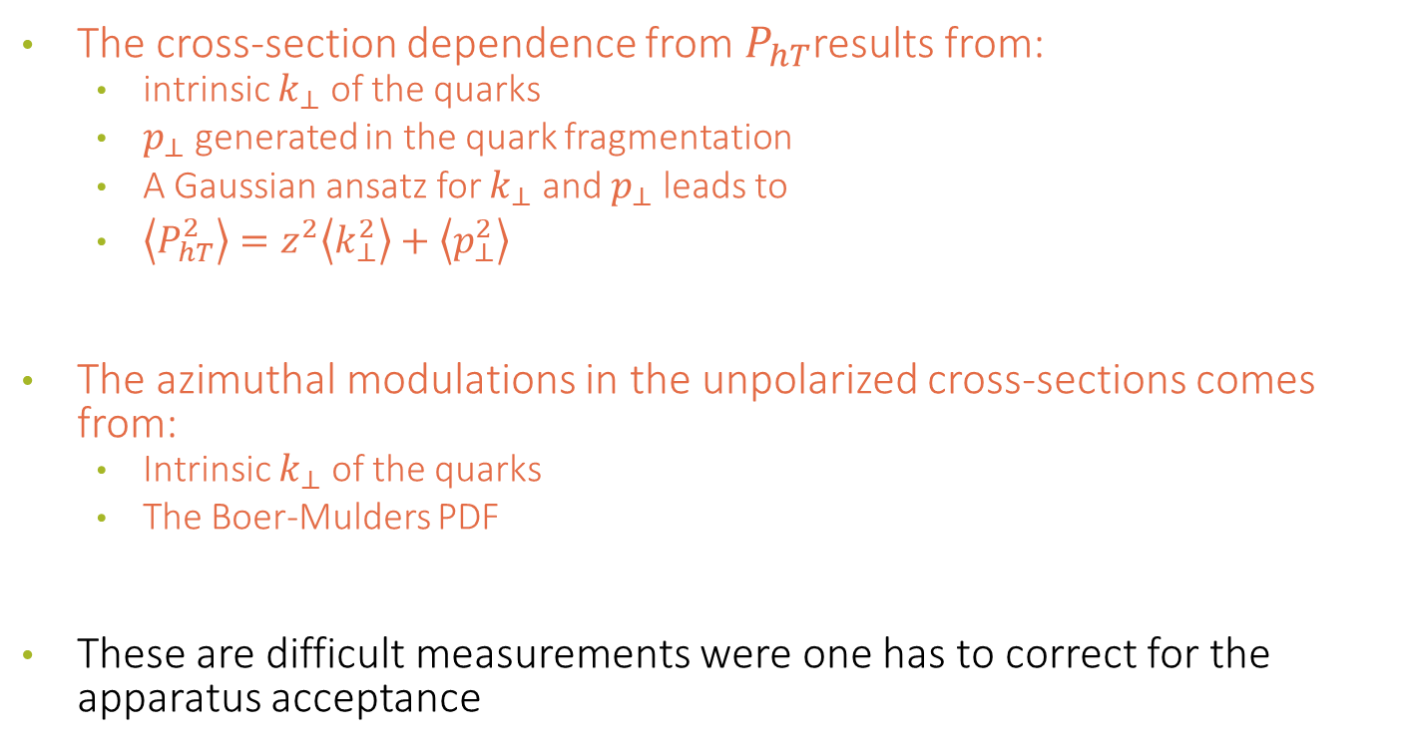
Importance of unpolarized SIDIS for TMDs
The cross-section dependence from $P_{hT}$results from:
  intrinsic $k_{⊥}$ of the quarks
  $p_{⊥}$ generated in the quark fragmentation
  A Gaussian ansatz for $k_{⊥}$ and $p_{⊥}$ leads to
  $\left\langle P_{hT}^{2}\right\rangle =z^{2}\left\langle k_{⊥}^{2}\right\rangle +\left\langle p_{⊥}^{2}\right\rangle$
The azimuthal modulations in the unpolarized cross-sections comes from:
  Intrinsic $k_{⊥}$ of the quarks
  The Boer-Mulders PDF
These are difficult measurements were one has to correct for the apparatus acceptance

Slide 12
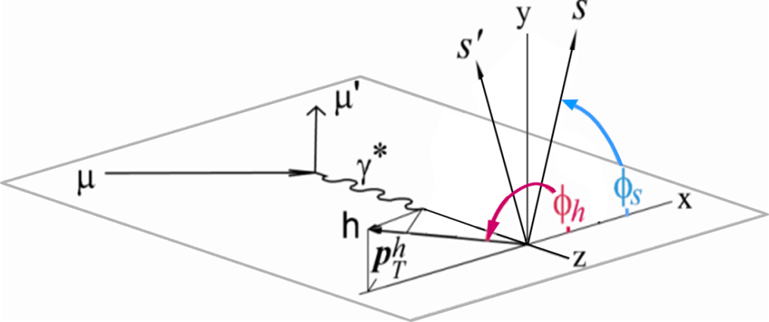
Azimuthal asymmetries in SIDIS
We look at our events in the Gamma Nucleon System (GNS), i.e. we need a perfectly reconstructed lepton kinematic.

Slide 13
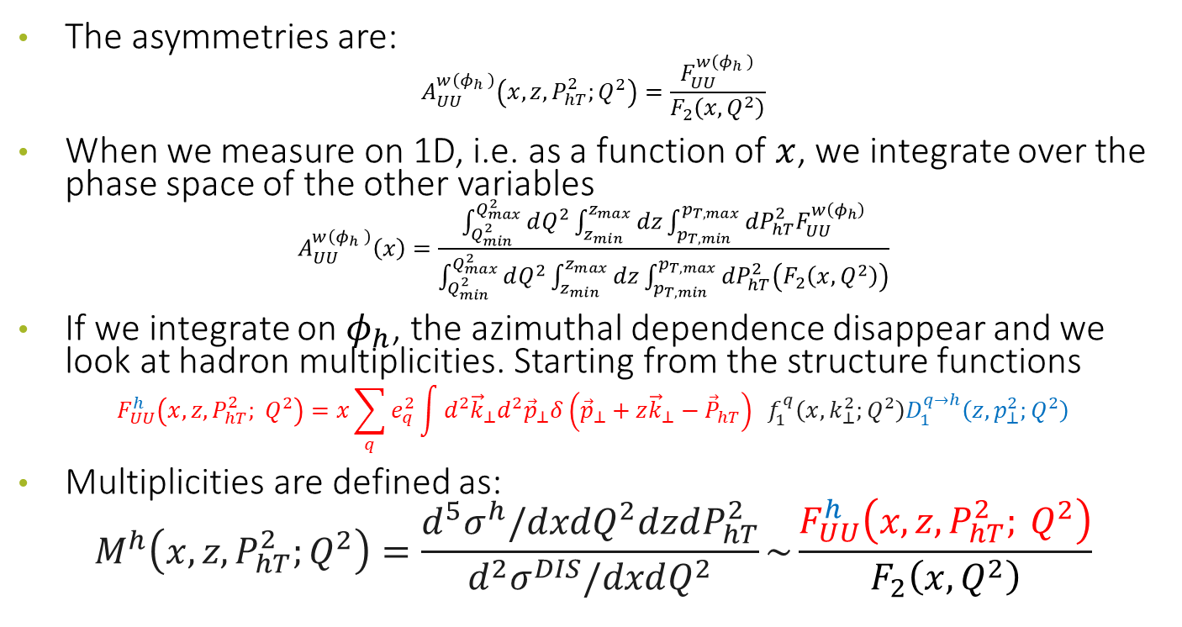
The asymmetries and the multiplicities
The asymmetries are:
$$A_{UU}^{w\left(φ_{h} \right)}\left(x,z,P_{hT}^{2};Q^{2}\right)=\frac{F_{UU}^{w\left(φ_{h} \right)}}{F_{2}\left(x,Q^{2}\right)}$$
When we measure on 1D, i.e. as a function of $x$, we integrate over the phase space of the other variables
$$A_{UU}^{w\left(φ_{h} \right)}\left(x\right)=\frac{\int_{Q_{min}^{2}}^{Q_{max}^{2}}{dQ^{2}\int_{z_{min}}^{z_{max}}{dz\int_{p_{T,min}}^{p_{T,max}}{{dP}_{hT}^{2}F_{UU}^{w\left(φ_{h}\right)}}}}}{\int_{Q_{min}^{2}}^{Q_{max}^{2}}{dQ^{2}\int_{z_{min}}^{z_{max}}{dz\int_{p_{T,min}}^{p_{T,max}}{{dP}_{hT}^{2}\left(F_{2}\left(x,Q^{2}\right)\right)}}}}$$
If we integrate on $φ_{h}$, the azimuthal dependence disappear and we look at hadron multiplicities. Starting from the structure functions
$$F_{UU}^{h}\left(x, z, P_{hT}^{2}; Q^{2}\right)=x\sum_{q}{e_{q}^{2}\int{d^{2}{\vec{k}}_{⊥}d^{2}{\vec{p}}_{⊥}δ\left({\vec{p}}_{⊥}+z{\vec{k}}_{⊥}−{\vec{P}}_{hT}\right) f_{1}^{q}\left(x, k_{⊥}^{2};Q^{2}\right)D_{1}^{q→h}\left(z,p_{⊥}^{2};Q^{2}\right)}}$$
Multiplicities are defined as:
$$M^{h}\left(x,z, P_{hT}^{2};Q^{2}\right)=\frac{d^{5}σ^{h}/dxdQ^{2}dzdP_{hT}^{2}}{d^{2}σ^{DIS}/dxdQ^{2}}\sim \frac{F_{UU}^{h}\left(x, z, P_{hT}^{2}; Q^{2}\right)}{F_{2}\left(x,Q^{2}\right)}$$

Slide 14
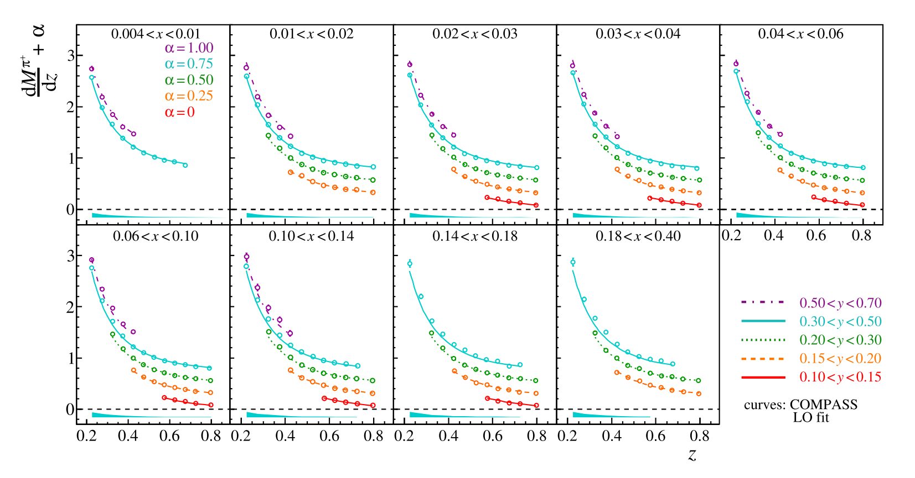
Collinear Multiplicities
hep-ex/1604.02695

Slide 15
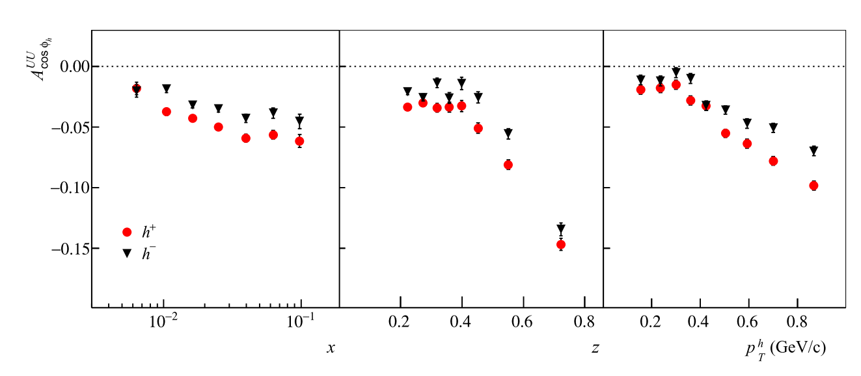
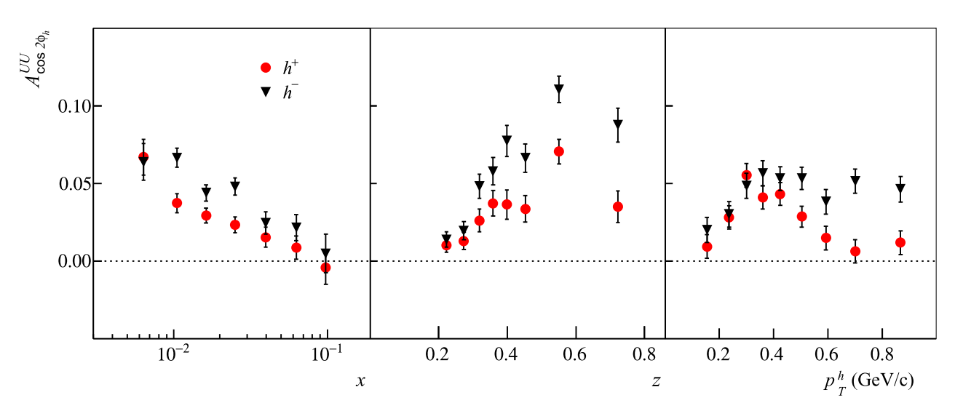
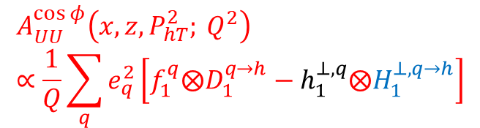
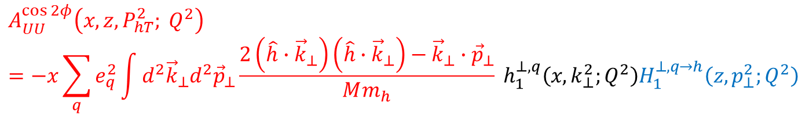
Cahn $A_{UU}^{\cos{φ}}$ and Boer-Mulders$A_{UU}^{\cos{2φ}}$modulation
$$A_{UU}^{\cos{φ}}\left(x, z, P_{hT}^{2}; Q^{2}\right)∝\frac{1}{Q}\sum_{q}{e_{q}^{2}}\left[f_{1}^{q}⨂D_{1}^{q→h}−h_{1}^{⊥,q}⨂H_{1}^{⊥,q→h}\right]$$
$$A_{UU}^{\cos{2φ}}\left(x, z, P_{hT}^{2}; Q^{2}\right)=−x\sum_{q}{e_{q}^{2}\int{d^{2}{\vec{k}}_{⊥}d^{2}{\vec{p}}_{⊥}\frac{2\left(\hat{h}∙{\vec{k}}_{⊥}\right)\left(\hat{h}∙{\vec{k}}_{⊥}\right)−{\vec{k}}_{⊥}∙{\vec{p}}_{⊥}}{Mm_{h}} h_{1}^{⊥,q}\left(x, k_{⊥}^{2};Q^{2}\right)H_{1}^{⊥,q→h}\left(z,p_{⊥}^{2};Q^{2}\right)}}$$

Slide 16
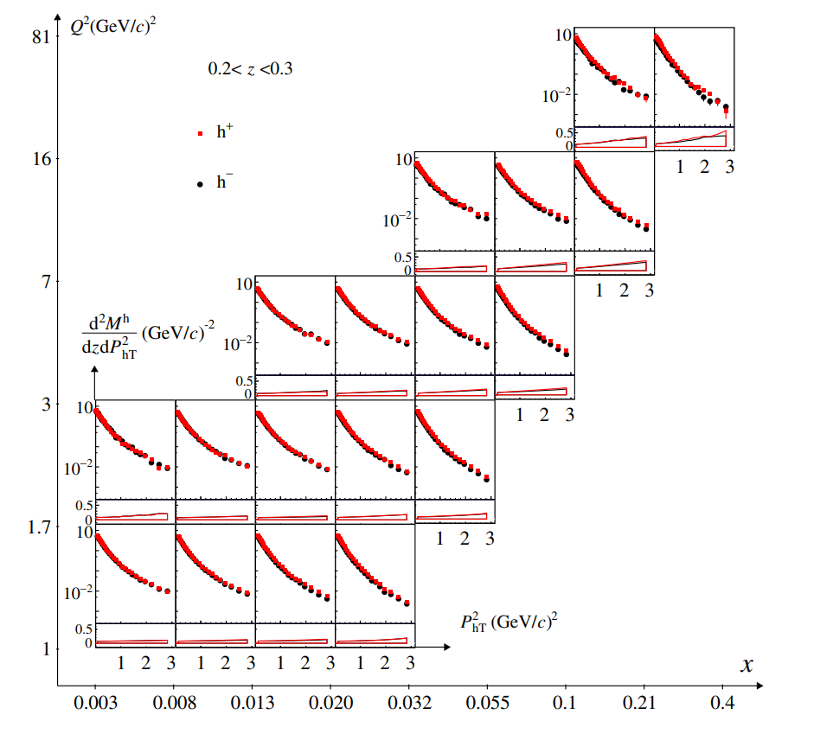
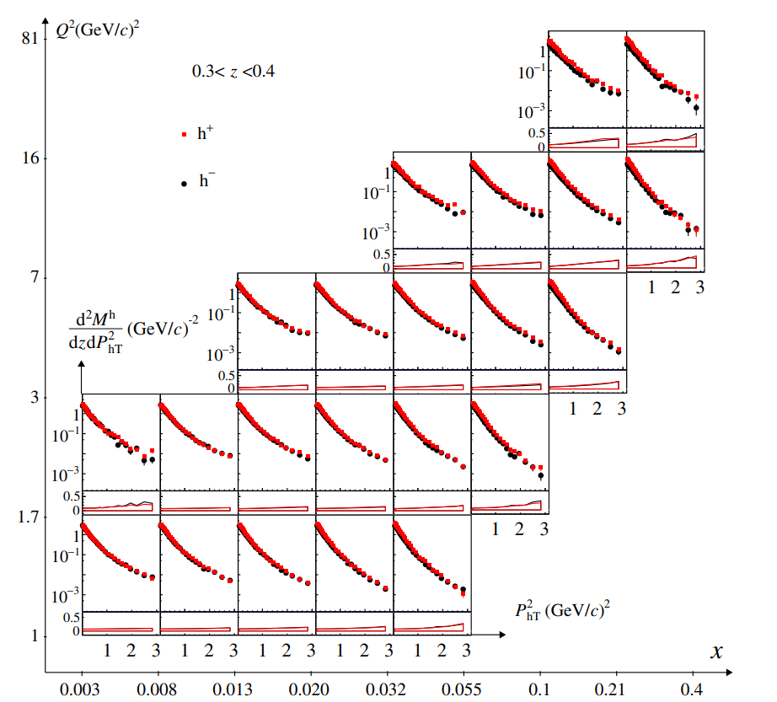
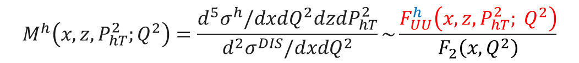
$P_{hT}$ dependent Multiplicities $M_{UU}^{h}$
$$M^{h}\left(x,z, P_{hT}^{2};Q^{2}\right)=\frac{d^{5}σ^{h}/dxdQ^{2}dzdP_{hT}^{2}}{d^{2}σ^{DIS}/dxdQ^{2}}\sim \frac{F_{UU}^{h}\left(x, z, P_{hT}^{2}; Q^{2}\right)}{F_{2}\left(x,Q^{2}\right)}$$

Slide 17
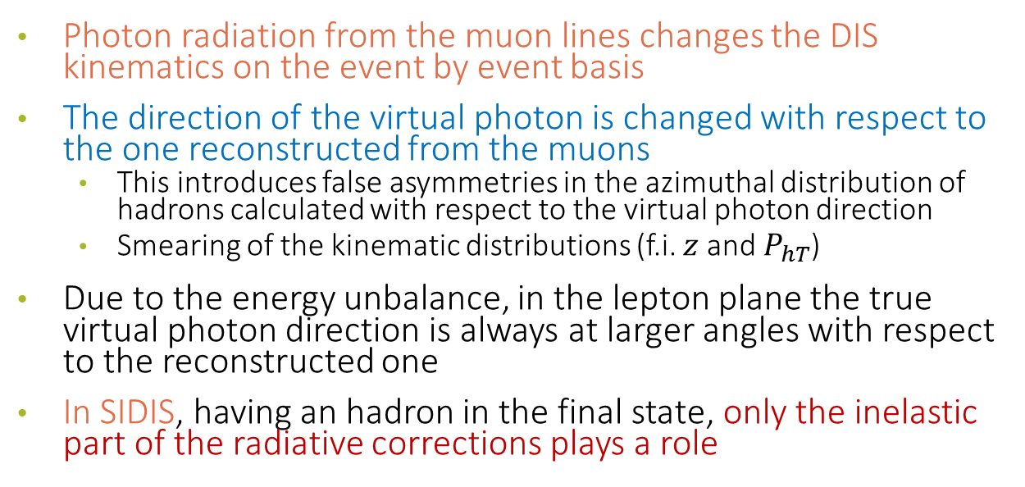
The problem for SIDIS
Photon radiation from the muon lines changes the DIS kinematics on the event by event basis
The direction of the virtual photon is changed with respect to the one reconstructed from the muons
  This introduces false asymmetries in the azimuthal distribution of hadrons calculated with respect to the virtual photon direction
  Smearing of the kinematic distributions (f.i. $z$ and $P_{hT}$)
Due to the energy unbalance, in the lepton plane the true virtual photon direction is always at larger angles with respect to the reconstructed one
In SIDIS, having an hadron in the final state, only the inelastic part of the radiative corrections plays a role

Slide 18
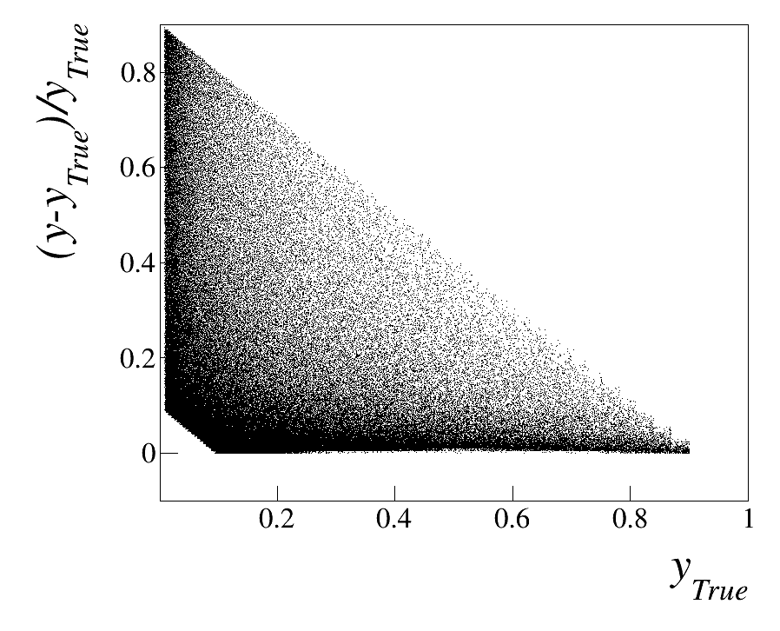
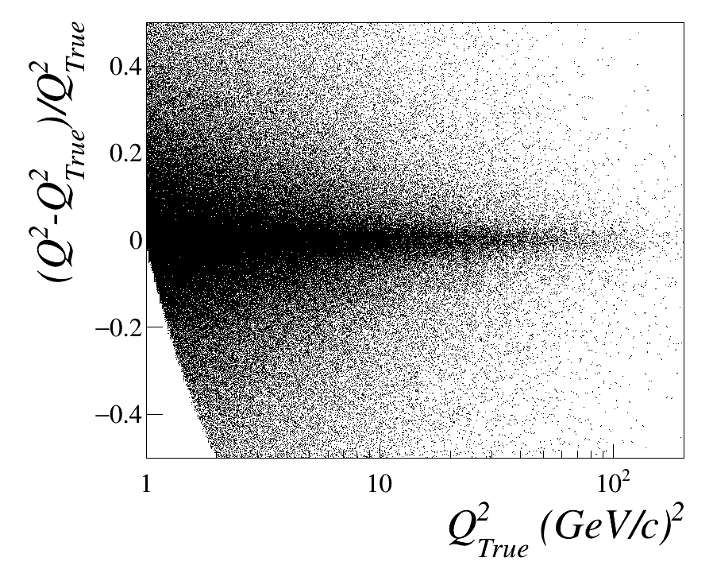
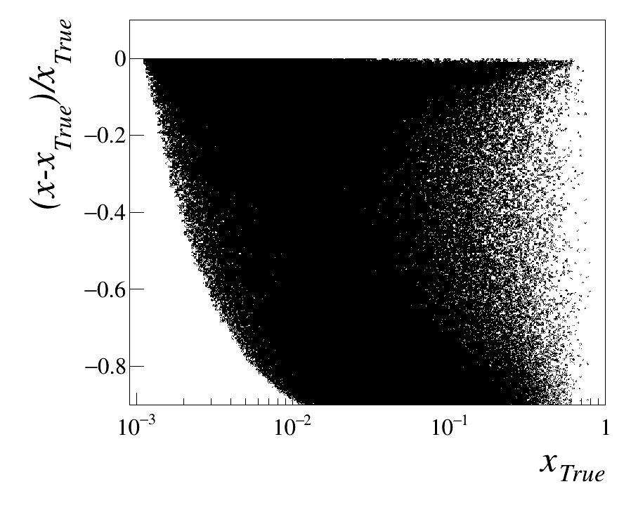
Smearing of variables DIS

Slide 19
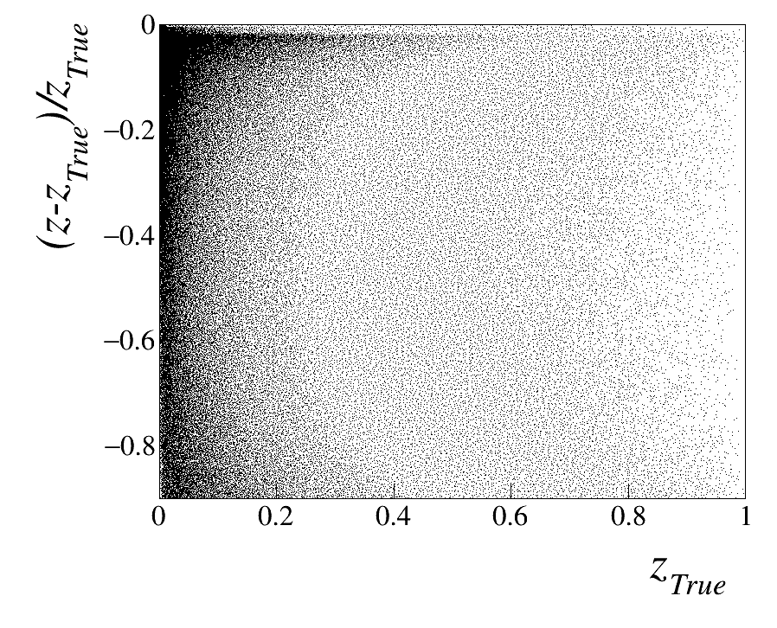
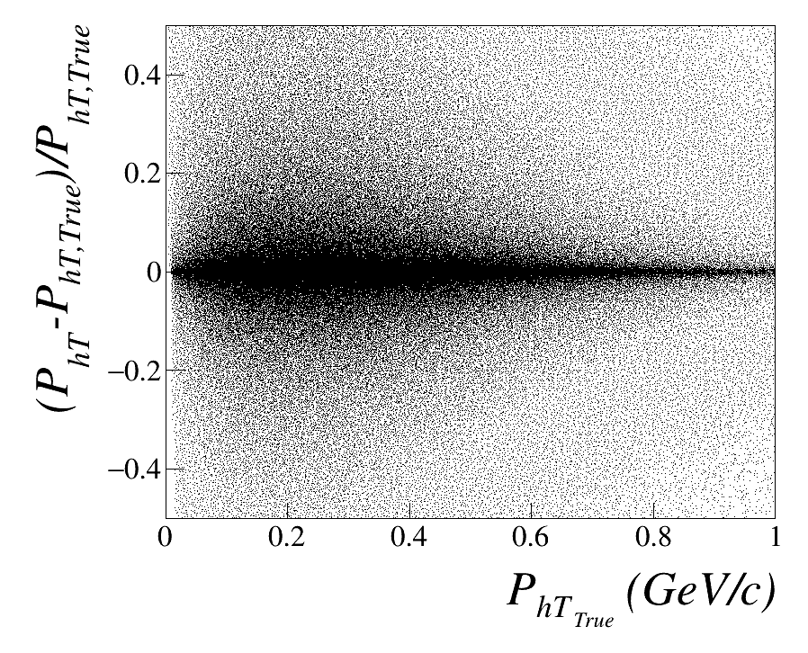
Smearing of variables SIDIS

Slide 20
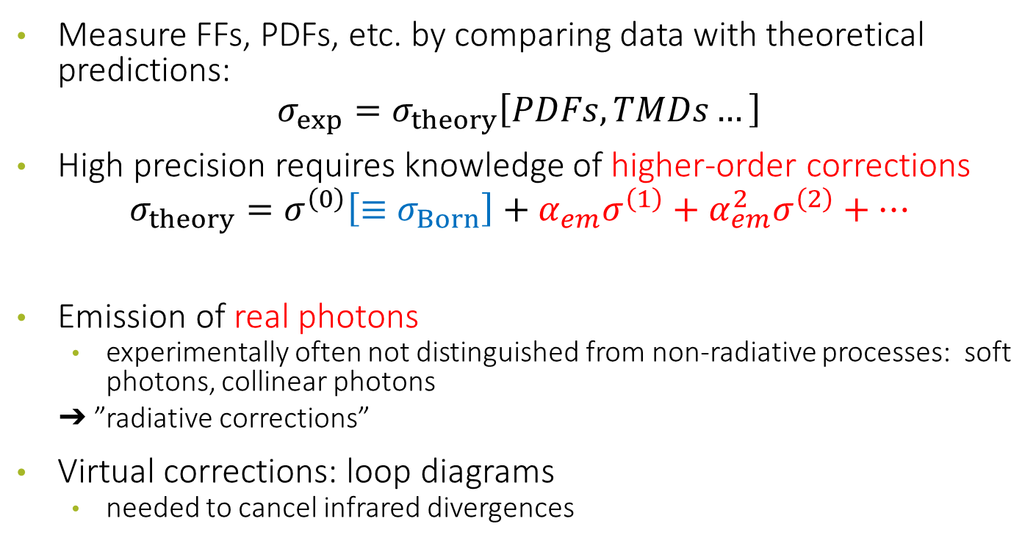
RADIATIVE CORRECTIONS
Measure FFs, PDFs, etc. by comparing data with theoretical predictions:
$$σ_{exp}=σ_{theory}\left[PDFs, TMDs…\right]$$
High precision requires knowledge of higher-order corrections
$$σ_{theory}=σ^{\left(0\right)}\left[≡σ_{Born}\right]+α_{em}σ^{\left(1\right)}+α_{em}^{2}σ^{\left(2\right)}+…$$
Emission of real photons
  experimentally often not distinguished from non-radiative processes: soft photons, collinear photons
  ➔ ”radiative corrections”
Virtual corrections: loop diagrams
  needed to cancel infrared divergences

Slide 21

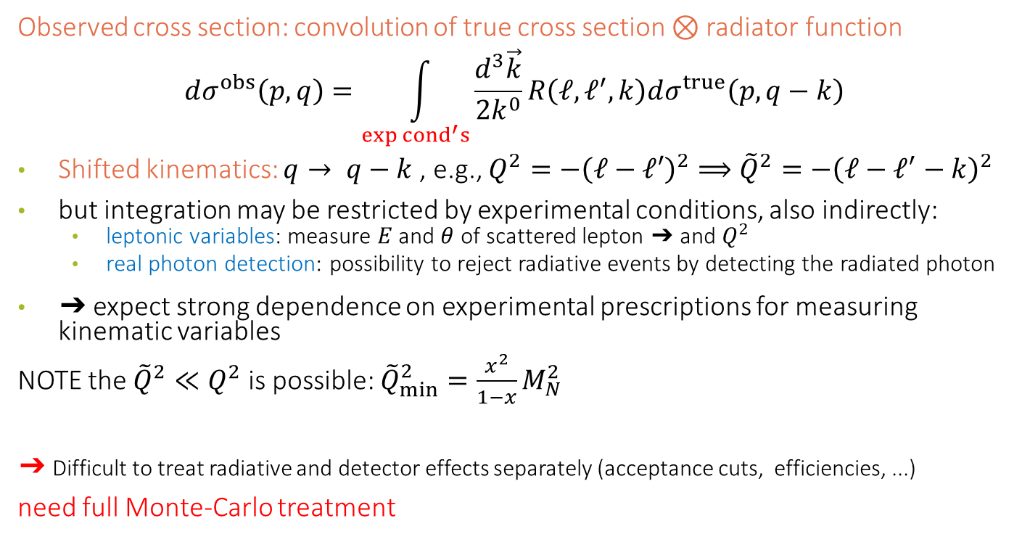


LEPTONIC RADIATION
Observed cross section: convolution of true cross section $⊗$ radiator function
$$dσ^{obs}\left(p,q\right)=\int_{exp {cond}^{′}s}{\frac{d^{3}\vec{k}}{2k^{0}}R\left(ℓ,ℓ^{′},k\right)dσ^{true}\left(p,q−k\right)}$$
Shifted kinematics: $q→ q−k$, e.g., $Q^{2}=−{\left(ℓ−ℓ′\right)}^{2}⟹{\tilde{Q}}^{2}=−{\left(ℓ−ℓ^{′}−k\right)}^{2}$
but integration may be restricted by experimental conditions, also indirectly:
  leptonic variables: measure $E$ and $θ$ of scattered lepton ➔ and $Q^{2}$
  real photon detection: possibility to reject radiative events by detecting the radiated photon
➔ expect strong dependence on experimental prescriptions for measuring kinematic variables
NOTE the ${\tilde{Q}}^{2}≪Q^{2}$ is possible: ${\tilde{Q}}_{min}^{2}=\frac{x^{2}}{1−x}M_{N}^{2}$
➔ Difficult to treat radiative and detector effects separately (acceptance cuts, efficiencies, ...)
need full Monte-Carlo treatment
$$k^{μ}$$
$$γ^{∗}\left(q^{μ}\right)$$

Slide 22
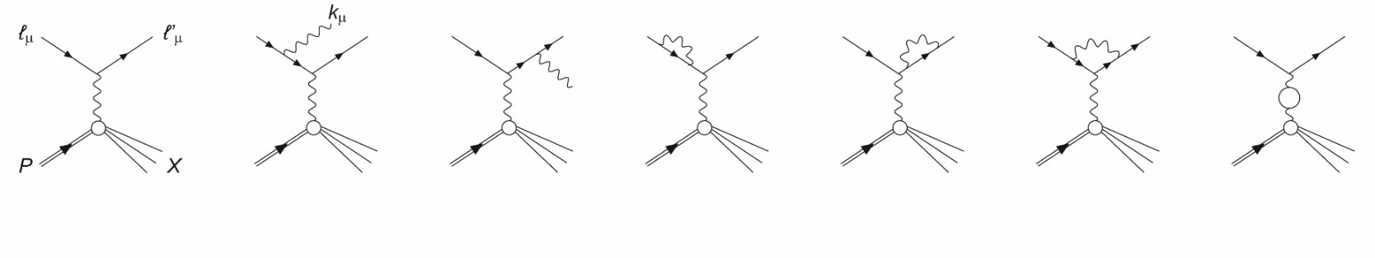
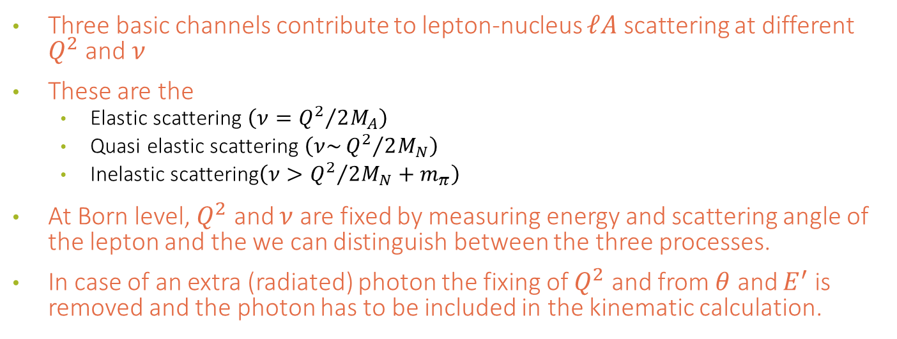
RADIATIVE CORRECTIONS
Three basic channels contribute to lepton-nucleus $ℓA$ scattering at different $Q^{2}$ and $ν$
These are the
  Elastic scattering $\left(ν={Q^{2}}/{2M_{A}}\right)$
  Quasi elastic scattering $\left(ν\sim {Q^{2}}/{2M_{N}}\right)$
  Inelastic scattering$\left(ν>{Q^{2}}/{2M_{N}}+m_{π}\right)$
At Born level, $Q^{2}$ and $ν$ are fixed by measuring energy and scattering angle of the lepton and the we can distinguish between the three processes.
In case of an extra (radiated) photon the fixing of $Q^{2}$ and from $θ$ and $E^{′}$ is removed and the photon has to be included in the kinematic calculation.

Slide 23
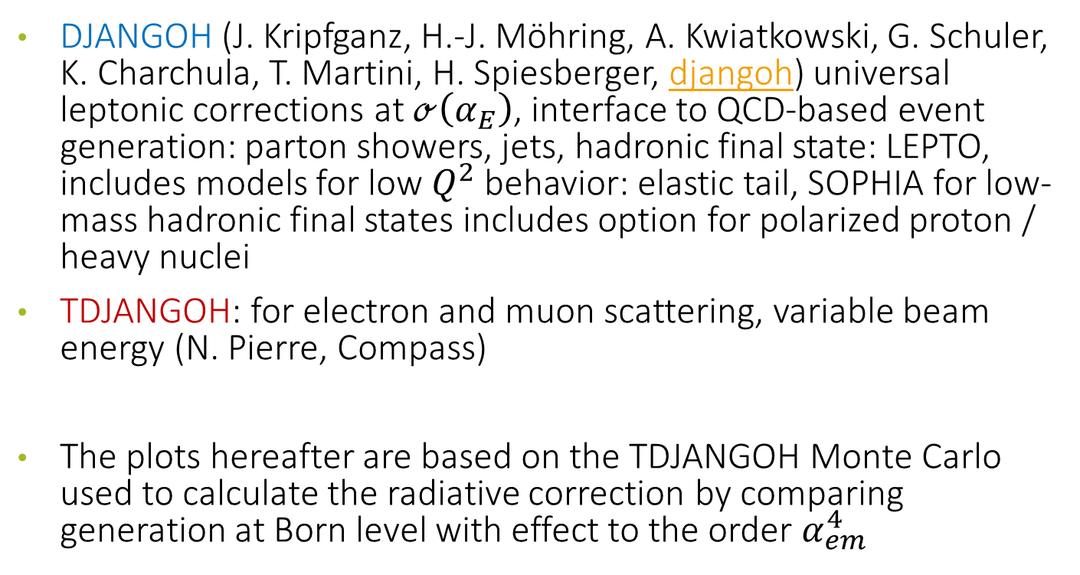
MC USED TO CHECK RC IN TMD SIDIS
DJANGOH (J. Kripfganz, H.-J. Möhring, A. Kwiatkowski, G. Schuler, K. Charchula, T. Martini, H. Spiesberger, djangoh) universal leptonic corrections at $ℴ\left(α_{E}\right)$, interface to QCD-based event generation: parton showers, jets, hadronic final state: LEPTO, includes models for low $Q^{2}$ behavior: elastic tail, SOPHIA for low-mass hadronic final states includes option for polarized proton / heavy nuclei
TDJANGOH: for electron and muon scattering, variable beam energy (N. Pierre, Compass)
The plots hereafter are based on the TDJANGOH Monte Carlo used to calculate the radiative correction by comparing generation at Born level with effect to the order $α_{em}^{4}$

Slide 24
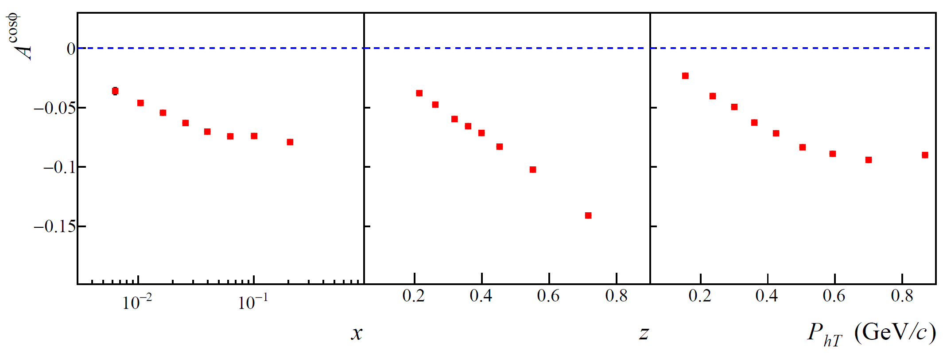
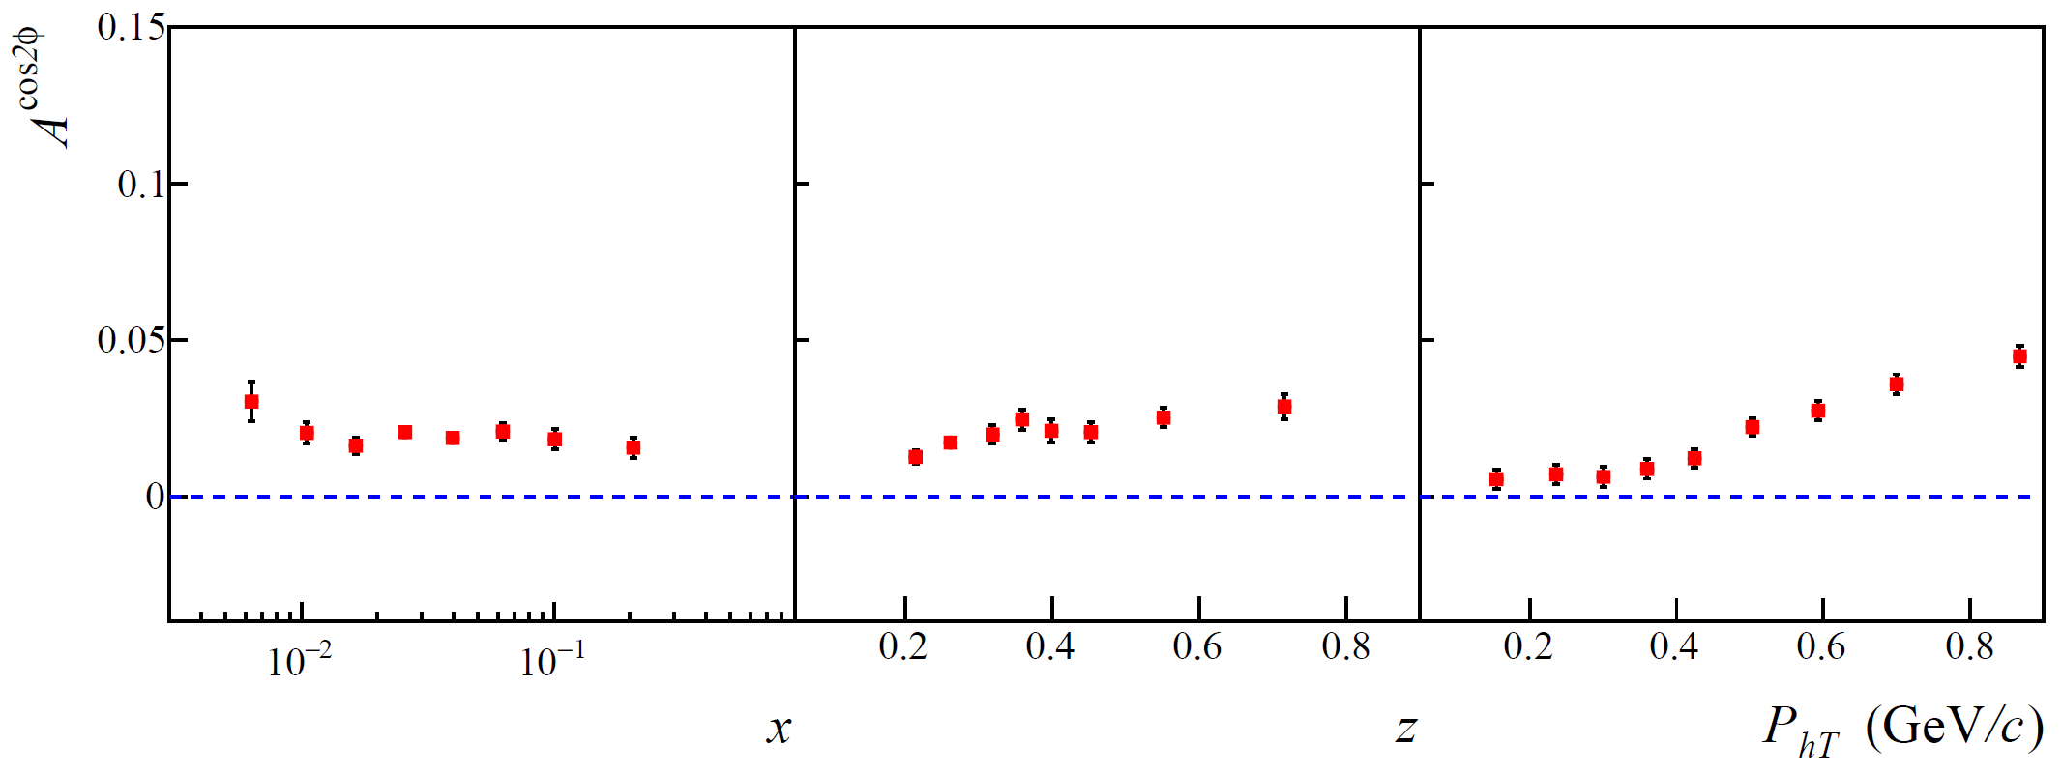

Cahn and Boer-Mulder effects in the MC
We have parametrised the $k_{⊥}$ dependence of the SIDIS cross section.
This parametrization, applied in TDjangoh, is in accordance with [A. Kerbizi et al., Phys. Rev.D100 (2019) 014003.]
$$\left\langle k_{⊥}^{2}\right\rangle =1.43x^{0.75}\left(1−x\right) {\left(GeV/c\right)}^{2}$$

Slide 25
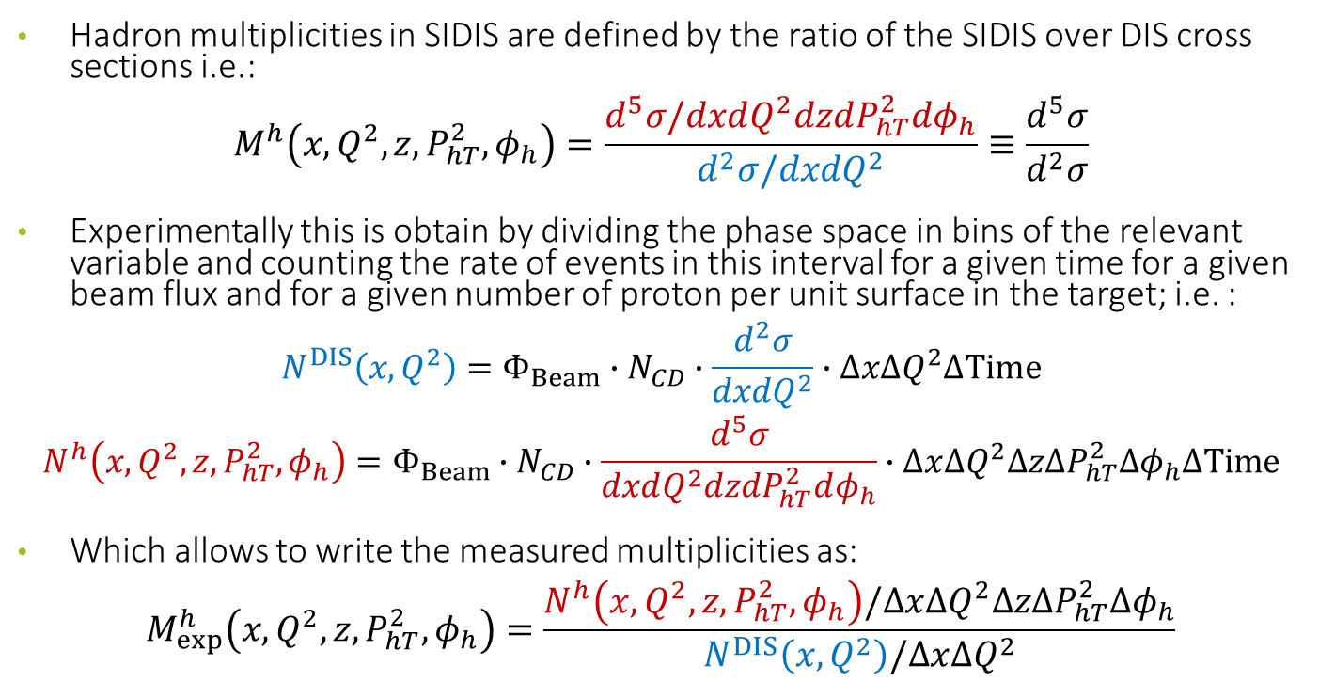
Corrections for Multiplicities:
Hadron multiplicities in SIDIS are defined by the ratio of the SIDIS over DIS cross sections i.e.:
$$M^{h}\left(x, Q^{2},z, P_{hT}^{2},φ_{h}\right)=\frac{d^{5}σ/dxdQ^{2}dzdP_{hT}^{2}dφ_{h}}{d^{2}σ/dxdQ^{2}}≡\frac{d^{5}σ}{d^{2}σ}$$
Experimentally this is obtain by dividing the phase space in bins of the relevant variable and counting the rate of events in this interval for a given time for a given beam flux and for a given number of proton per unit surface in the target; i.e. :
$$N^{DIS}\left(x, Q^{2}\right)=Φ_{Beam}∙N_{CD}∙\frac{d^{2}σ}{dxdQ^{2}}∙∆x∆Q^{2}∆Time$$
$$N^{h}\left(x, Q^{2},z, P_{hT}^{2},φ_{h}\right)=Φ_{Beam}∙N_{CD}∙\frac{d^{5}σ}{dxdQ^{2}dzdP_{hT}^{2}dφ_{h}}∙∆x∆Q^{2}∆z∆P_{hT}^{2}∆φ_{h}∆Time$$
Which allows to write the measured multiplicities as:
$$M_{exp}^{h}\left(x, Q^{2},z, P_{hT}^{2},φ_{h}\right)=\frac{N^{h}\left(x, Q^{2},z, P_{hT}^{2},φ_{h}\right)/∆x∆Q^{2}∆z∆P_{hT}^{2}∆φ_{h}}{N^{DIS}\left(x, Q^{2}\right)/∆x∆Q^{2}}$$

Slide 26
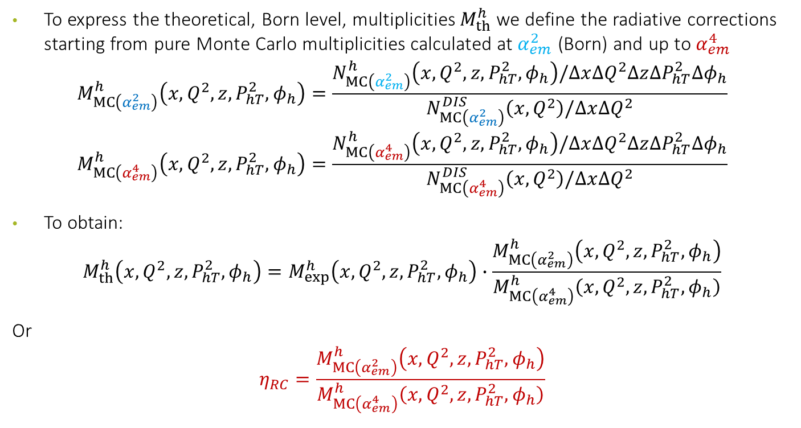
Corrections for Multiplicities:
To express the theoretical, Born level, multiplicities $M_{th}^{h}$ we define the radiative corrections starting from pure Monte Carlo multiplicities calculated at $α_{em}^{2}$ (Born) and up to $α_{em}^{4}$
$$M_{MC\left(α_{em}^{2}\right)}^{h}\left(x, Q^{2},z, P_{hT}^{2},φ_{h}\right)=\frac{N_{MC\left(α_{em}^{2}\right)}^{h}\left(x, Q^{2},z, P_{hT}^{2},φ_{h}\right)/∆x∆Q^{2}∆z∆P_{hT}^{2}∆φ_{h}}{N_{MC\left(α_{em}^{2}\right)}^{DIS}\left(x, Q^{2}\right)/∆x∆Q^{2}}$$
$$M_{MC\left(α_{em}^{4}\right)}^{h}\left(x, Q^{2},z, P_{hT}^{2},φ_{h}\right)=\frac{N_{MC\left(α_{em}^{4}\right)}^{h}\left(x, Q^{2},z, P_{hT}^{2},φ_{h}\right)/∆x∆Q^{2}∆z∆P_{hT}^{2}∆φ_{h}}{N_{MC\left(α_{em}^{4}\right)}^{DIS}\left(x, Q^{2}\right)/∆x∆Q^{2}}$$
To obtain:
$$M_{th}^{h}\left(x, Q^{2},z, P_{hT}^{2},φ_{h}\right)=M_{exp}^{h}\left(x, Q^{2},z, P_{hT}^{2},φ_{h}\right)∙\frac{M_{MC\left(α_{em}^{2}\right)}^{h}\left(x, Q^{2},z, P_{hT}^{2},φ_{h}\right)}{M_{MC\left(α_{em}^{4}\right)}^{h}\left(x, Q^{2},z, P_{hT}^{2},φ_{h}\right)}$$
Or
$$η_{RC}=\frac{M_{MC\left(α_{em}^{2}\right)}^{h}\left(x, Q^{2},z, P_{hT}^{2},φ_{h}\right)}{M_{MC\left(α_{em}^{4}\right)}^{h}\left(x, Q^{2},z, P_{hT}^{2},φ_{h}\right)}$$

Slide 27
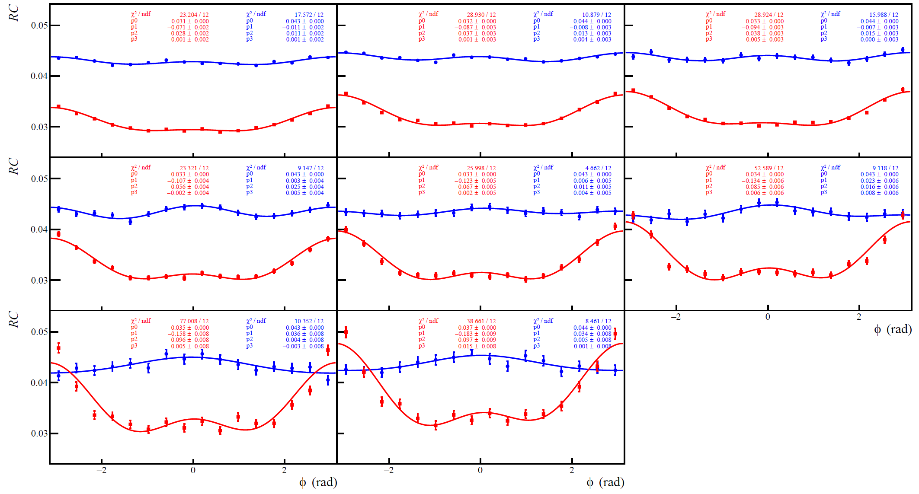
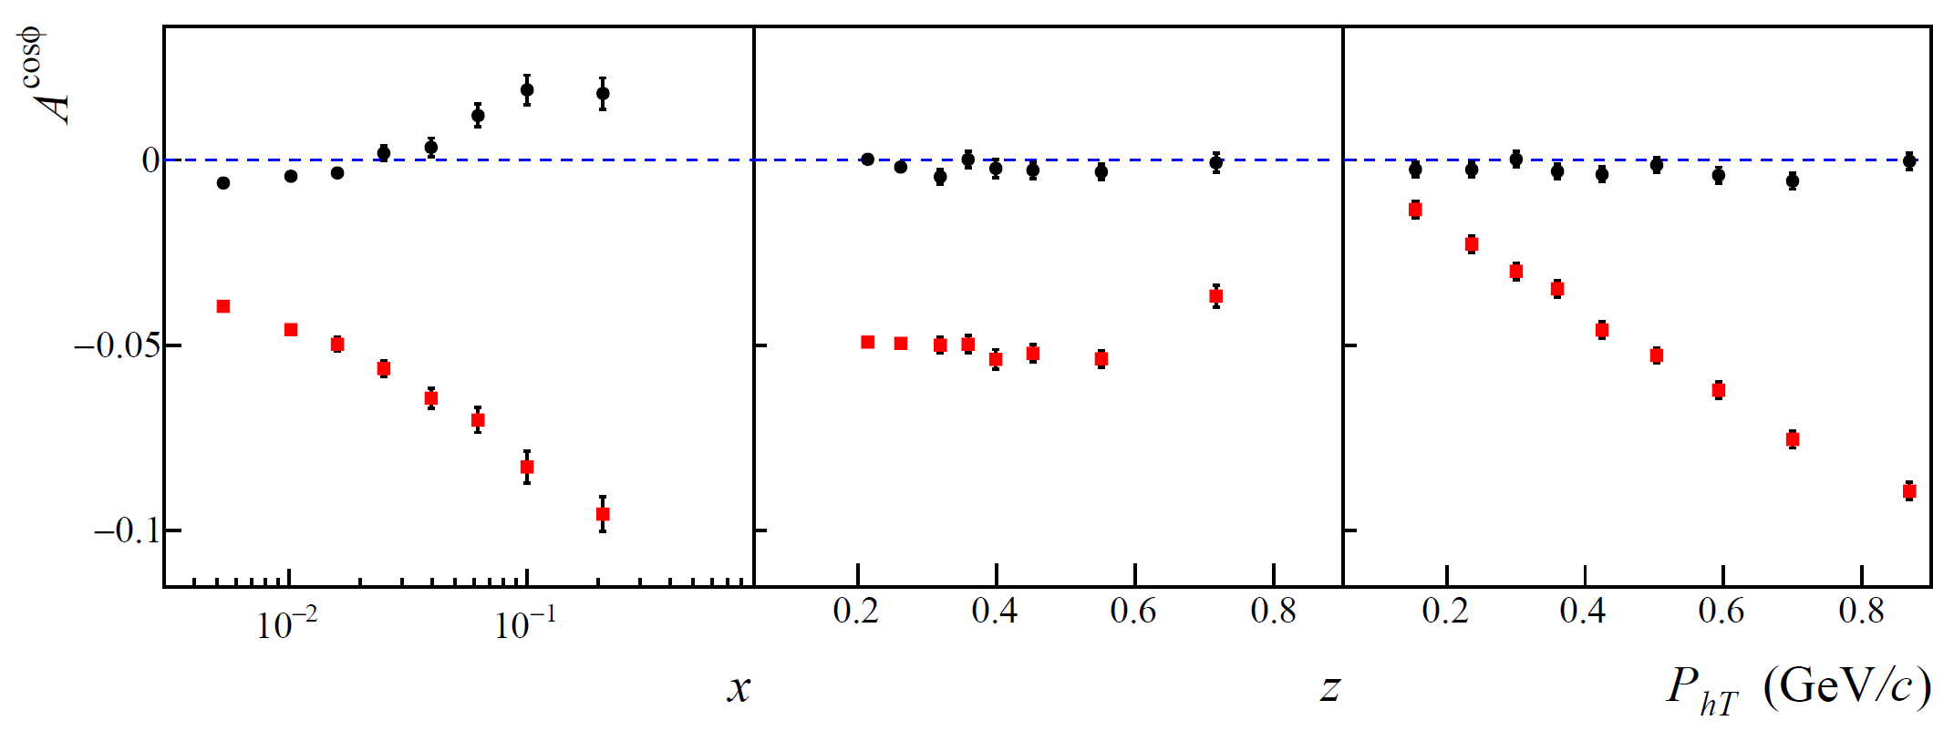
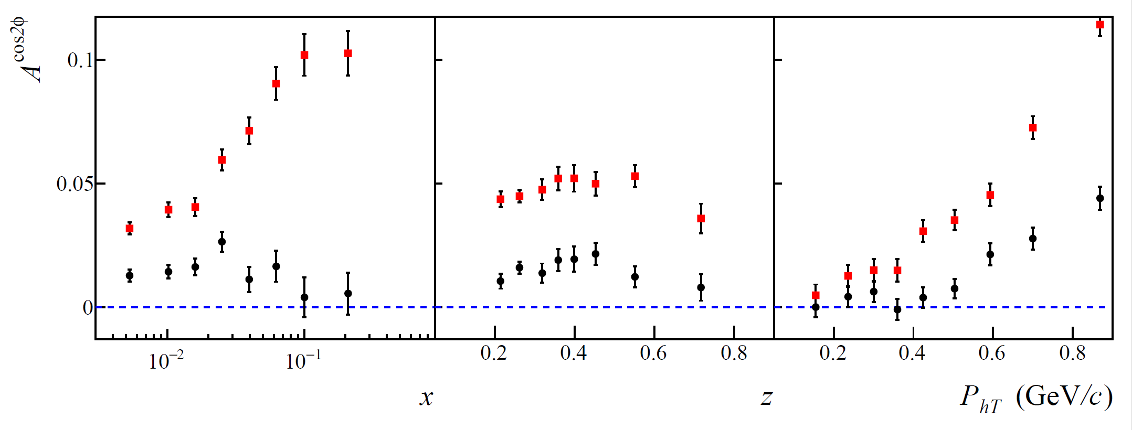
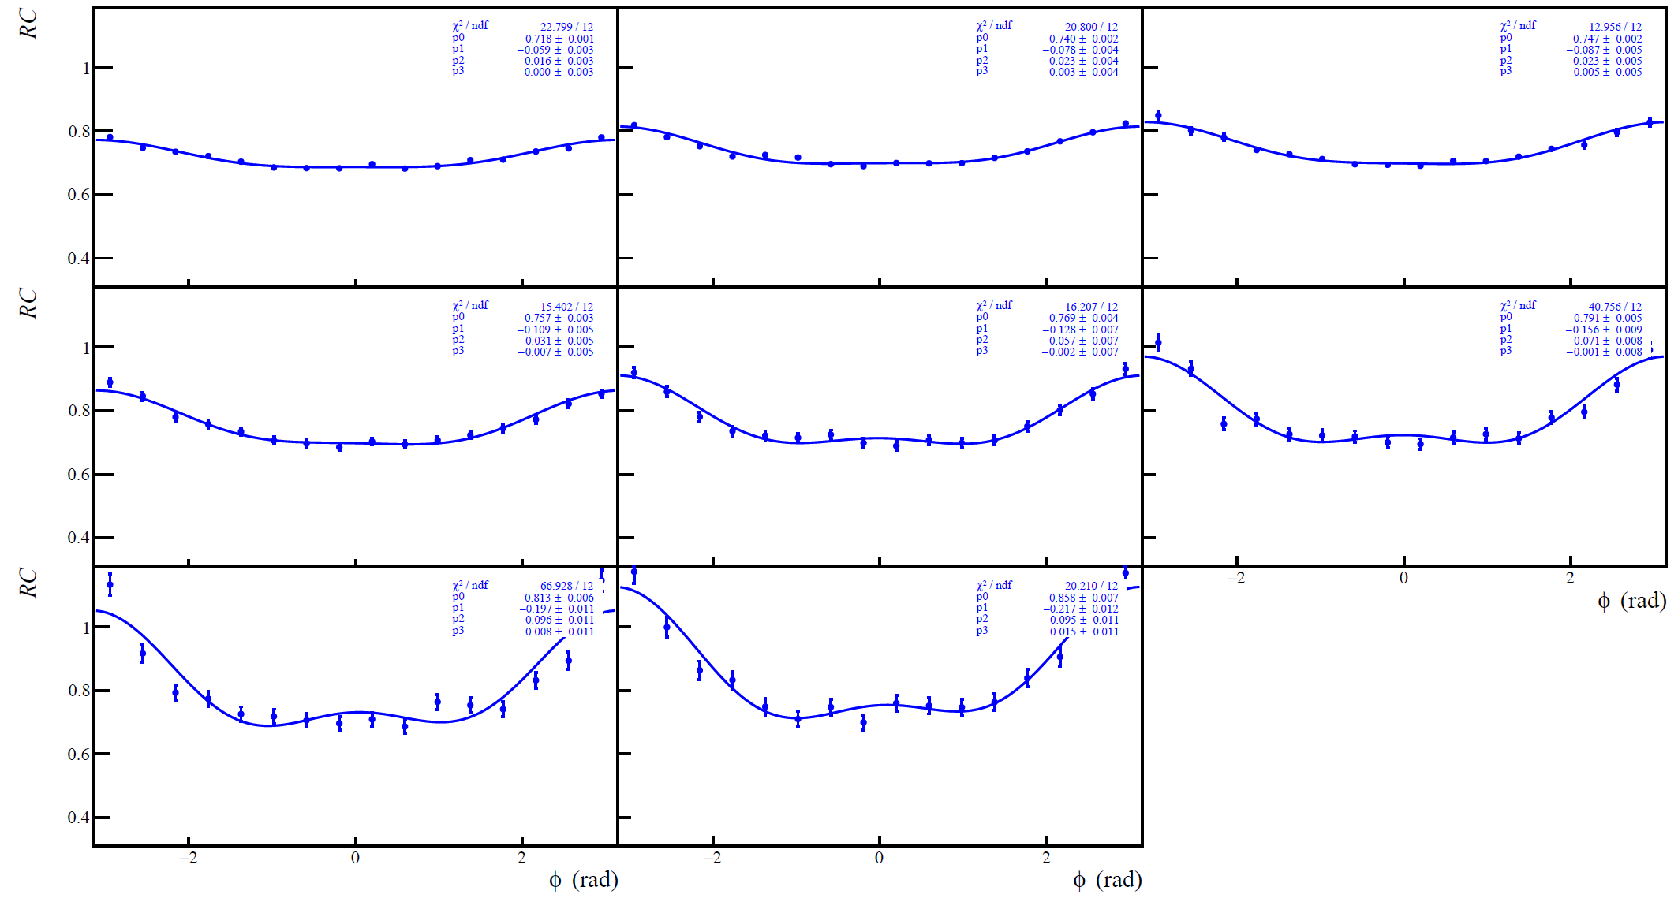


Examples of Radiative Corrections (No Cahn&BM):

Slide 28





Examples of Radiative Corrections (Cahn&BM):

Slide 29





$\cos{φ}$ distribution and corrections for hadrons
$$P_{hT}^{2}$$
$$0.10 0.30 0.50 0.64 1.00$$
$$z$$
$$0.20 0.25 0.32 0.40 0.55 0.70 0.85$$

Slide 30



$\cos{2φ}$ distribution and corrections for hadrons
$$P_{hT}^{2}$$
$$0.10 0.30 0.50 0.64 1.00$$
$$z$$
$$0.20 0.25 0.32 0.40 0.55 0.70 0.85$$

Slide 31





Distributions and corrections for $0.2<z<0.3$
$$7.0 16 81$$
$$1.0 1.7 3.0 7.0$$
$$Q^{2} {\left(GeV/c\right)}^{2}$$
$$0.003 0.008 0.013 0.02 0.032 0.055 0.10 0.21 0.40$$
$$x$$

Slide 32



Distributions and corrections for $0.3<z<0.4$
$$7.0 16 81$$
$$1.0 1.7 3.0 7.0$$
$$Q^{2} {\left(GeV/c\right)}^{2}$$
$$0.003 0.008 0.013 0.02 0.032 0.055 0.10 0.21 0.40$$
$$x$$

Slide 33



Distributions and corrections for $0.4<z<0.6$
$$7.0 16 81$$
$$1.0 1.7 3.0 7.0$$
$$Q^{2} {\left(GeV/c\right)}^{2}$$
$$0.003 0.008 0.013 0.02 0.032 0.055 0.10 0.21 0.40$$
$$x$$

Slide 34



Distributions and corrections for $0.6<z<0.8$
$$7.0 16 81$$
$$1.0 1.7 3.0 7.0$$
$$Q^{2} {\left(GeV/c\right)}^{2}$$
$$0.003 0.008 0.013 0.02 0.032 0.055 0.10 0.21 0.40$$
$$x$$

Slide 35
Comments and conclusions
My approach was to pick up an analysis (unpolarised multidimensional sidis) very sensitive to the detailed knowledge of both the apparatus and to the biased from photon radiation
In a plain “analysis” like this one, with no attempts of rejecting radiative events, corrections are not negligible (as expected)
More refined approaches as the ones used at HERA will allow to decrease the impact of RCs.
Nevertheless comparing results of analysis using different approaches will offer a way to check the quality of the Monte Carlo simulations

Slide 36


Thank you

Slide 37



${}_{}^{3}{P_{0}}$; a model for the Collins FF $H_{1}^{⊥}$
A model by X. Artru for the Collins effect is based on the ${}_{}^{3}{P_{0}}$ mechanism applied to the string fragmentation [Single spin asymmetry in inclusive pion production, Collins effect and the string model, X. Artru, J. Czyzewski, H. Yabuki, Z.Phys. C 73 (1997) 527].
In this model, the $q\overline{q}$ pairs at each string breaking are produced in a state that has total orbital angular momentum $L=1$ and total spin $S=1$ opposite to the orbital angular momentum such that $J=L+S=0$.
For a struck quark $q_{A}$ with spin along $\hat{y}$, the first $q_{2}{\overline{q}}_{2}$ at the string breaking will be polarized along $−\hat{y}$, while the angular momentum ${\vec{L}}_{2}$ is along $\hat{y}.$ If the initial quark $q_{A}$ is $u$ then the ${}_{}^{3}{P_{0}}$ mechanism produces opposite effects for positive and for negative pions

Slide 38


$A_{Coll}^{p}$ on proton and ${}_{}^{3}{P_{0}}$ model for FF
Albi Kerbizi @ DSPIN17 http://theor.jinr.ru/~spin/2017/
Phys. Rev. D 97, 074010 (2018)/arXiv:1802.00962
The full points are Monte Carlo data, scaled by $λ\sim \left\langle {h_{1}^{u}}/{f_{1}^{u}}\right\rangle \sim 0.055$
Agreement with the measured Collins asymmetry is quite satisfactory
Notes:
38

Slide 39


LEPTONIC RADIATION
Feynman diagrams for leptonic radiation
Born
The radiative leptonic tensor $S\left(ℓ, ℓ^{′},k\right)$, include Born + loops at $ℴ\left(α_{em}^{2}\right)$: $δ^{4}\left(k^{μ}\right)$ and is
  Gauge invariant
  Infrared finite
  Universal (for $1γ$ exchange)
  The kinematic is shifted ${\tilde{q}}^{μ}=q^{μ}−k^{μ}$

Slide 40

PROPERTIES OF LEPTONIC RADIATION
Using partial fractioning, write: $R\left(ℓ,ℓ^{′},k\right)=\frac{ℓ}{k∙ℓ}+\frac{F}{k∙ℓ^{′}}+⋯$
  initial state radiation, $k∙ℓ$ small for $∢\left(e_{in},γ\right)→0$
  final state radiation, $k∙ℓ^{′}$ small for $∢\left(e_{out},γ\right)→0$
narrow peaks, width $≃\sqrt{{m_{e}}/{E_{e}}}$: collinear or mass singularities
Upon angular integration: large logarithm: $∝\frac{α}{π}\log{\frac{Q^{2}}{m_{e}^{2}}}≈10\%$
NOTE: $E_{γ,max}^{2}∝Q^{2}\frac{1−x}{x}$
➔ large corrections at large $Q^{2}$, large $y$ and at small $x$
➔ Radiation suppressed at small $Q^{2}$ and at large $x$,
large negative corrections from uncancelled virtual contributions
➔ Separation is unique only for the large logarithms!

Slide 41

Azimuthal asymmetries in SIDIS

