Slide 1
1-Jettiness + HERA Comparison
Henry Klest
Group Meeting 6/22

Slide 2
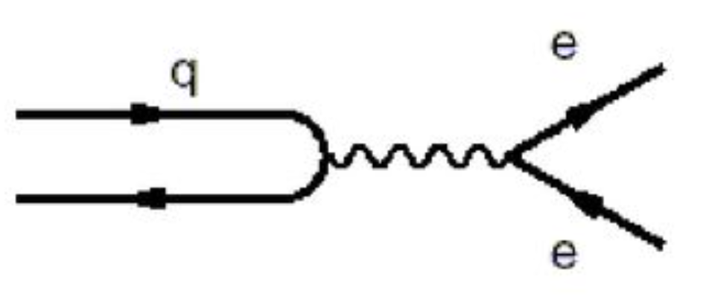
The Breit Frame + Thrust
Breit frame, “infinite-momentum” frame or “brick wall” frame
Frame in which struck quark has momentum reversed
In Breit frame DIS, you have the quark getting its momentum reversed and the proton remnants continuing forward.
This lends itself to a measurement of “hemispheres” in Breit frame, corresponding to participant quark vs. remnant, so called “current hemisphere” (CH) and “remnant hemisphere” (RH)
CH RH

Slide 3
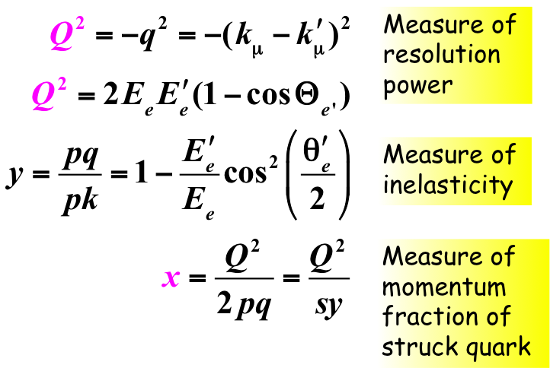
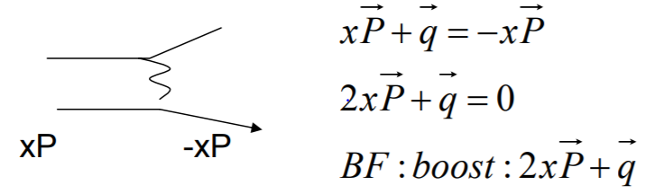
Aside: Breit Frame Transformation
If the scattered lepton is measured accurately, the lorentz transformation to the Breit frame can be made from the lab frame
Need to learn x, q from lepton
For EIC, may need to learn P and E_{e} from t₀ due to crab crossing?
By finding Q² and y from lepton, x and q are defined.
Lepton energy scale is a very important systematic in BF studies

Slide 4

The Breit Frame + Thrust
This version of thrust (below; as used by HERA experiments) measures the longitudinal momentum components of particles in current hemisphere projected onto the current hemisphere axis
Note: Variable can also be studied in e⁺e⁻!
This crucially omits the remnant hemisphere, making it non-global
n = boson direction
P_{h} = hadron momenta in CH
CH RH
n
CH RH
Situation where τ = 1, longitudinal projection of CH particle momenta onto hemisphere axis is 0, high “thrust” in current direction
n
Situation with low thrust, high “spherocity” – another event shape variable effectively opposite of thrust

Slide 5
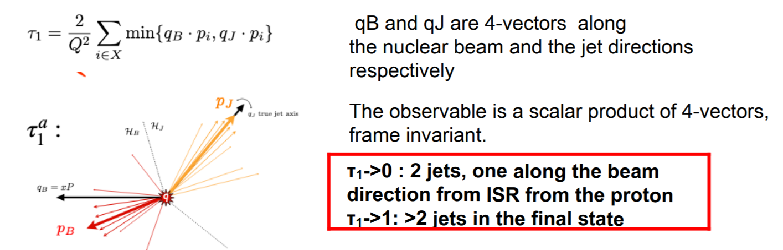
1-Jettiness
Event shape observable with theoretical calculation uncertainty of the order of 1%, sensitivity to α_{s} and PDFs (non-perturbative parameter α₀?)
To be compared to inclusive/dijet extractions in DIS with uncertainties of ~10%
“1-jettiness” in DIS measures final states with beam radiation + one additional jet, NOT the same as thrust from above, remnant is included in measurement
Measure 1-Jettiness cross section with high precision, theory does the rest.
Caveat: Larger systematic error due to non-cancellation of hadronic energy scale (unlike in thrust)
Put simply: minimizing dot products W.R.T beam or jet = group into hemispheres based on which 4-vector is closest, beam or jet
Working with 4-Vectors, so mass plays a role -> PID!

Slide 6
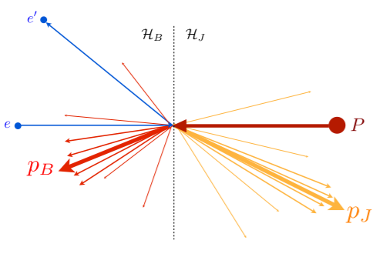
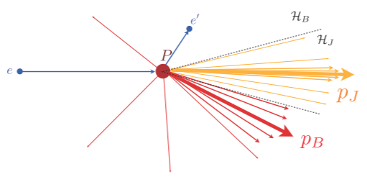
1-Jettiness in the fixed target frame
EIC Lab frame will be somewhere in-between
(HERA had lab-to-CM boost of γ = 2.86)
1-Jettiness in the center-of-momentum frame

Slide 7
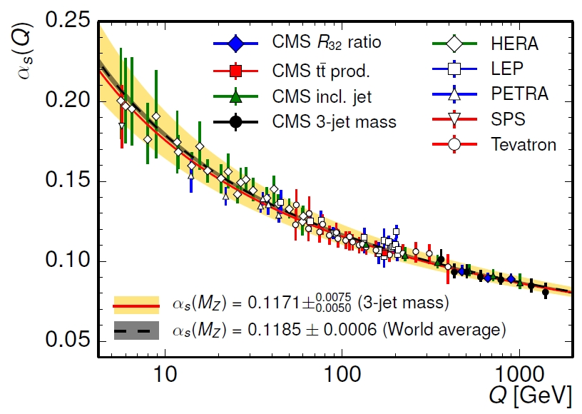
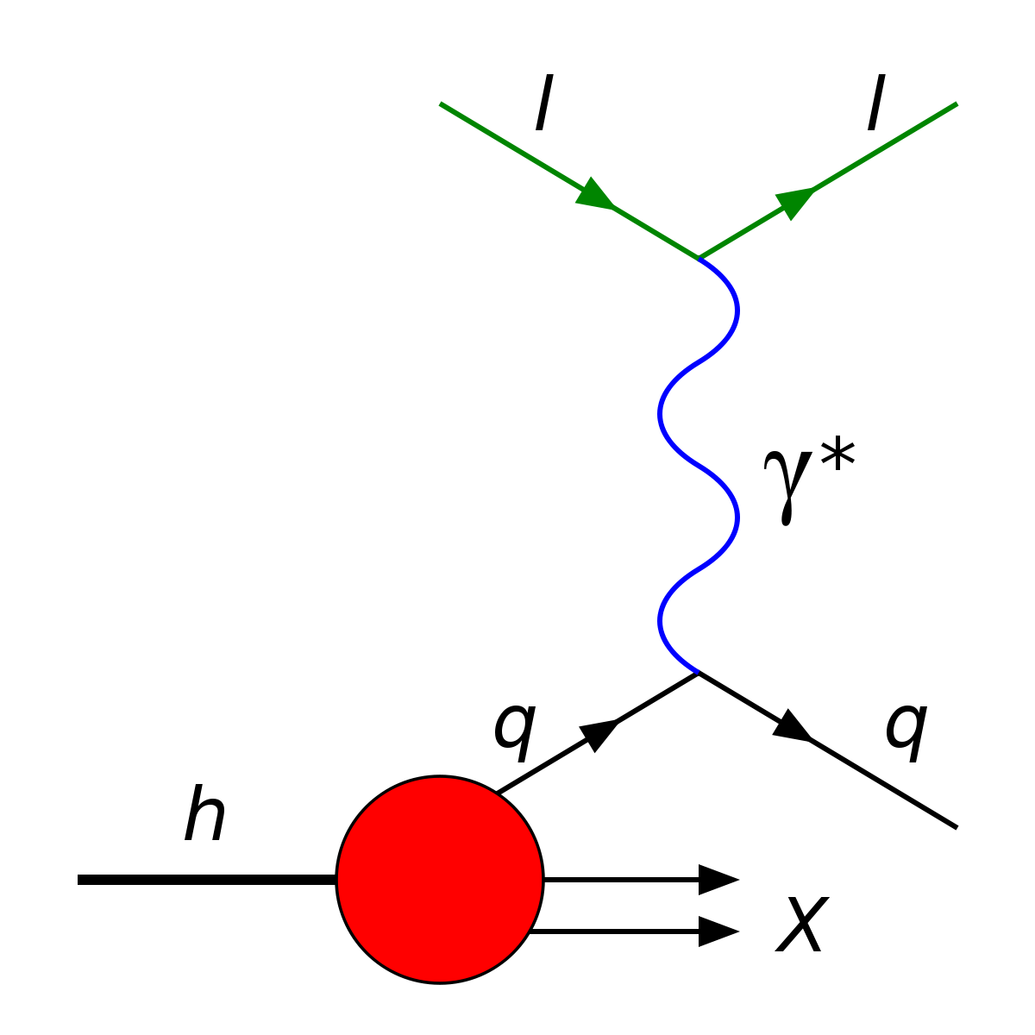
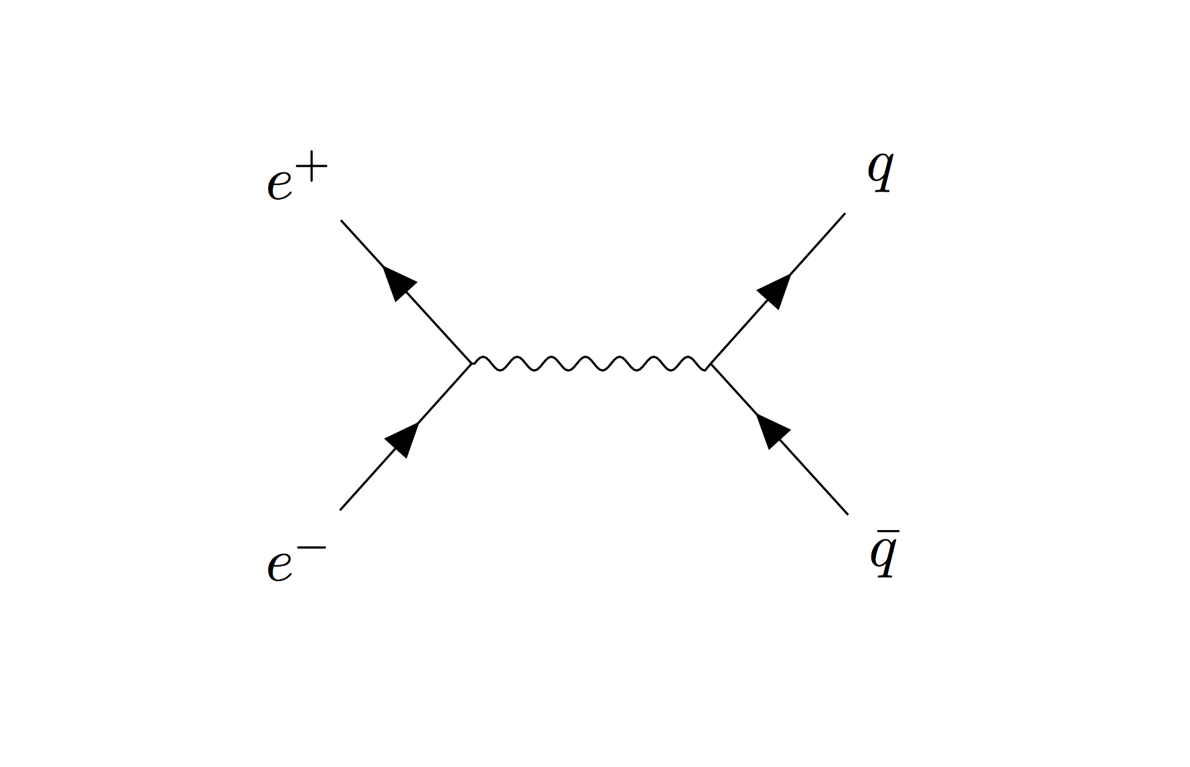
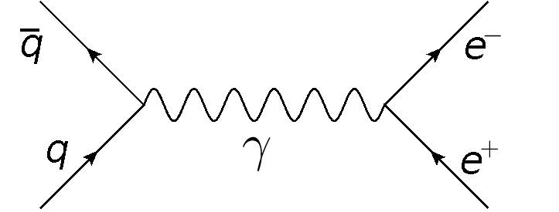
1-Jettiness and α_{s}
α_{s} is the only coupling parameter in QCD, needs to be experimentally measured and checked in as many channels as possible
Unique running of α_{s} is a byproduct of the complexity and richness of QCD
Measurement of α_{s} through standard “knockout” DIS, calculable to N³LL
Crossing symmetry with e⁺e⁻, h+h collisions

Slide 8
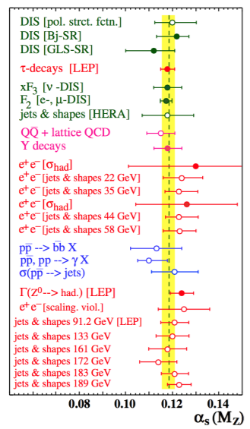
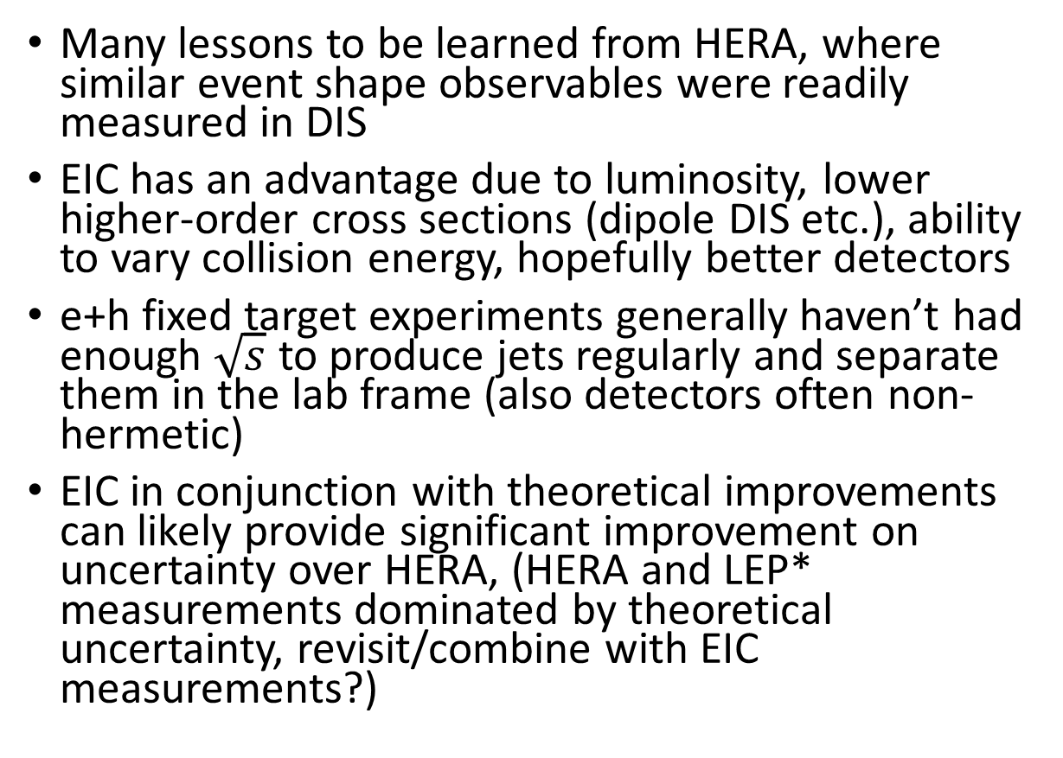
1-Jettiness
Many lessons to be learned from HERA, where similar event shape observables were readily measured in DIS
EIC has an advantage due to luminosity, lower higher-order cross sections (dipole DIS etc.), ability to vary collision energy, hopefully better detectors
e+h fixed target experiments generally haven’t had enough $\sqrt{s}$ to produce jets regularly and separate them in the lab frame (also detectors often non-hermetic)
EIC in conjunction with theoretical improvements can likely provide significant improvement on uncertainty over HERA, (HERA and LEP* measurements dominated by theoretical uncertainty, revisit/combine with EIC measurements?)
LEP value ± Exp. Uncert. ± Theo. Uncert
*Might be fun to look at data from an experiment that shut down when I was 5

Slide 9
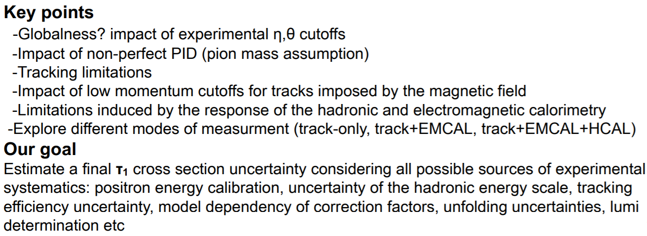
1-Jettiness
For the Yellow Report, it’s necessary to quantify the feasibility of this measurement at the EIC to see whether or not it’s worth including in the physics program.
My small contribution is to dig into HERA experiments and quantify the ways in which the EIC can make the measurement more or less precisely than they did.
Big question: why did they only analyze HERA I data?
Total of 82.2 pb⁻¹ integrated luminosity from HERA I analyzed by ZEUS (in 2006) and 106 pb⁻¹ from HERA I from H1 (in 2006)… < 2 days of EIC run time at initial luminosity if my math is correct. 10 fb⁻¹/183 days (6 months), 55 pb⁻¹/day
Possible that at the time, theoretical uncertainty still dominated experimental so nobody wanted to spend their time improving on the measurement.

Slide 10
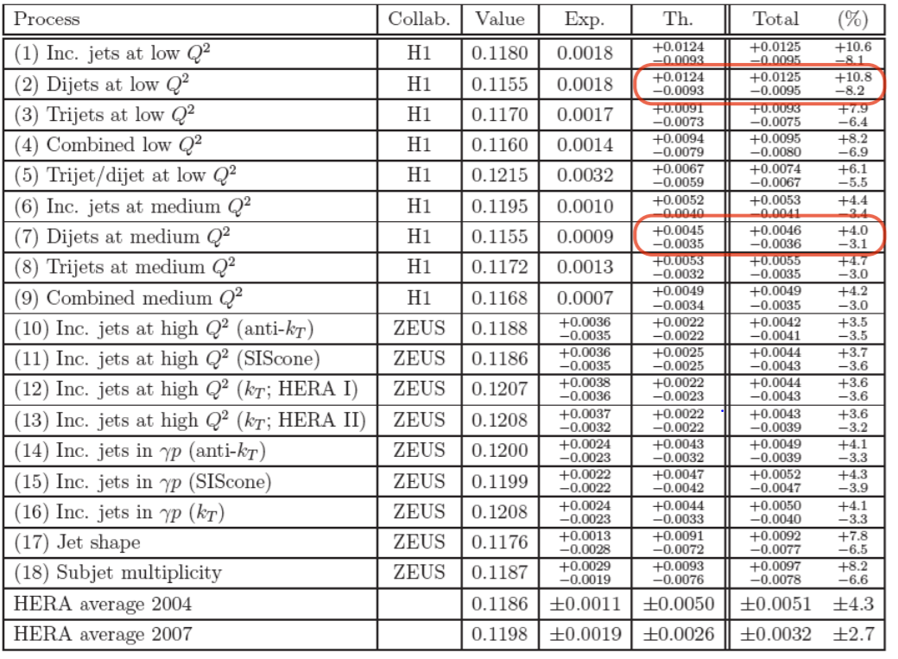
Extraction of α_{s} in any channel is a delicate balance of complicated theory (scheme dependences etc. that I don’t understand) with experimental measurements
In principle, if Chris Lee and collaborators are correct about the precision of their calculations, simply re-analyzing HERA in terms of 1-Jettiness could yield a significant improvement in the uncertainties

Slide 11
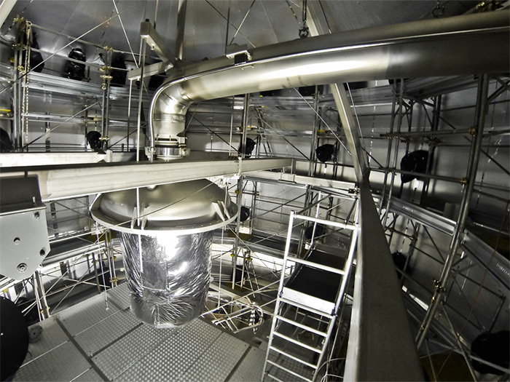

PS: Axions?
https://arxiv.org/abs/2006.09721
Paper published a few days ago by XENON 1T “Observation of Excess Electronic Recoil Events in XENON1T”
“The solar axion model has a 3.5 σ significance”
Axions provide a neat explanation for the strong CP problem, namely why should the θ parameter contributing to CP-violation in QCD be so darn small? (Current limit is < 10⁻¹⁰ radians)
Highlights the huge variation in experimental techniques used to test QCD!
3.3 tons of ultra pure liquid Xenon!
as usual, grains of salt abound.

