Slide 1
PID/Calorimetry
TK Hemmick P Rossi

Slide 2
PID @ Joint Integration Meetings
“Requirements”
“Performance”
PID/Tracking (May 13)
Information flowed both ways.
Requirements were dominantly PID’s needs as deliverables from tracking.
PID/Calorimetry (July 8)
Information will flow both ways.
Likely primary areas of concern:
Additional e/π separation as supplied from PID devices to aid EMCAL at low momentum.
Material requirements to prevent e/π devices from adversely affecting EMCAL.

Slide 3
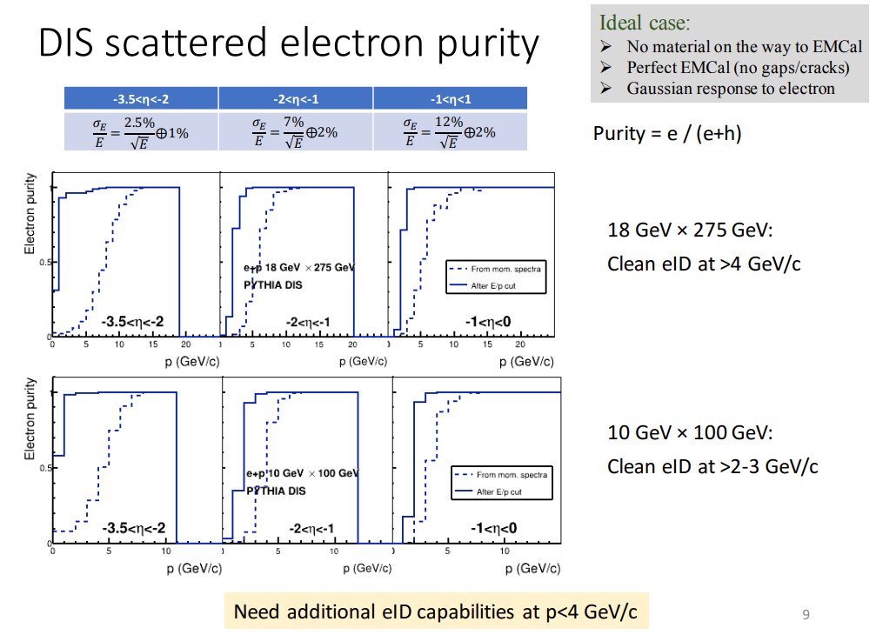
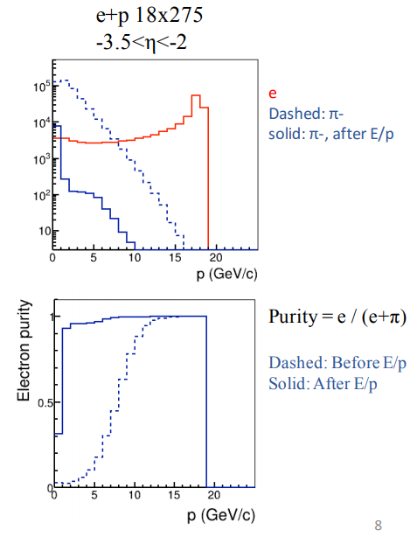
Gleaned from Pavia
Presently idealized
No cuts
EMCAL @ 95% Efficiency
E/P matching in EMCAL fine at higher momenta.
EMCAL needs assistance at lower momenta.
How to make the requirements crisp?
Depends upon required purity (function of η).
Depends upon required efficiency
Depends upon additional realism (e.g. material)
Need guidance on required performance
Some devices measure separation in σ
Some devices measure rejection factor (95%→20X)

Slide 4
Power Point Analysis
-3.5 < η < -2.0
-2.0 < η < -1.0
-1.0 < η < 0.0
4 GeV
Roughly matched criteria vs h
A guess why:
Spectra evolve with η
Calorimeter Technology also evolves.
Another guess:
Falloff in purity at low momentum is steep.
Playing with definitions of required parameters (eff, purity, etc) will likely make only small changes to the final requirement.
4 GeV e/π is likely as robust as any other spec for our developing EIC designs.

Slide 5
Gathering of options @ 4 GeV
Good news:
There are ways to do much better than 3σ e/π at 4 GeV.
The game will be a require an optimization of secondary considerations:
Physical space for the detectors along the particle path.
Material budget.
Etc…
Need to find the Goldilocks Solution.
Natural candidate for detector complementarity discussions.
Hot
J.R.
Cold

Slide 6
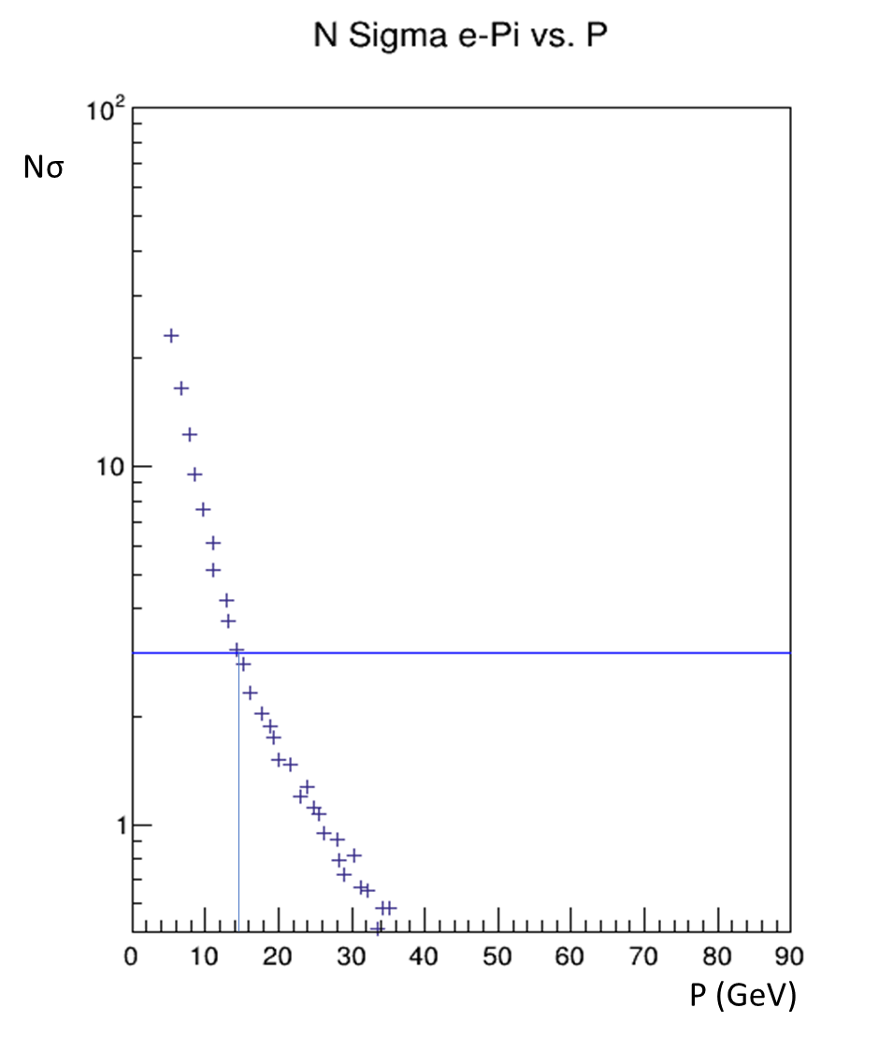
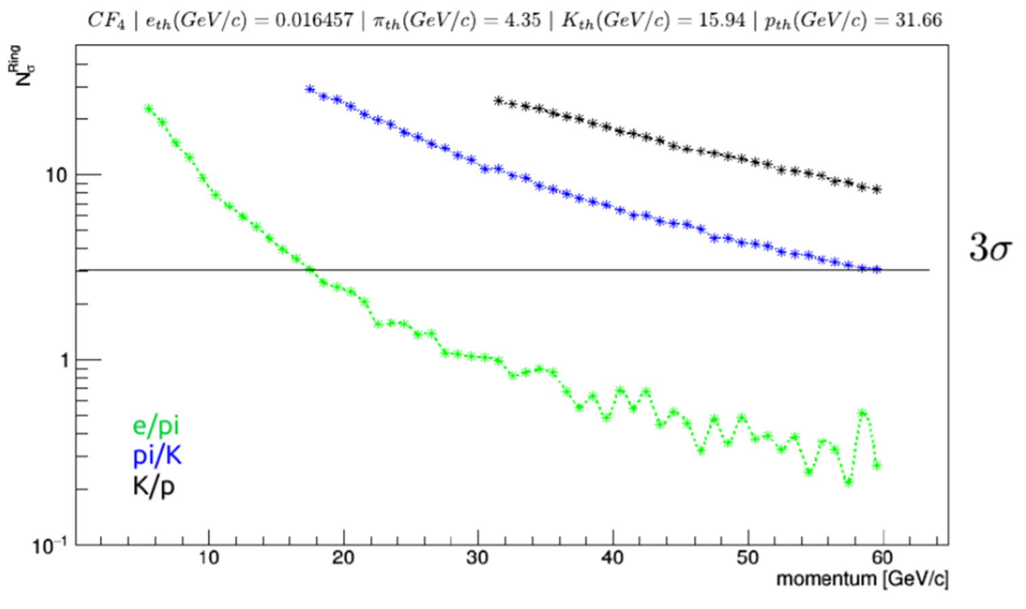
Superb e/p Separation
eRD6 RICH
prototype
eRD14 “dual RICH”
simulation
Focused Gas RICH
Low index gas pushed the e/π out to 15 GeV or beyond.
Compromise parameter is Zed length:
1-1.5 meters in Zed
Under study:
Move Z_{vertex} toward –η exacerbating the space issue.

Slide 7
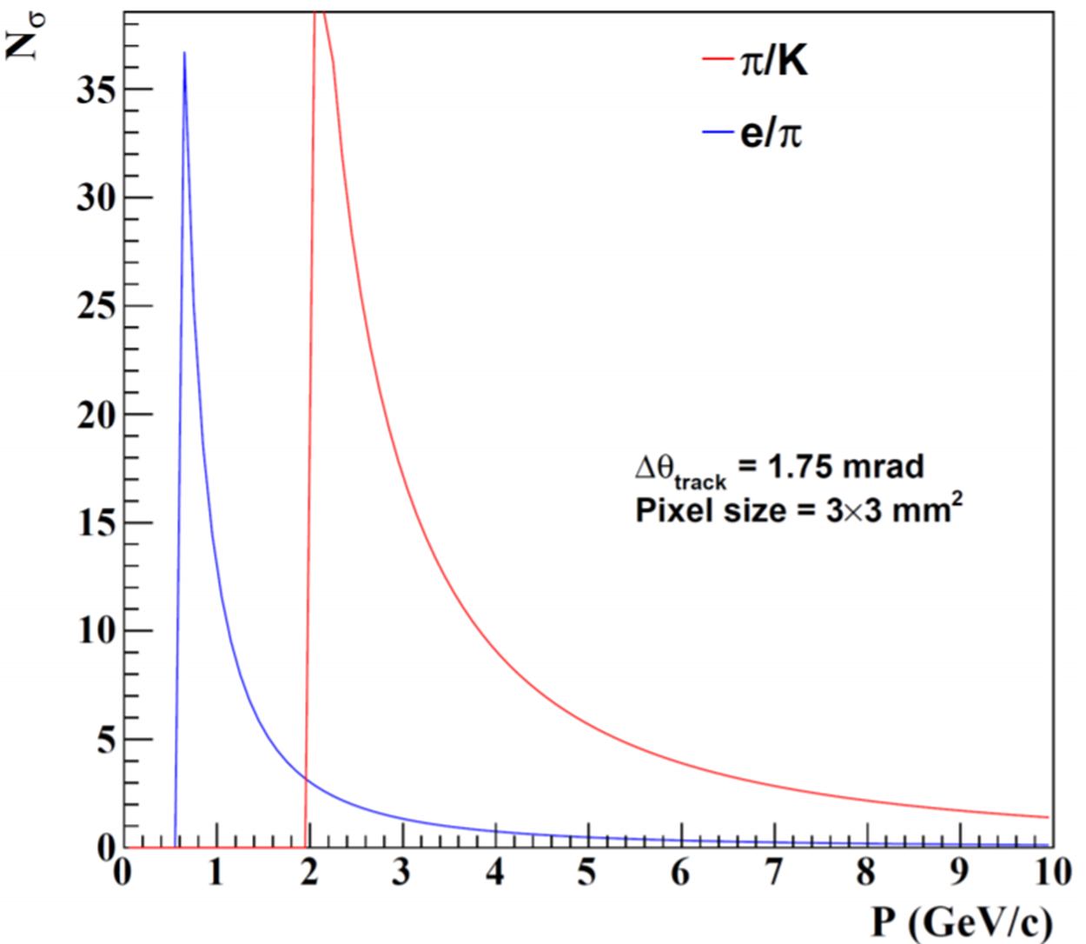
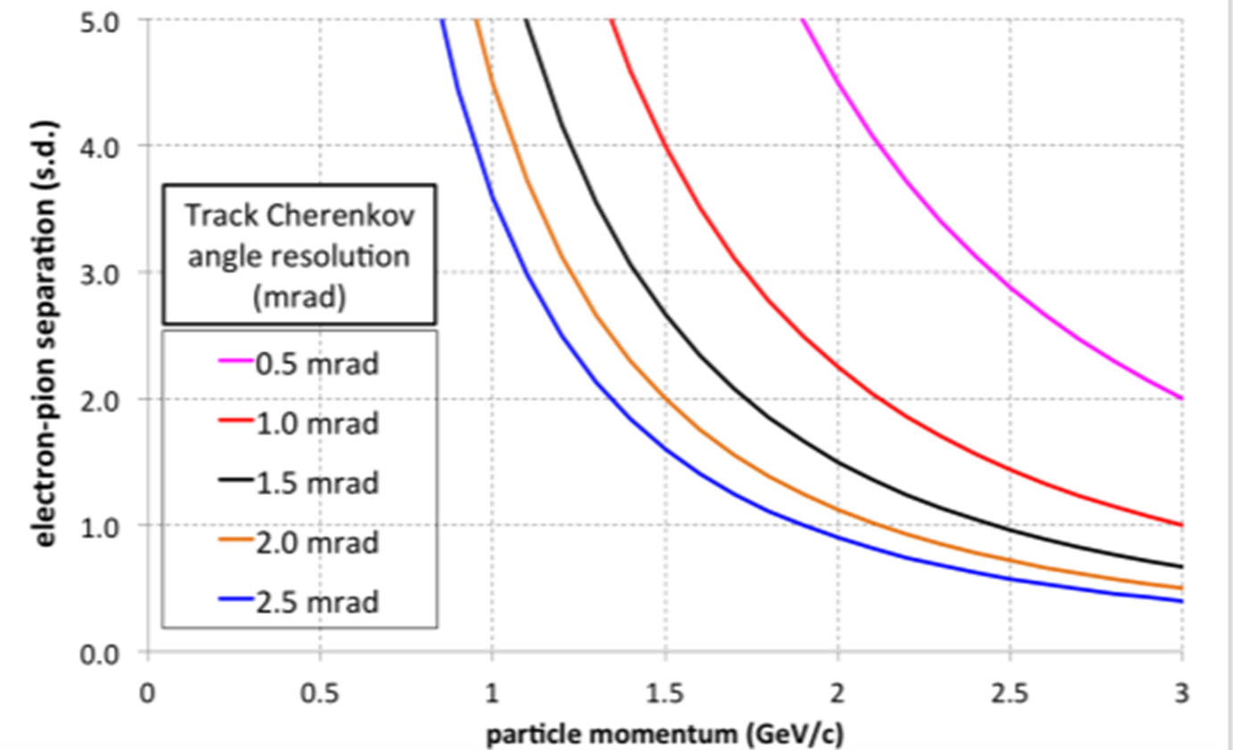
More Compact Cherenkov eID Detectors
Modular RICH
Close to 4 GeV.
Effective enough alone for eID?
Desiring complementary detector?
TRD?
dE/dx?

Slide 8
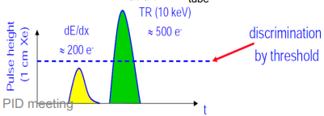
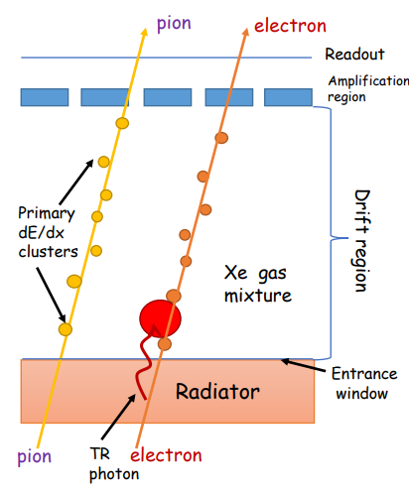
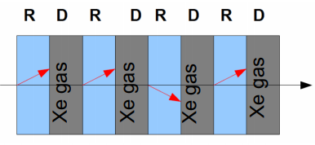
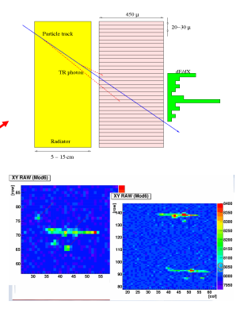
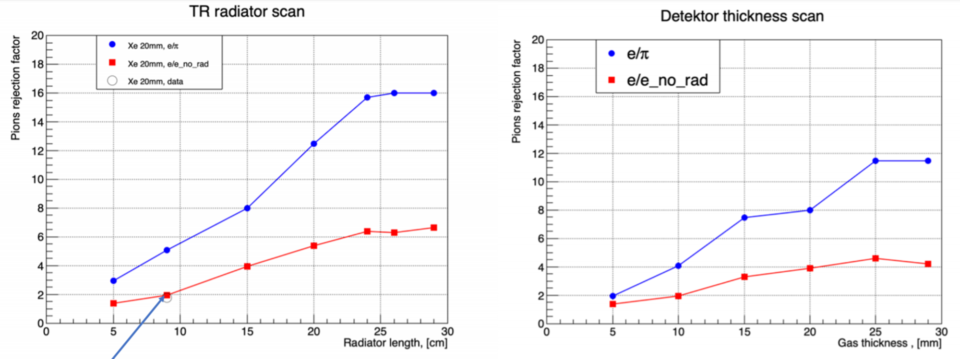
Transition Radiation
“Threshold detector” (TR X-rays produced or not)
P_{min} ~ 1 GeV (photon rate close to constant for electrons above threshold)

Slide 9
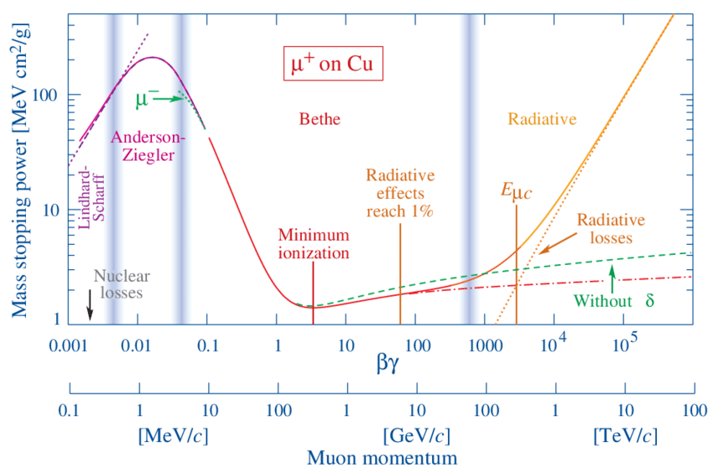
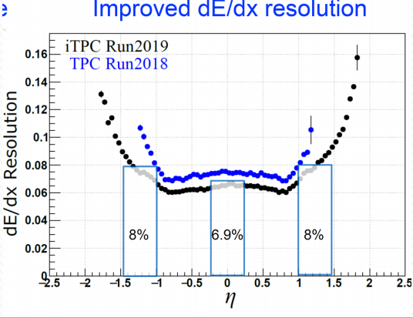
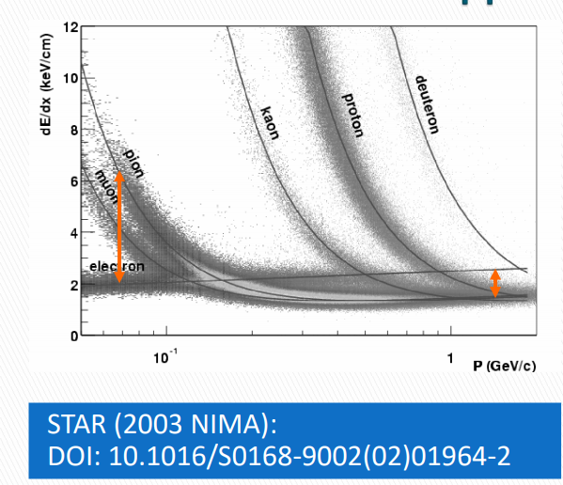
dE/dx
Specific ionization is a function of β.
PID bands vs momentum.
Crossing ~β = 0.7
“Assistance” 1.5 – 2.5 σ level
Dots = STAR
Boxes = sPHENIX Test Beam
Zeus @ 6% dE/dx Resolution

Slide 10
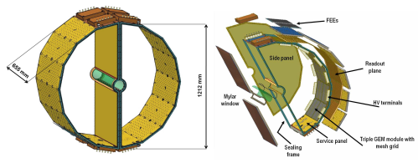
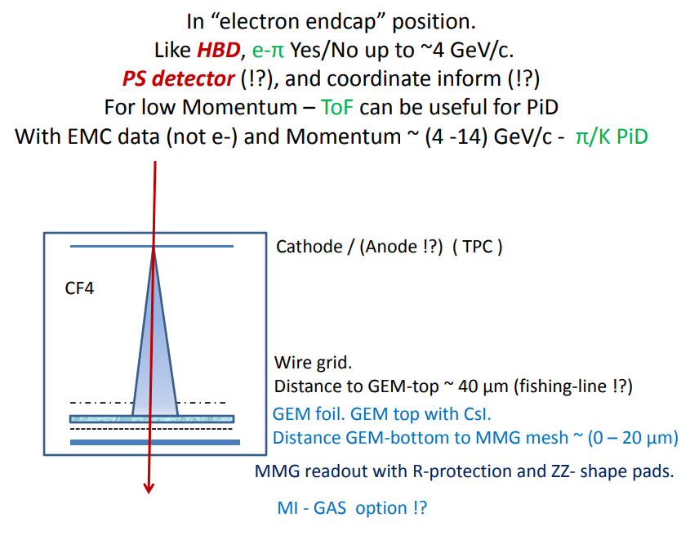
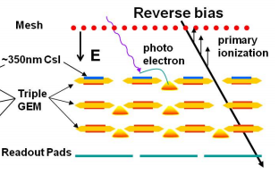
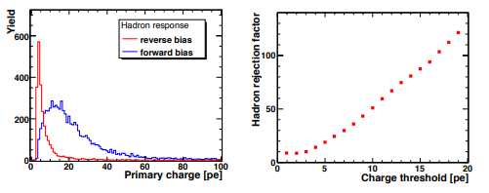
HBD(++)
Charge is collected from Transfer gaps
Makes non-zero hadron response
N. Smirnov
Minimize gas volume below 1st GEM
Mixed GEM/microMEGAS
Possibility for timing?
PHENIX HBD was optimized for 1e-vs-2e separation.
Non-zero hadron response.
Re-optimize for EIC??

Slide 11
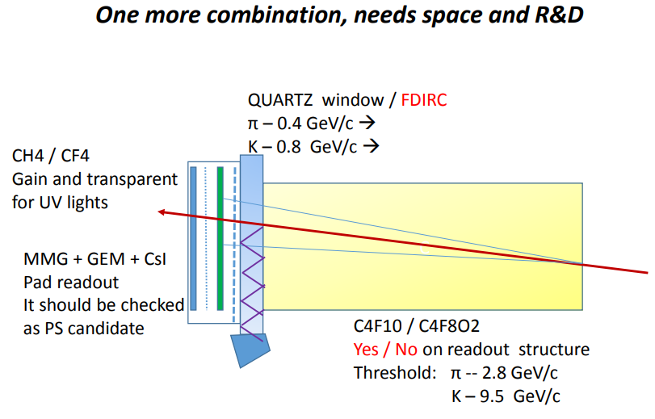
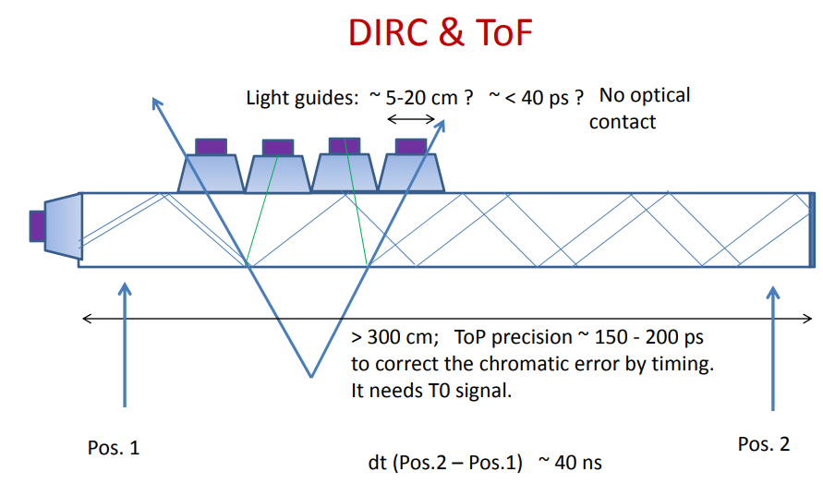
Dual Technologies (N Smirnov)

