Slide 1
Kinematic reconstruction for SIDIS processes
Anselm Vossen
Duke
YR Meeting 6/7/2020

Slide 2
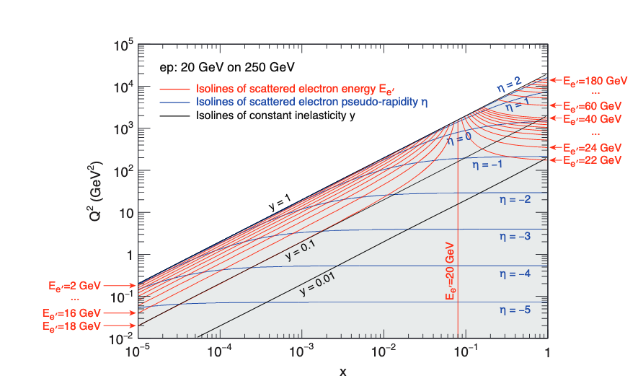
What is the issue
At low $y$resolution of kinematic variables $x_{Bj}$, $Q^{2}$ suffers due to relatively large uncertainty on $y$
→potentially also a problem for $φ$ measurements in Breit frame, due to $q$dependent boost (haven’t looked at this yet, but $Q^{2} re$solution is in general less problematic then $x_{Bj}$, so there is hope)
The low $y$region is the overlap region with the Jlab kinematic regime
At low $y,$we also loose sensitivity to pretzelosity $g_{1L}$ and worm-gear $g_{1T}$

Slide 3
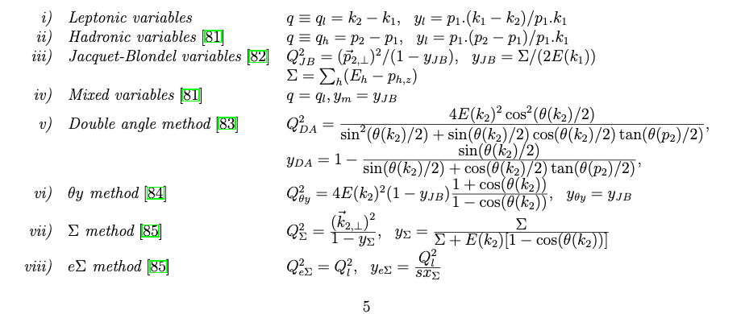
What can be done?
Reconstruct kinematic variables from final state
Multiple methods available
Jaquet-Blondel
Double-Angle
Mixed Method
See plots in
for studies with BEAST detector
(in backup slides)
Bluemlein, arXiv:1208.6087

Slide 4
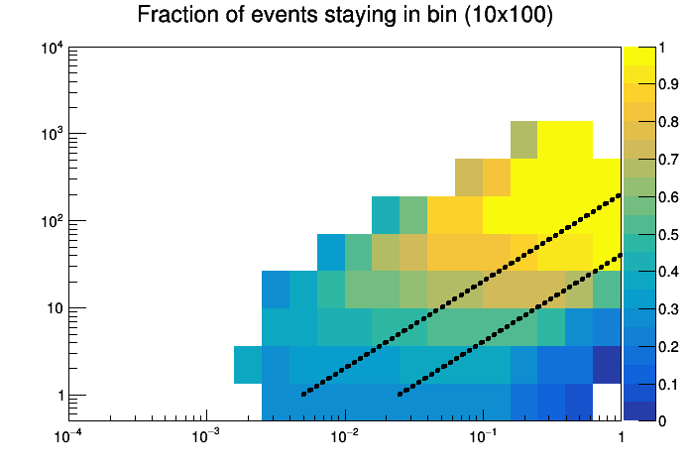
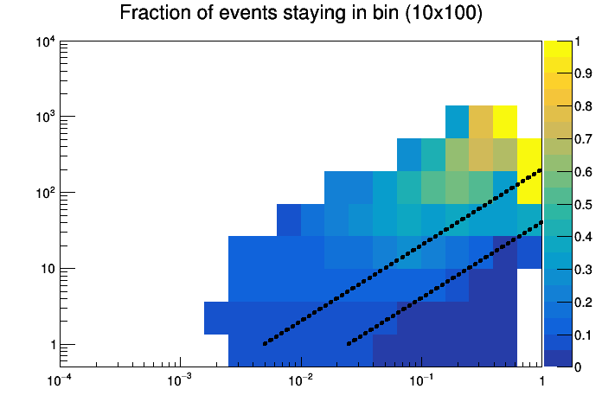
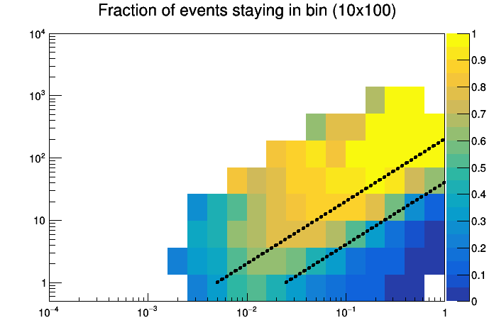
Results with EIC smear (100k events)
$$Q^{2}$$
Double angle
Just electron
$$y=0.05$$
$$y=0.01$$
x
$$Q^{2}$$
$$Q^{2}$$
Mixed method
JB method
$$y=0.05$$
$$y=0.05$$
$$y=0.01$$
$$y=0.01$$
x
x

Slide 5
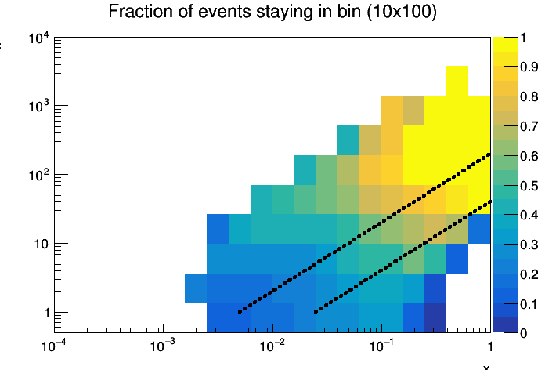
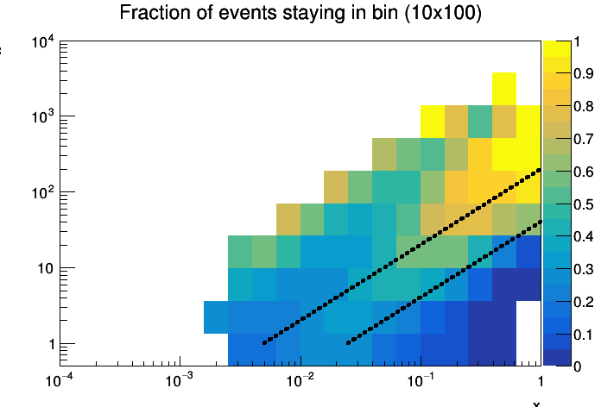
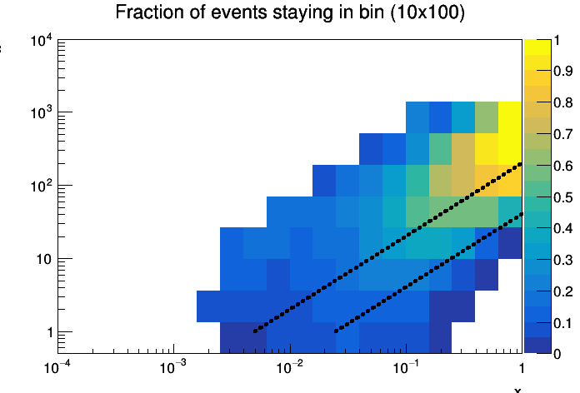
Using Delphes+EFlow: consistent results
$$Q^{2}$$
Double angle
Just electron
$$y=0.05$$
$$y=0.01$$
x
$$Q^{2}$$
$$Q^{2}$$
Mixed method
JB method
$$y=0.05$$
$$y=0.05$$
$$y=0.01$$
$$y=0.01$$
NB: we observed some strange behavior using eflow which is still being investigated (some momenta set to 0)
x
x

Slide 6
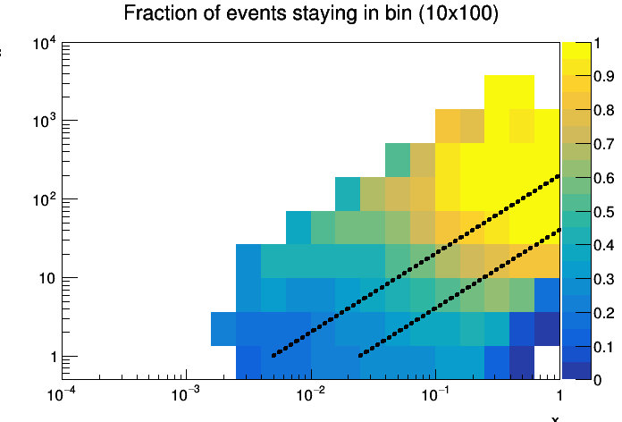
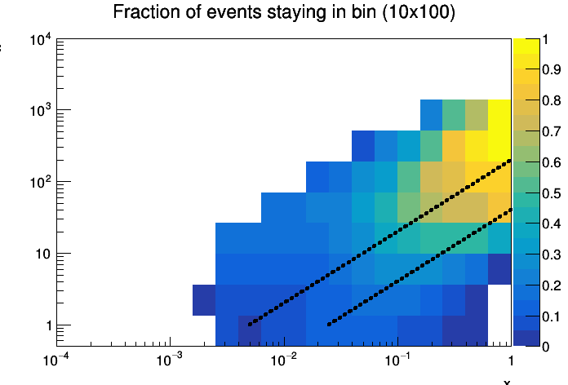
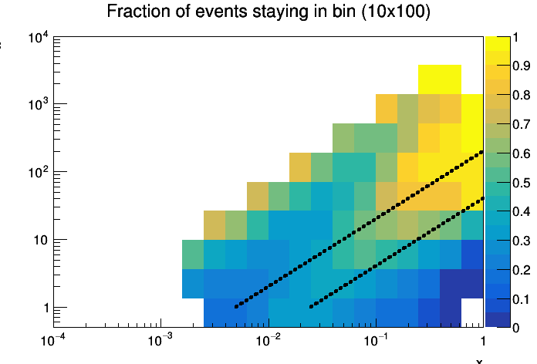
Expanding coverage to $\left|η\right|<4$
$$Q^{2}$$
Double angle
Just electron
$$y=0.05$$
$$y=0.01$$
x
$$Q^{2}$$
$$Q^{2}$$
Mixed method
JB method
$$y=0.05$$
$$y=0.05$$
$$y=0.01$$
$$y=0.01$$
x
x

Slide 7
Comparison
$$Q^{2}$$
Double angle
$$Q^{2}$$
Double angle
$$\left|η\right|<3.5$$
$$\left|η\right|<4.0$$
$$y=0.05$$
Some improvement
At low $x$high $Q^{2}$
$$y=0.05$$
$$y=0.01$$
$$y=0.01$$
x
x
$$Q^{2}$$
$$Q^{2}$$
$$\left|η\right|<4.0$$
Mixed method
Mixed method
$$\left|η\right|<3.5$$
$$y=0.05$$
$$y=0.05$$
$$y=0.01$$
$$y=0.01$$
7
x
7
x

Slide 8
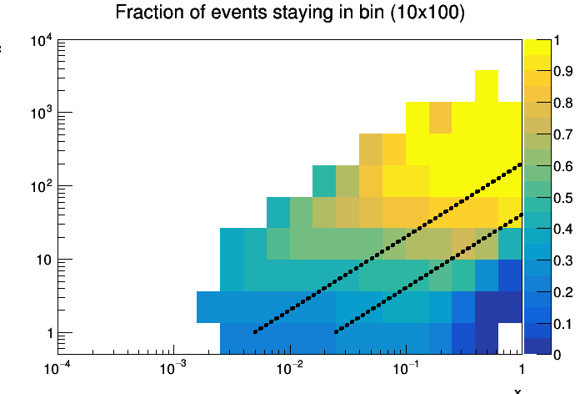
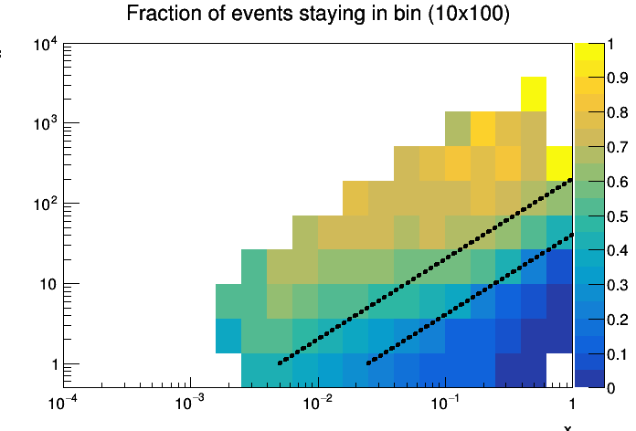
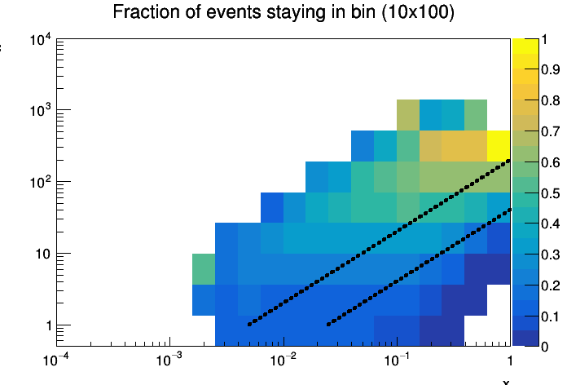
No HCAL,$\left|η\right|<3.5$
$$Q^{2}$$
Double angle
Just electron
$$y=0.05$$
$$y=0.01$$
x
JB method worse, others
Same if not better?
$$Q^{2}$$
$$Q^{2}$$
Mixed method
JB method
$$y=0.05$$
$$y=0.05$$
$$y=0.01$$
$$y=0.01$$
x
x

Slide 9
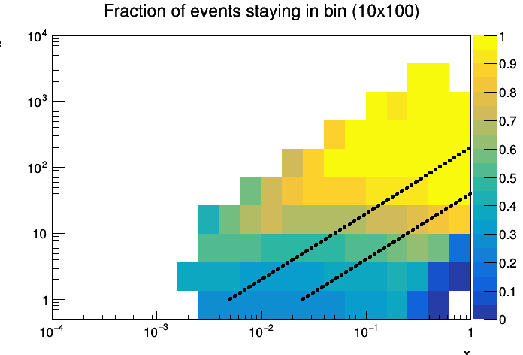
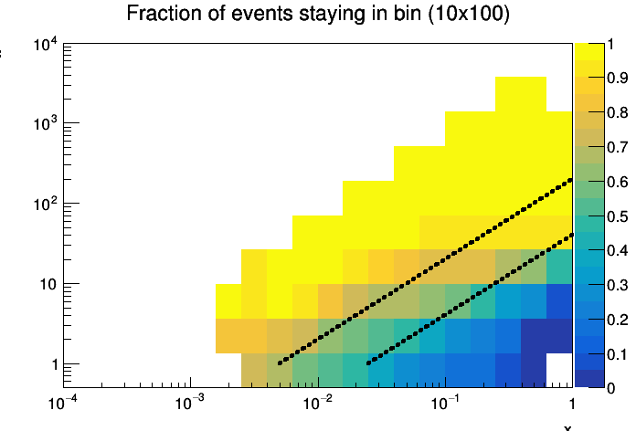
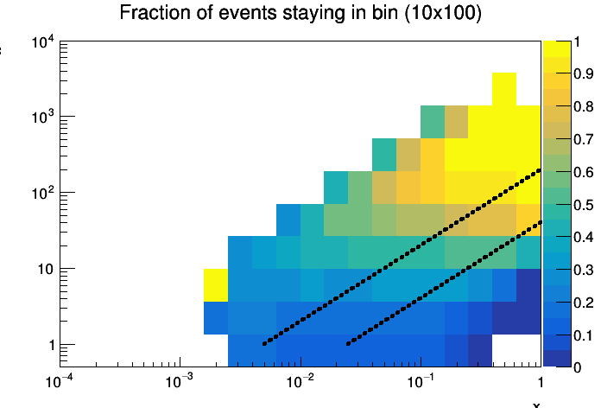
Perfect detector |$η|<4.0:$ minimal gain at low$y$→ resolution driven by acceptance
$$Q^{2}$$
Double angle
Just electron
$$y=0.05$$
$$y=0.01$$
x
$$Q^{2}$$
$$Q^{2}$$
Mixed method
JB method
$$y=0.05$$
$$y=0.05$$
$$y=0.01$$
$$y=0.01$$
x
x

Slide 10
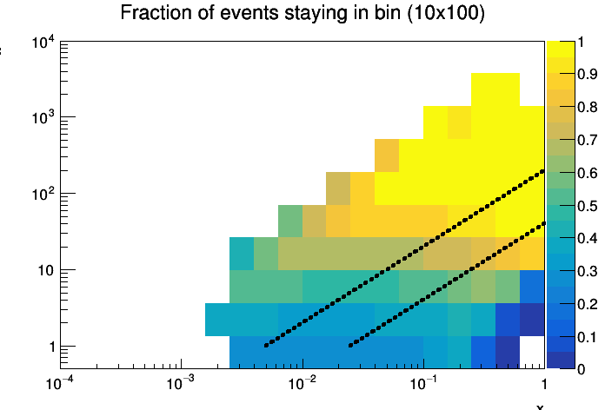
Perfect detector with min $p_{T}$ cut: little change
$$Q^{2}$$
Double angle
Just electron
$$y=0.05$$
$$y=0.01$$
x
$$Q^{2}$$
$$Q^{2}$$
Mixed method
JB method
$$y=0.05$$
$$y=0.05$$
$$y=0.01$$
$$y=0.01$$
x
x

Slide 11
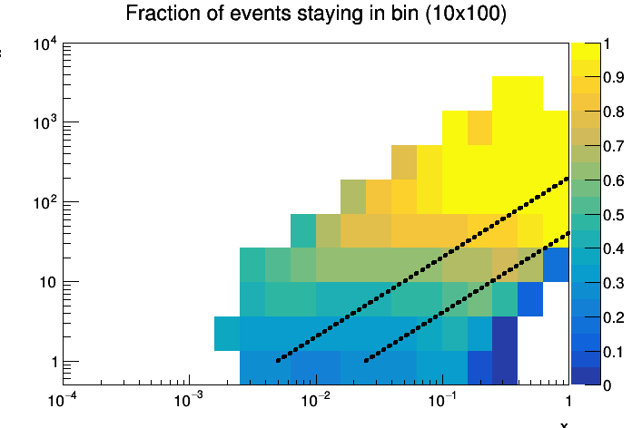
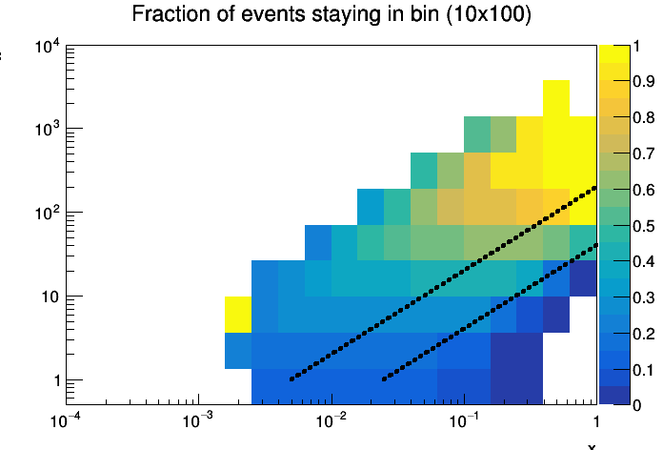
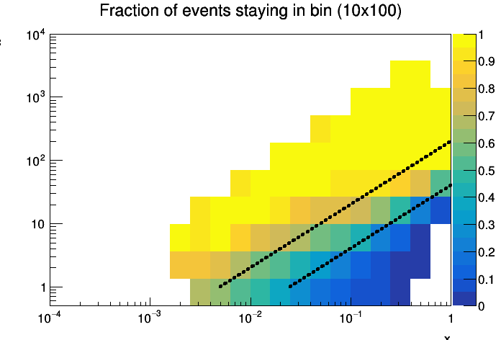
Perfect detector with $\left|η\right|<3.5,\min{p_{T}}$ cut: sig. impact on resolution at low $y$
$$Q^{2}$$
Double angle
Just electron
$$y=0.05$$
$$y=0.01$$
x
$$Q^{2}$$
$$Q^{2}$$
Mixed method
JB method
$$y=0.05$$
$$y=0.05$$
$$y=0.01$$
$$y=0.01$$
x
x

Slide 12
Summary
Important to extend coverage to $\left|η\right|<4$
HCAL seems to be important for JB method, for mixed and DA not so much

Slide 15
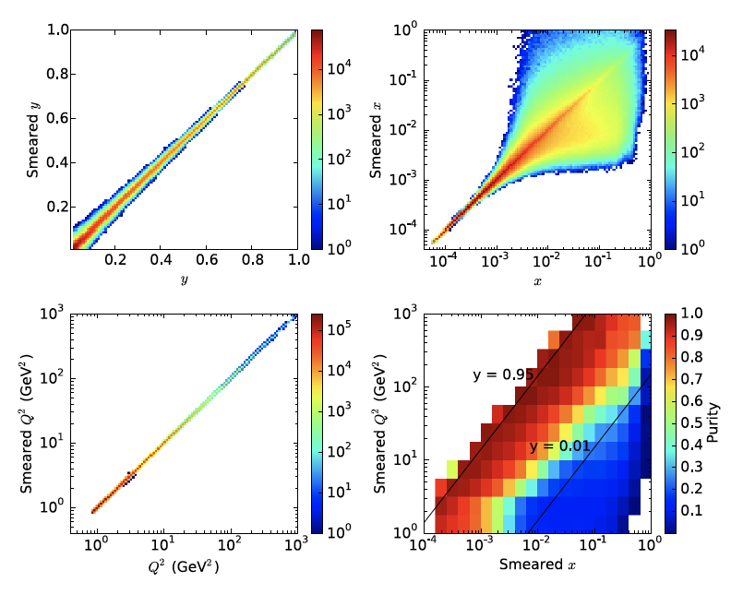
Electron method – BEAST detector
These and following plots from
Simulations are for 15x250 and $38\%/\sqrt{E}$ HCAL
(’handbook’ detector has $\frac{45\%}{\sqrt{E}}+6\%$)

Slide 16
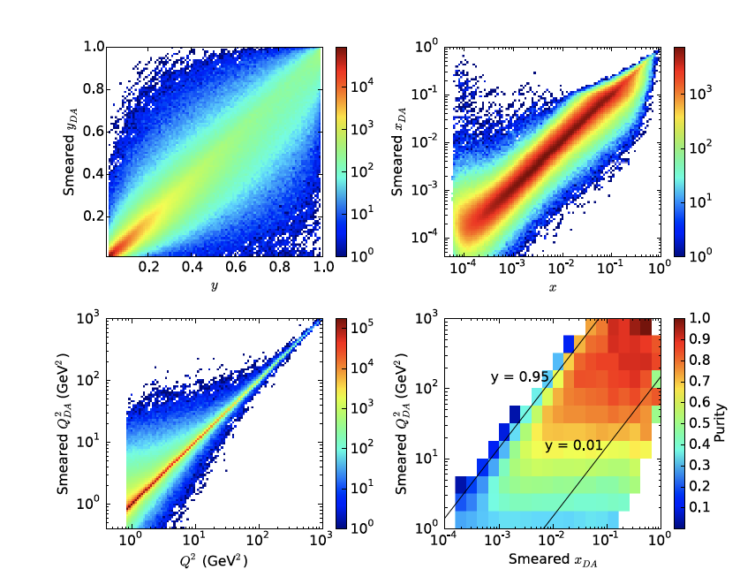
Double Angle Method – BEAST detector

Slide 17
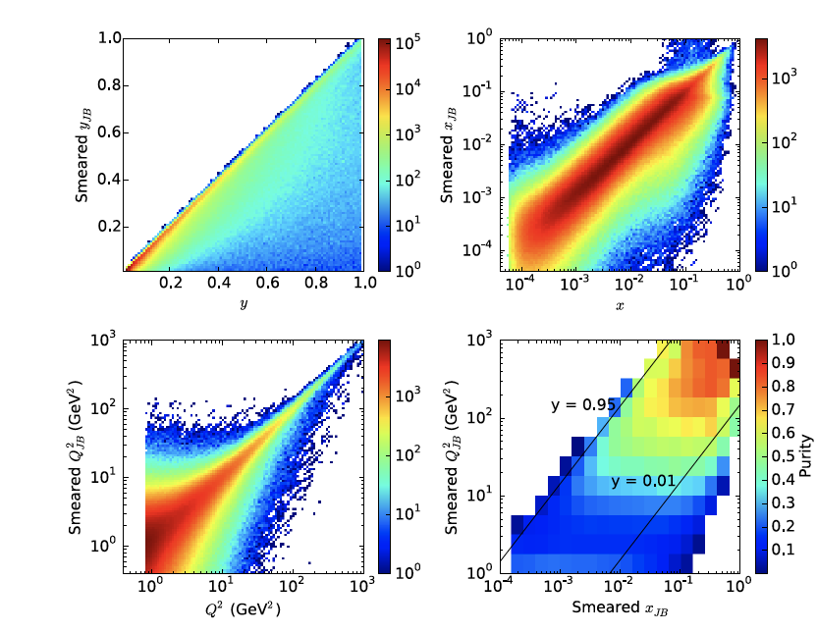
JB Method –BEAST detecto

