Slide 1
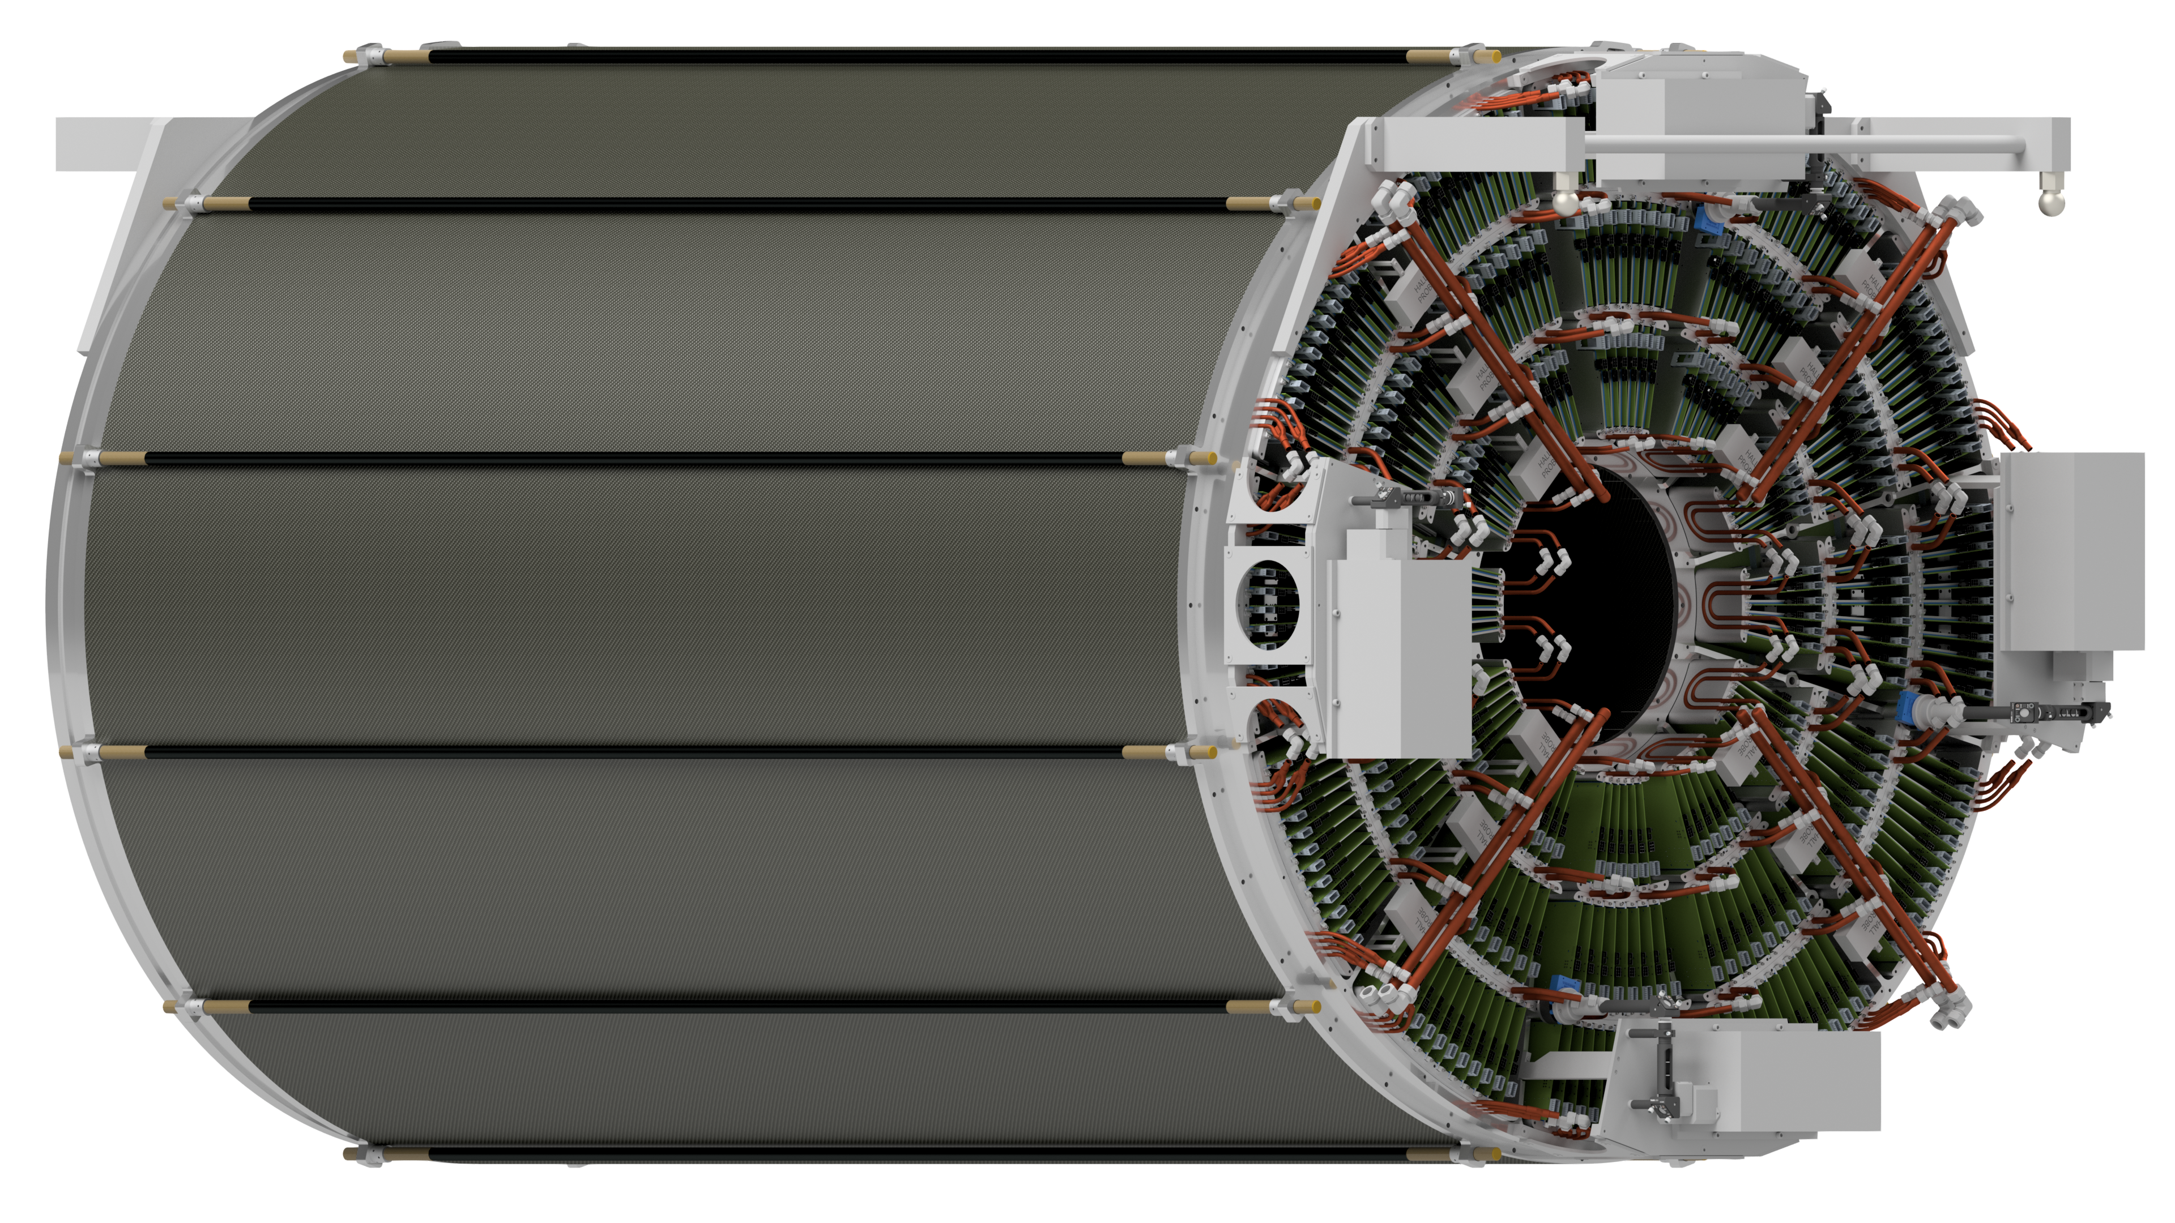
1.2 TPC Update
Name shout outs with orange background; Mistakes/omissions are the fault of TKH
Production & Services
TK Hemmick
Faculty, Graduate Students, Undergraduate Students, Engineers

Slide 2
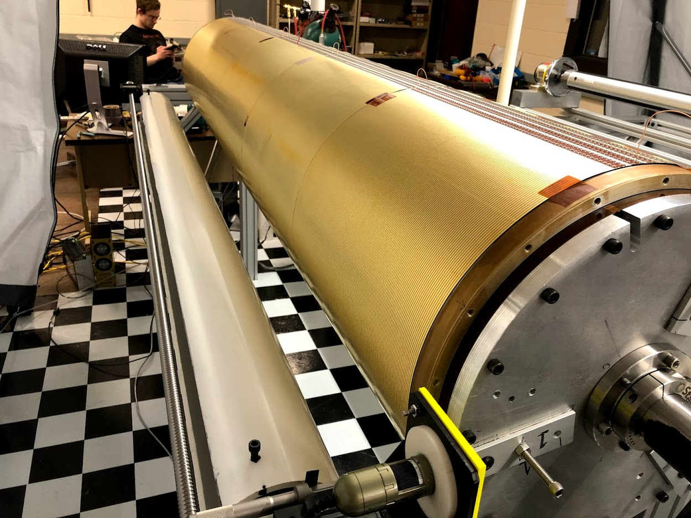
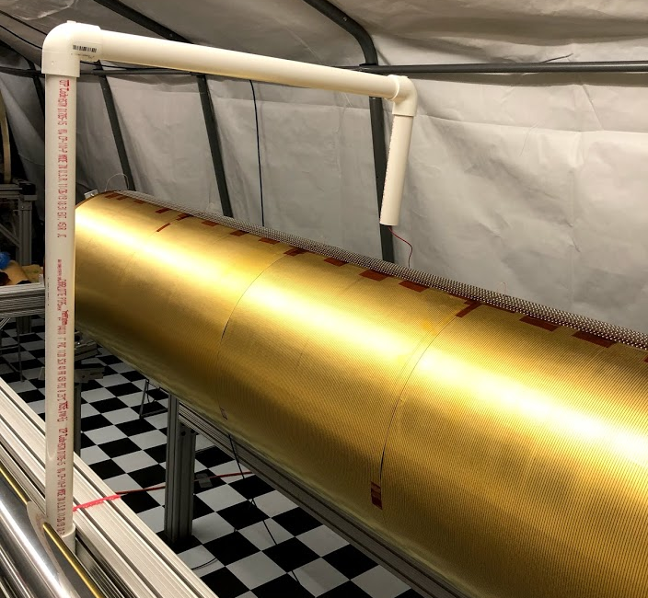
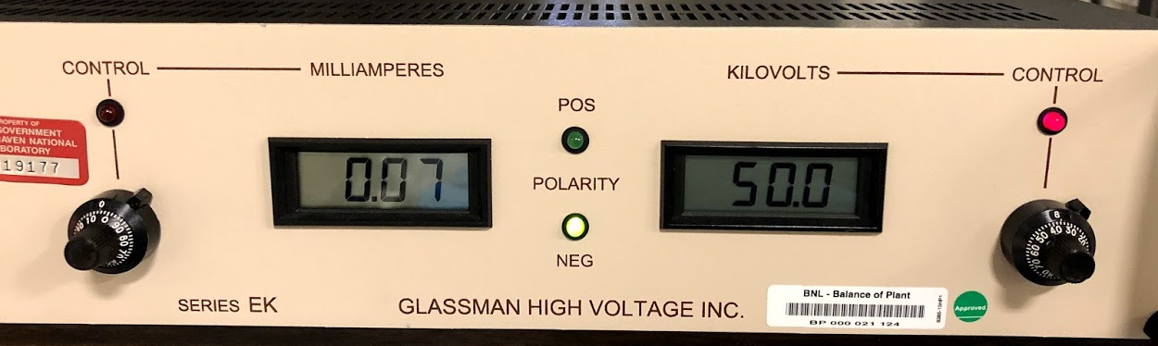
Inner Field Cage HV
Inner Field Cage Test
Max Running Voltage = 44.5 kV
Sample Material re-tested (2 years on shelf) to 80 kV.
Actual field cage tested to 50 kV
Current as expected.
Zero “activity”.
1 hour test.
Prakhar Garg, Klaus Dehmelt, Henry Klest, Luke Legnosky

Slide 3
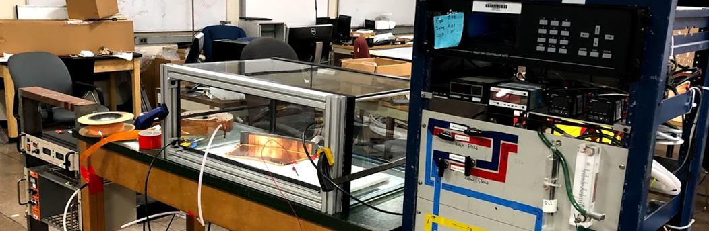
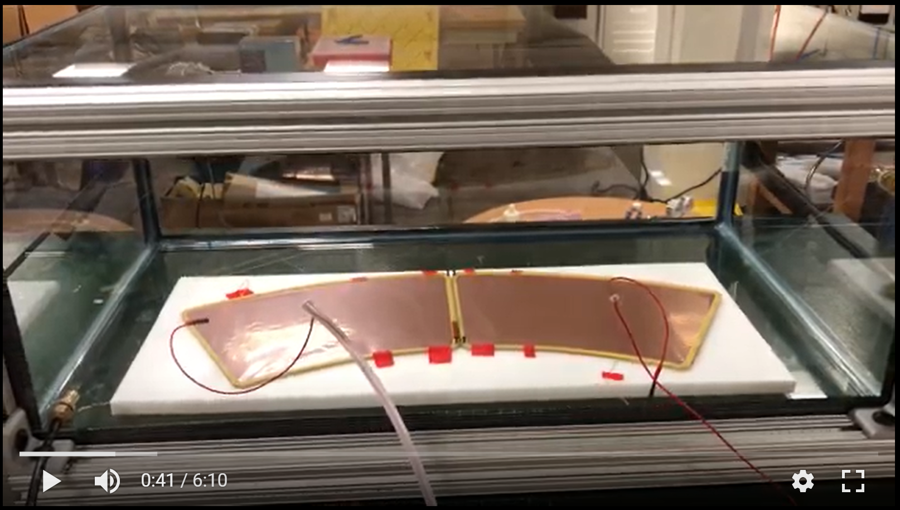
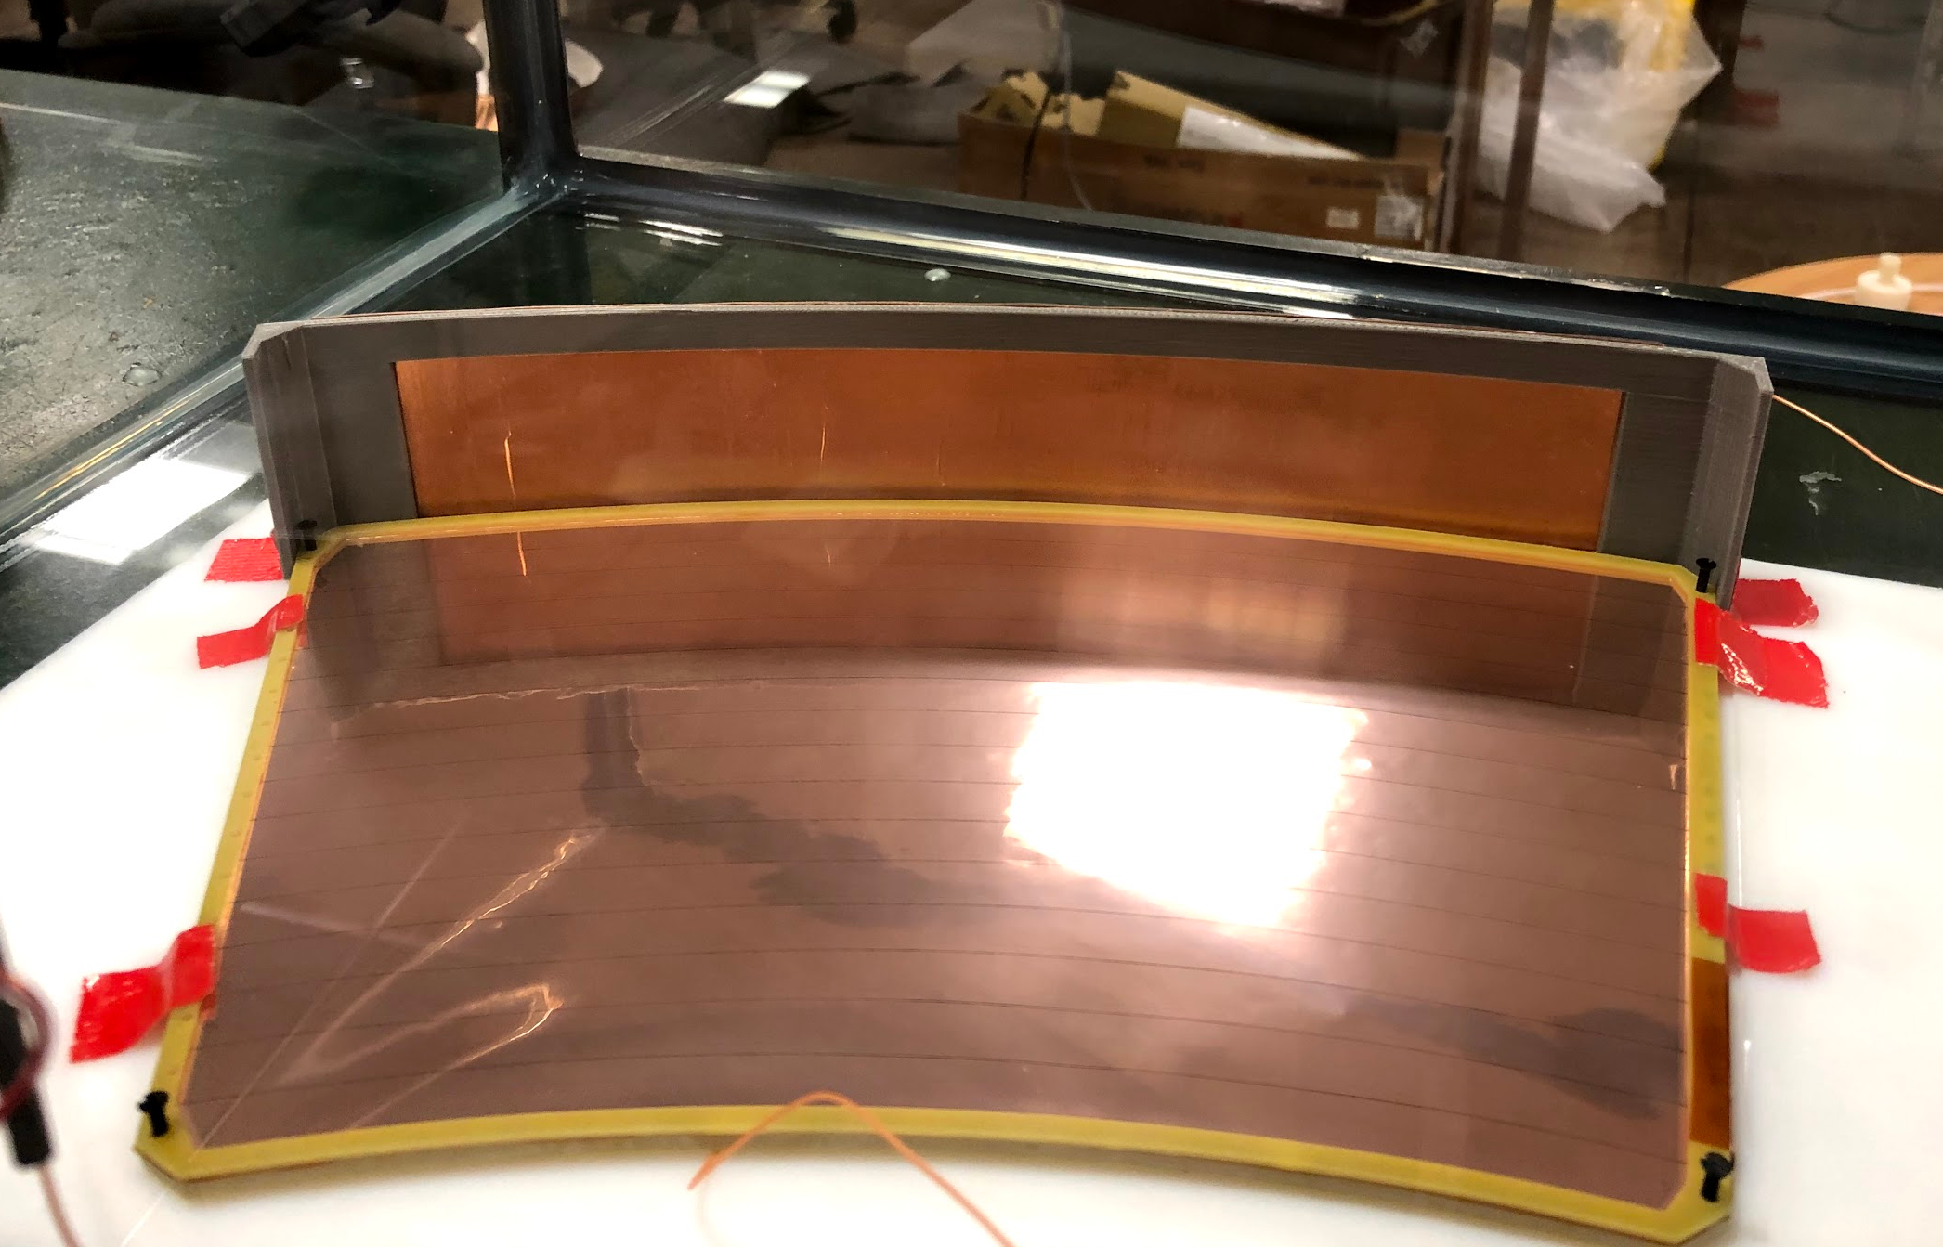
Voltage Tests for Trip Conditions
Running condition: 4.5 kV
A concern raised during the prior review concerning sparks during trip conditions:
Normally module-to-module is at the same voltage (tail = obvious exception).
Normally module-to-cage is at the same voltage.
When one module trips, it becomes ground.
A simple stand-in test:
GEM-to-GEM in air:
Position two GEMs accurately.
Ground one (top & bottom)…HV on the other.
Run up the HV to the spark point.
GEM-to-GEM in gas:
Built a clear gas vessel (aquarium).
Flow 6 turns Ne:CF4.
GEM-to-Field Cage
Use 3D printed fake wall (establishes spacing).
In air and in gas.
Caveats:
No gain
No radiation
Prakhar Garg, Henry Klest

Slide 4
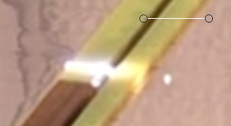
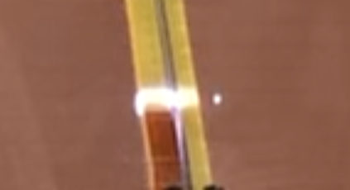
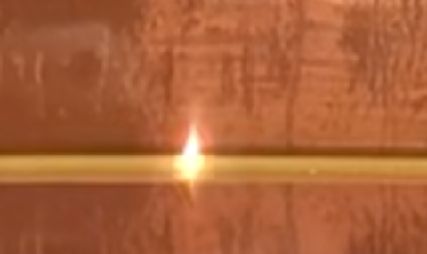
Results
Test Procedure:
Run Bertan supply to limit (5 kV…modified by BNL) watching current.
Wait at 5 kV (zero activity under all conditions).
Run Glassman supply to spark point.
Observe spark locus (in gap?, surface to surface?, moves around?, …)
Gap | Gas | Spark Point | Locus/pattern
GEM-GEM/tail | Air | 14 kV | Surface→Surface Fixed
GEM-GEM/tail | Ne:CF₄ 50:50 | 13 kV | Surface→Surface Moving
GEM-Cage | Air | 13 kV | Surface→Surface Fixed
GEM-Cage | Ne:CF₄ 50:50 | 11.5 kV | Surface→Surface Fixed
All tests stable at 10 kV
Air 14 kV
Ne:CF₄ 13 kV
Ne:CF₄ 11.5 kV
Prakhar Garg, Henry Klest

Slide 5
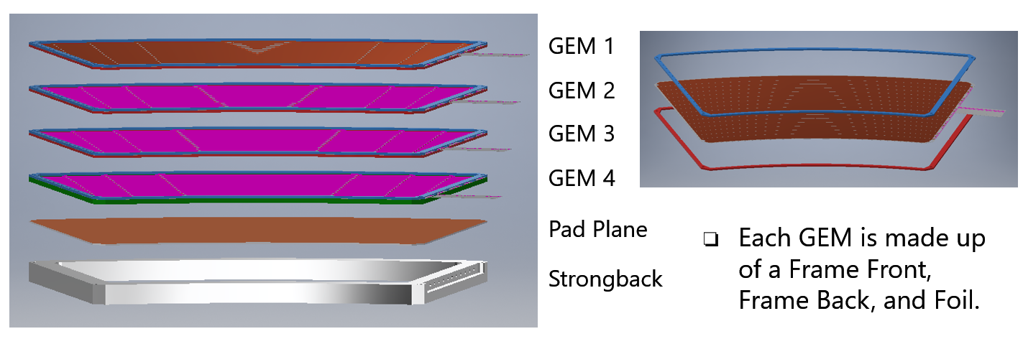
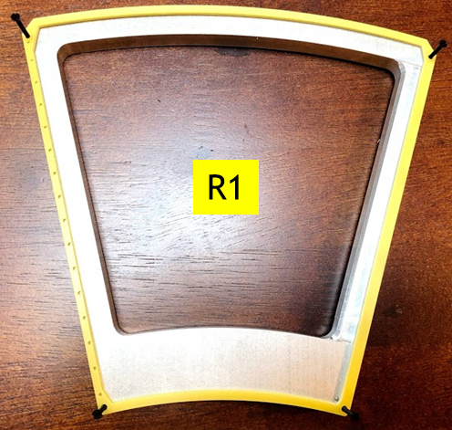
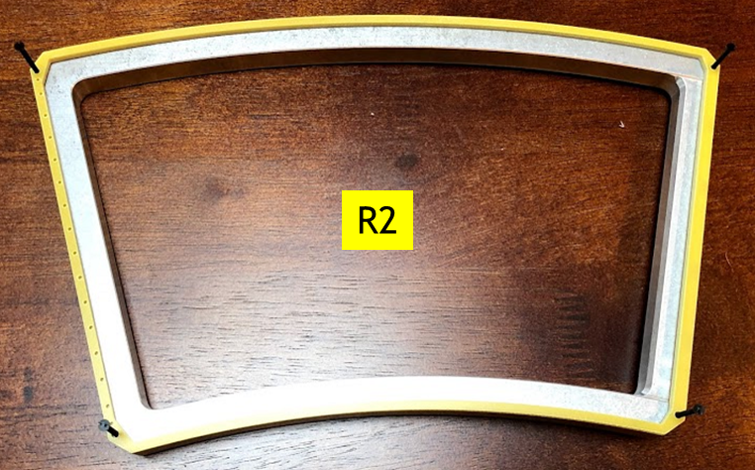
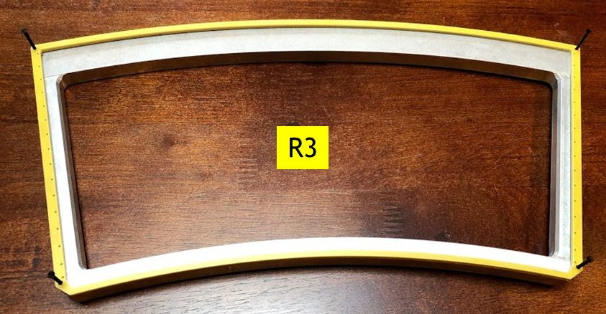
Module Progress
Frames
GEMs
Pad Planes
Strongback
Frames 100% Complete, Delivered to Factories

Slide 6
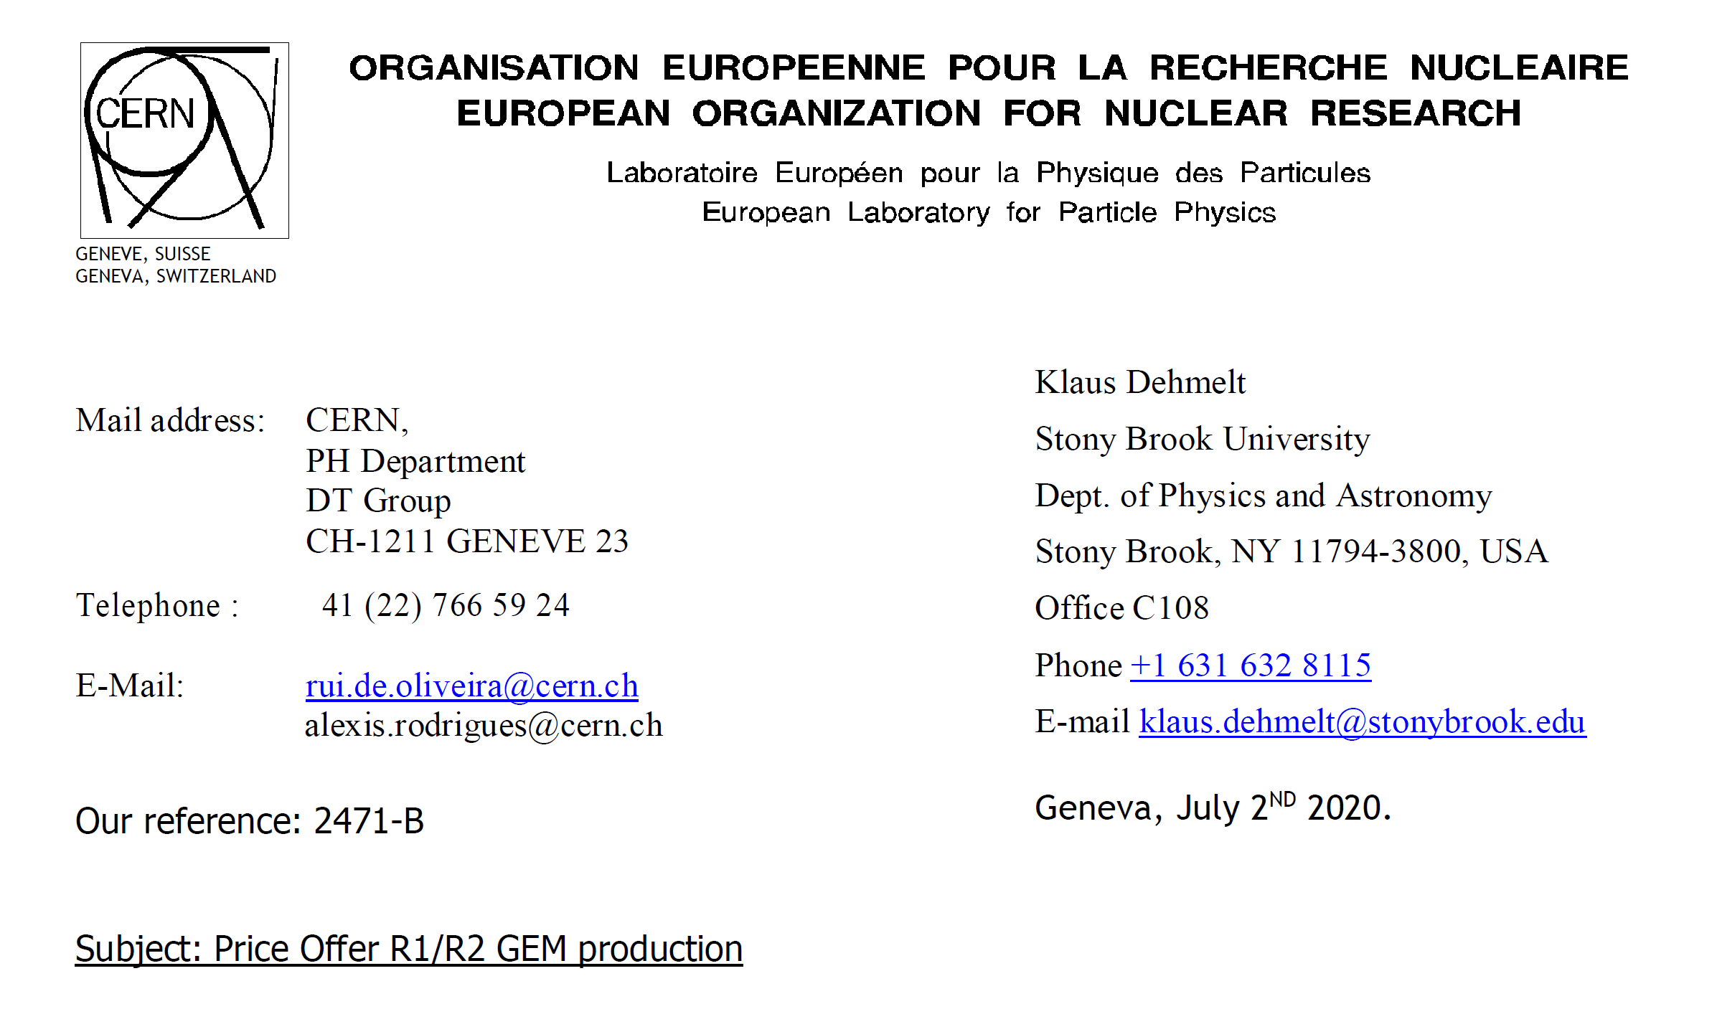
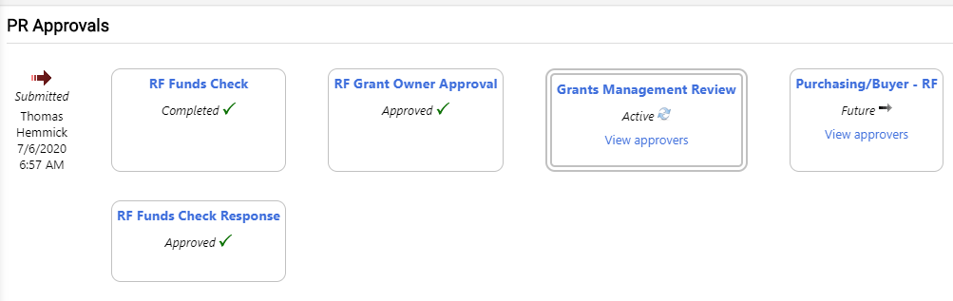
GEMs Order Placed (today)
GEM order placed today.
Should be out this week. (EVMS: $$ = Time)
Klaus Dehmelt

Slide 7
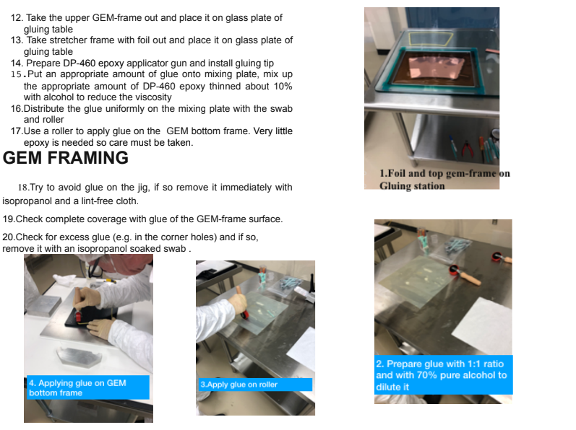
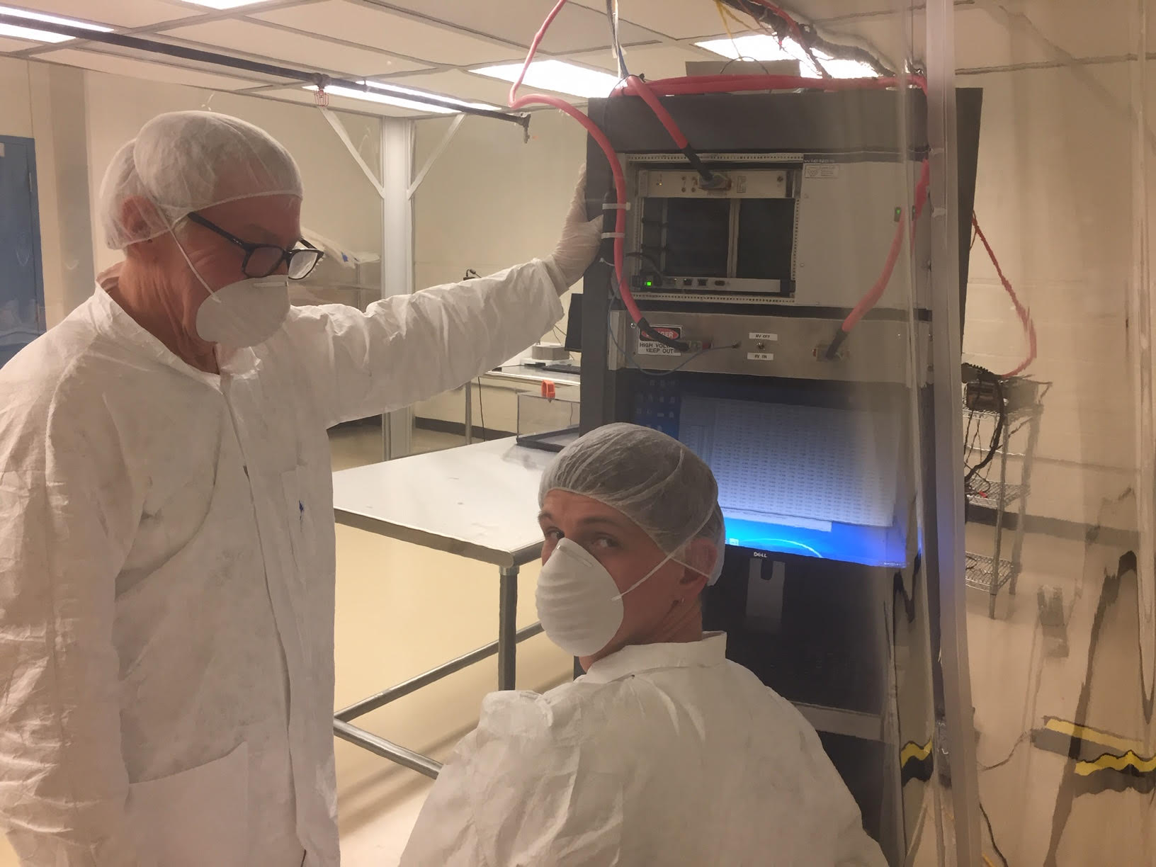
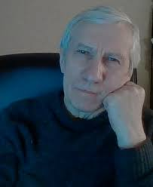
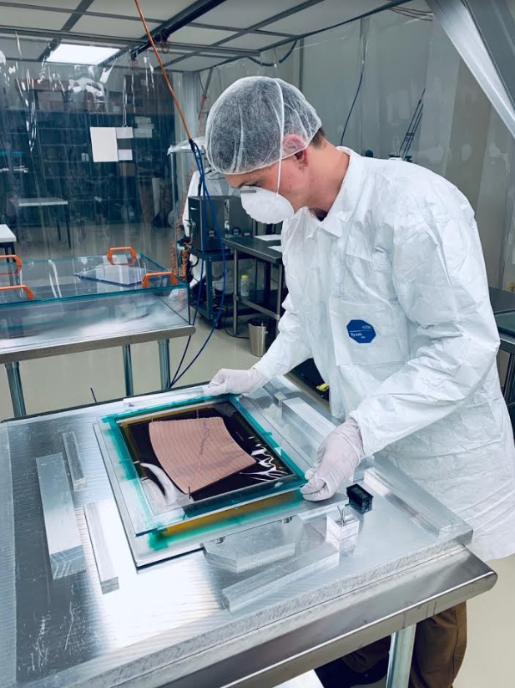
School(s) of ROC
School of ROC
Oleg Grachov (WSU): GEM Factory Manager
Personally Trained all personnel via WSU visits.
Wrote Procedures to be followed at all sites.
Make production GEMs and guide/supervise all factories.
Oleg Grachov

Slide 8
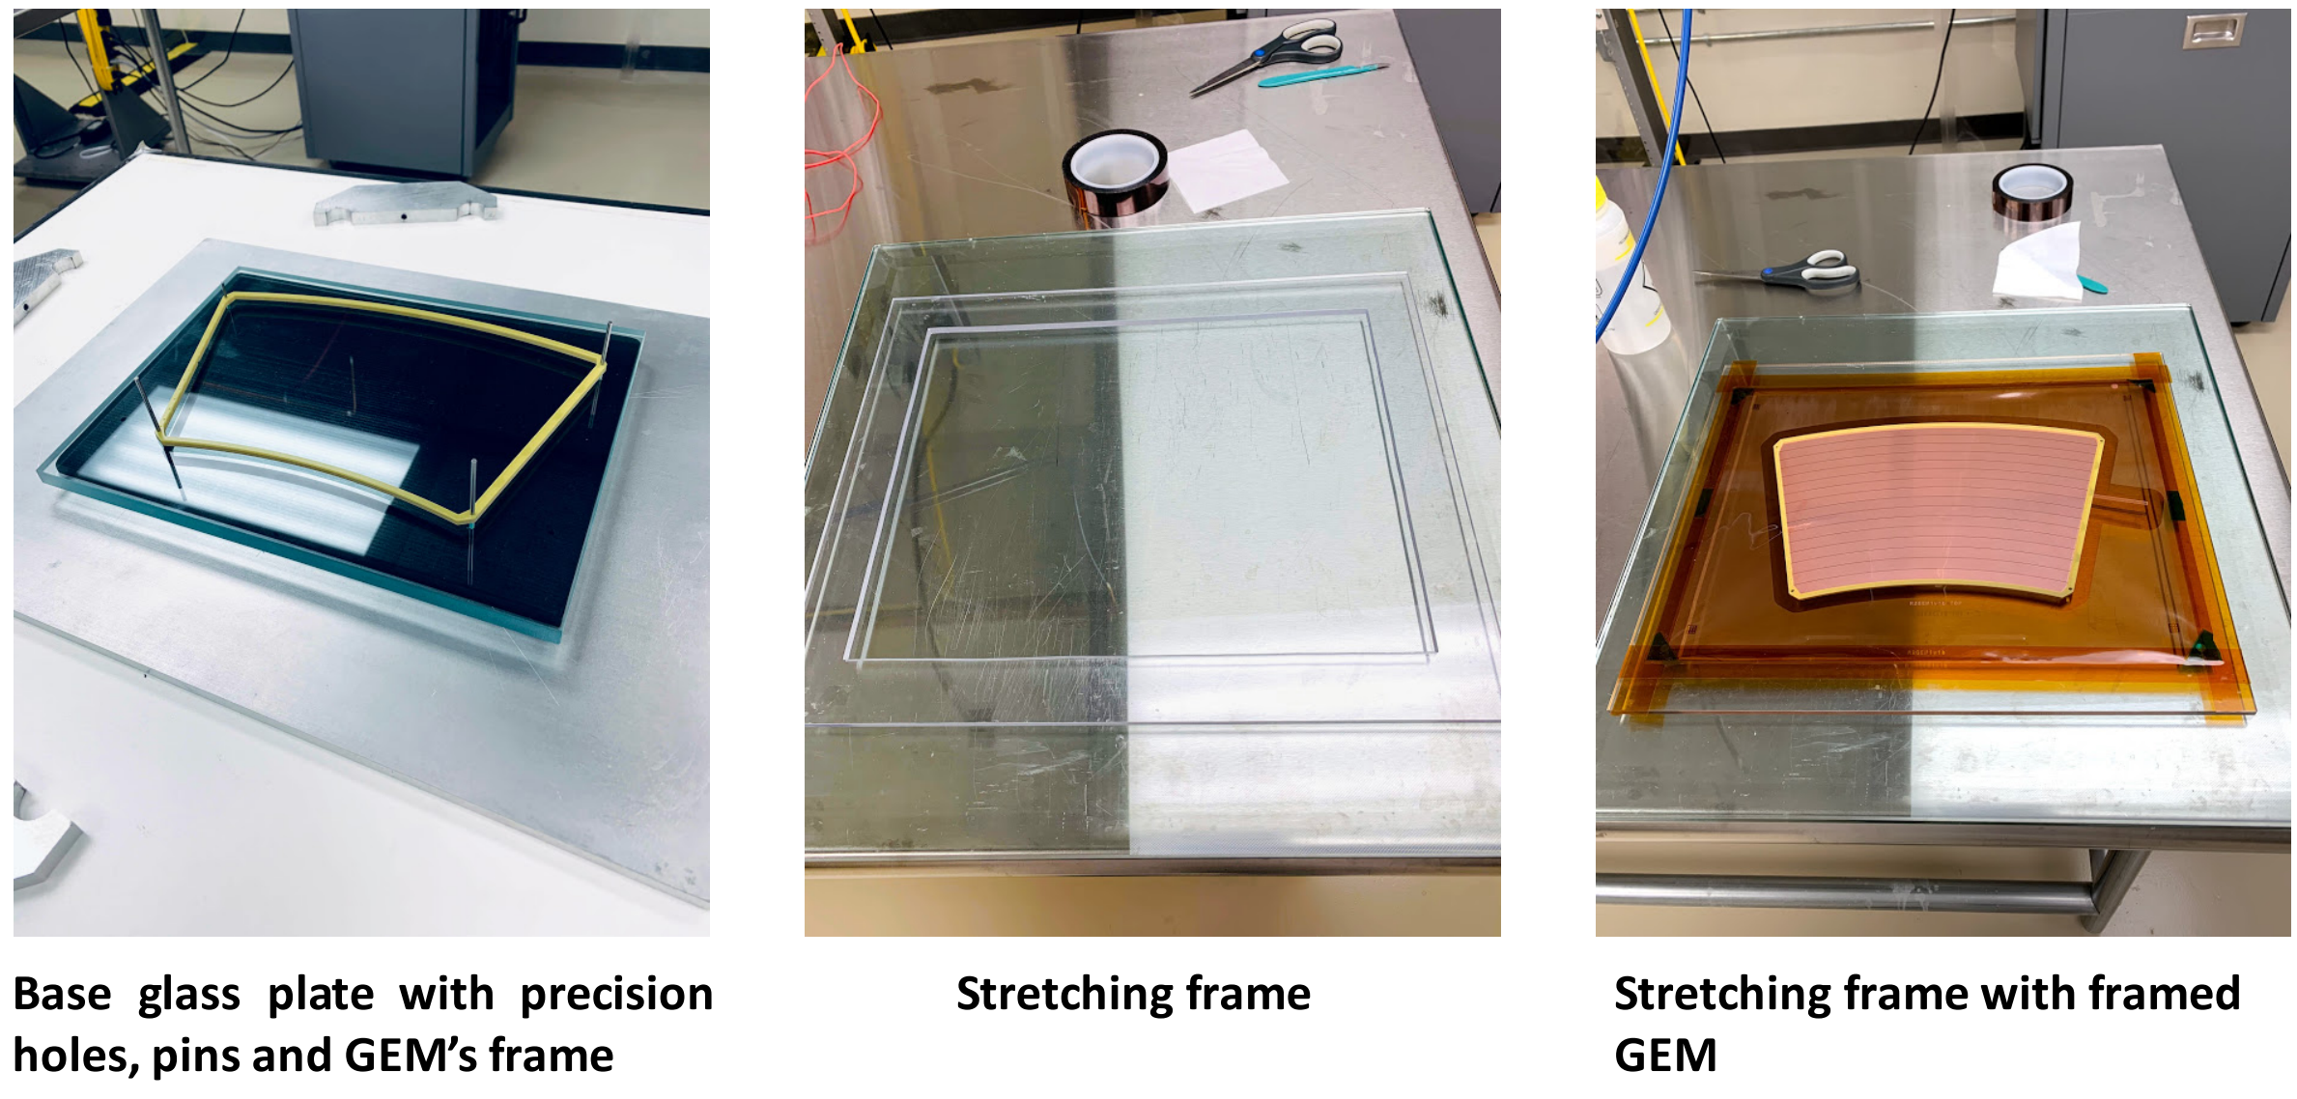
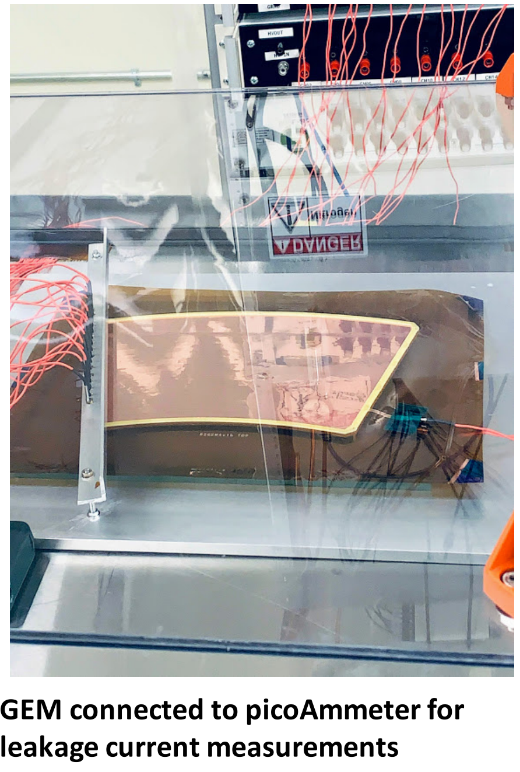
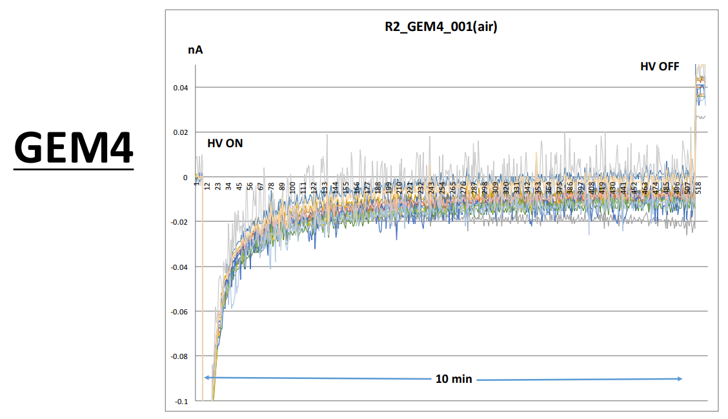
Early GEM Results from WSU
Excellent results from all framed GEMs.
Vanderbilt (Sourav) actively framing pre-production GEMs.
Also excellent currents!
Vanderbilt trained: Sourav Tarafdar (lead person)
Temple Trained: Matt Posik (lead person)
Weizmann Trained: Evgeny Shulga (lead person)

Slide 9
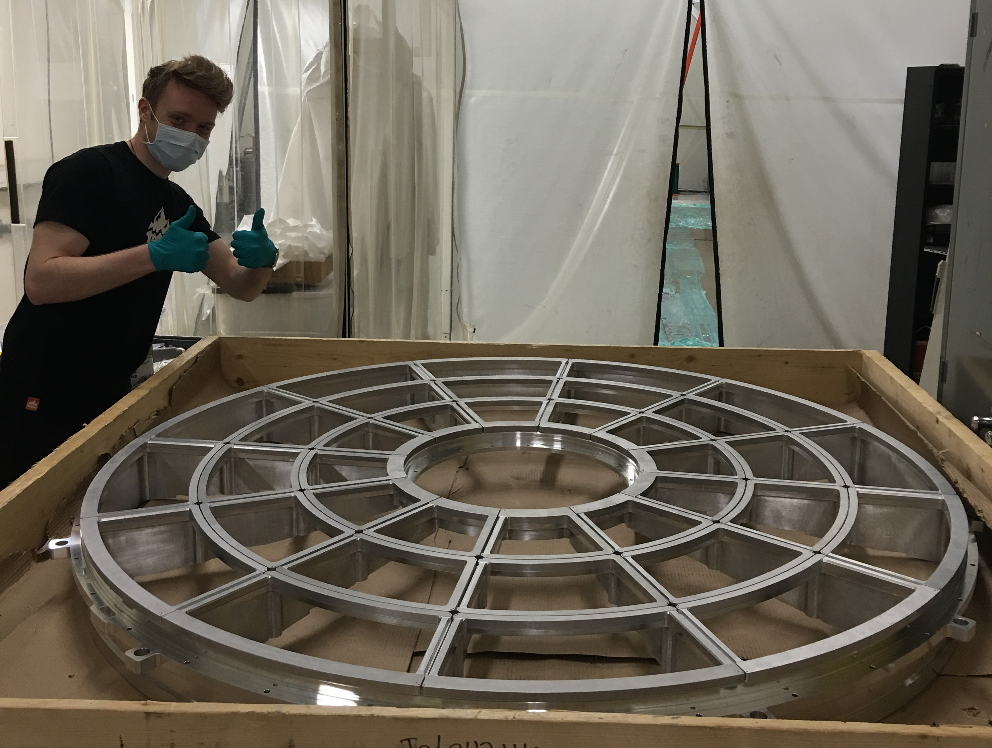
Strongbacks (100% Complete)
All strongbacks were test fitted to one wagon wheel.
Perfect fits.
Spring Energized Seals:
Inner Field cage:
Both fit.
Outer field cage:
Two seals not identical.
One 0.5-0.75” too large circumference.
Company will replace (no charge).
No schedule impact.
Henry Klest, Aiwu Zhang, Ross Corliss

Slide 10
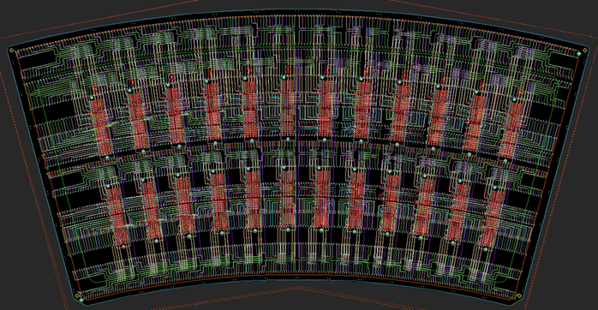
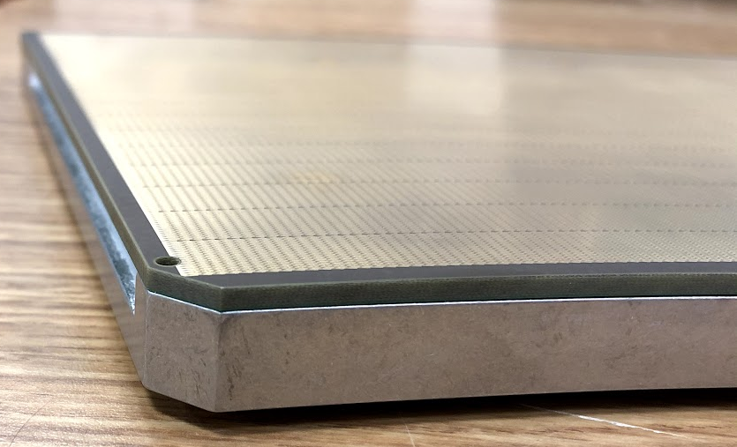
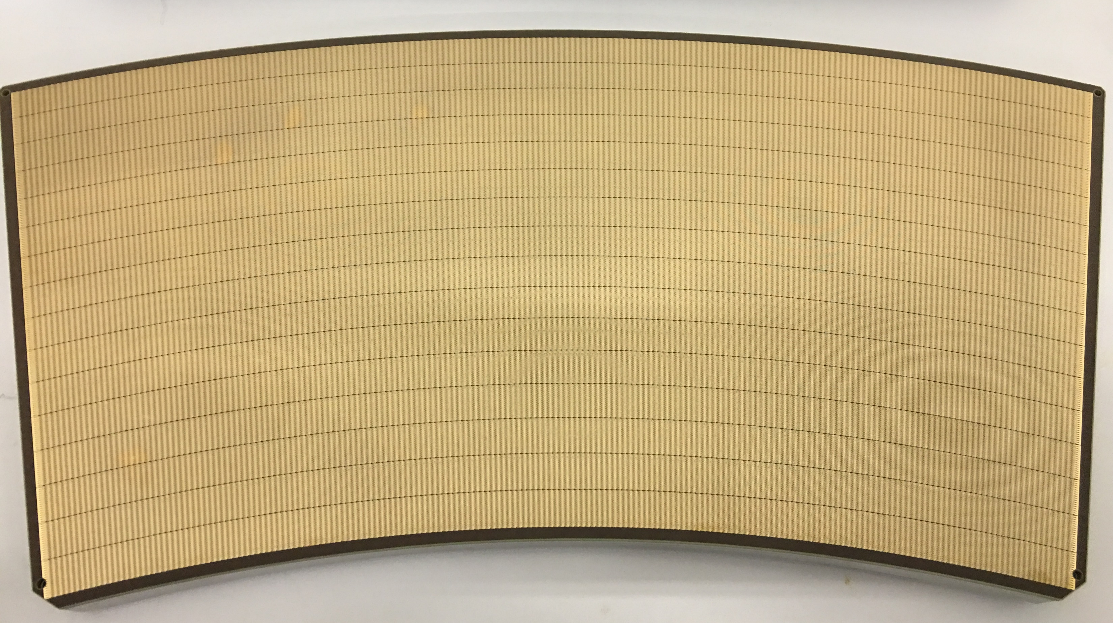
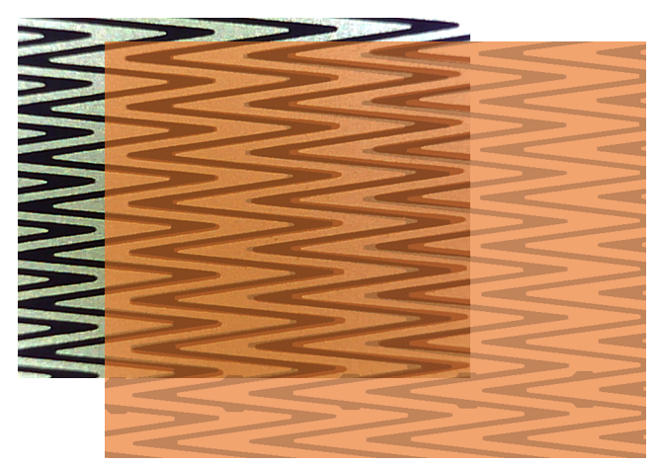
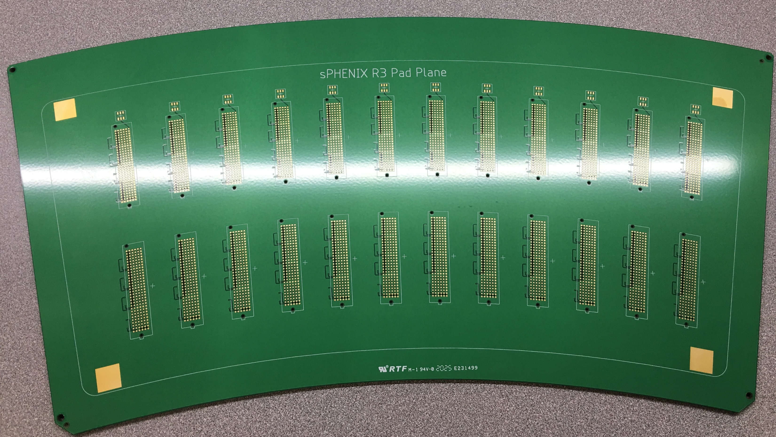
R3 Pad Planes
New vendor (whew)
Excellent quality.
July 15 estimate.
R2 & R1 order TBD
Same vendor
Sole Source

Slide 11
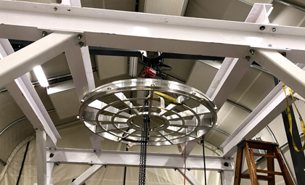
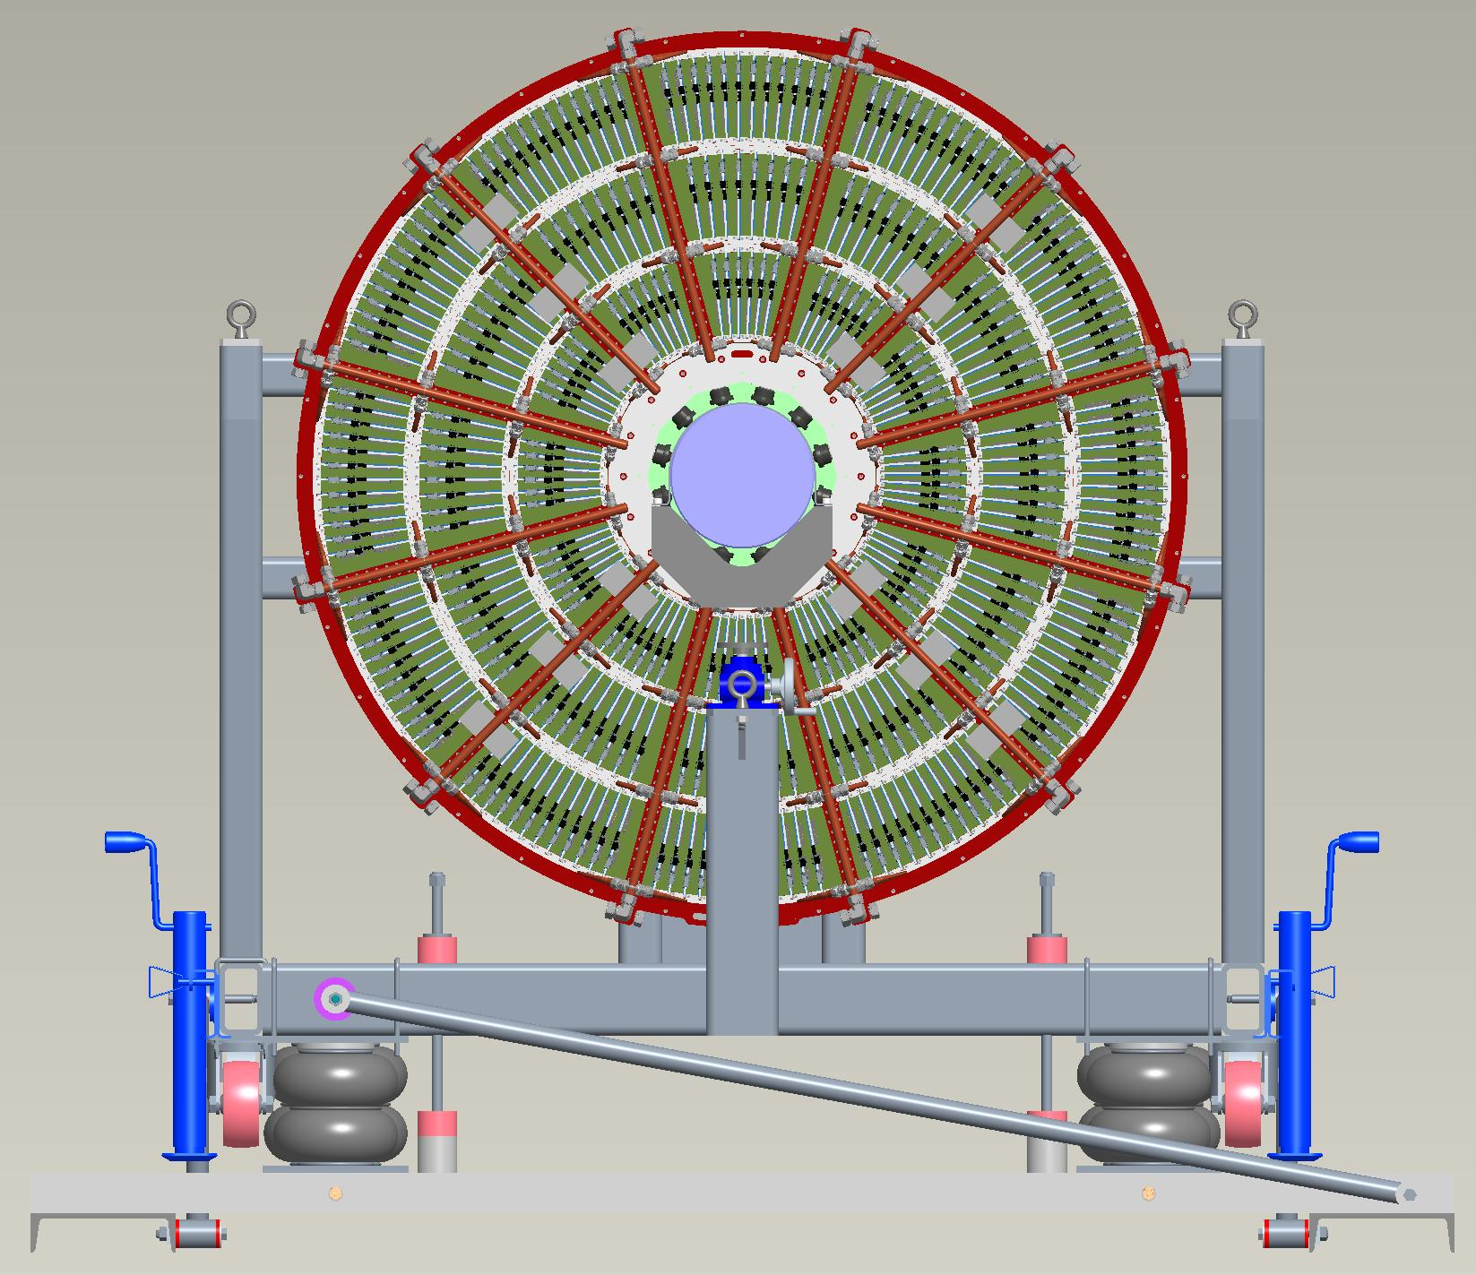
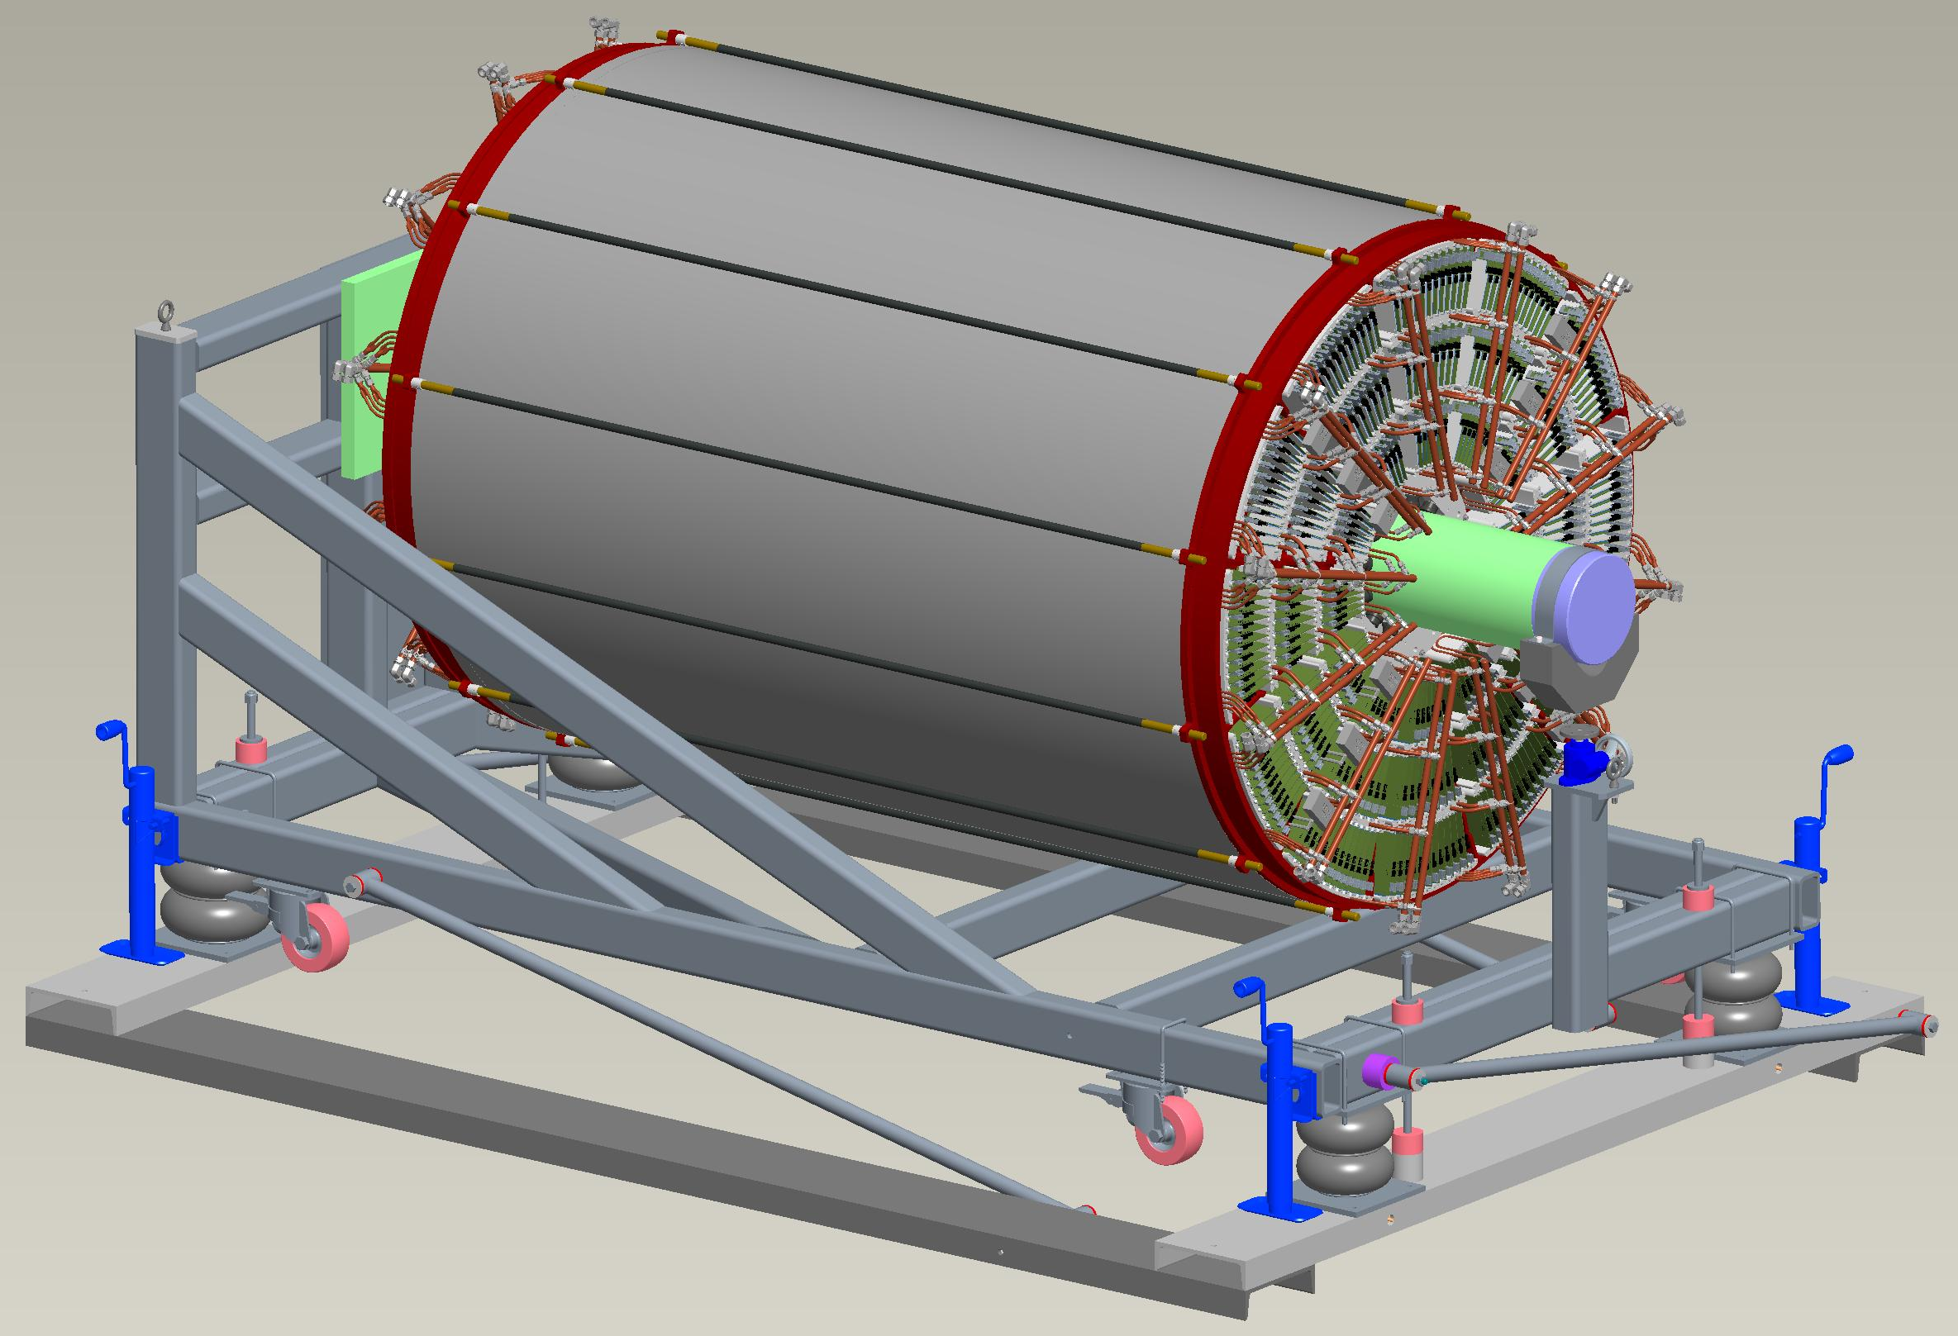
Assembly of Field Cage & Modules
Cage Assembled Vertically
The TPC is assembled at Stony Brook and transported to BNL via air ride suspension truck.
During transport, the TPC and Assembly Cart will be mounted on top of an isolation system.
All parts except green tube being welded now.
Modules Installed Horizontally
John Cozzolino, Connor Miraval

Slide 12
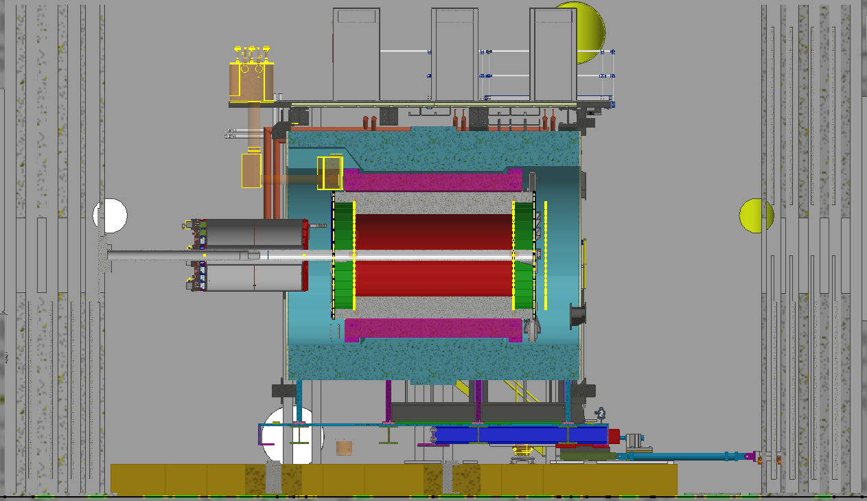
TPC FEA Position 1
Connor Miraval

Slide 13
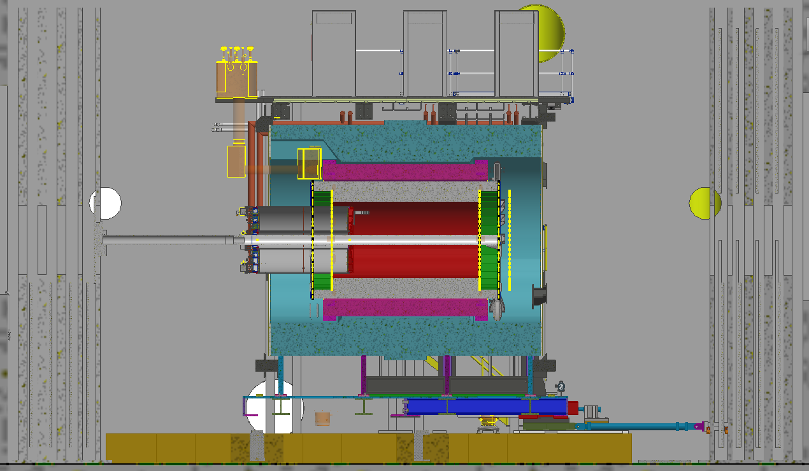

TPC FEA Position 2
Connor Miraval

Slide 14
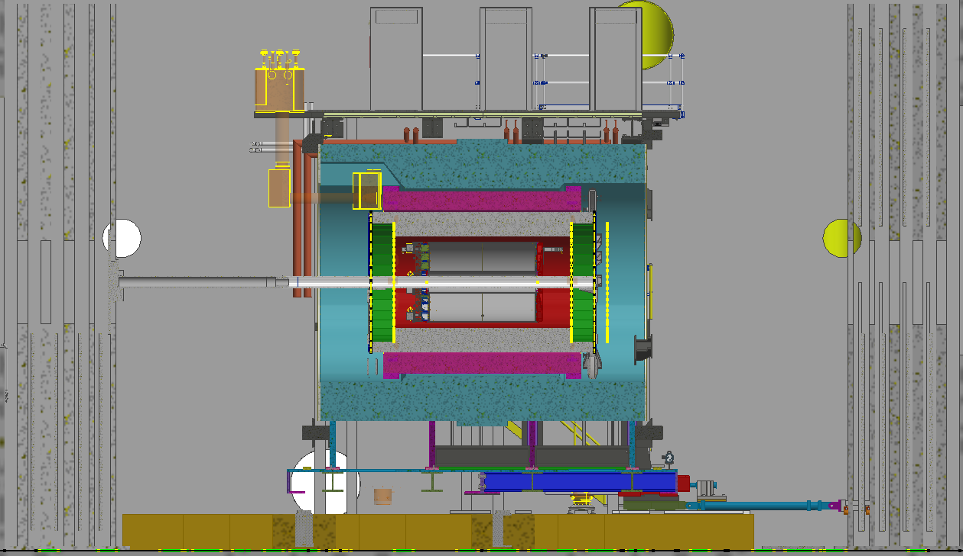
TPC FEA Position 3
Connor Miraval

Slide 15
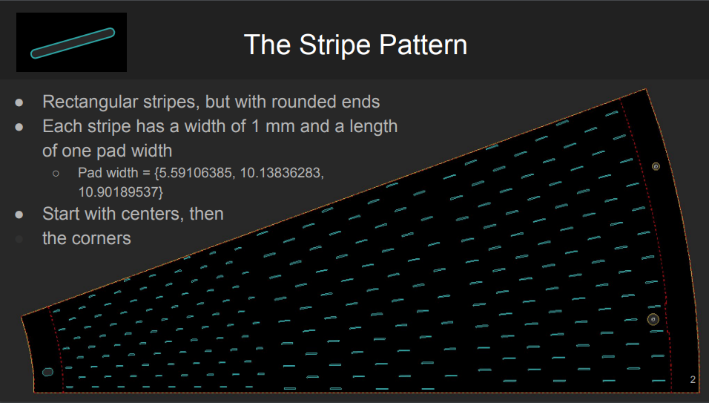
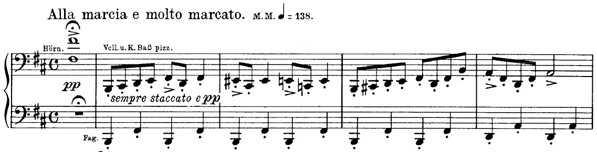
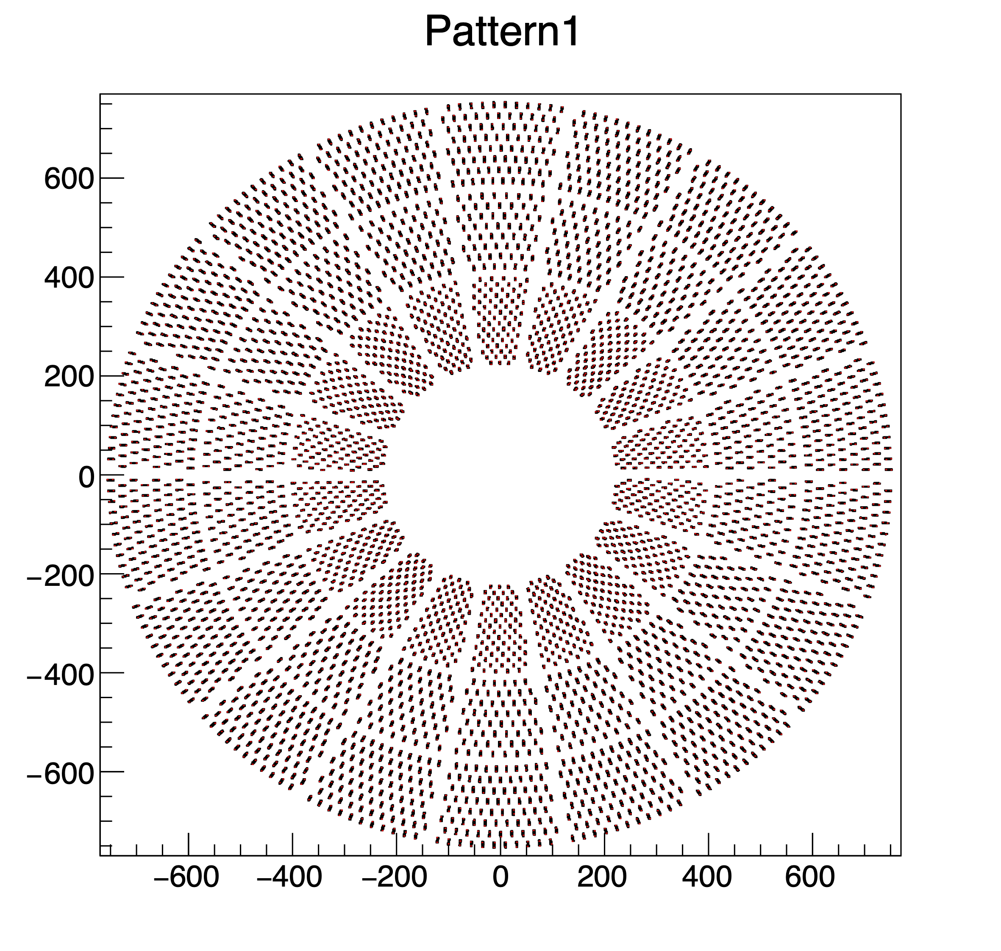
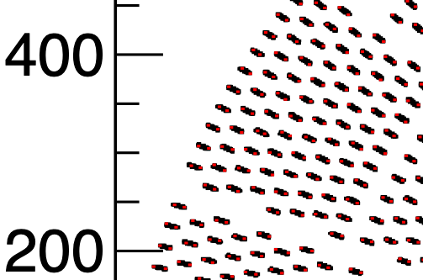
Central Membrane Stripes (Calibration)
Hall of the Mountain King
Evaporated Al stripes on Gold (ENIG) surface.
~2X MIP p.e. per flash from Al; few from Au.
Laser rate ~ trigger rate.
Stripe Pattern: ~4000 stripes per side.
g4hits!
Sara Kurdi, Nikhil Kumar, Ross Corliss

Slide 16
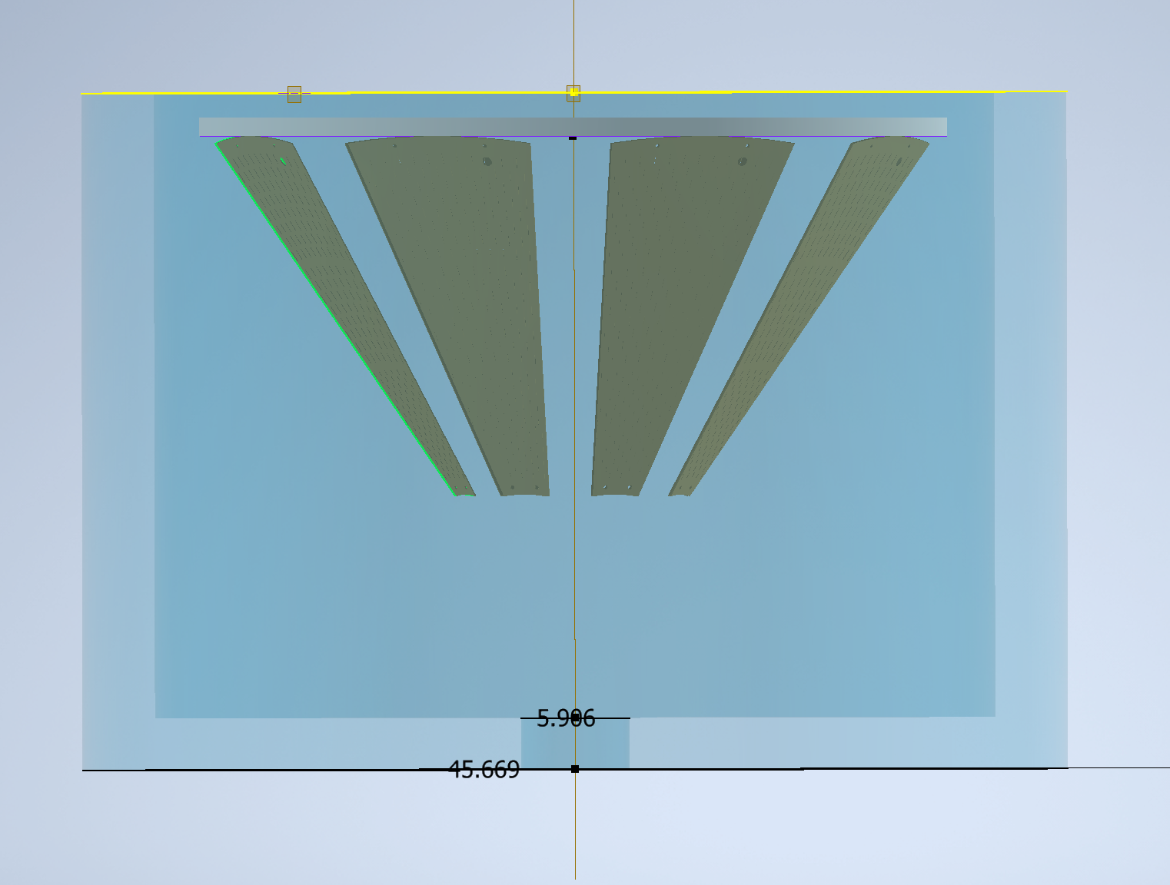
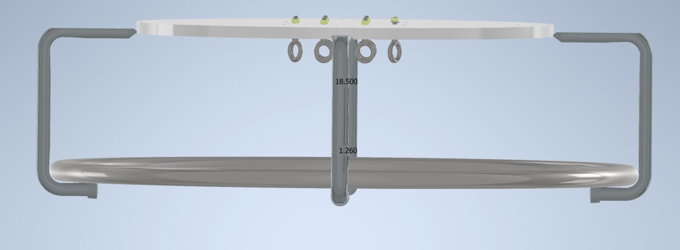
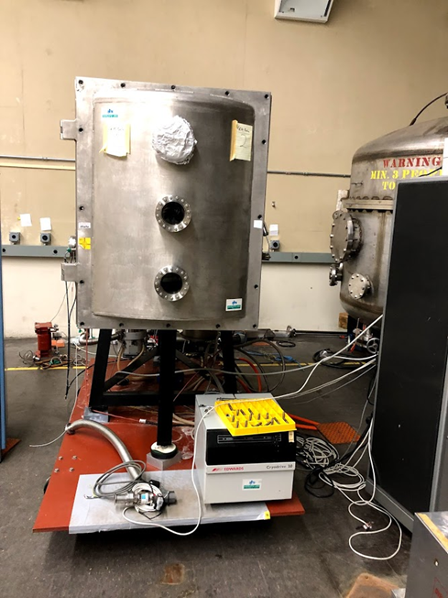
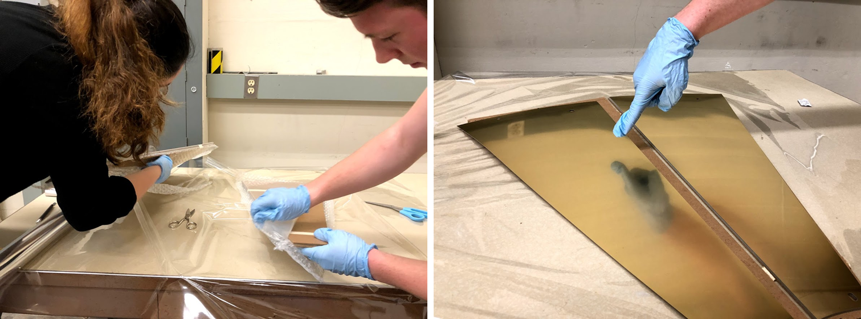
Evaporator Rig
Slow rotation
Aperture
Src
Nikhil Kumar
Uses the CsI evaporator (from HBD days)
Upgraded for e-beam source.
Cr followed by Al
Multiple panels in one step.
“Mask” asserts pattern of Al stripes.
Petal awaiting Evap
Mask for evaporation
Aperture
Src
Nikhil Kumar, Ross Corliss, Klaus Dehmelt

Slide 17
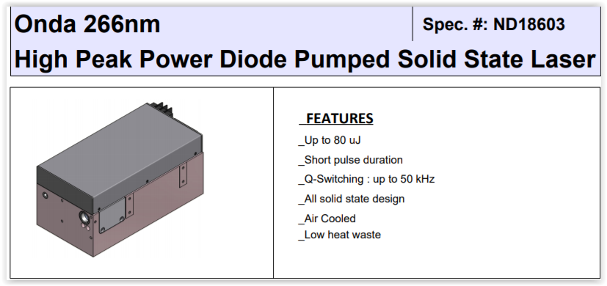
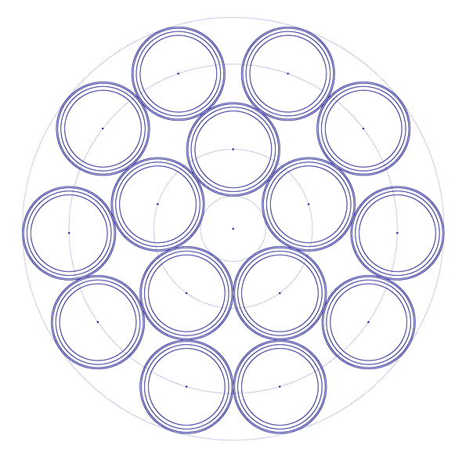
General Layout of diffuse light source
1 fiber bundle per laser head; 1 laser head per endcap
Beam pick-off for energy monitor/trigger (~5%)
Large core (600um), multi-mode, step index bundled fibers (Attenuation ~500dB/km, Trans. ~ 95%/km)
Beam Expander (~98%)
(Galilean telescope)
Light Pipe Homogenizer (~98%), uniformity depends on LP length
Fiber bundle
15 fibers: 12 + 3 spare
Quad diffuser on each of 12 fibers provides ~uniform illumination
Couple flat top laser light into fiber bundle
Bob Azmoun, Nikhil Kumar, Ross Corliss

Slide 18
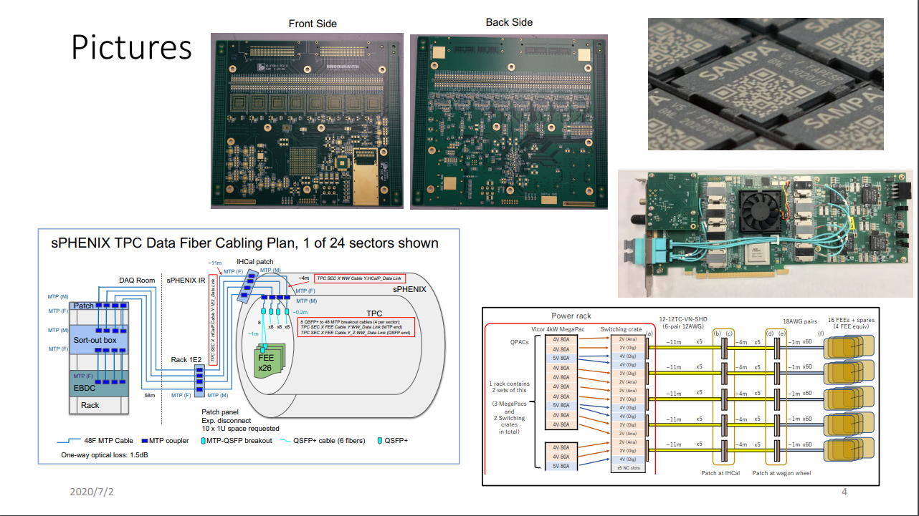
Electronics
SAMPA v5
FEE Card
DAM (Felix) Card
Low Voltage Plant
Optical Data Plant
Takao Sakaguchi, John Kuczewski, Jin Huang

Slide 19
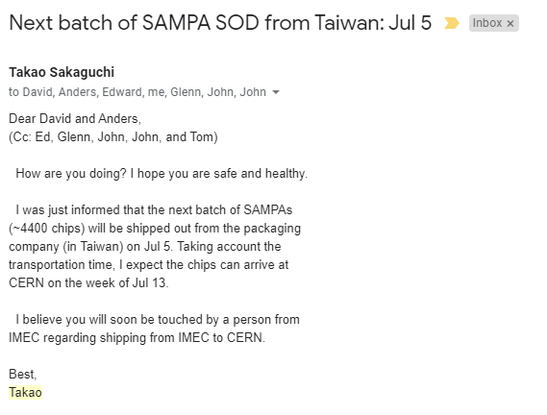
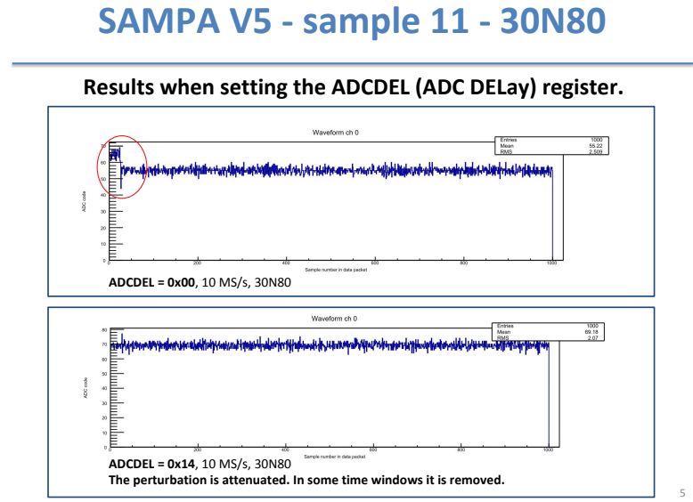
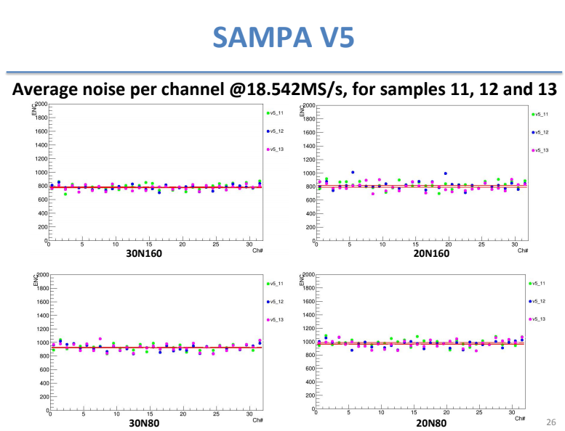
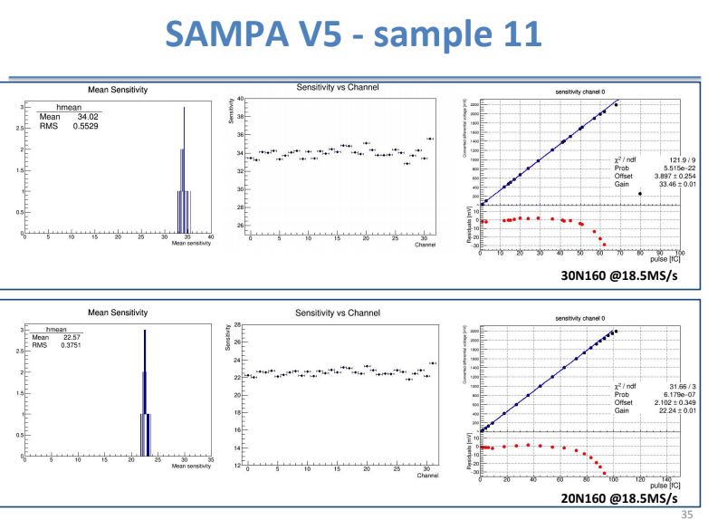

SAMPA Deliveries Starting
Wow, Sunday Delivery!
SAMPA accepted.
All tests passed.
OK to proceed:
Balance of Engineering Run
Production Run.
~4400 packaged SAMPA chips to ship soon.
Reminder:
$\left(12+8+6\right)=26\frac{cards}{sector}$
$26\frac{cards}{sector}×24\frac{sectors}{TPC}=624 \frac{cards}{TPC}$
$624\frac{cards}{TPC}×8\frac{SAMPA}{card}=4992\frac{cards}{TPC}$
Accounting for spares, yield, etc… the shipment is less than ½ the need, but it is still very significant.
Marco Bregant, Wilhelmus Van Noije, Takao Sakaguchi, David Silvermyr

Slide 20



FEE card production
MAJOR purchase requires major paperwork & careful bidding process.
Three trusted vendors identified by us and recommended.
Three bids came in (reasonably similar costs)
Order will include first articles.
First article boards will be tested before release of full order.
First article boards will use V5 chips (sufficient quantity passed Lund testing)
No additional paperwork after approval of first boards to complete acquisition.
In the hands of BNL purchasing.
Now
Soon
Takao Sakaguchi, John Kuczewski, Joe Mead, Kevin Wolniewicz

Slide 21



Line Laser (“lighthouse”)
Light carried into volume via TIR in quartz bar.
Full map of TPC volume achieved by scanning the beam.
Full phi
Up to 85º incident angle.
Full 3D Map of Static Distortions (E-field only, E & B-fields)
Dan Cacace, Kristina Finnelli

Slide 22




Dual Mirror system controlled by piezo motors
Advantages
All angles possible.
Larger mirror pieces.
Simpler machining.
Redundancy of angles.
Disadvantage
Two motors.
Selected as design.
Can avoid this effect:
Dan Cacace, Kristina Finnelli

Slide 23

Laser Bench Updated
Beam shaping optics
Dog Leg Mirror #1
Primary steering
Dog Leg Mirror #2
Secondary steering cavity (SSC)
Dan Cacace, Connor Miraval

Slide 24


Updated Optical Table Assembly
NOTE: Everywhere you see green, you’re looking at low mass.
INTT and MVTX will like this
All the parts of laser system moved away from beam pipe.
Elegant
Dan Cacace, Connor Miraval

Slide 25



TPC Wagon Wheel Cooling
Next cooling step requires lab access for Rob Pisani
NOTE:
Further updated picture available from Dan
It was “live share” of Inventor screen.
Updated pics coming soon…
Wagon wheel adding Line laser heads & Cooling Blocks.
Laser head compactly directs line laser into quartz bars.
45% of gas system orders are now placed (Thanks Rob).
Rob Pisani

Slide 26


ANSYS Temps – Improvement
Input: Air 22C, Water in 16C, 0.62l/min and 2.14l/min flow, FEE 15W (FPGA 4W, REGs 4W, SAMPAs 7W), Gap Pad 2.4W/mK
PCB 1W/mK (iso), Connector 16W/mK (iso), Water HTC 2000W/m2K and 3000W/m2K, Air HTC 2W/m2K, epoxy conductance 11800W/m2K
Pressure
Temperature
Other: Gap Pad Pockets Added, Regulators Added, Blocks 4” Tall, Aluminum Plates 220W/mK and Blocks 160W/mK
Dan Cacace, Rob Pisani

Slide 27

Cooling Scheme Further Details
Rob Pisani

Slide 28

Summary
TPC making very much progress despite challenging times.
Design work coming along very efficiently,
Lab work delayed somewhat, but resuming.
Limited undergrad availability.
SBU will add a technician after job search (at least 1 good candidate)
Note shown, but significant:
HV Central Membrane Supply ordered.
HV GEM Power Supplies ordered.
Mechanics for Central Membrane assembly complete. (road trip after evaporation SBU → Vandy)
Hall Probes & Rad monitor allocated space.
Non-TPC news:
SBU shop remained open, but reduced staff.
EMCAL sawteeth were kept running.
Machinists made EMCAL cooling loop parts while working from home.

Slide 29



Laser Bench – Improvement

Slide 30



Apparent Ionization profile with Trans. Diffusion
Gas: Ne-CF4 (50/50)
D_T = 40μm/sq(cm) @ 1.4T
Ion. Yield Ratio
~ w0²/w(z)²
W(z) ~1/e² ~2σ
Case study for properties along ~130cm track at ~35º
$$\text{Meas}\text{. }track width at pads:$$
$$\sim \sqrt{{σ_{Ion. }^{2}+ (D_{T}∗\sqrt{L_{drift}})}^{2} }$$
$σ_{Ionization}$ ~ (W(z)/2)/$\sqrt{2}$
Since trans. diffusion contributes significantly to broadening the ionization profile at large drift lengths, is it better to focus the beam at larger z to counter-act this effect?
Answer: diffusion dominates, so it doesn’t really make a big difference where we focus, *in terms of ionization profile*. Looks like black dashed curve (w/ beam focused mid-way) gives the best overall results (see next slide for direct comparison).

Slide 31


Ionization Yield Consideration
Case study for properties along ~130cm track at ~35º
Though the spatial profile of the collected charge cannot be changed much, we do have a strong handle on the ionization yield profile along the beam
The ionization yield directly impacts the contribution to the resolution via N_{eff}: σ²_{drift} = D²_{T}L/N_{eff}
Focus beam near endcap (concentrate our efforts where they are most effective)
→Small gains, larger losses
$$\text{Meas}\text{. }track width at pads:$$
$$\sim \sqrt{{σ_{Ion. }^{2}+ (D_{T}∗\sqrt{L_{drift}})}^{2} }$$
Neff along track ~ Ion. Yield (IY) profile
$${Relative σ}_{drift}\left(z\right)\sim C∗\sqrt{\text{L}\text{/}{IY}_{Ratio} }$$
Focus beam in nominal TPC center (optimize for ~avg. pathlength)
→Best overall res. along beam, smallest IY ratio
Results are similar due to diffusion, but w0(z=65cm) looks like best overall candidate
(Assume pads collect charge uniformly along track, ie, Neff dictated by IY profile alone)
Focus beam close to membrane (counteract D_T)
→Small gains, moderate losses
Seems like w0(z=65) is probably the best compromise: better avg. rel. res. along the beam (right plot) and a smaller IY ratio (~2 compared to ~5; see gold curves on prev. slide). So, we’ve come full circle, but hopefully we now feel better about it ☺
Because we are so dominated by diffusion and w0(z=65) is a bit of a sweet spot, looks like a variable zoom lens isn’t worth considering

Slide 32

Pad Planes
R3 “First Article” Samples delivered to SBU Friday.
Likely to us on Tuesday ~mid day.
Inspections:
Microscope for quality of pad shapes.
Mechanical fit to strongback.
R2 pad plane under final cross-checks:
Electrical/design rules: Hemmick
Mechanical (aligns with cooling etc…): Cacace
Update Fab. Notes ala R3 Engineering Questions
Likely send out this week.

Slide 33




AC/DC Review
Ivan & Takao
Review of AC and DC power distribution.
DC for FEE (Takao for Ivan, John, Connor, Eric, Steve)
Power for TPC Laser Systems (Bob Azmoun)
HV for field cage and GEMs (Klaus, next slide).

Slide 34


HV Power Supplies/Crates
Central Membrane HV supply ordered weeks ago.
Standalone rack-mounted 60 kV power supply.
Operating voltage ~45 kV (“Administrative Limit”);
GEM HV Power Supply Requisition placed
Quotation matches BOE very well.
6 kV/1mA power supplies
>5kV operation in test beam.
Removed “double-thick” frame at bottom GEM (now single thick)
Same voltage configuration = below 4600 operating voltage
Uses “special” SVH connector:
Mechanically the same as ordinary SHV.
Rated for 8 kV.
Wish to order these connectors through Weiner as separate order.
Easiest to defend with Safety Committee that we got the right thing…

Slide 35



Laser Bench Converging on Final Scheme

Slide 36


Things To Consider
The pictured Attenuator is different than the provided dimensions.
The connector for the Beam Energy Monitor is displayed on opposite sides, and the possible orientation of the provided dimensions does not match that of the picture.
We should verify with QLI that our Attenuator does indeed fit the laser. Should not effect design so long as the 42.5 mm thickness does not change.

Slide 37

Things To Consider
Where exactly do we put the beam intensity/timing pickoff?
Laser exit.
Made to mount.
Pushes back laser a bit.
Disturbs “elegance”.
Former Beam Shaper Location
Puts laser into ~ideal mechanical spot.
We have to mount it ourselves.

Slide 38




Laser Error Propagation
Bore sight lasers are precision aligned.
Finite Precision of Piezo motors propagates to final laser direction.
Trace Pro Model allows for understanding how these errors accumulate on final laser direction.
Updates coming to put BS optics after the dog leg.
On Order

