Slide 1
Flow test with New Staves Added
Rob Pisani

Slide 2
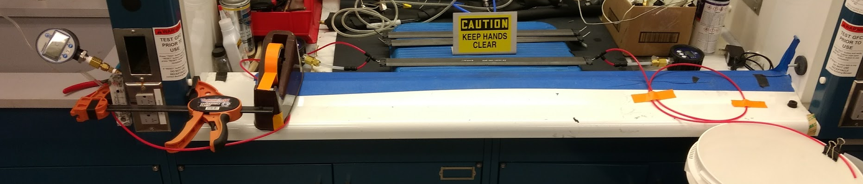
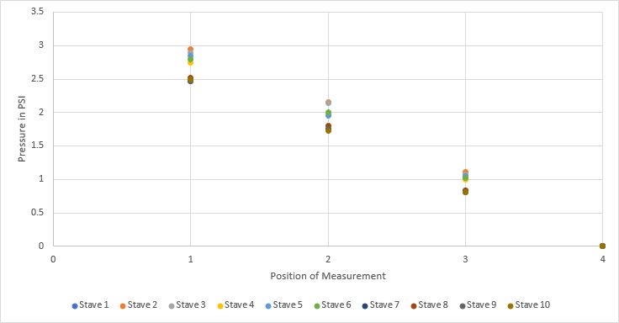
50" tubing
1
2
3
Stave
50" tubing
4
Location | Stave 1 | Stave 2 | Stave 3 | Stave 4 | Stave 5 | Stave 6 | Stave 7 | Stave 8 | Stave 9 | Stave 10
1 | 2.5 | 2.95 | 2.9 | 2.75 | 2.85 | 2.8 | 2.47 | 2.52 | 2.47 | 2.5
2 | 1.75 | 2.16 | 2.15 | 1.97 | 1.95 | 2 | 1.76 | 1.8 | 1.75 | 1.73
3 | 1.01 | 1.11 | 1.08 | 1 | 1.05 | 1.02 | 0.83 | 0.84 | 0.81 | 0.81
4 | 0 | 0 | 0 | 0 | 0 | 0 | 0 | 0 | 0 | 0
Pressure in PSI
Flow set to 200 CCM water
Tube ID 2.7-- 50" on each side of stave
Stave ID 2.0mm
New Staves seem to have slightly less pressure drop across them
New Staves
 | Stave 1 | Stave 2 | Stave 3 | Stave 4 | Stave 5 | Stave 6 | Stave 7 | Stave 8 | Stave 9 | Stave 10
Stave Drop | 0.74 | 1.05 | 1.07 | 0.97 | 0.9 | 0.98 | 0.93 | 0.96 | 0.94 | 0.92

