Slide 1
EIC Yellow Report – Readout and DAQ FJ Barbosa, K Chen, J Huang
EIC Readout and DAQ – CD-1 Perspective
Fernando Barbosa, JLab
Kai Chen, BNL
Jin Huang, BNL
CD-1 as a critical milestone
Timeline
EIC Streaming Readout Architecture
Development Flow
Other Items (Power, Grounding, etc.)
Summary
30 July 2020

Slide 2
EIC Yellow Report – Readout and DAQ FJ Barbosa, K Chen, J Huang
1 CD-1
Critical Decision 1.
DOE Review.
“…baseline CD-1 project must be based on a simple, but day-0 feasible solution, to show to DOE that the EIC detector can be built in a way that is compatible with the EIC science goal.” A. Celentano, 30 June 2020.
March 2021.
All documentation must be completed by December 2020. We need to deliver the project package before completion of YR, with focus on one defendable design.
Upon approval, funds will be available for EIC detector design.
Various DOE reviews will occur during project execution.
30 July 2020

Slide 3
EIC Yellow Report – Readout and DAQ FJ Barbosa, K Chen, J Huang
2 Timeline (tentative)
CD-1: Design
April 2021 – September 2025 (4.5 Years).
CD-3: Construction & Installation
September 2023 – September 2030 (7 Years).
CD-4a: Operations
September 2030 - …
Note that parts of CD-1 and CD-3 overlap:
Detectors will require readout and DAQ for testing, validation and software development (data, controls, etc.) before CD-3.
CD-1 will result in resource-loaded schedules:
Project costs and schedules are closely followed by DOE.
30 July 2020

Slide 4
EIC Yellow Report – Readout and DAQ FJ Barbosa, K Chen, J Huang
3 EIC Streaming Readout Architecture
EIC collision data rate is relatively low
Comparing to hadron collider, lowered by α_{EM}^2
O(100) Gbps [see also 2020 User meeting YR DAQ talk by Andrea/Damien]
Background and noise likely to drive the design requirement
Systematic control of EIC physics calls for low noise detectors and low background experiment at EIC
However, noise and background rate cannot be accurately determined at this early stage
One of main uncertainty is synchrotron background: rate calculation range from manageable to extreme high rate for various tunings of the EIC IR optics and shielding designs. Narrowing the range prior to CD-1
→ Readout architecture considerations
Streaming readout front-end (FE) supporting high speed data transmission off the detector
Aim to archive all raw data, after data reductions with minimal physics loss
Typical techniques include zero-suppression and loss-less compression
Mitigation of high backgrounds: further data reductions :
Calorimeter-based trigger signals that throttles the data stream : Well established technology at possible loss of physics
Feature extraction and noise-hit filtering, e.g. clustering, tracklet building : Calibration and systematics control is critical
A reliable DAQ: global timing synchronization with low-jitter beam collision clock; low and deterministic data loss with busy handling
Active data monitoring: server farm reconstruct fraction of data, anomaly detection, online calibration
30 July 2020

Slide 5
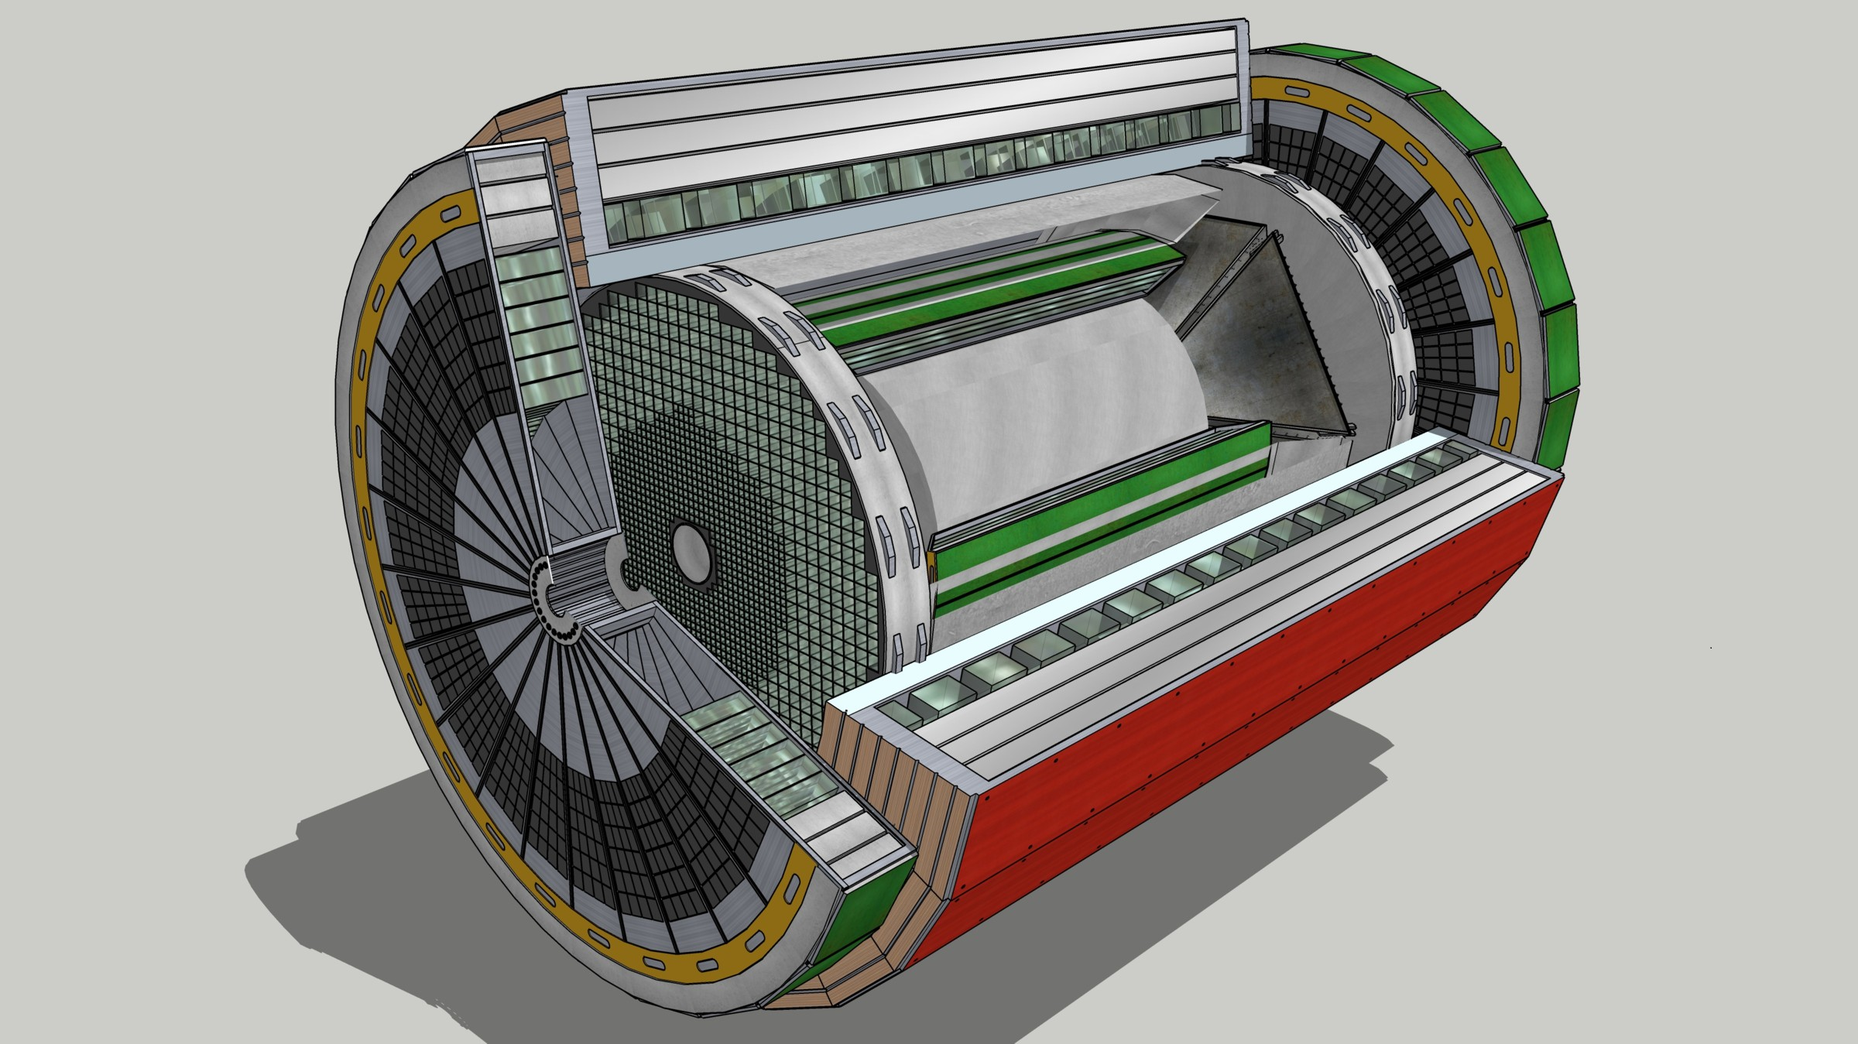
EIC Yellow Report – Readout and DAQ FJ Barbosa, K Chen, J Huang
EIC Streaming Readout Architecture
Data
Configuration & Control
Power
Detector
FE
(Front End)
FEP
(Front End Processor)
Net Switch/Server
O(100 Tbps)
O(1 Tbps)
Global timing, busy & sync
Beam collision clock input
L ~ 100 m
fiber
ASIC
O(0.1 Tbps)
Storage
Fiber
FEP
Server
Switch / Server: Readout
Switch / Server: Proc.
Switch / Server: Buffer
FE
FPGA
Fiber
Monitoring
FEP
FE
L ~ 1-10 m: SLVS, LVDS
Power Supply System
(HV, LV, Bias)
Cooling Systems
30 July 2020

Slide 6
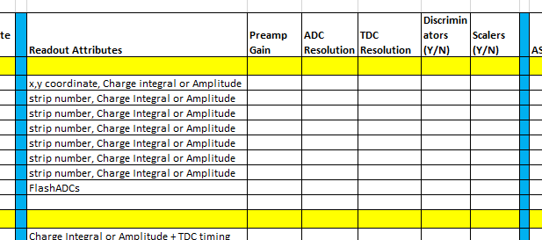
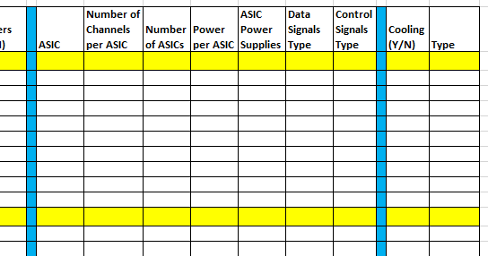
EIC Yellow Report – Readout and DAQ FJ Barbosa, K Chen, J Huang
4 Development Flow
Specifications from detector groups
Si maps
TPC
GEM
ZDC
Iterative Processes
Develop FE specifications
(ASIC, PCBs, Interconnects, etc.)
Develop FEP specifications
(FPGA, PCBs, Interconnects, etc.)
Develop System specifications
(Data Format, Configuration, Control, Interface, etc.)
Readout & DAQ
Group
30 July 2020

Slide 7
EIC Yellow Report – Readout and DAQ FJ Barbosa, K Chen, J Huang
FE
“Coalesce” specifications to minimize the number of ASIC part numbers, e.g., one ASIC type for all GEM-type detectors.
Power is now nominally 1 W ± 0.25 W per ASIC (64 ch, 32 ch). Detector groups need to consider that cooling will be needed and make provisions for installation. Liquid cooling is efficient and low cost.
Consider serviceability as a design criteria.
ASIC Development (specifications, simulation, design, layout, verification, prototype fabrication and packaging) > 2 years. Must consider re-spin or > 1 year. Therefore, consider an ASIC design cycle of > 3 years.
Testing is a big effort, especially with a detector for validation.
Production (i.e., engineering run) ~ 1 year.
And then, a lot more testing.
PCB designs must occur concurrently, more testing.
What if an existent ASIC already meets all the specifications and can be used as is?
Will the technology node still be available in a few years?
Are the fab masks still maintained and available for fabrication?
30 July 2020

Slide 8
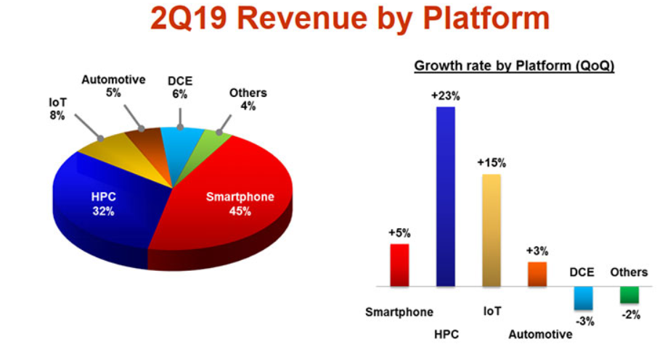
EIC Yellow Report – Readout and DAQ FJ Barbosa, K Chen, J Huang
ASIC Technology Nodes
Looking at TSMC, as an example, our niche is not that large.
Presently, the most popular node at MOSIS for TSMC is 180 nm.
For comparison, the 250 nm node, popular in our community for a number of years, is still supported by TSMC and MOSIS.
The 250 nm technology node debuted in 1995.
It is likely that any present robust technology in use by our community will still be supported in 10 years.
30 July 2020

Slide 9
EIC Yellow Report – Readout and DAQ FJ Barbosa, K Chen, J Huang
ASICs Survey
A survey is being carried out for existing ASICs in the NP & HEP field for different types of sub-detectors.
Pixel sensor with MAPS architecture is preferred considering the material budget. The next-generation ALPIDE in 65nm CMOS process, and HV/HR-CMOS designs with small electrode collection are possible technique solutions.
ASICs for calorimeter, various gaseous detector, silicon timing detector, to support energy (with amplitude measurement, full pulse high speed digitization in Gsps level, or continuous digitization) and timing measurement with resolution in 10ps level. The detailed specification for different sub-detector is not finalized yet, so the survey covers examples with different dynamic range, peaking time, buffer depth and sampling rate.
High speed data transmission: FESoC with embedded serializer; independent serializer and deserializer for data aggregation; and versatile optical links for radiation environment on front-end with limited space.
Most of the surveyed designs are with 250nm, 130nm and 65nm technologies.
30 July 2020

Slide 10
EIC Yellow Report – Readout and DAQ FJ Barbosa, K Chen, J Huang
FEP
“Coalesce” specifications to minimize the number of FPGA/PCB part numbers.
Standardization of data format (header, timestamp, etc.) at the system design level is very desirable. However, standardization of inputs from the FE is not easy at an early stage. Output of the FE may be specific to the ASIC design. Aim for FEP reformatting into standardized format for downstream processing.
Hardware development is not as constrained as for the ASICs – FPGAs are commercially available off-the-shelf (COTS) products.
Firmware development requires specialized expertise in close connection with the detector development.
Power demands can be high. But for the FEPs that are outside of the detector volume, it is easier to manage cooling and other infrastructure needs.
Consider serviceability as a design criteria.
Testing and integration takes considerable time and resources.
Allocating a minimum of 3 years for development (and overlapping co-design with the FE) is sensible.
30 July 2020

Slide 11
EIC Yellow Report – Readout and DAQ FJ Barbosa, K Chen, J Huang
5 Other Items
Power Supply & Cooling Systems
Use COTS units – Wiener, CAEN, …
Grounding & Shielding
We have a plan based on recent projects: floating supplies referenced to ground at the detector grounding mesh/grid for low noise and good signal integrity.
30 July 2020

Slide 12
EIC Yellow Report – Readout and DAQ FJ Barbosa, K Chen, J Huang
6 Summary
We are working on one defendable streaming DAQ design for the CD-1 project following an aggressive schedule. Expected to deliver prior completion of YR
Building upon on-going YR work. Inputs and suggestions will be appreciated
Need to finalize specifications:
From detectors
For ASICs, FE and FEP
For DAQ, system.
Is it possible to design a series of ASICs, FEs, FEPs (possibly one per each detector type) with the same, or a sub-set of, I/O interface specifications?
Data, control, configuration formats (channel, timestamp, etc.)
Zero suppression, timing, synchronization, etc.
CD-3
~3 years away and overlaps CD-1.
The large number of items will require considerable resources for procurements.
Large procurements will likely take ~1 year per each contract award.
Schedules will be challenging but doable.
30 July 2020

