Slide 1
Mechanical Structure for FST
20 July 2020 @ F2F meeting
Han-Sheng Li, Pu-Kai Wang, Yi Yang
Chung-De Chen, Pei-Chia Chung,
Bing-Teng Hong, Tsai-Hsuan Hsieh,
Jian-Yu Wang, Tian-Shiang Yang
Tang-Shiang Chang, Ming-Tang Dong,
Yuan-Ruey Chuang, Yean Ho Liao
Department of Physics, NCKU
Department of Mechanical Engineering,
NCKU
Aerospace Industrial Development Corporation

Slide 2
Presentations/Document
Document:
Version 2: https://www.dropbox.com/s/cndffu9ybv8zkyu/Mechanical_Structure_for_FST_at_STAR_v2.pdf?dl=0
F2F Meetings:
2020-02-28: https://www.dropbox.com/s/xaszsze9q5es1g7/20200228_FST_Mechanical_YiYang.pdf?dl=0
2019-08-08: https://www.dropbox.com/s/8a5o85qvgy8haof/20190808_FST_Mechanical_YiYang.pdf?dl=0
2019-03-30: https://www.dropbox.com/s/43aiy53zandld9q/20190331_FST_status_YiYang.pdf?dl=0

Slide 3
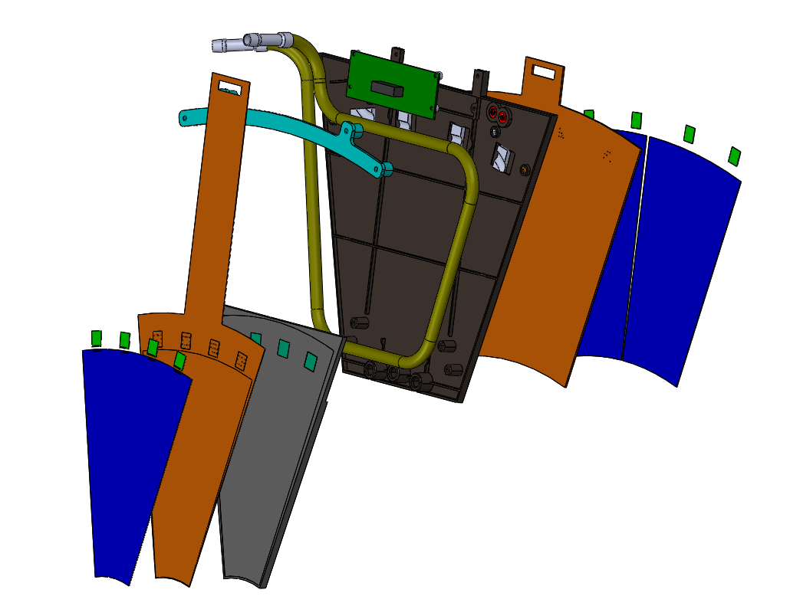
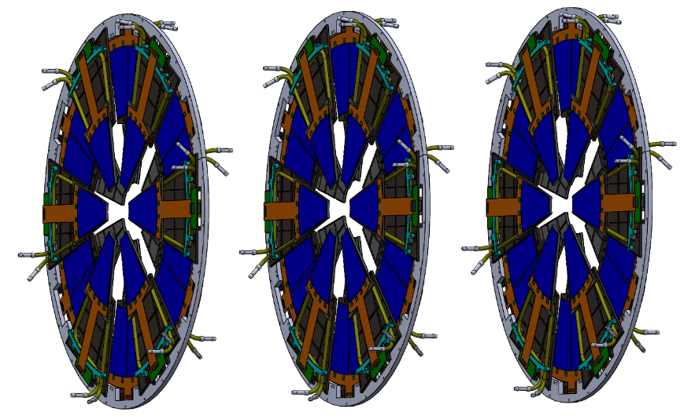
The Forward Silicon Tracker
Flexible hybrid PCB: SDU/IU
Inner Signal Cable: BNL
T-Board: SDU/IU
Mechanical Structure
(+ cooling pipe): NCKU/AIDC
APV25 Chip: UIC
Supporting Structure &
Integration: BNL
Silicon sensor: UIC/SDU/NCKU
Cooling: BNL/NCKU
Simulation: UIC/BNL/IISER/NCKU

Slide 4
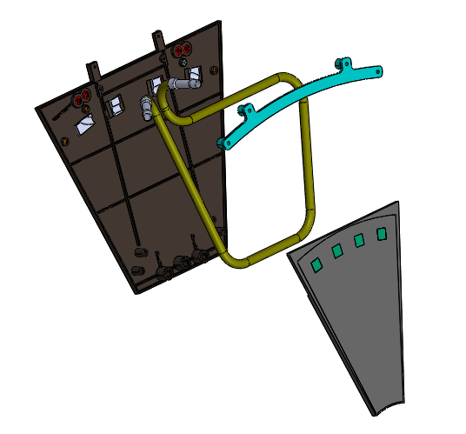
The Final Design
Main structure:
Material: PEEK
Thermal Conductivity: 0.24 W/m/K
Tube fixture:
Material: PEEK
Tube:
Material: Stainless 316 (with Chroming)
Size: OD 6.35 mm, ID 5.54 mm
Thermal Conductivity: 14 W/m/K
Heat sink:
Material: Al 6061
Size: ~8.2 x 8.0 x 3 mm²

Slide 5
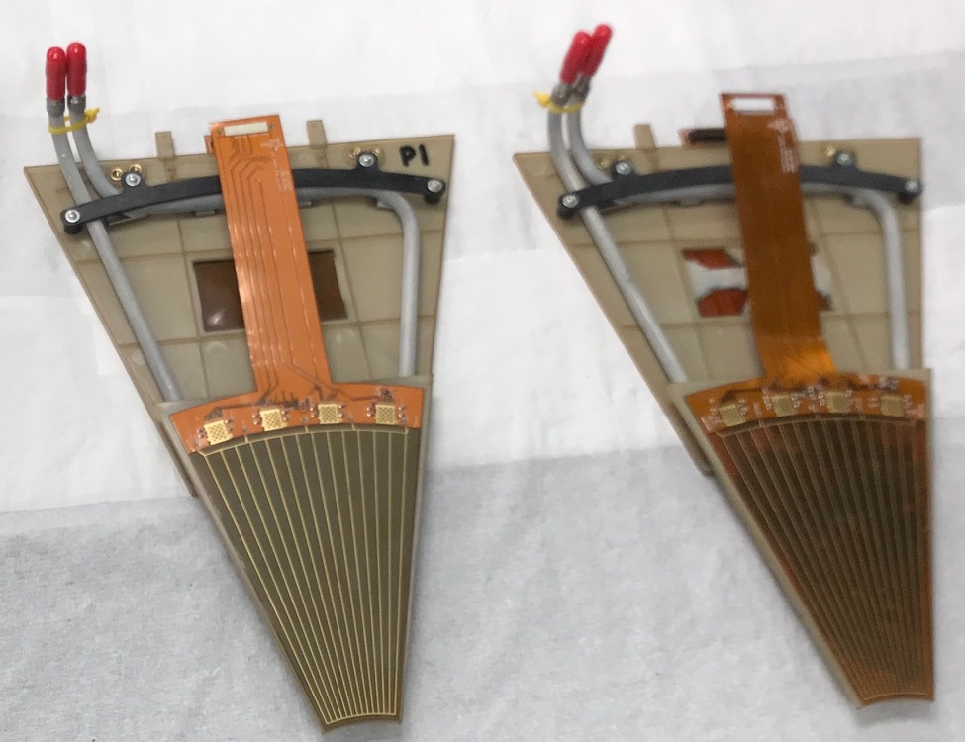
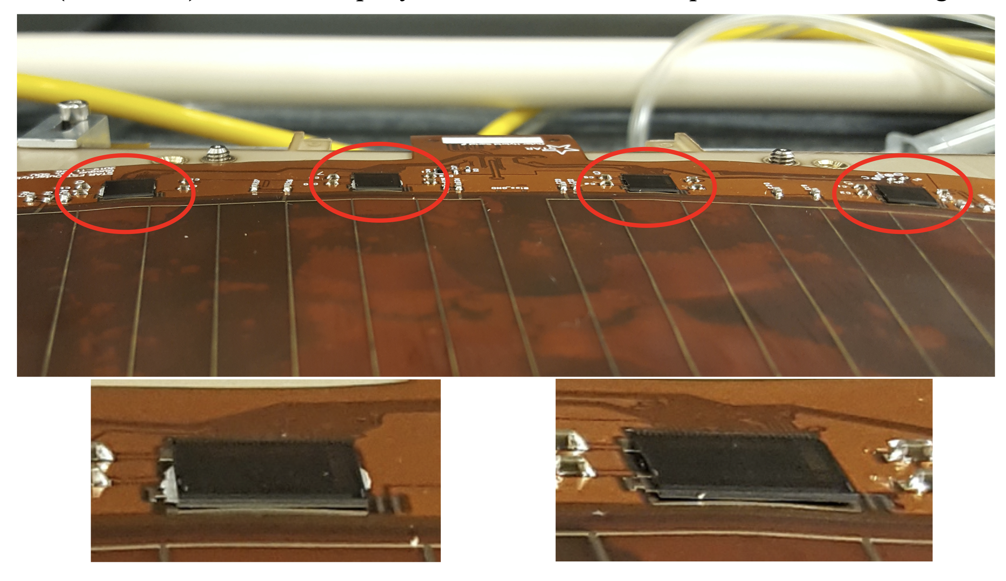
First Prototypes: FST-001, FST-002
Two prototypes assembled by AIDC on Jan. 30 and Feb. 11, 2020
Many issues found: flatness, bubbles, shifting…
Thicker hybrid
(new vender)
Thinner hybrid
(older vender)
~2-3 mm
Flatness (RMS) | Thicker hybrid | Thinner hybrid
Inner | 0.2942 (mm) | 0.2663 (mm)
Outer | 0.4654 (mm) | 0.2585 (mm)

Slide 6
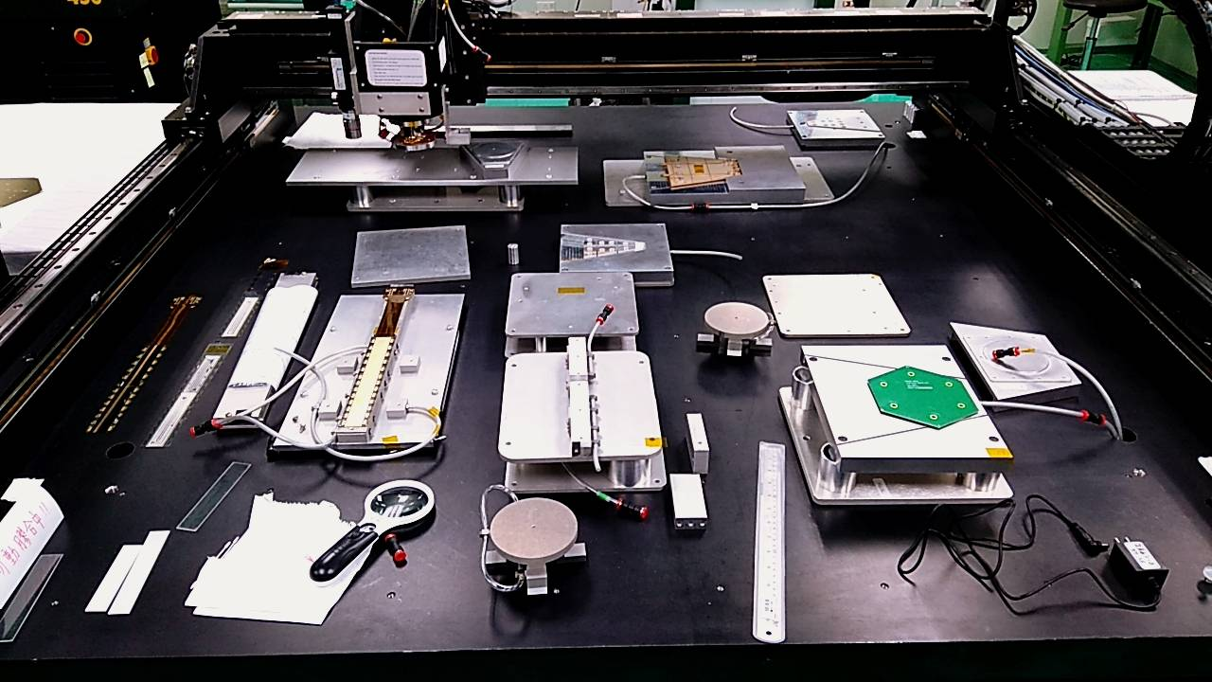
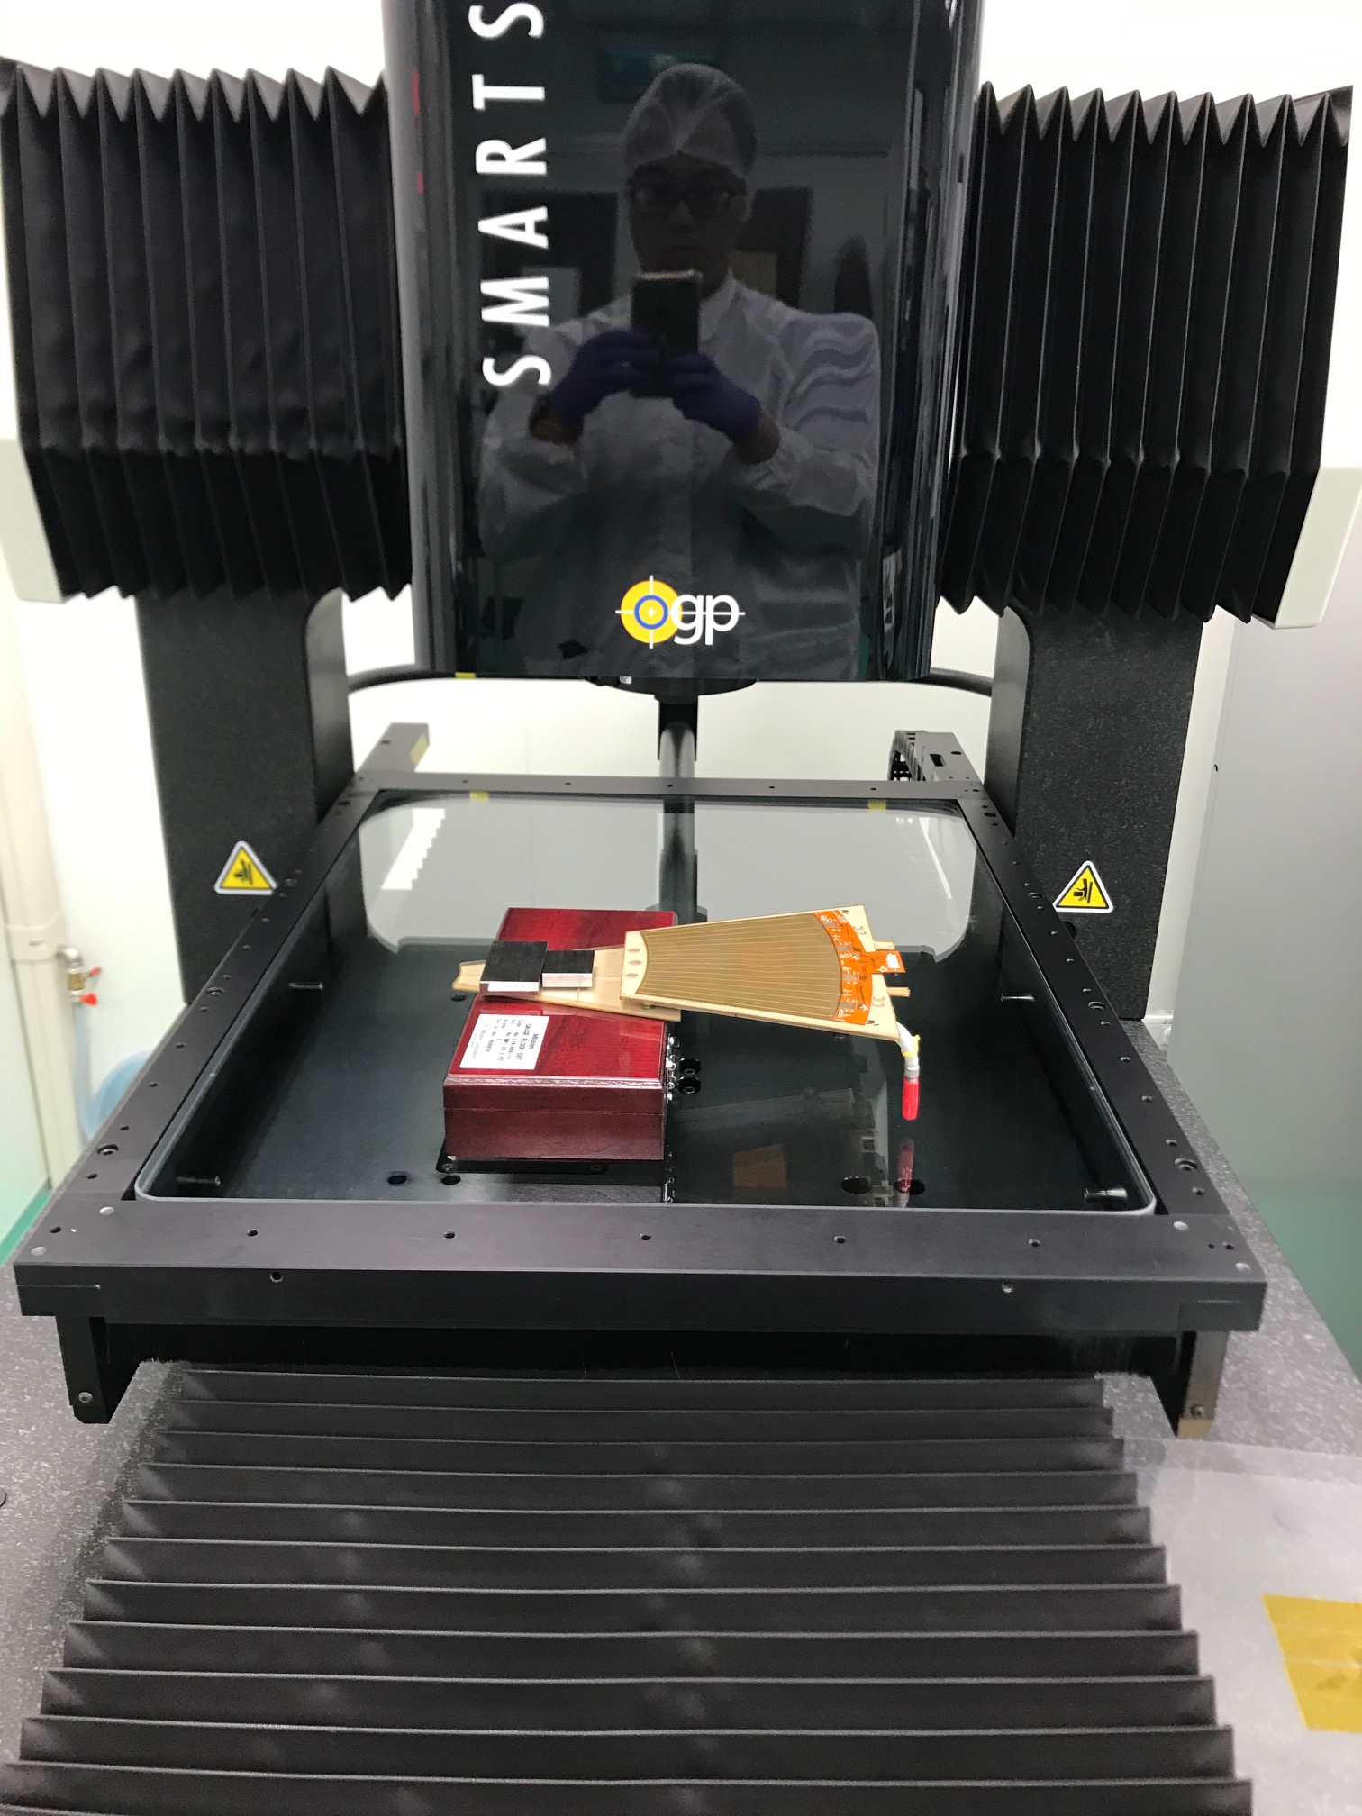
New Assembly Procedure
To improve the precision of the assembly, we are using the robotic machine at TiDC (https://www.taiwan-tidc.org) to mount hybrid PCBs to inner and outer structures
➔ More precise positioning
➔ New fixtures and LabView codes are ready
Optical Gauging Products (OGP)
Assembly table and gantry
STAR FST
CMS HGCal
sPHENIX INTT

Slide 7
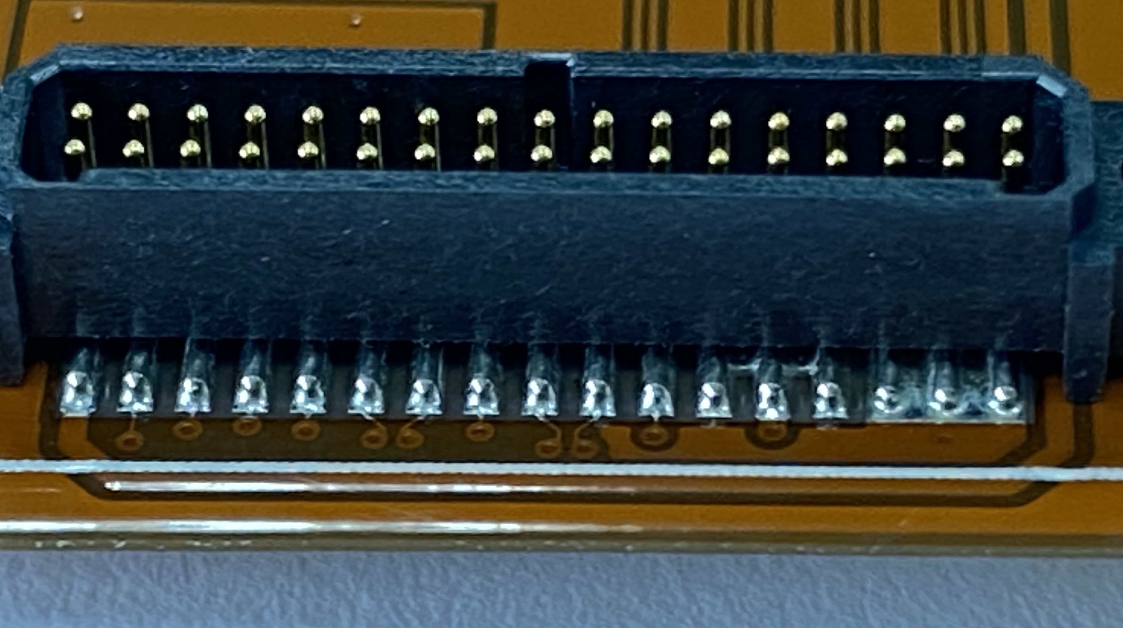
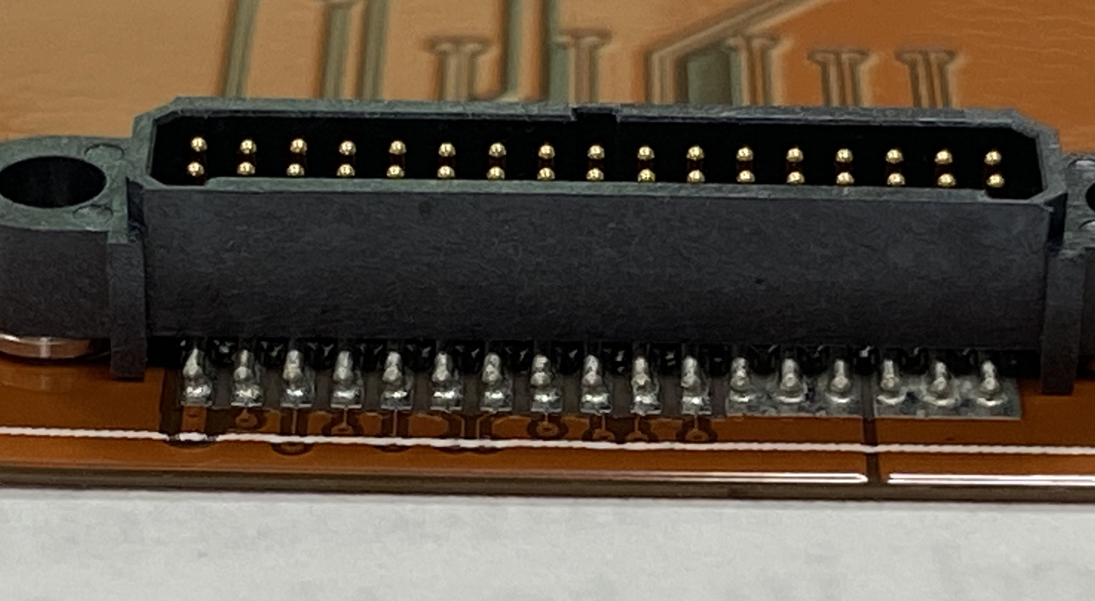
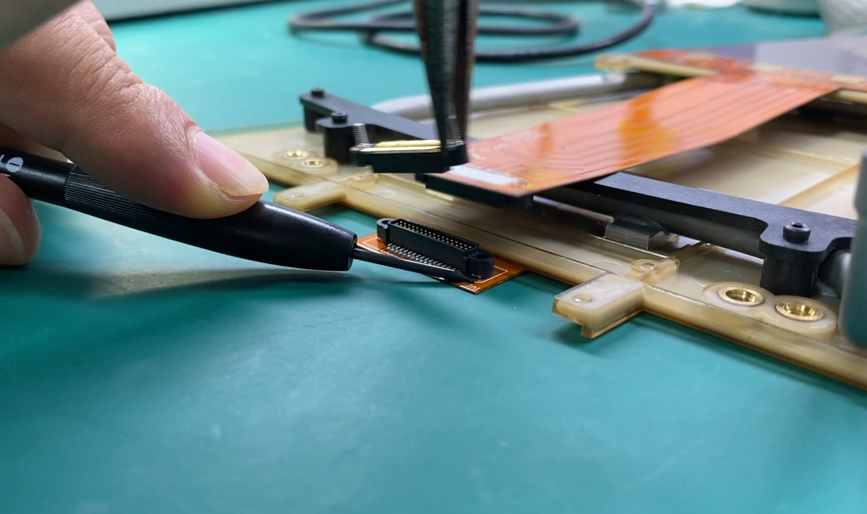
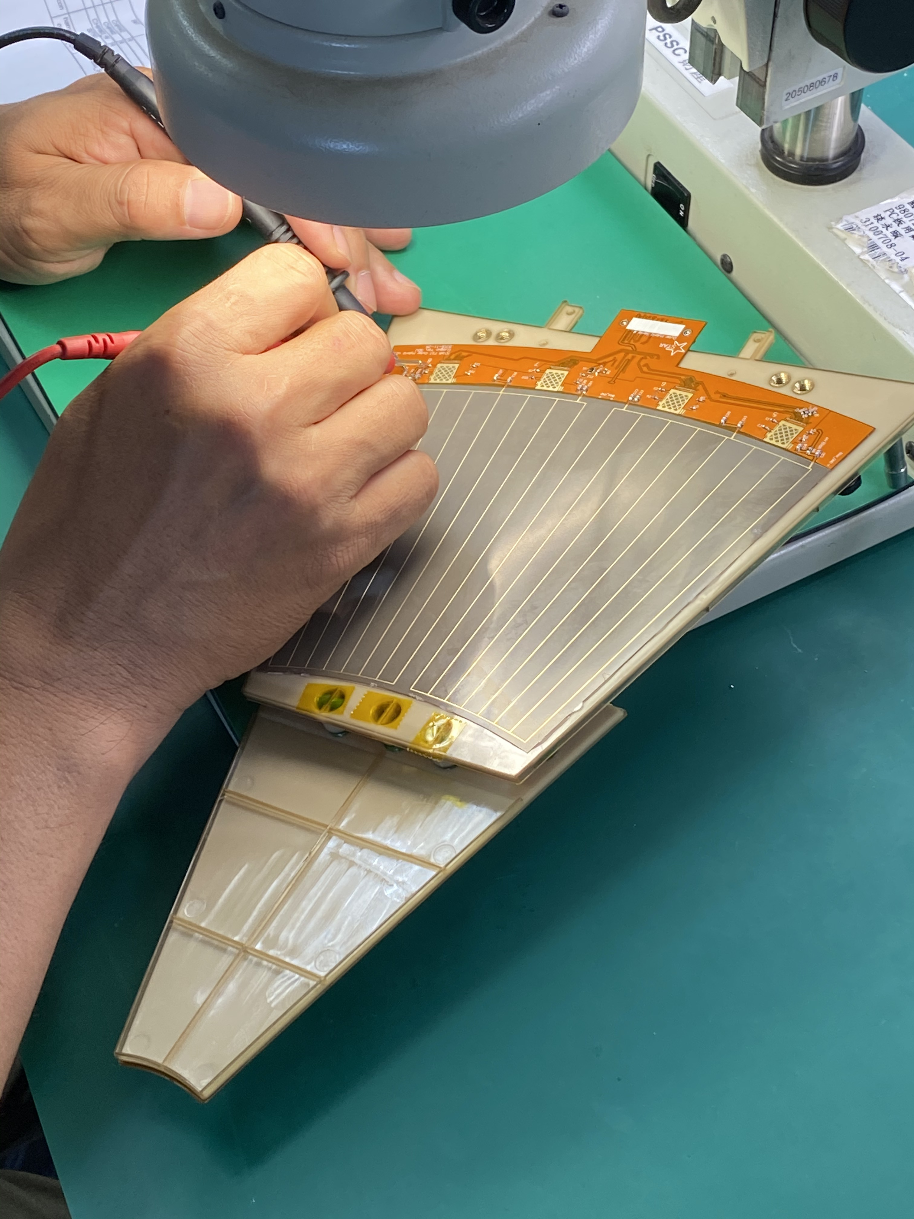
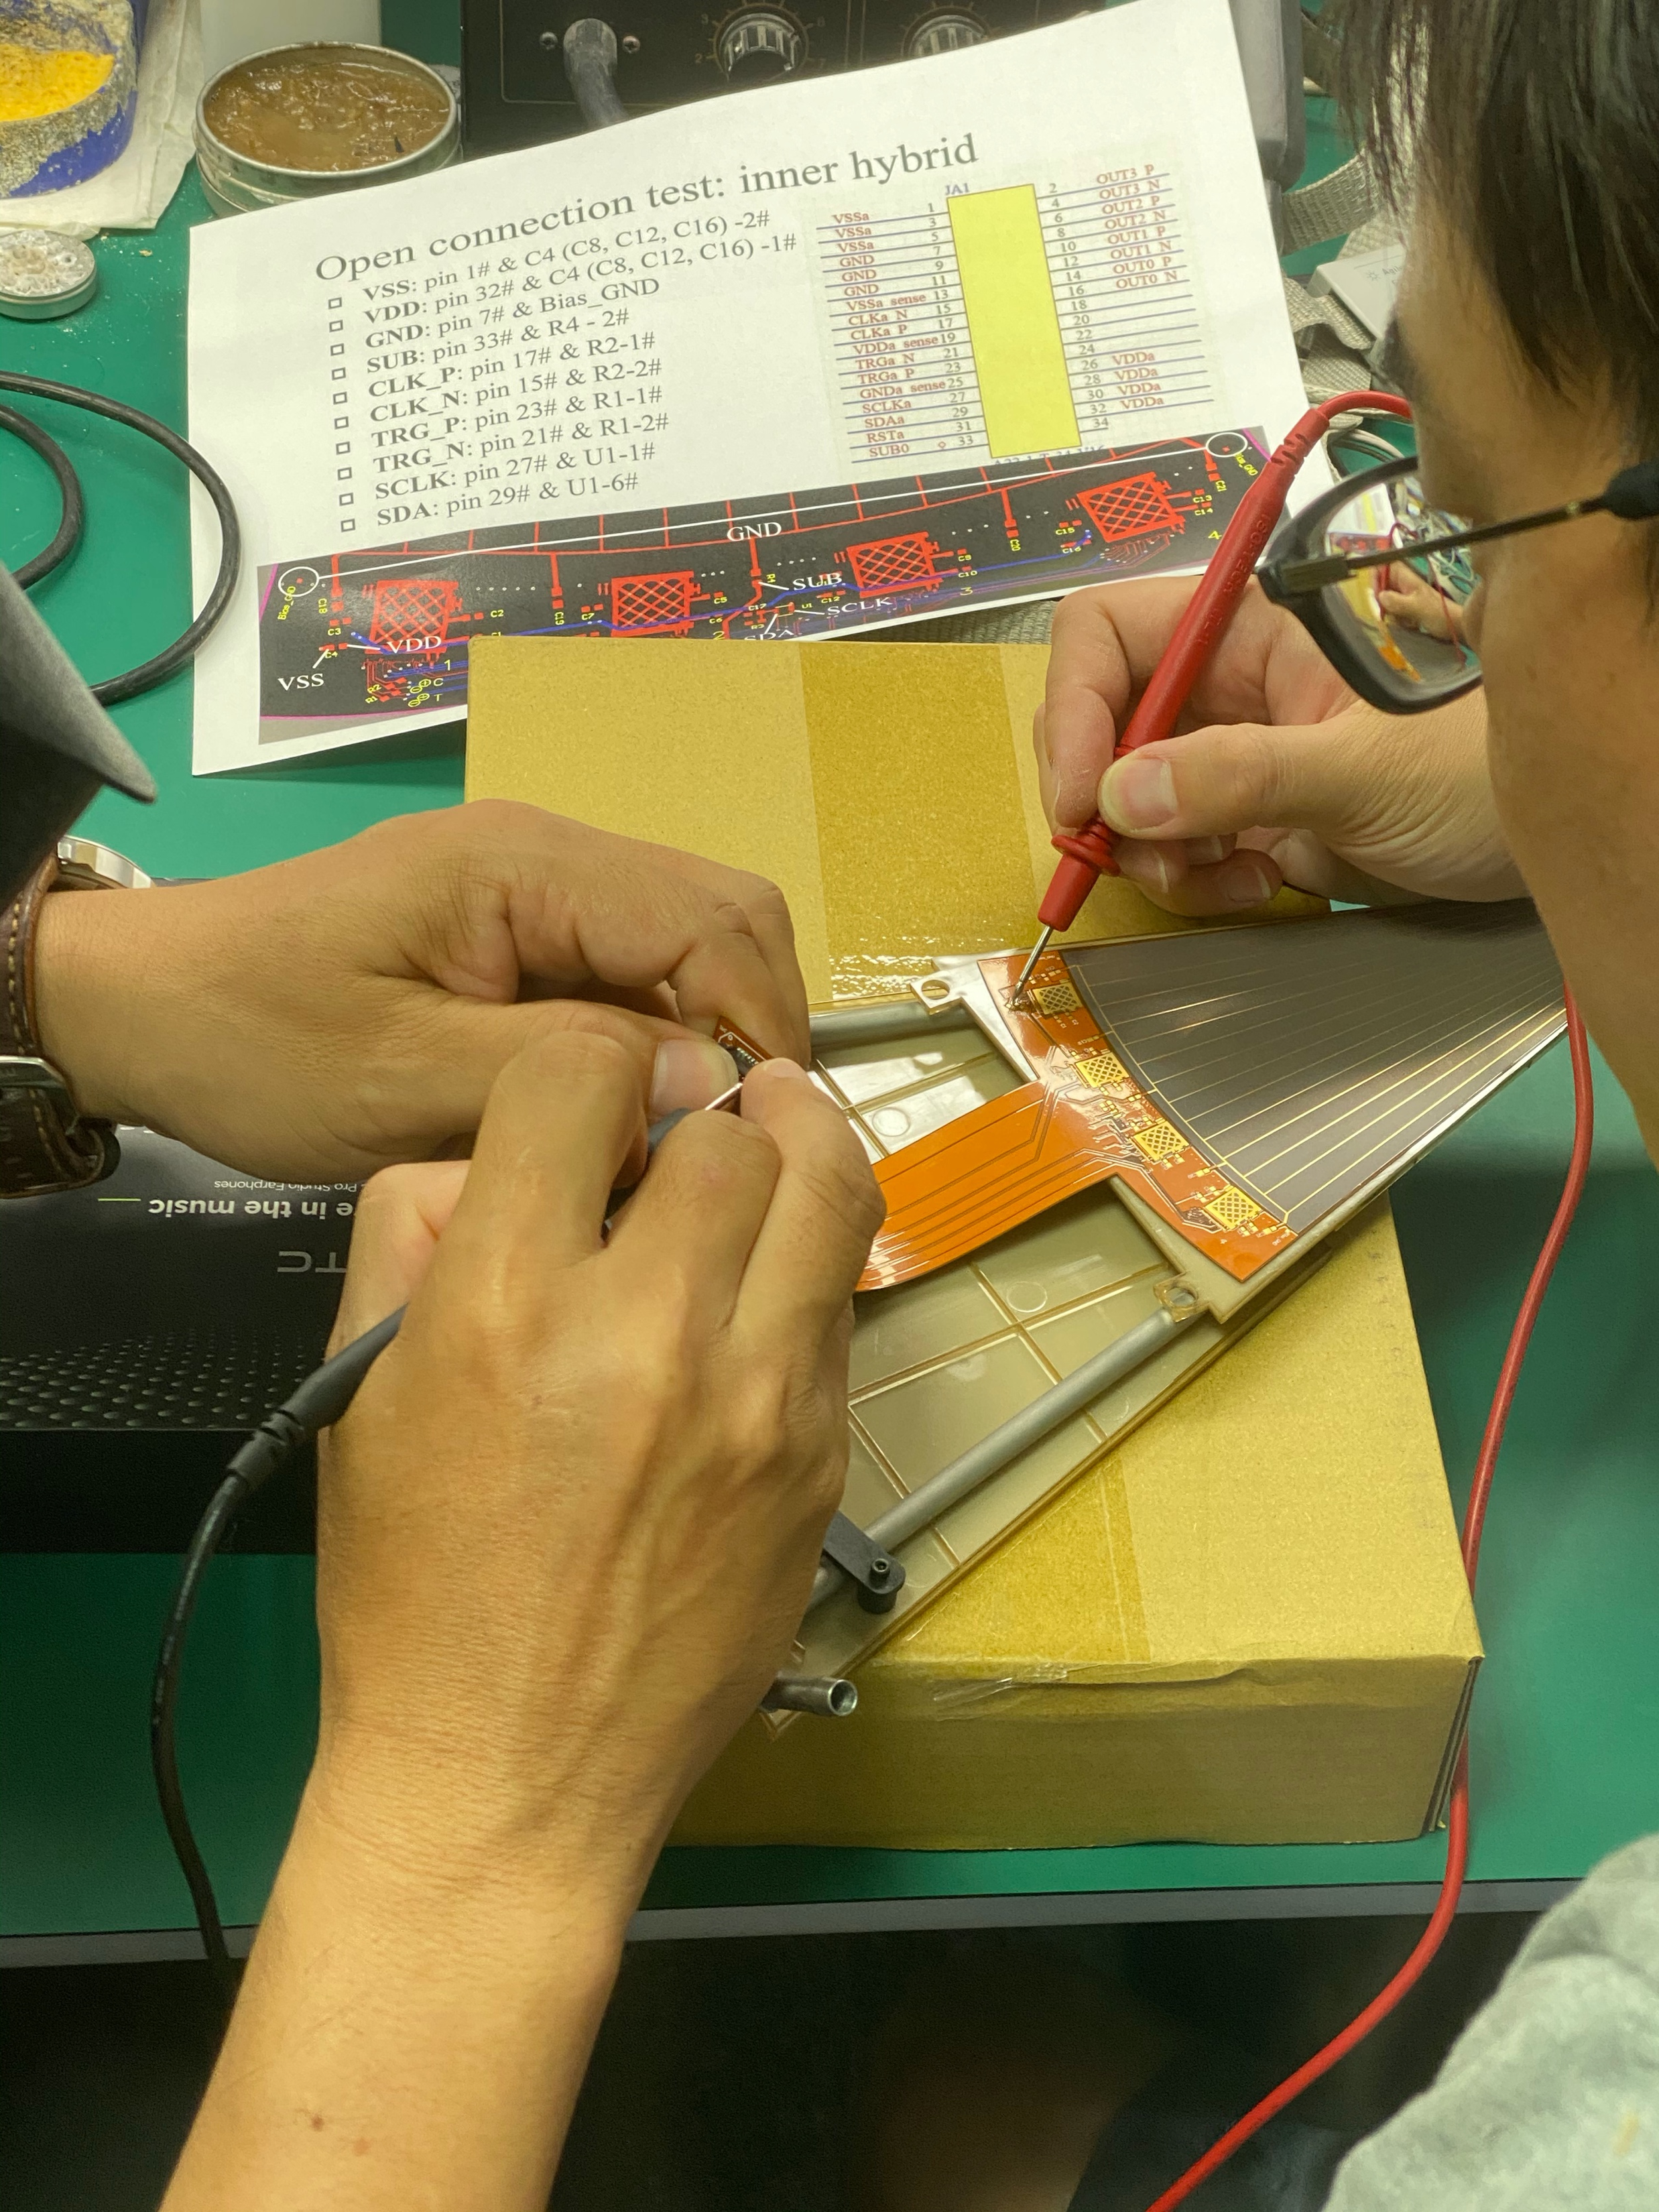
Connector & Components on Hybrid
FST-001 & FST-002: connector and components were mounted before assembly
New procedure (FST-003, FST-004):
Connector were mounted by outsourcing company
Perform plugging-unplugging test
Perform open connection test
(Assembly hybrid + mechanical structure)
Solder components manually
Perform electrical test

Slide 8
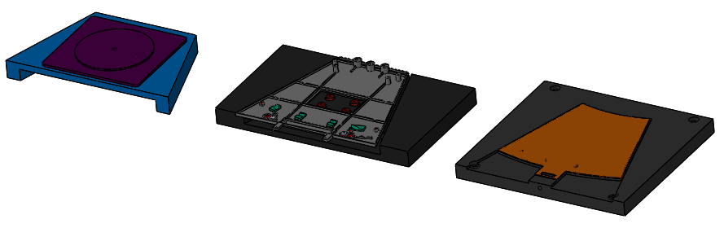
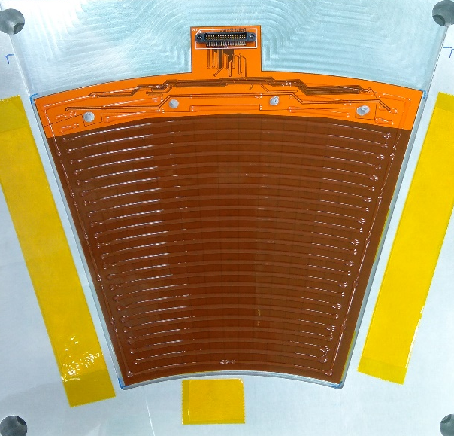
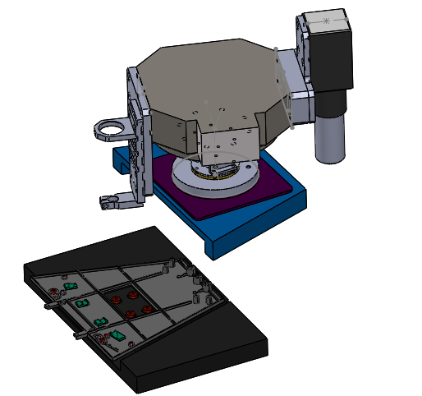
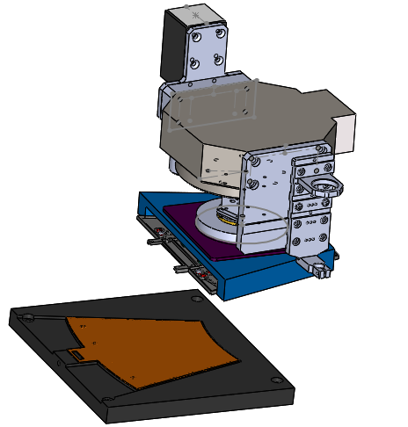
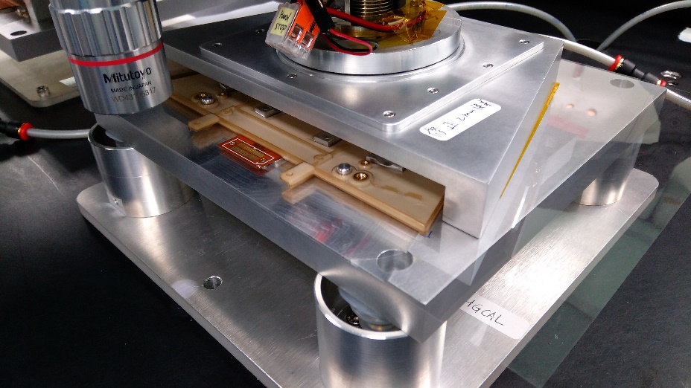
New Assembly Procedure: Outer
Place the pickup tool, outer MS + tray, outer Hybrid + tray on table
Place guide pin on outer MS
Apply glue on outer Hybrid
Use camera to locate the reference points
Glue
Outer MS + tray
Outer Hybrid + tray
pickup tool

Slide 9
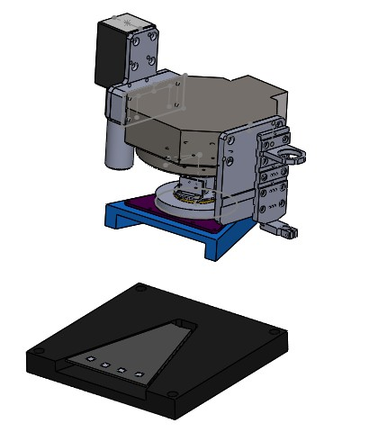
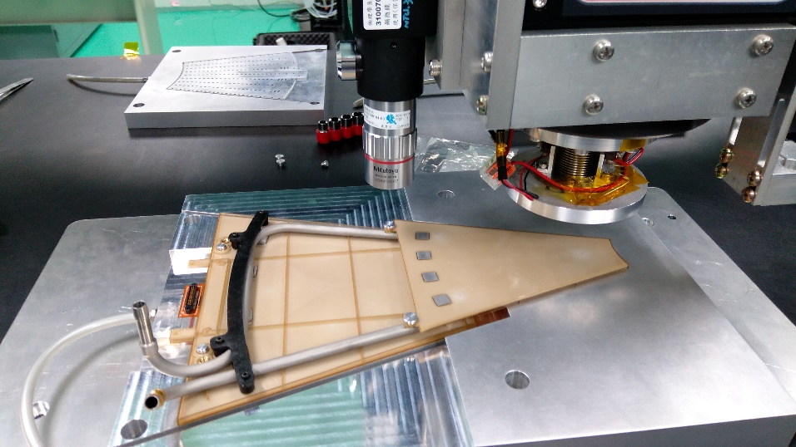
New Assembly Procedure: Inner
Need to pre-fit and calculate the correct positions due to the shrinking of the MS (will be fixed)
Place the outer MS+Hybrid+Cooling tube (outer wedge) + tray and inner MS + tray on table
Located the reference points
Use robotic arm to place the inner MS on the outer wedge
Record the positions and calculate the shifting
Outer wedge + tray
Inner MS + tray

Slide 10
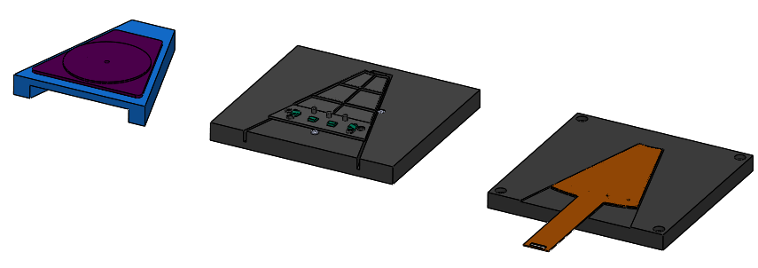
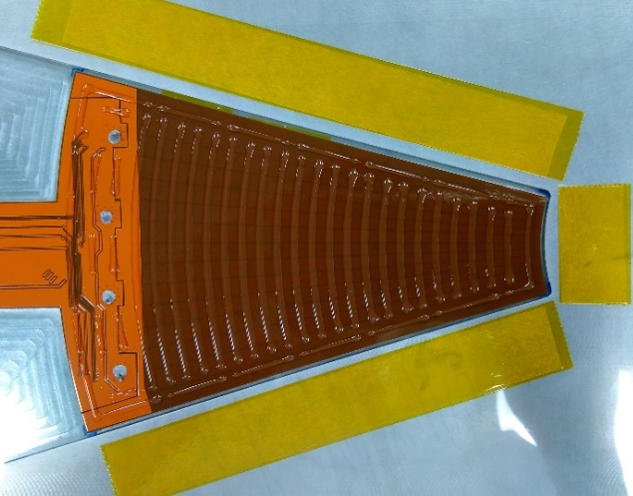
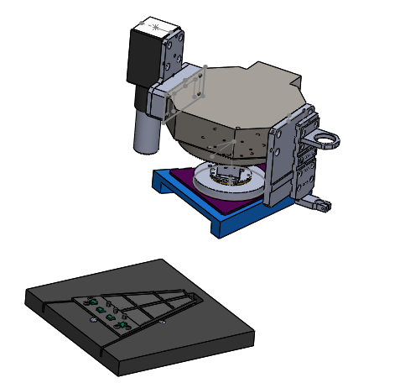
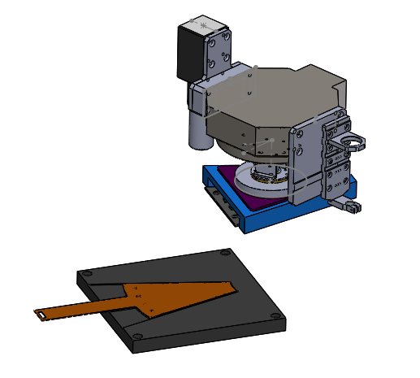
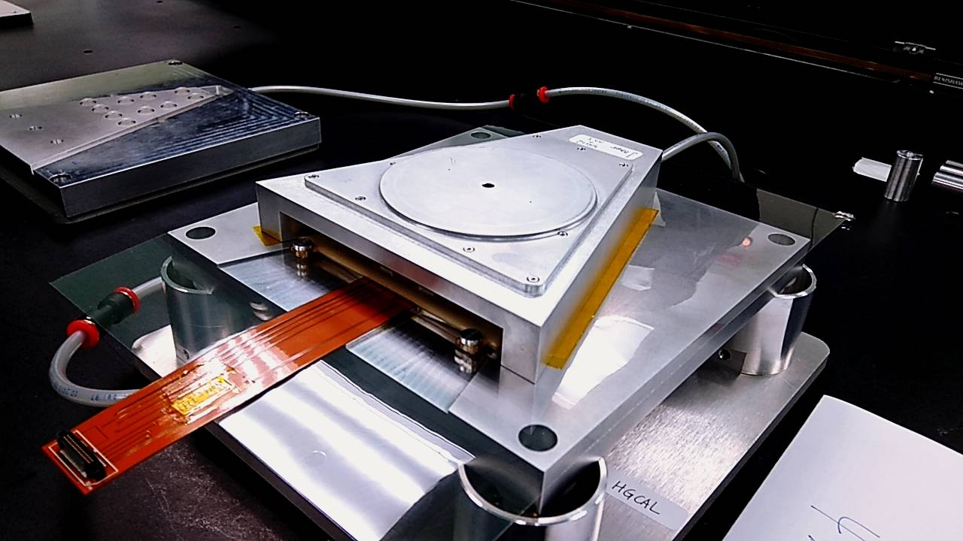
New Assembly Procedure: Inner
Place pickup tool, inner MS + tray, inner Hybrid + tray on table
Use camera to locate the reference points
Pick up inner MS and glue it on the inner Hybrid
Inner Hybrid + tray

Slide 11
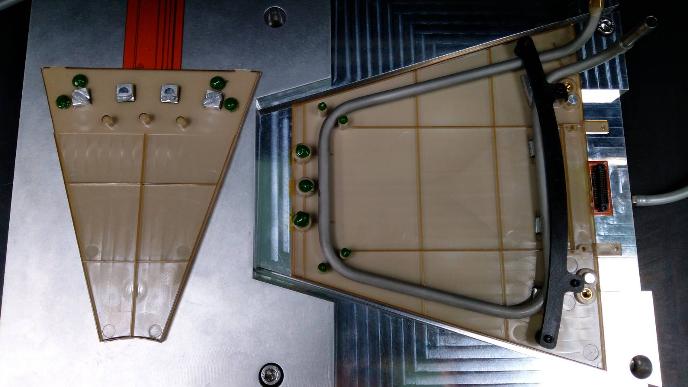
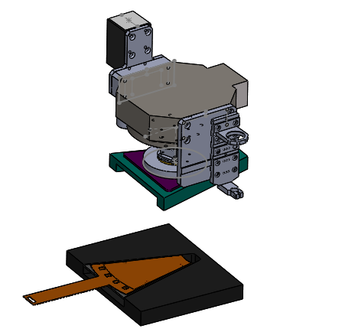
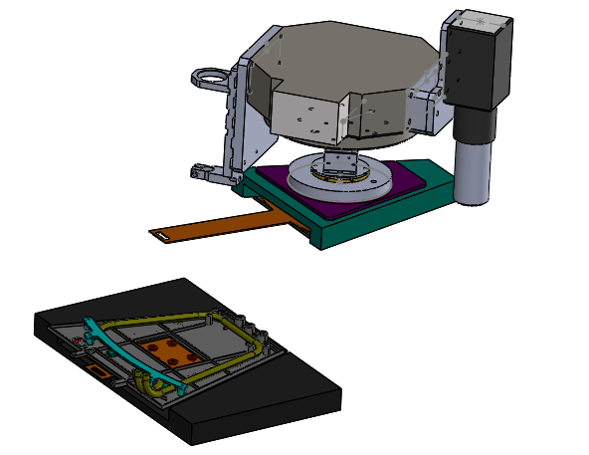
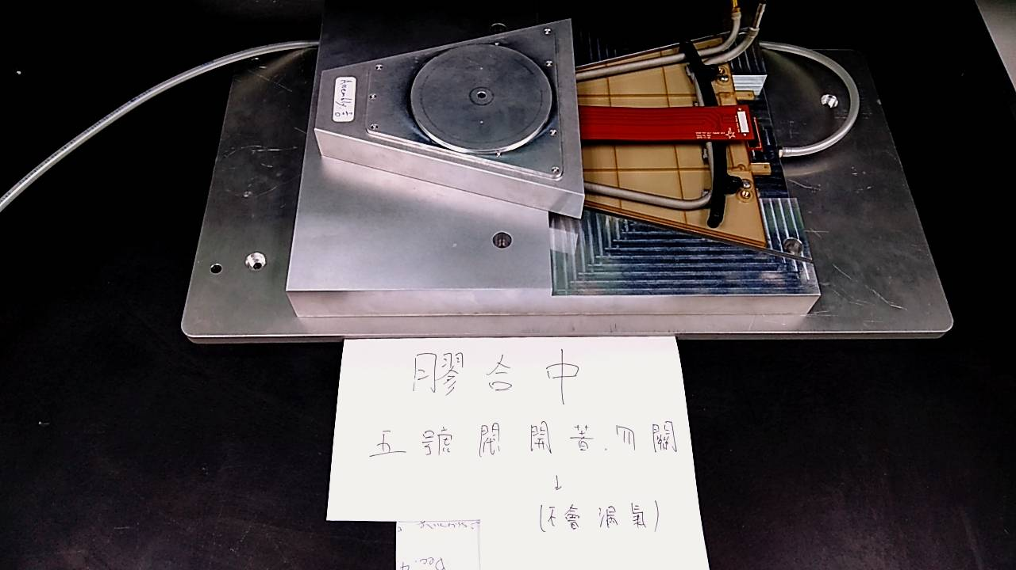
New Assembly Procedure: Outer+Inner
Place pickup tool, inner wedge + tray, outer wedge + tray on table
Use camera to locate reference points
Pick up inner wedge and glue

Slide 12
New Assembly Procedure: Video

Slide 13
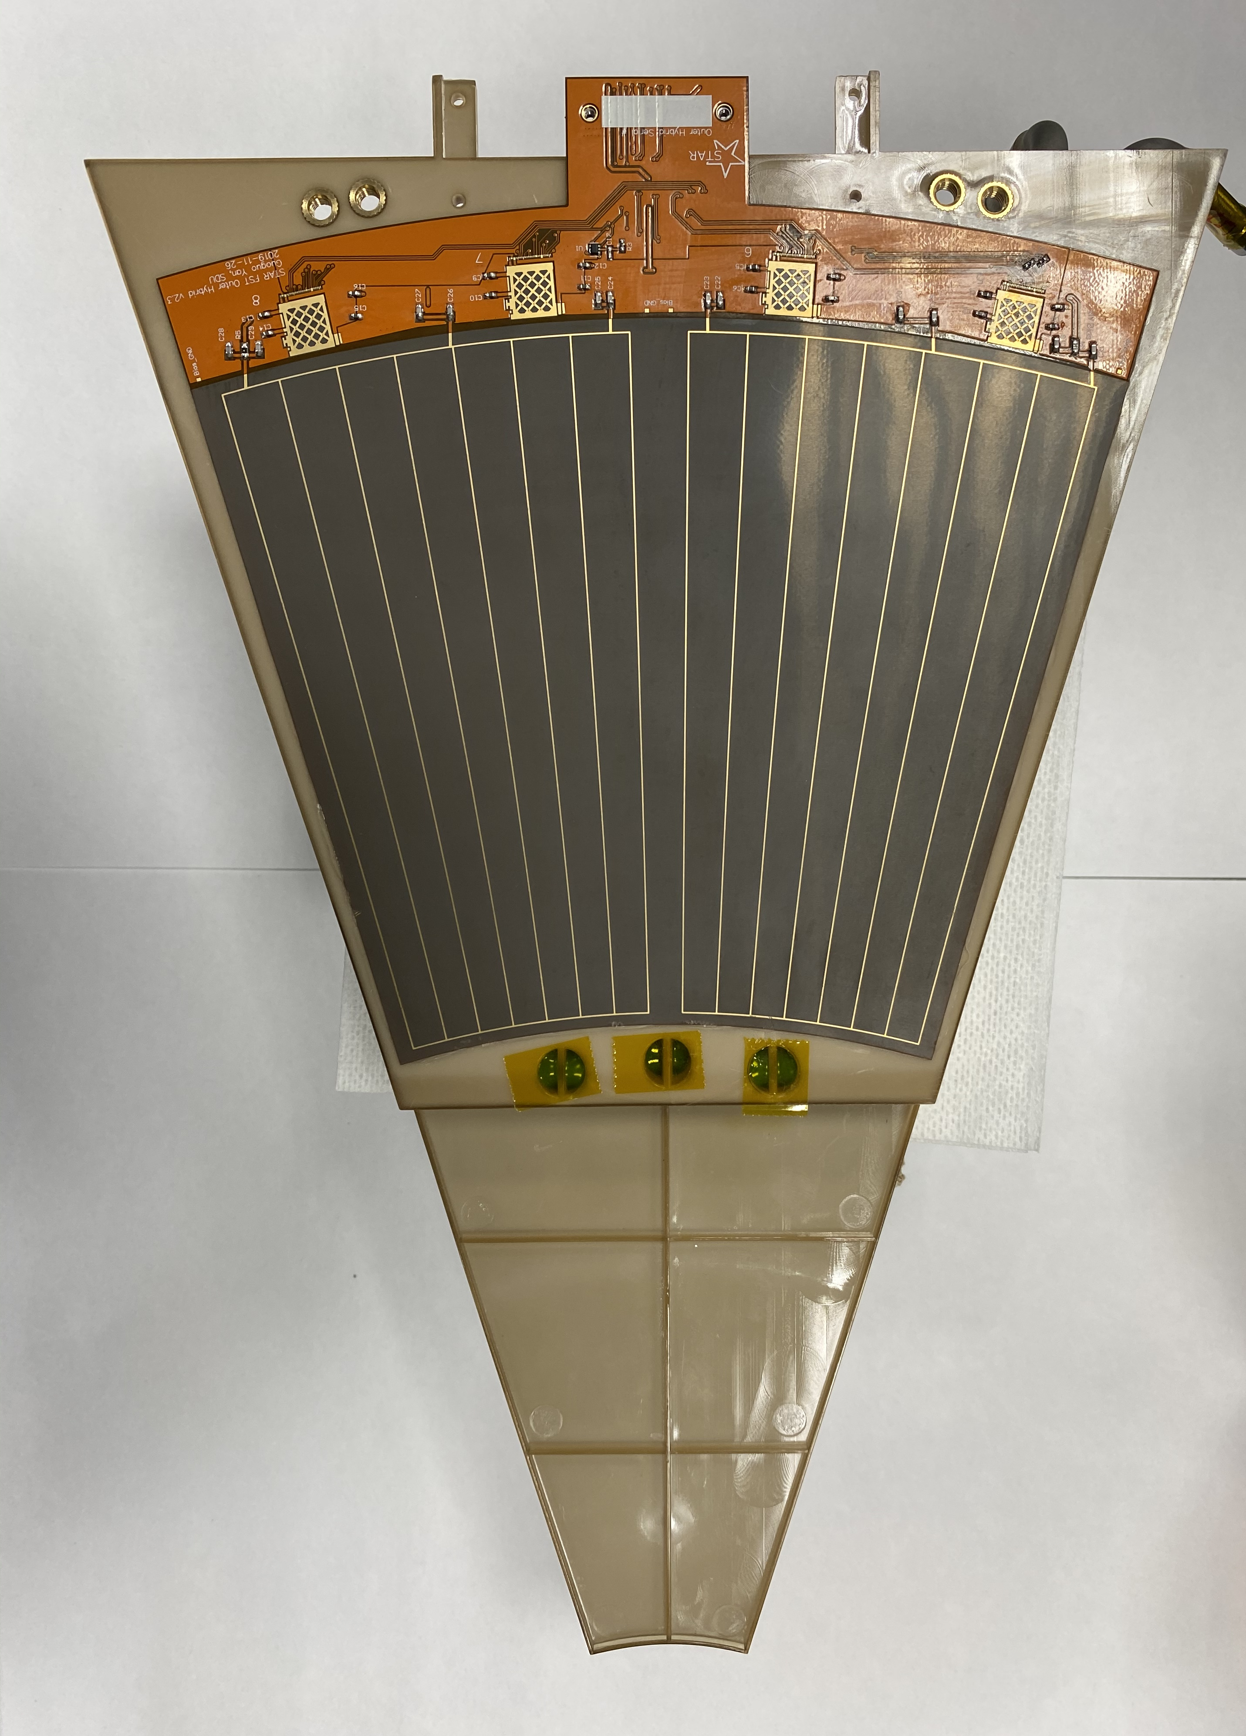
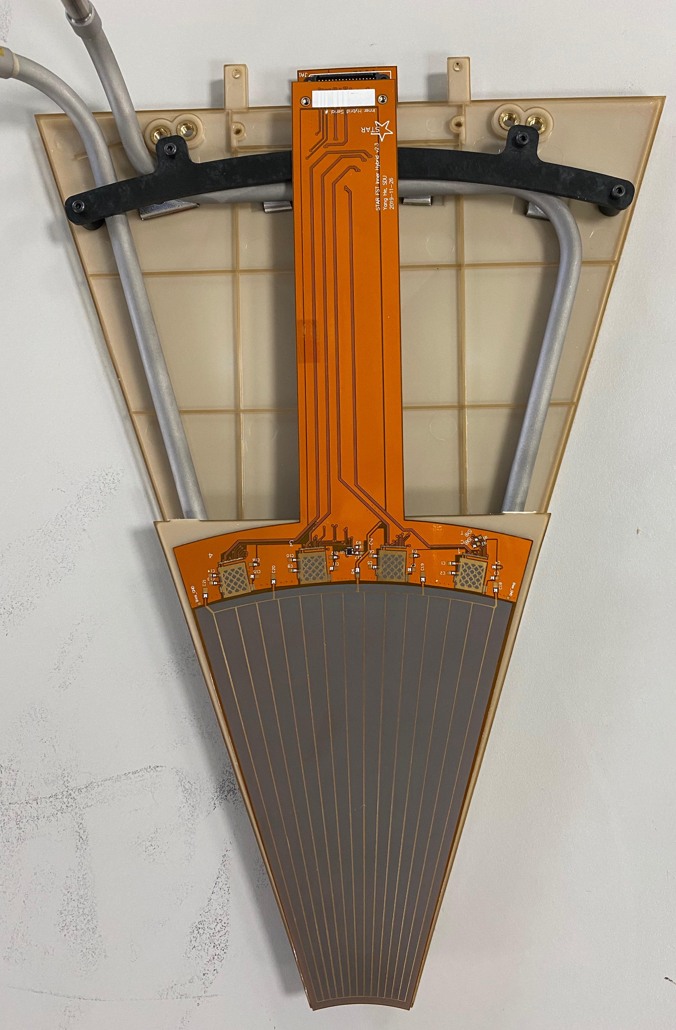
Second Prototypes: FST-003, FST-004
Look good by eyes!
FST-003
FST-004

Slide 14
Second Prototypes: FST-003, FST-004
"The inner chip placement was off .500 mm so I needed to reposition. The outer placement was off .200 mm”
(slightly larger misalignment for FST-004)
"They were inboard toward the sensor area . I needed to slide the chips back or outward. Michelle mention adhesion under some pads was not so good and created some issue but she got all in adjusting the powers.”
(Only for FST-003)
(1) Mainly due to the guide pin and this will be fixed after using the recommendation from Rahul’s team
(2) Will improve the glue pattern
(See next slides)

Slide 15
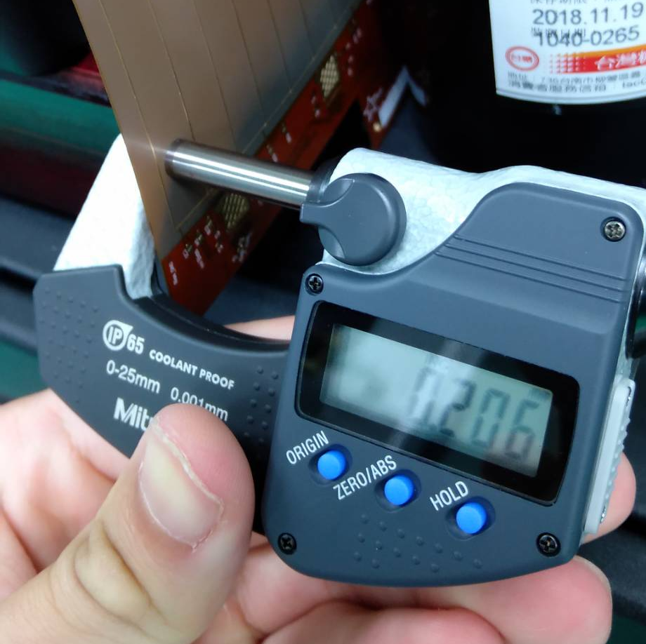
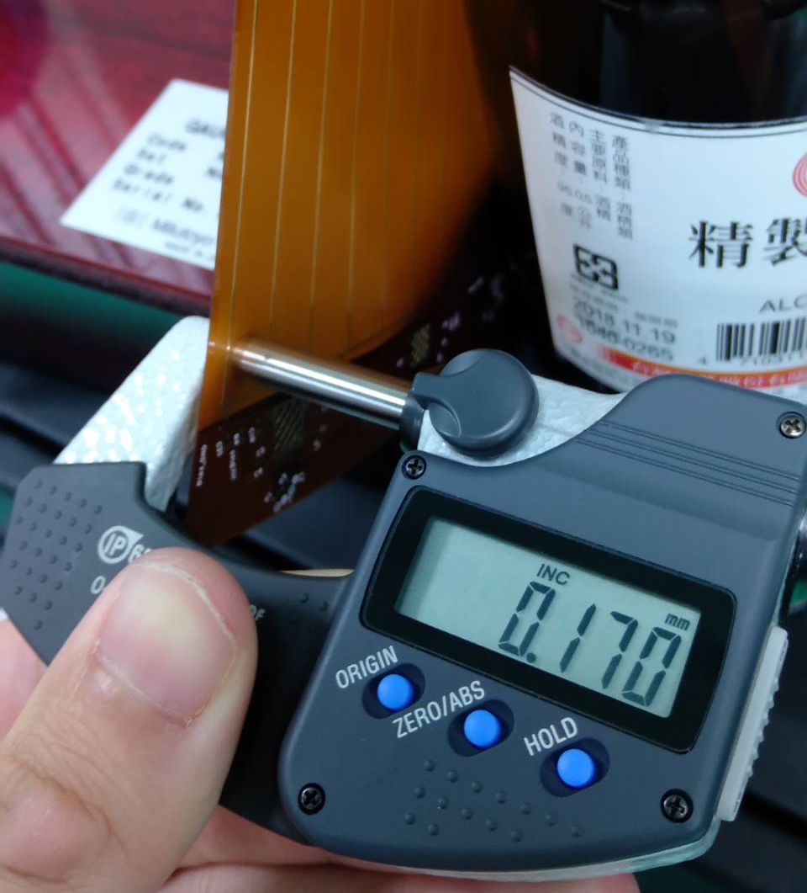
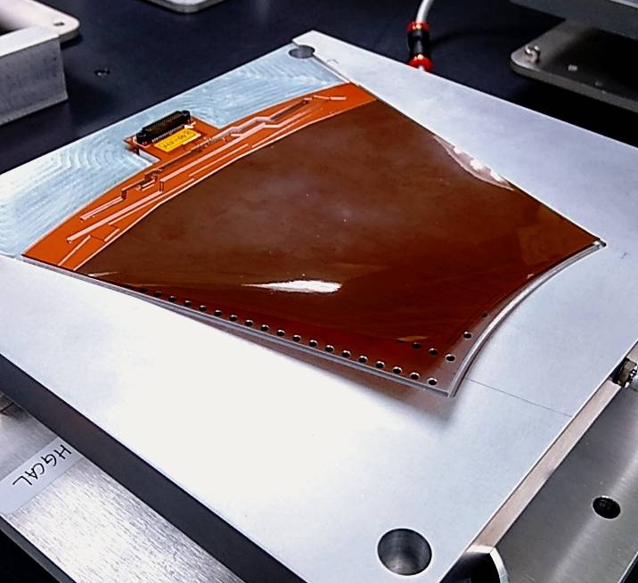
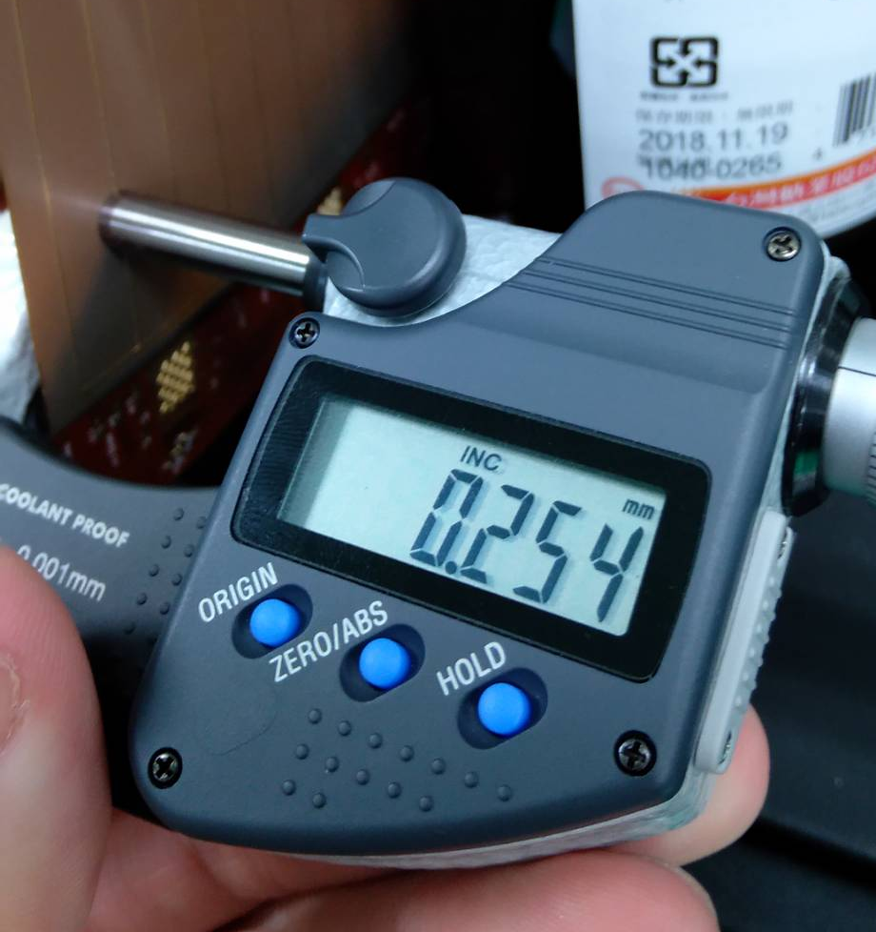
Issue on Thicker Hybrid (new vender)
The conducting lines are too thick: 48 μm vs. 24 μm
➔ Difficult to be fixed on the vacuum tray
➔ Need to use the thinner one for production
Thicker
Thinner

Slide 16
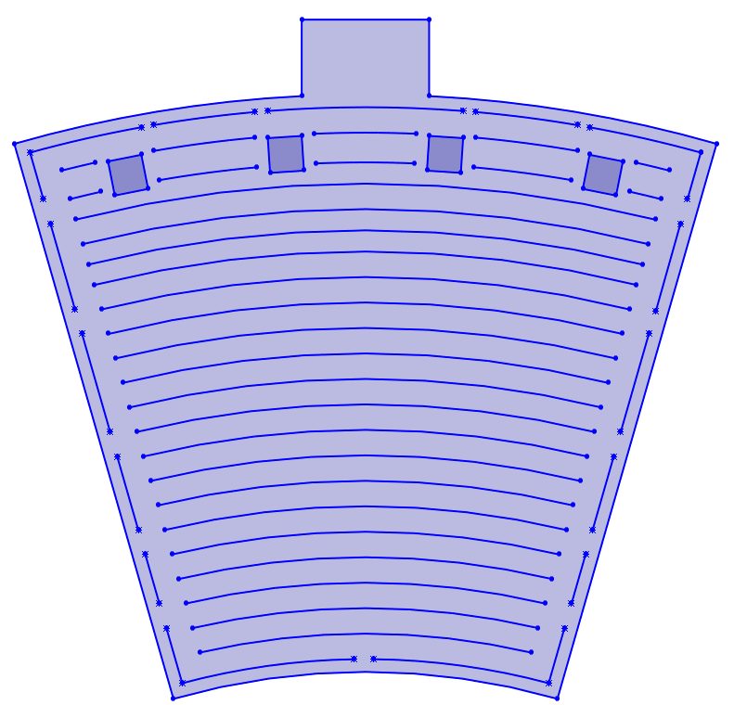
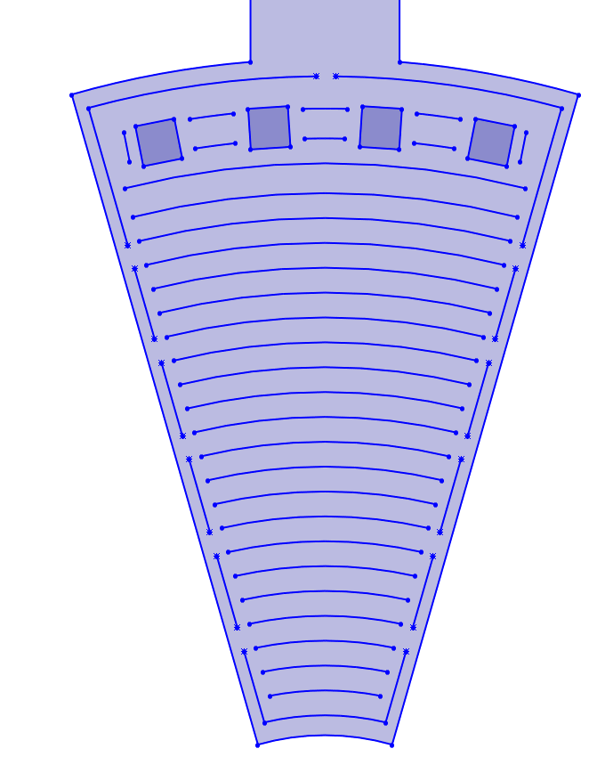
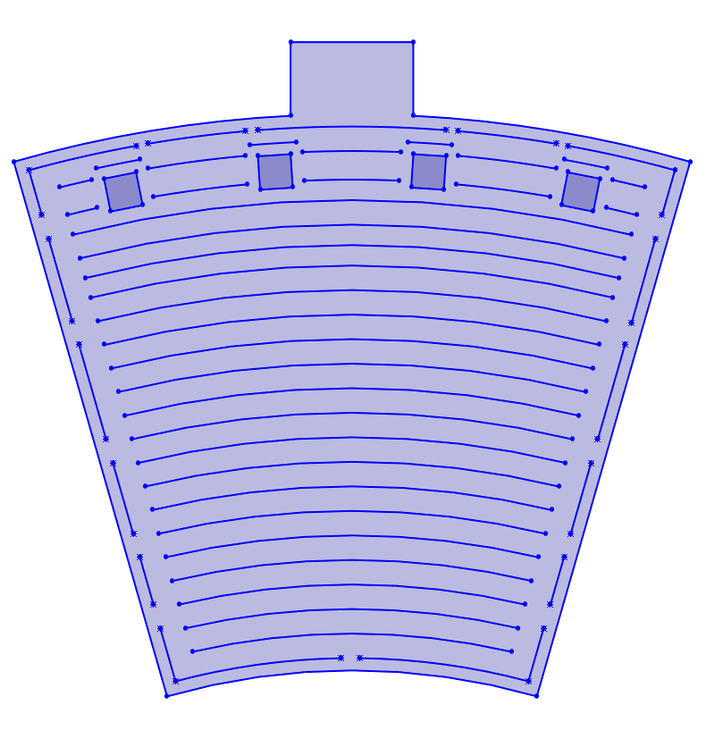
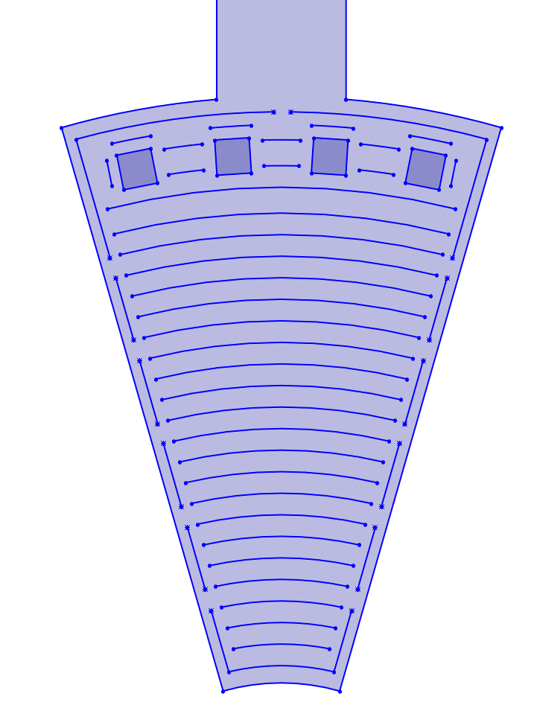
Modified Gluing Pattern
Old
Add extra glue
underneath the
bonding pads
New

Slide 17
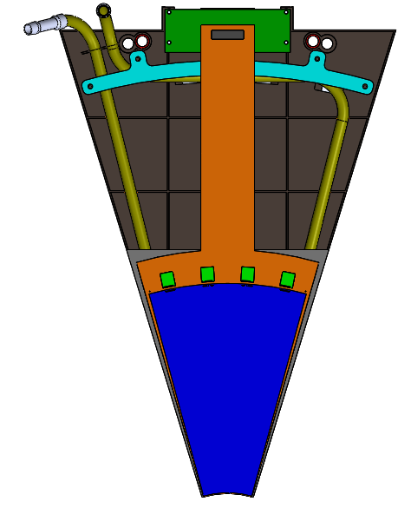
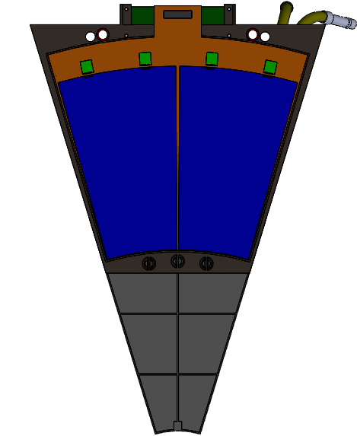
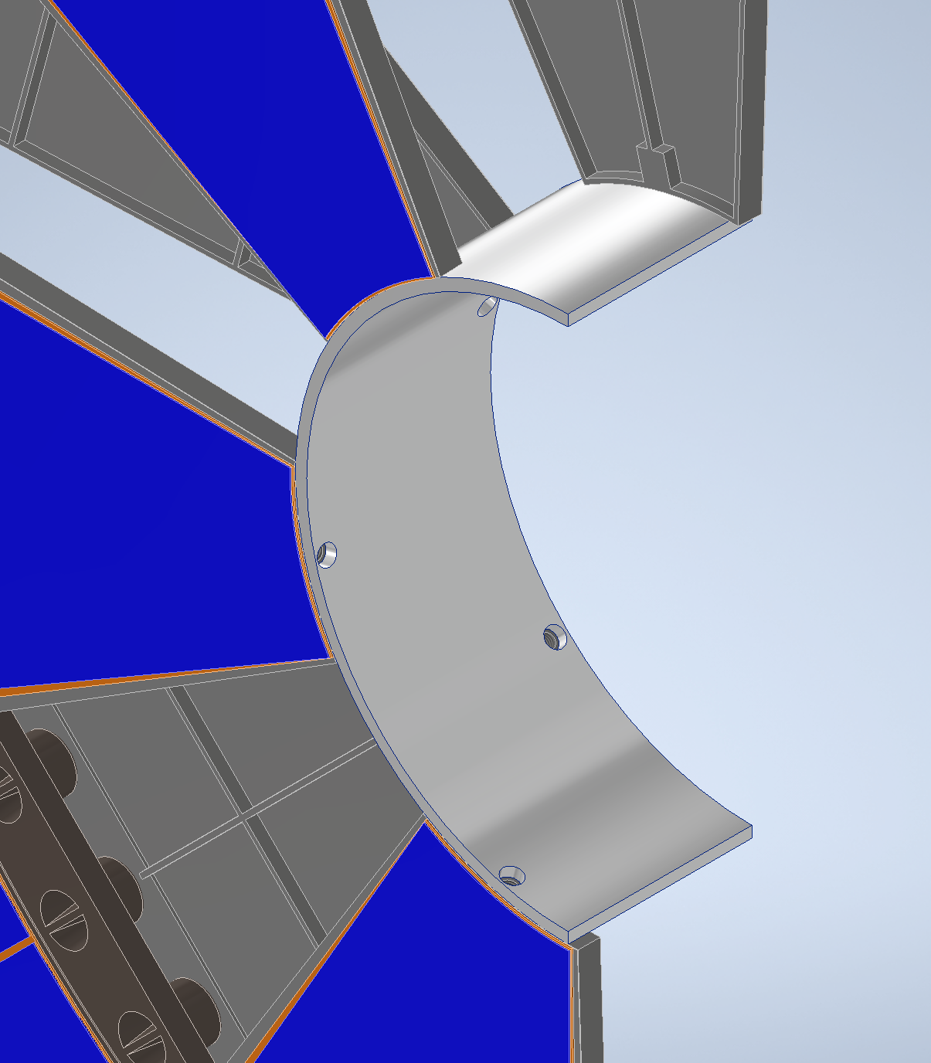
Modified Mechanical Structure
Implemented the suggestions from Rahul’s team
Precision bushings and pins (inner holes), larger through holes (outer holes)
Add inner supporting part (screw hole)
Precision bushing

Slide 18
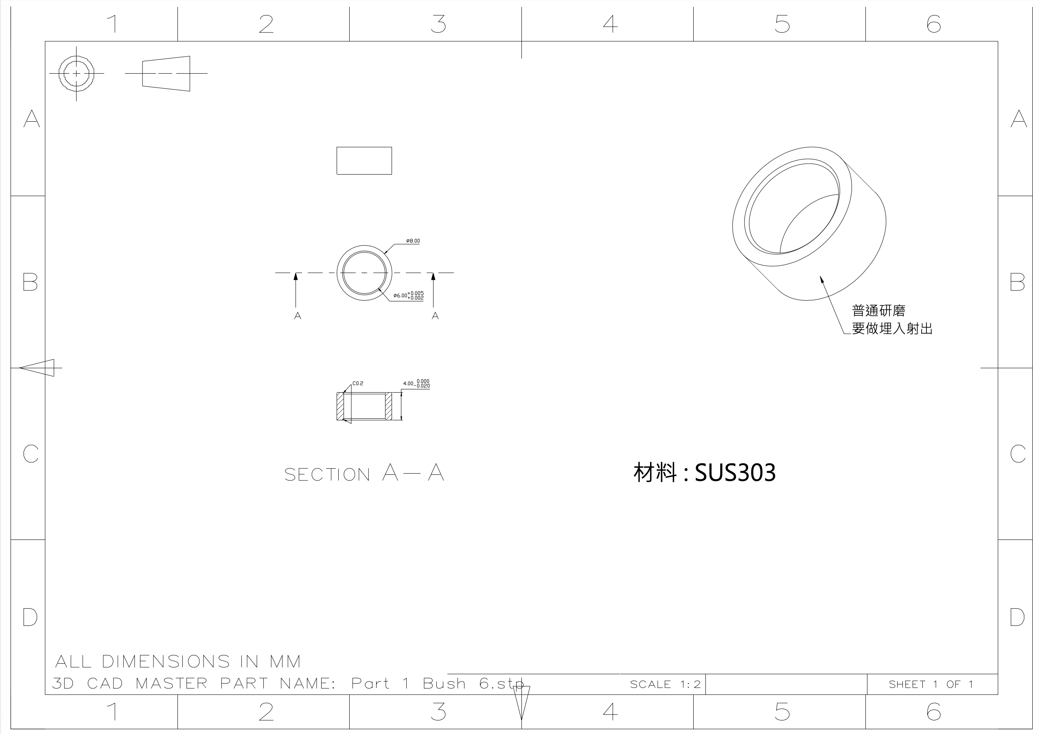
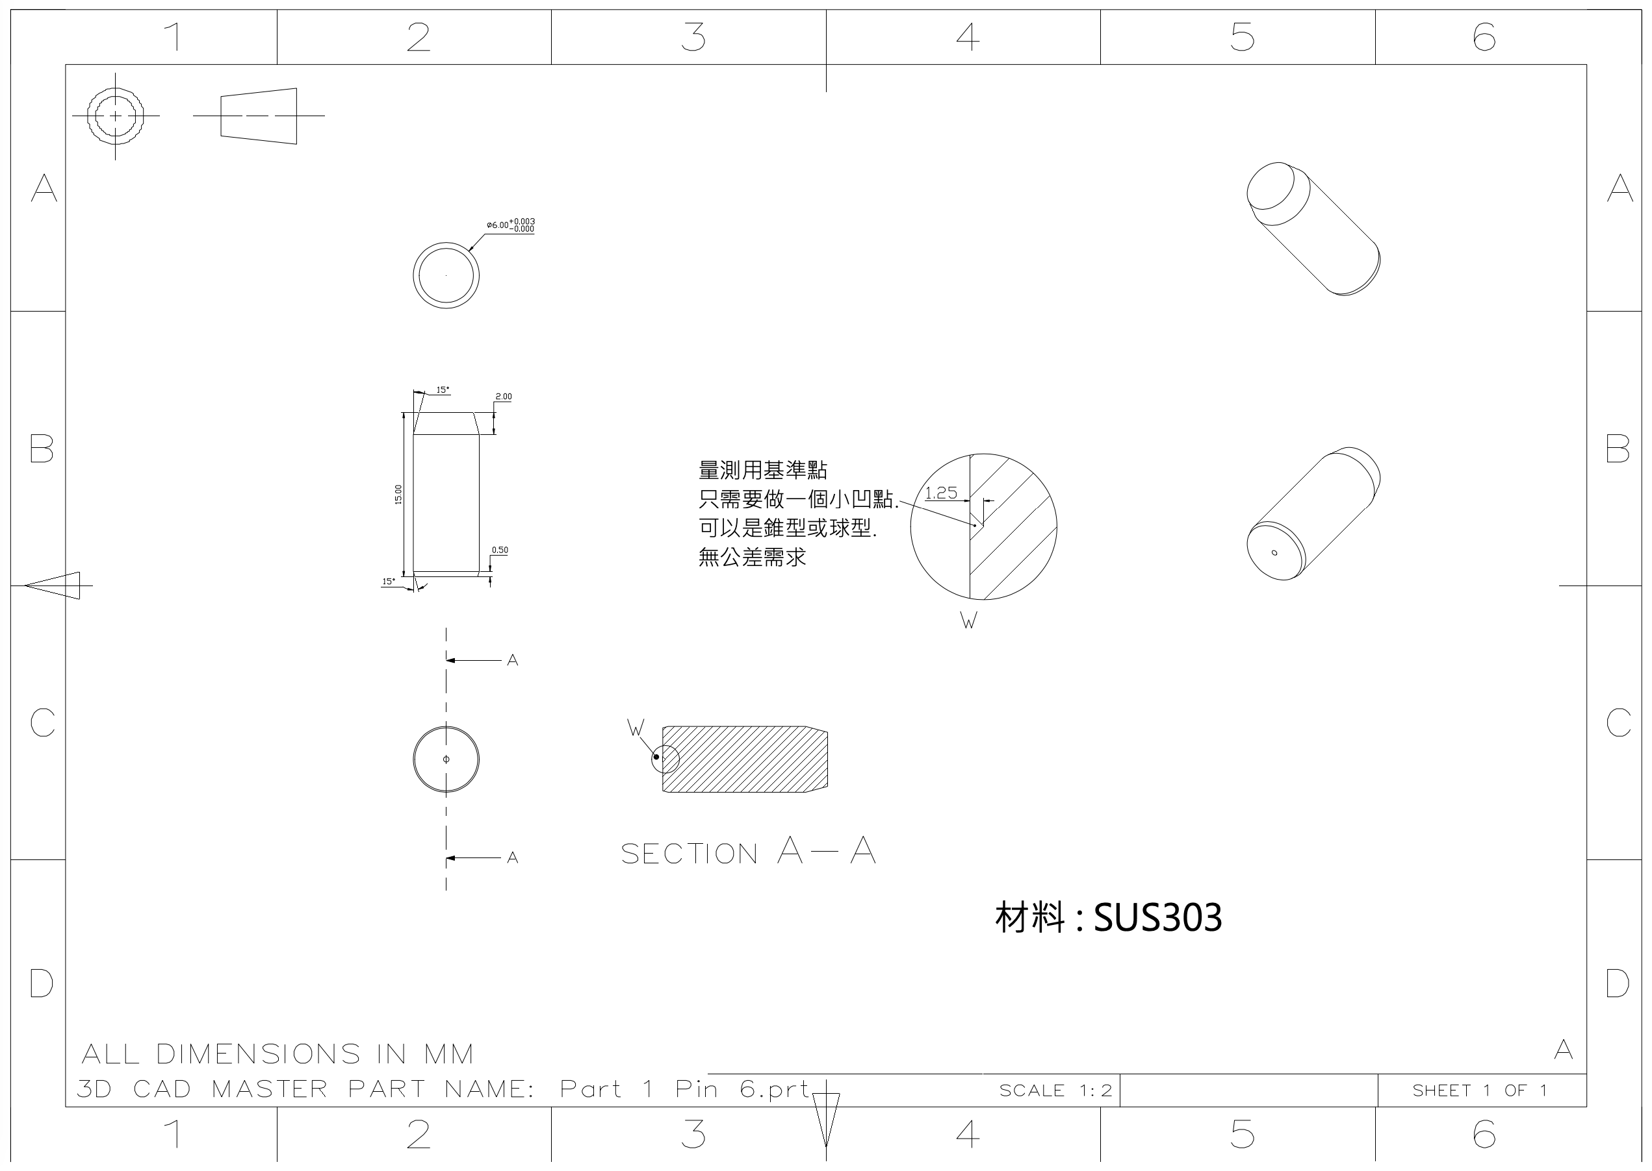
Bushing and Pin
Precision bushings and pins will be customizely made in Taiwan
Bushing: MOQ: 500 pcs, ~15 USD/pc
Pin: MOQ: 500 pcs, ~4 USD/pc
Total: ~9,500 USD
Tolerance: H7
Tolerance: H7

Slide 19
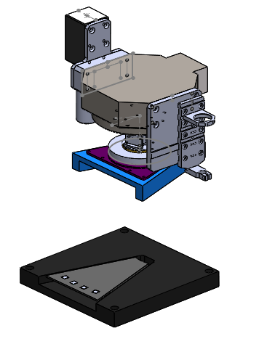
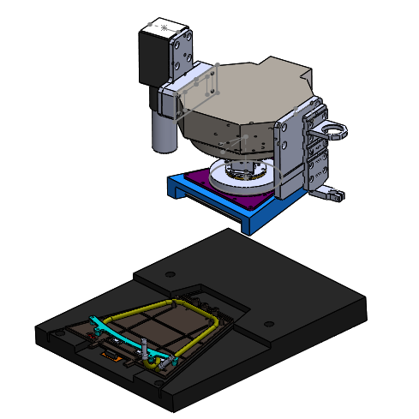
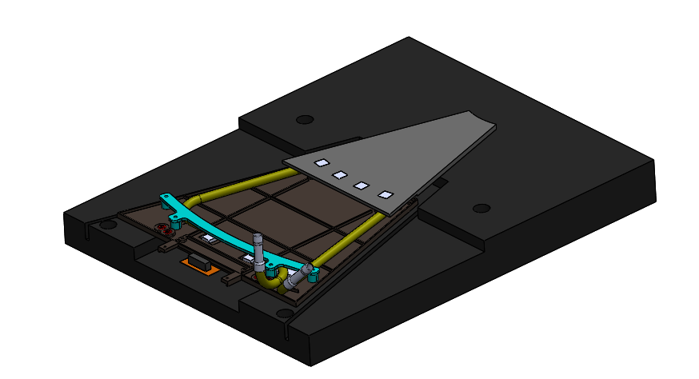
Modified Gluing Procedure for Inner Hybrid
* Manufacturing new fixtures now
Glue the inner MS first
Place pickup tool, inner MS + tray, outer wedge + tray on table
Use camera to locate reference points
Pick up inner MS and glue it on the outer wedge

Slide 20
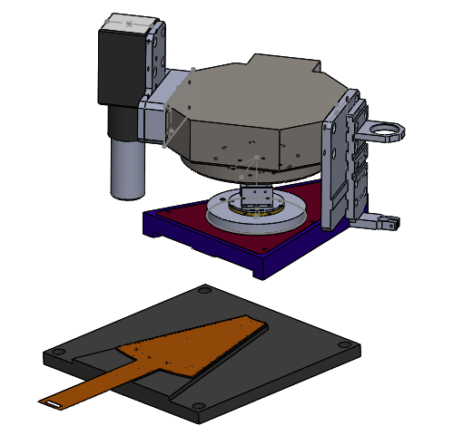
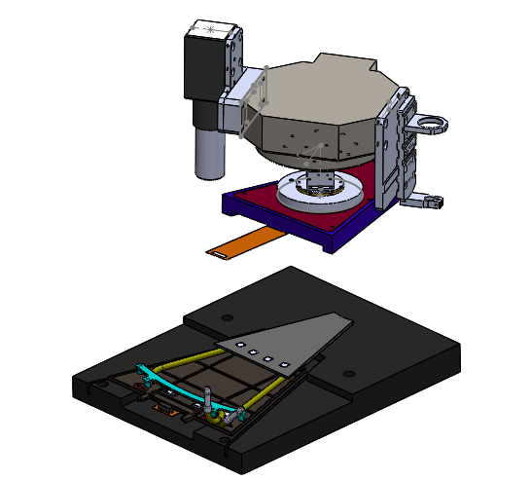
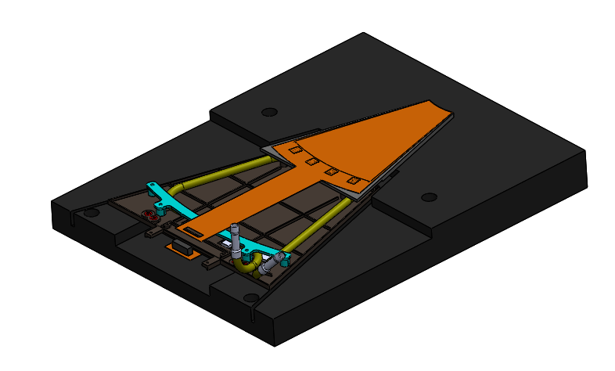
Modified Gluing Procedure for Inner Hybrid
Follow the “same” procedure as the outer Hybrid
Place pickup tool, inner Hybrid + tray, outer wedge + inner MS + tray on table
Use camera to locate the reference points
Pick up inner Hybrid and glue it on the inner MS

Slide 21
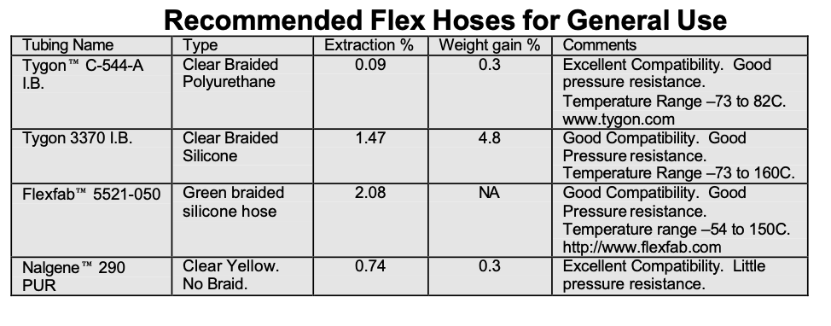
Soft Tube Compatibility Tests
Use the Soxhlet extraction method (suggested by 3M)
Tygon C-544-A I.B.
Tygon 3370 I.B.

Slide 22
Soft Tube Radiation Tests
Use Co⁶⁰ source at Institute of Nuclear Energy Research (INER)
Cost: ~150 USD/test
Two dosages:
3.2 kGy (from proposal)
16 kGy (5 times higher)
Tygon C-544-A I.B.
Tygon 3370 I.B.

Slide 23
Plan for the Measurements
Plan to outsource (Taiwan CK Techno Co.,Ltd.) the measurements of flatness and parallelism
Extremely expensive:
Flatness for single inner or outer MS (before assembly):
Price: ~200 USD/pc
Method: optical
Flatness and parallelism for assembled module:
Price: ~400 USD/pc
Method: mechanical (their know-how)
Total of 60 sets: 48,000 USD Working on getting a better deal
Plan for the prototypes:
Flatness for single inner or outer MS (before assembly) at TiDC
Flatness and parallelism for assembled module (first 10) by CK Techno

Slide 24
Schedule for Production
Estimated production times:
One week for preparation
One module per day
70 working days for 60 modules
Current Schedule:
Aug. 12, 2020: place orders
Sept. 14, 2020: preparation
Sept. 21, 2020: start production
Dec. 24, 2020: finish production
Dec. 31, 2020: ship to UIC

Slide 25
Backup

