Slide 1
FST Integration
- Rahul Sharma

Slide 2
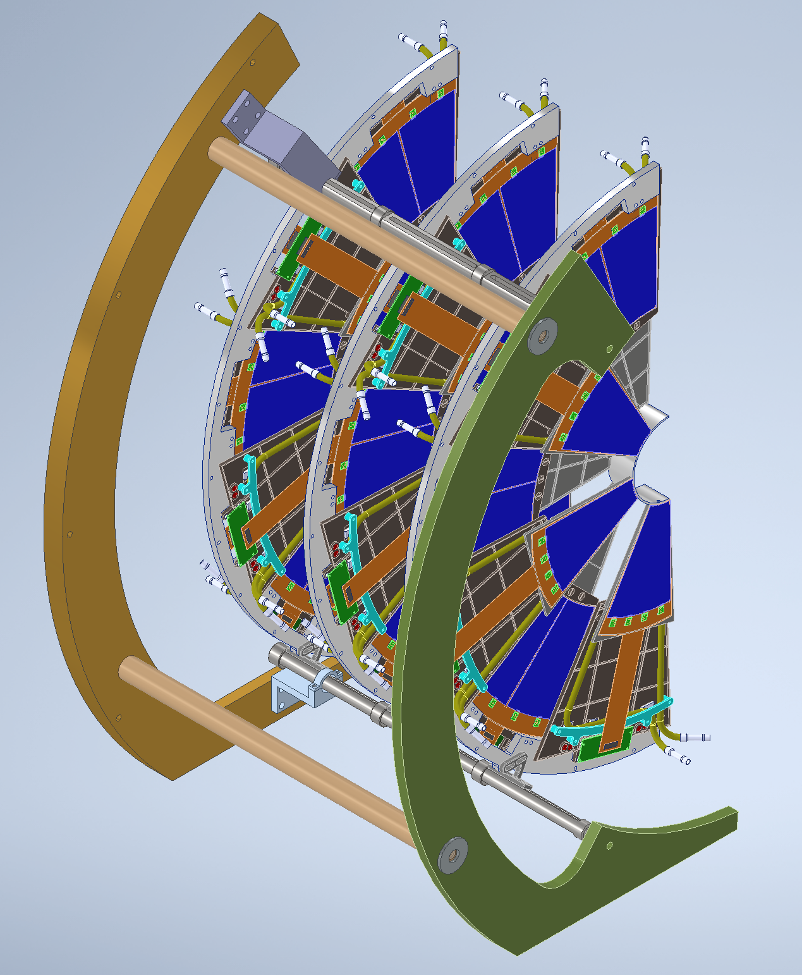
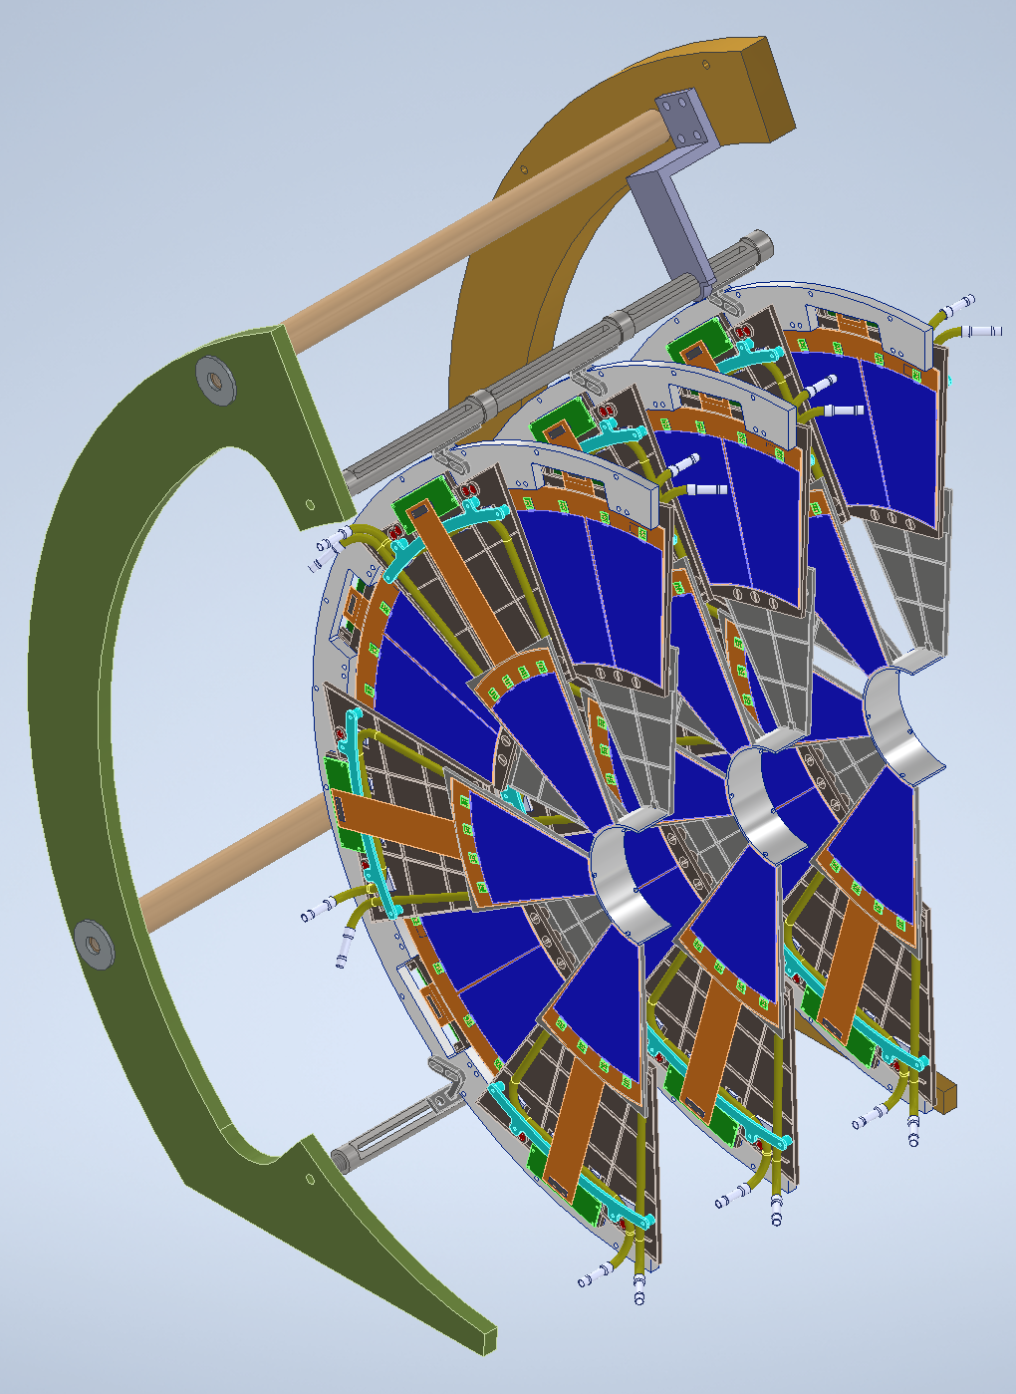
Cleanroom Assembly
Weight ~ 35lbs (16kg)
Size: 24”W x 32”H x 19”L

Slide 3
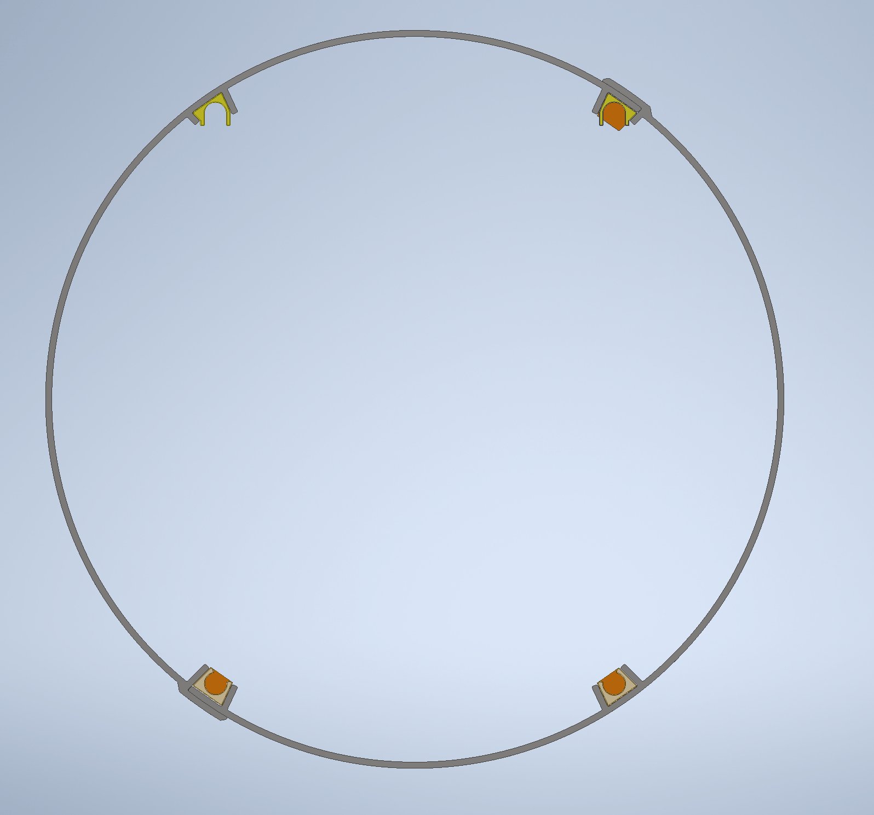
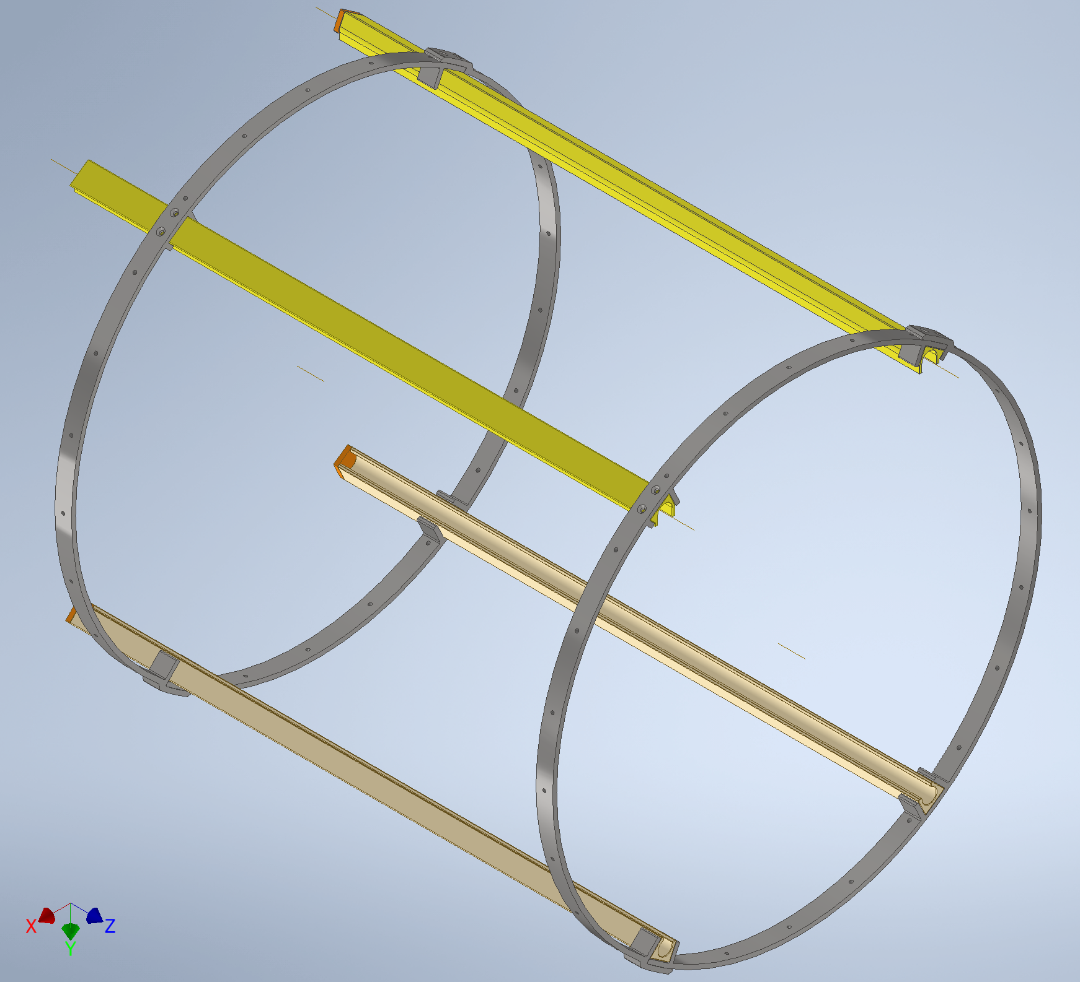
Inner Support Structure

Slide 4
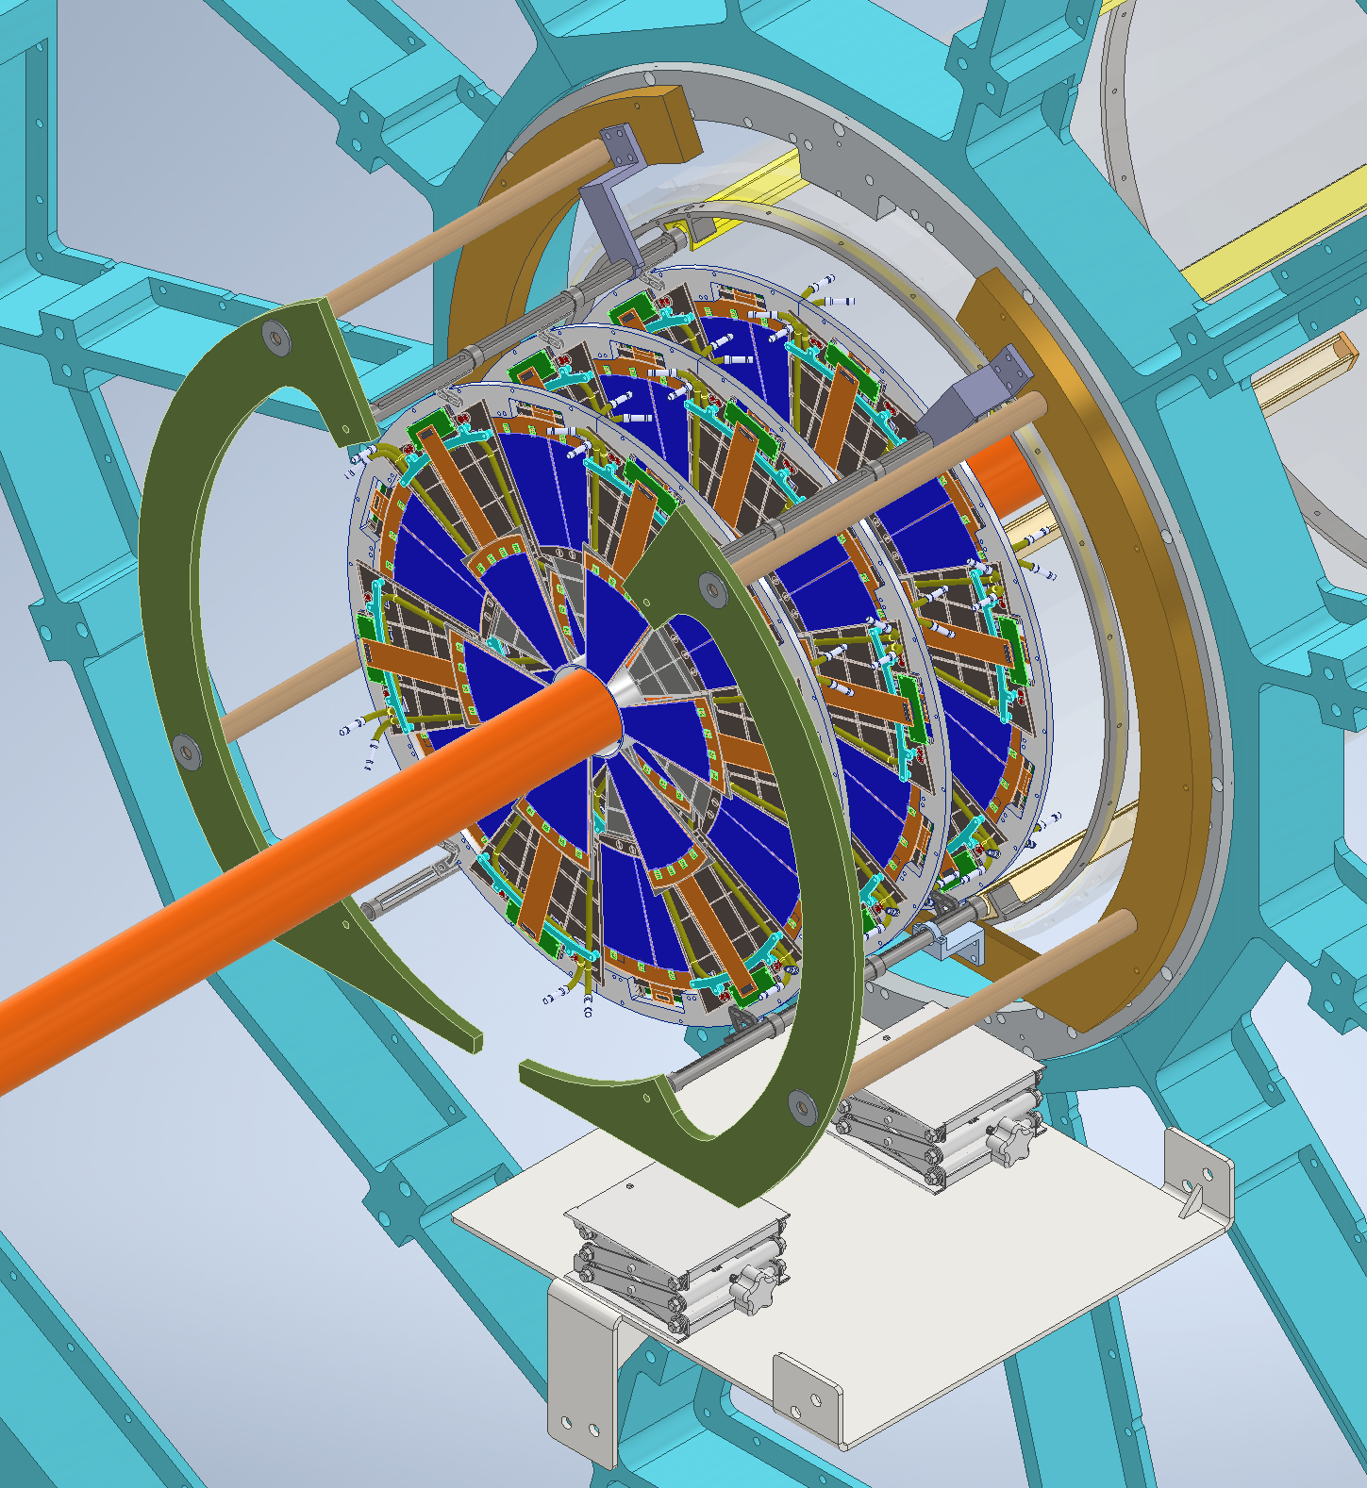
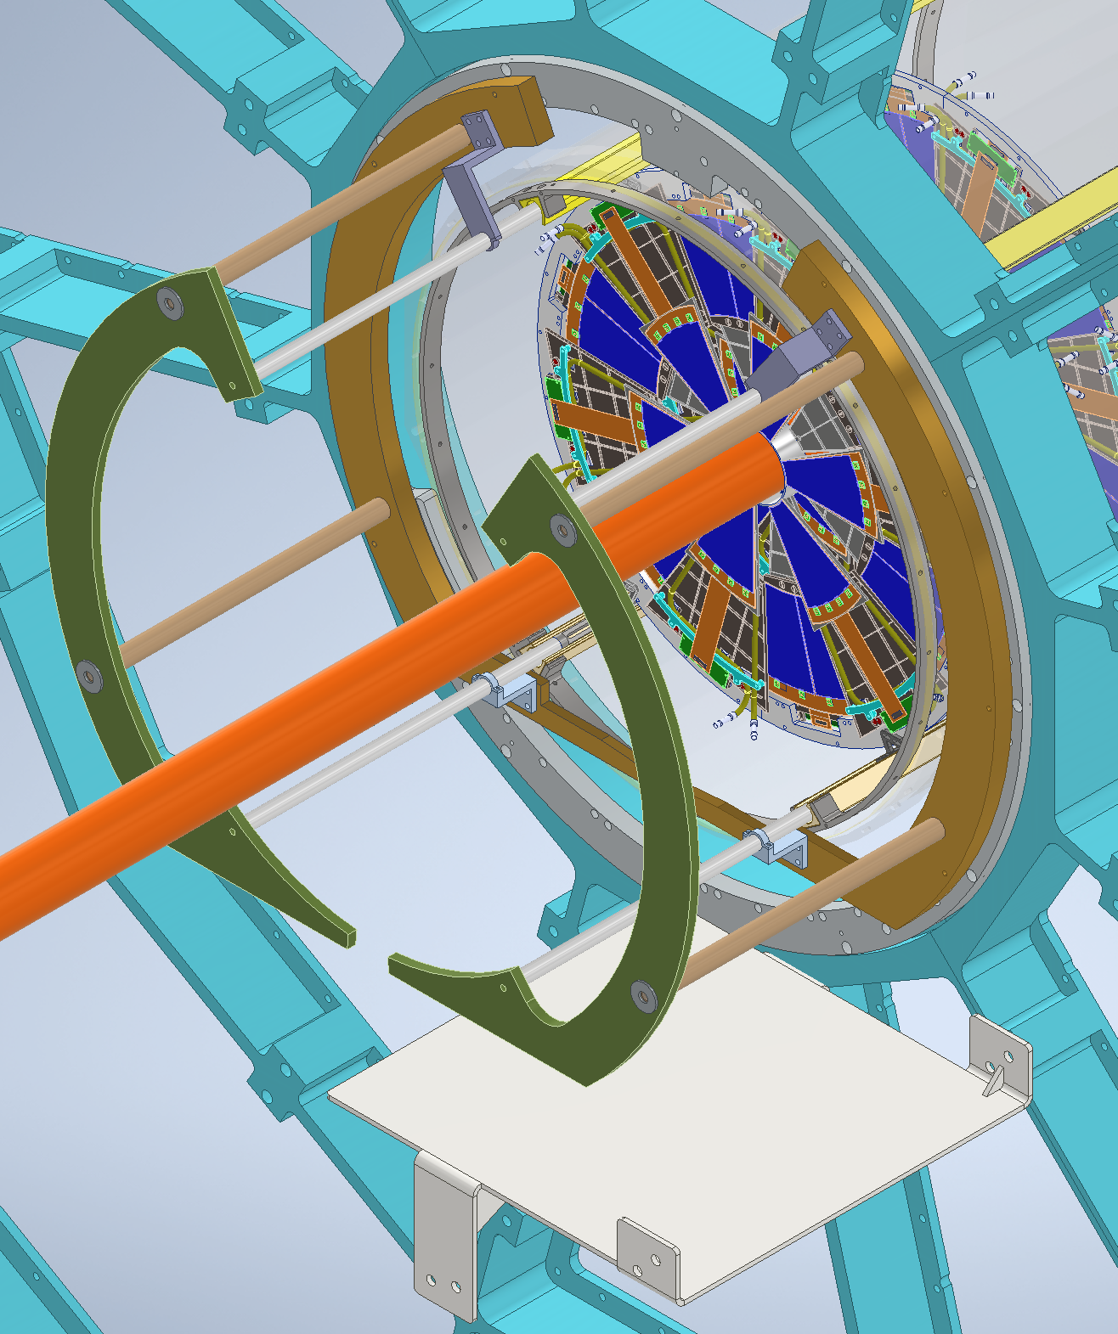
Installation

Slide 5
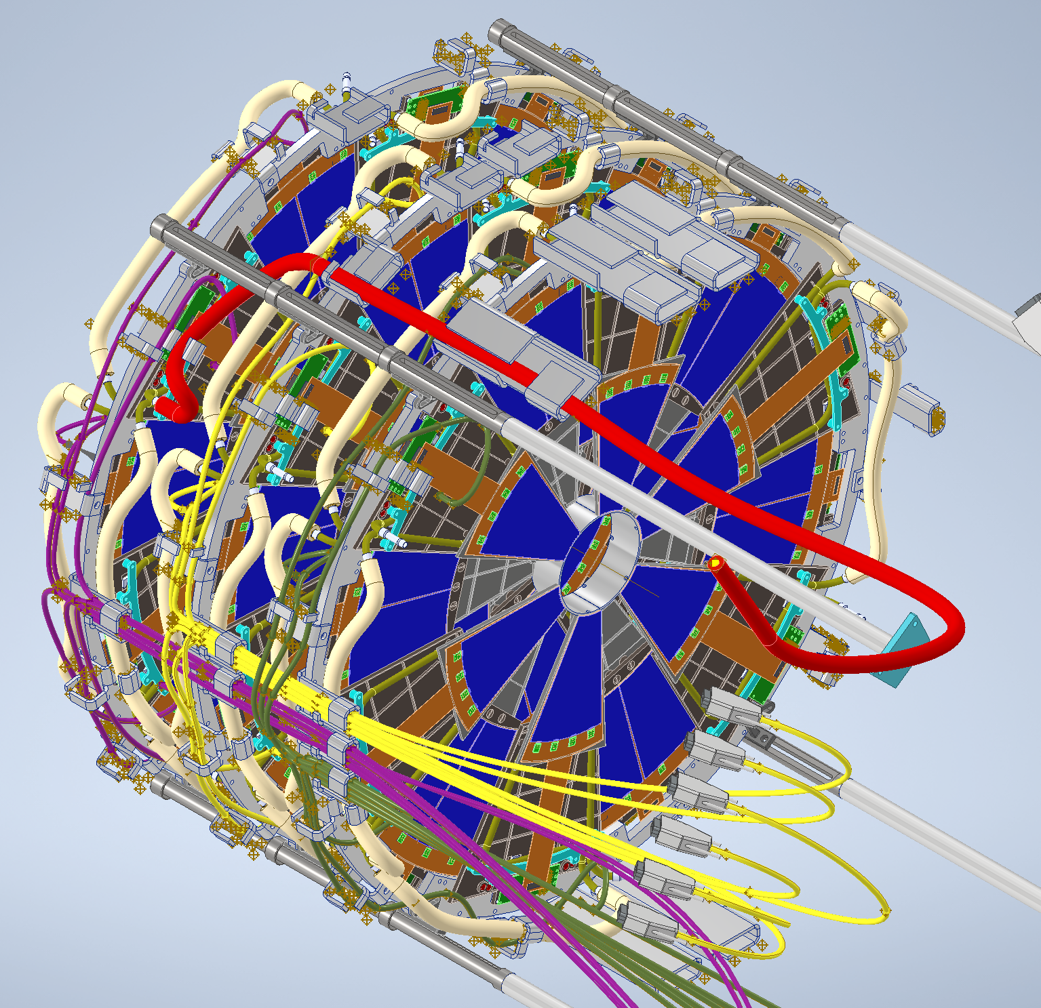
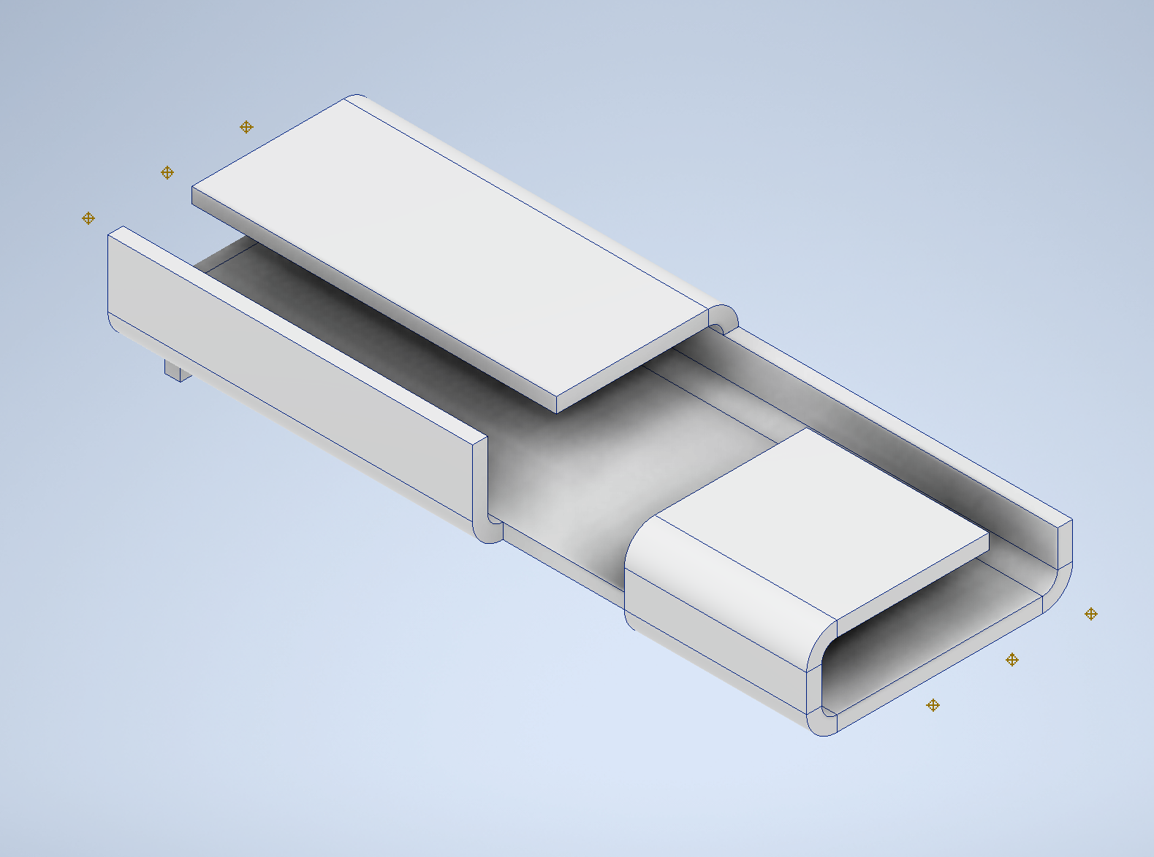
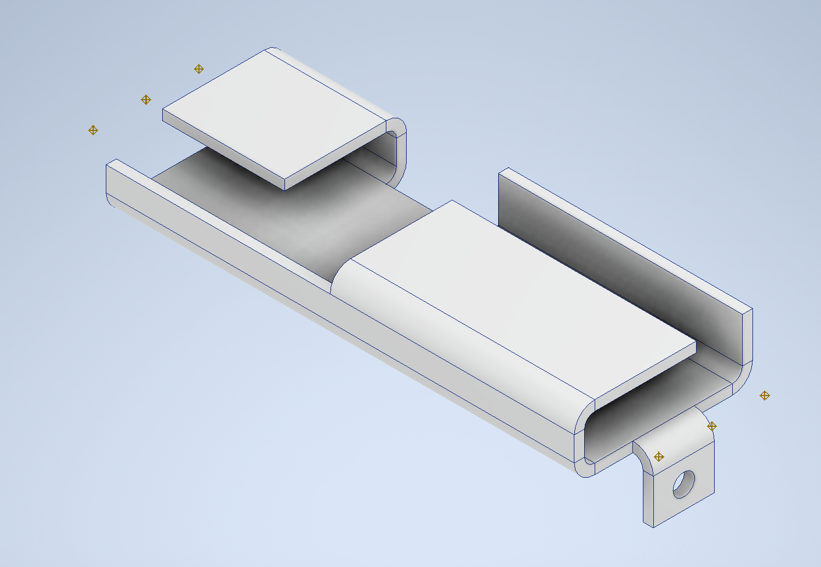
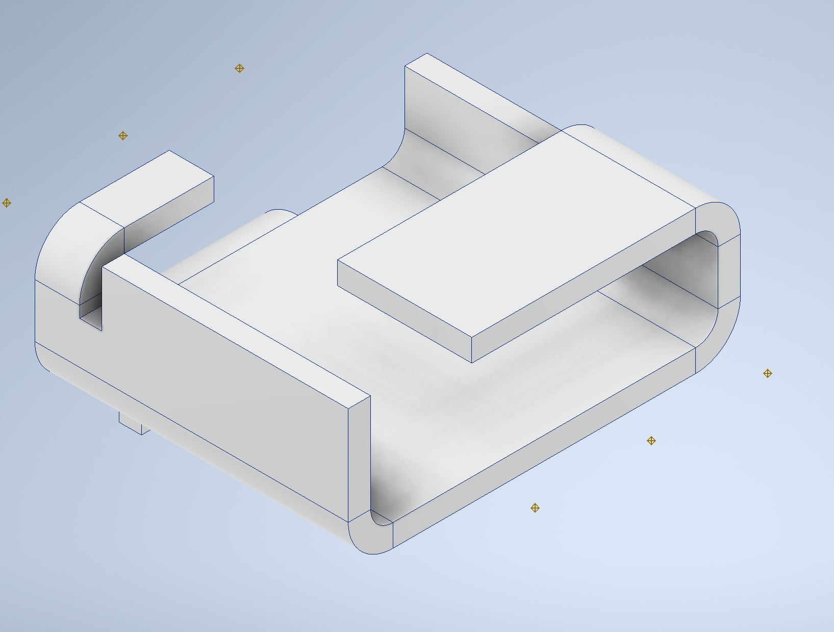
Cabling and Cooling Lines (Details)

Slide 6
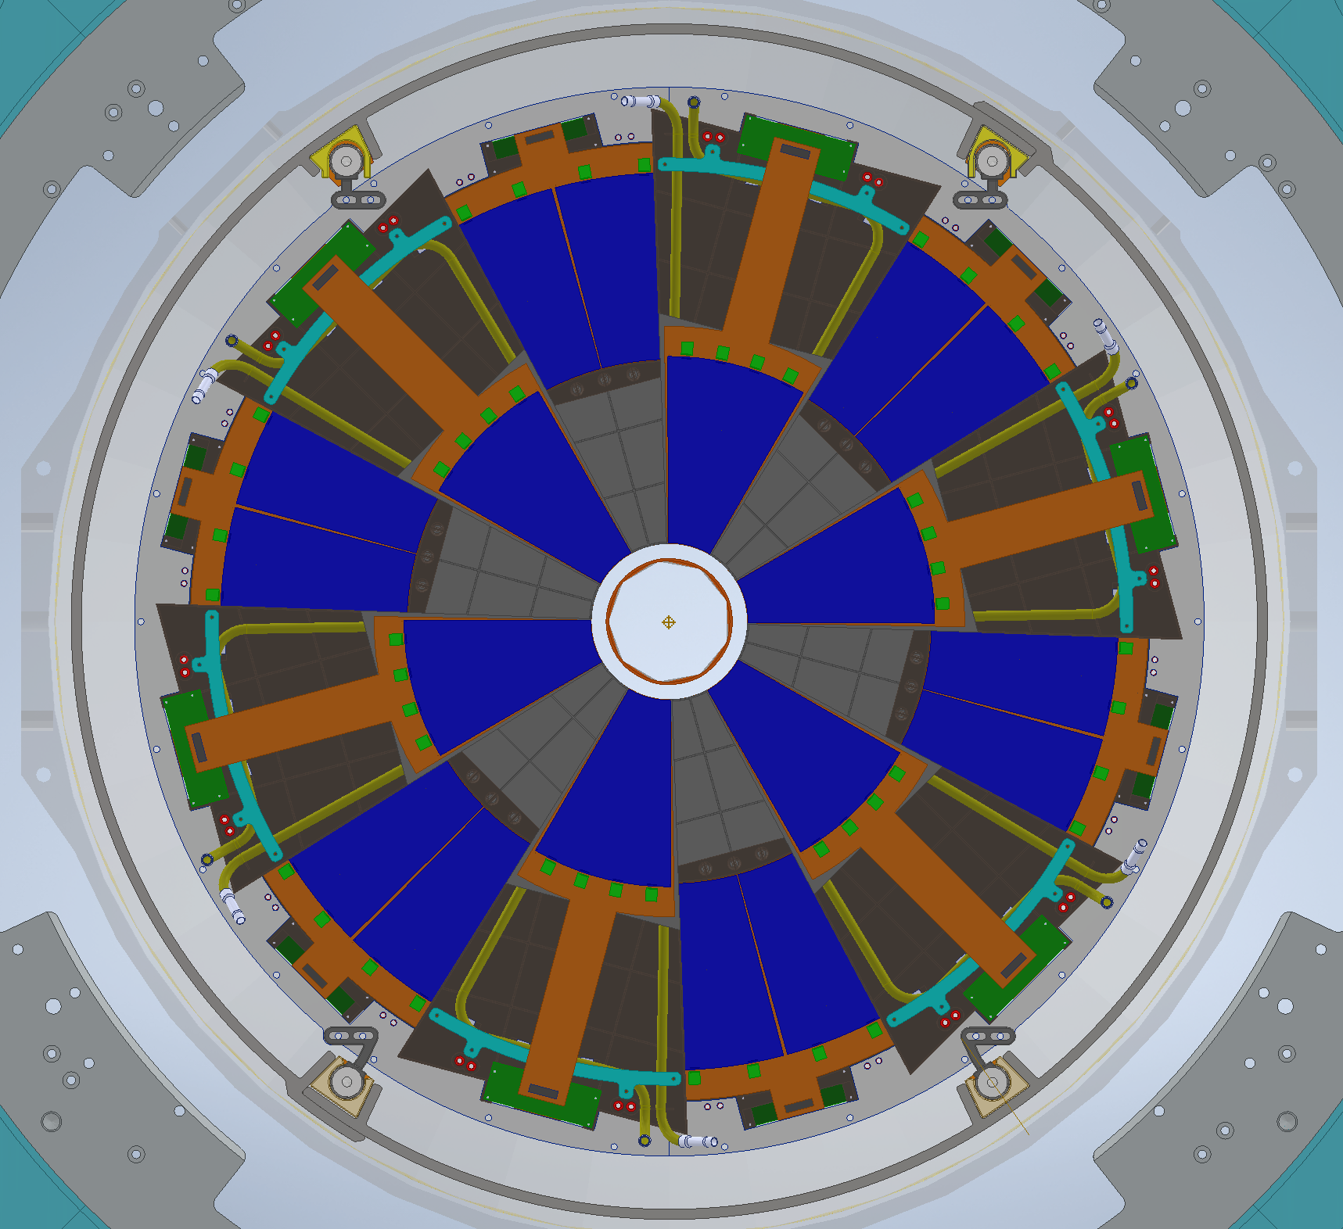
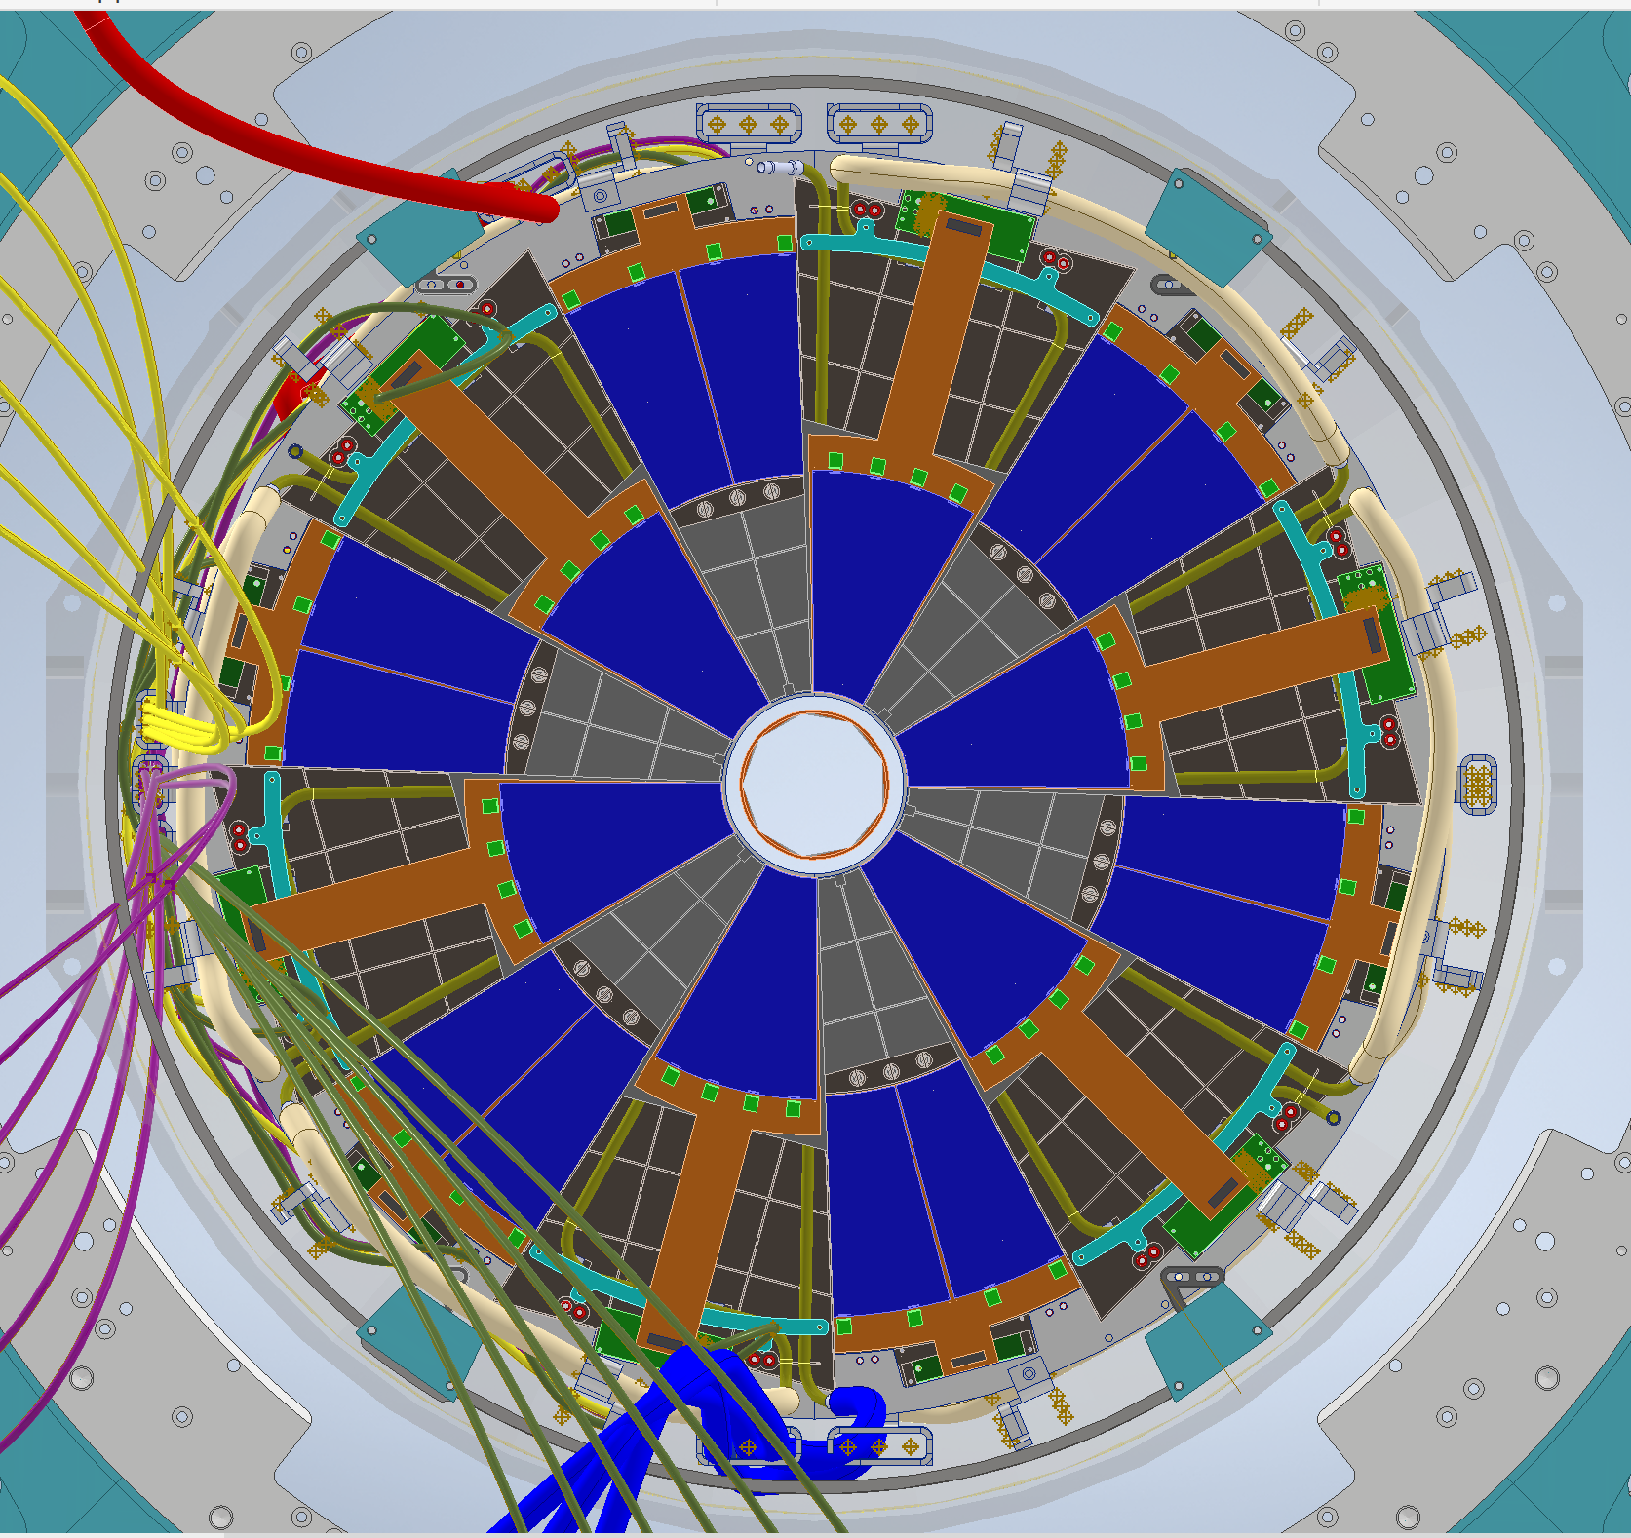
Front View

Slide 7
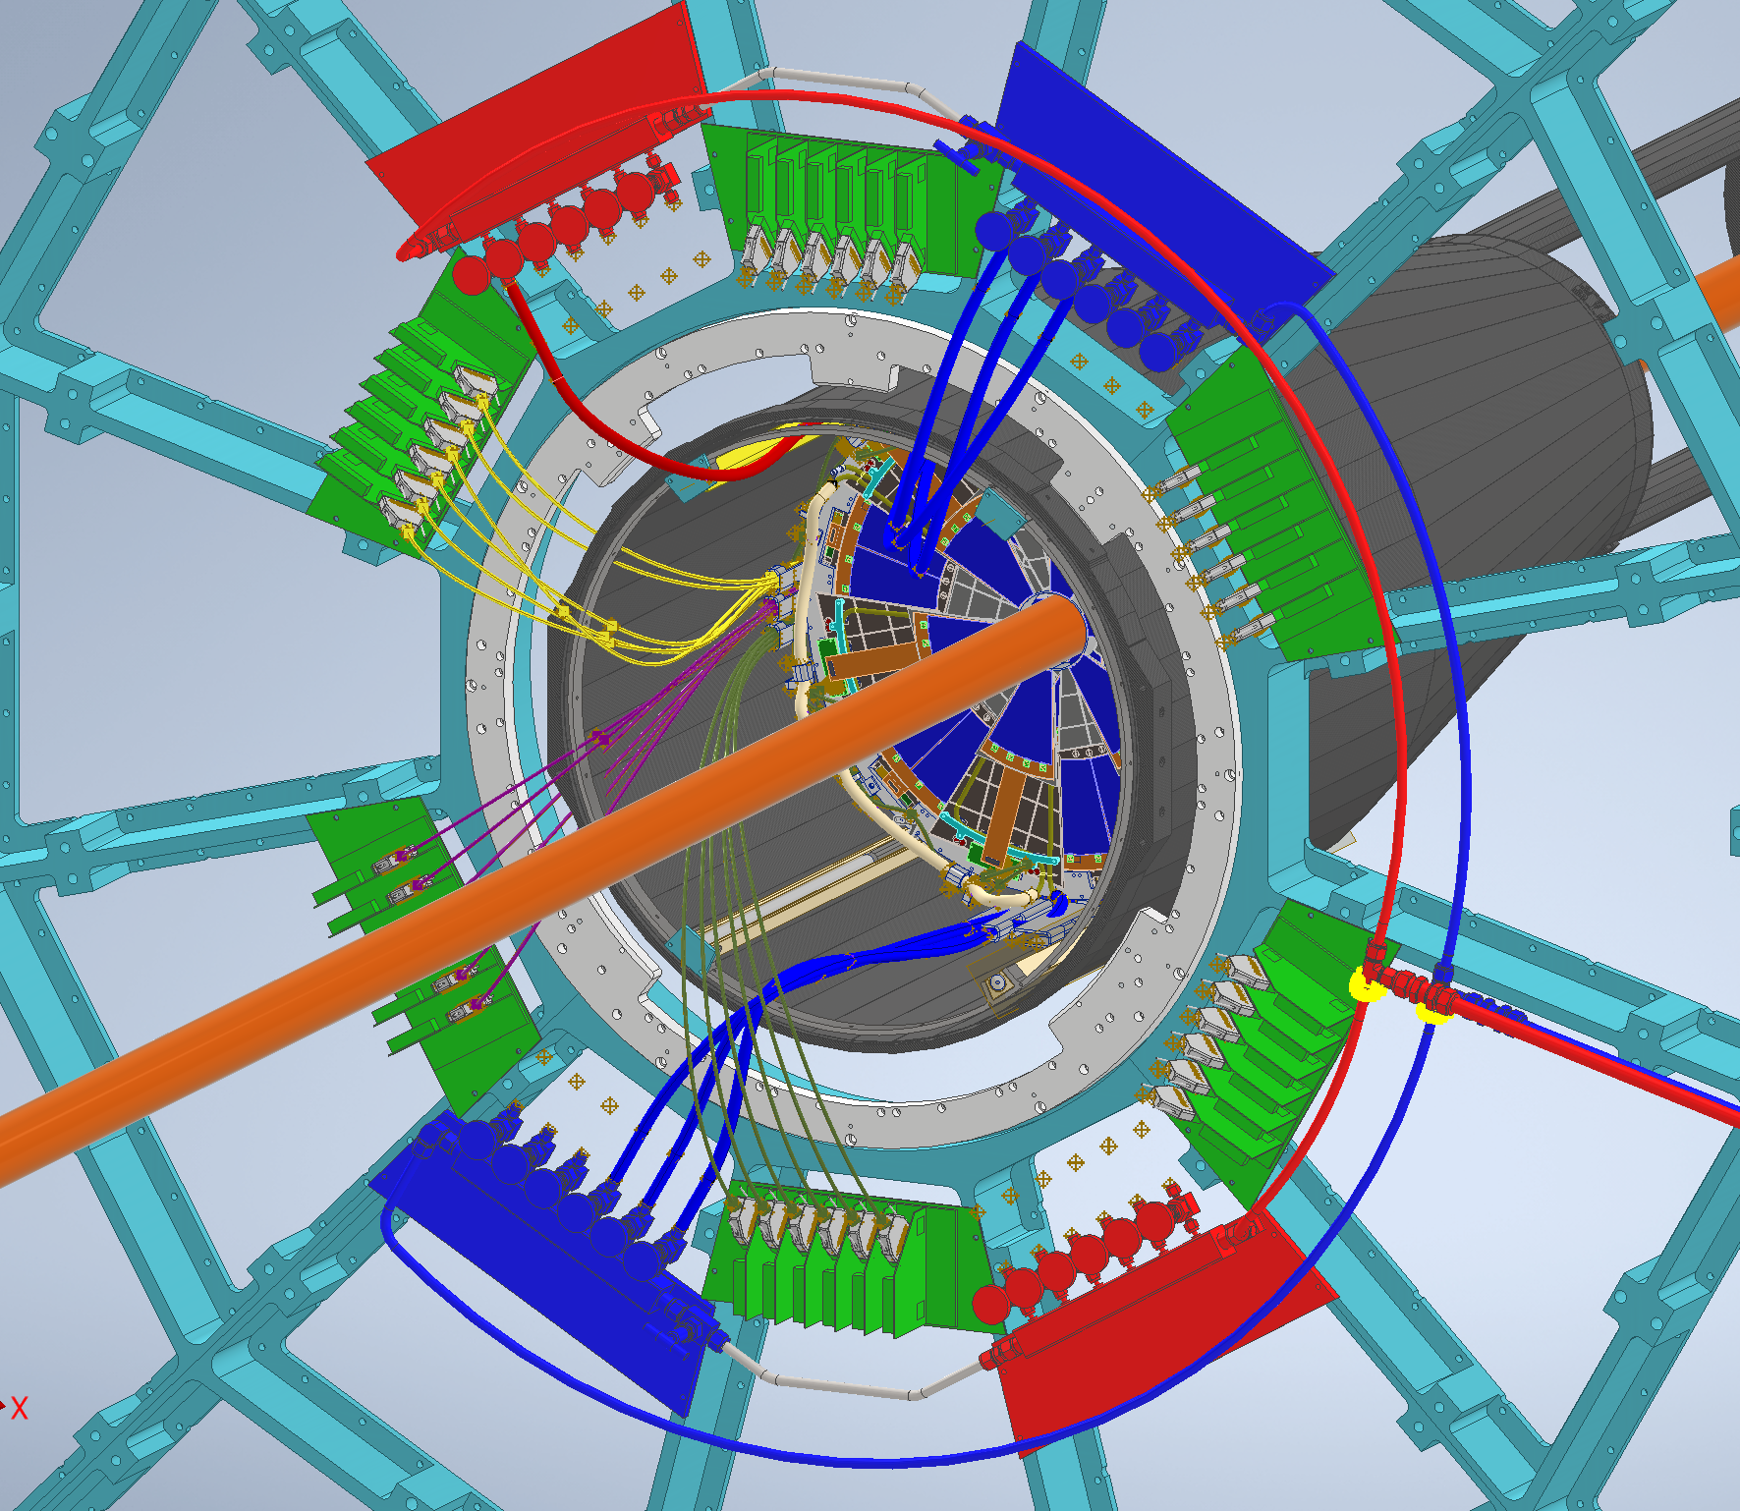
FST

Slide 8
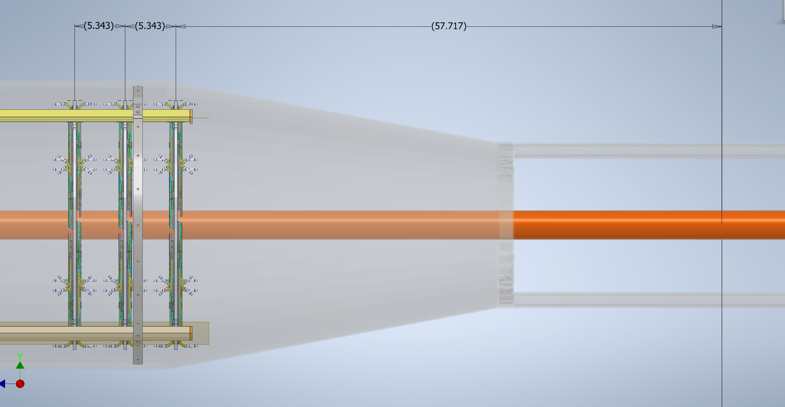
Distance From IP

Slide 9
FST Cooling System
Cooling system Assembly done (Except for Filter)
Charcoal + Silica Media for Filter on order
Test Setup as shown will be used to test the unit for leaks + 2 candidate materials of flex tubing will also be tested

